Slide 1
Statistical Methods for Data Analysis
Modeling PDF’s with RooFit
Luca Lista
INFN Napoli

Slide 2
Credits
RooFit slides and examples extracted and/or inspired by original presentations by Wouter Verkerke under the author’s permission

Slide 3
Prerequisites
RooFit is a tool designed to work within ROOT framework
RooFit is distributed together with ROOT in recent versions
  Must install the full ROOT release to also have RooFit
From CINT prompt, load RooFit shared library:
  gSystem->Load(“libRooFit.so”);

Slide 4
Variables/parameters definition
Variables and parameters are not distinct with RooFit
  RooRealVar x("x", "x coordinate", -1, 1);
  RooRealVar mu("mu", "average", 0, -5, 5);
  RooRealVar sigma("sigma", “r.m.s.", 1, 0, 5);
  x = 1.2345;
  x.Print();
Assignment beyond limits are brought back at extreme values:
  x = 3;
  [#0] WARNING:InputArguments -- RooAbsRealLValue::inFitRange(mu): value 3 rounded down to max limit 1
name
description
range
initial value

Slide 5
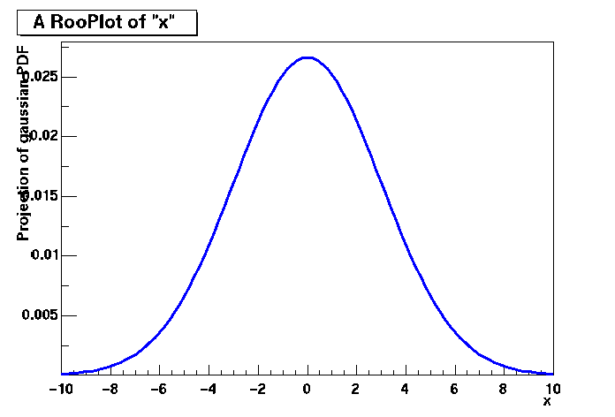
PDF definition and plotting
// Build Gaussian PDF
RooRealVar x("x","x",-10,10);
RooRealVar mean("mean","mean of gaussian",0,-10,10);
RooRealVar sigma("sigma","width of gaussian",3);
RooGaussian gauss("gauss","gaussian PDF",x,mean,sigma);
// Plot PDF
RooPlot* xframe = x.frame();
gauss.plotOn(xframe);
xframe->Draw();
Axis label from gauss title
Unit
normalization
A RooPlot is an empty frame
capable of holding anything
plotted versus it variable
Plot range taken from limits of x

Slide 6
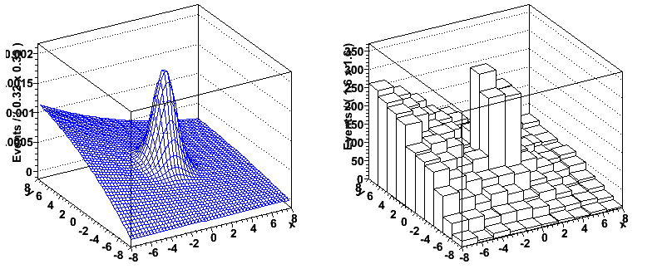
Plotting in more dimensions
No equivalent of RooPlot for >1 dimensions
  Usually >1D plots are not overlaid anyway
Easy to use createHistogram() methods provided in both RooAbsData and RooAbsPdf to fill ROOT 2D,3D histograms
TH2D* ph2 = pdf.createHistogram(“ph2”,x,YVar(y)) ;
TH2* dh2 = data.createHistogram(“dg2",x,Binning(10),
YVar(y,Binning(10)));
ph2->Draw("SURF");
dh2->Draw("LEGO");

Slide 7
Pre-defined PDF’s
RooFit provides a variety of pre-defined PDF’s
Automatic normalization in the variable range provided by RooFit
Roo2DKeysPdf RooArgusBG RooBCPEffDecay
RooBCPGenDecay RooBDecay RooBMixDecay
RooBifurGauss RooBlindTools RooBreitWigner
RooBukinPdf RooCBShape RooChebychev
RooDecay RooDstD0BG RooExponential
RooGExpModel RooGaussModel RooGaussian
RooKeysPdf RooLandau RooNonCPEigenDecay
RooNovosibirsk RooParametricStepFunction RooPolynomial
RooUnblindCPAsymVar RooUnblindOffset RooUnblindPrecision
RooUnblindUniform RooVoigtian ...

Slide 8
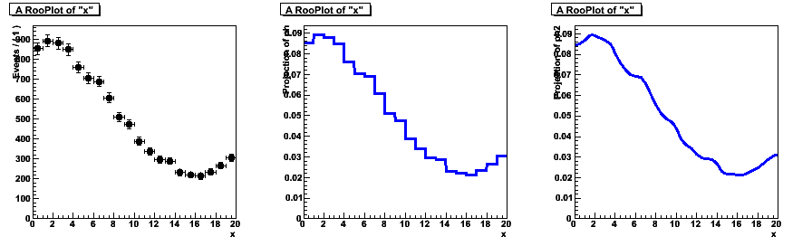
PDF inferred from histogram
Will highlight two types of non-parametric p.d.f.s
Class RooHistPdf – a p.d.f. described by a histogram
  Not so great at low statistics (especially problematic in >1 dim)
dataHist
RooHistPdf(N=0)
RooHistPdf(N=4)
// Histogram based p.d.f with N-th order interpolation
RooHistPdf ph("ph", "ph", x,*dataHist, N) ;

Slide 9
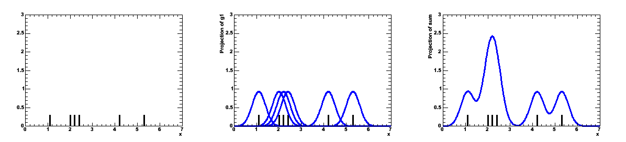
Kernel estimated PDF
Class RooKeysPdf – A kernel estimation p.d.f.
  Uses unbinned data
  Idea represent each event of your MC sample as a Gaussian probability distribution
  Add probability distributions from all events in sample
Gaussian
probability distributions
for each event
Summed
probability distribution
for all events in sample
Sample of events

Slide 10
Custom PDF’s
String based description (RooGenericPdf)
  RooRealVar x("x", "x", -10, 10);
  RooRealVar y("y", "y", 0, 5);
  RooRealVar a("a", "a", 3.0);
  RooRealVar b("b", "b", -2.0);
  RooGenericPdf pdf("pdf", "my pdf",
  "exp(x*y+a)-b*x", RooArgSet(x, y, a, b));
Variable and parameter list is taken from the data set one wants to analyze
  Note that plotting requires x.frame() !

Slide 11
Writing PDF’s in C++
Generate a class skeleton directly within ROOT prompt:
  gSystem->Load("libRooFit.so");
  RooClassFactory::makePdf("RooMyPdf","x,alpha");
ROOT will create two files definig a subclass of RooAbsPdf:
  RooMyPdf.cxx RooMyPdf.h
Edit the skeleton cxx file and implement the method:
  Double_t RooMyPdf::evaluate() const {
  return exp(-alpha*x*x) ;
  }
User your new class as PDF model ini RooFit

Slide 12
Overload PDF defaults
Overloading default numerical integration:
  Int_t getAnalyticalIntegral(const RooArgSet& integSet,
  RooArgSet& anaIntSet);
  Double_t analyticalIntegral(Int_t code);
Overloading default hit or miss generator:
  Int_t getGenerator(const RooArgSet& generateVars,
  RooArgSet& directVars);
  void generateEvent(Int_t code);
integSet: set of dependents for which integration is requested
copy the subset of dependents it can analytically integrate to anaIntSet
Return non-null codes for supported integral
Perform analytical integration for given code

Slide 13
Combining PDF’s
Multiplication
Addition
Composition
Convolution

Slide 14
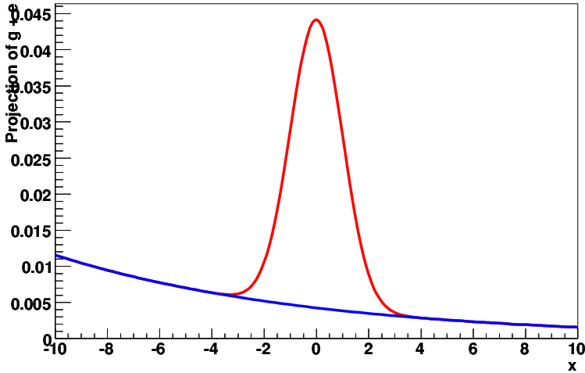
Adding PDF’s
Add more PDF’s with different fractions
  n − 1 fractions are provided; the last fraction is 1 − Σ_{i} f_{i}
  RooRealVar x("x", "x", -10, 10);
  RooRealVar mu("mu", "average", 0, -1, 1);
  RooRealVar sigma("sigma", "r.m.s", 1, 0, 5);
  RooGaussian gauss("gauss","gaussian PDF", x, mu, sigma);
  RooRealVar lambda("lambda", "exponential slope", -0.1);
  RooExponential expo("expo", "exponential PDF", x, lambda);
  RooRealVar f("f", "gaussian fraction", 0.5, 0, 1);
  RooAddPdf sum("sum", "g+e", RooArgList(gauss, expo),
  RooArgList(f));
Can plot the different components separately
  RooPlot * xFrame = x.frame();
  sum.plotOn(xFrame, RooFit::LineColor(kRed)) ;
  sum.plotOn(xFrame, RooFit::Components(expo),
  RooFit::LineColor(kBlue));

Slide 15
Multiplying PDF’s
Produces product of PDF’s in more dimensions:
  RooRealVar x("x", "x", -10, 10);
  RooRealVar y("y", "y", -10, 10);
  RooRealVar mux("mux", "average-x'", 0, -1, 1);
  RooRealVar sigmax("sigmax", "sigma-x'", 0.5, 0, 5);
  RooGaussian gaussx("gaussx","gaussian PDF x'", x, mux, sigmax);
  RooRealVar muy("muy", "average-y'", 0, -1, 1);
  RooRealVar sigmay("sigmay", "sigma-y'", 1.5, 0, 5);
  RooGaussian gaussy("gaussy","gaussian PDF y'", y,
  muy, sigmay);
  RooProdPdf gaussxy("gaussxy", "gaussxy", RooArgSet(gaussx, gaussy));
PDF’s can’t share dependent components

Slide 16
Composition of functions
Some of PDF parameters can be defined as RooFormulaVar, being function of other PDF’s
  RooRealVar x("x", "x", -10, 10);
  RooRealVar y("y", "y", 0, 3);
  RooRealVar a("a", "a", 3.0);
  RooRealVar b("b", "b", -2.0);
  RooFormulaVar mean("mean", "a+b*y", RooArgList(a, b, y));
  RooRealVar sigma("sigma", "r.m.s", 1, 0, 5);
  RooGaussian gauss("gauss","gaussian PDF", x, mean, sigma);
Needs some string interventions

Slide 17
Convolution
RooResolutionModel is a base class for all PDF that can model a resolution
  Specialization of ordinary PDF
Special cases are provided by RooFit for fast analytical convolution
  E.g.: Exp ⊗ Gaussian
  RooRealVar x(“x”,”x”,-10,10);
  RooRealVar meanl(“meanl”, ”mean of Landau”, 2);
  RooRealVar sigmal(“sigmal”,”sigma of Landau”,1);
  RooLandau landau(“landau”, ”landau”,x, meanl, sigmal);
  RooRealVar meang(“meang”, ”mean of Gaussian”, 0);
  RooRealVar sigmag(“sigmag”, ”sigma of Gaussian”, 2);
  RooGaussian gauss(“gauss”, ”gauss”, x, meang, sigmag);
  RooNumConvPdf model(“model”, ”model”, x, landau, gauss);
May be slow!
Integration range may be specified:
  landau.setConvolutionWindow(meang, sigmag, 5)

Slide 18
References
RooFit home:
  http://roofit.sourceforge.net/
RooFit online tutorial
  http://roofit.sourceforge.net/docs/tutorial/
  index.html

