Slide 1
All you need to know about Gravitational Waves – Vol. II
Fabio Garufi 2025

Slide 2
The (long) struggle against noise(s)
The sensitivity to expected signal is determined by the noises affecting the measurement
The more we reduce the effect of known sources of noise, the smaller is the signal we can recognize as our target
At different frequencies different noise source prevail, e.g.
  Low freqs (mHz – 10Hz): Newtonian, Seismic, radiation pressure on mirrors, environmental and control noises
  Medium freqs (10Hz – 10 kHz): Electromagnetic (e.g. from power line), Acoustic, suspension wires vibration (violin modes), thermal vibrations of mirrors
  High freqs (> 10 kHz): Shot Noise, electromagnetic noises (lightning, radiofrequency)
After mitigation of all known sources, a curve describing the mirror displacement’s spectral density in absence of signal is determined as a function of frequency: the Sensitivity Curve

Slide 3
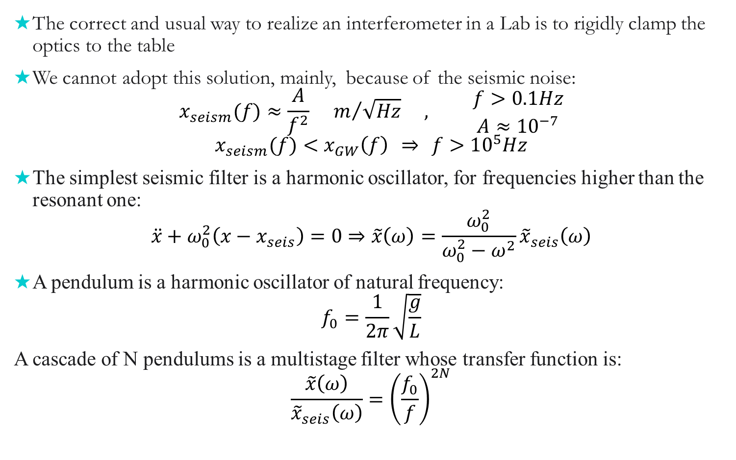


Seismic Noise
The correct and usual way to realize an interferometer in a Lab is to rigidly clamp the optics to the table
We cannot adopt this solution, mainly, because of the seismic noise:
$$x_{seism}(f)≈\frac{A}{f^{2}} m/{\sqrt{Hz}} , \begin{matrix}f>0.1Hz \\ A≈10^{−7}\end{matrix}$$
$$x_{seism}(f)<x_{GW}\left(f\right) ⇒ f>10^{5}Hz$$
The simplest seismic filter is a harmonic oscillator, for frequencies higher than the resonant one:
$$\ddot{x}+ω_{0}^{2}\left(x−x_{seis}\right)=0⇒\tilde{x}\left(ω\right)=\frac{ω_{0}^{2}}{ω_{0}^{2}−ω^{2}}{\tilde{x}}_{seis}\left(ω\right)$$
A pendulum is a harmonic oscillator of natural frequency:
$$f_{0}=\frac{1}{2π}\sqrt{\frac{g}{L}}$$
A cascade of N pendulums is a multistage filter whose transfer function is:
$$\frac{\tilde{x}\left(ω\right)}{{\tilde{x}}_{seis}\left(ω\right)}={\left(\frac{f_{0}}{f}\right)}^{2N}$$
$$x$$
$$x_{seism}$$
3
Notes:
3

Slide 4
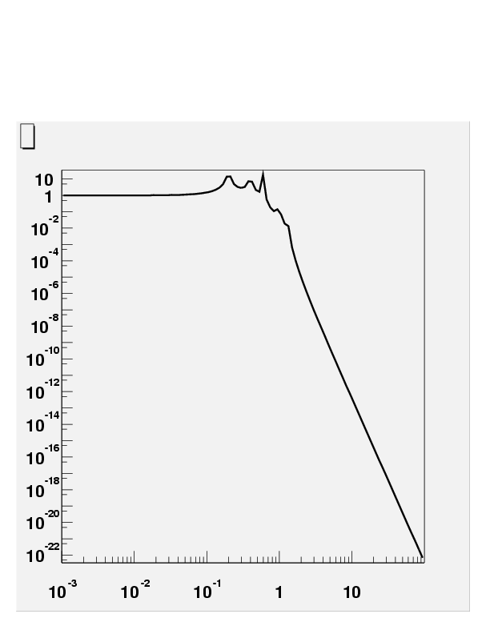
Seismic Noise mitigation
Ground
Chain
Transmission
2 Hz
f ^{-2N}
Resonances
Frequency (Hz)
Long Pendula
Mirror
Soft Spring

Slide 5
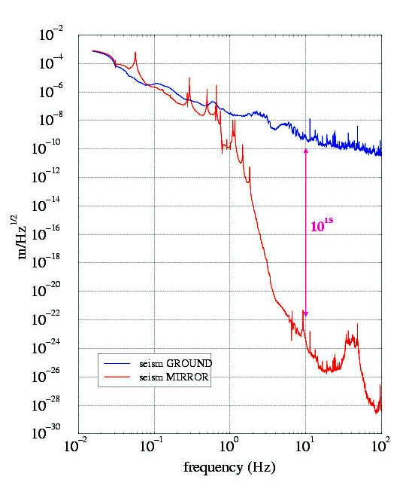
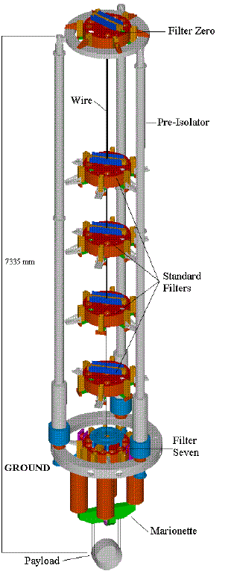
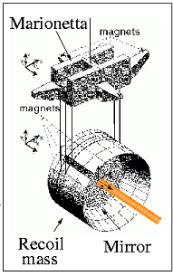
Seismic noise mitigation – the true story
Superattenuator: filters off the seismic vibrations.
Thermal noise

Slide 6
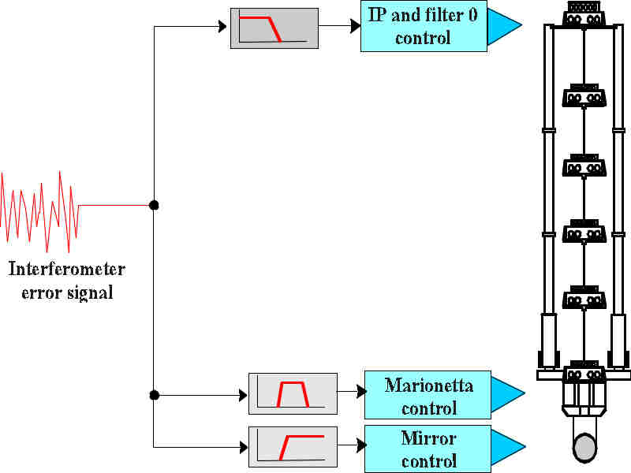

Local control on superattenuators
3 application points for 3 frequency ranges:
  Top of inverted pendulum (Filter 0)
  On the “marionetta”
  On the mirror
Locking requirement:
  δL < 10⁻¹² m
Tides along the 3 km:
  δL < 10⁻⁴ m
Mirror’s resonances
  δL < 10⁻⁴ m
  It is necessary to control mirrors in a wide range of frequencies and displacements: a hierarchic control system, is needed
DC-0.01 Hz
0.01-8 Hz
8-50 Hz
6
Notes:
6

Slide 7
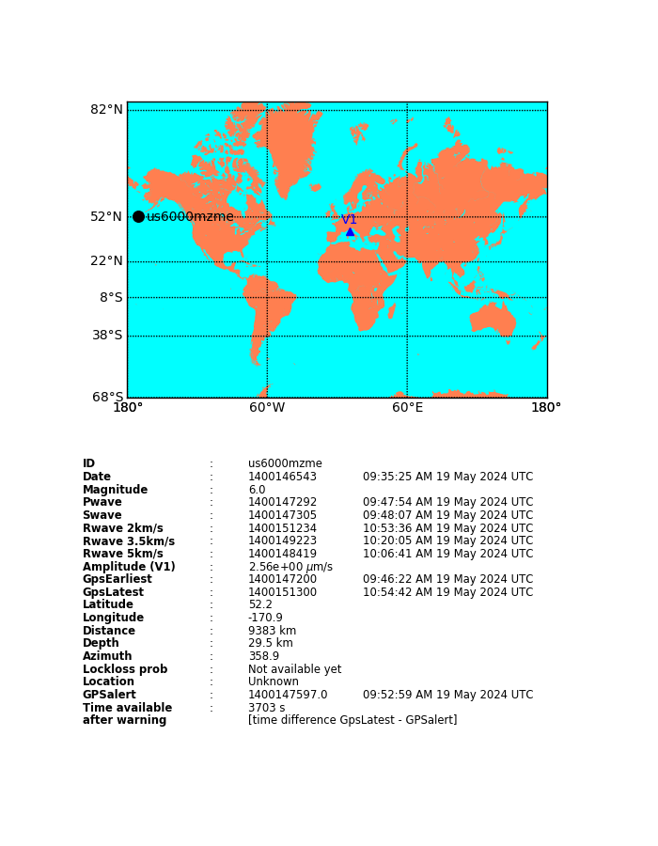
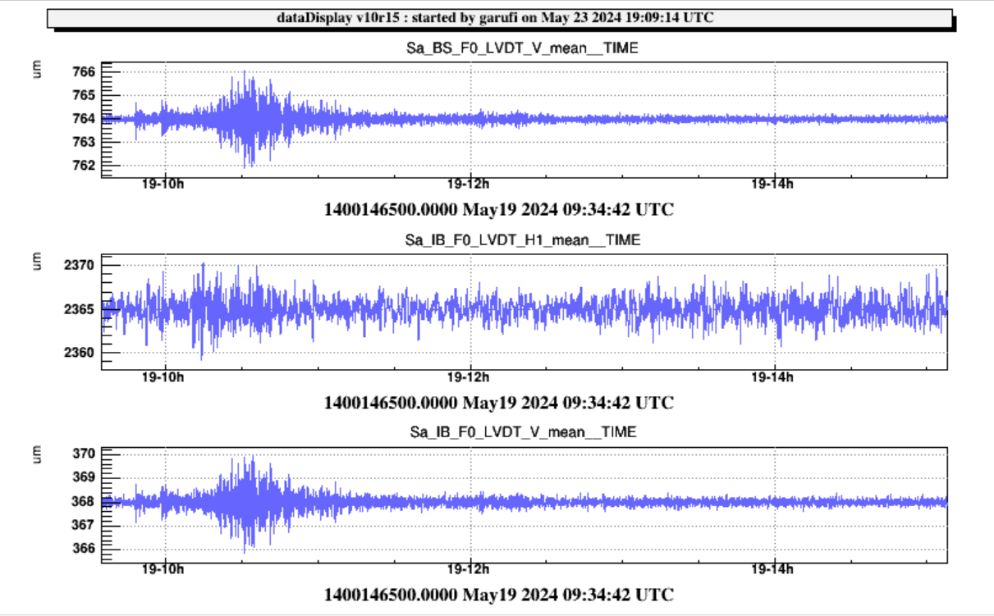
A teleseism as seen by «Filter 0» displacement

Slide 8

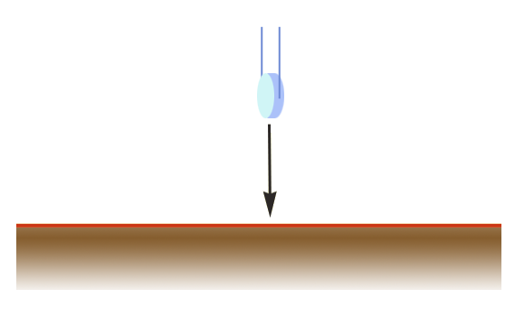
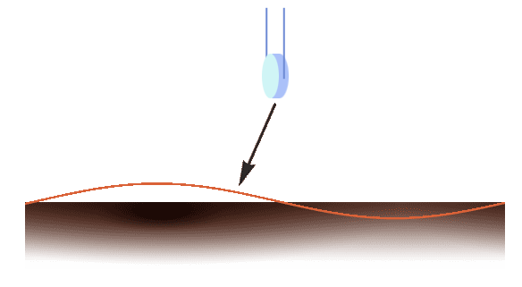
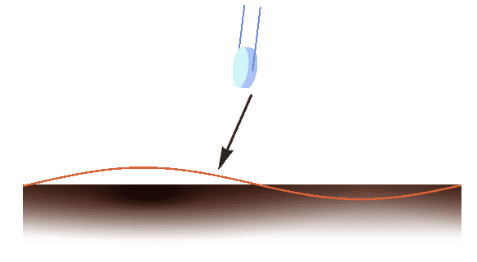
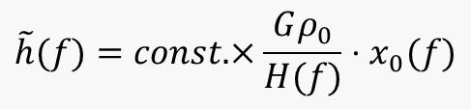
Newtonian Noise
The Newtonian noise
will be dominant below 10 Hz for cryogenic detectors
Surface waves die
exponentially with depth
GO UNDERGROUND!
Newtonian noise
$$\tilde{h}(f)=const.×\frac{Gρ_{0}}{H(f)}⋅x_{0}(f)$$
SEISMIC NOISE
Figure: M.Lorenzini

Slide 9
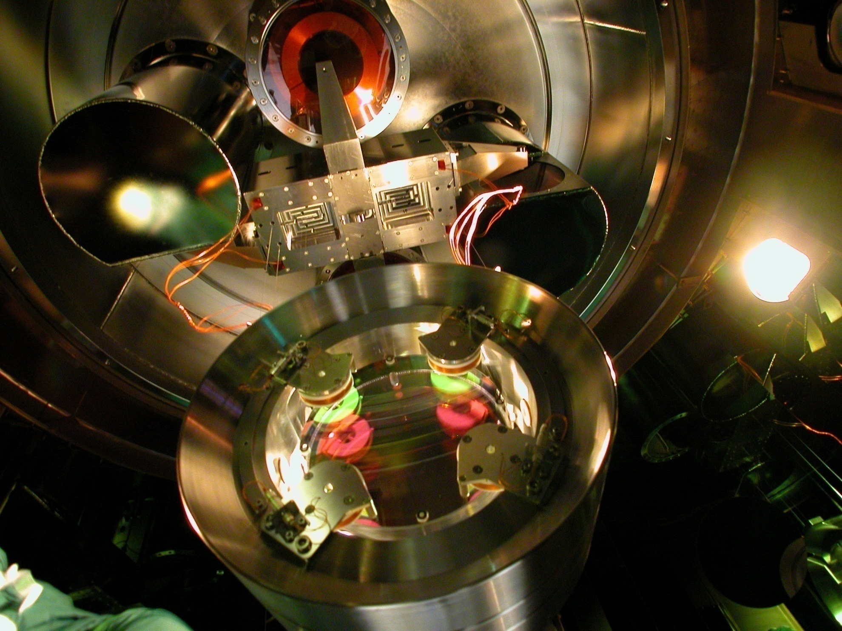
Actuators on back of mirrors
3rd VESF school - Michele Punturo - Virgo
9
Notes:
9

Slide 10
Mirrors’ Thermal compensation
Need:
Compensate beam wavefront deformation due to mirrors’ deformation as a consequence of high power in the cavities
Solution:
  - Heating rings around test masses
  - CO₂ laser (almost all absorbed) to correct punctually the deformation of recycling mirrors
  Extra optical element (compensation plate) upstream test masses

Slide 11
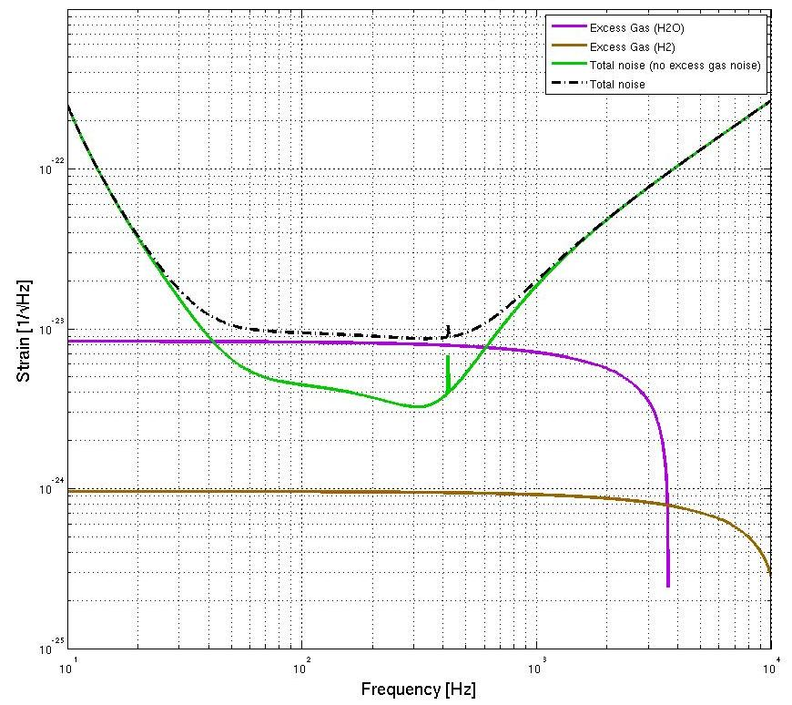
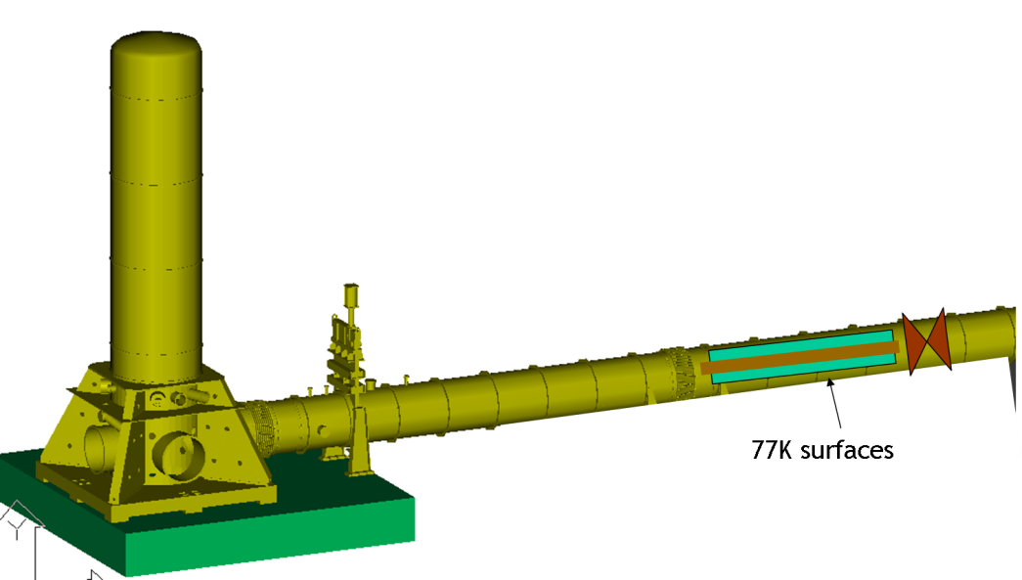
Vacuum
Residual pressure in VIRGO is 10⁻⁷ mbar (H₂O+H₂+HC) without bake-out,
In Advanced VIRGO the requirement is 10⁻⁹ mbar (bake-out necessary)
The noise due to residual pressure can limit AdV sensitivity
Therfore :
Every time from atmospheric pressure we pass to vacuum, the bake-out is needed
6 km of vacuum pipr bake-out is quite expensive!!
Solution
High vacuum in Towers is separated from lower vacuum in the pipe, introducing cryogenic traps

Slide 12
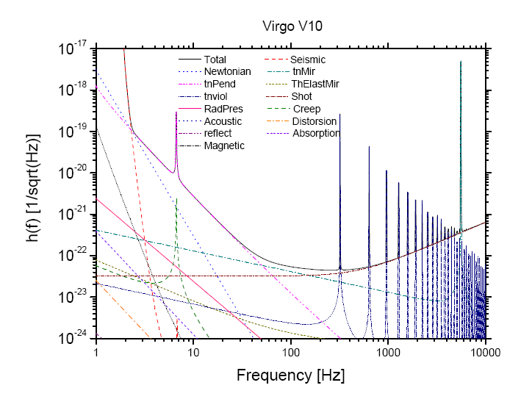
Sensitivity Curve
Seismic
Thermal
Shot

Slide 13
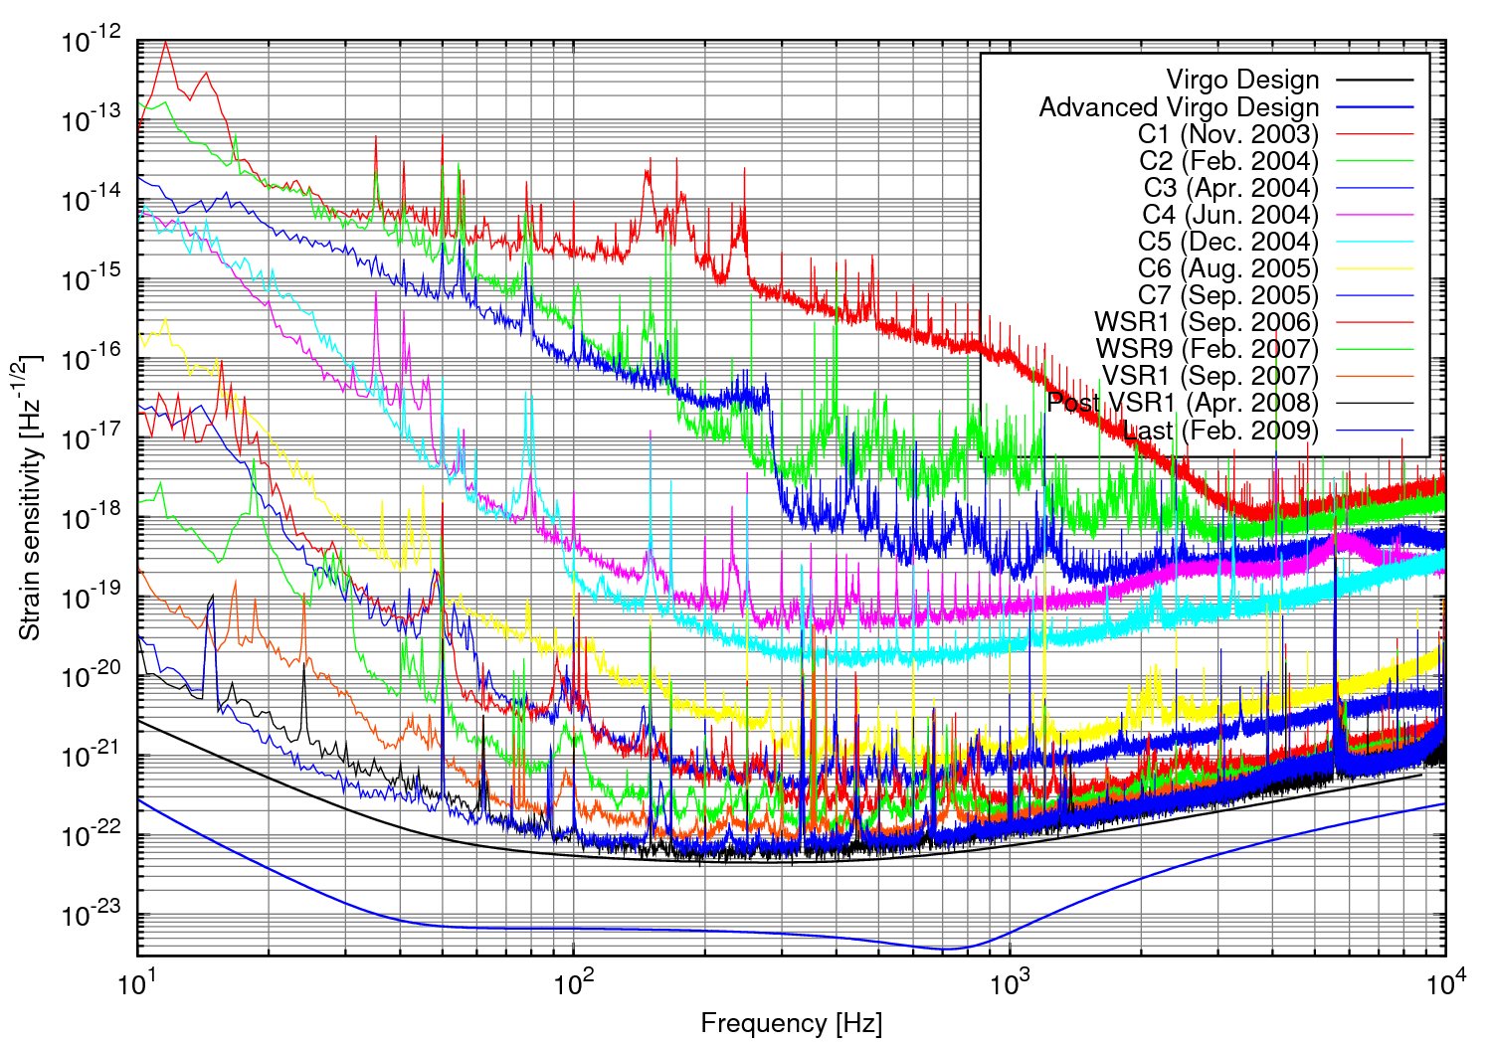
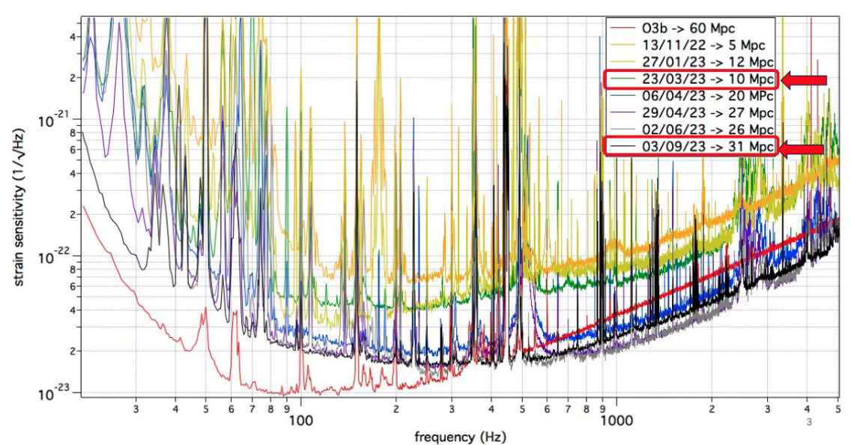
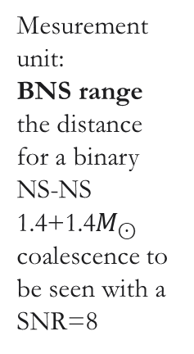
The path to detection
Mesurement unit:
BNS range
the distance for a binary NS-NS 1.4+1.4$M_{⊙}$ coalescence to be seen with a SNR=8

Slide 14
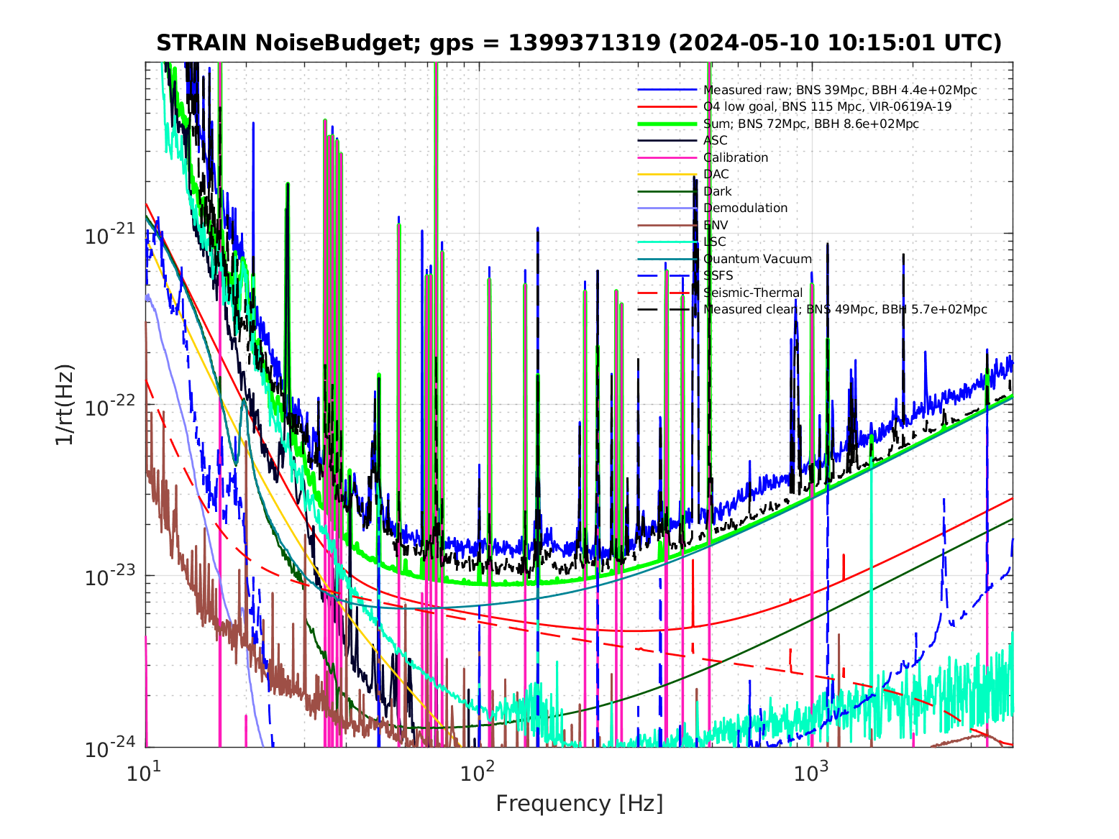
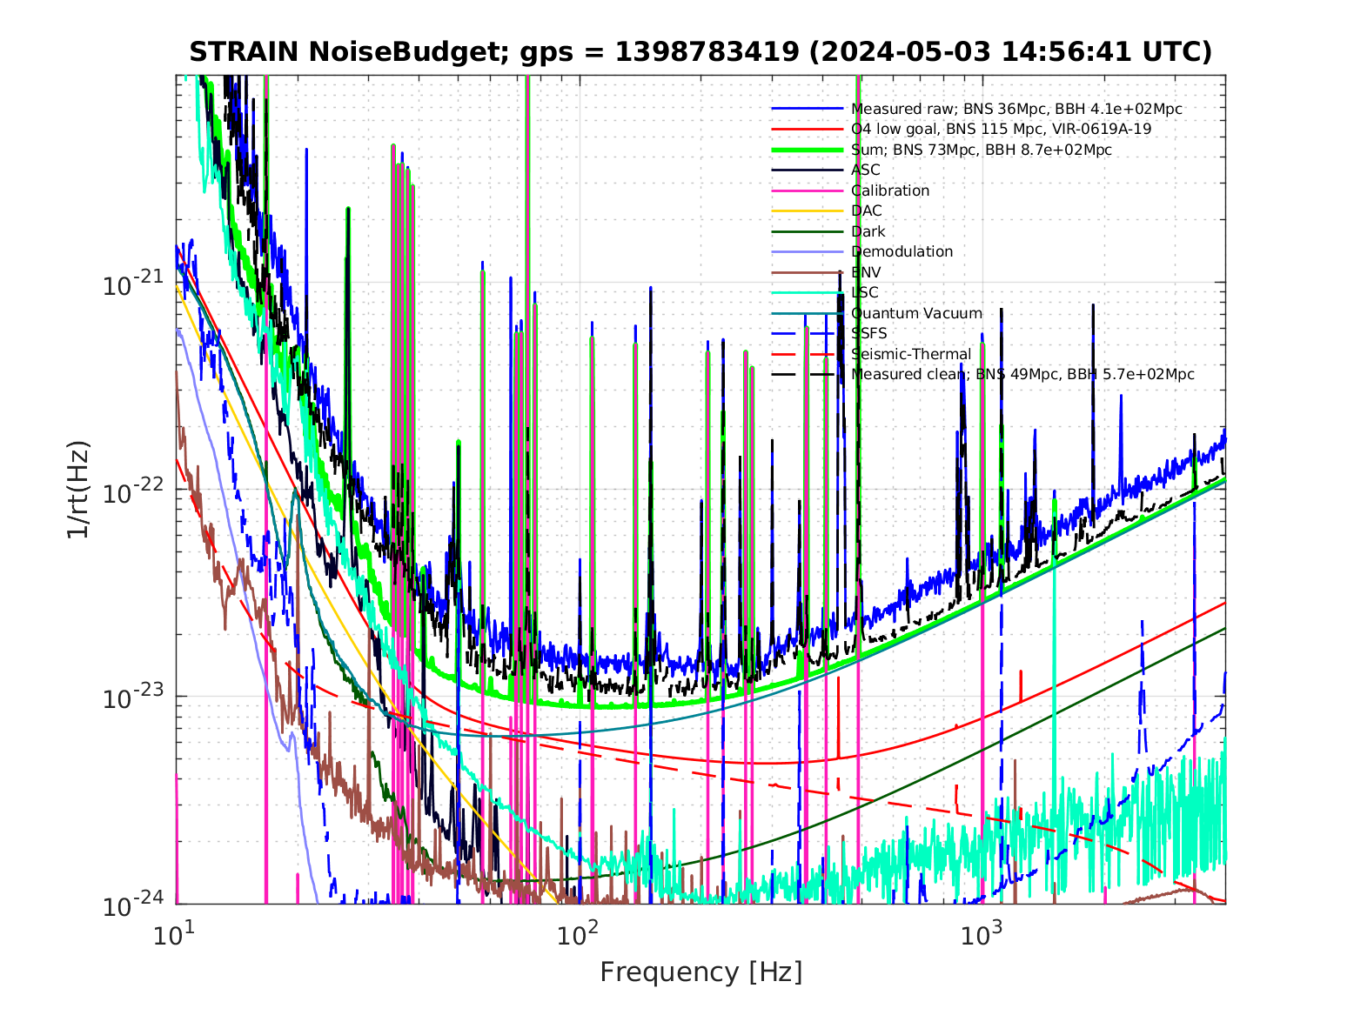

Slide 15
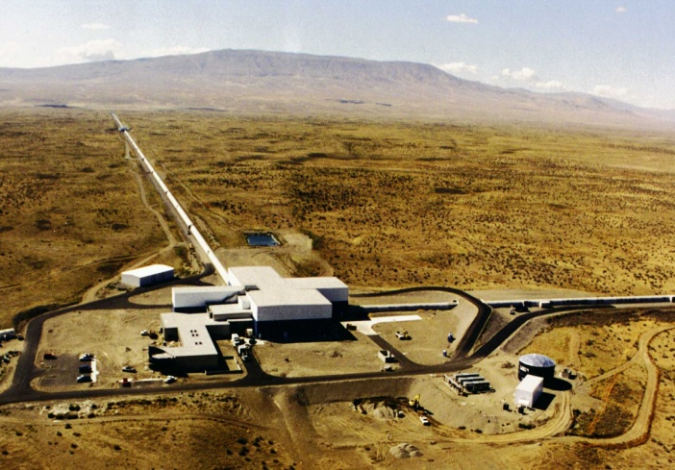
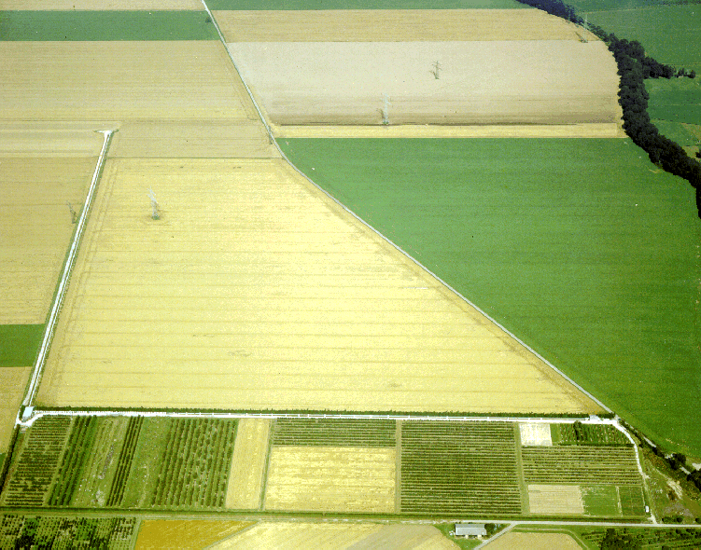
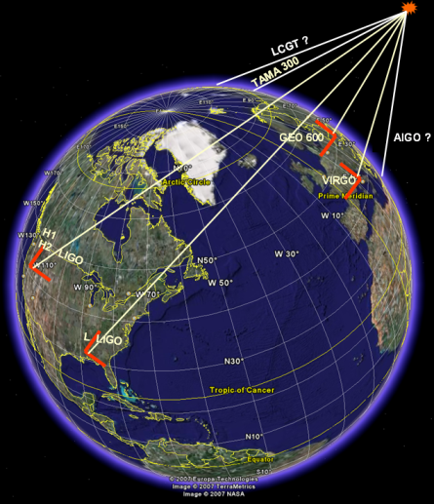
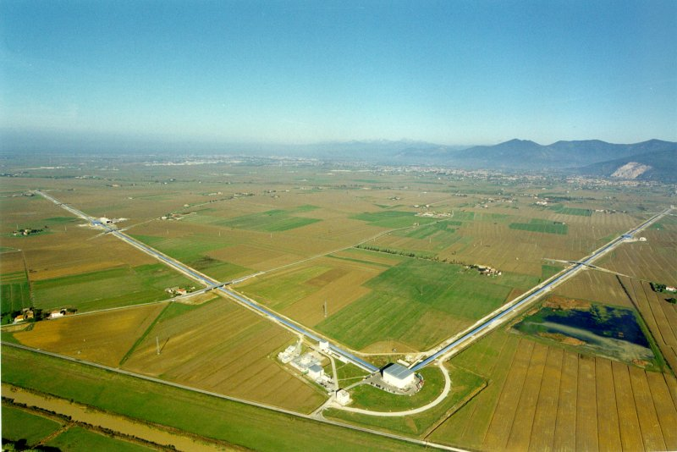
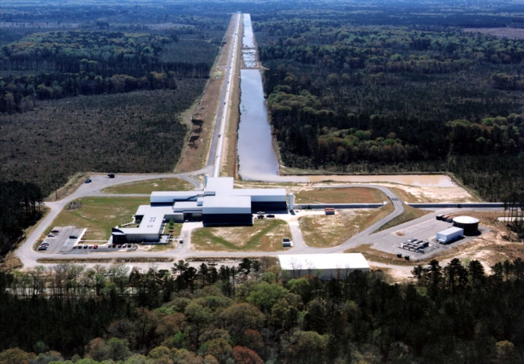
GW NETWORK
Un network di 4 (5) rivelatori di GW
LIGO – Hanford, WA
GEO600, Hannover, D
LIGO – Livingston, LA
VIRGO, Pisa, Italy
Virgo and the LIGO Scientific Collaboration (LSC) signed an MoU to exchange data, joint data analysis and pubblication policy. First common papers in – 2008-09

Slide 16
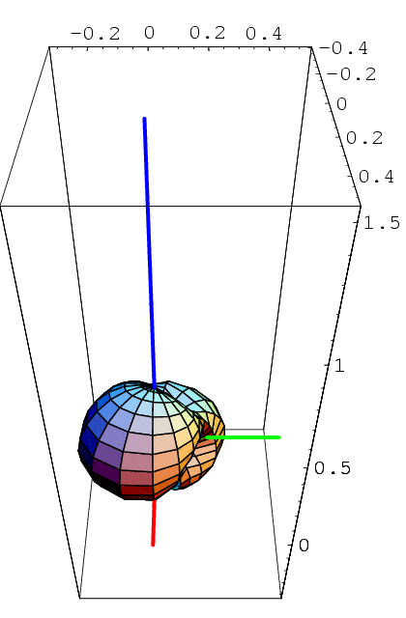
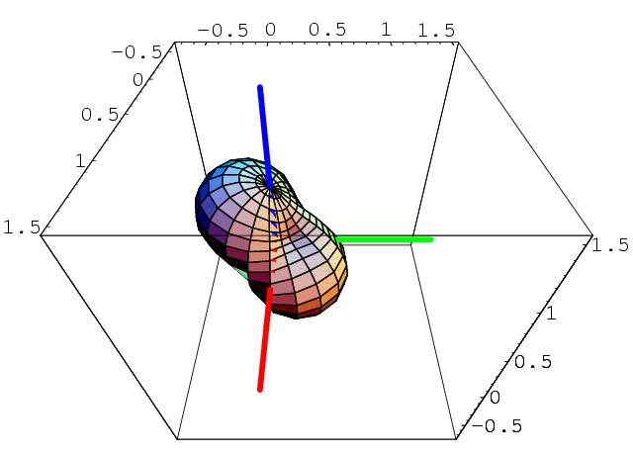
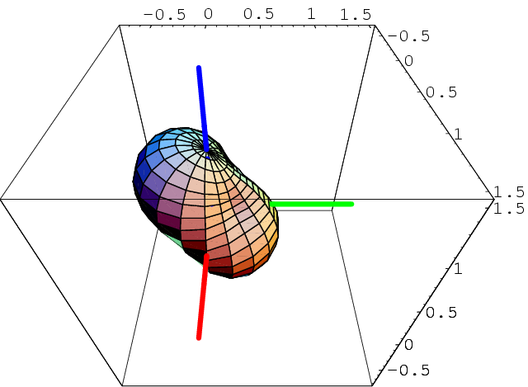
Antenna patterns and the network
LIGO
VIRGO
Spurious event rejection :
LIGO H1+L1
LIGO+VIRGO
LIGO+VIRGO
In principle, by combining LIGO-Virgo data coherently the observation range for BNS goes up to 300Mpc

Slide 17
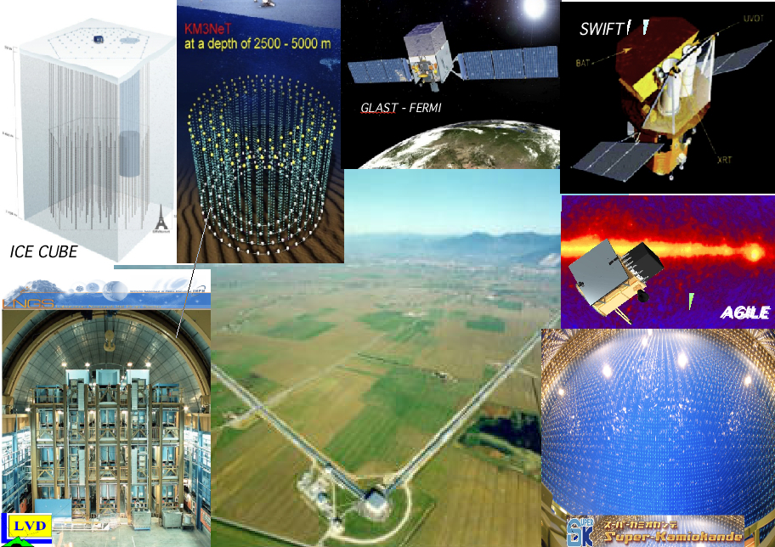
Ad VIRGO: a project coordinated with Astroparticle world

Slide 18
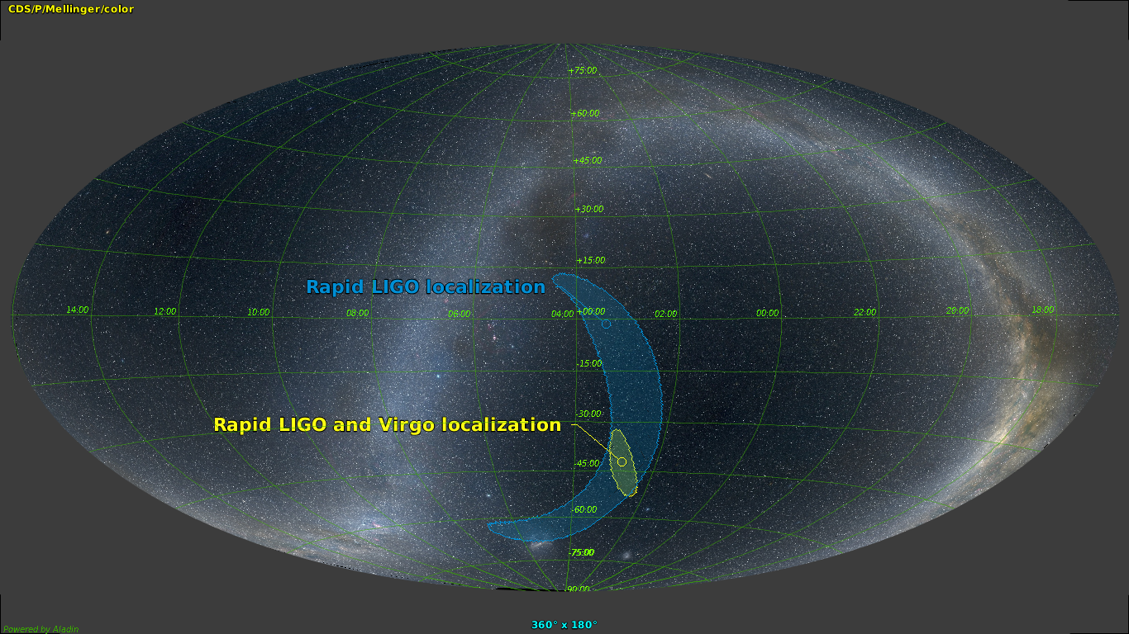
GW170814 The first BH-BH network observation
SNR=7.3
SNR=13.7
SNR=4.4
The sky region for GW170814 has a size of only 60 square degrees, more than 10 times better than for the two LIGO interferometers alone
Polarization
Virgo doesn’t respond in the exactly same way to passing gravitational waves as the LIGO detectors because of its orientation on Earth, meaning that one can test polarizations of gravitational waves.
The analysis of the data shows that Einstein’s prediction is strongly favored

Slide 19
GW170817 – NS-NS coalescence
The signal is clearly visible in the time-frequency plane for the three detectors with different SNR:
  H1: 18.8;
  L1: 26.4;
  V1: 2.0;
Combined SNR: 32.4
  It is the strongest signal detected so far:
    GW150914: 24;
    GW161226: 13;
    GW170114: 13;
    GW170814: 18;
  It is also the longest
    About 100 s vs 0.2 – 1 s;

Slide 21
GW170817 – the role of VIRGO
The signal is scarcely visible in Virgo data;
Nonetheless, Virgo horizon, at the event date was about 58 Mpc (L1: 218 Mpc and H1: 107 Mpc);
From waveform analysis, the source distance can be estimated to be around 40 Mpc
This contradiction can be explained with the source position with respect to the interferometer’s antenna pattern
As we have seen before, interferometers are not isotropically sensitive

Slide 22
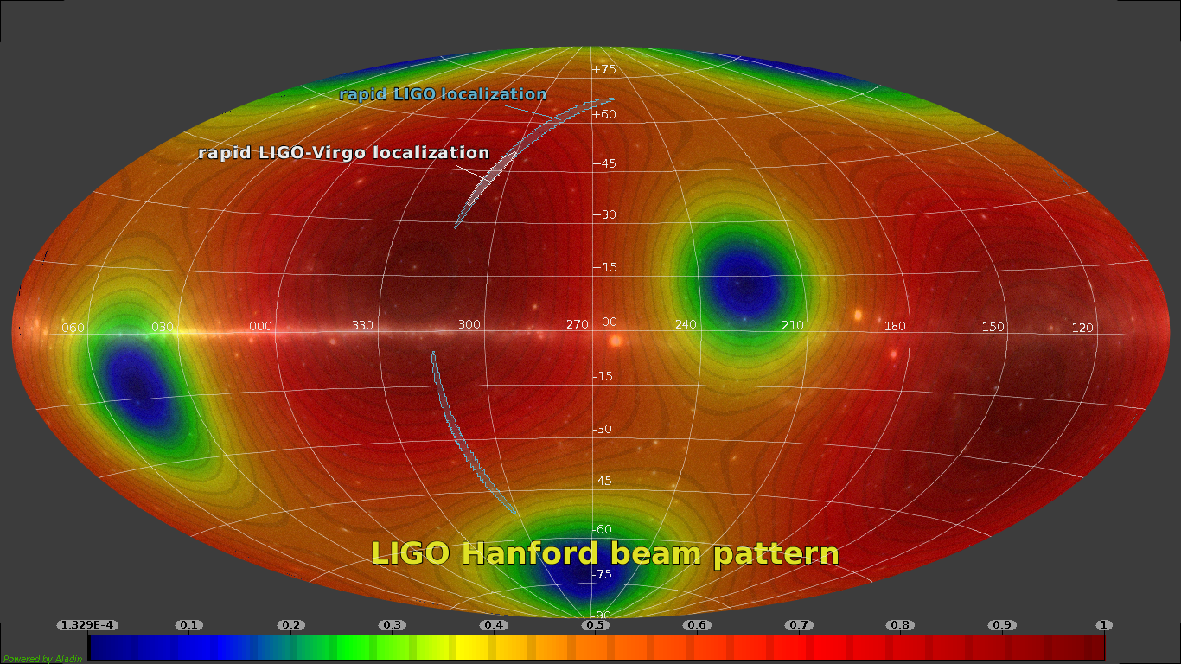

Slide 23
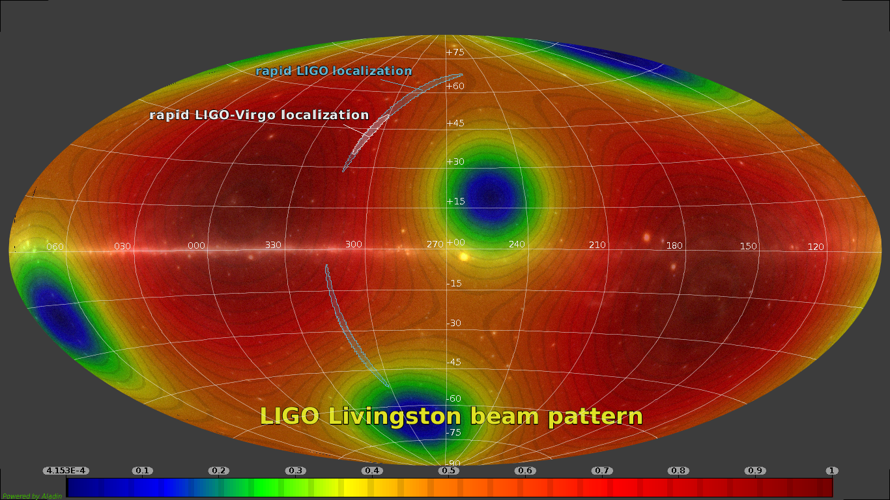

Slide 24
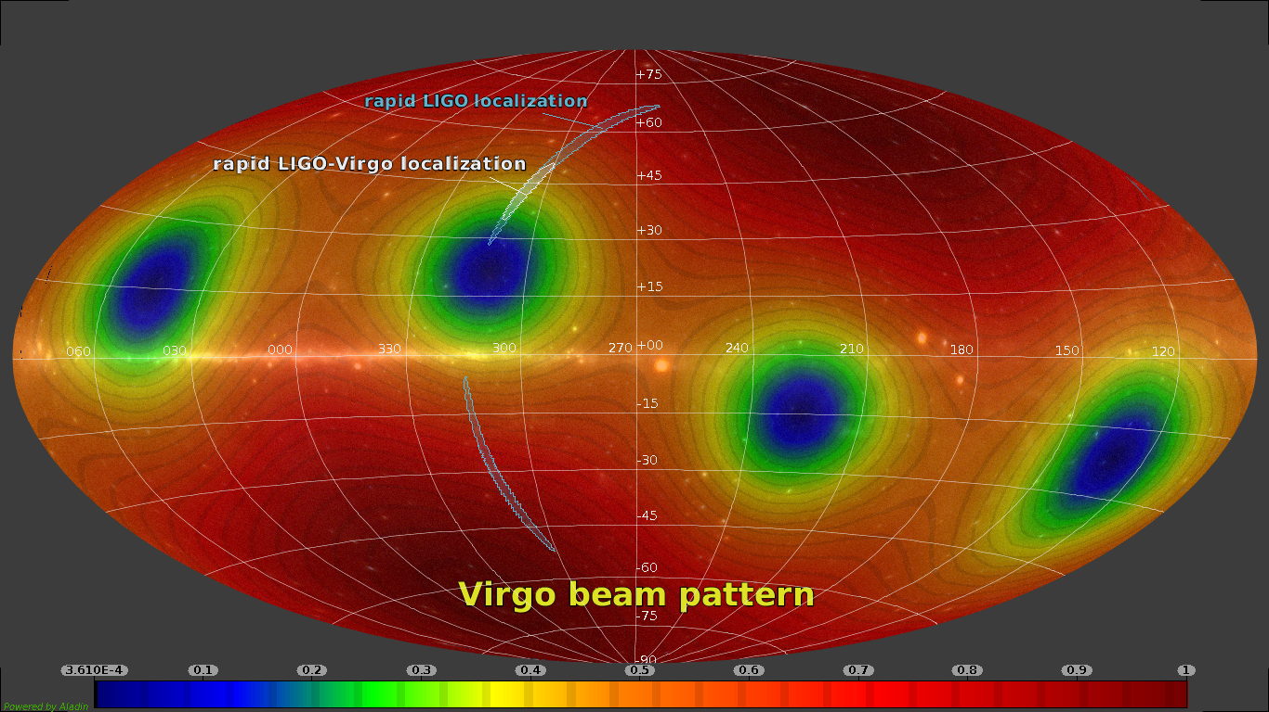

Slide 25
GW170817 – the role of Virgo: source localization
Although the Virgo signal has not been used to estimate the source physical parameters, its role has been fundamental in the source localization.
The localization with LIGO data only, determines an area of 190 deg²;
With the inclusion of Virgo information, this area is reduced to 28 deg²;
The distance to source is 40 Mpc (130 millions of light years);
We have seen that the distance can be found by GW data only

Slide 26
GW170817 – Source characteristics
Source characteristics have been extracted using different pipelines, based on the matched filtering technique, with a template bench with a combined mass ranging from 2 to 100 solar masses;
The total mass of the system is between 2.73 and 3.29 M_{S};
Each component mass is between 0.86 and 2.26 M_{S};
A strong correlation between mass ratio and the spin of the components does not allow to identify the individual components masses

Slide 27
TITLE: GCN CIRCULAR
NUMBER: 21505
SUBJECT: LIGO/Virgo G298048: Fermi GBM trigger 524666471/170817529: LIGO/Virgo Identification of a possible gravitational-wave counterpart
DATE: 17/08/17 13:21:42 GMT
FROM: Reed Clasey Essick at MIT ressick@mit.edu
The LIGO Scientific Collaboration and the Virgo Collaboration report:
The online CBC pipeline (gstlal) has made a preliminary
identification of a GW candidate associated with the time of Fermi
GBM trigger 524666471/170817529 at gps time 1187008884.47
(Thu Aug 17 12:41:06 GMT 2017) with RA=186.62deg Dec=-48.84deg and an error radius of 17.45deg.
The candidate is consistent with a neutron star binary coalescence with False Alarm Rate of
~1/10,000 years.
An offline analysis is ongoing. Any significant updates will be provided
by a new Circular.
[GCN OPS NOTE(17aug17): Per author's request, the LIGO/VIRGO ID
was added to the beginning of the Subject-line.]

Slide 28
Coincidences with other observatories
21516 LIGO/Virgo G298048: Potential host galaxies from the GLADE catalog
21515 LIGO/Virgo G298048: IPN triangulation of Fermi/GBM trigger 524666471/170817529
21514 LIGO/Virgo G298048: Astrosat CZTI upper limits
21513 LIGO/Virgo G298048: Further analysis of a binary neutron star candidate with updated sky localization
21512 LIGO/Virgo G297595: Liverpool Telescope observations of MASTER transients
21511 LIGO/Virgo G298048: COINCIDENT IceCube neutrino candidate with Fermi GBM trigger 524666471/170817529
21510 LIGO/Virgo G298048: correction to the luminosity distance reported in GCN 21509
21509 LIGO/Virgo G298048: Identification of a binary neutron star candidate coincident with Fermi GBM trigger 524666471/170817529
21508 LIGO/Virgo G298048: FOUND COINCIDENT IceCube neutrino observation
21507 LIGO/Virgo G298048: INTEGRAL detection of a prompt gamma-ray counterpart
21506 LIGO/Virgo G298048: Fermi GBM trigger 170817.529 and LIGO single IFO trigger
21505 LIGO/Virgo G298048: Fermi GBM trigger 524666471/170817529: LIGO/Virgo Identification of a possible gravitational-wave counterpart

Slide 29
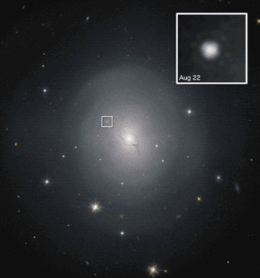
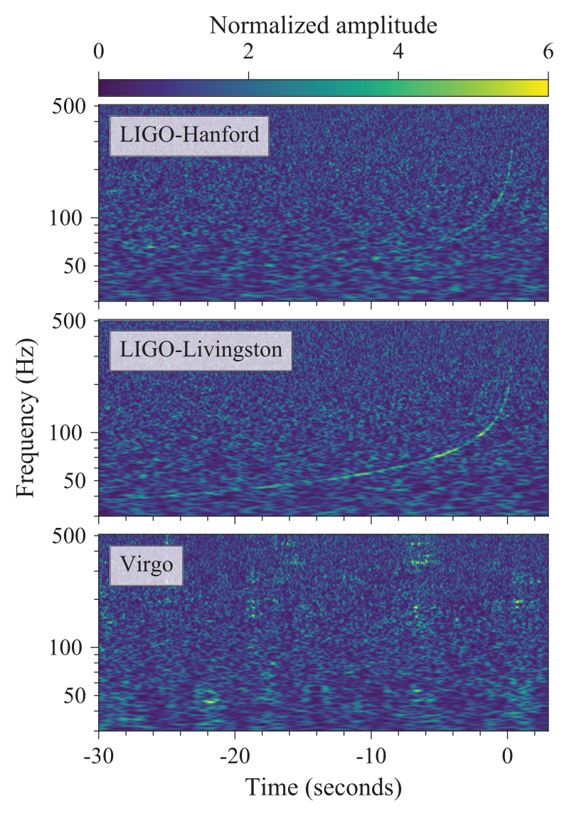
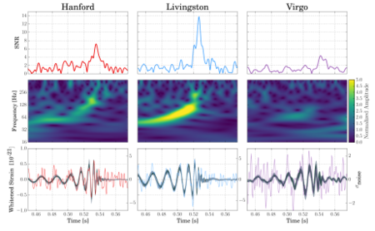
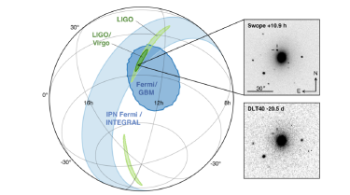
Previous observation runs
Adv Virgo and O3 run
Jan. 15, 2001 : brightest NS-BH merger
O3 ended on March 2020
Several exceptional events
NS-BH coalescences
  GW191219_163120 : extremely unequal mass components: 31M☉ + 1.2 M☉, and the lightest NS ever observed
  GW200115_042309: the brightest BH-NS coalescence detected up to now 6 M☉ + 1.4 M☉
BH-BH coalescences with IMBH
  GW190521_030229: 85 M☉ + 66 M☉ -> 142 M☉
  GW200220_061928: 87 M☉ + 61 M☉ -> 148 M☉
May 21, 2019: BH-BH merger to IMBH
Aug. 14, 2017:first triple detection
Sept. 14, 2015 first GW observation
August 17, 2017: first neutron-star merger detected
Aug. 1. 2017 Virgo joins the network

Slide 30
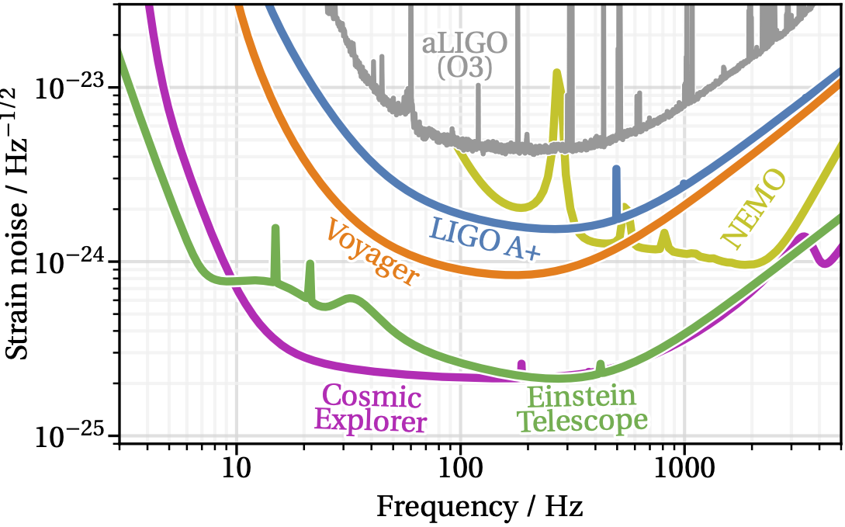
From 2nd to 3rd generation GW detectors

Slide 31
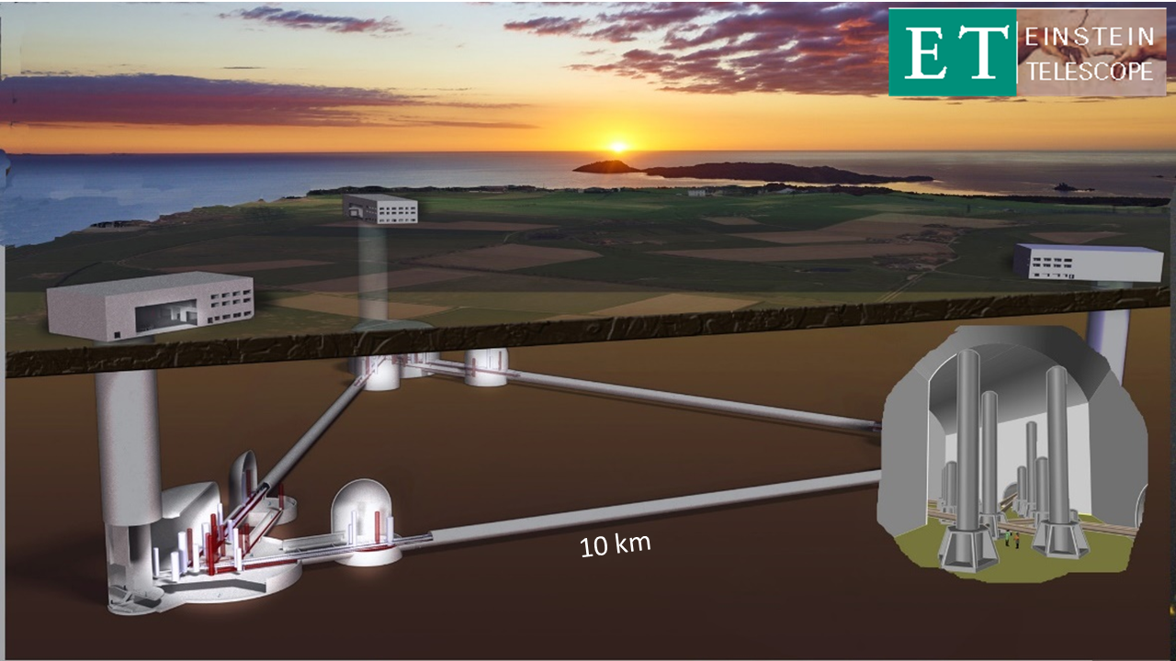
Einstein Telescope
3rd generation GW observatory Sensitivity aims at least one order of magnitude better with respect to the nominal sensitivity of advanced detectors in all the detection frequency band
Precision measurement and a new discovery project. A wide frequency band observatory
Special focus on massive (or intermediate mass) black holes. Extraordinary sensitivity at low frequency (few Hz)
High reliability. High observation duty cycle
Lifetime of several decades, (50 years in the ET proposal). Capable to host the evolution of the detectors, without limiting their sensitivity
Corner halls depth about 200m

Slide 32
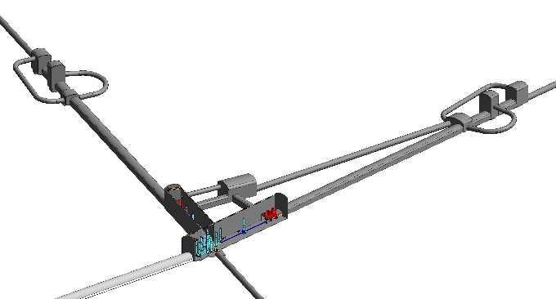
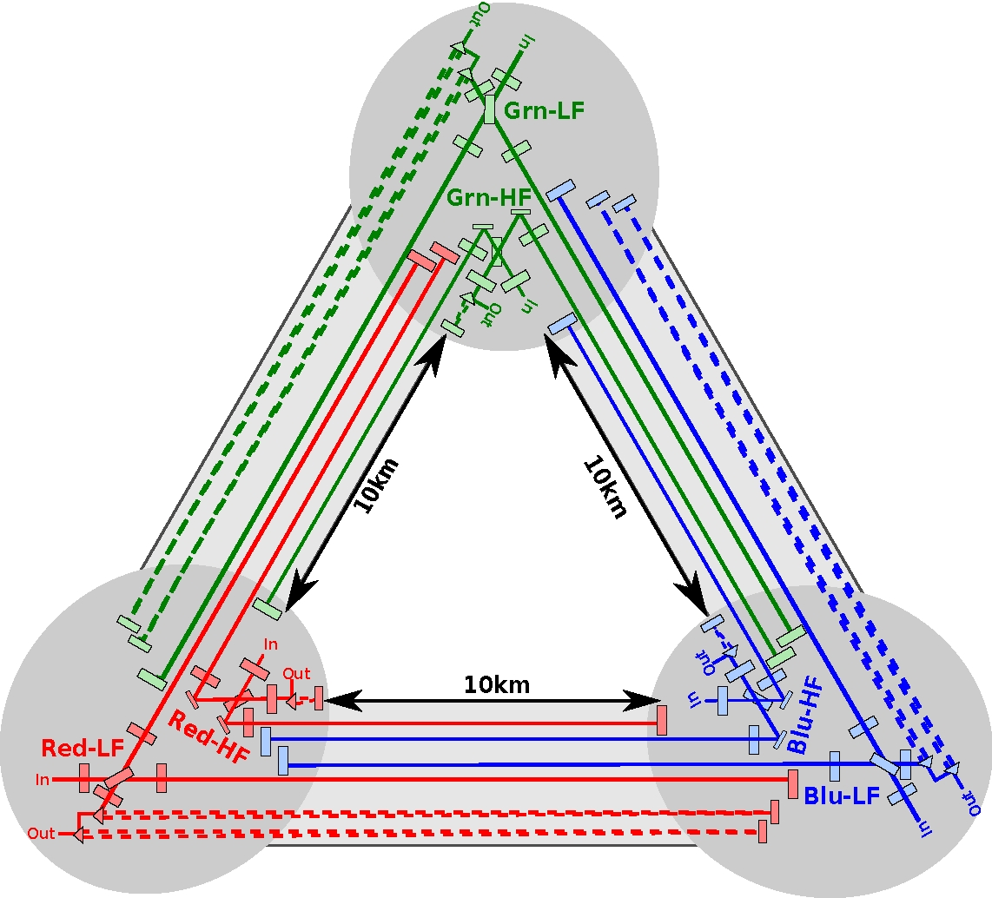

ET Design: key elements
Underground
Xylophone configuration
Longer arms
Cryogenic
ET-HF
ET-LF
Notes:
Multiple Interferometers per Detector (MIPD) or Xylophone design, two interferometers, one specialised in the low frequency band (ET-LF, from 3Hz to about 30-40 Hz), and one specialised in the high frequency (ET-HF, from 30 Hz to almost 10 kHz) are contributing to the implementation of a single ET detector.
Underground infrastructure, (~-200m) to reduce the impact of seismic noise, gravity gradient noise wind and acoustic disturbances impacting on the low frequency range
Longer arms, to increase the signal-to-noise (SNR) ratio with respect to all the displacement noises limiting the sensitivity of the current detectors. In the ET reference design ET has 10km long arms
Triangular geometry: to satisfy the localisation capability, the polarisation disentanglement, the sky coverage and the high reliability requirements, a multiple detector configuration is needed: each detector is composed by two interferometers with 10km long arms.

Slide 33
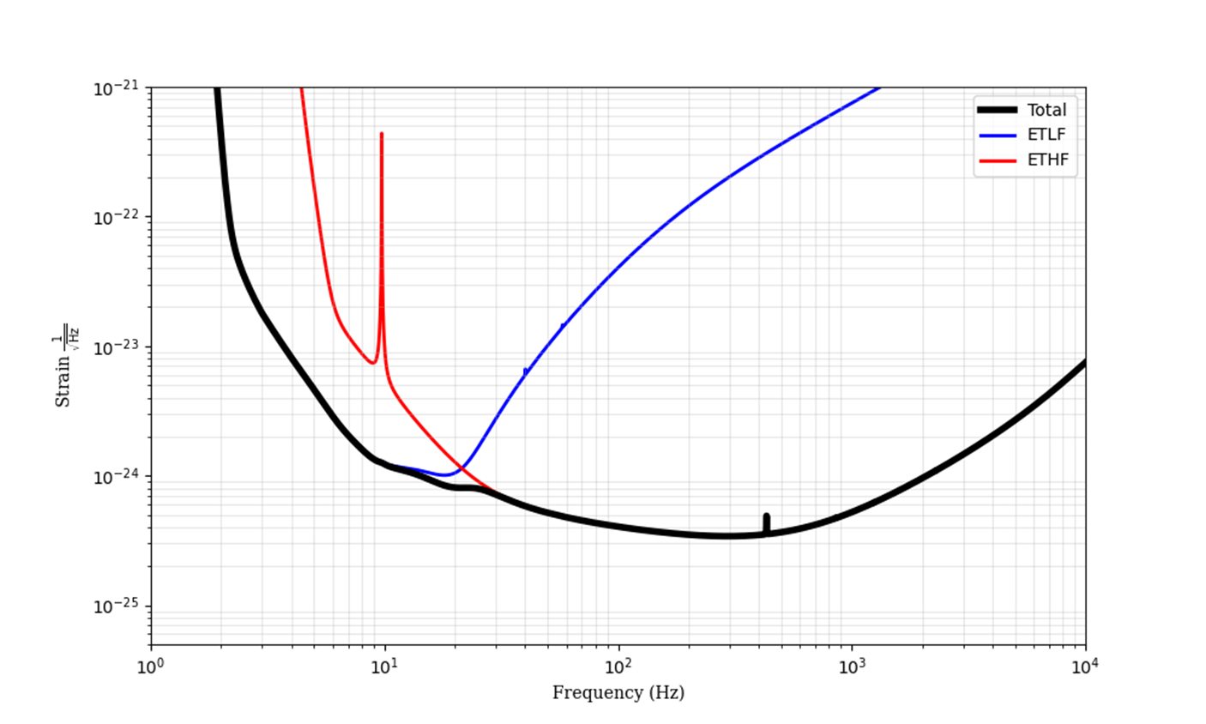
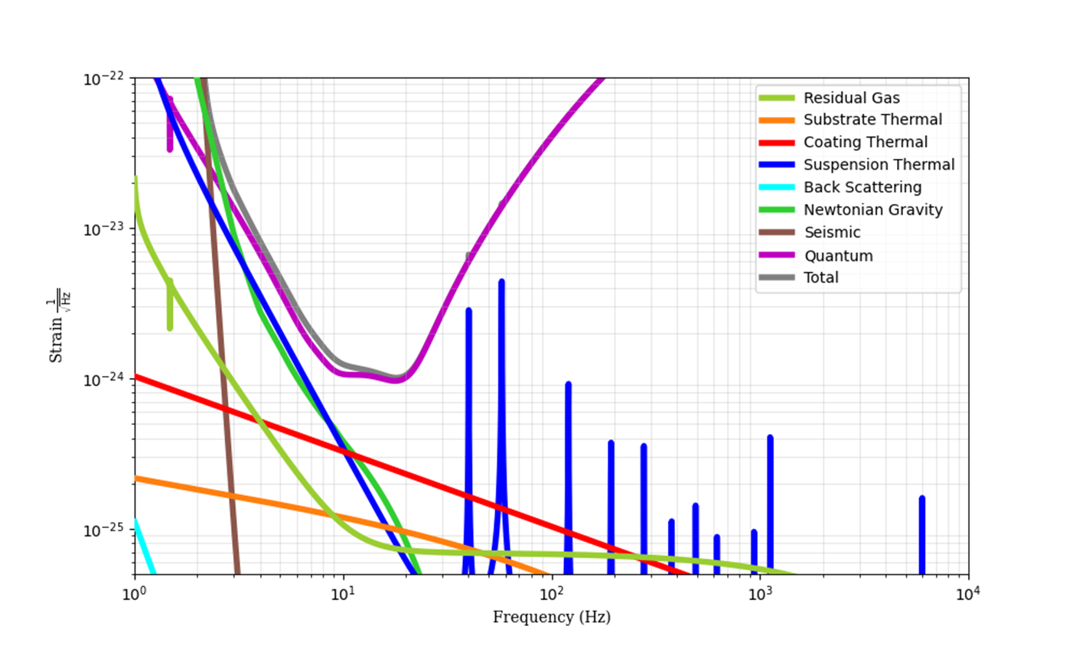
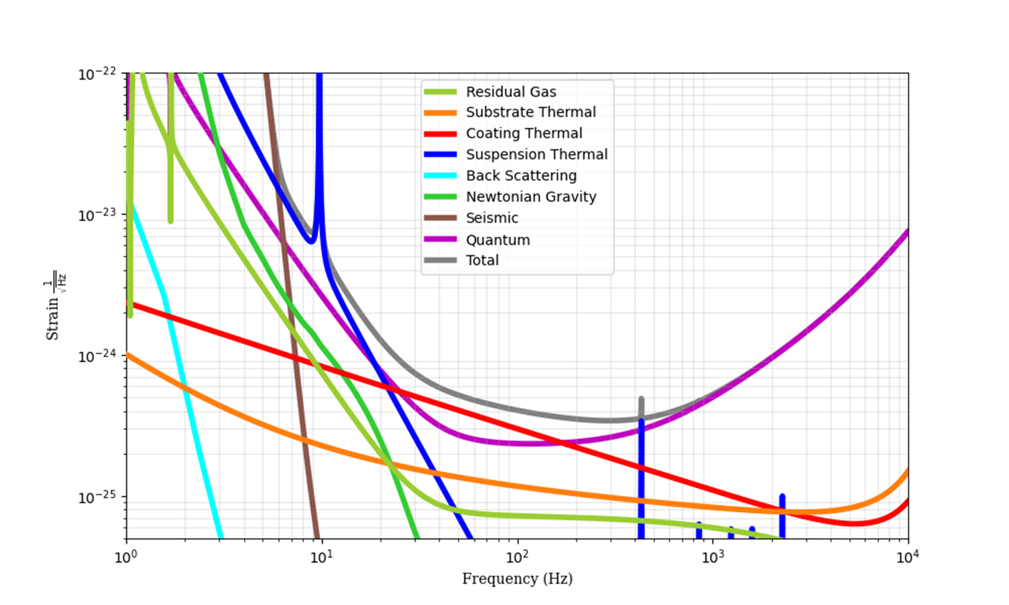
ET design: Xylophone configuration
ET sensitivity
(3-30 Hz)
Xylophone configuration (multi-interferometer)
(30 Hz – 10 kHz)
LF
HF

Slide 34
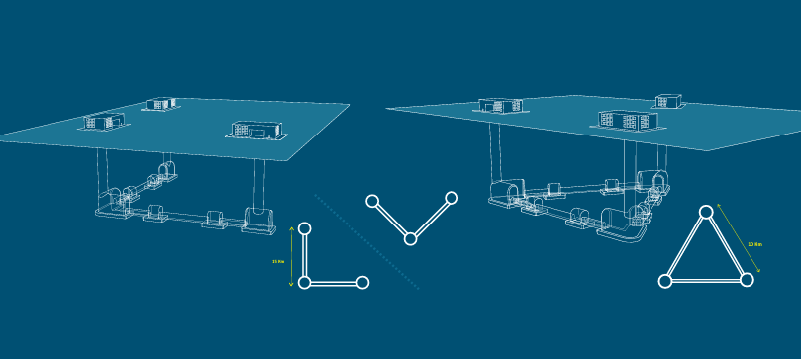
ET science case: Δ or (two) L
Since 2011 (CDS, triangle configuration) the situation drastically changed:
  First detections, GTWC-3 catalog → BH population → new evolution models;
  Science case developed;
  Know-how with advanced (L) detectors;
  International scenario (+ Cosmic Explorer in US)
The Collaboration is analyzing both configurations: optimizing science return, differential risk assessment.
  First results on the science return published in Marica Branchesi et al JCAP07(2023)068: https://doi.org/10.1088/1475-7516/2023/07/068
A preliminary differential risk analysis, provided by a specific committee, shown that for integration, commissioning, data taking and upgrade activities, the L geometry has a lower risk level
In the last two of years, the collaboration started the evaluation of the best configuration for ET, considering the alternative of two L configuration (as LIGO, Cosmic Explorer) to maximize the science return and reduce risks.
2L
Δ
10 km
15 km
The 2L 15 km geometry shows an improved science return in a relevant number of science targets

Slide 35
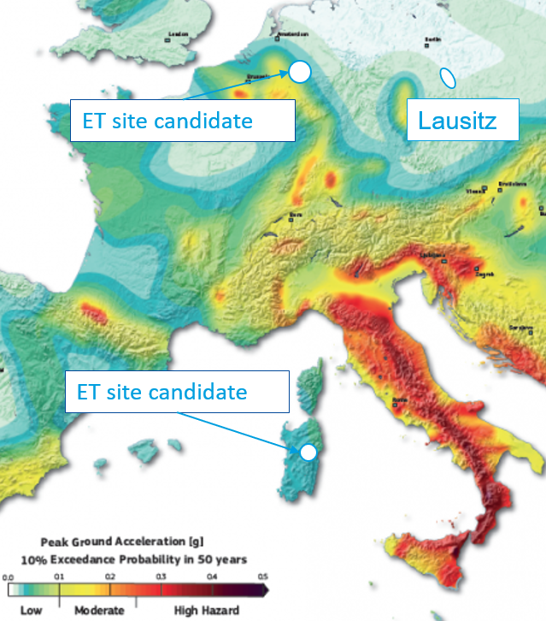
ET candidate sites
Two sites formally candidate to host ET:
  EMR EUregio, border region between Nederland, Belgium and Germany
  Sardinia (Lula area, Barbagia)
A third potential site, located in Saxony (Lausitz), is now proposed
Overall site evaluation is a complex task depending on:
  Geophysical and environmental quality
  Financial and organization aspects
  Services, infrastructures
EMR EUregio
Lausitz
Sos-Enattos (Lula –NU)
Decision about the location expected by 2026

Slide 36
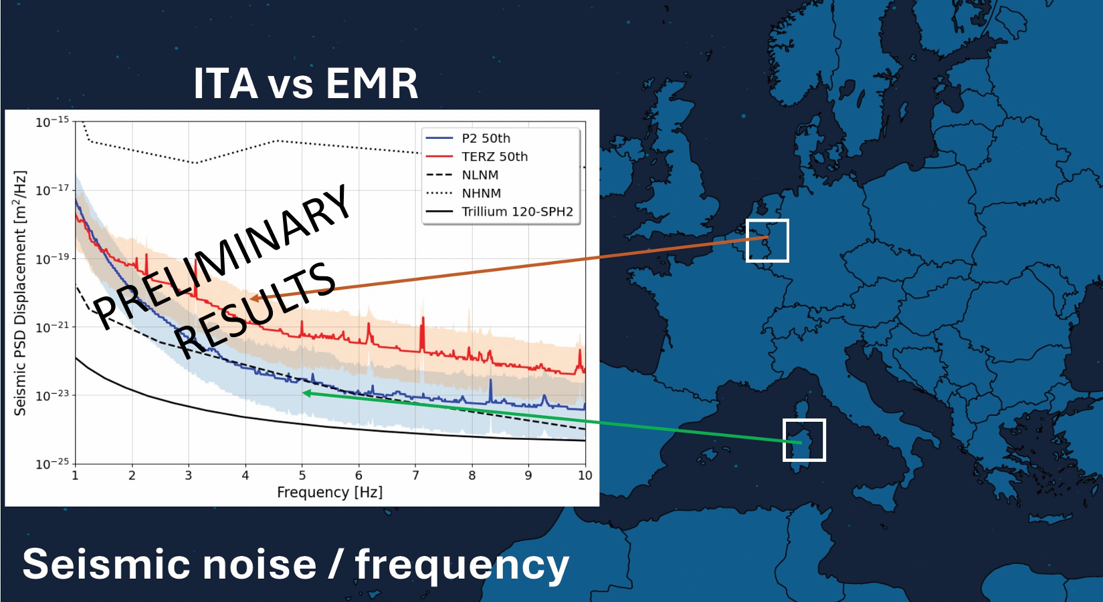
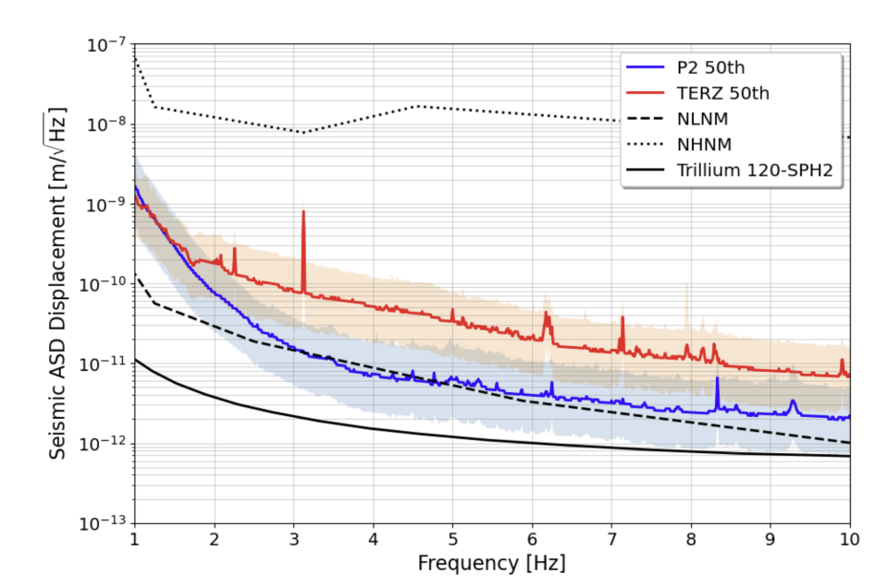
M. Di Giovanni et al, https://www.arxiv.org/pdf/2503.02166

Slide 37
LISA: Laser Interferometer Space Antenna

Slide 38
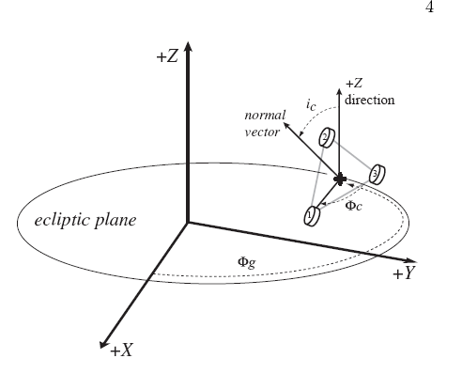
LISA
It’s a 3 spacecrafts constellation on Earth’s heliocentric orbit, around the Earth-Sun Lagrangian point
The average distance between two satellites is 3Mkm
Each satellite hosts two lasers and receives the beam from the remaining two
each satellite contains teo free-falling masses. It is the satellite that follows the free-falling bodies, correcting its position
Time Delay Interferometry (TDI)
Pathfinder successfully launched in 2015
LISA, at present is scheduled in the 30’s

Slide 39

The breath of LISA constellation
La dinamica orbitale produce una rotazione non rigida di un triangolo equilatero.

Slide 40




Interferometry with LISA
La luce in uscita è agganciata in fase con quella in ingresso: Trasponder
Si vogliono mantenere gli errori sul cammino ottico inferiori a 40 pm/√Hz

Slide 41

How many interferometers with 3 full satellites?

Slide 42




Time Delay Interferometry (TDI)
Eliminano i termini in φ_{i,} quindi il rumore di fase dei laser

Slide 47

The drag-free key elements: 1 the displacement sensor

Slide 49




LISA PATH FINDER
(2011 Launch)

Slide 50



