Slide 1
All you need to know about Gravitational Waves – Vol. I
Fabio Garufi 2025

Slide 2
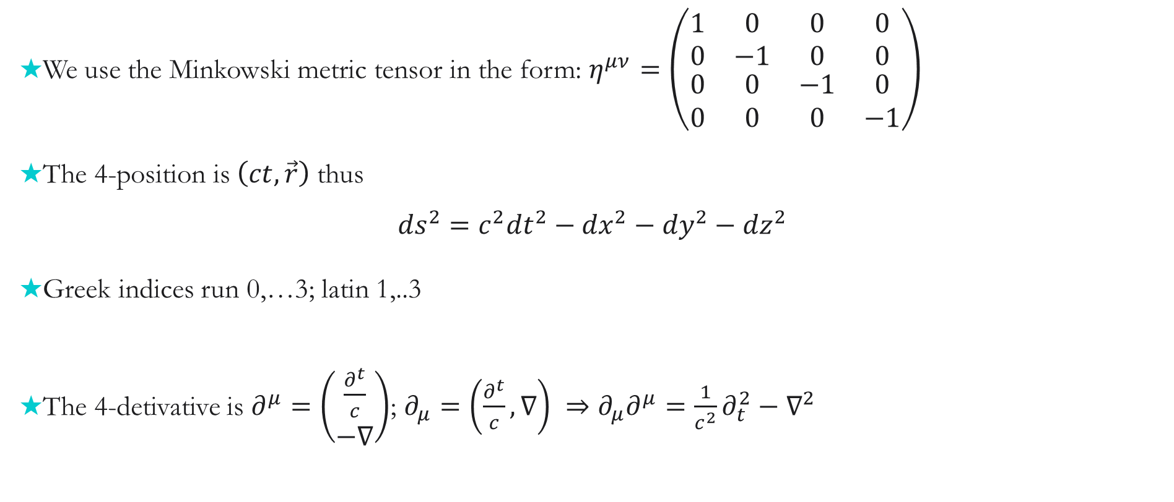
GW: Starting point and conventions
We use the Minkowski metric tensor in the form: $η^{μν}=\left(\begin{matrix}1 & 0 & 0 & 0 \\ 0 & −1 & 0 & 0 \\ \begin{aligned}0 \\ 0\end{aligned} & \begin{aligned}0 \\ 0\end{aligned} & \begin{aligned}−1 \\ 0\end{aligned} & \begin{aligned}0 \\ −1\end{aligned}\end{matrix}\right)$
The 4-position is $\left(ct, \vec{r}\right)$ thus
${ds}^{2}={c^{2}dt}^{2}−{dx}^{2}−{dy}^{2}−{dz}^{2}$
Greek indices run 0,…3; latin 1,..3
The 4-detivative is $∂^{μ}=\left(\begin{matrix}\frac{∂^{t}}{c} \\ −∇\end{matrix}\right)$; $∂_{μ}=\left(\frac{∂^{t}}{c}, ∇\right) ⇒∂_{μ}∂^{μ}=\frac{1}{c^{2}}∂_{t}^{2}−∇^{2}$

Slide 3
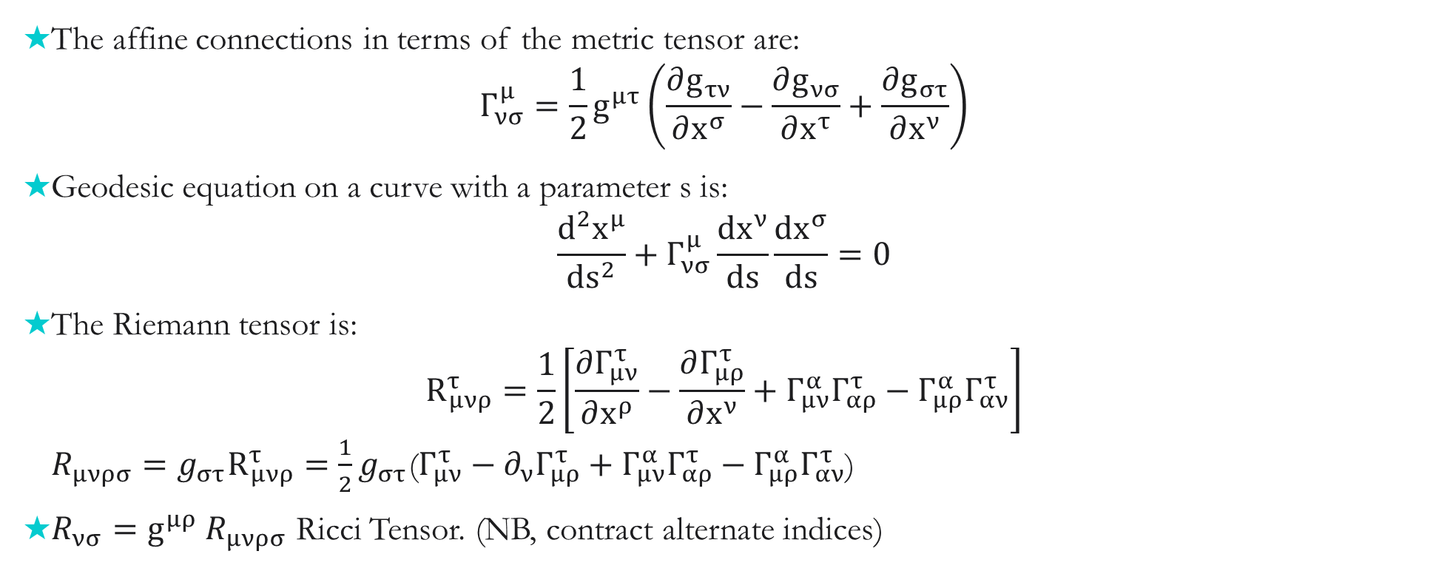
GW: Starting point and conventions
The affine connections in terms of the metric tensor are:
$$Γ_{νσ}^{μ}=\frac{1}{2}g^{μτ}\left(\frac{∂g_{τν}}{∂x^{σ}}−\frac{∂g_{νσ}}{∂x^{τ}}+\frac{∂g_{στ}}{∂x^{ν}}\right)$$
Geodesic equation on a curve with a parameter s is:
$\frac{d^{2}x^{μ}}{{ds}^{2}}+Γ_{νσ}^{μ}\frac{dx^{ν}}{ds}\frac{dx^{σ}}{ds}=0$
The Riemann tensor is:
$R_{μνρ}^{τ}=\frac{1}{2}\left[\frac{∂Γ_{μν}^{τ}}{∂x^{ρ}}−\frac{∂Γ_{μρ}^{τ}}{∂x^{ν}}+Γ_{μν}^{α}Γ_{αρ}^{τ}−Γ_{μρ}^{α}Γ_{αν}^{τ}\right]$
$R_{μνρσ}=g_{στ}R_{μνρ}^{τ}=\frac{1}{2}g_{στ}$($Γ_{μν}^{τ}−∂_{ν}Γ_{μρ}^{τ}+Γ_{μν}^{α}Γ_{αρ}^{τ}−Γ_{μρ}^{α}Γ_{αν}^{τ}$)
$R_{νσ}=g^{μρ}$ $R_{μνρσ}$ Ricci Tensor. (NB, contract alternate indices)

Slide 4
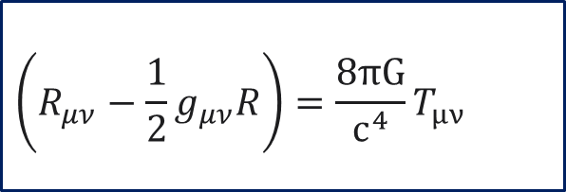
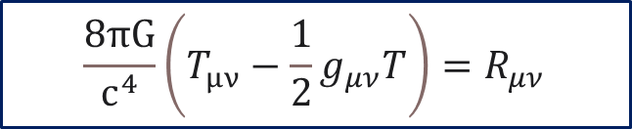
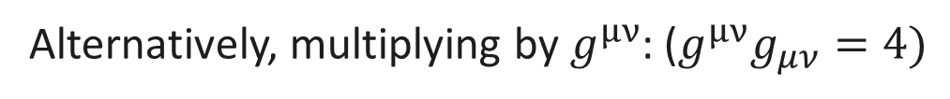
Einstein’s Equations
Link the space-time curvature to the energy-momentum $T_{μν}$
$$\left(R_{μν}−\frac{1}{2}g_{μν}R\right)=\frac{8πG}{c^{4}}T_{μν}$$
Alternatively, multiplying by $g^{μν}$: (${g^{μν}g}_{μν}=4)$
$R−\frac{1}{2}{g^{μν}g}_{μν}R=\frac{8πG}{c^{4}}g^{μν}T_{μν} ⇒R=−\frac{8πG}{c^{4}}T$ and, substituting
$$\frac{8πG}{c^{4}}\left(T_{μν}−\frac{1}{2}g_{μν}T\right)=R_{μν}$$
$T_{μν}$ is a conserved quantity, i.e. ${∂^{μ}T}_{μν}=0$, so, deriving the alternative form, we get: $∂^{μ}\left(T_{μν}−\frac{1}{2}g_{μν}T\right)=−$ $\frac{1}{2}∂_{ν}T$

Slide 5
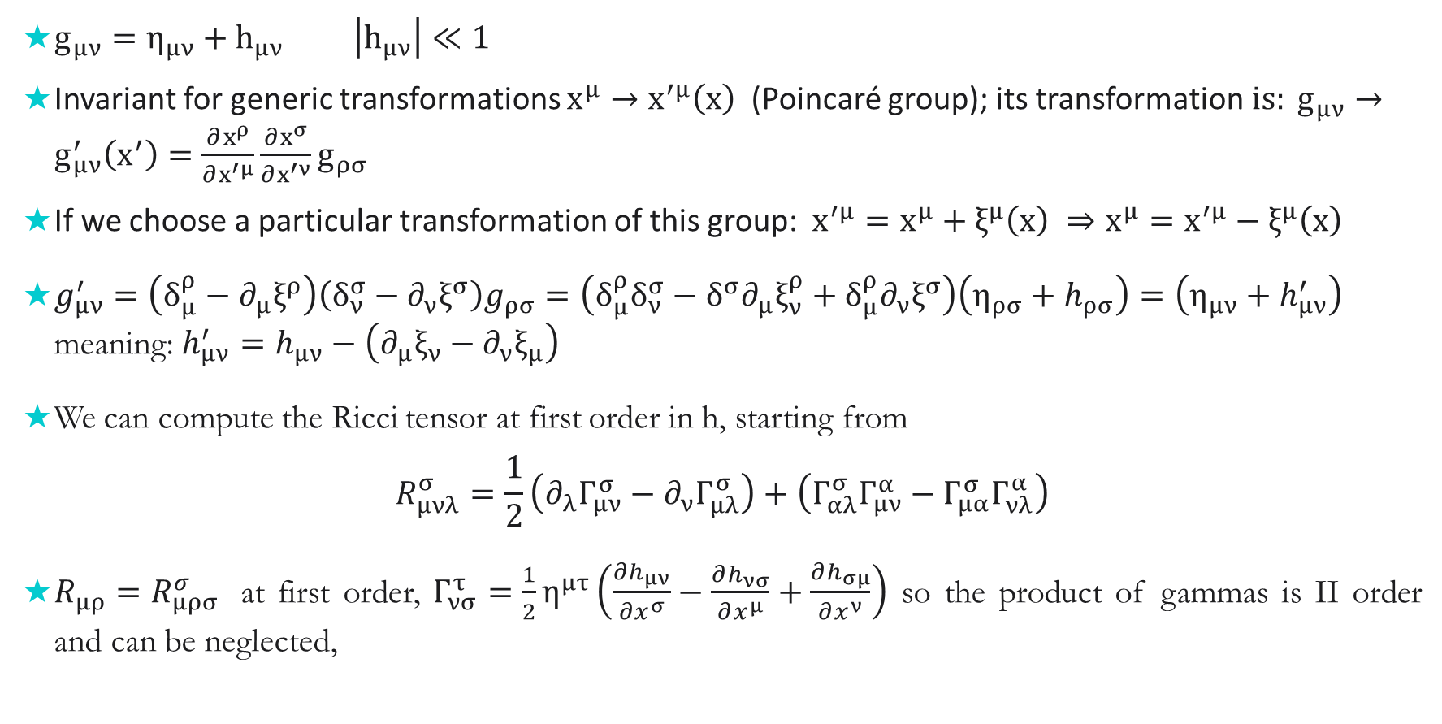
Linearized equations
$g_{μν}=η_{μν}+h_{μν} \left|h_{μν}\right|≪1$
Invariant for generic transformations $x^{μ}→x^{′μ}\left(x\right)$ (Poincaré group); its transformation$is: g_{μν}→g_{μν}^{′}\left(x^{′}\right)=\frac{∂x^{ρ}}{∂x^{′μ}}\frac{∂x^{σ}}{∂x^{′ν}}g_{ρσ}$
If we choose a particular transformation of this group: $x^{′μ}=x^{μ}+ξ^{μ}\left(x\right) ⇒x^{μ}=x^{′μ}−ξ^{μ}\left(x\right)$
$g_{μν}^{′}=\left(δ_{μ}^{ρ}−∂_{μ}ξ^{ρ}\right)\left(δ_{ν}^{σ}−∂_{ν}ξ^{σ}\right)g_{ρσ}=\left(δ_{μ}^{ρ}δ_{ν}^{σ}−δ^{σ}∂_{μ}ξ_{ν}^{ρ}+δ_{μ}^{ρ}∂_{ν}ξ^{σ}\right)\left(η_{ρσ}+h_{ρσ}\right)=\left(η_{μν}+h_{μν}^{′}\right)$ meaning: $h_{μν}^{′}=h_{μν}−\left(∂_{μ}ξ_{ν}−∂_{ν}ξ_{μ}\right)$
We can compute the Ricci tensor at first order in h, starting from
$$R_{μνλ}^{σ}=\frac{1}{2}\left(∂_{λ}Γ_{μν}^{σ}−∂_{ν}Γ_{μλ}^{σ}\right)+\left(Γ_{αλ}^{σ}Γ_{μν}^{α}−Γ_{μα}^{σ}Γ_{νλ}^{α}\right)$$
$R_{μρ}=R_{μρσ}^{σ}$ at first order, $Γ_{νσ}^{τ}=\frac{1}{2}η^{μτ}\left(\frac{∂h_{μν}}{∂x^{σ}}−\frac{∂h_{νσ}}{∂x^{μ}}+\frac{∂h_{σμ}}{∂x^{ν}}\right)$ so the product of gammas is II order and can be neglected,

Slide 6
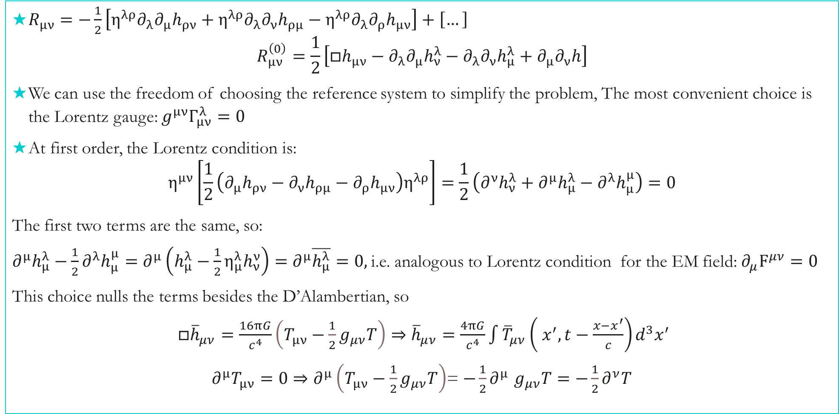
$R_{μν}=−\frac{1}{2}\left[η^{λρ}∂_{λ}∂_{μ}h_{ρν}+η^{λρ}∂_{λ}∂_{ν}h_{ρμ}−η^{λρ}∂_{λ}∂_{ρ}h_{μν}\right]+\left[…\right]$
$R_{μν}^{\left(0\right)}=\frac{1}{2}\left[□h_{μν}−∂_{λ}∂_{μ}h_{ν}^{λ}−∂_{λ}∂_{ν}h_{μ}^{λ}+∂_{μ}∂_{ν}h\right]$
We can use the freedom of choosing the reference system to simplify the problem, The most convenient choice is the Lorentz gauge: $g^{μν}Γ_{μν}^{λ}=0$
At first order, the Lorentz condition is:
$η^{μν}\left[\frac{1}{2}\left(∂_{μ}h_{ρν}−∂_{ν}h_{ρμ}−∂_{ρ}h_{μν}\right)η^{λρ}\right]=\frac{1}{2}\left(∂^{ν}h_{ν}^{λ}+∂^{μ}h_{μ}^{λ}−∂^{λ}h_{μ}^{μ}\right)=0$
The first two terms are the same, so:
$∂^{μ}h_{μ}^{λ}−\frac{1}{2}∂^{λ}h_{μ}^{μ}=∂^{μ}\left(h_{μ}^{λ}−\frac{1}{2}{η_{μ}^{λ}h}_{ν}^{ν}\right)=∂^{μ}\overline{h_{μ}^{λ}}=0,$i.e. analogous to Lorentz condition for the EM field: ${∂_{μ}F}^{μν}=0$
This choice nulls the terms besides the D’Alambertian, so
$□{\overline{h}}_{μν}=\frac{16πG}{c^{4}}\left(T_{μν}−\frac{1}{2}g_{μν}T\right)⇒{\overline{h}}_{μν}=\frac{4πG}{c^{4}}\int{{\overline{T}}_{μν}\left({ x}^{′}, t−\frac{x−x^{′}}{c}\right)d^{3}x^{′}}$
$∂^{μ}T_{μν}=0⇒∂^{μ}\left(T_{μν}−\frac{1}{2}g_{μν}T\right)$= $−\frac{1}{2}∂^{μ}$ $g_{μν}T=−\frac{1}{2}∂^{ν}T$

Slide 7
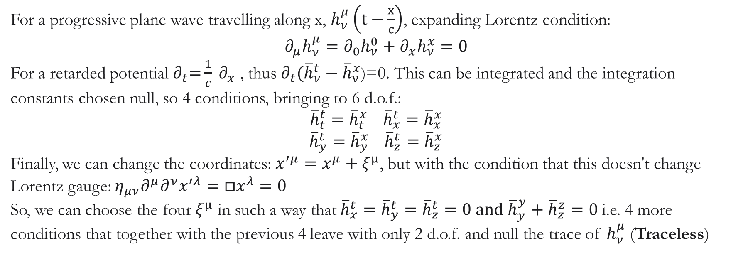
Plane wave approximation
Consider a plane wave solution ${\overline{h}}_{μν}=A_{μν}e^{ik^{α}x_{α}}$ , where A_{μν} is a time independent symmetric tensor => 10 independent components. Plugging this solution into wave equation, we get: $k_{α}k^{α}=0$
i.e. the wave vector is a light type vector (or null)
With the Lorenz condition $∂_{μ}{\bar{h}}_{ν}^{μ}=0⇒k_{μ}A_{ν}^{μ}=0$ i.e. the wave vector is tranverse
For a progressive plane wave travelling along x, $h_{ν}^{μ}\left(t−\frac{x}{c}\right)$, expanding Lorentz condition:
$$∂_{μ}h_{ν}^{μ}=∂_{0}h_{ν}^{0}+∂_{x}h_{ν}^{x}=0$$
For a retarded potential $∂_{t}\text{=}\frac{1}{c} ∂_{x}$ , thus $∂_{t}({\overline{h}}_{ν}^{t}−{\overline{h}}_{ν}^{x}$)=0. This can be integrated and the integration constants chosen null, so 4 conditions, bringing to 6 d.o.f.:
$${\overline{h}}_{t}^{t}={\overline{h}}_{t}^{x} {\overline{h}}_{x}^{t}={\overline{h}}_{x}^{x}$$
$${\overline{h}}_{y}^{t}={\overline{h}}_{y}^{x} {\overline{h}}_{z}^{t}={\overline{h}}_{z}^{x}$$
Finally, we can change the coordinates: $x^{′μ}=x^{μ}+ξ^{μ}$, but with the condition that this doesn't change Lorentz gauge: $η_{μν}∂^{μ}∂^{ν}x^{′λ}=□x^{λ}=0$
So, we can choose the four $ξ^{μ}$ in such a way that${\overline{h}}_{x}^{t}={\overline{h}}_{y}^{t}={\overline{h}}_{z}^{t}=0$and ${\overline{h}}_{y}^{y}+$ ${\overline{h}}_{z}^{z}=0$i.e. 4 more conditions that together with the previous 4 leave with only 2 d.o.f. and null the trace of $h_{ν}^{μ}$ (Traceless)

Slide 8
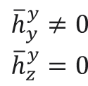
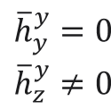
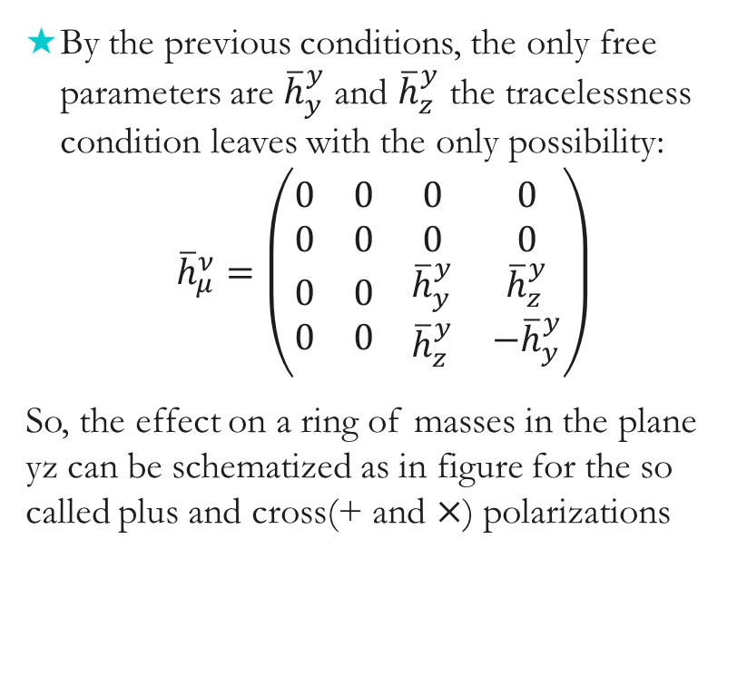
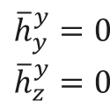
Transverse traceless gauge
$$\begin{aligned}{\overline{h}}_{y}^{y}=0 \\ {\overline{h}}_{z}^{y}=0\end{aligned}$$
By the previous conditions, the only free parameters are ${\overline{h}}_{y}^{y}$and ${\overline{h}}_{z}^{y}$ the tracelessness condition leaves with the only possibility:
$${\overline{h}}_{μ}^{ν}=\left(\begin{matrix}0 & 0 & 0 & 0 \\ 0 & 0 & 0 & 0 \\ \begin{aligned}0 \\ 0\end{aligned} & \begin{aligned}0 \\ 0\end{aligned} & \begin{aligned}{\overline{h}}_{y}^{y} \\ {\overline{h}}_{z}^{y}\end{aligned} & \begin{aligned}{\overline{h}}_{z}^{y} \\ −{\overline{h}}_{y}^{y}\end{aligned}\end{matrix}\right)$$
So, the effect on a ring of masses in the plane yz can be schematized as in figure for the so called plus and cross(+ and $×$) polarizations
$$\begin{aligned}{\overline{h}}_{y}^{y}=0 \\ {\overline{h}}_{z}^{y}≠0\end{aligned}$$
$$\begin{aligned}{\overline{h}}_{y}^{y}≠0 \\ {\overline{h}}_{z}^{y}=0\end{aligned}$$

Slide 9
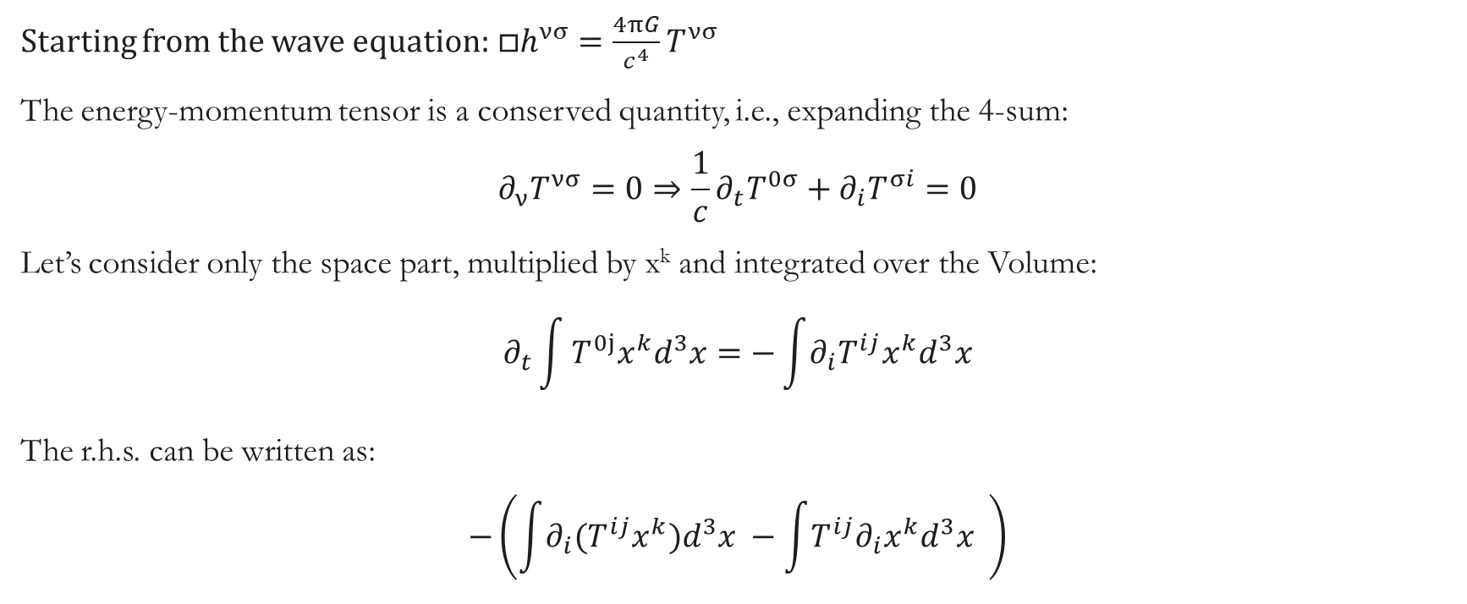
Production of GW
Starting from the wave equation:$□h^{νσ}=\frac{4πG}{c^{4}}T^{νσ}$
The energy-momentum tensor is a conserved quantity, i.e., expanding the 4-sum:
$$∂_{ν}T^{νσ}=0⇒\frac{1}{c}∂_{t}T^{0σ}+∂_{i}T^{σi}=0$$
Let’s consider only the space part, multiplied by x^{k} and integrated over the Volume:
$$∂_{t}\int{T^{0j}x^{k}d^{3}x}=−\int{∂_{i}T^{ij}x^{k}d^{3}x}$$
The r.h.s. can be written as:
$$−\left(\int{∂_{i}(T^{ij}x^{k})d^{3}x} −\int{T^{ij}∂_{i}x^{k}d^{3}x} \right)$$

Slide 10
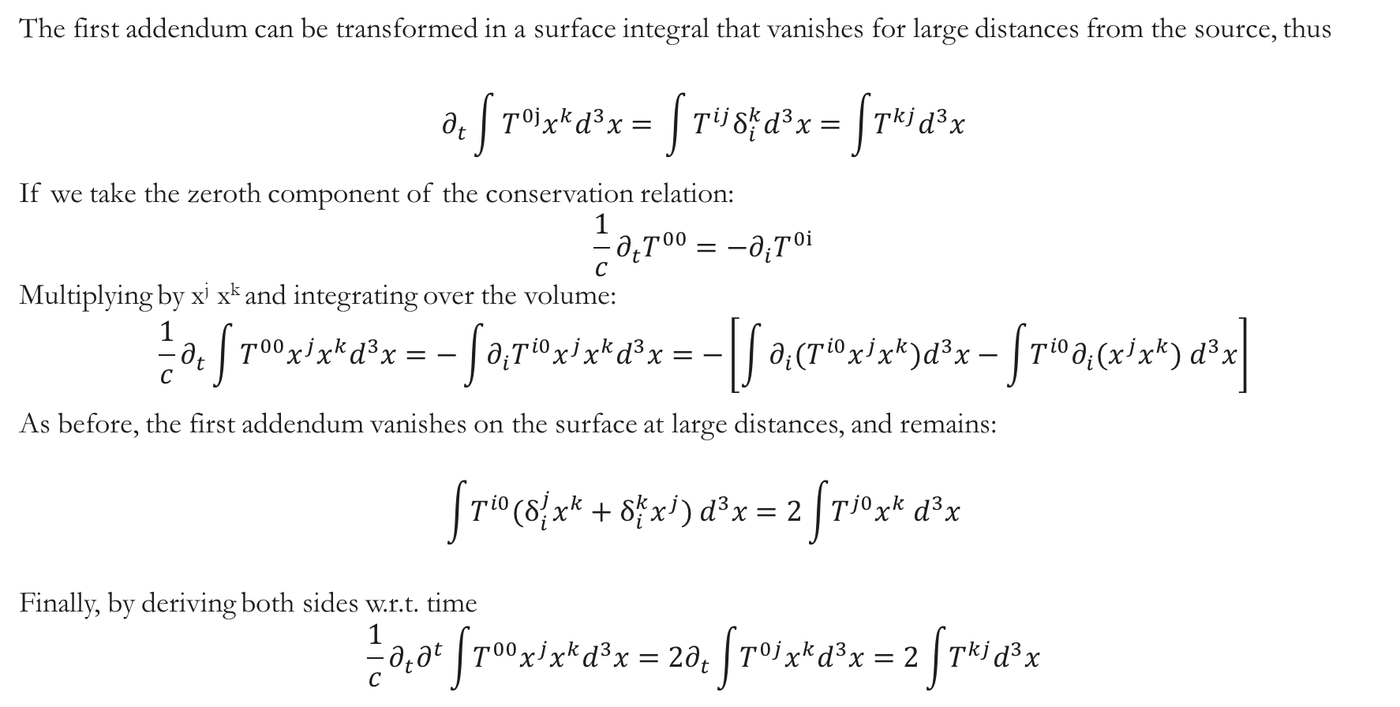
The first addendum can be transformed in a surface integral that vanishes for large distances from the source, thus
$$∂_{t}\int{T^{0j}x^{k}d^{3}x= }\int{T^{ij}δ_{i}^{k}d^{3}x=\int{T^{kj}d^{3}x}}$$
If we take the zeroth component of the conservation relation:
$$\frac{1}{c}∂_{t}T^{00}=−∂_{i}T^{0i}$$
Multiplying by x^{j} x^{k} and integrating over the volume:
$$\frac{1}{c}∂_{t}\int{T^{00}x^{j}x^{k}d^{3}x=−\int{∂_{i}T^{i0}x^{j}x^{k}d^{3}x}=−\left[\int{∂_{i}{(T}^{i0}x^{j}x^{k})d^{3}x−\int{T^{i0}∂_{i}{(x^{j}x}^{k}) d^{3}x}}\right]}$$
As before, the first addendum vanishes on the surface at large distances, and remains:
$$\int{T^{i0}{(δ}_{i}^{j}x^{k}+δ_{i}^{k}x^{j}) d^{3}x}=2\int{T^{j0}x^{k} d^{3}x}$$
Finally, by deriving both sides w.r.t. time
$$\frac{1}{c}∂_{t}∂^{t}\int{T^{00}x^{j}x^{k}d^{3}x}=2∂_{t}\int{T^{0j}x^{k}d^{3}x}=2\int{T^{kj}d^{3}x}$$

Slide 11
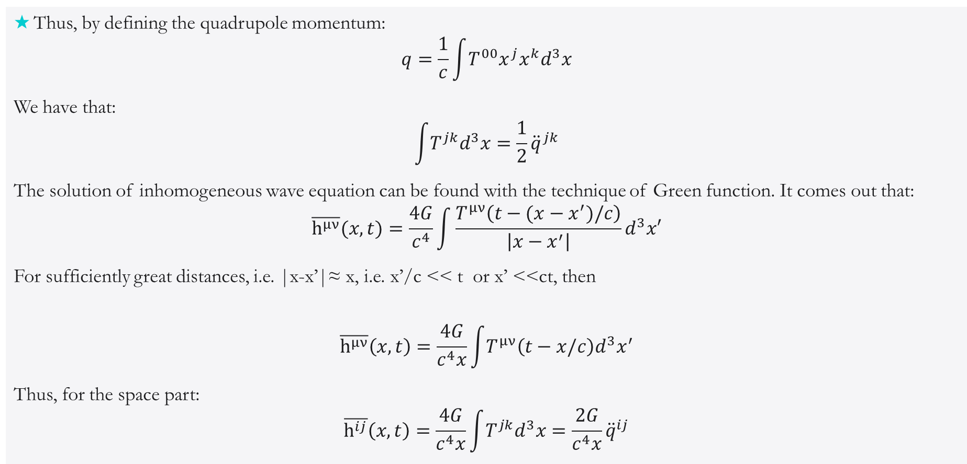
The quadrupole
Thus, by defining the quadrupole momentum:
$$q=\frac{1}{c}\int{T^{00}x^{j}x^{k}d^{3}x}$$
We have that:
$$\int{T^{jk}d^{3}x}=\frac{1}{2}{\ddot{q}}^{jk}$$
The solution of inhomogeneous wave equation can be found with the technique of Green function. It comes out that:
$$\overline{h^{μν}}(x,t)=\frac{4G}{c^{4}}\int{\frac{T^{μν}\left(t−(x−x^{′})/c\right)}{\left|x−x^{′}\right|}d^{3}x′}$$
For sufficiently great distances, i.e. |x-x’|≈ x, i.e. x’/c << t or x’ <<ct, then
$$\overline{h^{μν}}\left(x,t\right)=\frac{4G}{c^{4}x}\int{T^{μν}\left(t−x/c\right)d^{3}x^{′}}$$
Thus, for the space part:
$$\overline{h^{ij}}\left(x,t\right)=\frac{4G}{c^{4}x}\int{T^{jk}d^{3}x}=\frac{2G}{c^{4}x}{\ddot{q}}^{ij}$$

Slide 12

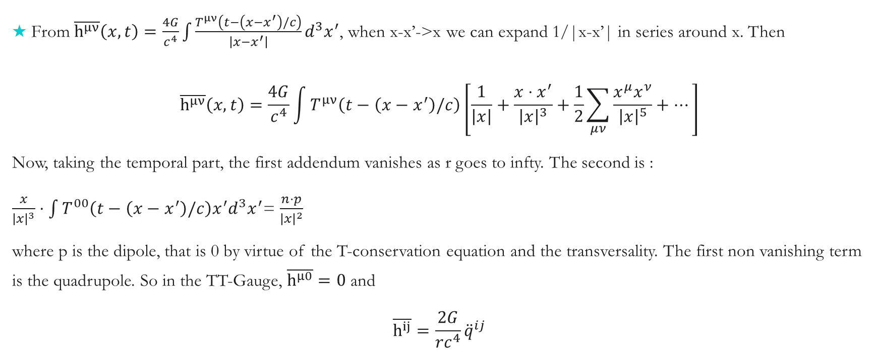
Quadrupole from multipole expansion
From $\overline{h^{μν}}\left(x,t\right)=\frac{4G}{c^{4}}\int{\frac{T^{μν}\left(t−\left(x−x^{′}\right)/c\right)}{\left|x−x^{′}\right|}d^{3}x^{′}}$, when x-x’->x we can expand 1/|x-x’| in series around x. Then
$$\overline{h^{μν}}\left(x,t\right)=\frac{4G}{c^{4}}\int{T^{μν}\left(t−\left(x−x^{′}\right)/c\right)}\left[\frac{1}{\left|x\right|}+\frac{x⋅x^{′}}{{\left|x\right|}^{3}}+\frac{1}{2}\sum_{μν}{\frac{x^{μ}x^{ν}}{{\left|x\right|}^{5}}}+…\right]$$
Now, taking the temporal part, the first addendum vanishes as r goes to infty. The second is :
$\frac{x}{{\left|x\right|}^{3}}⋅\int{T^{00}\left(t−\left(x−x^{′}\right)/c\right)x^{′}d^{3}x^{′}}$= $\frac{n⋅p}{{\left|x\right|}^{2}}$
where p is the dipole, that is 0 by virtue of the T-conservation equation and the transversality. The first non vanishing term is the quadrupole. So in the TT-Gauge, $\overline{h^{μ0}}=0$and
$$\overline{h^{ij}}=\frac{2G}{{rc}^{4}}{\ddot{q}}^{ij}$$
$$1.4⋅{10}^{−42}$$

Slide 13
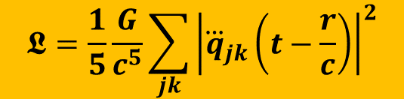
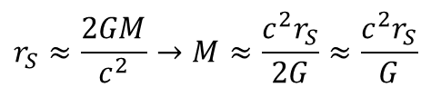

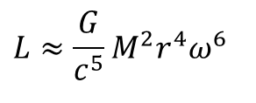
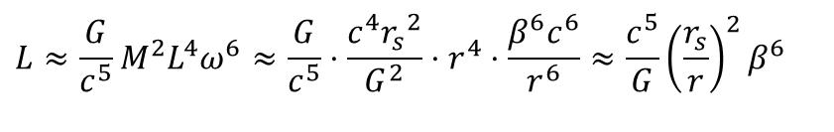


Orders of magnitude
ω
$$\frac{{6.6 10}^{−11}}{{\left(3⋅{10}^{8}\right)}^{5}}=2.7⋅{10}^{−53}$$
$$r_{S}=2⋅{10}^{3};r∼{10}^{4}$$
$$L≈\frac{G}{c^{5}}M^{2}r^{4}ω^{6}$$
Compact astrophysical object
$$r_{S}≈\frac{2GM}{c^{2}}→M≈\frac{c^{2}r_{S}}{2G}≈\frac{c^{2}r_{S}}{G}$$
pre-coalesent neutron star
$$v=rω→ω≈v/r→ω≈β(c/r)$$
3 10⁻²
$$L≈\frac{G}{c^{5}}M^{2}L^{4}ω^{6}≈\frac{G}{c^{5}}⋅\frac{c^{4}{r_{s}}^{2}}{G^{2}}⋅r^{4}⋅\frac{β^{6}c^{6}}{r^{6}}≈\frac{c^{5}}{G}{\left(\frac{r_{s}}{r}\right)}^{2}β^{6}$$
$${\left(3⋅{10}^{−2}\right)}^{6}=7⋅{10}^{2}⋅{10}^{−12}$$
$$L≈7⋅{10}^{41}W$$
Luminosità 10⁴² W → 10¹⁶volte il sole

Slide 14
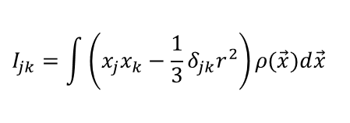

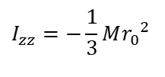
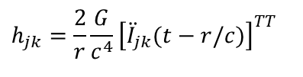

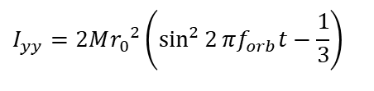
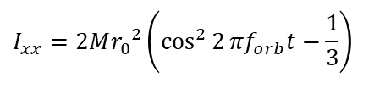
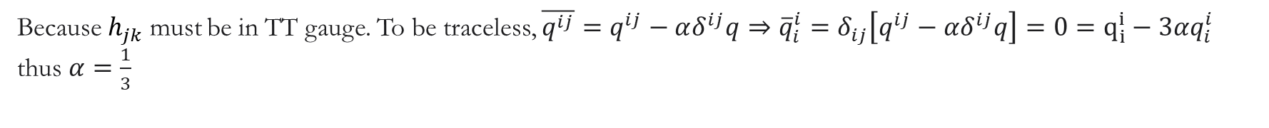
Orders of magnitude
$$\hat{z}$$
ω
$$h_{jk}=\frac{2}{r}\frac{G}{c^{4}}{\left[{\ddot{I}}_{jk}(t−r/c)\right]}^{TT}$$
M
M
$$I_{jk}=\int{\left(x_{j}x_{k}−\frac{1}{3}δ_{jk}r^{2}\right)}ρ(\vec{x})d\vec{x}$$
2r₀
Because $h_{jk}$ must be in TT gauge. To be traceless, $\overline{q^{ij}}=q^{ij}−αδ^{ij}q⇒{\overline{q}}_{i}^{i}=δ_{ij}\left[q^{ij}−αδ^{ij}q\right]=0=q_{i}^{i}−3αq_{i}^{i}$ thus $α=\frac{1}{3}$
$$I_{xx}=2M{r_{0}}^{2}\left(\cos^{2}{2}πf_{orb}t−\frac{1}{3}\right)$$
Dipole emission at twice the rotational
frequency
$$I_{yy}=2M{r_{0}}^{2}\left(\sin^{2}{2}πf_{orb}t−\frac{1}{3}\right)$$
$$I_{xy}=I_{yx}=2M{r_{0}}^{2}\cos{2}πf_{orb}t\sin{2}πf_{orb}t$$
$$I_{zz}=−\frac{1}{3}M{r_{0}}^{2}$$
(independent of time → no emission)

Slide 15
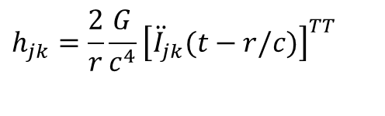
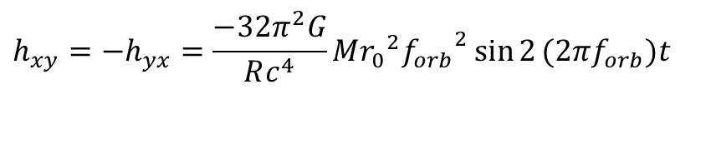
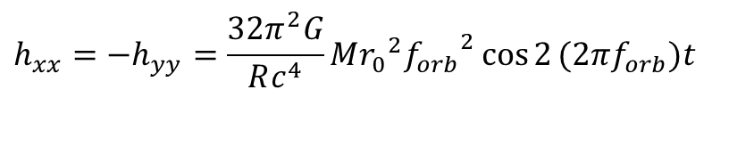
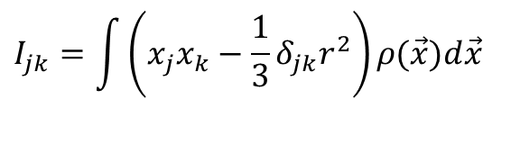
Orders of magnitude
$$\hat{z}$$
ω
$$h_{jk}=\frac{2}{r}\frac{G}{c^{4}}{\left[{\ddot{I}}_{jk}(t−r/c)\right]}^{TT}$$
M
M
$$I_{jk}=\int{\left(x_{j}x_{k}−\frac{1}{3}δ_{jk}r^{2}\right)}ρ(\vec{x})d\vec{x}$$
2r₀
$$h_{xx}=−h_{yy}=\frac{32π^{2}G}{Rc^{4}}M{r_{0}}^{2}{f_{orb}}^{2}\cos{2}(2πf_{orb})t$$
GW amplitude in a point at a distance
R on z-axis
$$h_{xy}=−h_{yx}=\frac{−32π^{2}G}{Rc^{4}}M{r_{0}}^{2}{f_{orb}}^{2}\sin{2}(2πf_{orb})t$$

Slide 16
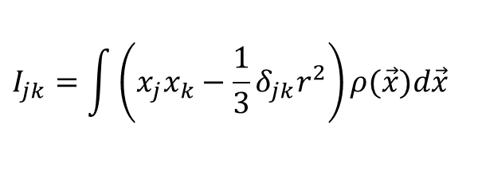

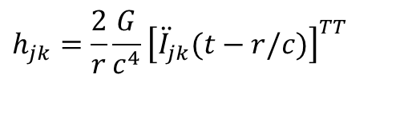

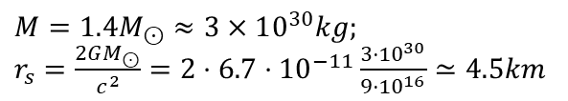
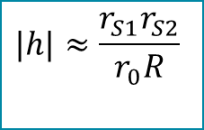

Orders of magnitude
$$\hat{z}$$
ω
$$h_{jk}=\frac{2}{r}\frac{G}{c^{4}}{\left[{\ddot{I}}_{jk}(t−r/c)\right]}^{TT}$$
M
M
$$I_{jk}=\int{\left(x_{j}x_{k}−\frac{1}{3}δ_{jk}r^{2}\right)}ρ(\vec{x})d\vec{x}$$
2r₀
Schwarzschild radius inserted and use of Newtonian equation to have the
orbital frequency as a function of time
$$M=1.4M_{⊙}≈3×10^{30}kg;$$
$r_{s}=\frac{2GM_{⊙}}{c^{2}}=2⋅6.7⋅{10}^{−11}\frac{3⋅{10}^{30}}{9⋅{10}^{16}}≃4.5km$
$$|h|≈\frac{r_{S1}r_{S2}}{r_{0}R}$$
$$h≈10^{−21}$$
(!)
$$r_{0}≈20km→f_{orbital}≈400Hz$$
$$R≈15Mpc=4.5x10^{23}m (1pc=3.26 ly)$$

Slide 17
Astrophysical GW sources
As we have shown, production of GW is highly unefficient: only astrophysical sources have enough energy to produce detectable GWs.
On the basis of their evolution in time, we can divide GW sources in:
    Impulsiive
    quasi periodic
    periodic

Slide 18
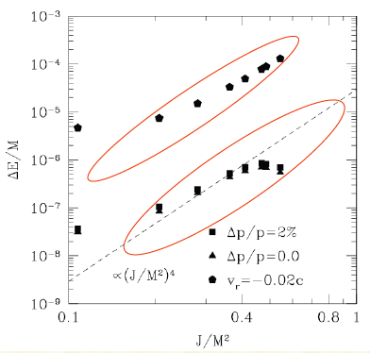
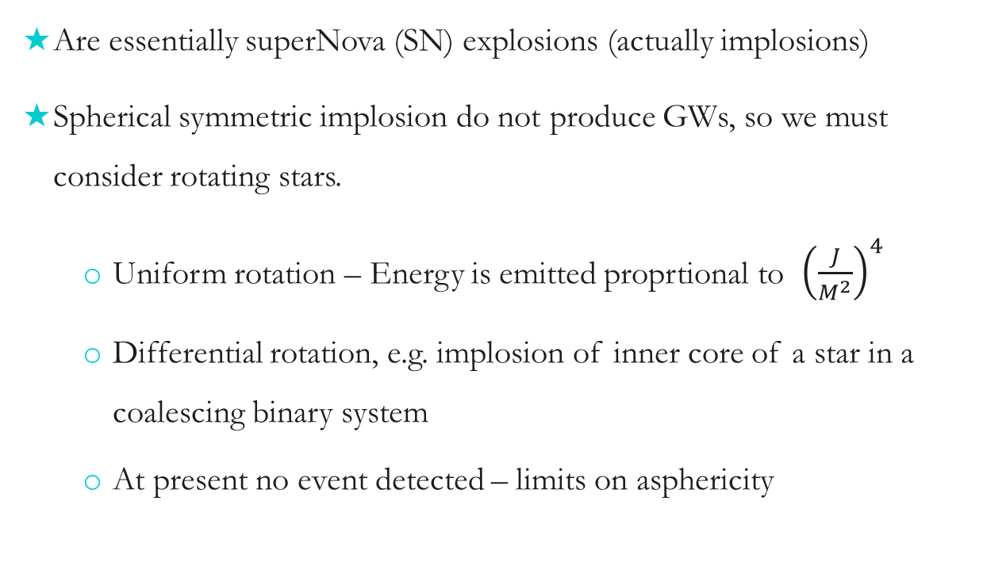
Impulsive sources
Are essentially superNova (SN) explosions (actually implosions)
Spherical symmetric implosion do not produce GWs, so we must consider rotating stars.
  Uniform rotation – Energy is emitted proprtional to ${\left(\frac{J}{M^{2}}\right)}^{4}$
  Differential rotation, e.g. implosion of inner core of a star in a coalescing binary system
  At present no event detected – limits on asphericity

Slide 19
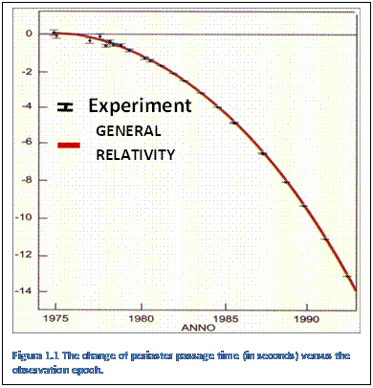
Quasi periodic sources
Hulse & Taylor Nobel 1993
It is essentially coalescing binaries
the first source observed to lose energy via GW radiation: the pulsar PSR1913-16
Two stars orbiting around the common centre of mass loose energy by emission of GWs. As a consequence, the distance from the centre of rotation diminishes, and the angular velocity increases. Thus, the emitted GWs amplitude increases with time and so their frequency.
In the final phase the two objects merge to form a compact object

Slide 20
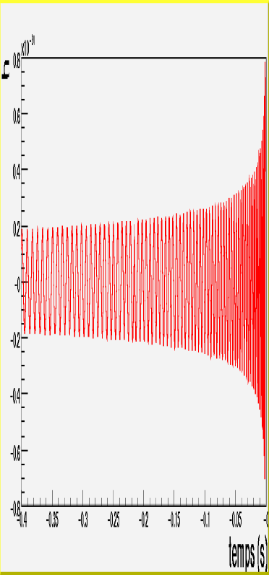
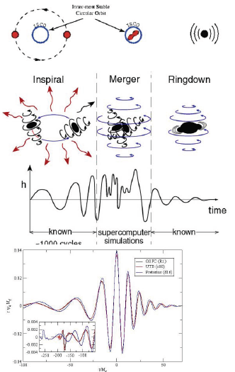
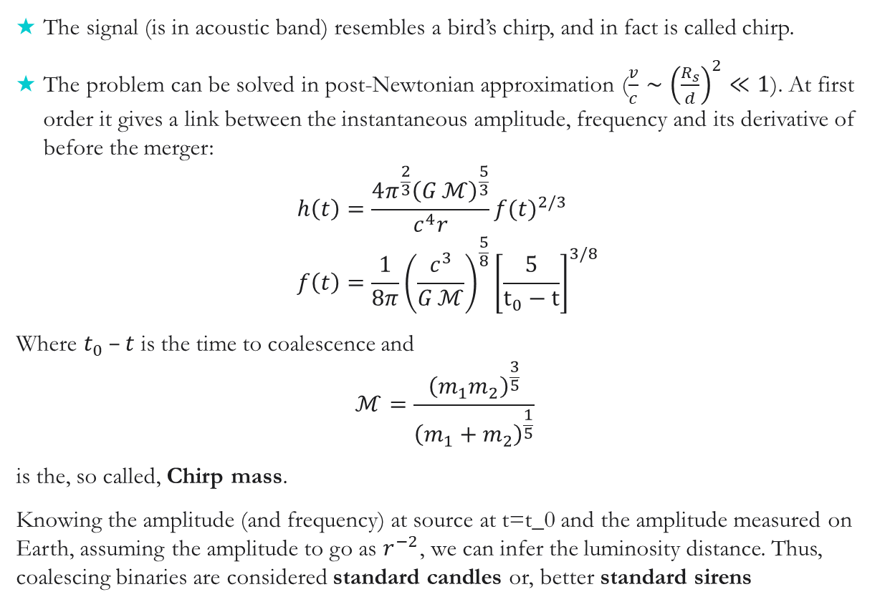
Signals from a binary merger
The signal (is in acoustic band) resembles a bird’s chirp, and in fact is called chirp.
The problem can be solved in post-Newtonian approximation ($\frac{v}{c}∼{\left(\frac{R_{s}}{d}\right)}^{2}≪1$). At first order it gives a link between the instantaneous amplitude, frequency and its derivative of before the merger:
$$h\left(t\right)=\frac{4π^{\frac{2}{3}}{\left(G ℳ\right)}^{\frac{5}{3}}}{c^{4}r}{f(t)}^{2/3} \\ f\left(t\right)=\frac{1}{8π}{\left(\frac{c^{3}}{G ℳ}\right)}^{\frac{5}{8}}{\left[\frac{5}{t_{0}−t}\right]}^{3/8}$$
Where $t_{0} –t$ is the time to coalescence and
$$ℳ=\frac{{\left(m_{1}m_{2}\right)}^{\frac{3}{5}}}{{\left(m_{1}+m_{2}\right)}^{\frac{1}{5}}}$$
is the, so called, Chirp mass.
Knowing the amplitude (and frequency) at source at t=t_0 and the amplitude measured on Earth, assuming the amplitude to go as $r^{−2}$, we can infer the luminosity distance. Thus, coalescing binaries are considered standard candles or, better standard sirens
Ringdown after merger

Slide 22
GW170817 la prima coalescenza NS-NS osservata

Slide 24

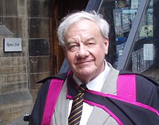
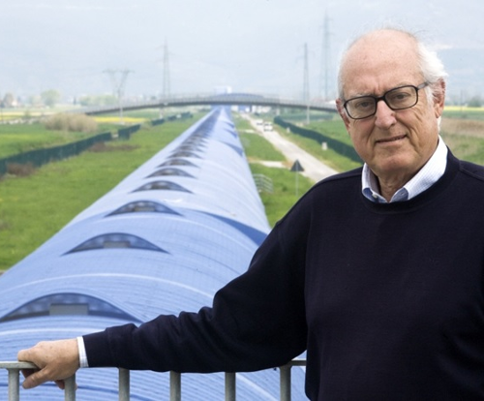
Un nobel preso ed uno mancato
Il premio Nobel si consegna a Ottobre e può essere condiviso al massimo da tre persone viventi. Drever si è spento a Marzo ed èstato sostituito da Barish.
Virgo era spento per aggiornamento al momento della prima osservazione.
Ronald Drever 1931-2017
Adalberto Giazotto 1940-2017

Slide 25
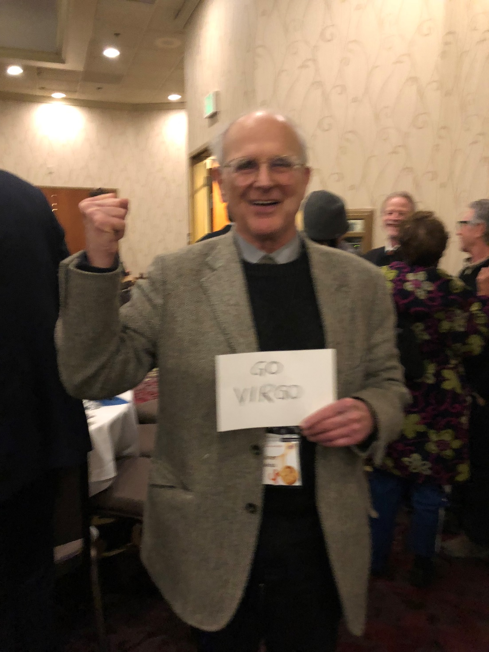
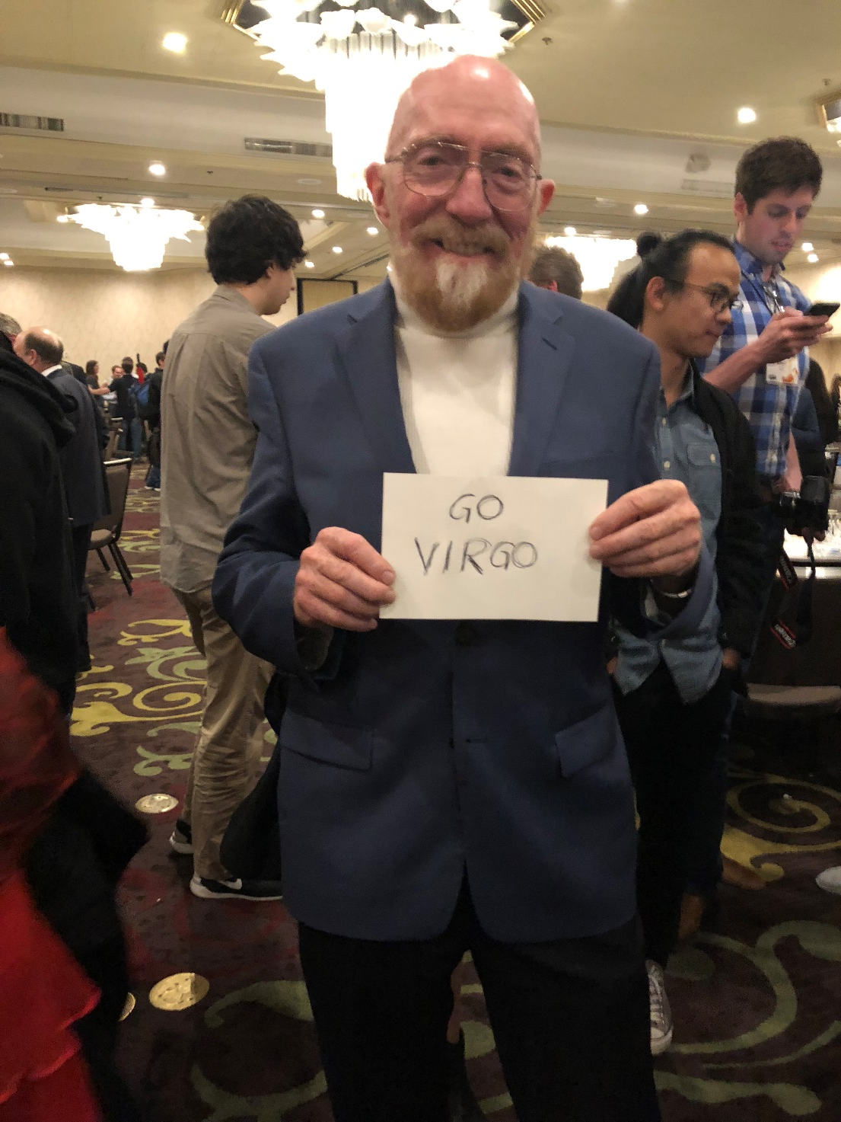

Slide 26
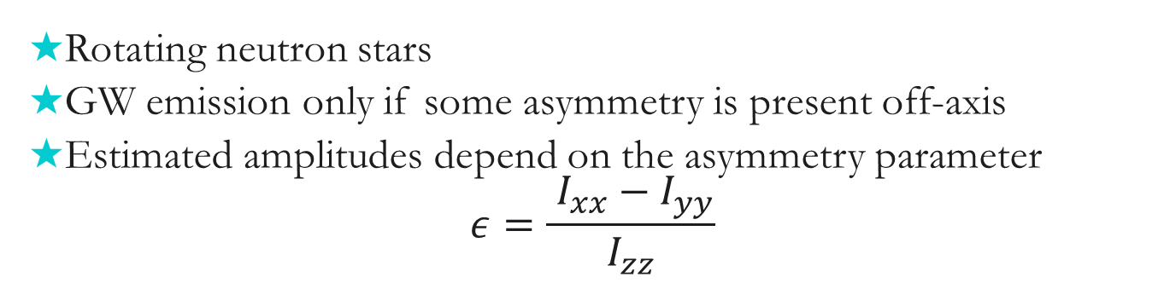
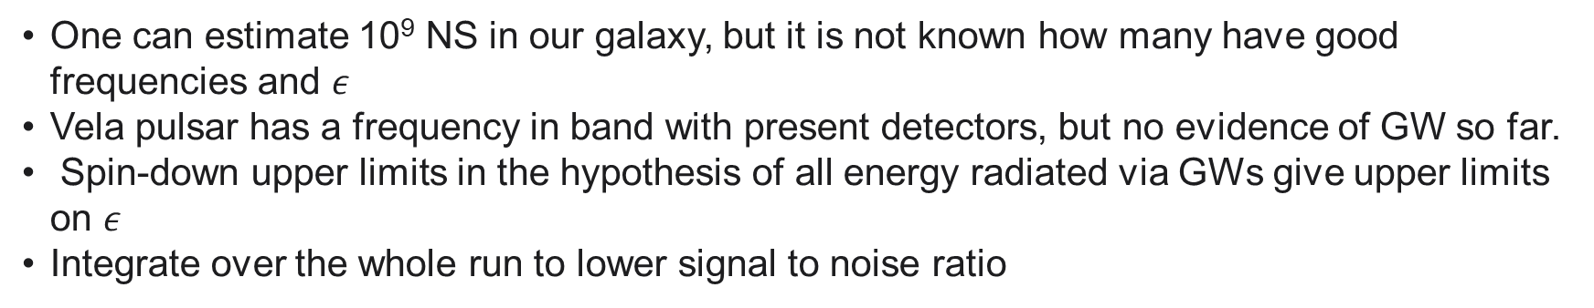
Periodic sources: pulsars
Rotating neutron stars
GW emission only if some asymmetry is present off-axis
Estimated amplitudes depend on the asymmetry parameter
$$ε=\frac{{ I_{xx}​−I}_{yy}}{I_{zz}}$$
for R=10R_{s}
One can estimate 10⁹ NS in our galaxy, but it is not known how many have good frequencies and $ε$
Vela pulsar has a frequency in band with present detectors, but no evidence of GW so far.
Spin-down upper limits in the hypothesis of all energy radiated via GWs give upper limits on $ε$
Integrate over the whole run to lower signal to noise ratio

Slide 27
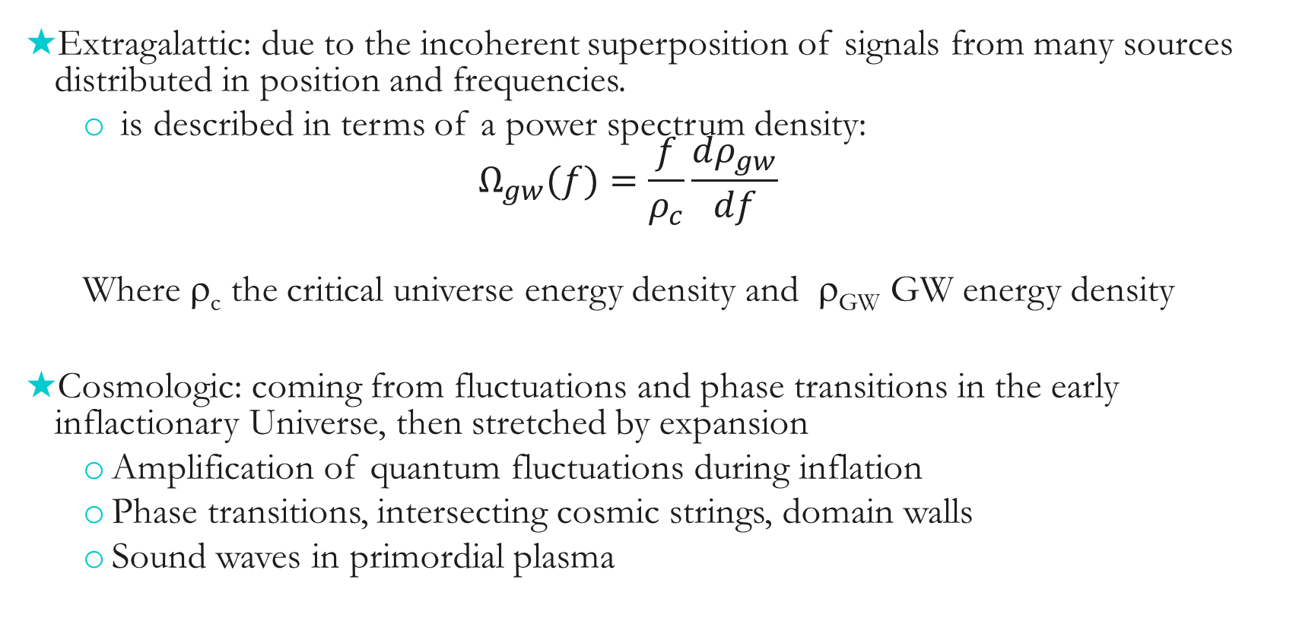
Stochastic GW background
Extragalattic: due to the incoherent superposition of signals from many sources distributed in position and frequencies.
  is described in terms of a power spectrum density:
  $$Ω_{gw}(f)=\frac{f}{ρ_{c}}\frac{dρ_{gw}}{df}$$
  Where ρ_{c} the critical universe energy density and ρ_{GW} GW energy density
Cosmologic: coming from fluctuations and phase transitions in the early inflactionary Universe, then stretched by expansion
  Amplification of quantum fluctuations during inflation
  Phase transitions, intersecting cosmic strings, domain walls
  Sound waves in primordial plasma

Slide 28
Detection of Gravitational Waves

Slide 29
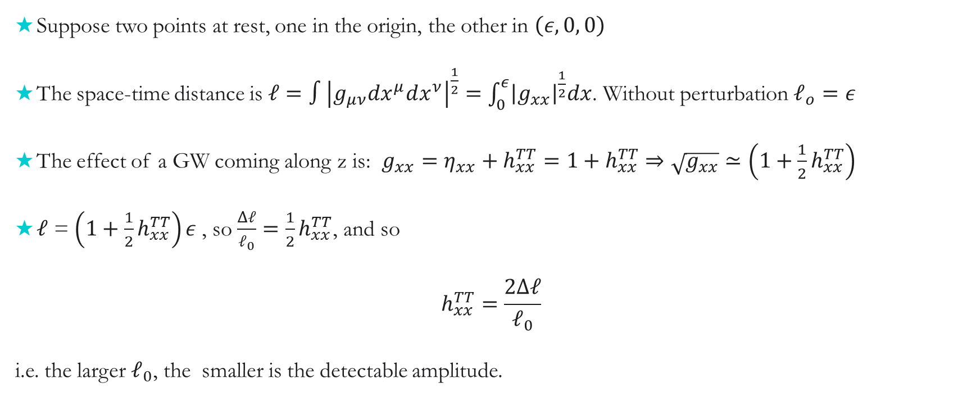
Effect on a monodimensional rod
Suppose two points at rest, one in the origin, the other in $\left(ε, 0, 0\right)$
The space-time distance is $ℓ=∫{\left|g_{μν}dx^{μ}dx^{ν}\right|}^{\frac{1}{2}}=\int_{0}^{ε}{{\left|g_{xx}\right|}^{\frac{1}{2}}dx}$. Without perturbation $ℓ_{o}=ε$
The effect of a GW coming along z is: $g_{xx}=η_{xx}+h_{xx}^{TT}=1+h_{xx}^{TT}⇒\sqrt{g_{xx}}≃\left(1+\frac{1}{2}h_{xx}^{TT}\right)$
$ℓ$ = $\left(1+\frac{1}{2}h_{xx}^{TT}\right)ε$, so $\frac{Δℓ}{ℓ_{0}}=\frac{1}{2}h_{xx}^{TT}$, and so
$$h_{xx}^{TT}=\frac{2Δℓ}{ℓ_{0}}$$
i.e. the larger $ℓ_{0}$, the smaller is the detectable amplitude.

Slide 30

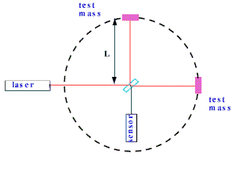
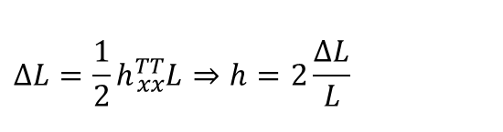
Rivelazione interferometrica
L-ΔL
L+ΔL
t = 0
t = Τ /4
t = Τ/2
t = 3Τ /4
t = T
$$ΔL=\frac{1}{2}h{}_{xx}^{TT}L⇒h=2\frac{ΔL}{L}$$
large L to detect small h
Target h ~ 10⁻²¹, L~10³m
(NS/NS @Virgo Cluster)
Bisogna misurare: ΔL ~ 10⁻¹⁸ m

Slide 31



Effect of a GW on the interferometer
$$ds^{2}=c^{2}dt^{2}−g_{ij}dx^{i}{dx}^{j}=c^{2}dt^{2}−\left(η_{ij}+h_{ij}\right)dx^{i}dx^{j}$$
For laser beam, it is a light interval, thus $c^{2}dt^{2}=\left(η_{ij}+h_{ij}\right)dx^{i}dx^{j}$
$\int_{0}^{τ_{1}}{dt}=\frac{1}{c}\int_{0}^{L}{\sqrt{1+h\left(t\right)}}dx≃ \frac{1}{c}\int_{0}^{L}{\left(1+\frac{1}{2}h\left(t\right)\right)dx}$
$$h\left(t\right)=h e^{iωt}; t=\frac{2x}{c}$$
$$τ_{1}=\frac{1}{c}2L+\frac{h}{2iω}\left(e^{\frac{2iωL}{c}}−1\right)$$
for a round trip from BS to M1 and back.
Similarly, along y, since $h_{yy}=−h_{xx}$:
$$τ_{2}=\frac{1}{c}2L−\frac{h}{2iω} \left(e^{\frac{2iωL}{c}}−1\right)$$
$${Δτ=τ}_{2}−τ_{1}=\frac{\frac{2L}{c}h}{\frac{ωL}{c}}e^{\frac{iωL}{c}}sin\left(\frac{ωL}{c}\right)$$
For $\frac{ωL}{c}≪1⇒Δτ=h\frac{2L}{c}\frac{sin\left(\frac{ωL}{c}\right)}{\frac{ωL}{c}}≃\frac{2Lh}{c}$
and a phase
$$Δφ=ωΔτ=\frac{2πc}{λ}Δτ=\frac{2π}{λ}2Lh⇒Δφ=\frac{4π}{λ}hL$$

Slide 32





Variation of output power due to GW
$$Ψ_{out}=−r_{s}t_{s}\left(r_{1}e^{2ikl_{1}}+r_{2}e^{2ikl_{2}}\right)Ψ_{in}$$
$$P_{out}={\left(r_{s}t_{s}\right)}^{2}\left[r_{1}^{2}+r_{2}^{2}+2r_{1}r_{2}\cos{(2kδl)}\right]P_{in}= \\ {\left(r_{s}t_{s}\right)}^{2}{(r}_{1}^{2}+r_{2}^{2})\left[1+C\cos{(2kδl)}\right]P_{in}$$
being the contrast
$$C=\frac{2r_{1}r_{2}}{r_{1}^{2}+r_{2}^{2}}$$
For a GW impinging on interferometer plane h₊ $l_{1}→l_{1}+\frac{1}{2}h_{+}l_{1}$
$$l_{2}→l_{2}+\frac{1}{2}h_{+}l_{2}$$
$$P_{out}=P_{mic}+δP_{grav}≈$$
$\frac{P_{in}}{2}\left[1+C\cos{(2kδl)}+Ckh_{+}(l_{1}+l_{2})sin{(2kδl)}\right]$
Assuming: $r_{s}{≈t}_{s}=\frac{1}{\sqrt{2}}$ e $r_{1}≈r_{2}=1$
$$t_{s}e^{ikl_{1}}$$
$${{−r}_{1}t}_{s}e^{ik{2l}_{1}}$$
$${{−r_{s}r}_{1}t}_{s}e^{ik{2l}_{1}}$$
So, the output power variation due to GW is proportional to GW amplitude and the sum of the arm-lengths

Slide 33



Shot Noise
Il numero di fotoni rivelati dal fotodiodo con efficienza η è:
Se assumiamo una statistica Poissoniana, la fluttuazione di potenza è √N, dunque il rapporto segnale-rumore sarà:
$$\frac{S}{N}=\frac{δP_{grav}}{δP_{Shot}}=\sqrt{\frac{P_{in}}{2}\frac{ληΔt}{hc}}\frac{C\sin\left(2kδl\right)}{\sqrt{1+C cos\left(2kδl\right)}}kh_{+}(l_{1}+l_{2})$$
Sens. alle fluttuazioni di potenza
$\cos\left(2kδl\right)=\frac{−1+\sqrt{1−C^{2}}}{C}$
Che ha un massimo per .
Dunque un interferometro reale massimizza il SNR leggermente sfasato dalla frangia scura. Nel caso ottimale di C=1, la sensibilità per una GW è data dal valore per cui S/N=1
Aumentare la lunghezza dei bracci
Aumentare la potenza

Slide 34



Aumentare la potenza, ma quanto?
Fluttuazioni della pressione di radiazione
Shot noise
$${\tilde{h}}_{shot}=\frac{1}{L}\sqrt{\frac{ℏcλ}{2πηP}}$$
$${\tilde{h}}_{rp}=\frac{1}{mLω^{2}}\sqrt{\frac{ℏP}{2π^{3}cλ}}$$
Limite quantistico: il miglior compromesso fra la diminuzione dello shot noise e l’aumento della pressione di radiazione. È il minimo rumore ottenibile (senza correzioni quantistiche).
$${\tilde{h}}_{QL}(ω)=\frac{1}{πωL}\sqrt{\frac{ℏ}{m}}$$

Slide 35
Can we beat quantum noise?
No, but we can reduce phase noise due to shot noise at the expenses of amplitude noise: Squeezed states.

Slide 37



Longer arms: Fabry-Perot cavities
Resonates for $2kL=2nπ$
$$\frac{2π}{λ}L=nπ⇒λ=\frac{2L}{n}$$
$r_{1}=r_{2}=R$ reflectivities
pass band $δ≅±\frac{1−R}{\sqrt{R}}$
Finesse: $F=\frac{Δν}{2δ}=\frac{2π}{2δ}=\frac{π\sqrt{R}}{1−R}$
$$Δφ=2NkL \\ N≅\frac{F}{π}⇒Δφ=\frac{2F}{π}kL⇒$$
$L_{fp}=\frac{2F}{π}$ is the equivalent length
$$E_{r}=E_{0}t_{1}^{2}r_{2}e^{−2ikL}\sum_{m=0}^{N→∞}{{\left(r_{1}r_{2}e^{−2ikL}\right)}^{m}=}E_{0}t_{1}^{2}r_{2}e^{−2ikL}\frac{1}{1−r_{1}r_{2}e^{−2ikL}}$$
When resonates$:E_{r}=E_{0}t_{1}^{2}r_{2}\frac{1}{1−r_{1}r_{2}}$

Slide 38




$$L_{fp}=L\frac{2F}{π} \\ Δφ_{fp}=\frac{4π}{λ}hL_{fp}=\frac{8F}{λ}hL$$
We cannot increase indefinitely the Finesse
$$Δτ=h\frac{2L}{c}sinc\left(ω_{gw}\frac{2L}{c}\right)e^{iω_{gw}2L/c}$$
For GW frequencies larger than the inverse of round-trip time, phase delay start decreasing

Slide 39

Why power recycling?
The gray fringe working point is not the right choice:
  The ITF is not a “Null Instrument”, that is the output is not null when the input is null: large DC
  We want to operate in the dark fringe, meaning all light back towards input.
  What to do with the light wasted in the input port?
Recycle it!
Shot noise reduced by the recycling factor, but how to extract the GW signal if we work at the dark fringe, where:
$$\frac{∂P_{out}}{∂ΔL}=0$$
Moreover, the beam must resonate also in the cavity formed by PRM and the reflection form the Fabry-Perot Michelson ITF (FPMI).
Finally, another mirror (SRM) can be added at the output to recycle the light on antisymmetric port and form a new cavity. What for, if output is on dark fringe?
Power recycling mirror
laser
39
Notes:
39

Slide 40


Modulation/demodulation schemes
A gravitational wave induces signal sidebands (blue dashed lines) due to differential changes in the interferometer arms.
These sidebands exit the dark port but are only detectable close to the carrier frequency: $f_{sig}= f_{c} ± f_{GW}.$
Signal sidebands $f_{sig}$ resonates in the Fabry-Perot cavities and are enhanced by their optical gain
Signal recycling cavity: close to the dark-fringe the SR cavity interacts mostly with the GW signal sidebands, shaping the frequency response of the interferometer.
Inserting an Electro-Optic Modulator (EOM) at the interferometer input introduces RF sidebands used for demodulation and cavity locking.
Modulation sidebands do not resonate in FP
Beatings of $f_{c}$with sidebands generate an error signal that is mixed with a local oscillator (demodulated) and low-passed obtaining a control signal (Pound-Drever-Hall)
In heterodyne scheme the beat $\left(f_{c} ± f_{GW}\right)±f_{H}.$ contains $f_{H} ± f_{GW}$that, is demodulated to get $f_{GW}$

Slide 41


Present interferometer scheme
Lengths to be controlled:
  Differential arm – $DARM=L_{N}−L_{W}$
  Michelson – $MICH=l_{n}−l_{w}$
  Common Arm - $CARM=\frac{L_{N}+L_{W}}{2}$
  Power Recycle Cavity – ${\text{P}\text{RCL}\text{=} l}_{p}+\frac{L_{n}+L_{w}}{2}$
  Signal Recycle Cavity - ${\text{SRCL}\text{=} l}_{s}+\frac{L_{n}+L_{w}}{2}$
LW
LN
lw
lP
ln
lS

Slide 42

Gaussian beams
Up to now we assumed beams to be ideal
A real laser beam has a finite transverse dimension and a Gaussian intensity profile
In facts the laser beam propagation law in a homogeneous material gives:
$$E_{mn}\left(x,y,z,t\right)=E_{0}\frac{w_{0}}{w\left(x\right)}ψ_{m}\left(\frac{\sqrt{2}y}{w\left(x\right)}\right)ψ_{n}\left(\frac{\sqrt{2}z}{w\left(x\right)}\right)⋅e^{i\left(m+n+1\right)φ}e^{−ik\frac{y^{2}+z^{2}}{2R\left(x\right)}}e^{−i\left(kx−ωt\right)}$$
Where ψ_{n} are the Hermite-Gauss functions:
$$ψ_{n}\left(ξ\right)=H_{n}\left(ξ\right)⋅e^{−\frac{ξ^{2}}{2}} \\ \begin{matrix}H_{0}\left(ξ\right)=1 & H_{1}\left(ξ\right)=ξ & H_{2}\left(ξ\right)=4ξ^{2}−2 & ...\end{matrix}$$
w(x) is the beam section:${ w}^{2}\left(x\right)=w_{0}^{2}⋅\left[1+{\left(\frac{λx}{πw_{0}^{2}}\right)}^{2}\right]≡w_{0}^{2}⋅\left[1+{\left(\frac{x}{x_{0}^{2}}\right)}^{2}\right]$ and $w_{0}$ is the minimum beam waist that occurs at the coordinate $x_{0}$
R(x) is the radius of curvature : $R\left(x\right)=\frac{x^{2}+x_{0}^{2}}{x}$ and $φ$ is defined by$: \tan{φ}=\frac{x}{x_{0}}$
Notes:
42

Slide 43

Transverse modes TEM00 and 01
3rd VESF school - Michele Punturo - Virgo
43
Notes:
43

Slide 44
Tranverse modes TEM11 e 22
3rd VESF school - Michele Punturo - Virgo
44
Notes:
44

Slide 45

Fabry-Perot as mode cleaner
Fabry-Perot cavity can be tuned to select a selected resonance frequency
As we have seen the condition is that the phase delay of the light stored in cavity is an entire number times 2π.
If, to simplify, we set: $x_{M_{2}}=−x_{M_{1}}=\frac{L}{2}$; the condition to resonance becomes (for a Gaussian beam):
$$k\frac{L}{2}−\left(m+n+1\right)\tan^{−1}\left(\frac{L}{2x_{0}}\right)−\left[−k\frac{L}{2}−\left(m+n+1\right)\tan^{−1}\left(\frac{L}{2x_{0}}\right)\right]=pπ, p=1,2,...$$
so:
$$λ_{mnp}=2L{\left[p+2\frac{m+n+1}{π}\tan^{−1}\left(\frac{L}{2x_{0}}\right)\right]}^{−1}$$
45
Notes:
45

