Slide 1
Flavor physics at 1 GeV scale
F. Ambrosino

Slide 2
Outline
Flavor physics and the intensity frontier
Precision tests of CKM and NP searches
  Vud
  Vus
  Universality
  Δm_{K} and ε_{K}
  Lepton Universality
Rare decays
Disclaimer: this is a Kaon – biased lecture….

Slide 3
Flavor physics
Investigating the structure of the CKM matrix
Enormous progress in last 10 years
Problem: hadronic uncertainties
Low energy (<GeV scale):
-u,d,s quark physics
-ChPT, Lattice
-Kaon factories
High energy :
-b quark physics
-HQET, Lattice
-B factories

Slide 4
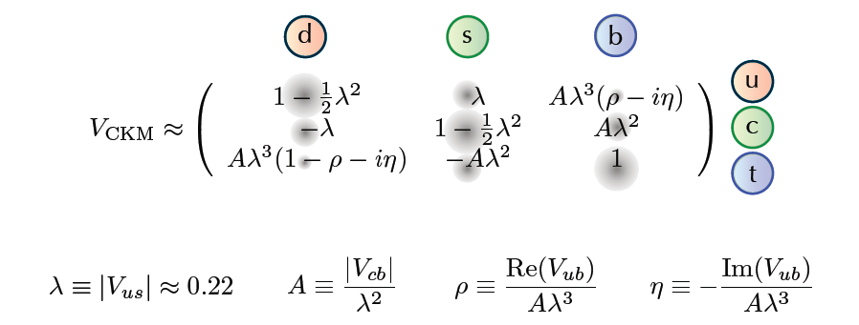
The CKM matrix
Non trivial flavor structure of the SM
Reason of its hierarchical structure yet unknown

Slide 5
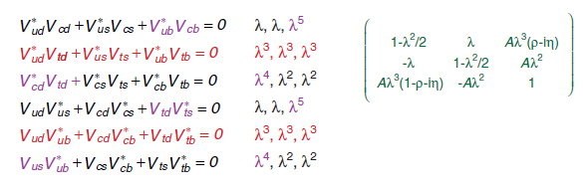
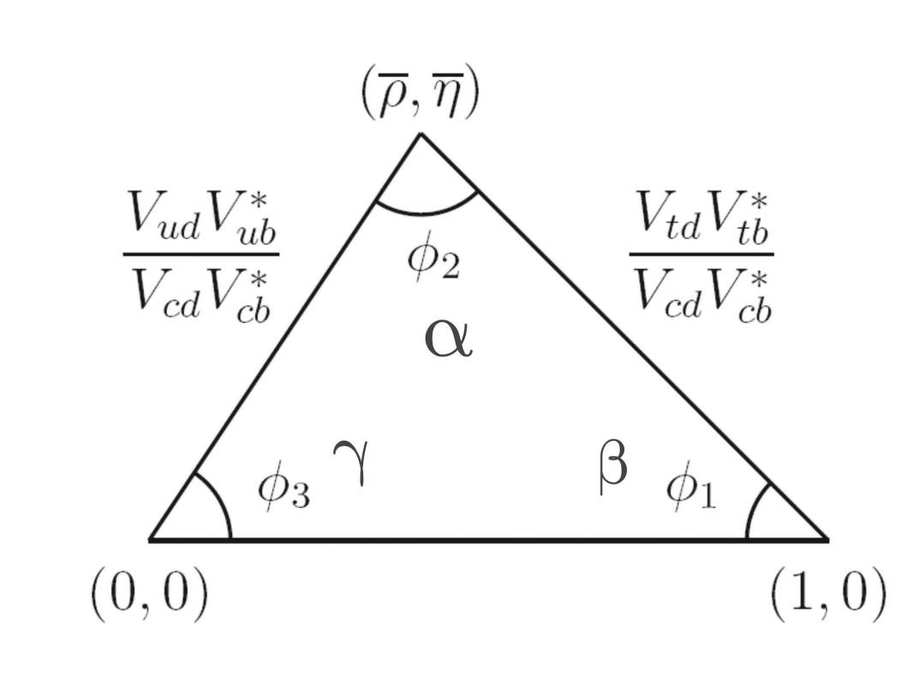
Unitarity triangle(s)

Slide 6
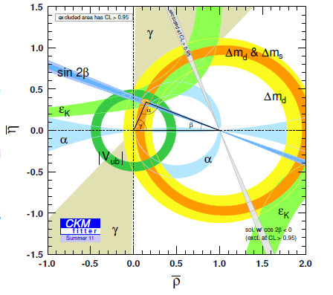
Unitarity triangle

Slide 7

Is the intensity frontier…
New physics may manifest itself in many ways and at different scales.
NP can give measurable effects at lower energies via quantum virtual corrections (remember β decay ?)
Need either high precision in both theory and experiment (like in (g-2)_{μ} )…
…or phenomena highly suppressed in the SM (like FCNC, helicity suppression etc.)

Slide 8
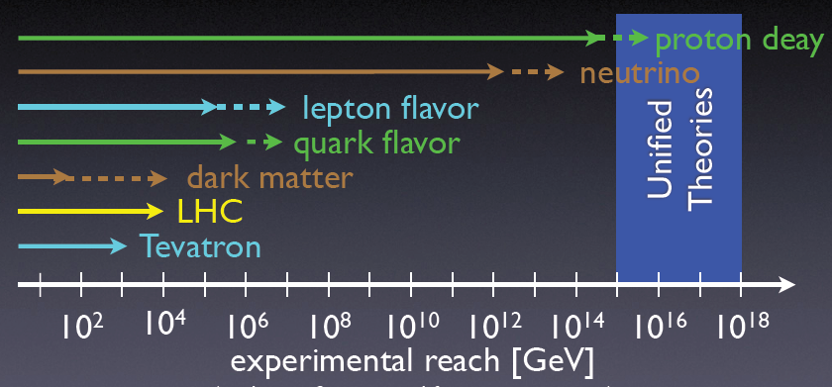
…the «true» energy frontier ?

Slide 9
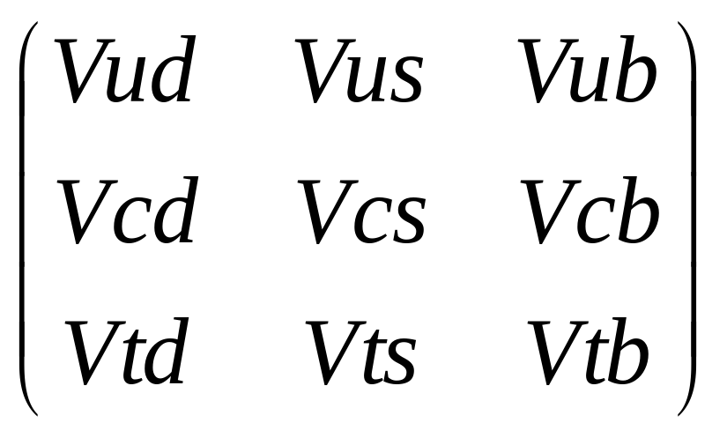
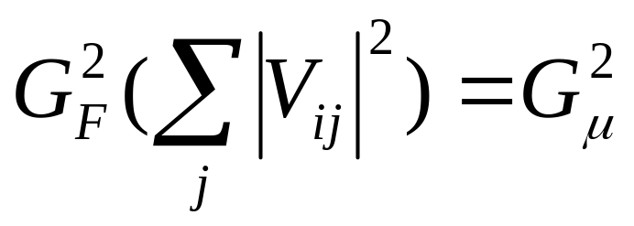
Flavor physics…
Flavor ew mixing
+
Coupling Universality

Slide 10
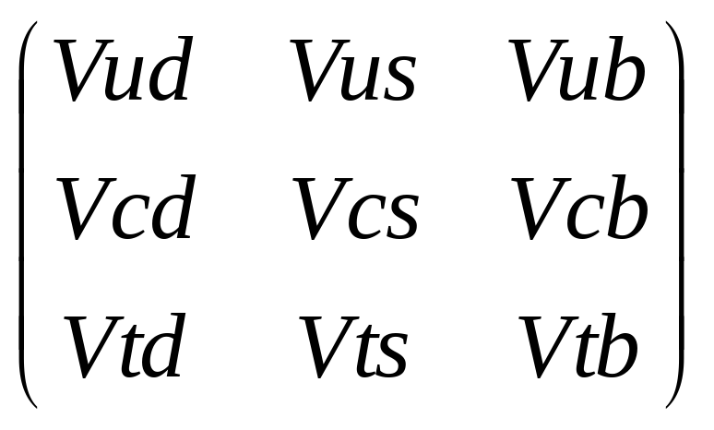
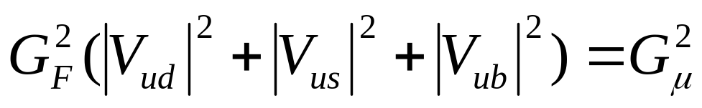
…at 1 GeV scale
Flavor ew mixing
+
FCNC loops
Tree level “β decays”
of nuclei and mesons
Coupling Universality 1st row

Slide 11
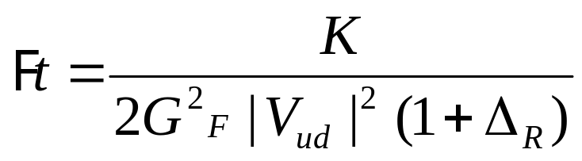
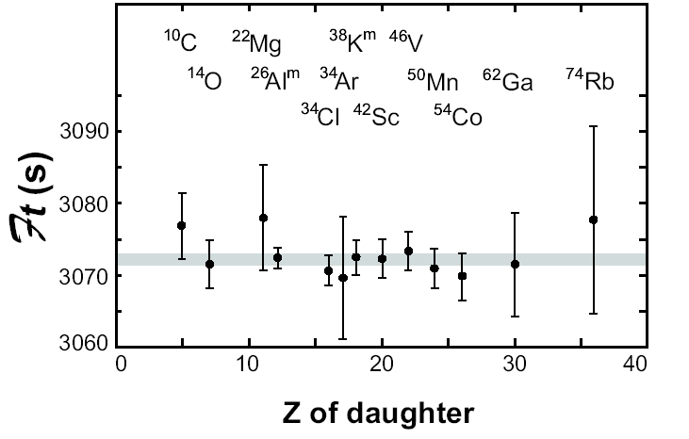
G_{F}|Vud|
Best result: from superallowed 0⁺→0⁺ nuclear transitions. (comprehensive review: [Towner & Hardy arXiv:0812.1202v1])
Master formula
Constancy of G_{V}= G_{F}|Vud| checked at 1.3 x 10⁻⁴ level
Scalar current consistent with zero (10⁻³G_{V})
Assuming universal coupling
(G_{F} =G_{μ}) can extract Vud

Slide 12
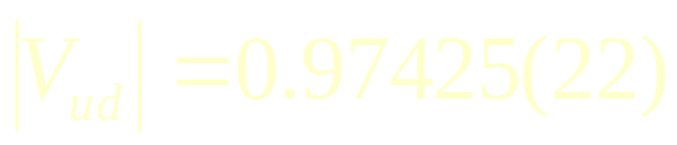
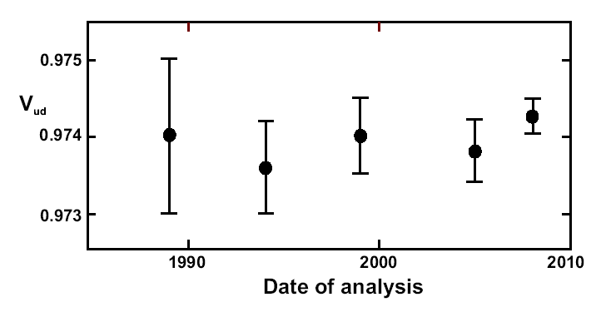
Vud
From neutron β decay(CKM2010): 0.9743(15)
From pion β decay (PDG10):0.9728(30)

Slide 13
Vus
A very big progress in the last few years. Strong interplay between experimental progress and lattice/ChPT results improvements.
Two main modes:
  K→μν / π→μν (KLOE)
  Kl3 (NA48, KTeV, KLOE, ISTRA+)

Slide 14
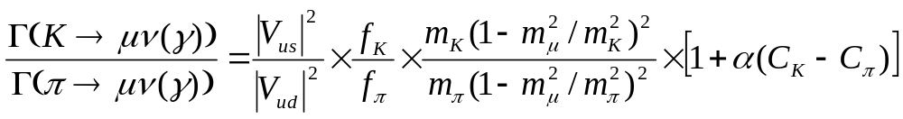
Vus : K→μν / π→μν
Master formula [Marciano]:

Slide 15
Vus : K→μν / π→μν
Master formula [Marciano]:
0.9930(35)
[Marciano PRL 93,2004]
[Cirigliano Rosell PRL 99 (07)]

Slide 16
Vus : K→μν / π→μν
Master formula [Marciano]:
1.189(7) HP/UKQCD [arXiv:0706.1726]
0.9930(35)
[Marciano PRL 93,2004]
[Cirigliano Rosell PRL 99 (07)]

Slide 17
Vus : K→μν / π→μν
Master formula [Marciano]:
1.189(7) HP/UKQCD [arXiv:0706.1726]
KLOE: absolute BR @ 0.27% [PLB 636 (2006)]
lifetime @ 0.25% [JHEP 0801:073]
0.9930(35)
[Marciano PRL 93,2004]
[Cirigliano Rosell PRL 99 (07)]

Slide 18
Vus : K→μν / π→μν
Master formula [Marciano]:
1.189(7) HP/UKQCD [arXiv:0706.1726]
KLOE: absolute BR @ 0.27% [PLB 636 (2006)]
lifetime @ 0.25% [JHEP 0801:073]
0.9930(35)
[Marciano PRL 93,2004]
[Cirigliano Rosell PRL 99 (07)]
|Vus|/|Vud| = 0.2323(15)
[KLOE JHEP 0804:059]

Slide 19
Vus : Kl3
Master formula:
Accurate calculations @ 0.2% from:
Cirigliano et al. [(02), (04)]
Cirigliano, Giannotti, Neufeld (08)
Andre hep-ph/0406006
Knecht (00)
Moussallam et al (06)

Slide 20
Vus : Kl3
Master formula:
Important exp. inputs BRs:
K_{L}e3 : KTeV[PRD 70(04)], KLOE [PLB 632 (06)], NA48 [PLB 645 (07)]
K_{L}μ3 : KTeV[PRD 70(04)], NA48 [PLB 602 (04)], KLOE [PLB 632,638 (06)]
K_{S}e3 : KLOE [PLB 636 (06)], NA48 [PLB 653 (07)]
K±e3 : NA48 [EPJC 50 (07)], ISTRA+ [arXiV 0704.2052], KLOE [JHEP 02 (08)]
K±μ3 : NA48 [EPJC 50 (07)], KLOE [JHEP 02 (08)]
+ KLOE result for BR(K⁺→π⁺π⁰ ) = 0.2065(5)(8) [PLB 666 (08)]
+ lifetimes (KLOE, NA48, KTeV)

Slide 21
Vus : Kl3
Master formula:
Important exp. inputs FFs:
Vector F.F.
Ke3 : KTeV[PRD 70(04)], KLOE [PLB 636 (06)], ISTRA+ [PLB 589 (04)],
NA48 [PLB 604 (04)]
Scalar + Vector F.F.
Kμ3 : KTeV[PRD 70(04)], KLOE [JHEP 12 (07)], ISTRA+ [PLB 581 (04)],
NA48 [PLB 647 (07)]

Slide 22
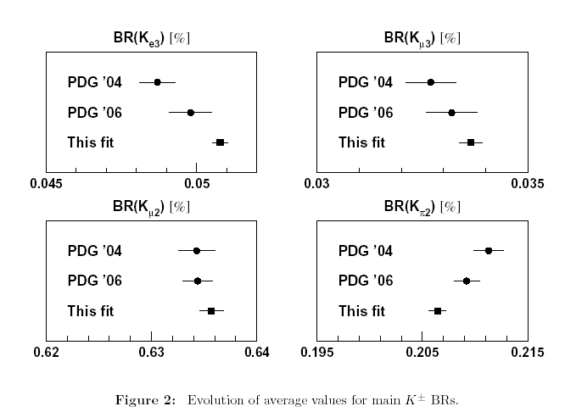
Effect of K⁺→π⁺π⁰
Flavianet arXiV 0801:1817

Slide 23
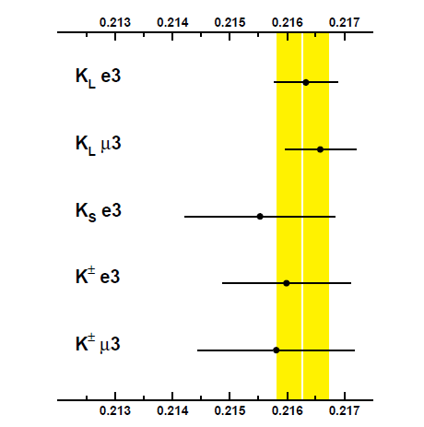
Vus : Kl3
Putting altogether and using coupling universality one gets (Flavianet WG [arXiV 1005:2323] )
Putting things together only possible thanks to the precise
evaluation of channel dependent corrections.
Extraction of |Vus|f₊(0) only possible thanks to precise SU(2) correction evaluation!
|V_{us}|f₊(0)=0.2163(5)

Slide 24
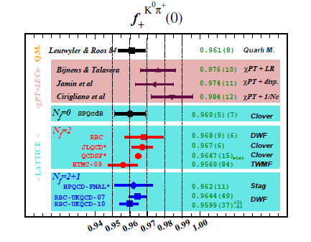
Vus : Kl3
Using the latest lattice result one can get Vus to a high level of precision.
|V_{us|}f₊(0)=0.2163(5)
+
f₊(0) = 0.959(5) RBC-UKQCD-10
=
|V_{us}| = 0.2254(13)
(Flavianet WG)

Slide 25
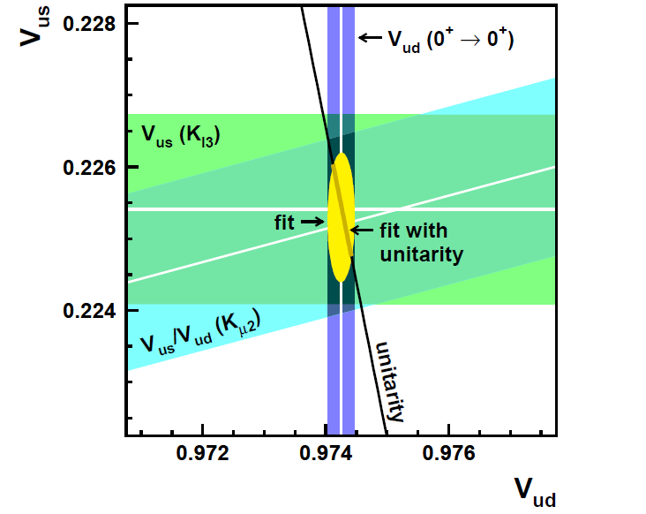
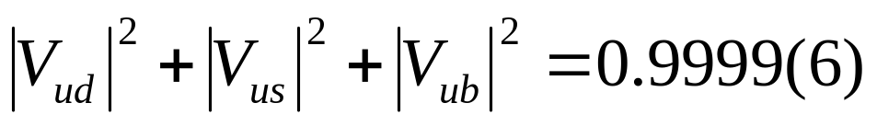
Puttings things together…
Using values obtained for Vud, Vus/Vud and Vus assuming universality, one can check for the unitarity of the first row:

Slide 26
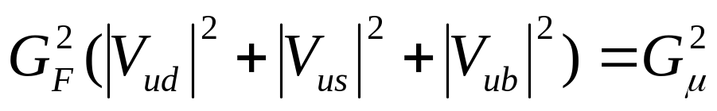
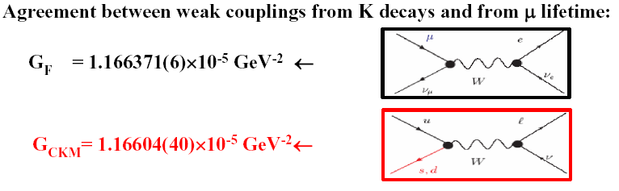
…and seeing it the other way around
A slightly different interpretation of the unitarity test is to think at it as a check if coupling universality holds:
$$G_{μ}=1.166371\left(6\right)×{10}^{−5}{GeV}^{−2}$$
$$G_{F}=1.16633\left(35\right)×{10}^{−5}{GeV}^{−2}$$

Slide 27
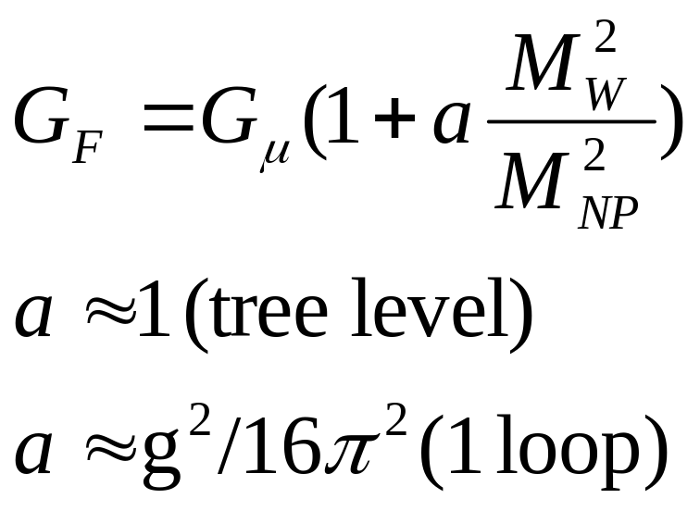
Bounds on NP
Naively a check of universality @ 6x10⁻⁴ level can test scales up to 10 TeV at tree level or 1 TeV in loops.
Larger effects in specific models.

Slide 28
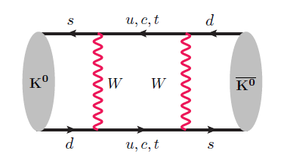
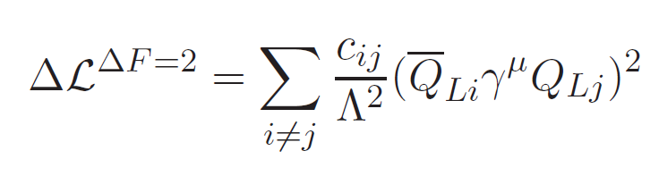
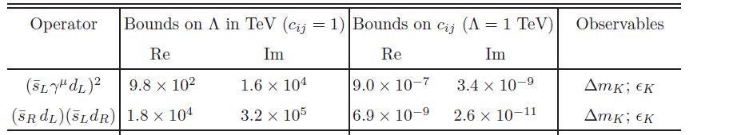
Neutral kaon mixing and NP
Real part→ Δm_{K}
Imaginary part → ε_{K}
Strong limits on new «generic» physics scale

Slide 29
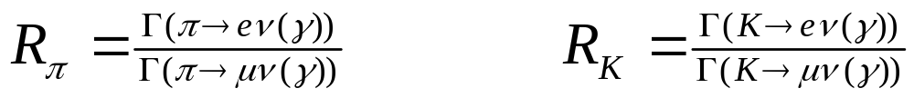
NP and Lepton Universality
The other side of universality: if mesons have same weak couplings with all leptons families, in ratios the coupling cancels out !
Golden modes for NP: helicity suppressed decays
R_{π} (SM) = 1.2352(1) x 10⁻⁴
R_{Κ} (SM) = 2.477(1) x 10⁻⁵ Cirigliano and Rosell [PRL 99 (07)]
A fantastic theoretical precision for an hadronic observable !!!

Slide 30
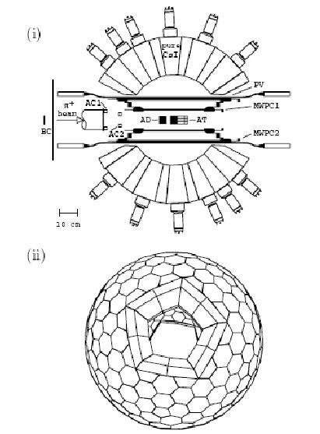
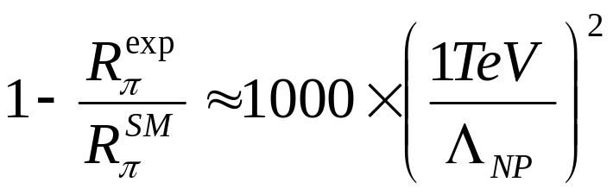
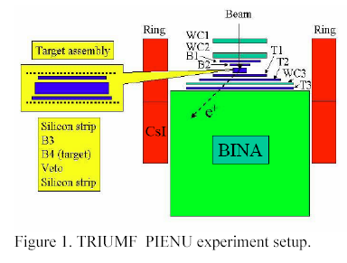
R_{π} : experiments
Best results to date:
1.2265(34)(44) [PRL 68 (92)] (@TRIUMF)
1.2346(35)(36) [PRL 70 (93)] (@ PSI)
Set scale for pseudoscalar NP at 600 TeV (Bryman, KAON 07)
New experiments aiming @ 0.1%
  PEN @ PSI
  PieNU @ TRIUMF

Slide 31
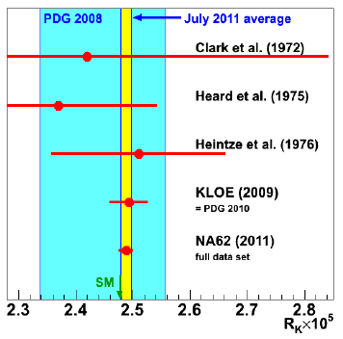
R_{Κ} : experiments
PDG 08 -> very poor number based on published results dating to the 70’s: 2.45(11)X10⁻⁵
New results from KLOE (@1.2%) and NA62 improved enormously our knowledge
Experimental error still 10 X theoretical uncertainty
New W.A.:
2.488(10) X 10⁻⁵

Slide 32
When the going gets tough…
Current flavor physics (not only at 1 GeV scale…) too much of a success for the SM and CKM…
Need to investigate processes further suppressed in the SM… let’s try FCNC proprotional to λ⁵ ...
…better if also theoretically clean !

Slide 33
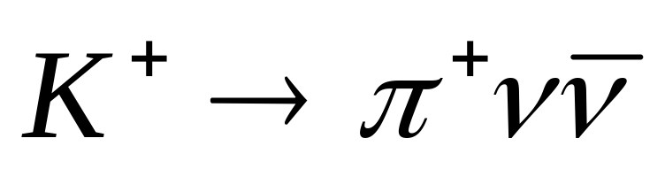
When the going gets tough…
Current flavor physics (not only at 1 GeV scale…) too much of a success for the SM and CKM…
Need to investigate processes further suppressed in the SM… let’s try FCNC proprotional to λ⁵ ...
…better if also theoretically clean !
“looking for a needle in a haystack”

Slide 34
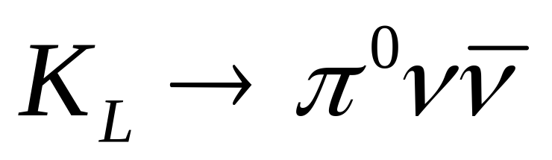
When the going gets tough…
Current flavor physics (not only at 1 GeV scale…) too much of a success for the SM and CKM…
Need to investigate processes further suppressed in the SM… let’s try FCNC proprotional to λ⁵ ...
…better if also theoretically clean !
“looking for a needle in a haystack”
“looking for an invisible needle in a
haystack”

Slide 35
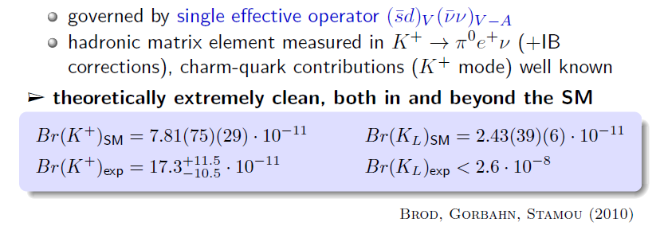
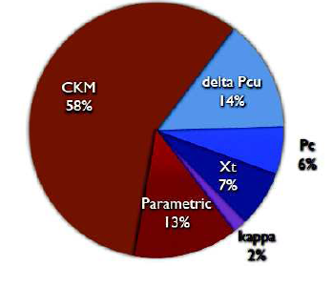
K→πνν : theory
The SM Prediction error is dominated
by the uncertainty on the CKM elements
The theory error can still be reduced

Slide 36
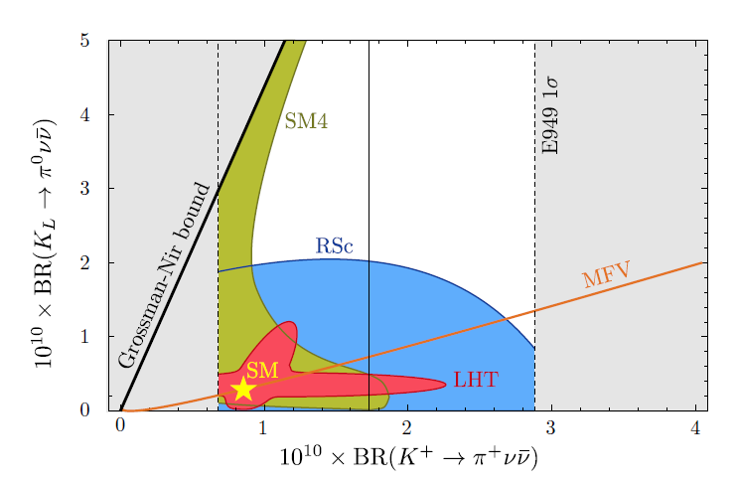
K→πνν : NP scenarios
(Straub, 2010)

Slide 37
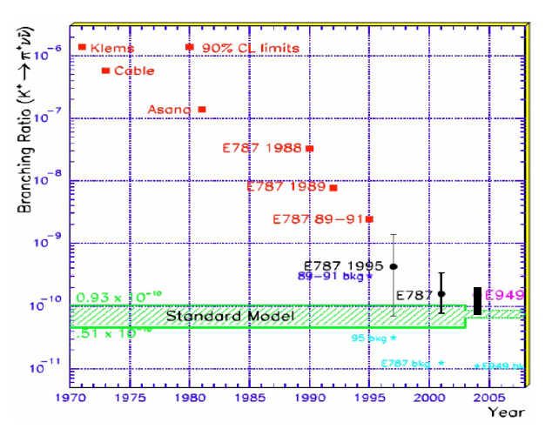
K→πνν : history

Slide 38
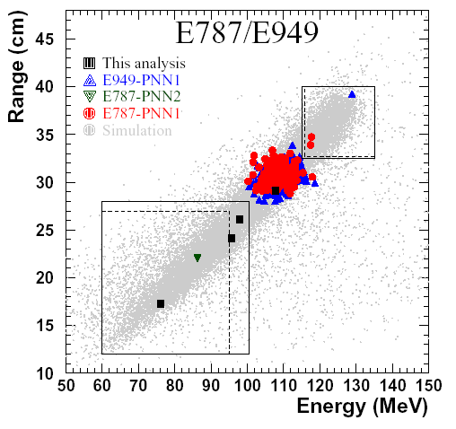
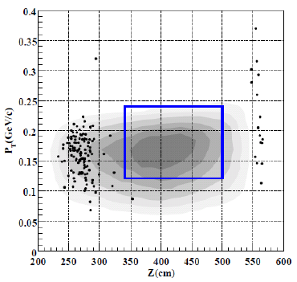
K→πνν : state of the art
BNL E787, E949 published in 2008 a result with 7 events observed in total [PRL 101 (08)]:
E391A Collaboration at KEK [PRL 100 (08)]
Cfr. SM = 7.8(8)X10⁻¹¹
Cfr. SM = 2.76(40)X10⁻¹¹

Slide 39
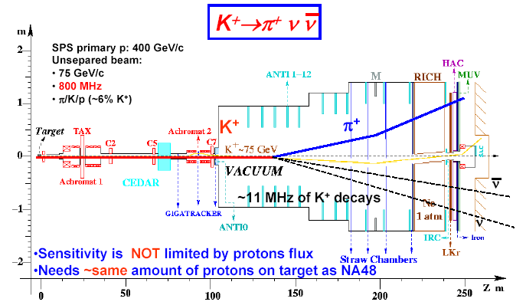
K⁺→π⁺νν : the future
NA62 approved by CERN council -> construction started
Technical run 2012, Physics run 2014
Aims at O(100) events, 10% S/B in 2 years data taking
Kinematical rejection + redundant PID as veto

Slide 40
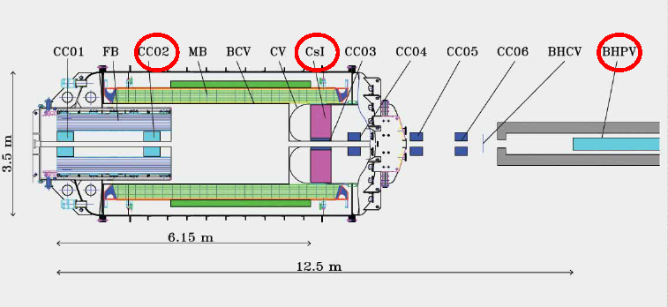
K_{L}→π⁰νν : the future
E14 project (KOTO) as upgrade of E391a at J-PARC
Increased flux (X40) runtime (X10) acceptance (X3) wrt E391a → SM sensitiviy (aim at 3 evts, 1.5 S/B)
Improved detector profiting of beautiful KTeV CsI
(T. Nomura, FPCP 08)

Slide 41
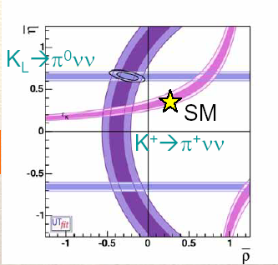
K→πνν : A.D. 2016 ?

Slide 42
Conclusions
Flavor physics at 1 GeV scale has become extremely precise and tests thoroughly the SM (…which unfortunatley passes the test with A+ grade !)
Continuous improvements in lattice calculations, ChPT evaluation of SU(2) and SU(3) breaking corrections etc. etc. of fundamental importance . Progress in hadronic physics and tests/refinements of these theories are crucial for developing future even better precision tests.
Scales in the range 10-100 TeV already tested: if NP is at the TeV scale it must have very non-generic flavor structure
While measured CPV effects are well described by the CKM there is need for other CPV sources to cope with cosmological models
A new generation of experiments will study in detail extremely suppressed decays and is fully complementary to the high energy frontier.

Slide 43
SPARE SLIDES

Slide 44
Standard Model in a nutshell
Gauge symmetry SU(3)_{c} X SU(2)_{L} X U(1)_{Y}
Spontanoeusly broken to SU(3)_{c} X U(1)_{e.m.}
Fermions in 5 mutiplets (in the interaction basis): (Y = Q_{e.m.}-T₃)
Q_{L} (3,2;1/6) (left handed up and down type quarks)
U_{R} (3,1;2/3) (right handed up type quarks)
D_{R} (3,1;-1/3) (right handed down type quarks)
L_{L} (1,2;-1/2) (left handed leptons)
E_{R} (1,1;-1) (right handed charged leptons)
Three generations (flavors) for each multiplet

Slide 45

Interaction vs Mass basis (1)
Interactions «flavor blind» : in this basis
Fermion masses dynamically generated through «Yukawa» couplings with Higgs field. Rather complicated form in interaction basis:

Slide 46

Interaction vs Mass basis (2)
The Y are generic complex 3X3 matrices. A proper rotation of the field basis can be used to diagonalize them («mass basis») But of course in this basis interaction is not at all «flavor blind» !
V_{CKM}

Slide 47
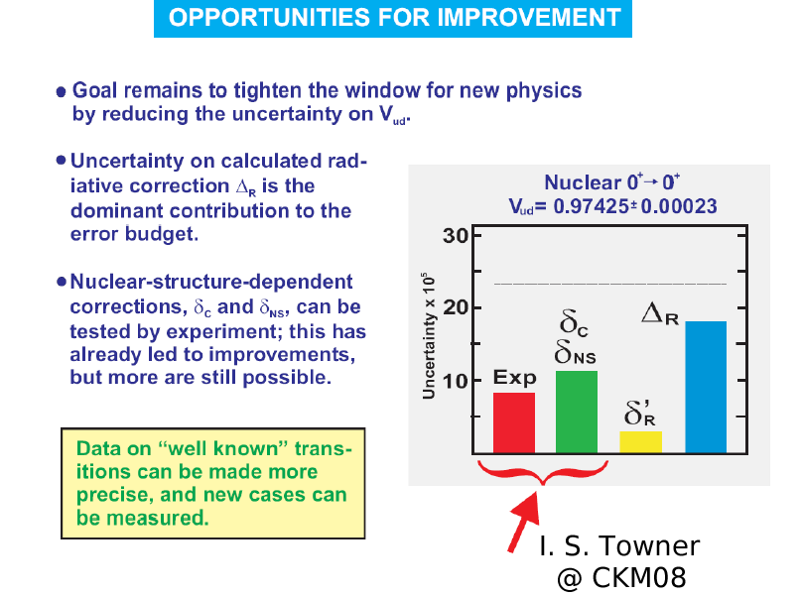
Vud : error budget

Slide 48
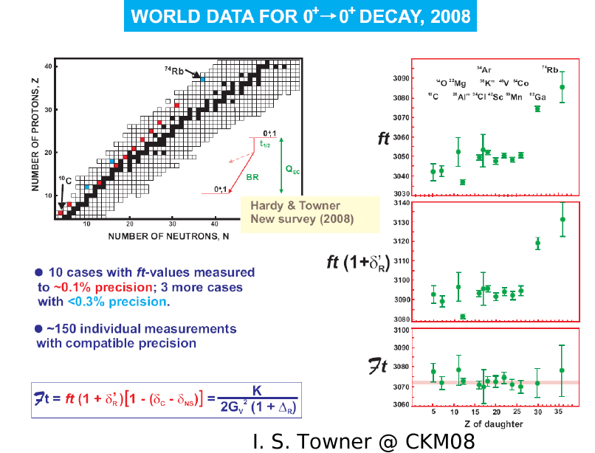
Vud : data

Slide 49
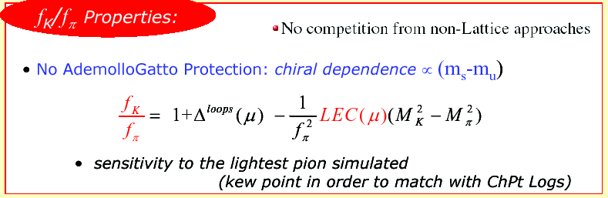
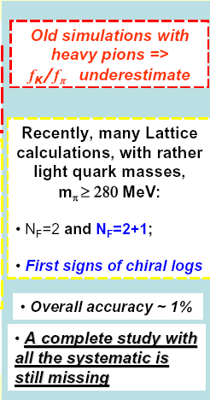
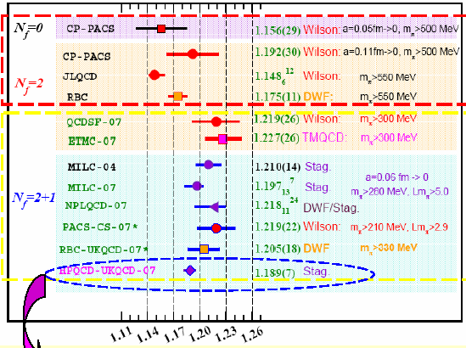
f_{K}/f_{π}
(F. Mescia FPCP08)

Slide 50
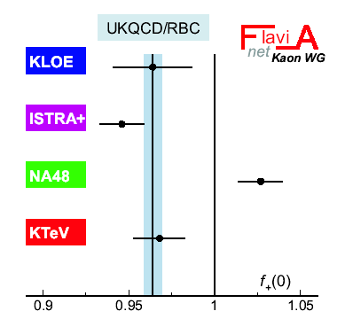
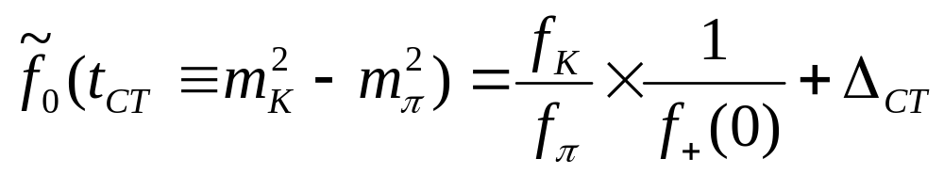
f₊(0) and Callan-Treiman relation
Using a dispersive parametrization of the scalar F.F. [Bernard et al PLB 638 (06)]
and the CT relation, one can check validity of lattice calculation for f₊(0) given the result on f_{K}/f_{π} .
Flavianet arXiV 0801:1817

Slide 51
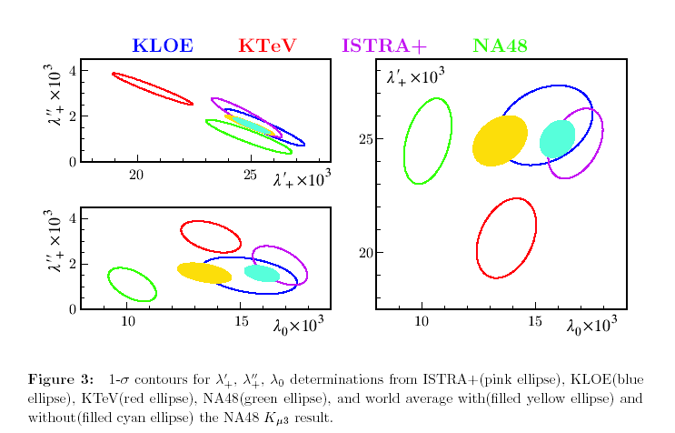
Form factors
Flavianet arXiV 0801:1817

Slide 52
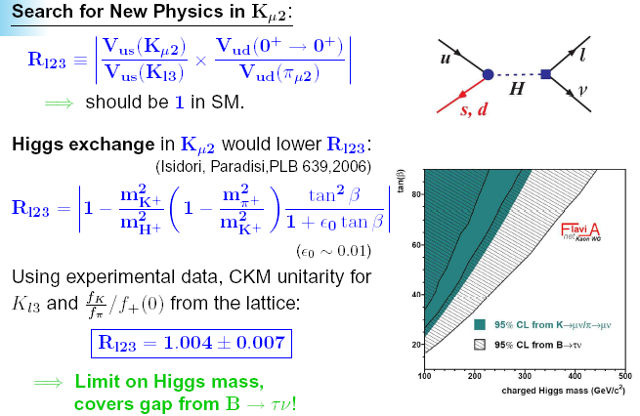
Bounds on NP (2)
R. Wanke, FPCP 08

Slide 53

R_{Κ} : NP constraints
R_{K} is a favoured process to study some specific models (MSSM with R parity)
Masiero, Paradisi Petronzio [PRD 74 (06)]
In this model effects on R_{π} are suppressed by a factor (m_{π} /m_{K})⁴=6x10⁻³
(M. Antonelli, La Thuile 09)

Slide 54

R_{Κ} : the NA62 data

Slide 55

R_{K} and SUSY
F.A. @ SUSY08

Slide 56

K⁺→π⁺νν and SUSY

Slide 57

What about ε’/ε ?
A beautiful piece of experimental work, has come to an end. For constraints on new physics scale, see Erler talk, this conf.
New W.A. after 2007 final NA48 and KTeV results:
Re(ε’/ε) = 16.8(1.4)X10⁻⁴
Also, no evidence for CP violation in K⁺→3π analyses from NA48/2

