Slide 1
1D SOM maps without (left) and with (right)
JVF cut (>0.75)
Cuts until the end of the analysis
(10/05/12)

Slide 2
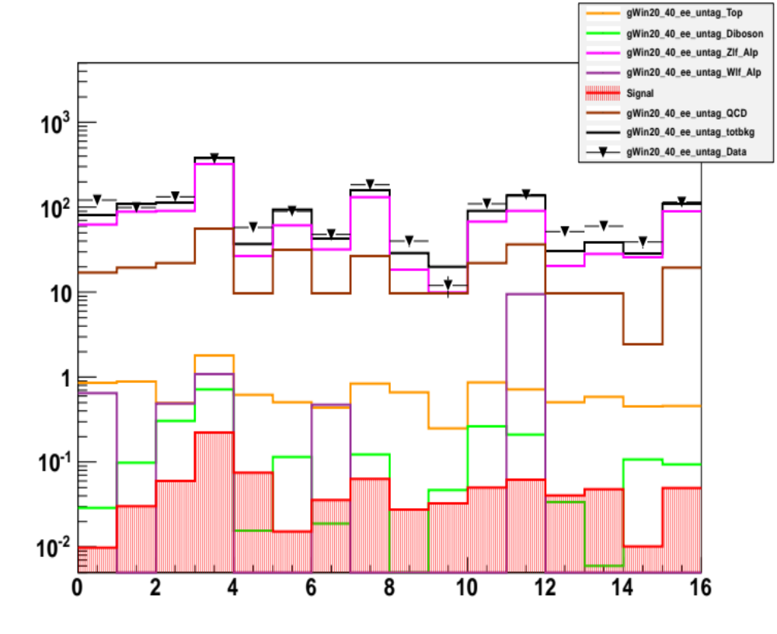
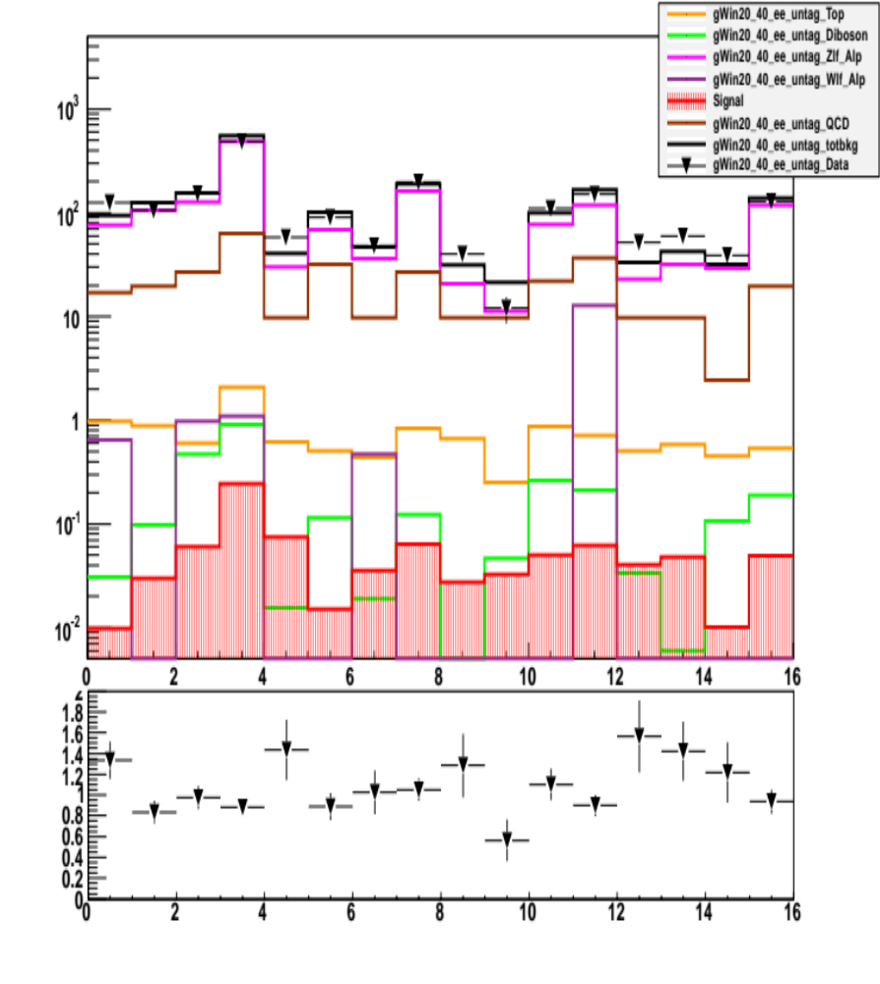
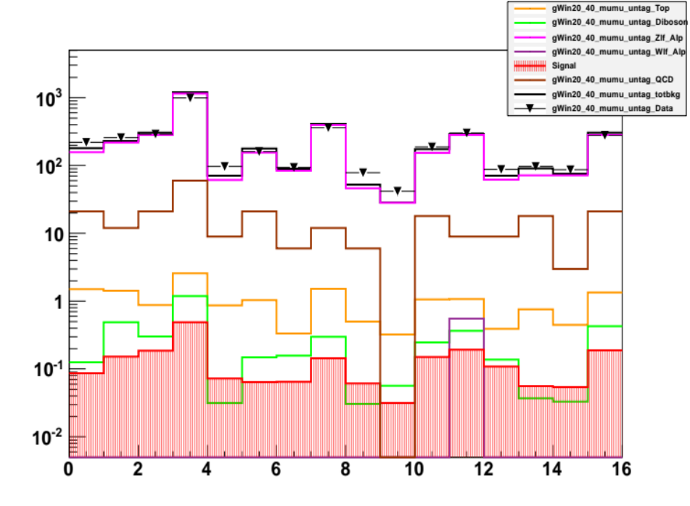
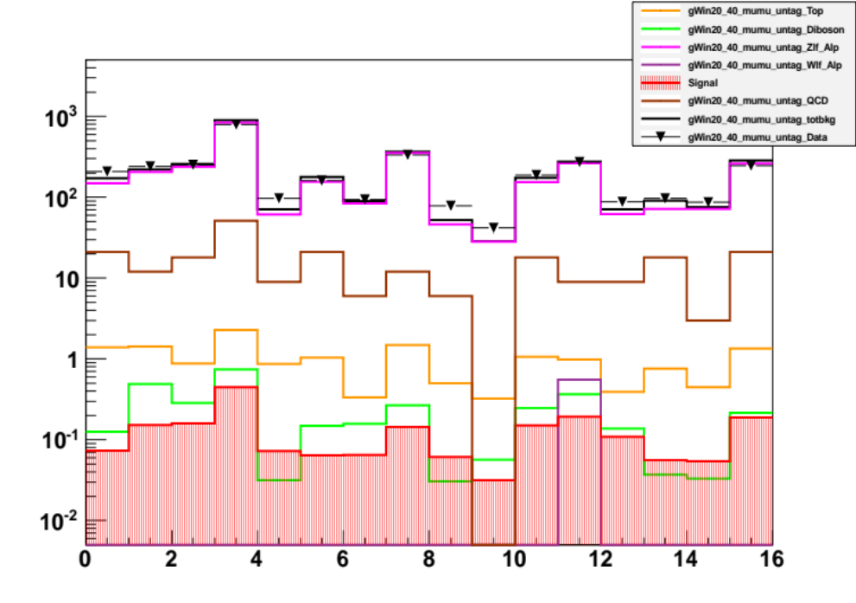
E2 channel
E2 channel (JVF)
SOM pT bin 20-40GeV
MU2 channel
MU2 channel (JVF)

Slide 3
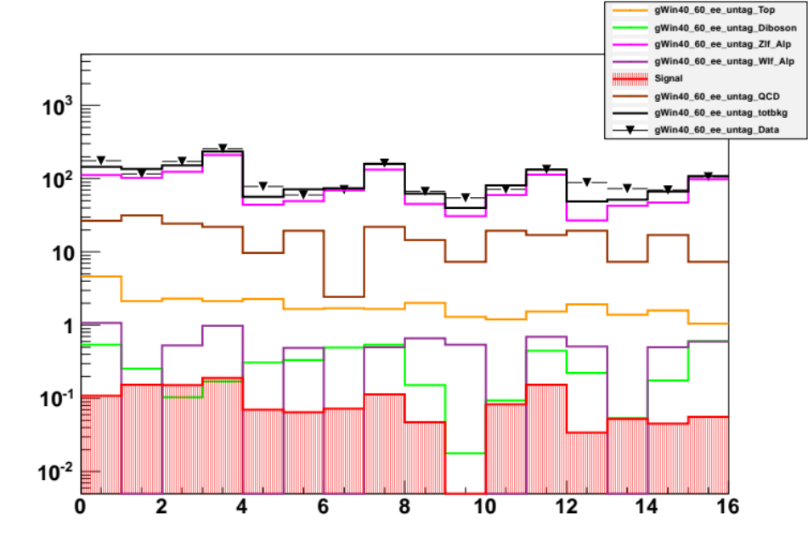
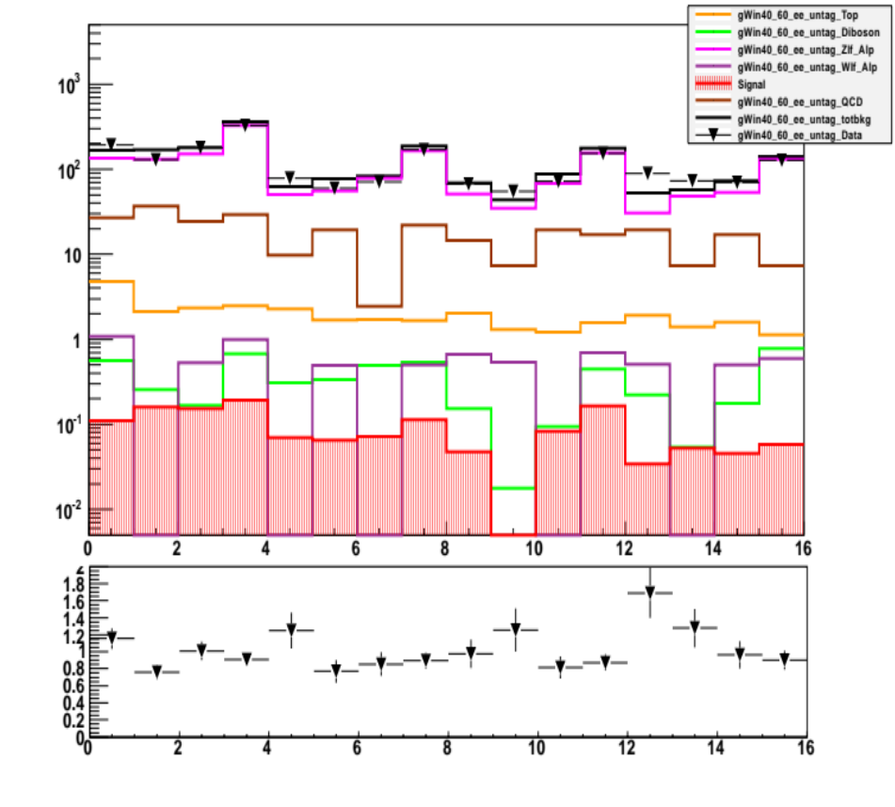
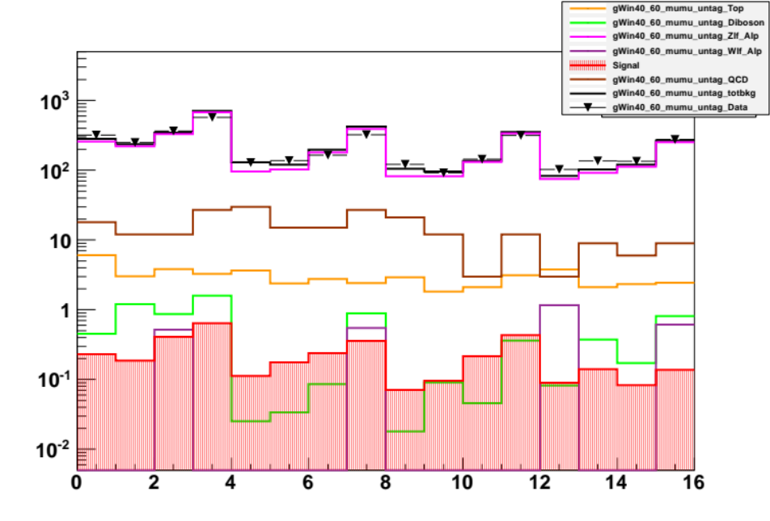
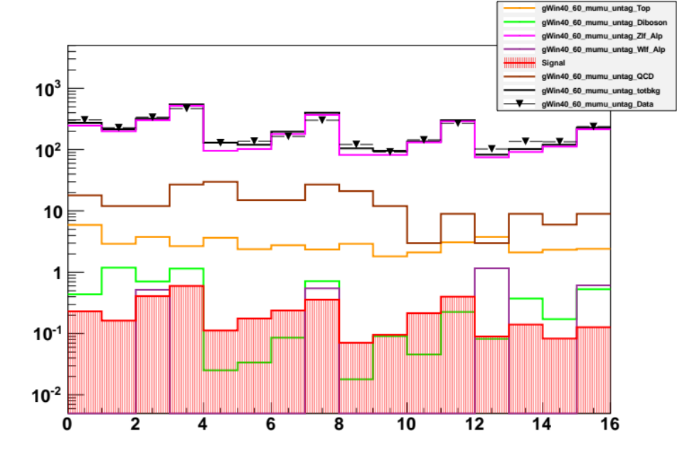
E2 channel
E2 channel (JVF)
SOM pT bin 40-60GeV
MU2 channel
MU2 channel (JVF)

Slide 4
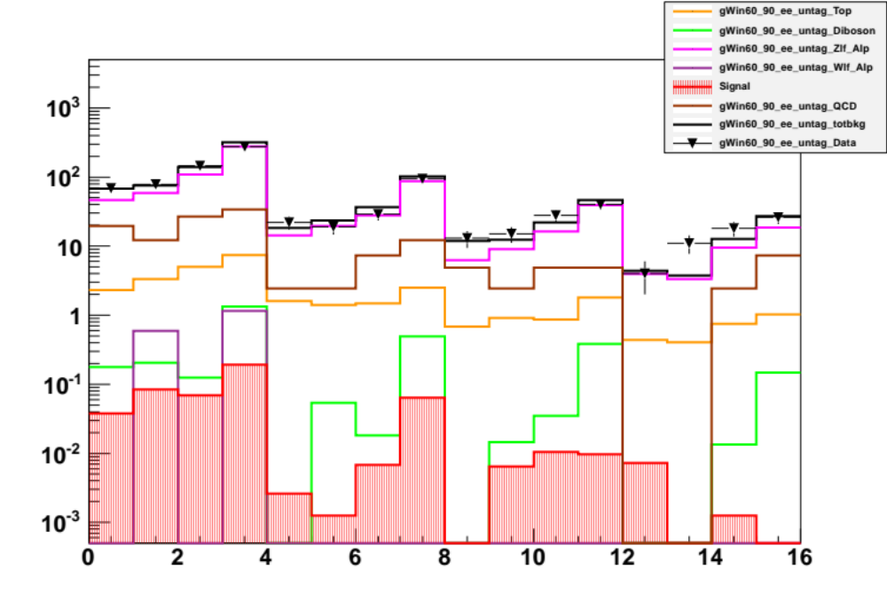
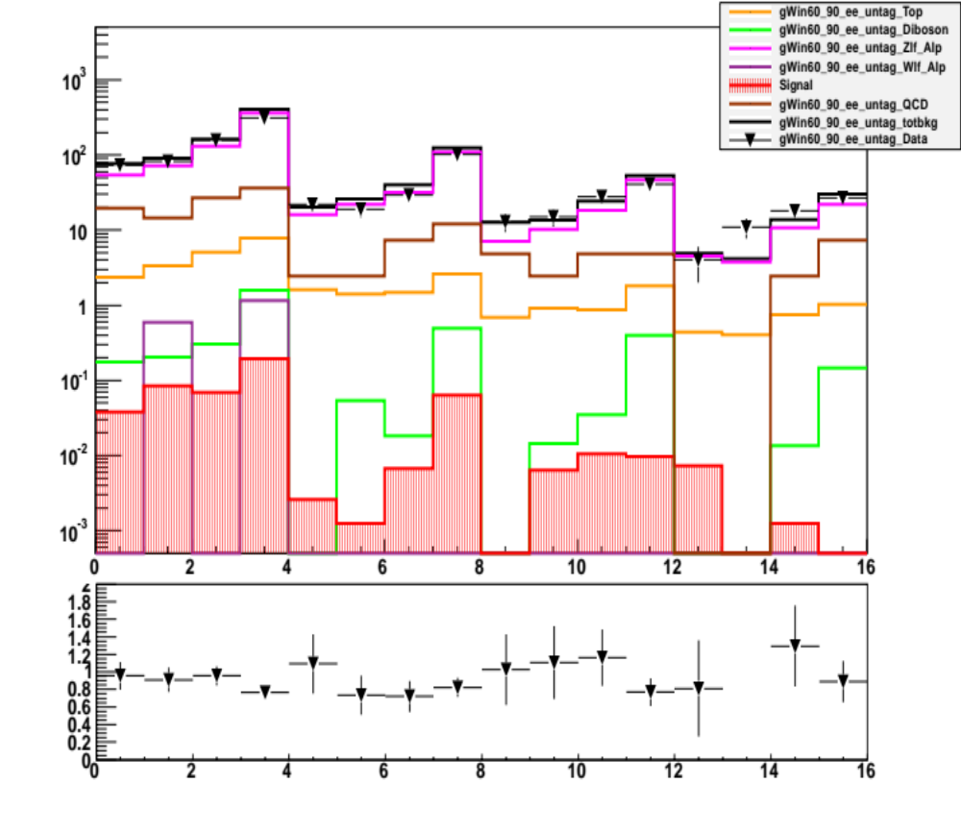
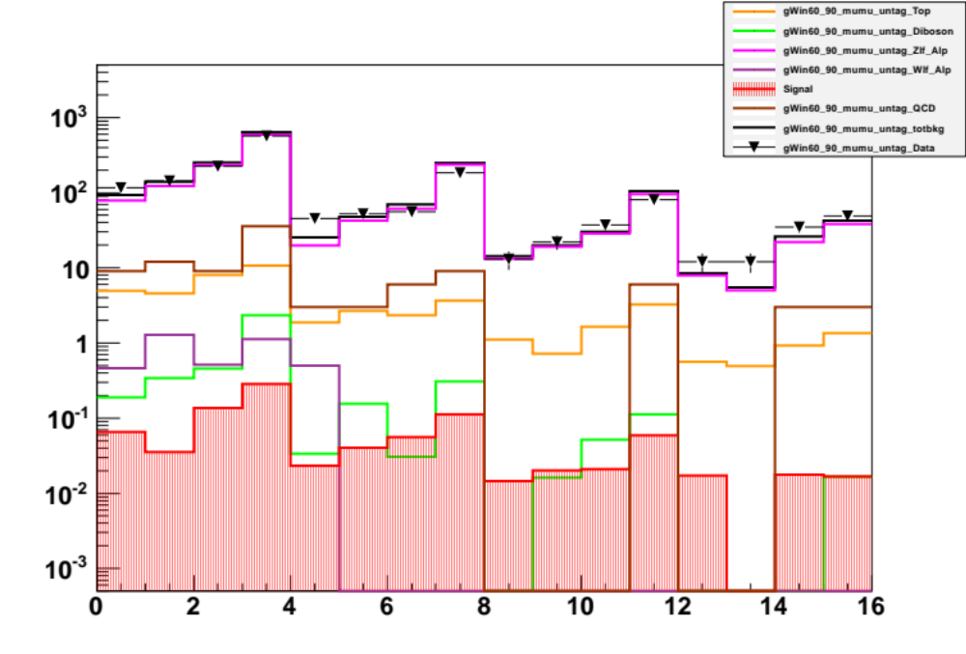
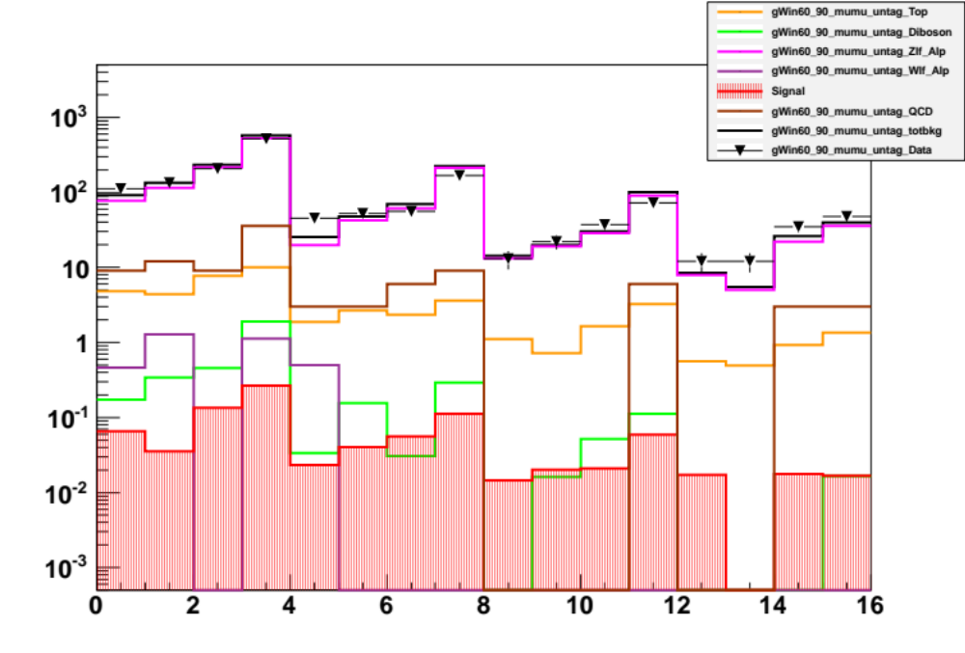
E2 channel
E2 channel (JVF)
SOM pT bin 60-90GeV
MU2 channel
MU2 channel (JVF)

Slide 5
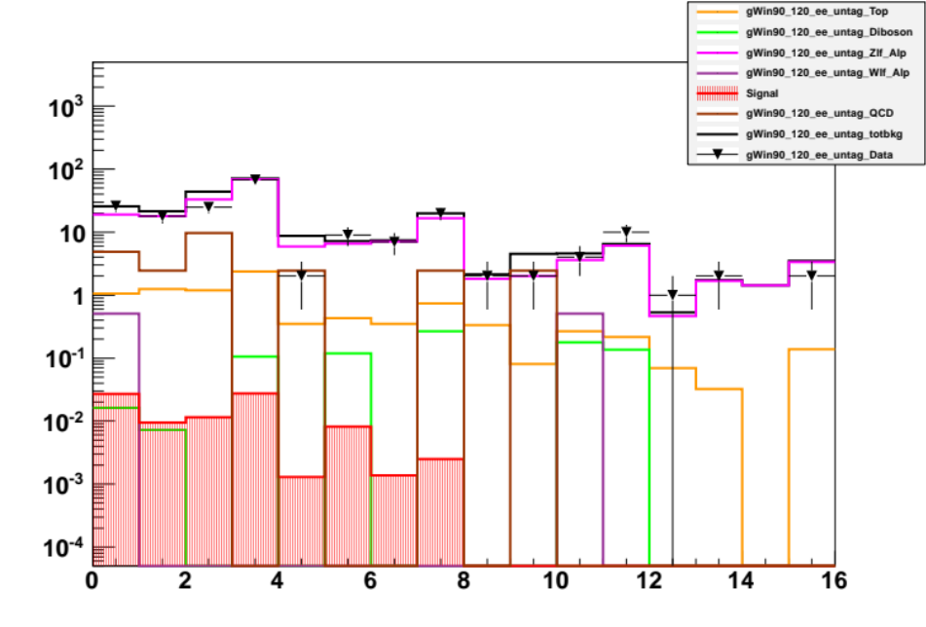
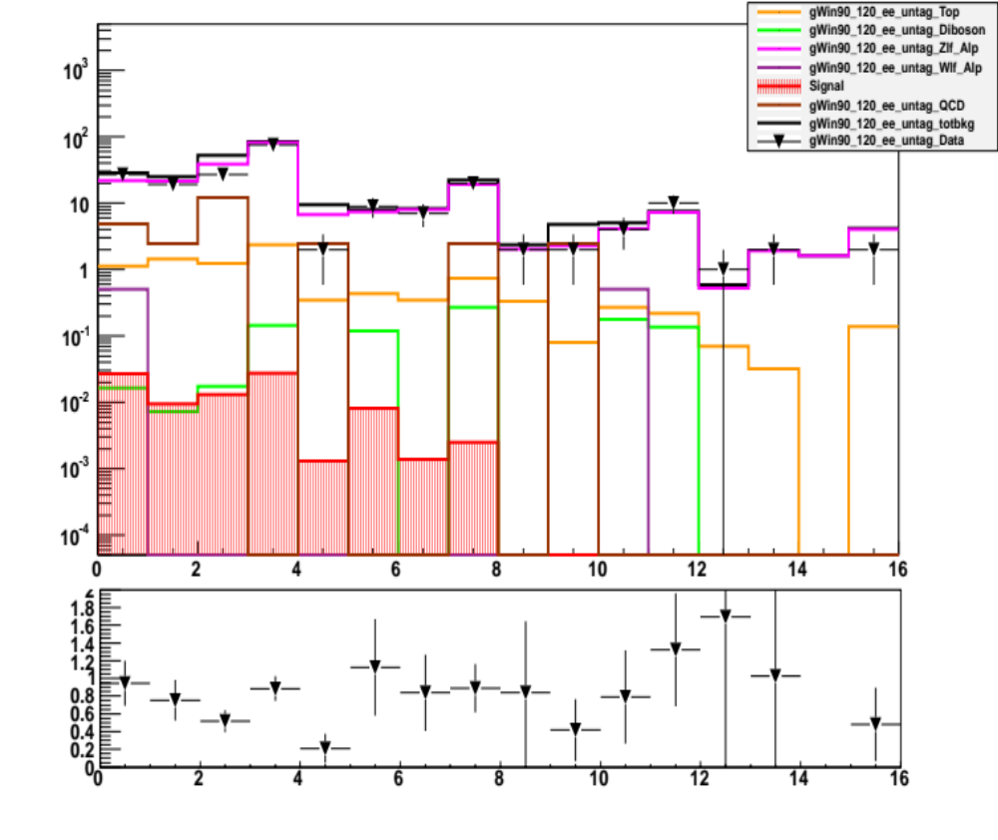
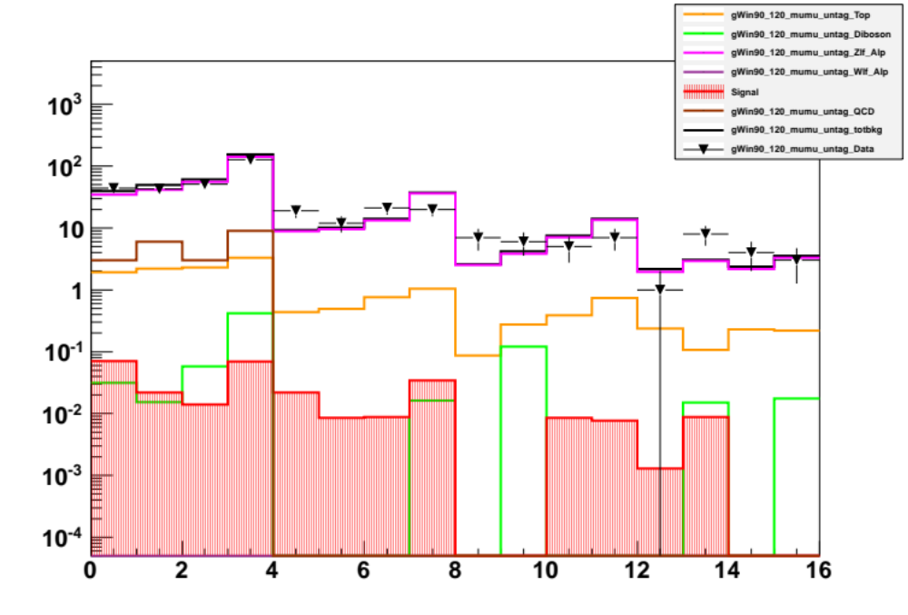
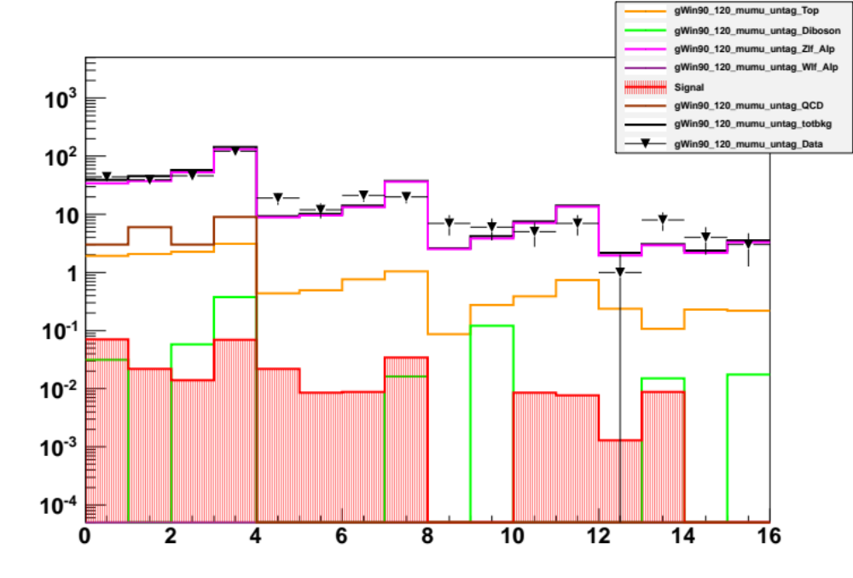
E2 channel
E2 channel (JVF)
SOM pT bin 90-120GeV
MU2 channel
MU2 channel (JVF)

Slide 6
1D SOM maps without (left) and with (right)
JVF cut (>0.75)
Cuts until the 2 jets request
(10/05/12)

Slide 7
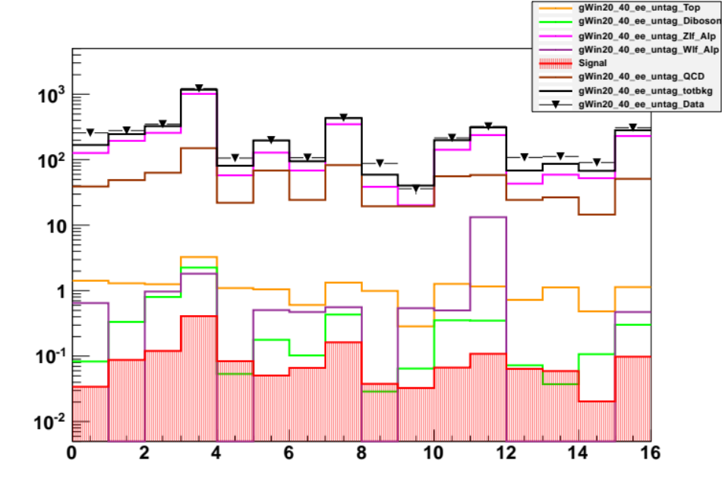
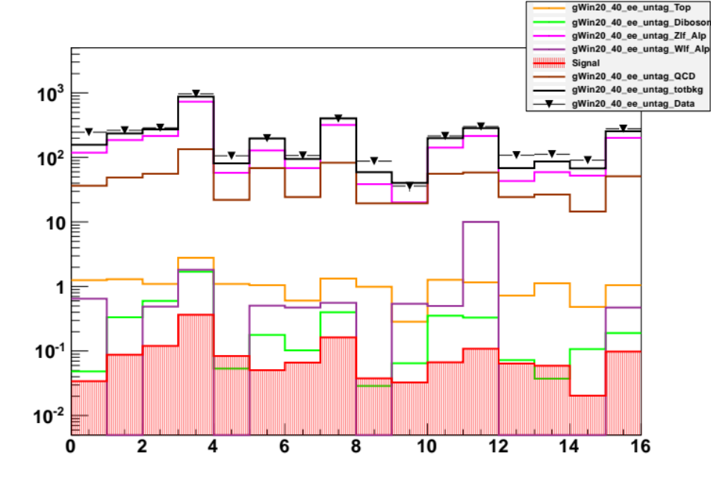
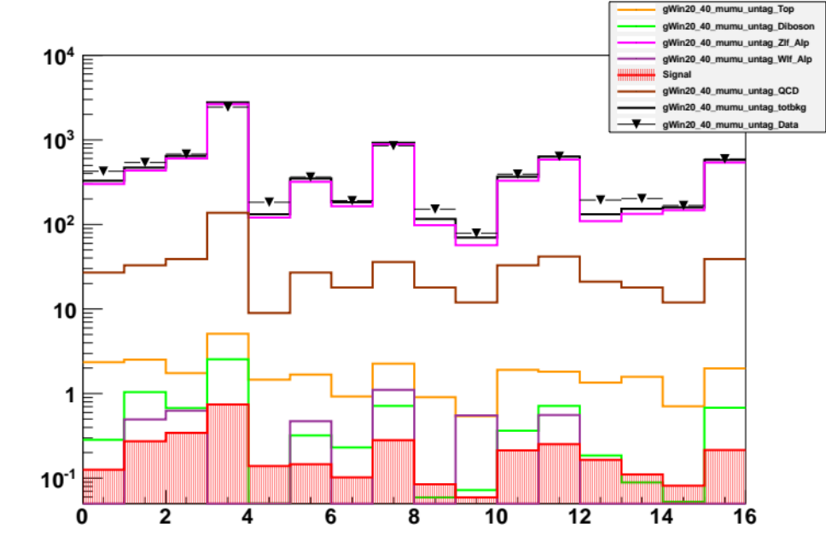
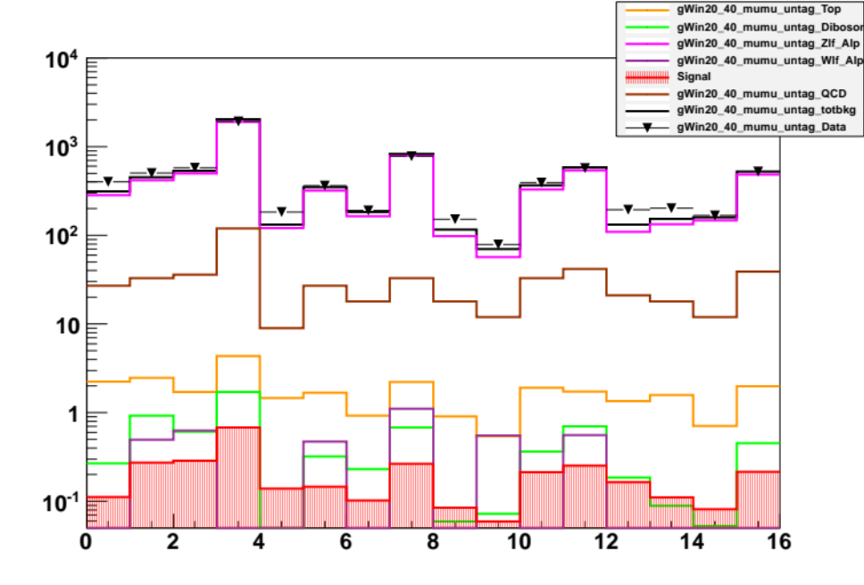
E2 channel
E2 channel (JVF)
SOM pT bin 20-40GeV
MU2 channel
MU2 channel (JVF)

Slide 8
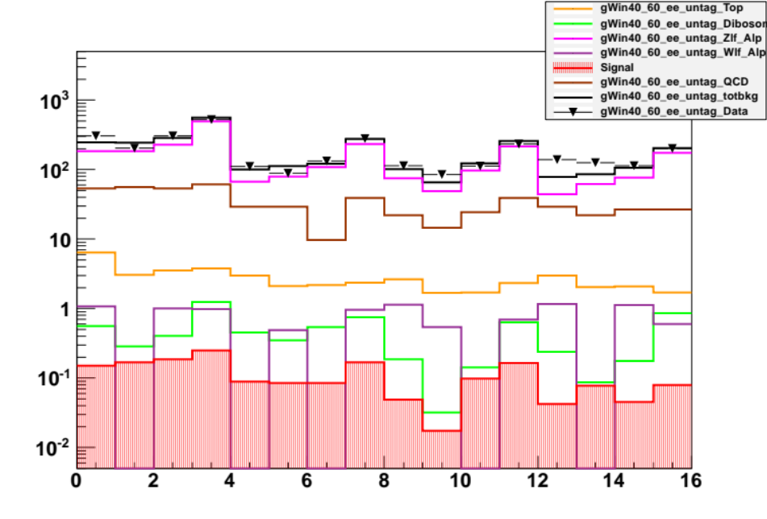
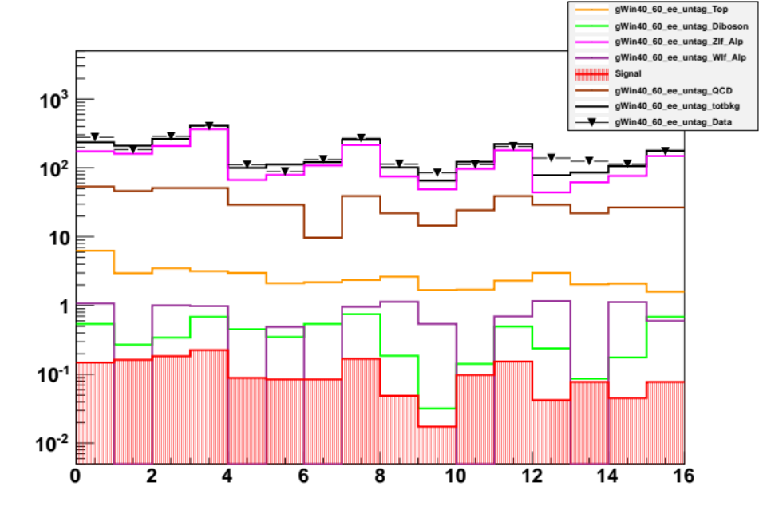
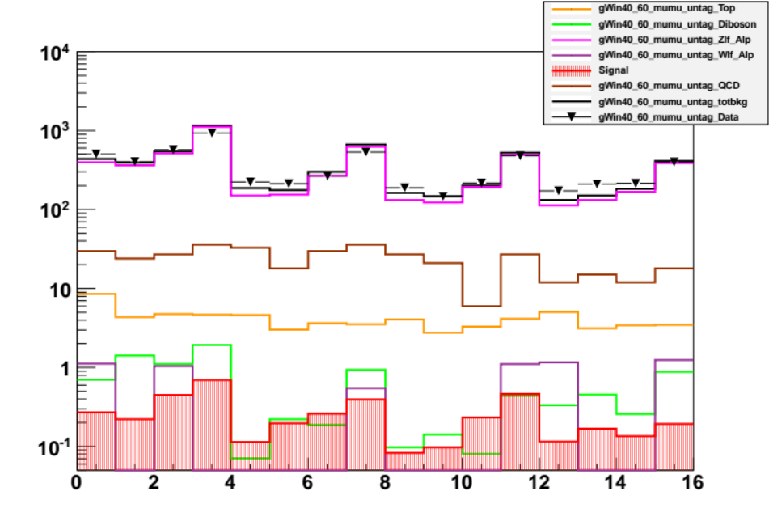
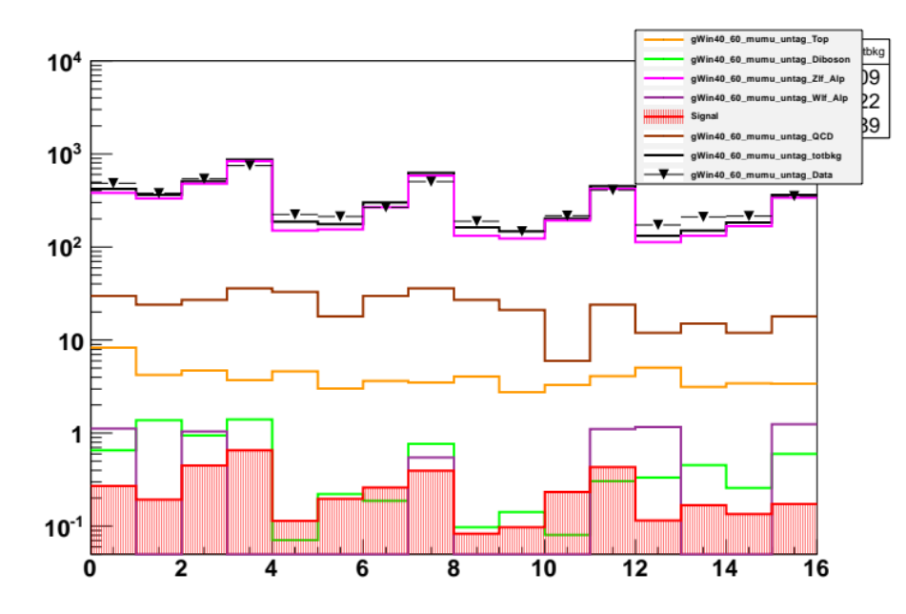
E2 channel
E2 channel (JVF)
SOM pT bin 40-60GeV
MU2 channel
MU2 channel (JVF)

Slide 9
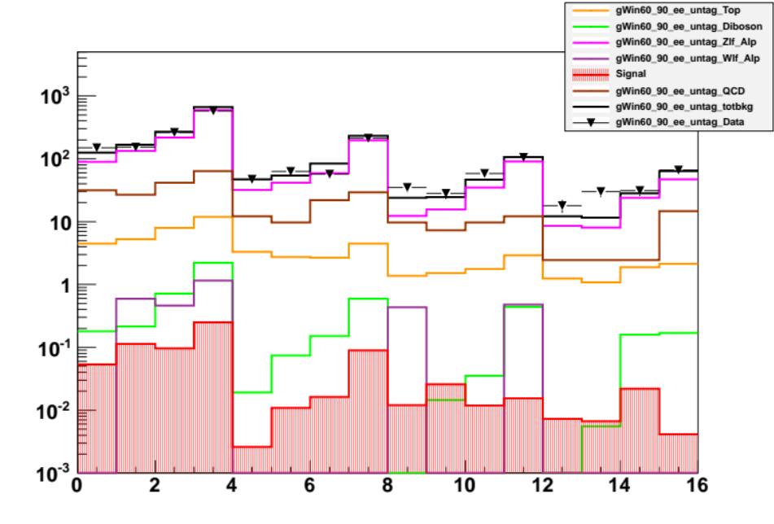
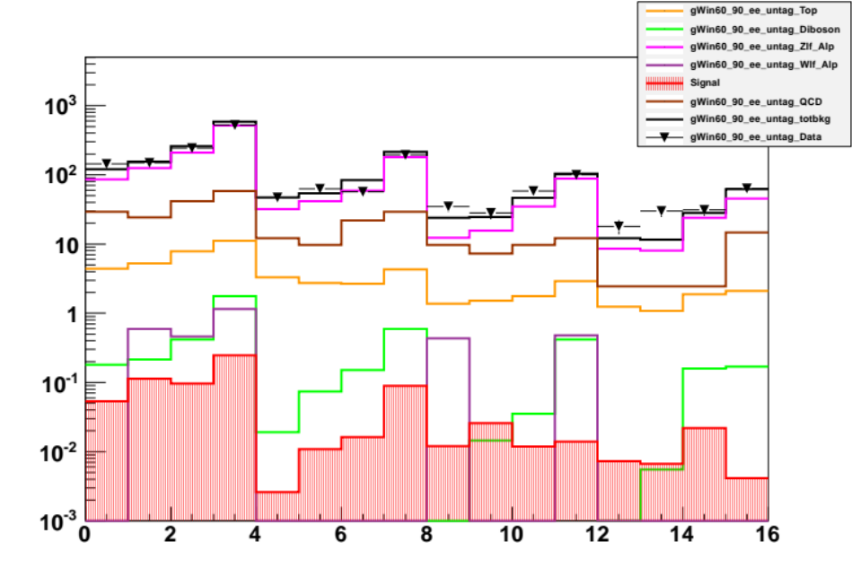
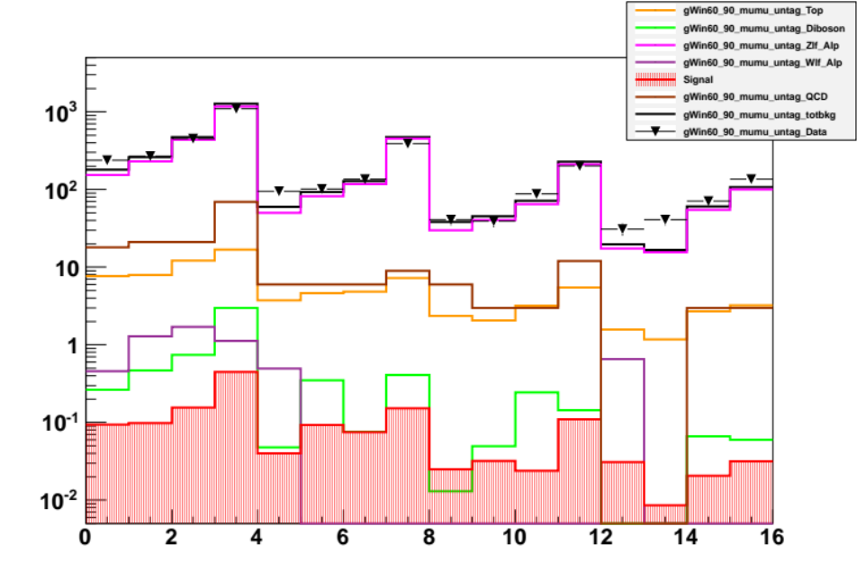
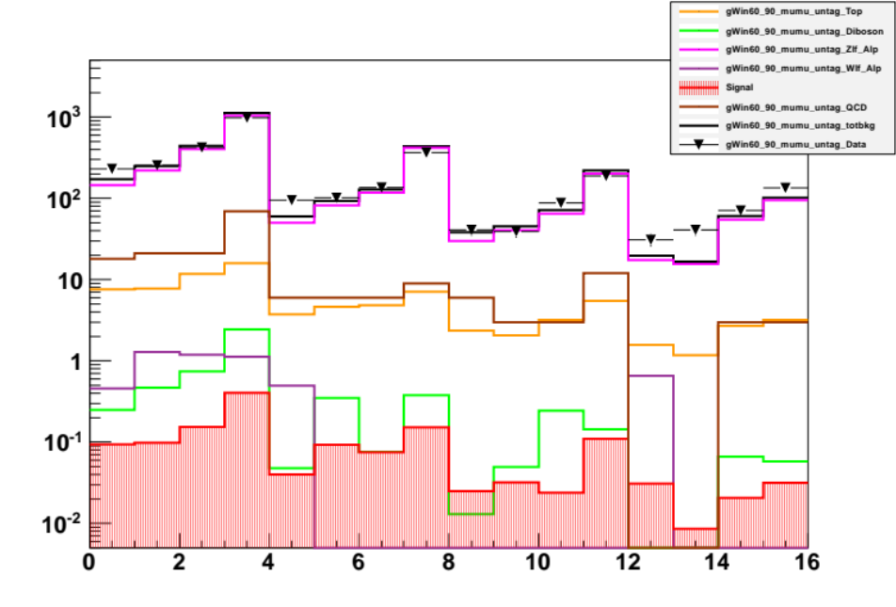
E2 channel
E2 channel (JVF)
SOM pT bin 60-90GeV
MU2 channel
MU2 channel (JVF)

Slide 10
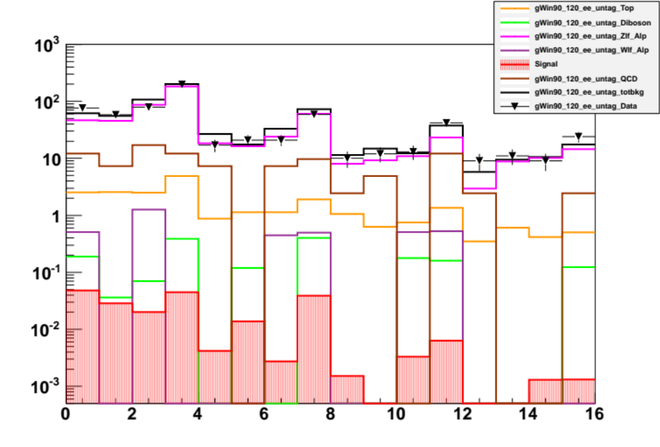

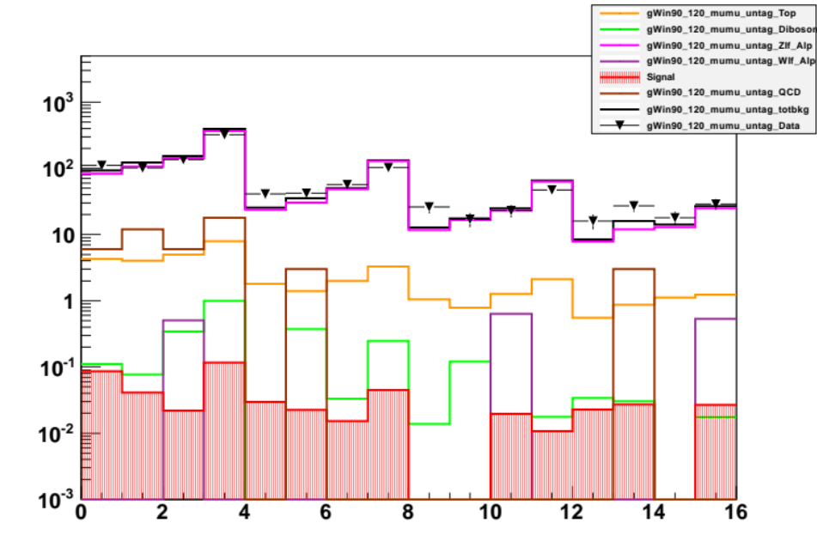
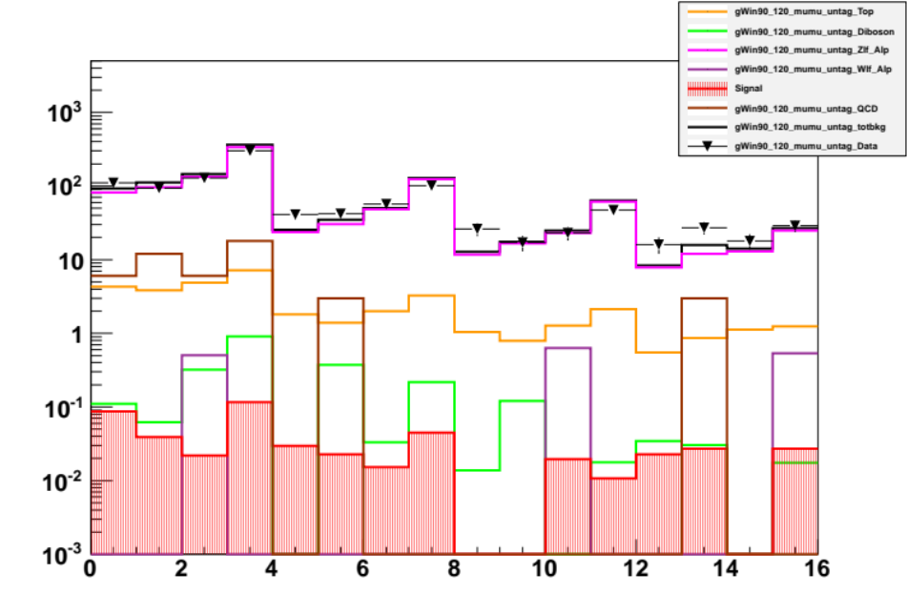
E2 channel
E2 channel (JVF)
SOM pT bin 90-120GeV
MU2 channel
MU2 channel (JVF)

