Slide 1
1D SOM maps
Cuts until the end of the analysis
(10/04/12)

Slide 2
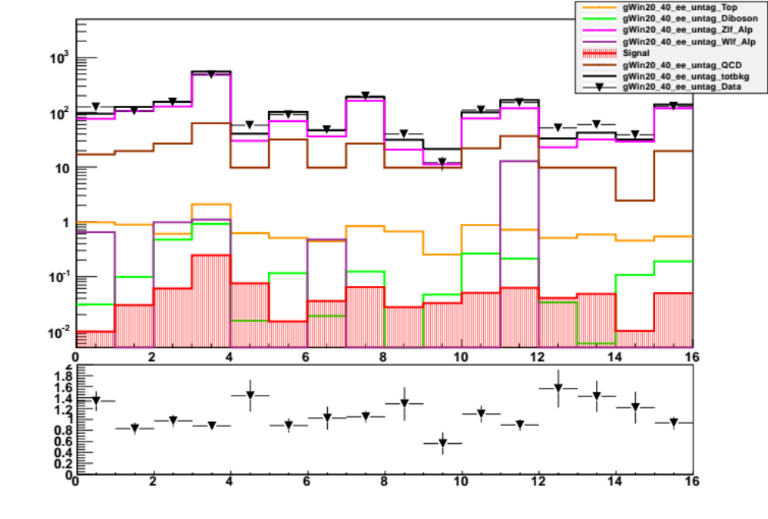
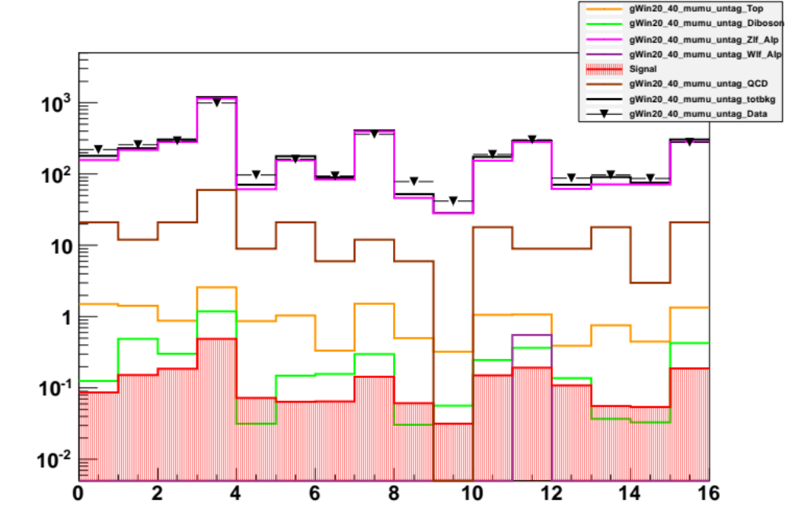
E2 channel
Best Cuts: Optimization output
[0,1,5,14]
MU2 channel
SOM pT bin 20-40GeV
Best Cuts: Optimization output
NONE

Slide 3
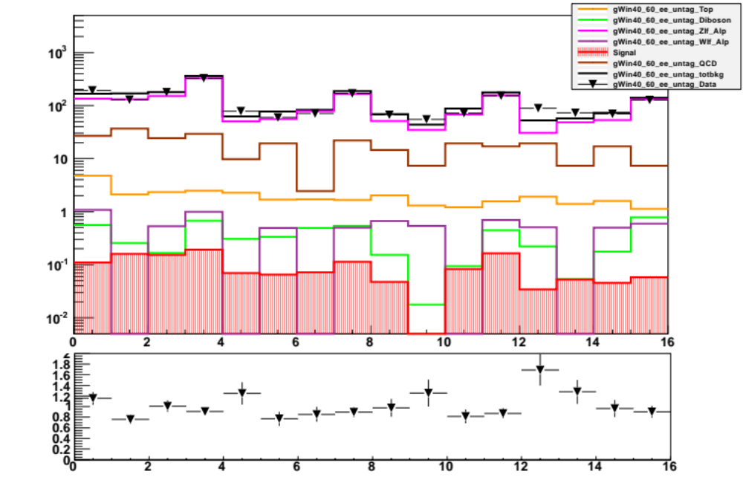
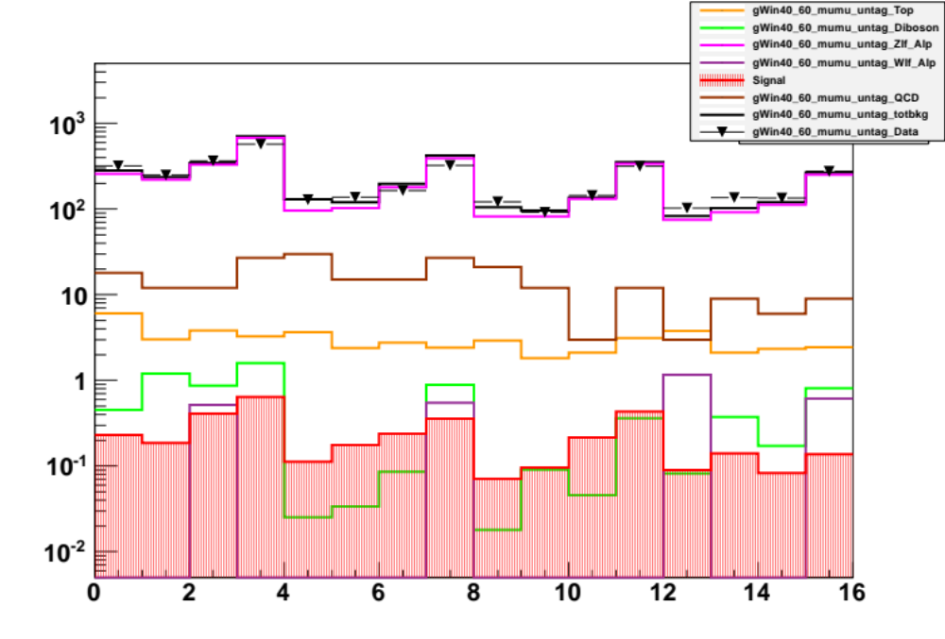
E2 channel
Best Cuts: Optimization output
[9,15]
MU2 channel
SOM pT bin 40-60GeV
Best Cuts: Optimization output
[15]

Slide 4
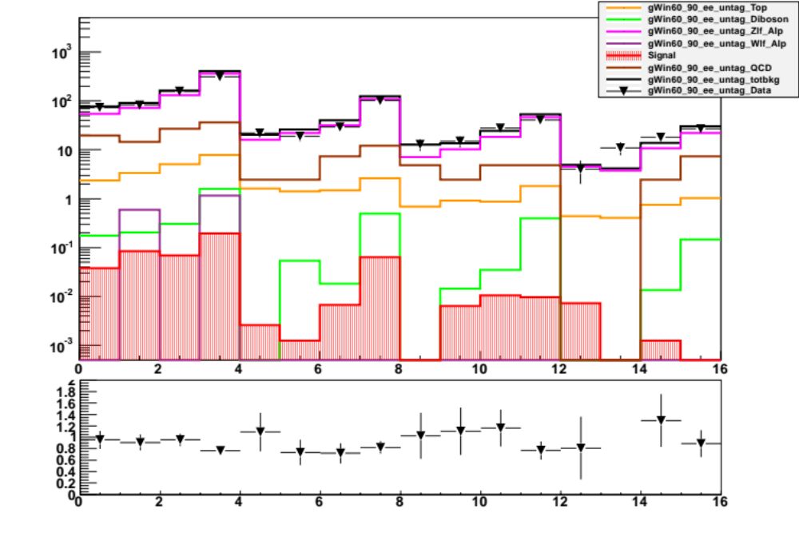
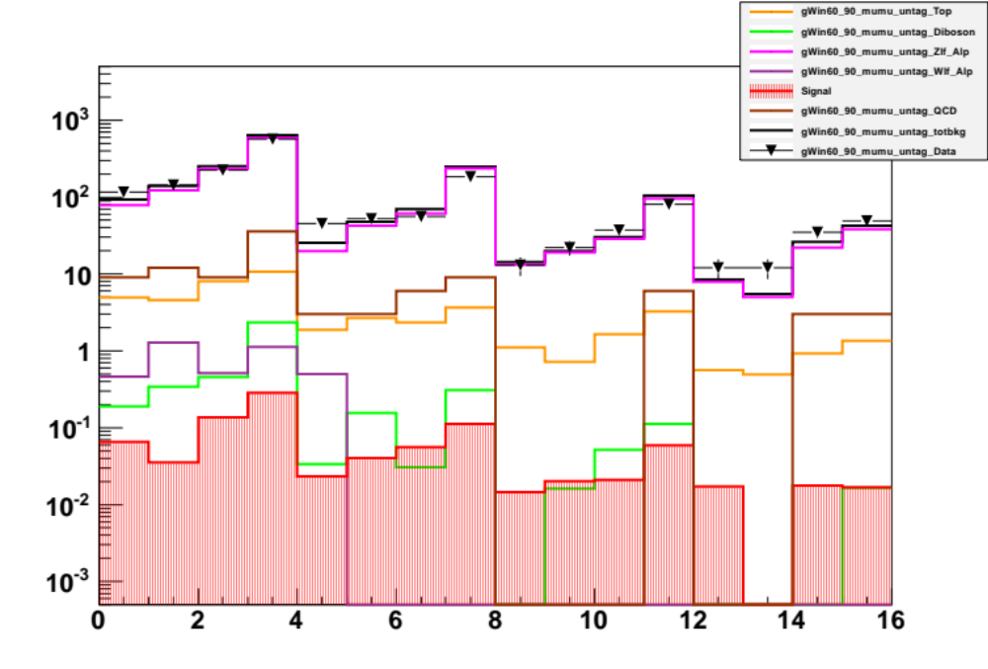
E2 channel
Best Cuts: Optimization output
[4,5,6,8,11,13,14,15]
MU2 channel
SOM pT bin 60-90GeV
Best Cuts: Optimization output
[1,13,15]

Slide 5
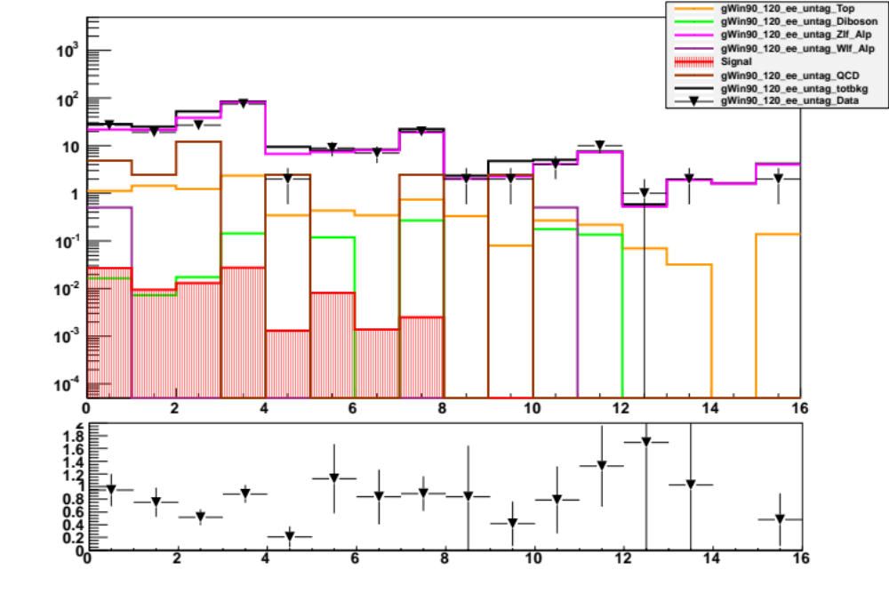
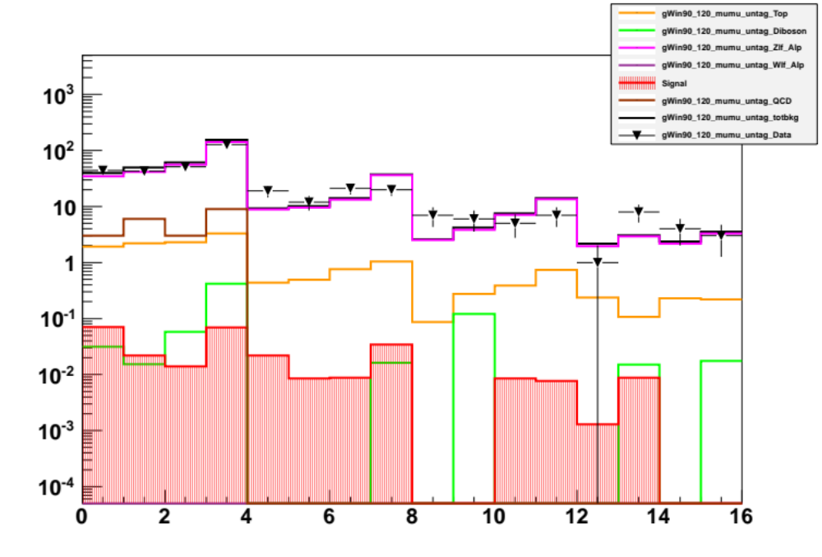
E2 channel
Best Cuts: Optimization output
[1,2,3,4,6,7,8,9,10,11,12,13,14,15]
MU2 channel
SOM pT bin 90-120GeV
Best Cuts: Optimization output
[1,2,3,6,8,9,11,12,14,15]

Slide 6
1D SOM maps
Cuts until the 2 jets request
(10/04/12)

Slide 7
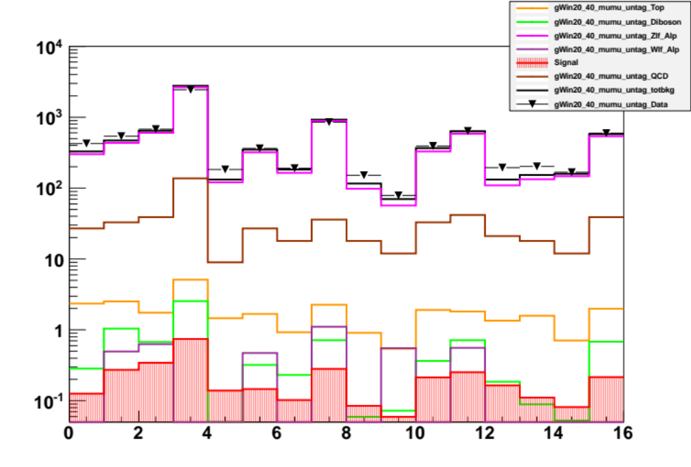
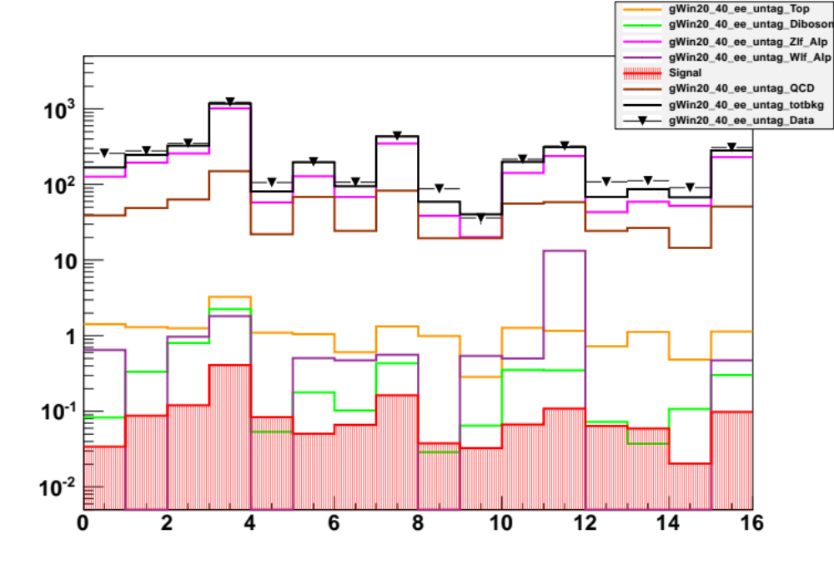
E2 channel
Best Cuts: Optimization output
[0]
MU2 channel
SOM pT bin 20-40GeV
Best Cuts: Optimization output
NONE

Slide 8
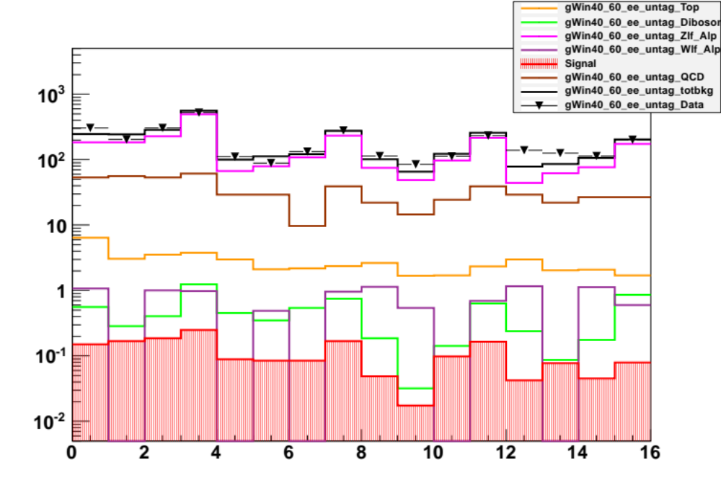
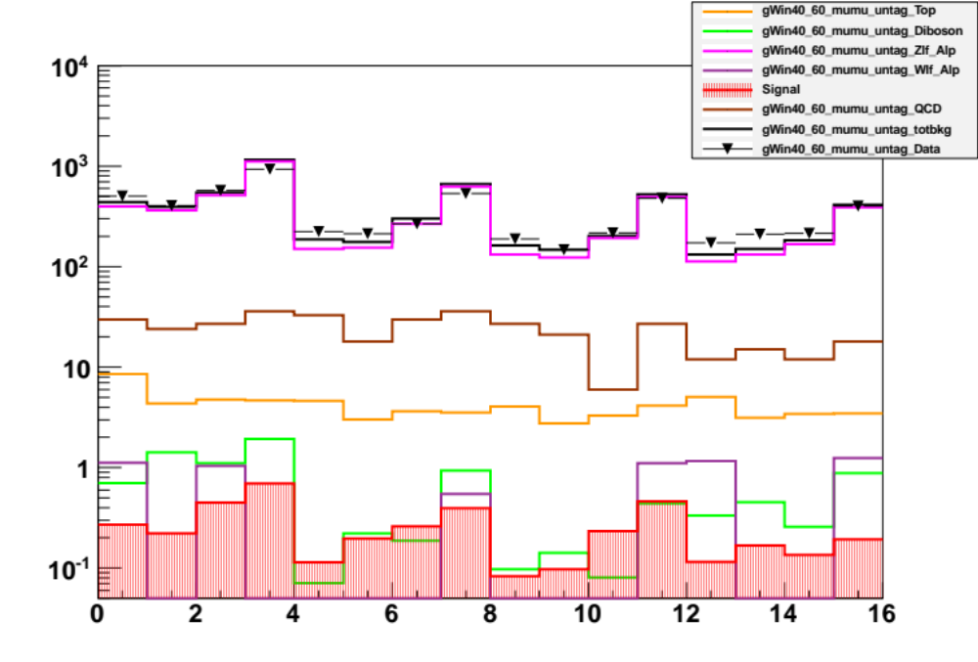
E2 channel
Best Cuts: Optimization output
[9]
MU2 channel
SOM pT bin 40-60GeV
Best Cuts: Optimization output
NONE

Slide 9
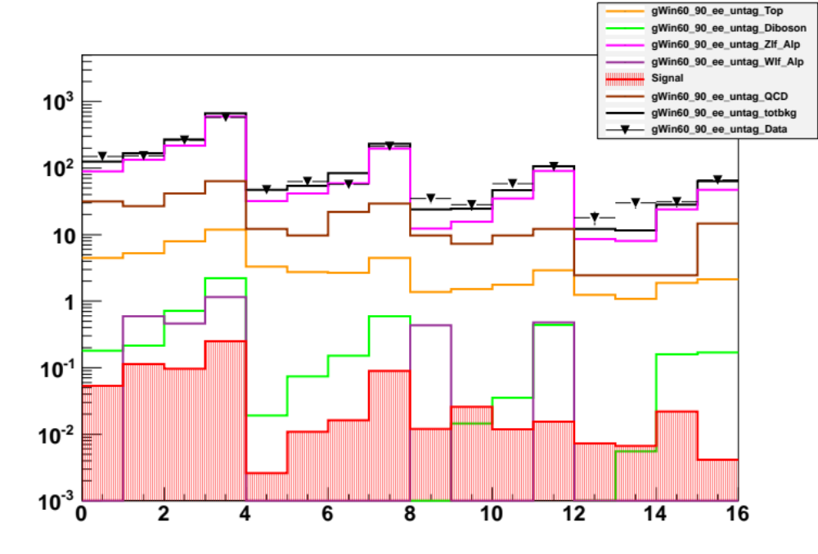
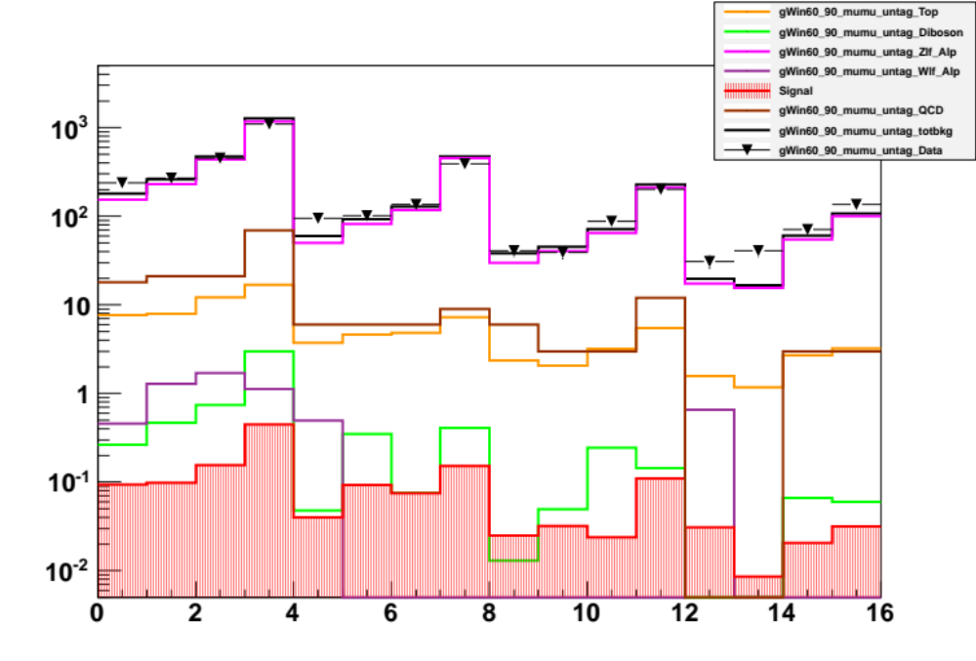
E2 channel
Best Cuts: Optimization output
[4,5,6,11,15]
MU2 channel
SOM pT bin 60-90GeV
Best Cuts: Optimization output
NONE

Slide 10
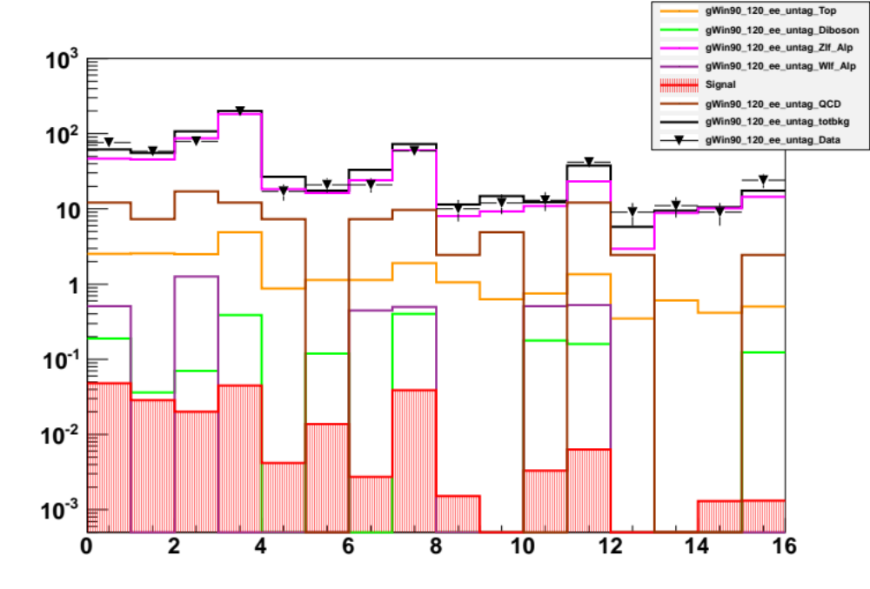
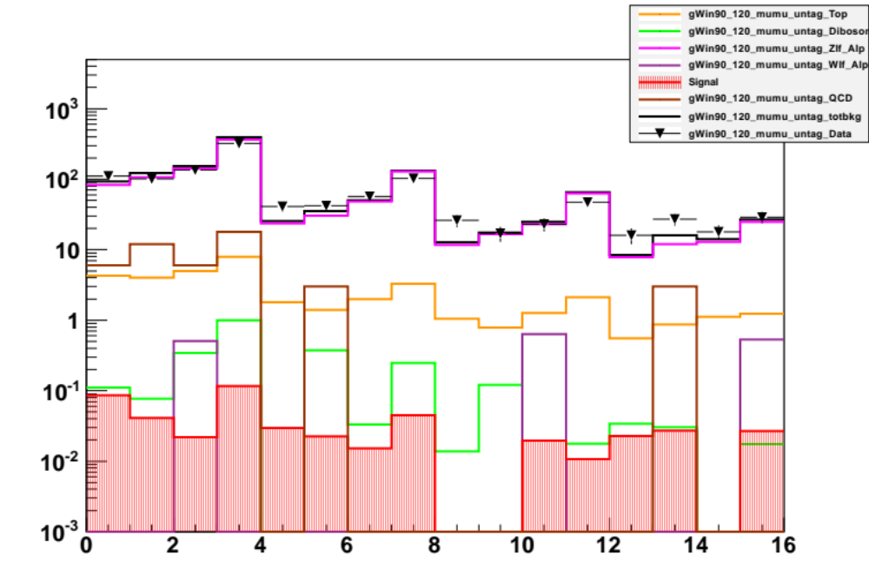
E2 channel
Best Cuts: Optimization output
[2,3,4,6,8,9,10,11,12,13,14,15]
MU2 channel
SOM pT bin 90-120GeV
Best Cuts: Optimization output
[1,2,3,6,7,8,9,11,14]

