Slide 1
Status of the Spin/CP analyses of the MELA group
E.Rossi
NoteZZ4linternal_Autumn2013:Spin/CP

Slide 2
outline
1D Hypothesis testing:
  cosθ* definition consistent with the JHU paper adopted
  acceptances and new description of the Wrong Pair distributions
  closure tests
  Hypothesis tests:
    Asyntothic: 2011/2012/Combined expected/observed
2D:
8D:
Status of the Spin/CP note

Slide 3
What’s new respect to Moriond
What has been done:
  1 dimensional Hypothesis test
    cosθ* definition consistent with JHU paper adopted [http://arxiv.org/abs/1208.4018]
    new acceptances definition for Good Paired events
    2⁻_{h} spin samples (both qq and gg) added and studied
  2 dimensional Hypothesis test
  8 dimensional Hypothesis test
Major improvements on going:
  new approach to treat Wrong Paired events (see F. Cirotto’s talk: https://indico.cern.ch/conferenceDisplay.py?confId=266091)

Slide 4
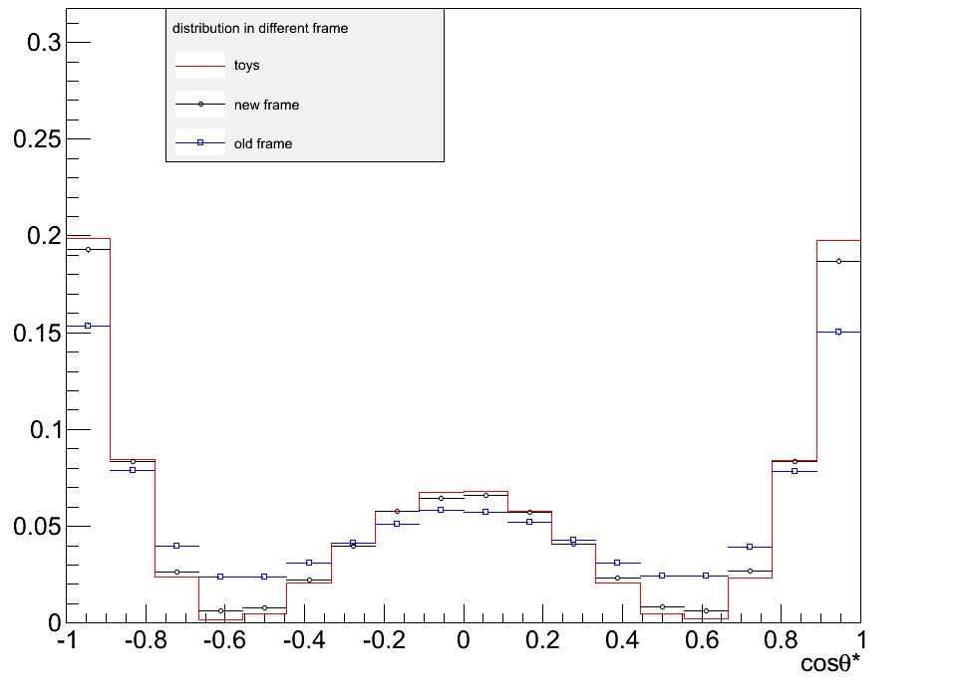
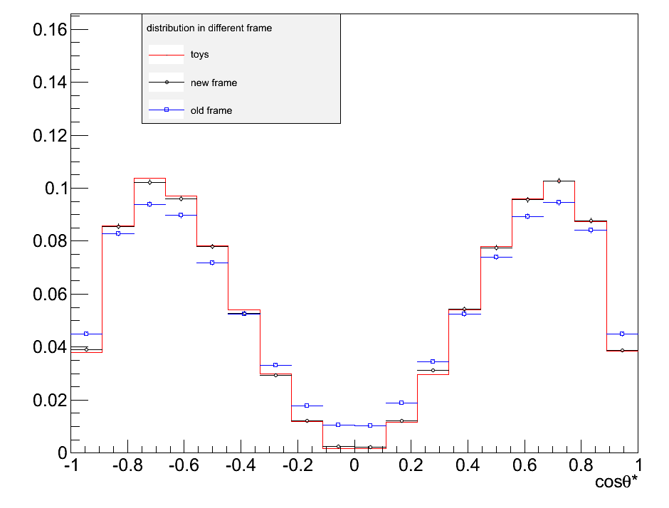
Definition of cosθ* consistent with JHU Paper
JHU paper: http://arxiv.org/abs/1208.4018
Truth MC distributions
MELA PDF
old definition of cosθ*
new definition of cosθ*
2⁻_{h} (gg) cosθ*
MELA PDF
old definition of cosθ*
new definition of cosθ*
2⁻_{h} (qq) cosθ*
MELA pdf: 100k toys
truth MC distributions with old definition
truth MC distributions with new definition
Better agreement between MC and MELA pdf for spin 2⁻_{h} samples
Other spin cases have NO significant changes.

Slide 5
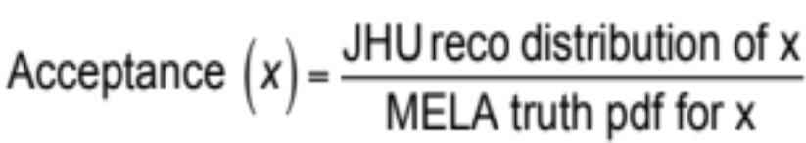

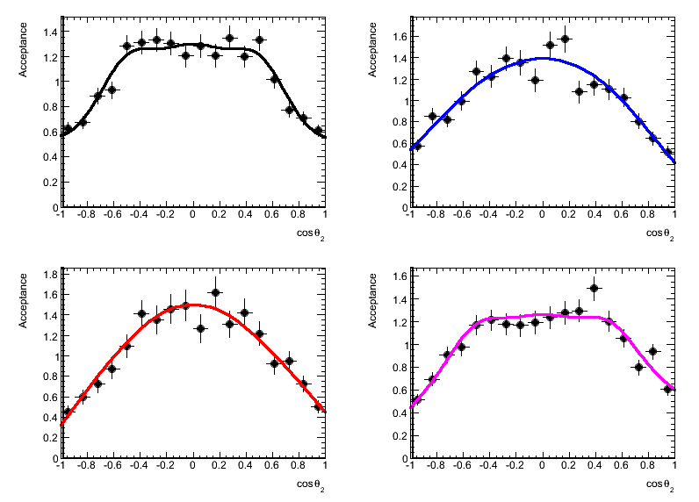
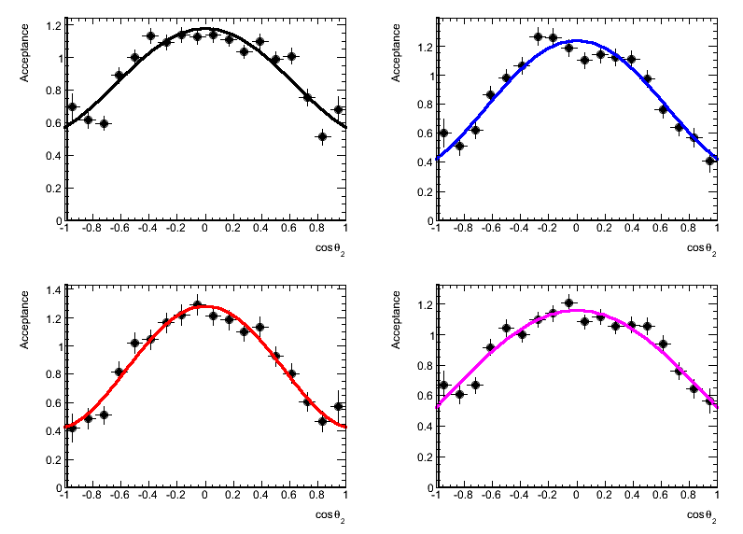
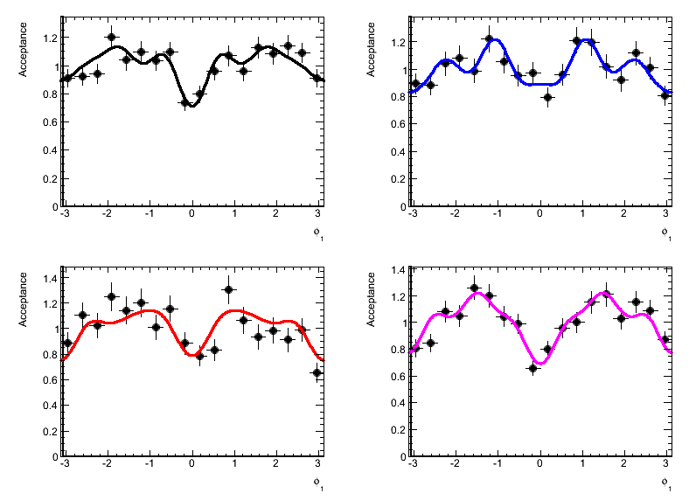
New Acceptance definition
New Acceptance definition
Acceptance distribution of the x variable is defined as ratio between reconstructed JHU MC distribution and MELA truth pdf (100k toys generated).
New approach improves the agreement between MELA pdfs and JHU distributions
OLD Acceptance definition
0⁻ cosθ₂ - 8TeV
1⁻ cosθ₂ – 7TeV
2⁺ φ₁ - 8TEV
4μ
2μ2e
4μ
2μ2e
4μ
2μ2e
2e2μ
4e
2e2μ
4e
2e2μ
4e
New approach improves the agreement between MELA pdf and JHU distributions
Fits for acceptances distributions of the angular variables are ready and almost optimized both for 2011 and 2012 MC samples

Slide 6
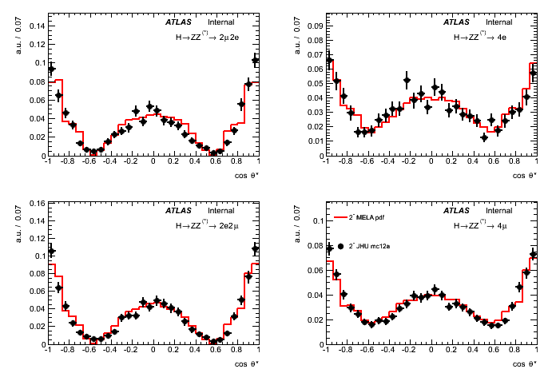
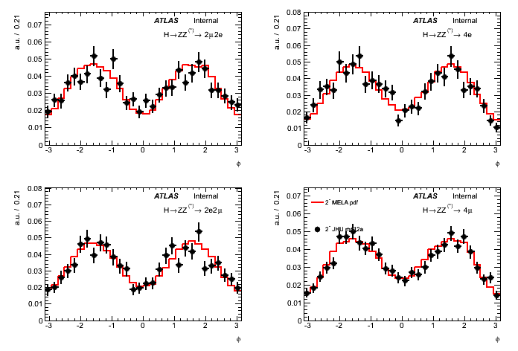
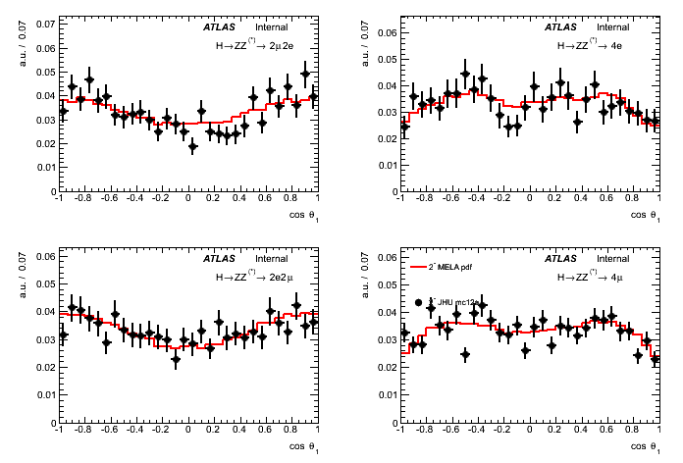
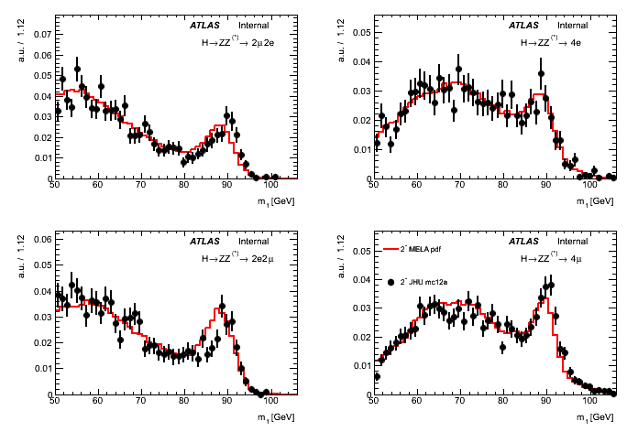
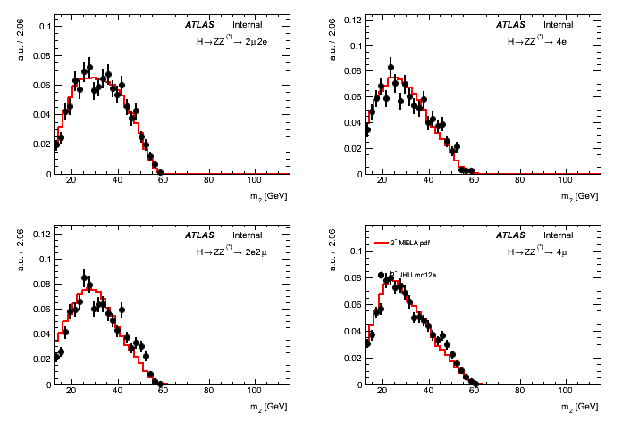
Spin 2⁻_{h} (fqq=0%): Closure tests
cosθ*
φ
cosθ₁
2μ2e
4e
2μ2e
4e
2μ2e
4e
2e2μ
4μ
2e2μ
4μ
2e2μ
4μ
m₁
m₂
2μ2e
4e
2μ2e
4e
RED: 100k toys generates from MELA pdf
BLACK: JHU MC events
2e2μ
4μ
2e2μ
4μ
Reminder: p.d.f.’s are used to build a multivariate discriminant
The better these comparisons look like, the more optimal is J^{P}-MELA as a discriminant
If something is suboptimal this will give lower separation between spin hypotheses, but not a bias!

Slide 7
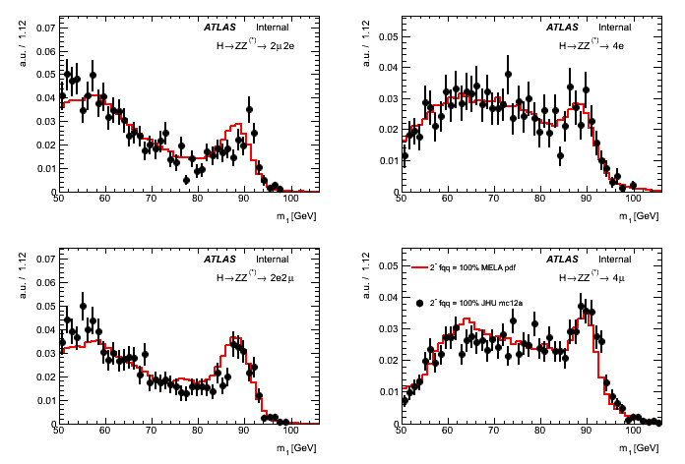
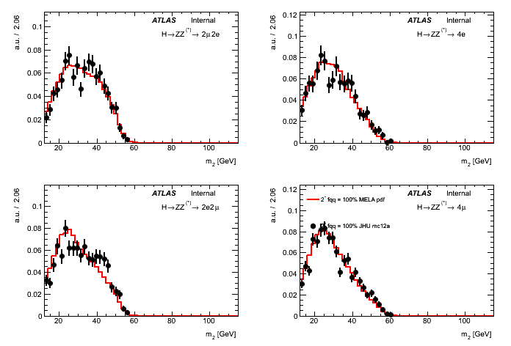
Spin 2⁻_{h} (fqq=100%): Closure tests
cosθ*
φ
cosθ₁
2μ2e
4e
2μ2e
4e
2μ2e
4e
2e2μ
4μ
2e2μ
4μ
2e2μ
4μ
m₁
m₂
2μ2e
4e
2μ2e
4e
RED: 100k toys generates from MELA pdf
BLACK: JHU MC events
2e2μ
4μ
2e2μ
4μ
Good agreement observed for all distributions
(See N. Bruscino’s talk for details: https://indico.cern.ch/conferenceDisplay.py?confId=266091)

Slide 8
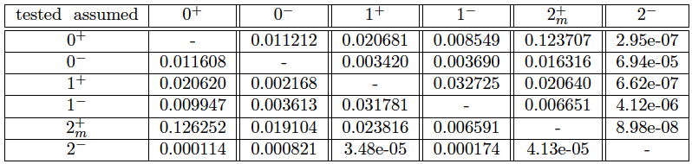
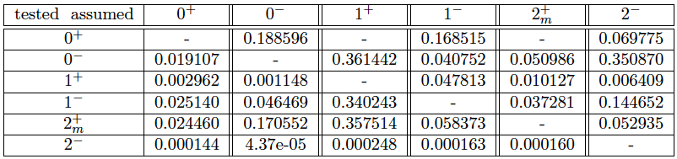
Preliminary Separations: 7 TeV and 8 TeV
using profile likelihoods, asymptotic separations with systematics
Expected μ=1
assumed
2⁻= 2⁻_{h}
tested
assumed
Expected μ=μ _{best}
tested
assumed
Observed
tested

Slide 9
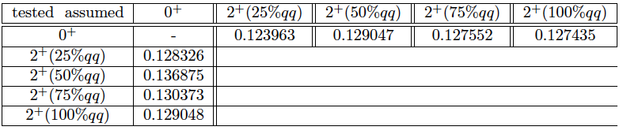
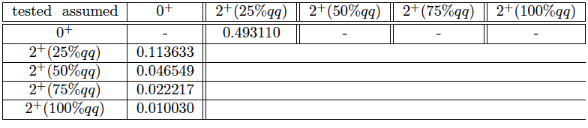
Preliminary Separations (2⁺_{m}): 7 TeV and 8 TeV
using profile likelihoods, asymptotic separations with systematics
assumed
Expected μ=1
tested
assumed
Observed
tested

Slide 10
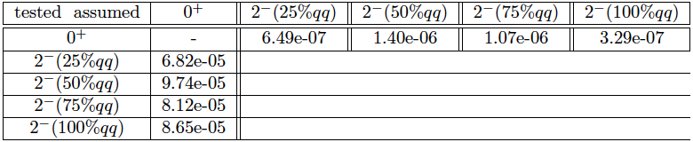
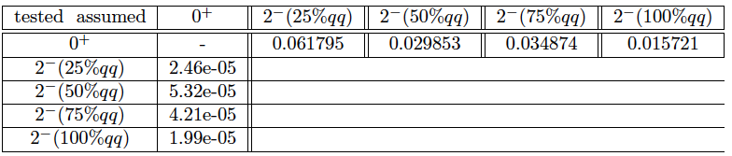
Preliminary Separations (2⁻_{m}): 7 TeV and 8 TeV
using profile likelihoods, asymptotic separations with systematics
assumed
Expected μ=1
2⁻= 2⁻_{h}
tested
assumed
Observed
tested
toys still running on grid
see in backup slides the 1D Hypothesis tests for 7 TeV and 8 TeV

Slide 11
Improvement to the analysis: building WP pdfs
Why a WP pdf?
Extend the use of ME to build WrongPair pdf
Towards complete symmetrical approach for GP and WP:
  Improved description of signal
  Full analytical 7D joint pdf over all the fit observables for the WP component
  WP acceptances
Plan to use WP pdf as a function of the g_i couplings in the likelihood fit
  immediately extendable for any g_i values
  Expect some sensitivity gain in both hypothesis testing and likelihood fit and expect reduced systematic from WP in likelihood fit
Da sistemare

Slide 12
Giuliano/stefano

Slide 13
Summary and Perspective
1D Hypothesis testing:
  Consistent definition of cosθ* (according to JHU Paper): agreement between JHU and theoretical distribution improved
  acceptances and new description of the Wrong Pair distributions: all the fits are ready both for 2011 and 2012
  closure tests
  Hypothesis tests:
    Asyntothic: 2011/2012/Combined expected/observed
    Toys: 2011/2012/Combined expected/observed
2D:
8D:
Status of the Spin/CP note
2­h admixtures samples ready
  ‣ hypothesis test with data and toys ready to run
Consistent definition of cosθ* (according to JHU Paper): agreement between JHU and theoretical distribution improved
New acceptance definitions, acceptance fits 2011/2012 optimized:
‣ effects of systematics uncertainties could be reduced
Analysis is in a very good shape

Slide 14
the end

Slide 15
Systematic uncertainties
Same approuch as in Moriond:
normalization systematics:
  signal x-section + MC statistic: 20%
  ZZ BG x-section + MC statistic: 7%
  ZJ BG: uncertainty from data-driven estimates: 32%
  all: high/low m4l bins migration due to assumed m_{H} and due to ES systematic: 14% (anti-correlated high-low)
shape systematics:
  wrong-pairing: very small with new selection
  ES: very small
  ZJ shape parametrisation: from variations in the multi-gaussian and adaptive-KDE models + variations related to the available data-driven statistic
  All systematics taken not correlated between 2011 and 2012 with the exception of the ZJ shape systematics (same data-driven sample used in both cases)

Slide 16
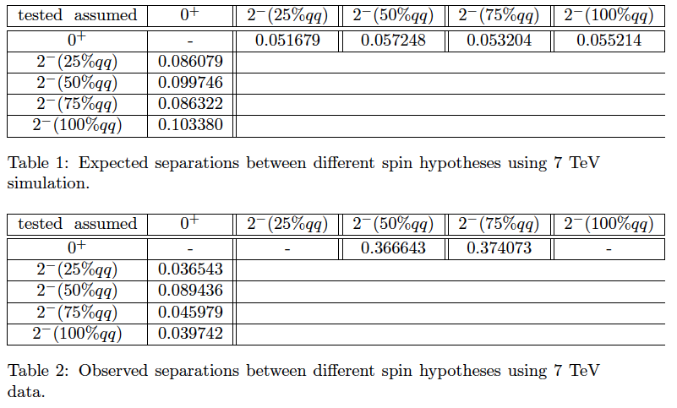
Preliminary Separations: 7 TeV
using profile likelihoods, asymptotic separations with systematics
Expected μ=1
assumed
2⁻= 2⁻_{h}
tested
Observed

Slide 17
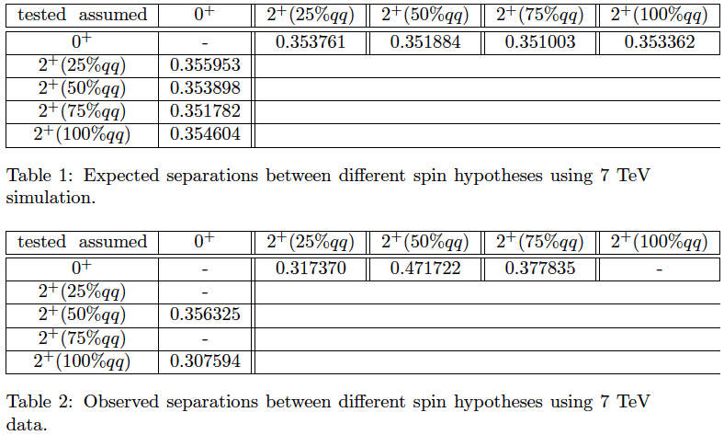
Preliminary Separations (2⁺_{m}): 7 TeV
using profile likelihoods, asymptotic separations with systematics
Expected μ=1
assumed
tested
Observed

Slide 18
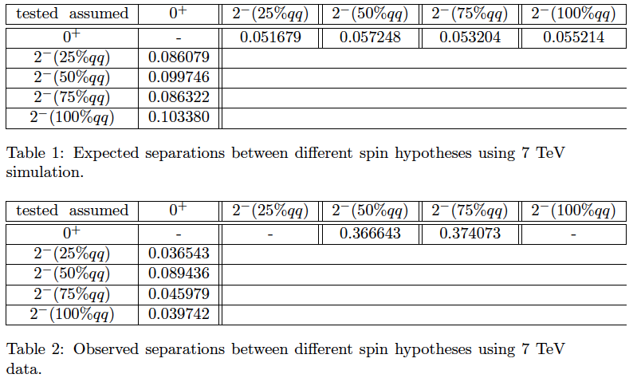
Preliminary Separations (2⁻_{m}): 7 TeV
using profile likelihoods, asymptotic separations with systematics
Expected μ=1
assumed
tested
Observed

Slide 19
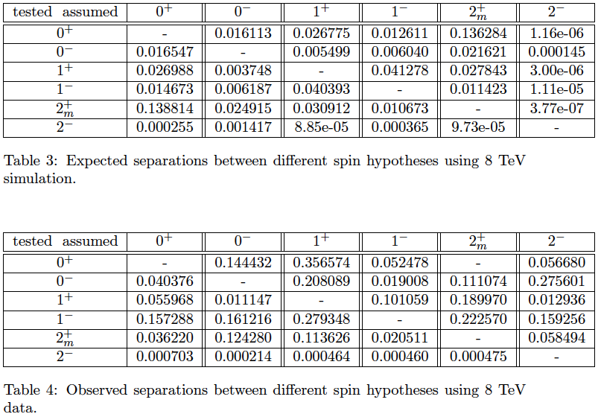
Preliminary Separations: 8 TeV
using profile likelihoods, asymptotic separations with systematics
Expected μ=1
assumed
2⁻= 2⁻_{h}
tested
Observed

Slide 20
Preliminary Separations (2⁺_{m}): 8 TeV
using profile likelihoods, asymptotic separations with systematics
Expected μ=1
assumed
tested
Observed

Slide 21
Preliminary Separations (2⁻_{m}): 8 TeV
using profile likelihoods, asymptotic separations with systematics
Expected μ=1
assumed
tested
Observed

Slide 22
Conclusions
2­h admixtures samples ready
  ‣ hypothesis test with data and toys ready to run
Consistent definition of cosθ* (according to JHU Paper): agreement between JHU and theoretical distribution improved
New acceptance definitions, acceptance fits 2011/2012 optimized:
‣ effects of systematics uncertainties could be reduced
Analysis is in a very good shape
NEXT WEEK:
Finalization
  ‣ adding systematics
‣ hypothesis tests with toys still running on grid

Slide 23
Building WP pdf
Why a WP pdf
Extend the use of ME to build WrongPair pdf:
Towards complete symmetrical approach for GP and WP :
  Improved description of signal
  Full analytical 7D joint pdf over all the fit observables for the WP component
WP acceptances
Plan to use WP pdf as a function of the g_i couplings in the likelihood fit
  immediately extendable for any g_i values
  Expect some sensitivity gain in both hypothesis testing and likelihood fit and expect reduced systematic from WP in likelihood fit

Slide 24




Building WP pdf
How to build a WP pdf
Pdf(m,Ω) <-> pdf(p1..p4)
  From GP truth pdf we have the five angles and the masses
  Perform a trasformation to obtain the pdf as a function of the 4 leptons quadrimomenta
  Swap leptons to obtain WP couples
  Calculate WP pdf variables
  Procedure applied to all spin hypotheses
$$GP pdf truth \vec{Ω}, \vec{m}$$
O$btain p_{i}^{μ}$
S$wap p_{i}^{μ}$
$$WP pdf truth \vec{Ω}, \vec{m}$$

Slide 25
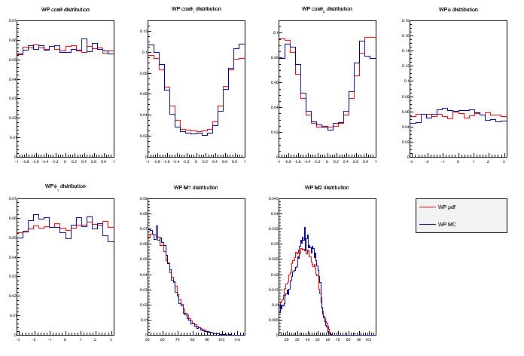
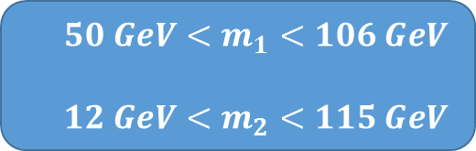
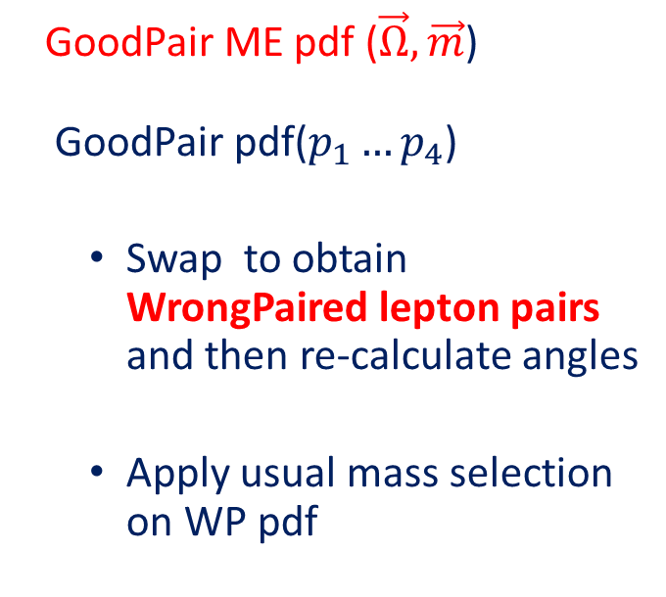







WP pdf
Validation with JHU MC
  GoodPair ME pdf ()
  GoodPair pdf()
  Swap to obtain WrongPaired lepton pairs and then re-calculate angles
  Apply usual mass selection on WP pdf
$$WP cosθ^{∗}$$
$$WP cosθ_{1}$$
$$WP cosθ_{2}$$
$$WP Φ$$
$$WP Φ_{1}$$
$$WP m_{1}$$
$$WP m_{2}$$
WP MC truth
  $$50 GeV<m_{1}<106 GeV$$
  $$12 GeV<m_{2}<115 GeV$$
WP pdf truth
0⁺ 4μ

Slide 26
WP pdf
We can take in account the MC p_{T} lepton cut
$$WP cosθ^{∗}$$
$$WP cosθ_{1}$$
$$WP cosθ_{2}$$
$$WP Φ$$
From MC: obtain Higgs p_{T} distribution
pdf leptons boosted to LAB frame
Cut on pdf events p_{t} < 6 GeV (as in MC) and after that boost again
Better agreement
$$WP Φ_{1}$$
$$WP m_{1}$$
$$WP m_{2}$$
WP MC truth
WP pdf truth
0⁺ 4μ

Slide 27
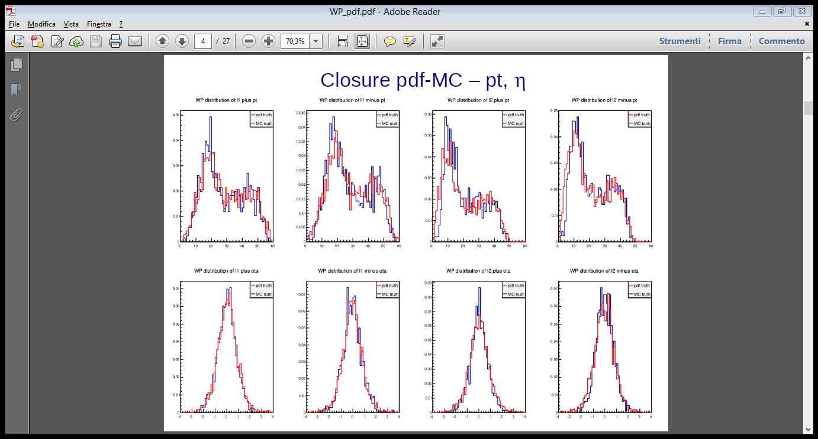
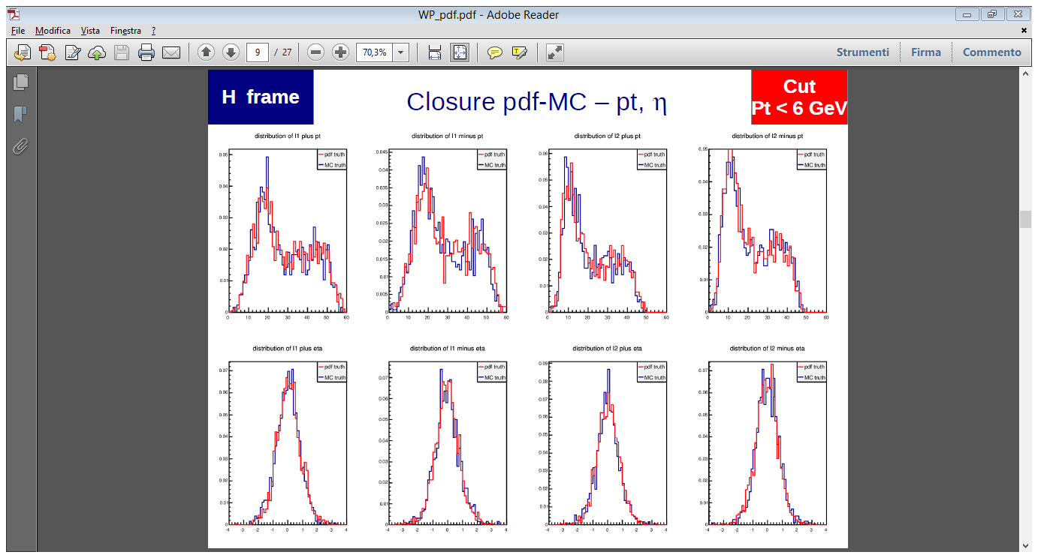








WP pdf
We can take in account the MC p_{T} lepton cut
p_{T}
Preliminary checks on GP truth distributions
From MC: obtain Higgs p_{T} distribution
pdf leptons boosted to LAB frame
Cut on pdf events p_{t} < 6 GeV (as in MC) and after that boost again
Better agreement
$$ℓ_{1}^{+}$$
$$ℓ_{1}^{+}$$
$$ℓ_{2}^{+}$$
$$ℓ_{2}^{−}$$
GP MC
η
GP pdf
p_{T}
$$ℓ_{1}^{+}$$
$$ℓ_{1}^{+}$$
$$ℓ_{2}^{+}$$
$$ℓ_{2}^{−}$$
η

Slide 28
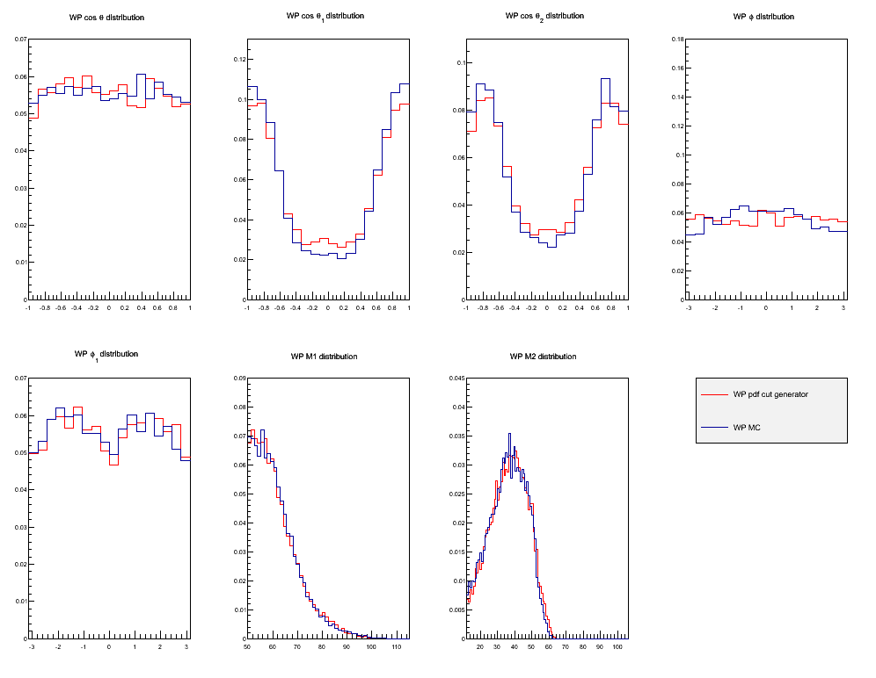


WP pdf
WP pdf with p_{T} cut generator
$$WP cosθ^{∗}$$
$$WP cosθ_{1}$$
$$WP cosθ_{2}$$
$$WP Φ$$
0⁺ 4μ
$$WP Φ_{1}$$
$$WP m_{1}$$
$$WP m_{2}$$
p_{T} cut < 6 GeV
WP MC truth
WP pdf truth

Slide 29
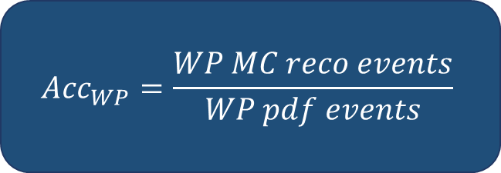

WP pdf
WP acceptances
  We aim to describe WP as we’ve done for GP
  2012 and 2011 fit on WP acceptances ready
  $${Acc}_{WP}=\frac{WP MC reco events}{WP pdf events}$$
  $f_{WP}={pdf}_{WP}$*${Acc}_{WP}$

Slide 30
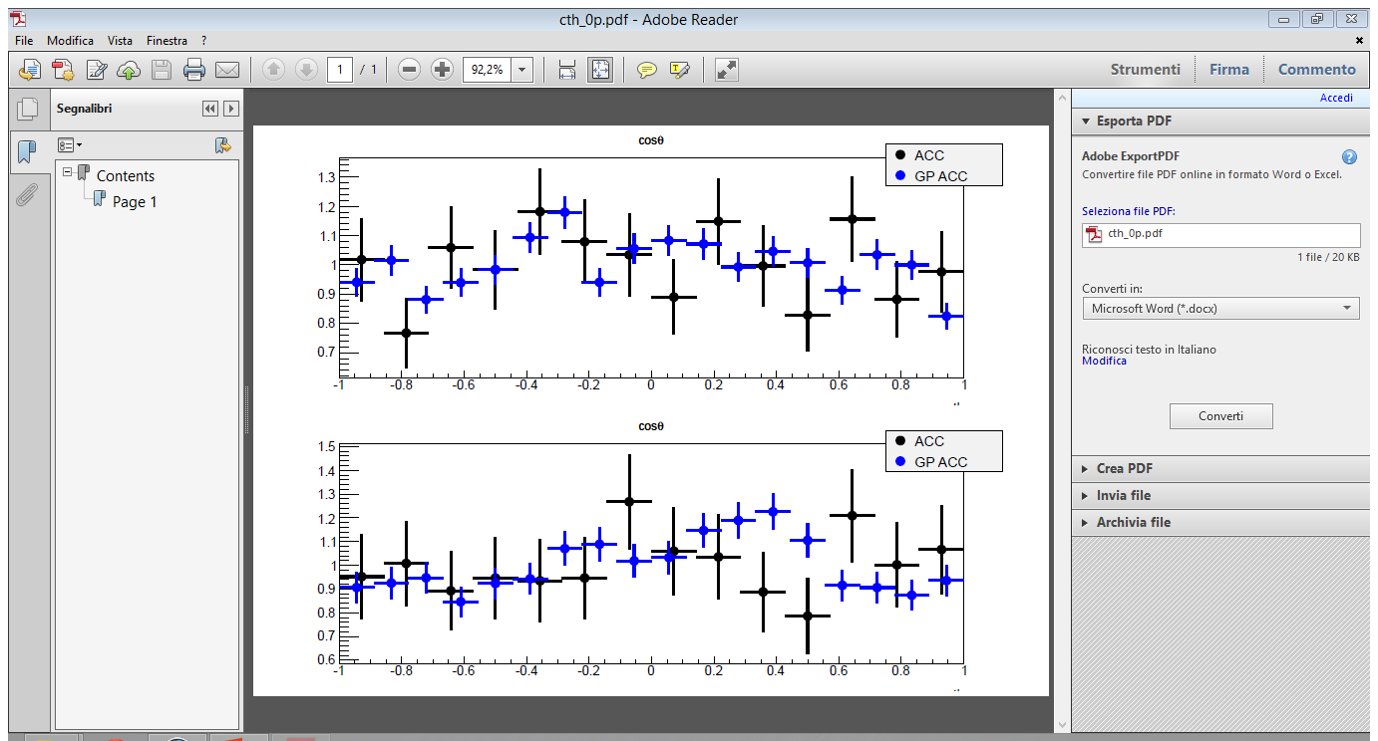
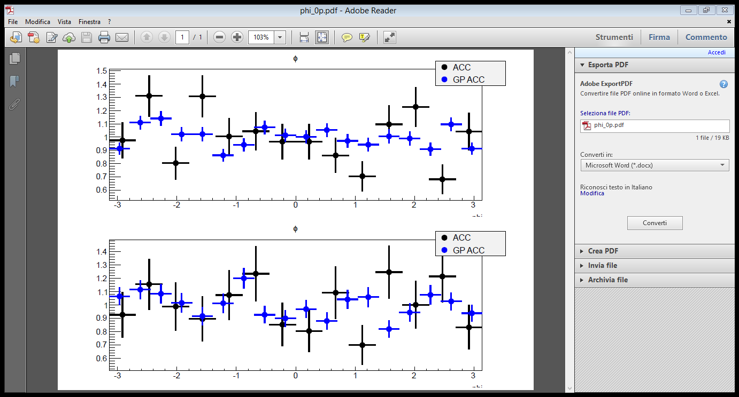
WP pdf
WP acceptances

Slide 31
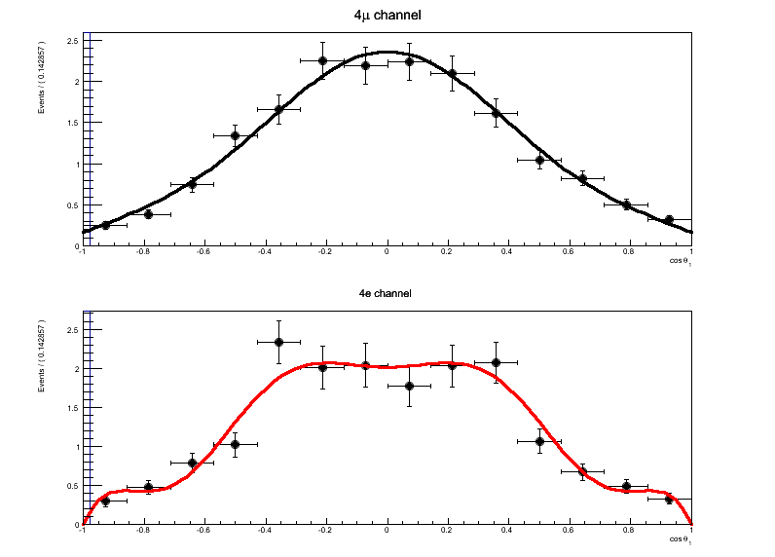
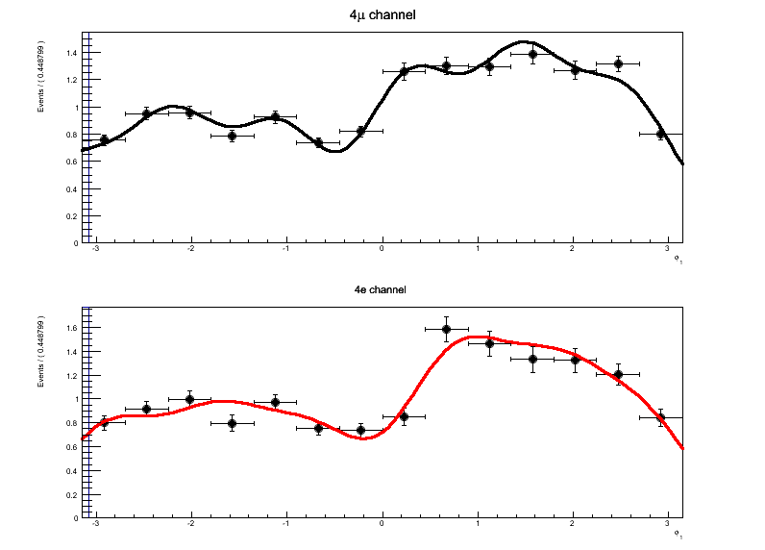


WP pdf
WP fit acceptances
0⁺
2⁻ 100% qq
$$cosθ_{2}$$
$$Φ_{1}$$

Slide 32
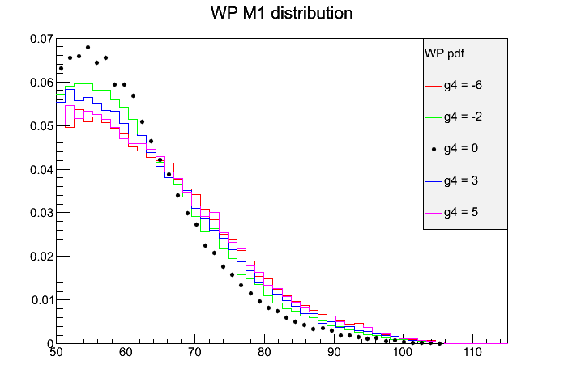
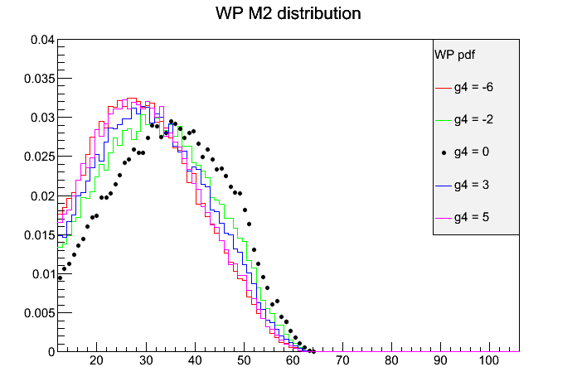
WP pdf
Studying $g_{4}≠0$ WP distibutions

Slide 33
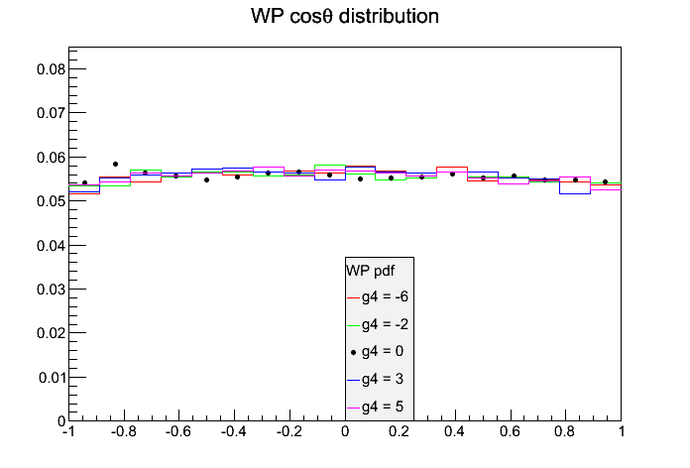
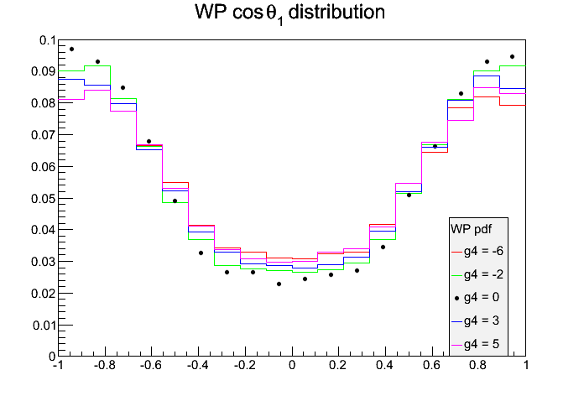
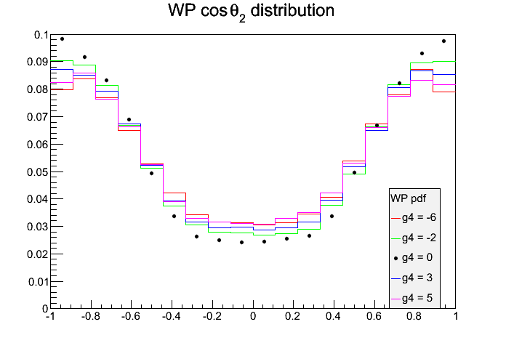
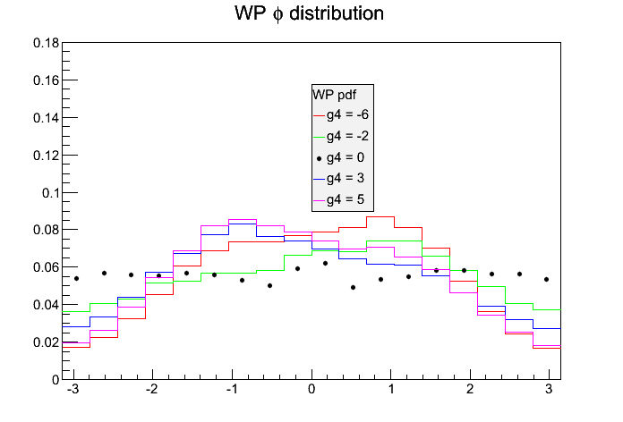
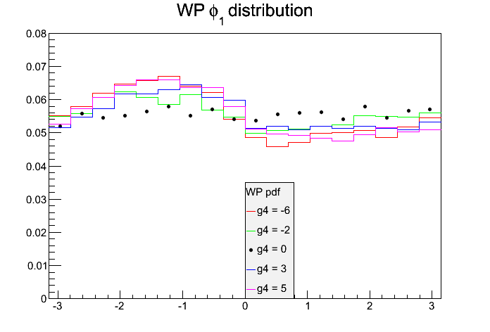
WP pdf
Studying $g_{4}≠0$ WP distibutions

Slide 34
Conclusions
We define a method to build WP pdf from GP ME pdf
  Validation test on MC JHU sample is ok
  Recover generator level MC p_{T} cuts
  MELA code almost ready to host both GP and WP pdf for all spin hypotheses
On going work
  Re-run hypothesis test with this approach
  Insert WP pdf in the likelihood fit (immediately extendable for any g_i values)

