Slide 1
KM3NeT timeline
Mar 2012
Feb 2006
Mar 2008
Dec 2009
2013
Design Study
CDR
TDR
Preparatory Phase
governance
legal entity
pre-production models
site decision
funding
new partners
tendering
construction
data taking

Slide 2
How to distribute light sensors over many km³
Key parameter: total photo-cathode area
Many optical sensors concentrated on ‘towers’
  horizontal extensions
  at large horizontal distances
Few optical sensors on ‘strings’
  Slender string structure
  At smaller horizontal distances
INFN
IN2P3
CEA/Saclay
Nikhef
KVI
- ECAP (Erlangen)
- Demokritos (Greece)
Both concepts worked out in the Design Study

Slide 3
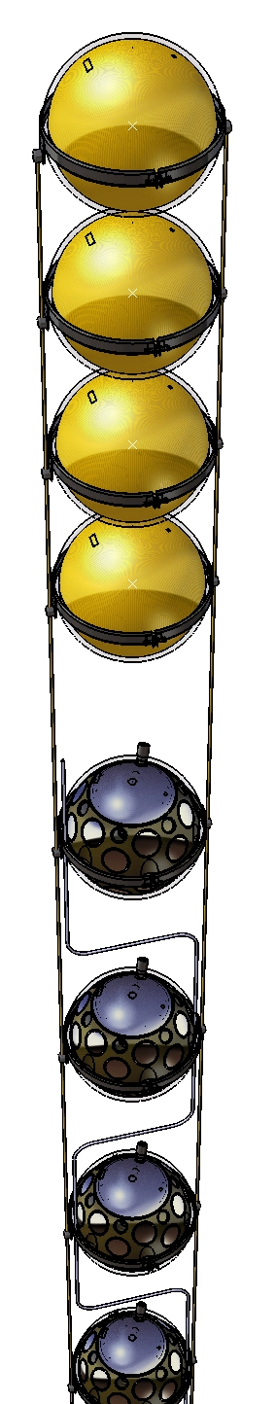
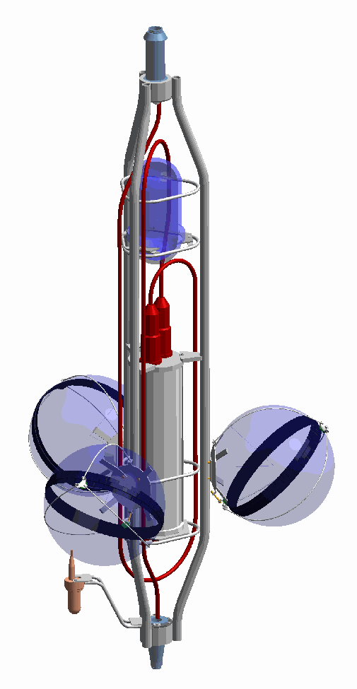
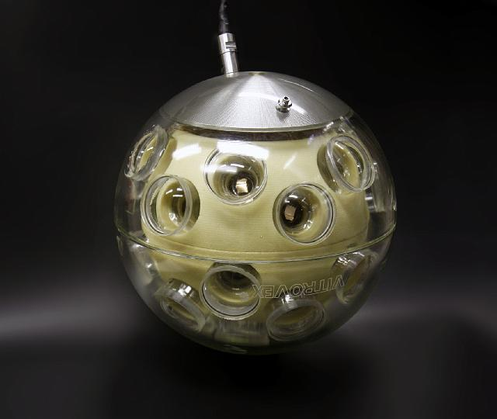
The slender string
Same area photocathode
+
Calibration instrumentation
+
Electronics
in one sphere
Multi-PMT Optical Module
Advantage:
Uniform angular acceptance
Photon counting
Good background rejection

Slide 4
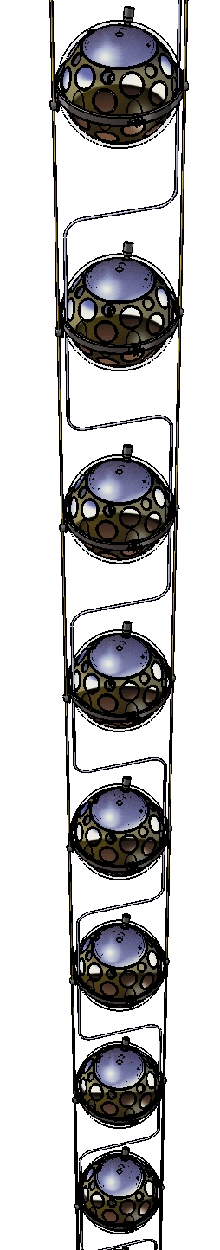

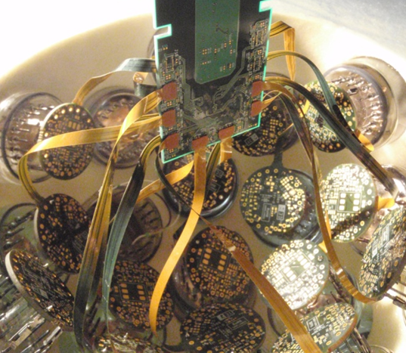
Multi PMT Optical Module
Custom HV board (4.5 mW) with amplifier and discriminator ~20 mW
Bit of effort to get all electronics in and keep power down and get heat out

Slide 5
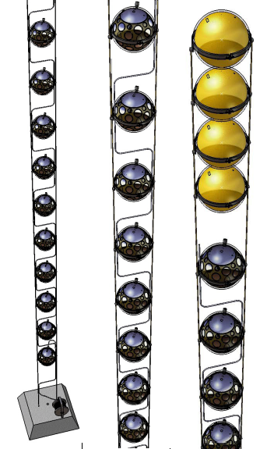
Slender string
Small diameter ropes for mechanical strength
20 Multi-PMT optical modules
4 empty spheres for buoyancy
Small diameter, oil-filled e/o cable for (data)communication
10 Gb/s communication network
~900 m long
KM3NeT: 640 strings

Slide 6
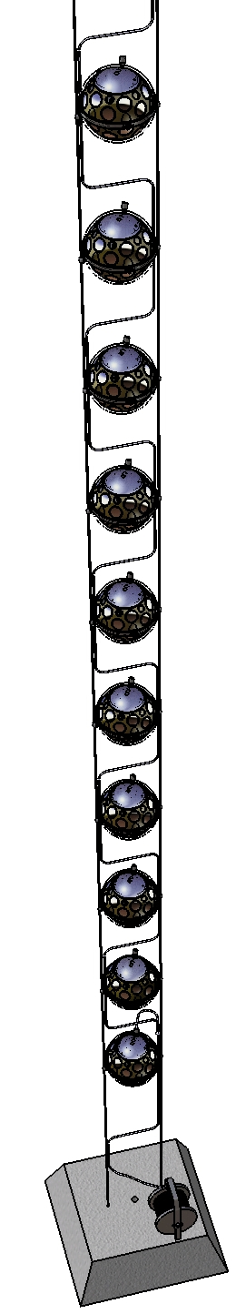
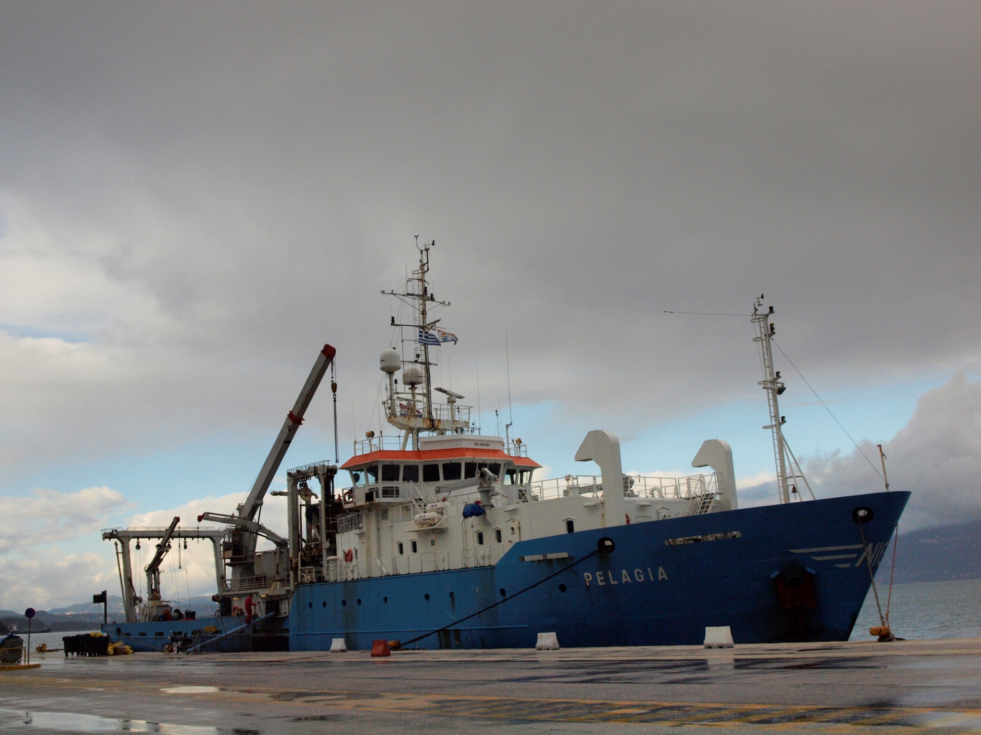
Test deployment December 2009 on board RV Pelagia

Slide 7
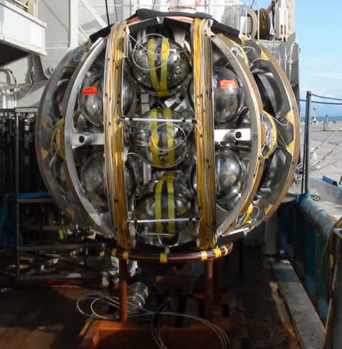
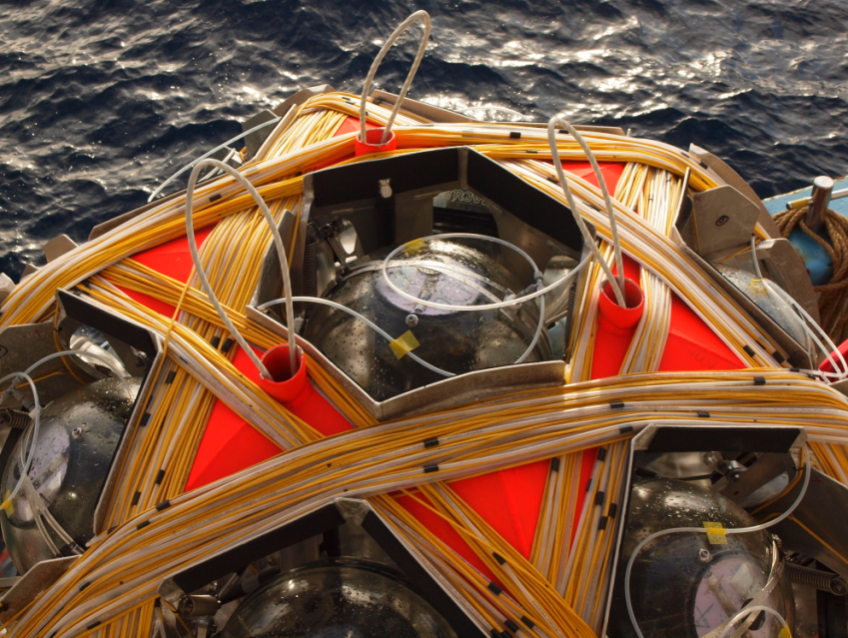
Launcher on deck
String (~900 m) wound onto launcher (NIOZ)
Dense packing: 37 spheres
anchor

Slide 8
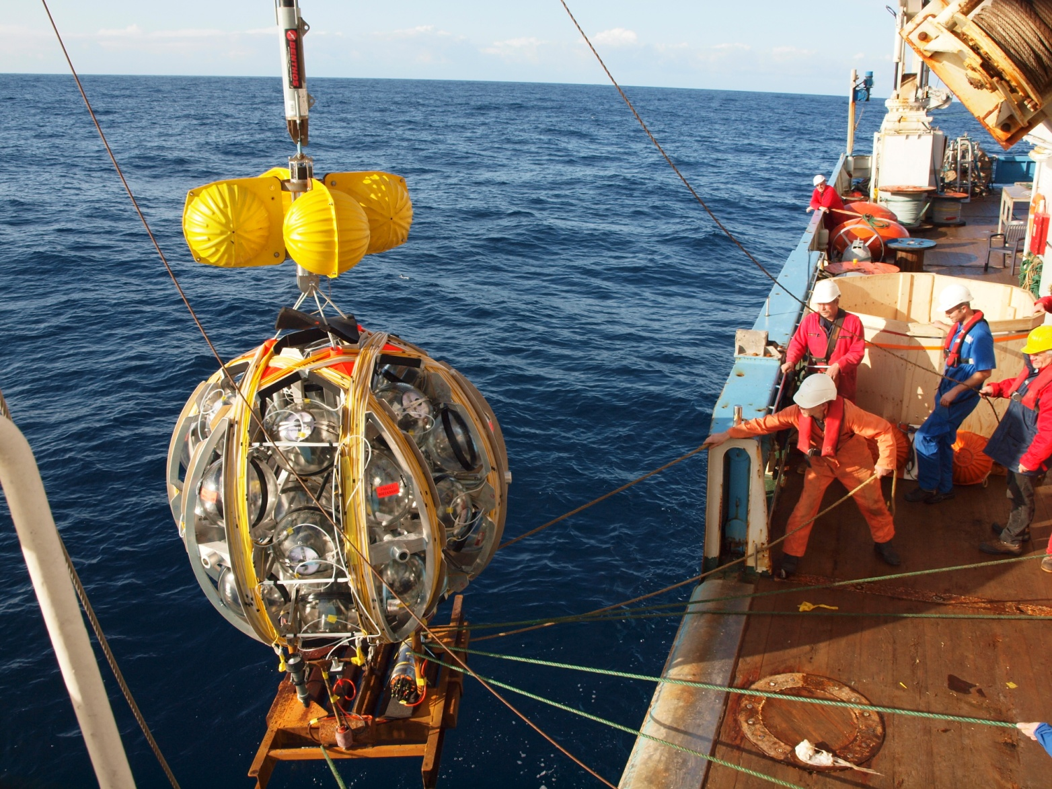
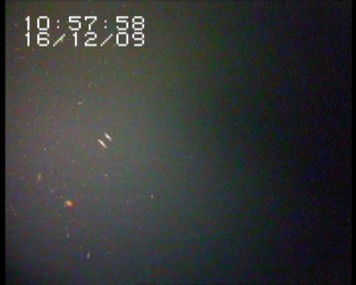
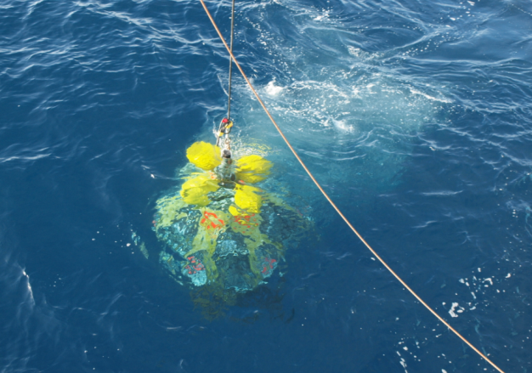
Deployment
16-12-2009
Pylos
850 m depth
Release 1
Buoyancy for release
Release 2 hook
Anchor

Slide 9

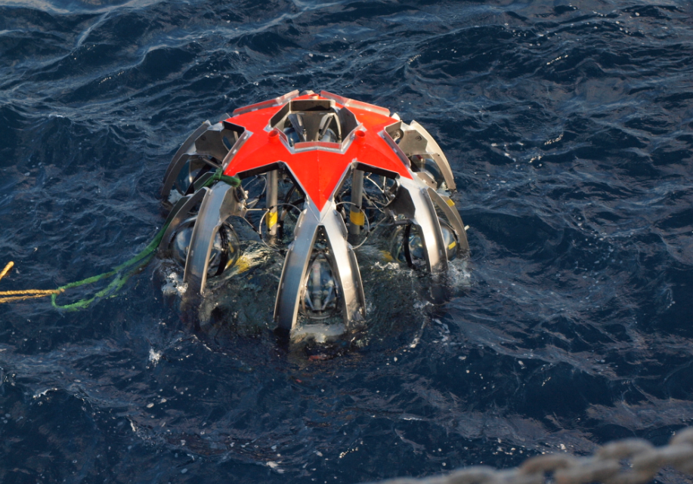
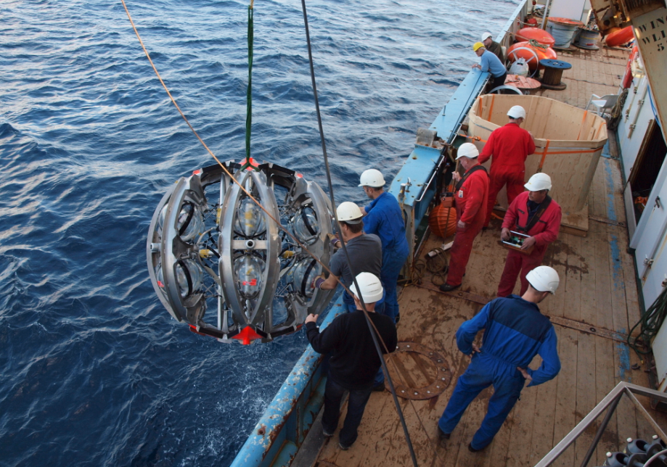
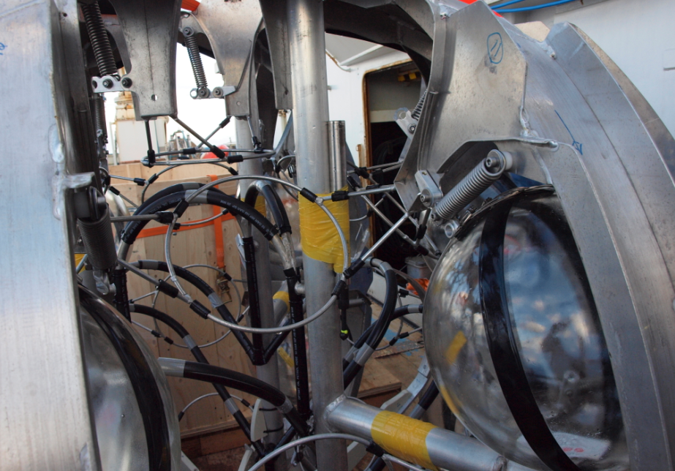
Recovery of LOM-frame
16-12-2009
Pylos
850 m depth

Slide 10
~8 km³
640 slender strings
12800 optical modules
200-250 MEuro
Buoy
OM
OM
Oil filled flexible vertical e/o cable
OM
10 kV / 400V
OM
OM
Junction box
Branch cable network on the seabed

Slide 11
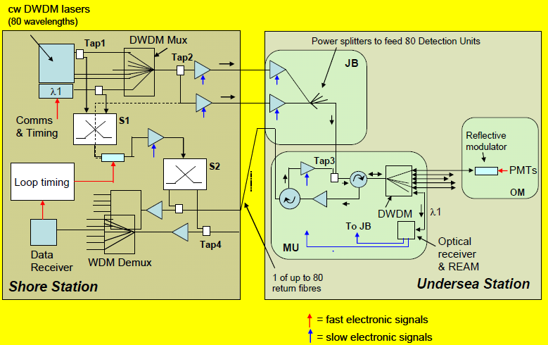
Sensor architecture

Slide 12
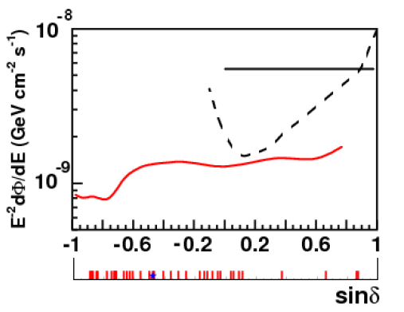
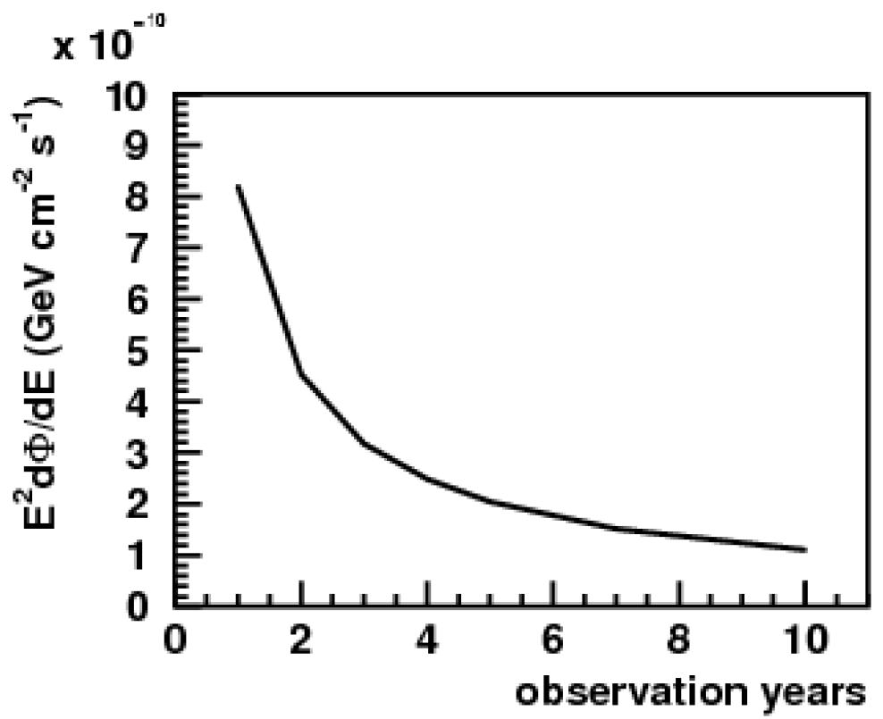
KM3NeT sensitivity
IceCube
10⁻⁹
10⁻¹⁰
2
4
6
8
10
Galactic sources
observation time [years]

Slide 13
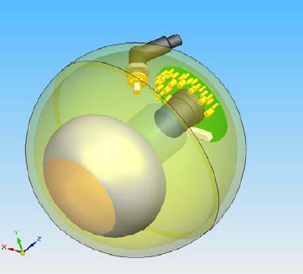
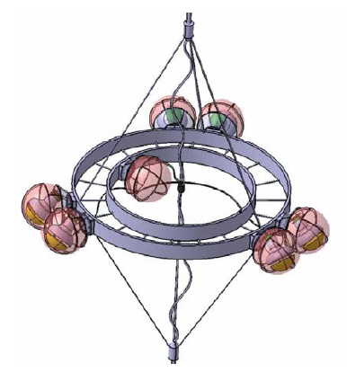
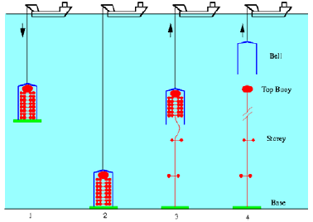


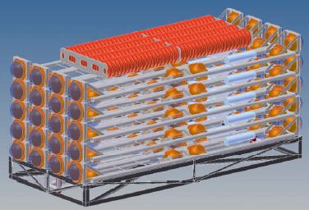
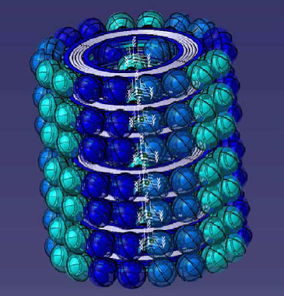
Alternatives
+ separate electronics container
6 m
2.5 m

Slide 14
KM3NeT TDR
Point-to-point optical network accepted
Multi-PMT optical module needs further tests
Both DU-designs need further tests:
  deployment, stability after deployment
Decisions ultimately end 2011
Final prototyping in 2012
Construction starts in 2013

Slide 15
At Nikhef for KM3NeT
2010
Improvement simulation/reconstruction software for string design; foot print of detector
Prototype optical 10 Gb/s point-to-point network
Development board for interface to network
Development of flexible oil-filled vertical e/o cable
Prototype of Multi-PMT optical module
Together with NIOZ: development of launcher for deployment
Design of assembly procedure + tooling + test setups for Multi-PMT optical module

Slide 16

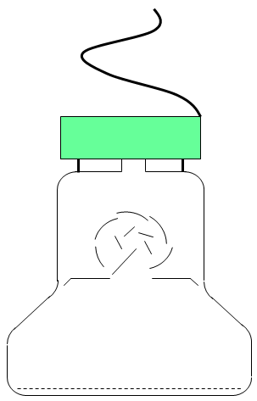

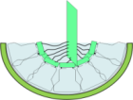

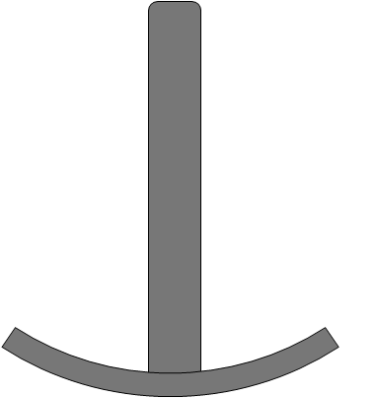
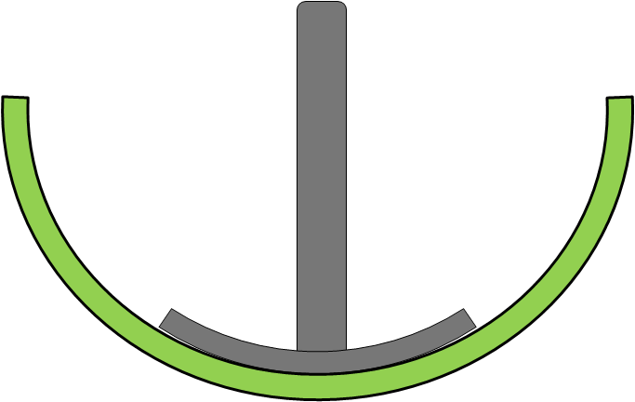
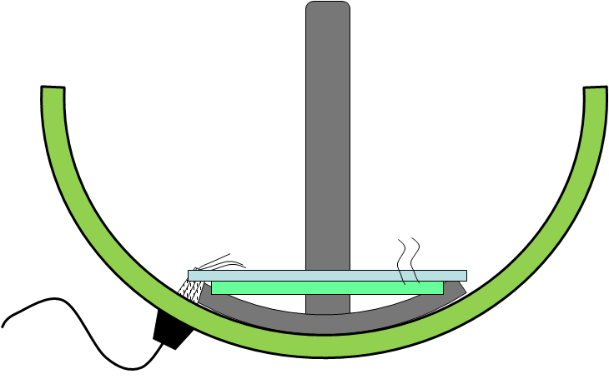
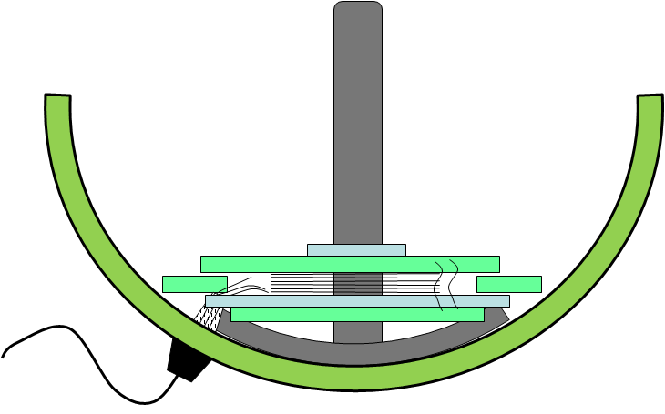
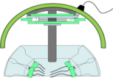



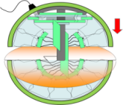
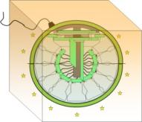
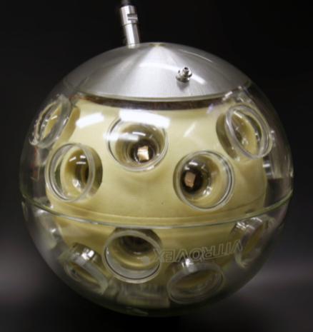
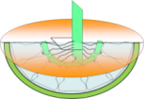
Assembly of Multi-PMT OM
  Tooling for handling of glass spheres
  Test setups for PMTs
  Dark room/boxes
  (Cleanish) room for parallel assembly lines
  Storage room
1. lower hemisphere
go / nogo
test
add
optical gel
1.1
1.2
1.3
1.4
1.5
1.6
1.7
2. upper hemisphere
A
glue
go / nogo
test
2.1
2.2
2.3
2.4
2.5
2.6
go / nogo
test
add
optical gel
2.7
2.8
2.9
2.10
2.11
2.12
2.13
B
3. closing the sphere
B
Test station
N flushing
Press. Validation
e/o validation
Burn in
A
storage
3.1
3.2
3.3
3.4
3.5
3.6

Slide 17
At Nikhef for KM3NeT
2011-2012
Prototype optical network
Prototype slender string
Development of assembly line + test setups for optical modules and detection units
Depending on KM3NeT decisions (external review):
Production preparation for slender string:
  multi-PMT optical module
  vertical e/o cable

Slide 18
Nikhef for KM3NeT
2013 - 2017
Construction:
optical network electronics
assembly of optical modules and electronics
assembly of detection units

Slide 20
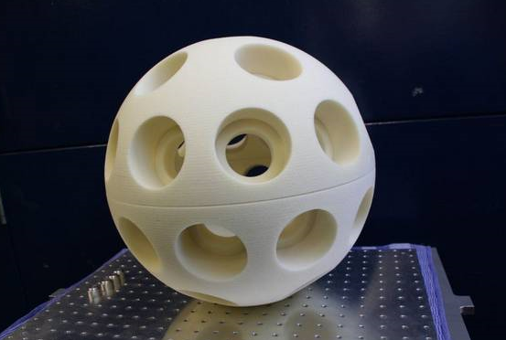
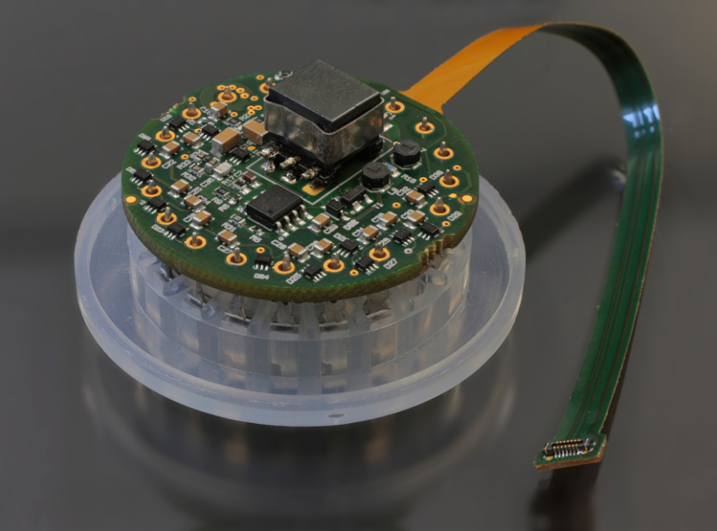
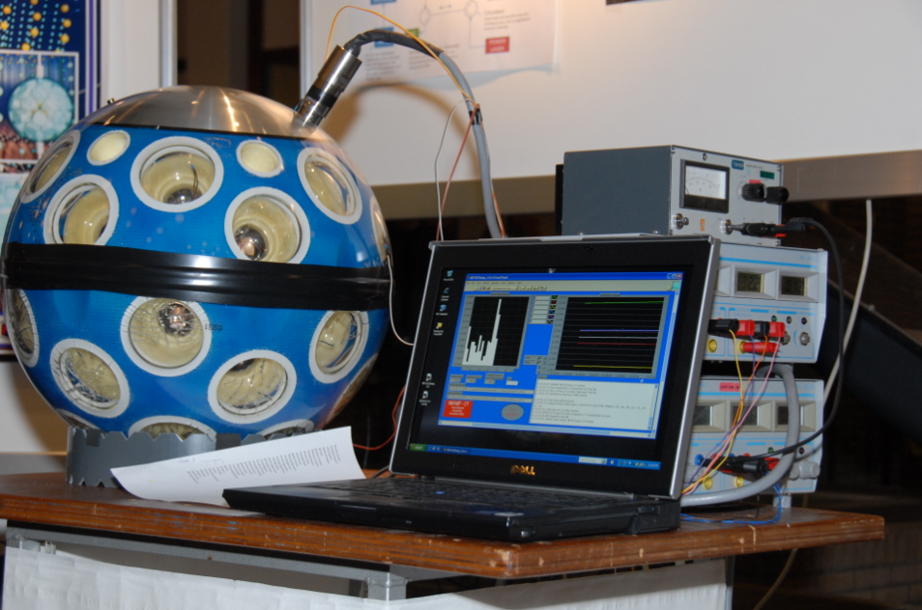
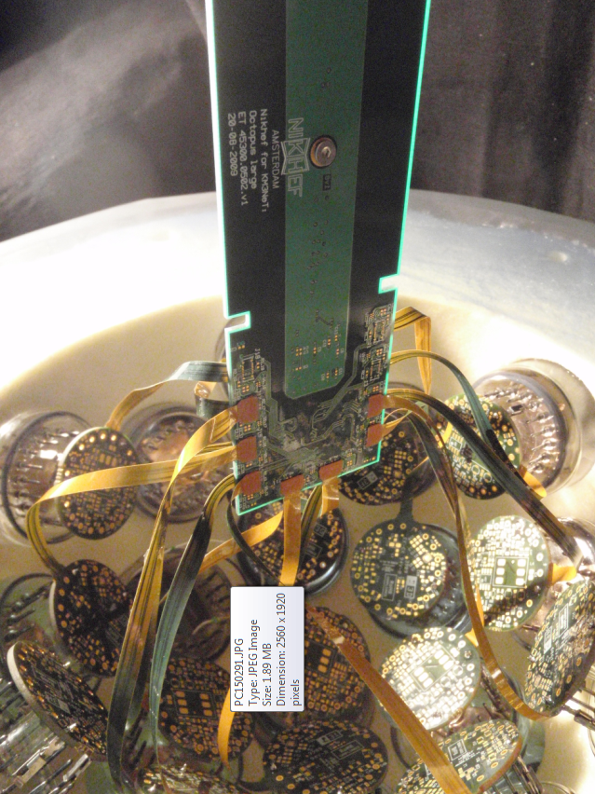

Multi-PMT Optical Module

Slide 21
KM3NeT PP
Nikhef+Saclay coordinate prototyping and design of assembly/integration lines
Specific coordination tasks Nikhef:
  Optical Module
  Design Assembly lines

