Slide 1
Optical Module in NEMO Phase-2
ISEG
TIM-CAL
A glass sphere 13” (Vitrovex):
Single large area photomultiplier : Hamamatsu 10” PMT R7081
Optical gel : Waker SilGel 612
μ-metal wire cage
PMT base circuit : ISEG PHQ7081-i-2m modified
FEM (Front End Module) electronic board
System for timing calibration (TIM-CAL)
FEM
13” OM sketch: lateral view

Slide 2
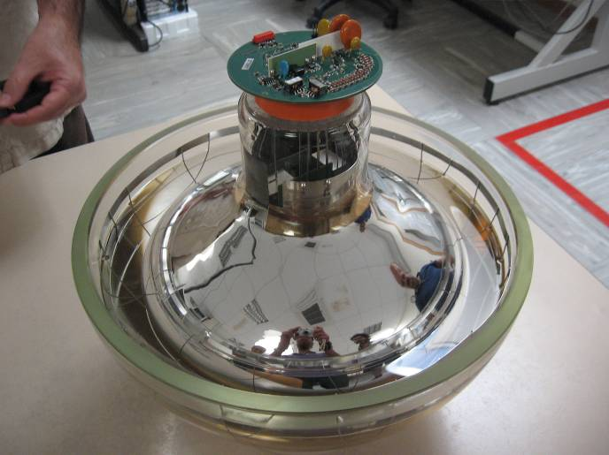
Assembled OM
Picture of an assembled hemisphere: glass, PMT, Gel, mu-metal cage, ISEG

Slide 3
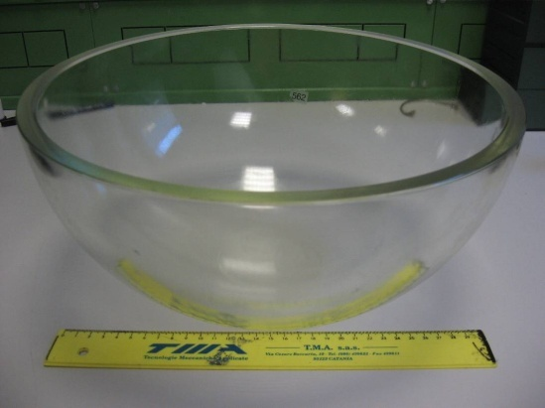
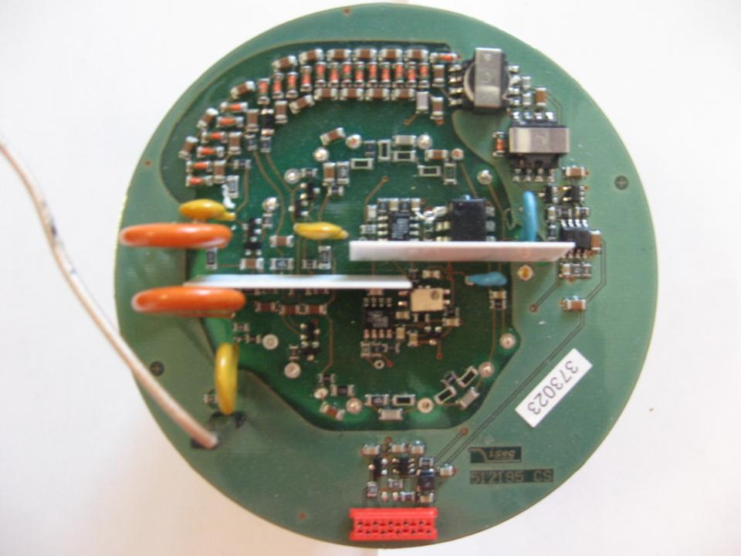
Glass sphere
standard 13 inches deep-sea instrumentation vessels in borosilicate glass, produced by Vitrovex
two half spheres: ½ transparent, ½ painted black
no vacuum valve
unique penetration for the 12-pin connector
Refractive index | 1.48 (>350 nm)
Transmission | >95% (>350 nm)
Density at 20 ⁰C | 2.23 g cm⁻³
Thermal conductivity | 1.2 W m⁻¹K⁻¹
Characteristics of 13 inches spheres
Depth rating (m) | 10000
Overall diameter (mm) | 330
Wall thickness (mm) | 11
Mass (kg) | 7.89
Buoyancy (empty) (N) | 114
Diameter shrinkage per 1000m depth (mm) | 0.30
Active base
+5 Volts supply (bipolar voltage supply before modification)
Cathode-1^dynode and 1^dynode-anode voltages individually controllable
Anode current max : 100 microAmpere
Power consumption : 150mW @ 2000 Volts

Slide 4
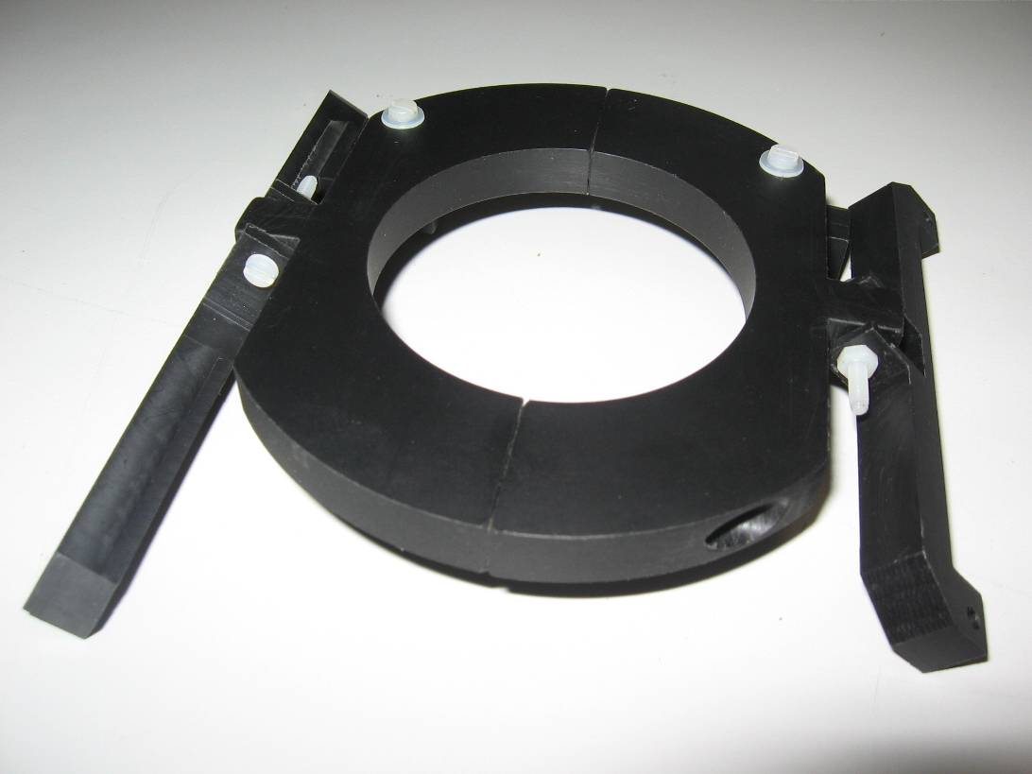
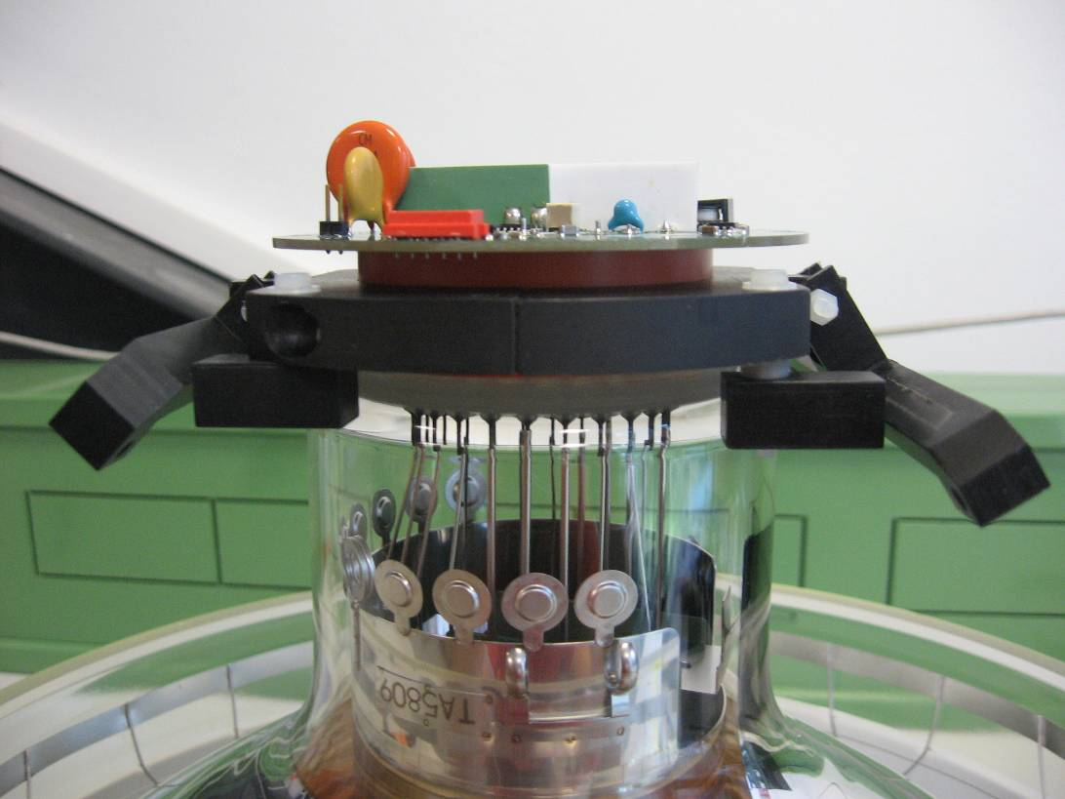
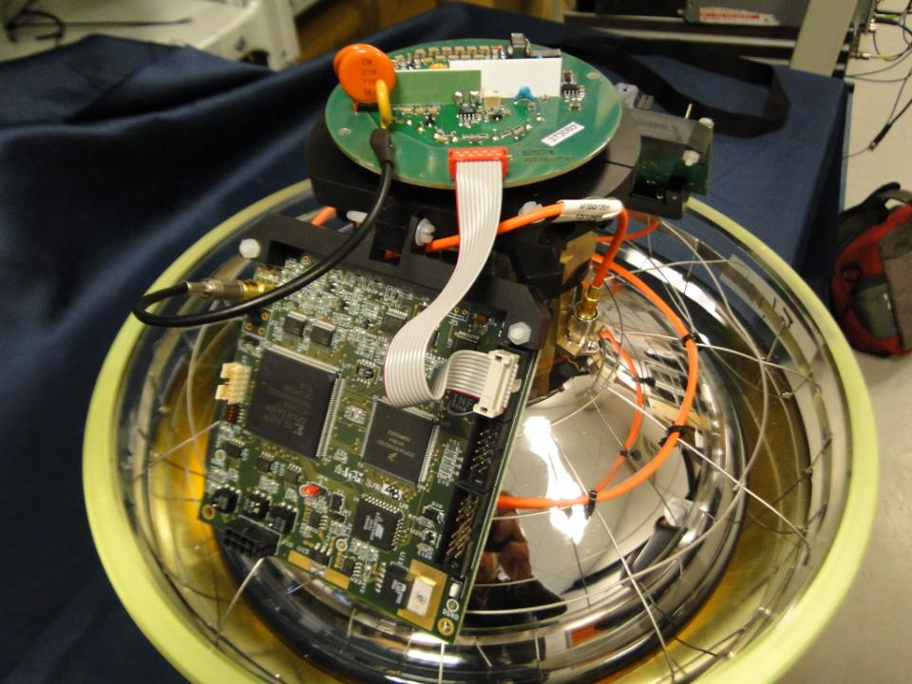
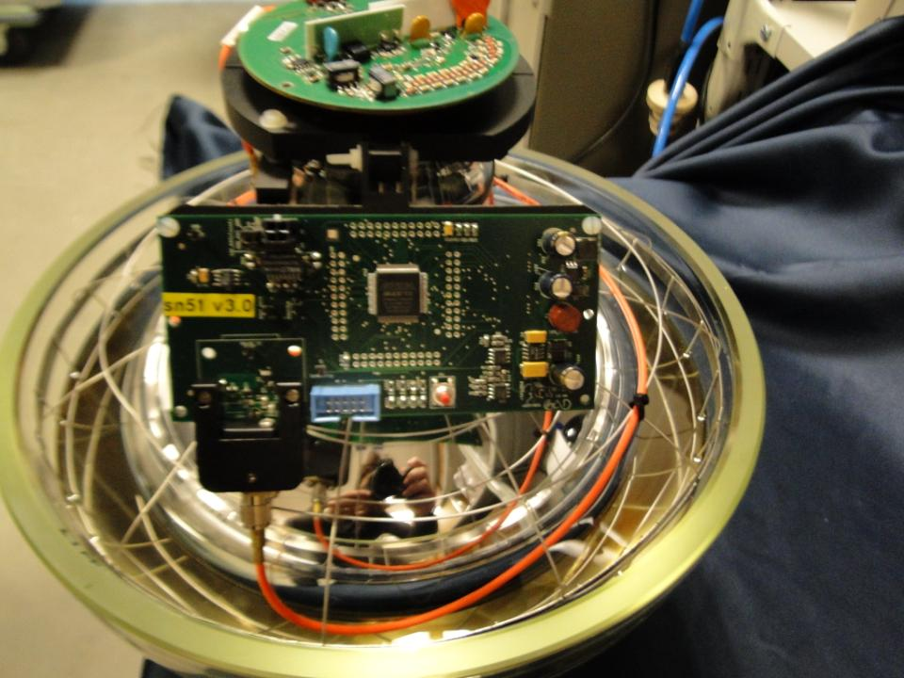
Mechanical support for FEM electronic board and TIM-CAL
The mounted FEM
The mounted TIM-CAL

Slide 5
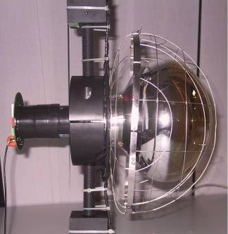
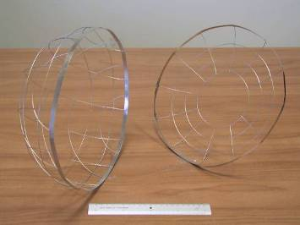
Magnetic shield
A cage of mu-metal wire was chosen as magnetic shield (ITEP, Moscow):
a hemispherical part ( 30 cm diameter, 14 cm height)
a flat part (30 cm diameter ) with a hole in its centre ( 12 cm diam.)
wire of 1 mm of diameter
pitch of 68 x 68 mm
shadow on the photocathode ≈ 5%
average shielding factor measured ≈ 4
Picture of the parts of the cage
The cage around the 10” PMT

Slide 6
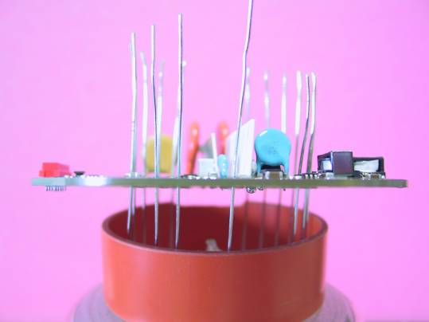
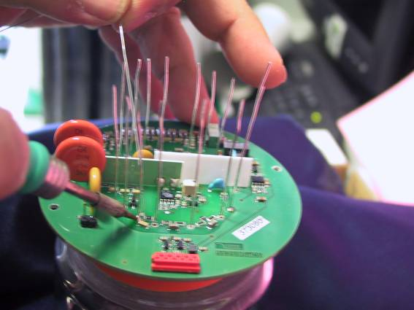
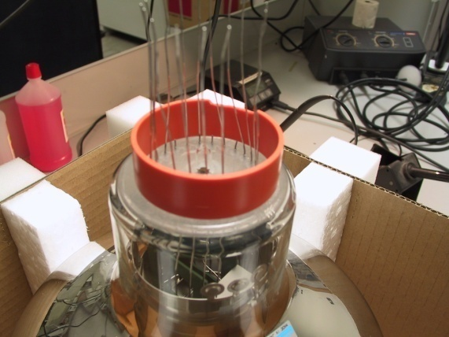
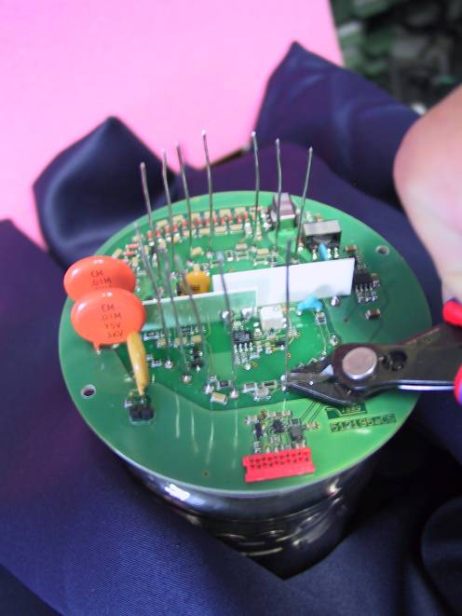
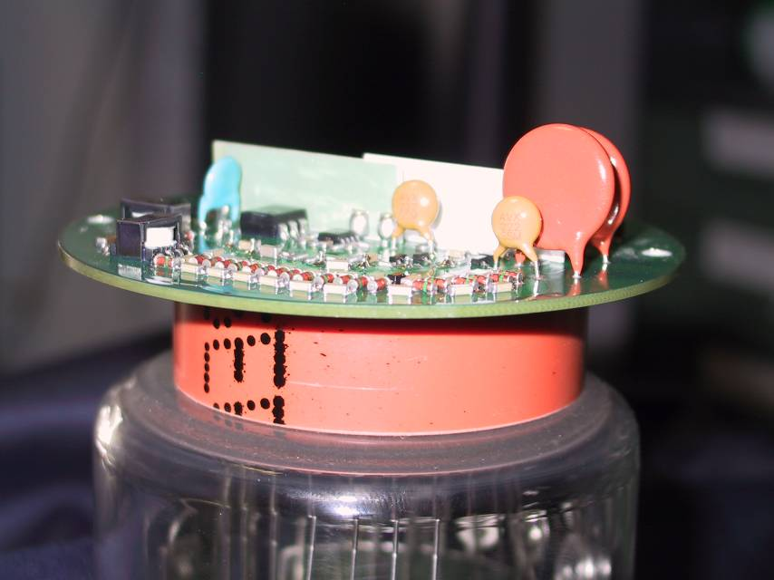
OM assembly procedure: base soldering
Soldering of the ISEG base on the PMT
Base soldering
Mechanical Frame
Base positioning
Wires cut off
The end

Slide 7
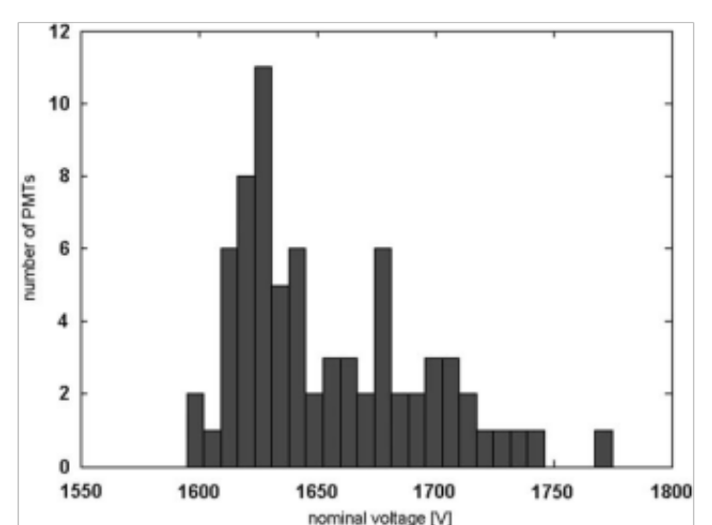
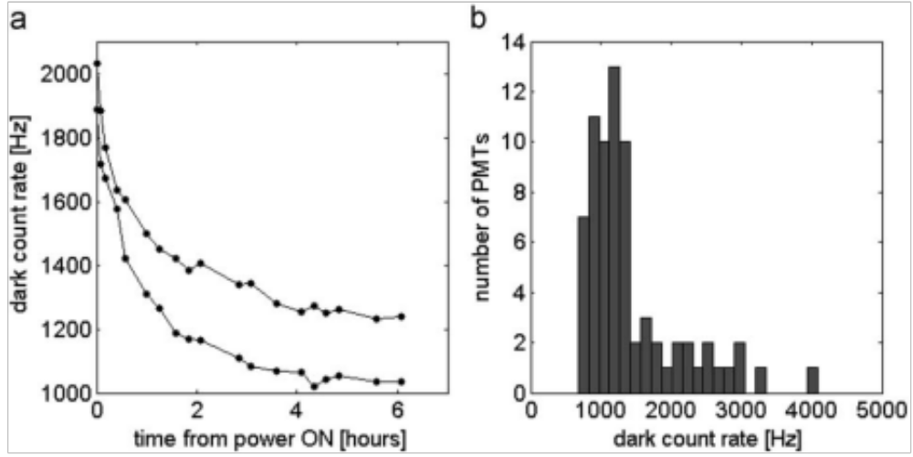
Spurious pulse
Pre-pulses appear in the 10–80 ns interval time before the main pulse and take the place of the main pulse. They arise from a direct photo-effect on the first dynode due to the photons which pass the photocathode without photoelectron conversion.
Late pulses appear in the 10–80 ns interval time after the main pulse and take the place of main pulse. They are caused by backscattered photoelectrons from the first dynode.
Type 1 after pulses appear in the 10–80 ns interval time after the main pulse, in the wake of the main pulse. They are produced by a luminous reaction on the electrodes bombarded by the electrons.
Type 2 after pulses arrive in the 80 ns–16μs interval time after the main pulse, in the wake of the main pulse. They are caused by the ionization of residual gases left or formed inside the PMT. These gas atoms can be ionized by electrons and, since they are of opposite charge, will accelerate back towards the photocathode where they can produce further photoelectrons. Common ions are H2+ , He+ , CH4+ , and Cs+.
G=5.10⁷

Slide 8
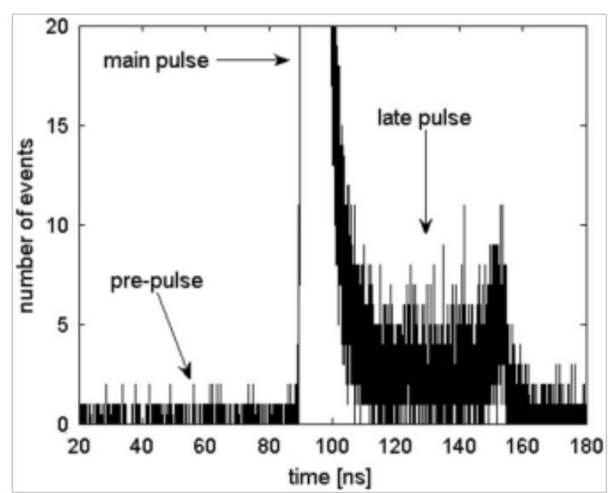
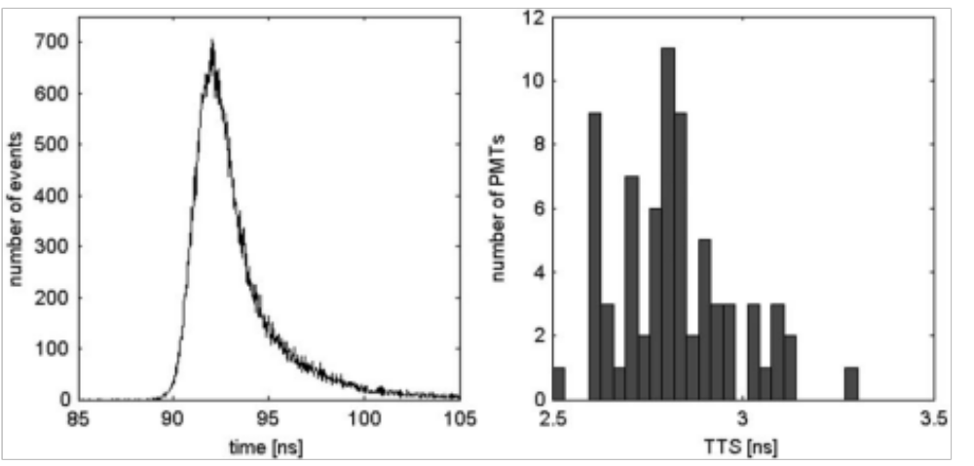
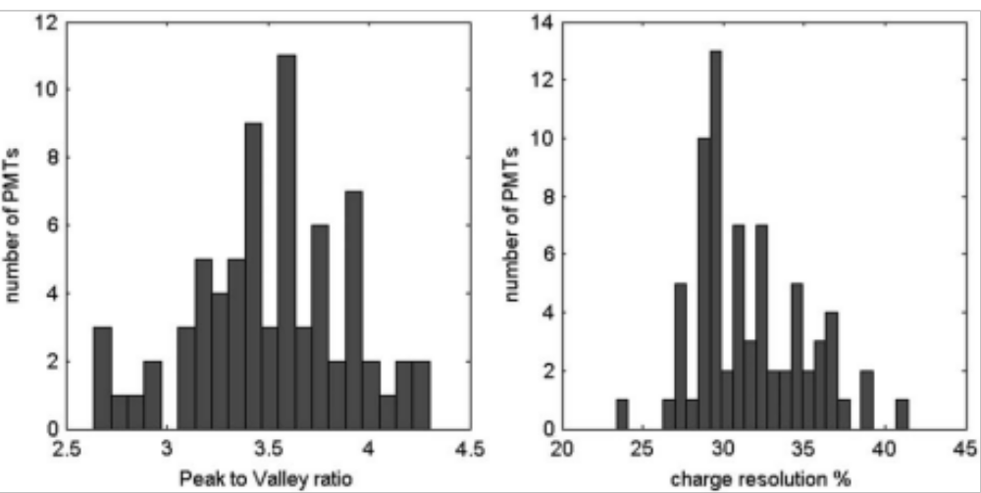
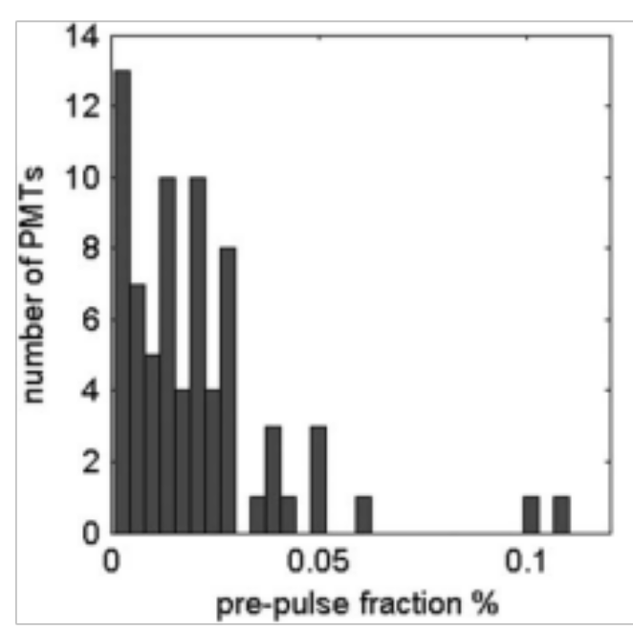

Slide 9
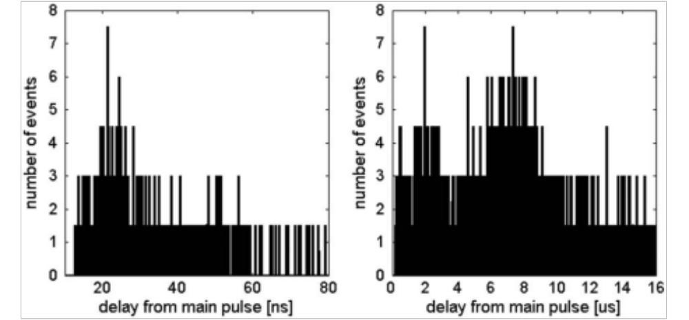
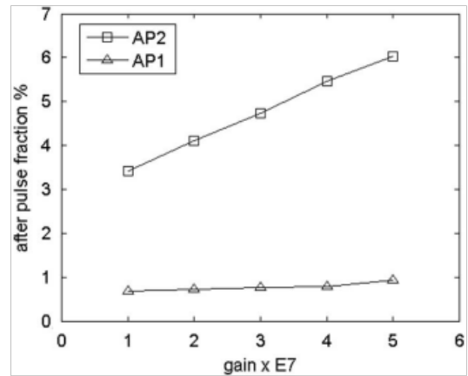
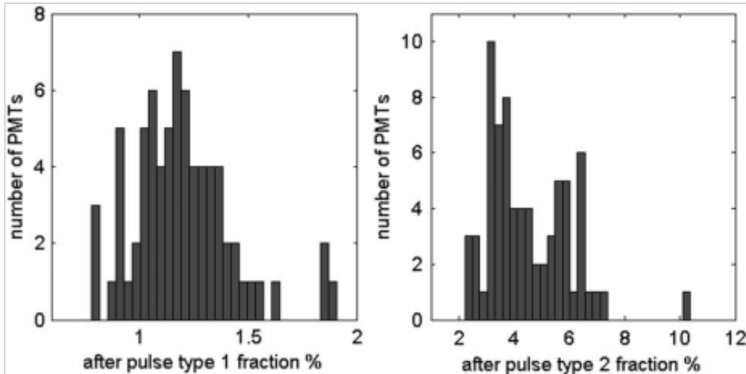
Afterpulses

Slide 10
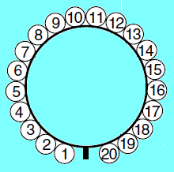
Measurements of the effects of the Earth’s magnetic field
Every PMTs was measured in 3 inclinations:
- vertical downwards ( Tilt = 0° ) ; 50° downwards ( Tilt = 50° ); horizontal ( Tilt = 90° )
Vertical position
Tilt : 0°
Tilt : 50°
Horizontal position
Tilt : 90°
Z
Vertical
axes
Z
Z
Vertical
axes
Vertical axes
Tilt
90°
90°
90°
180°
North
180°
North
North
0°
Horizontal
angles
0°
Horizontal
angles
180°
0°
Horizontal angles
270°
270°
270°
NORTH
0°
Top view
For each inclination, the PMT under test was rotated 360° around its vertical axis in 30° steps
Each PMT started its rotation from the same position with respect to the box and to the Earth’s magnetic field
Dy 1
Dy 2
90°
270°
PMT downwards
180°
Starting position for each PMT

Slide 11
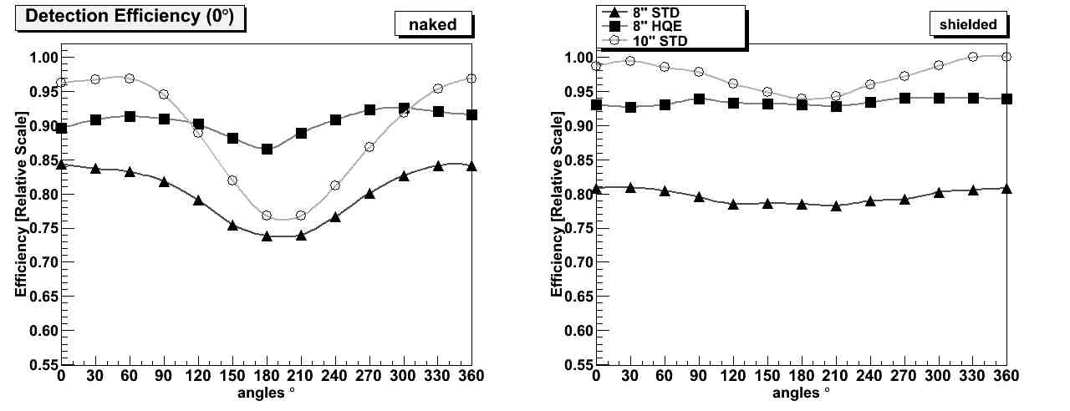
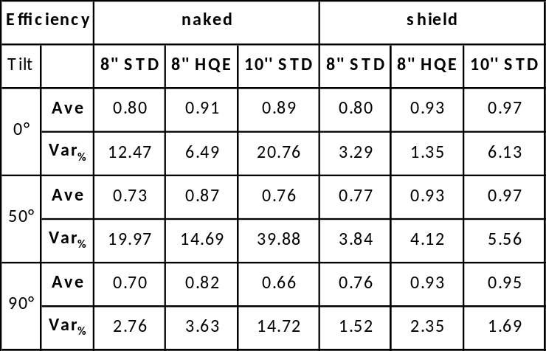


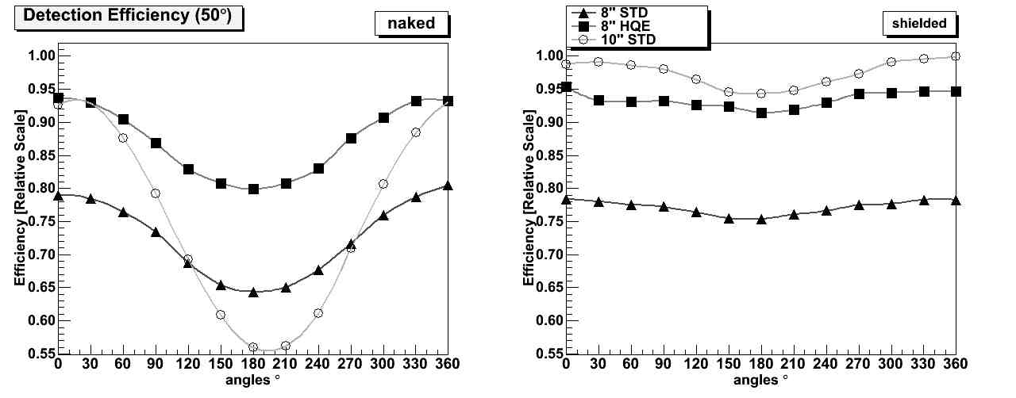
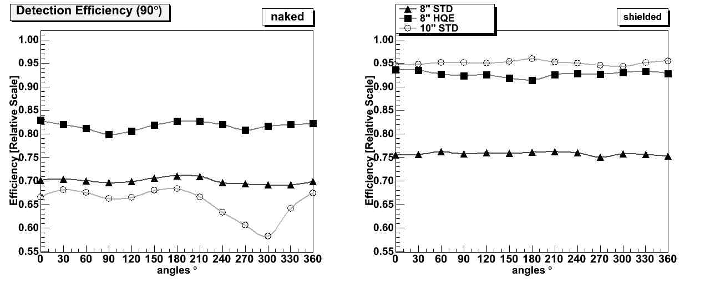
0°
0°
Detection efficiency
50°
50°
In naked 8” PMTs the impact of the magnetic field was smaller than naked 10”
The shield reduced considerably the variations for the 10” PMT
The increased QE in the HQE 8” PMT compensates the smaller detection area respect to the 10”
90°
90°
NAKED SHIELDED

Slide 12
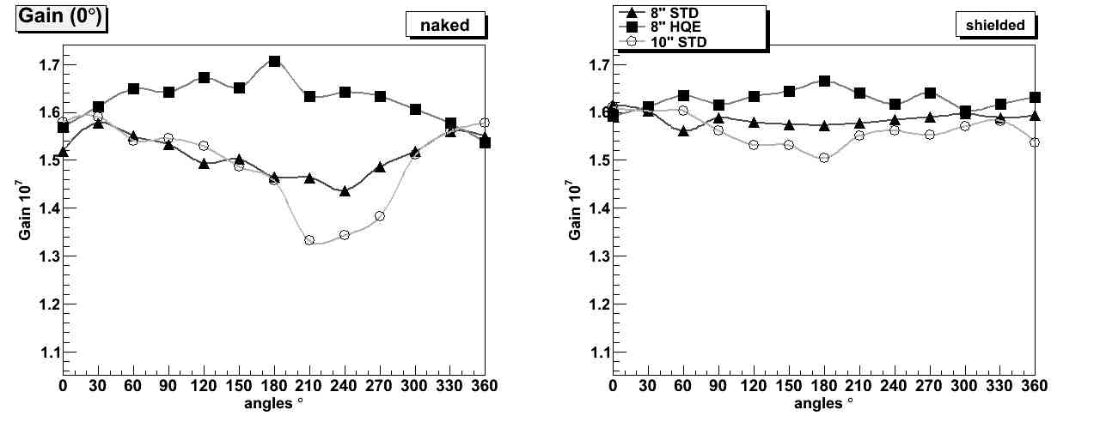
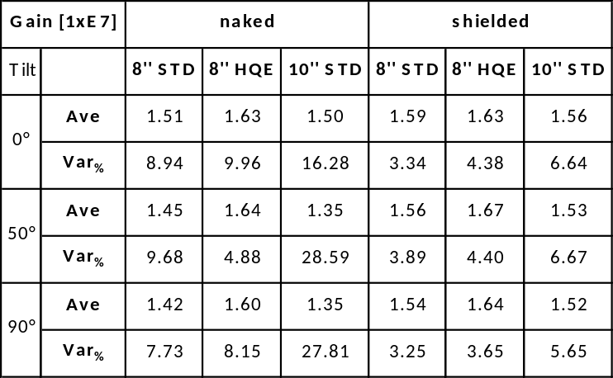
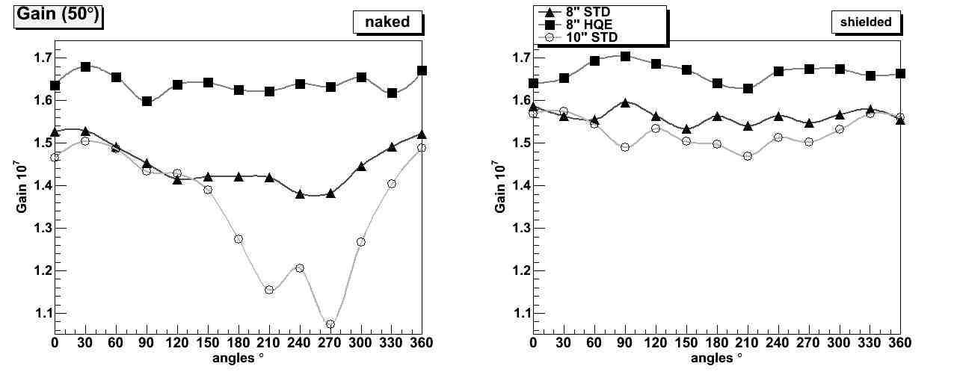
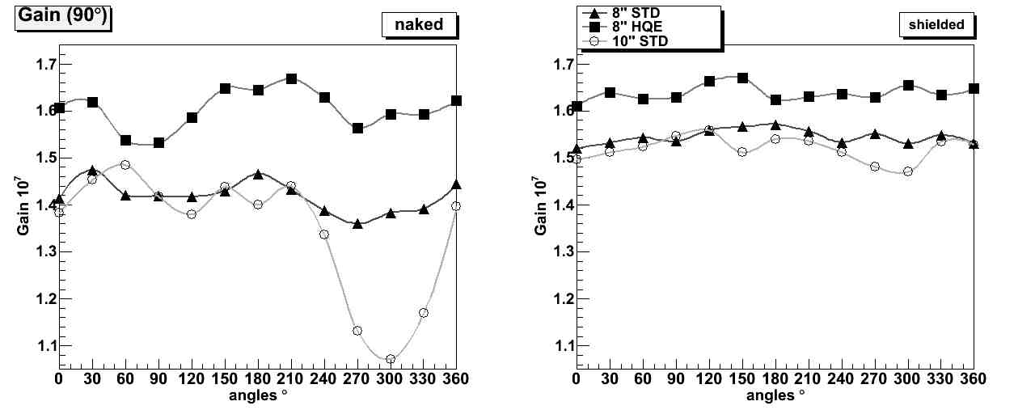
Gain
Greatest gain variation was less than 10% for both the naked 8”
Considerable variations in the 10” PMT naked, up to 29%
The shield reduces variations in both the 8” PMTs, with variations less than 4.4 %
The shield reduces strongly the variations in the 10” PMT, with variation less than 7%
NAKED SHIELDED

Slide 13
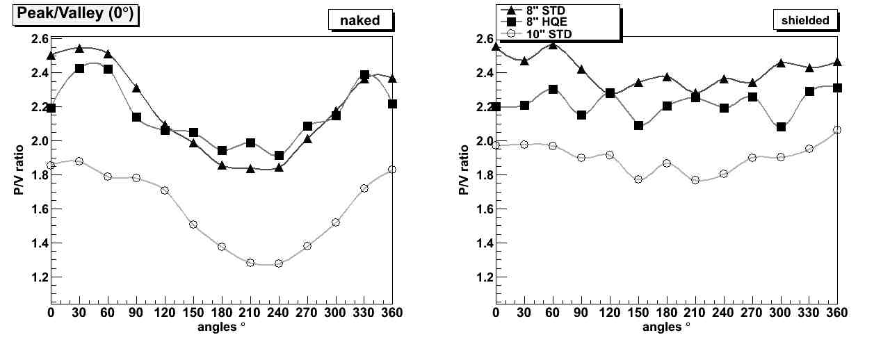
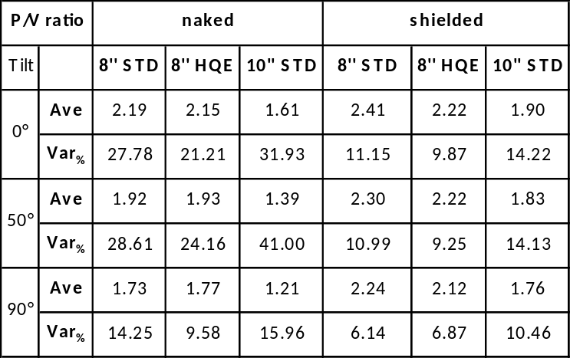
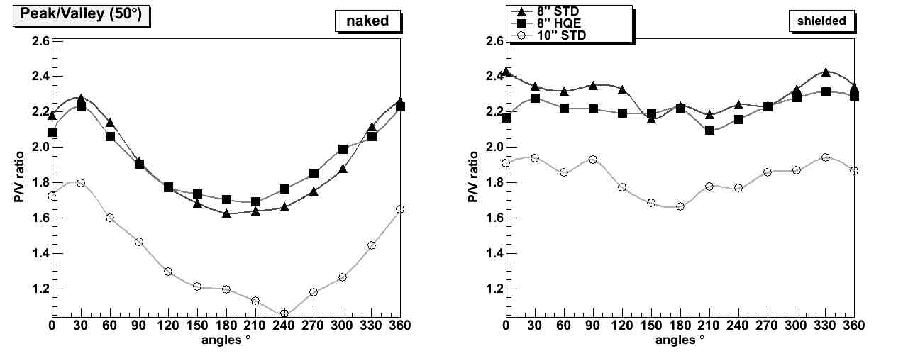
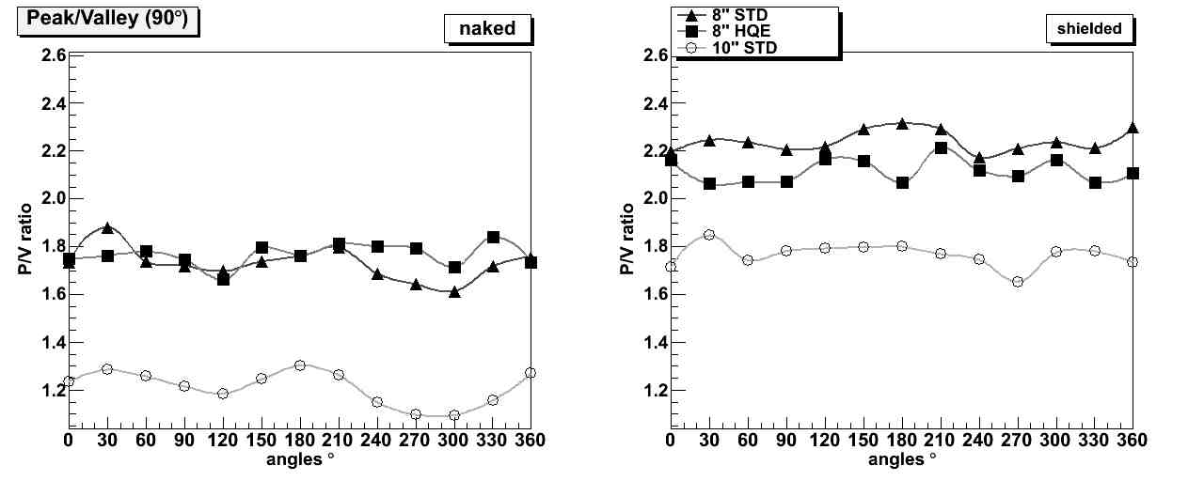
Peak to Valley ratio
Considerable variations for all the un-shielded PMTs
Great reductions in variation by using the magnetic shield
Small improvements in average values with the magnetic shield
NAKED SHIELDED

Slide 14
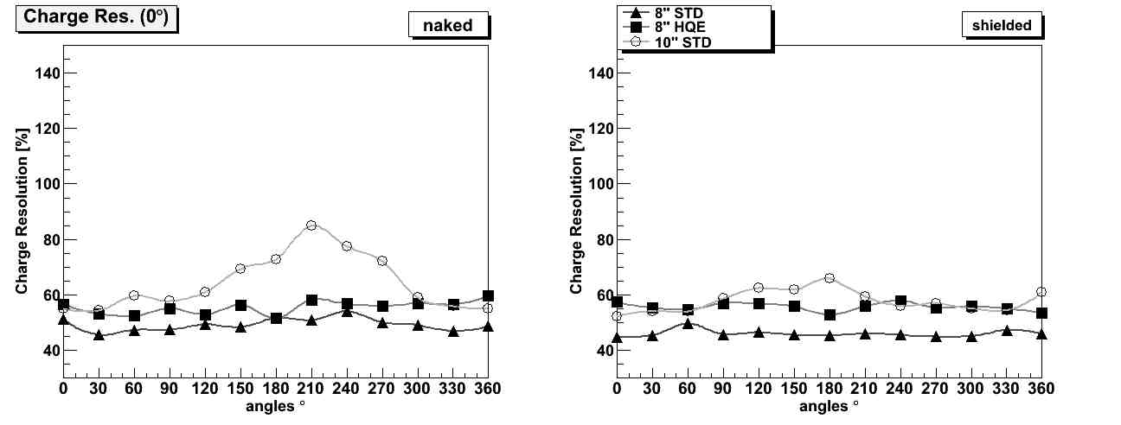
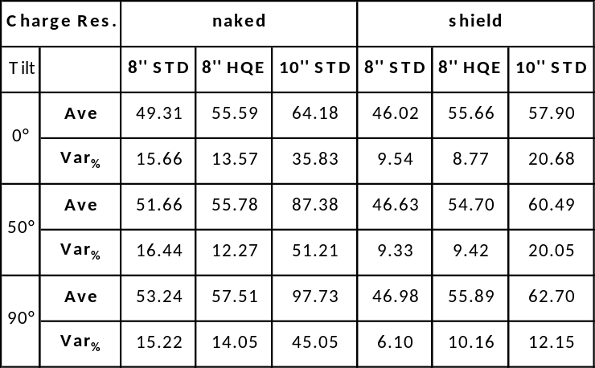
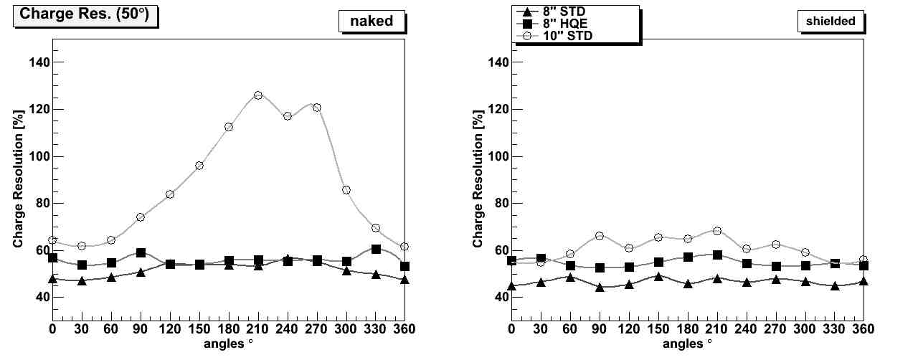
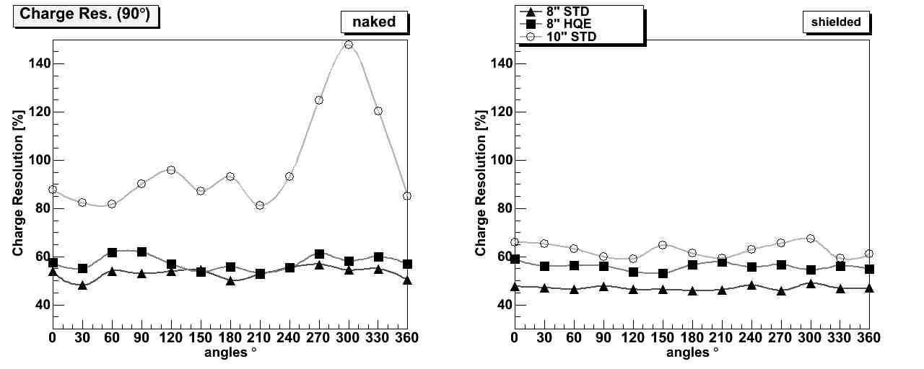
Charge Resolution (sigma)
Large effects of magnetic field for the unshielded 10” PMT
The mu-metal cage greatly reduced the variation in 10” PMT
No large effects due to the magnetic field for 8” PMTs.
The mu-metal cage reduced variations for both 8” PMTs
NAKED SHIELDED

Slide 15
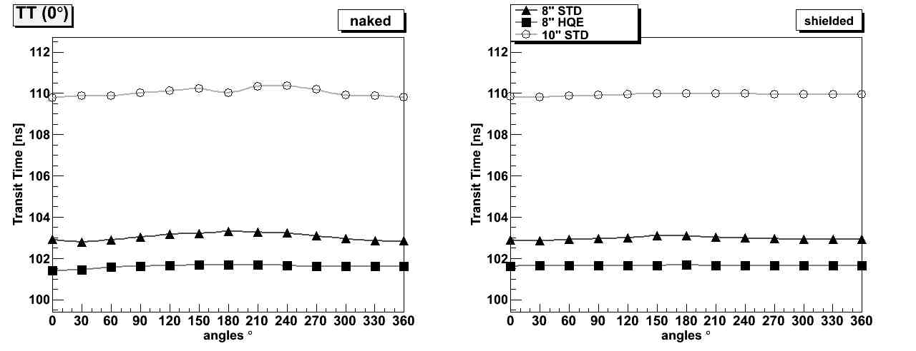
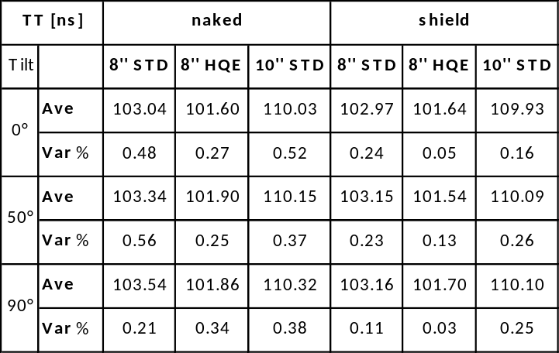
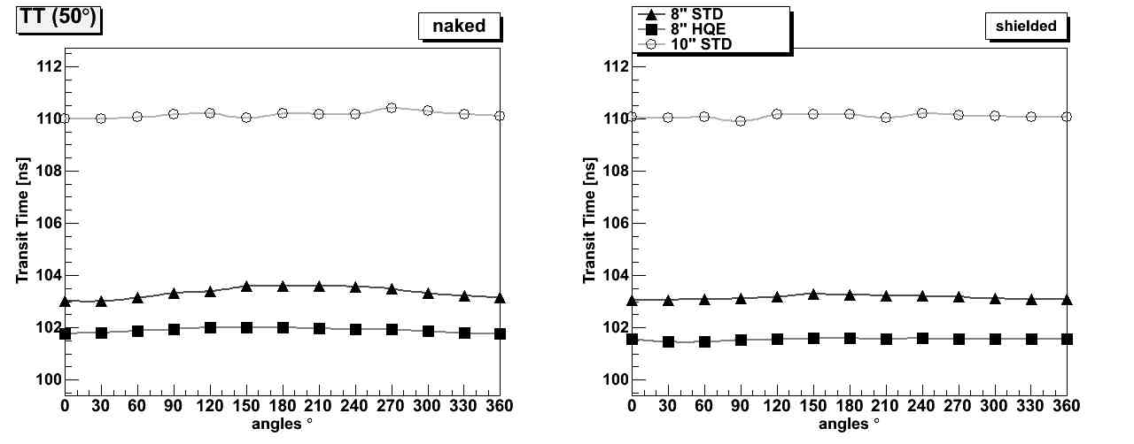
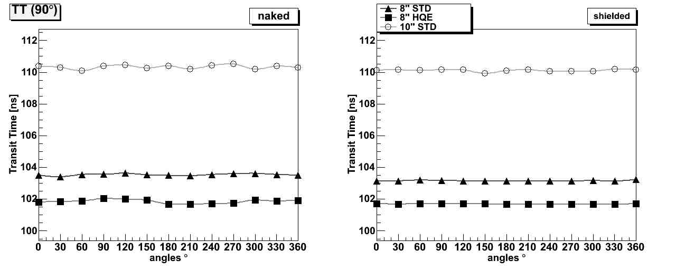
TT
No significant variations due to magnetic field for all the PMTs
No considerable effects of the mu-metal cage
Difference in average value due to the different size between 8” and 10” PMT
NAKED SHIELDED

Slide 16
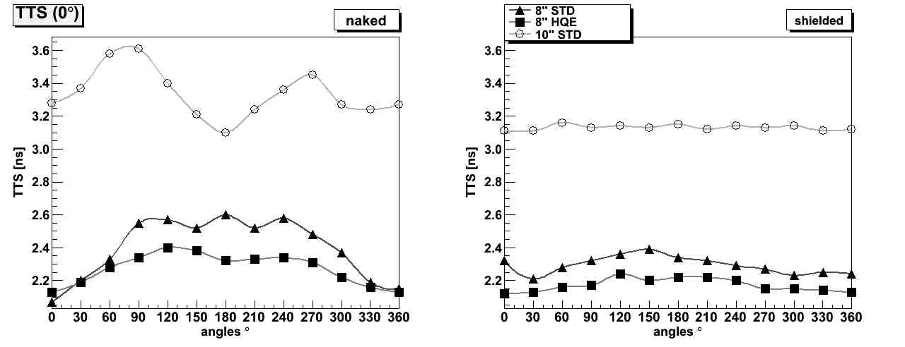
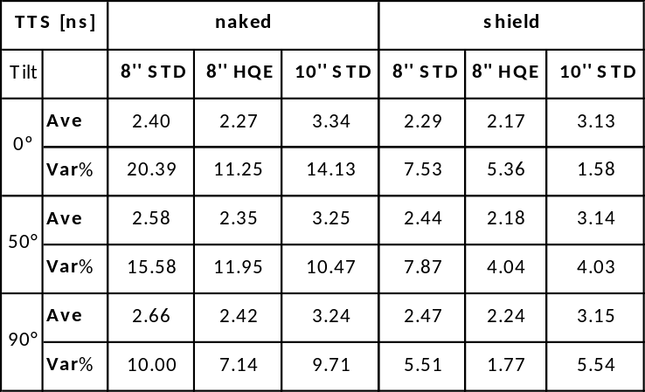
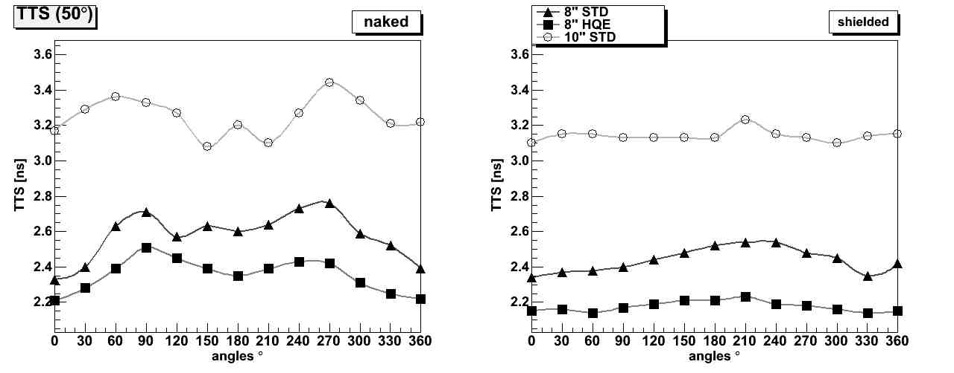
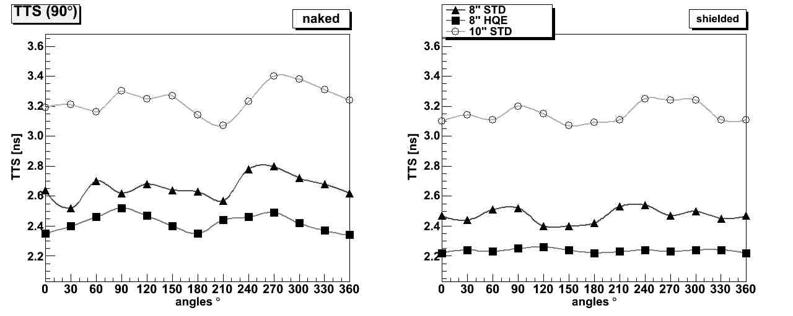
TTS
Variations over the 10% in all the un-shielded PMTs
Considerable reduction in variations with the magnetic shield
No significant improvement in average values with magnetic shield
NAKED SHIELDED

Slide 17
The segmentation of the detection area in the DOM will aid in distinguishing single-photon from multi-photon hits. Moreover, two-photon hits can be unambiguously recognised if the two photons are registered in separate tubes.

Slide 18
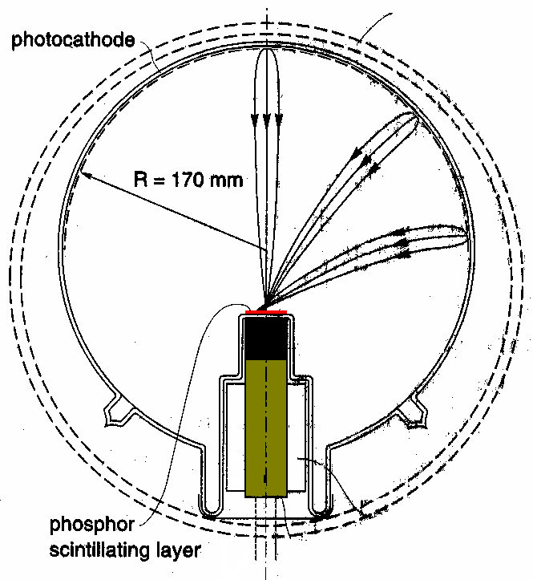
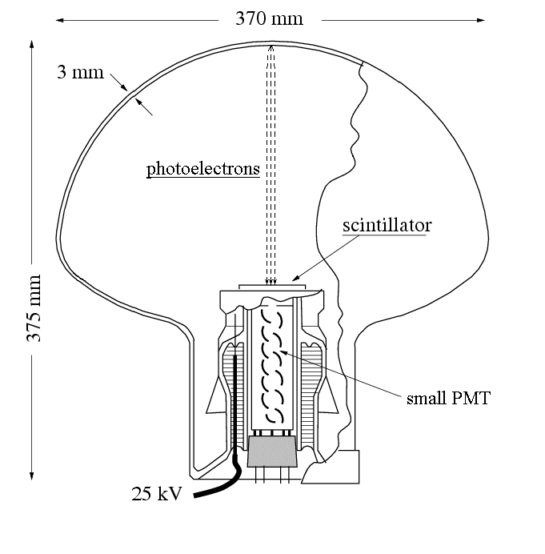
MOTIVATION
The segmentation of the detection area in the DOM will aid in distinguishing single-photon from multi-photon hits. Moreover, two-photon hits can be unambiguously recognised if the two photons are registered in separate tubes.
XP2600
QUASAR-370

Slide 19
Quasar-370 phototube has excellent time and
very good single electron resolutions
no prepulses
no late pulses in TTS
low level of afterpulses
~100% effective collection effiency
1 ns TTS (FWHM)
very good SER (competitive to HPD)
immunity to terrestrial magnetic field
>2π sensitivity

Slide 20


Quasar-370LSO with LSO crystal
1996-97, ICRC1997
Single electron resolution ~35%
(fwhm)
Jitter ~ 1 ns (fwhm)
The PMT used in the Quasar-370LSO had ~17% η(eff)

Slide 21


Slide 22



Slide 23

The Digital Optical Module (DOM)
Multi-PMT DOM
31 small PMTs
Almost uniform coverage
Photon counting
Minimize pressure transitions
All electronics inside

Slide 24

Multi-PMT Optical Module for KM3
In Mediterranean sea
31 3” PMTs inside a 17” glass sphere
Cooling shield and stem
First prototype end of 2011
Single vs multi photon hit separation
Larger photocade area per OM
Photon counting useful to:
-reduce background: isotropy of radioactivity
potassium.
-event: directionality
PMT solution: very coarse method to do photon
counting, charge proportional to time over
threshold. Poor time resolution
VSiPMT solution: true photon counting. Good
time resolution
Cerenkov
directional light
Fondo β da K40
Isotropic Cerenkov light
-Photon counting
-Time resolution

Slide 25


Slide 26


75 mm PMT
4 manufacturers
  ETEL ( 25 delivered )
  Hamamatsu ( 10 delivered )
  MELZ ( first prototype expected )
  Zhan Chuang Photonics
High QE (>32%@380nm;>22%@470nm)
Extension to ~90 mm diameter with concentrator ring
ETEL

Slide 27


Slide 28


Expantion cone

Slide 29


Slide 30

Ultima versione PMT

Slide 31

R12199 characteristics

Slide 32


Slide 33


New design HV with <35 mW power consumption
12 PMTs in top
19 PMTs in bottom
Front matched to sphere
Supported by foam cores via concentrator ring
Optically coupled with optical gel

Slide 34


Orientation of PMT’s. The
positive axis points upward

Slide 35



Slide 36


Power provided by two copper conductor
All data transmission and slow control communication requires a single optical fibre

Slide 37


Slide 38





Slide 39

Power management
Front End
Instrumentation
Data Management

Slide 40


Slide 41

DOM

Slide 42


Slide 43


