Slide 1
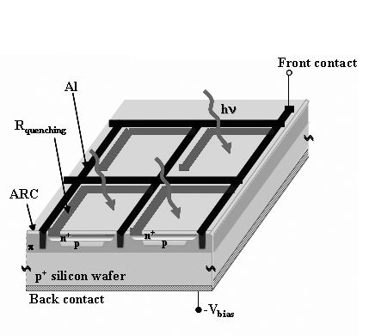
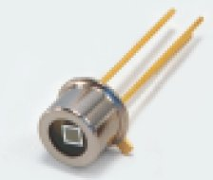
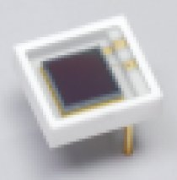
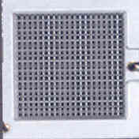
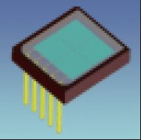
new
APD in regime Geiger/SiPM
luce
4/2007
1x1 mm
1600 celle
Molte celle Geiger con amplificazione
10⁵-10⁶. Luce proporzionale alle celle
accese
1 anno
di
progresso
luce
3x3 mm
14400 celle
1x1 mm²
fino a 1600 celle
si/no
4/2008
6x6 mm
2x2 array

Slide 2
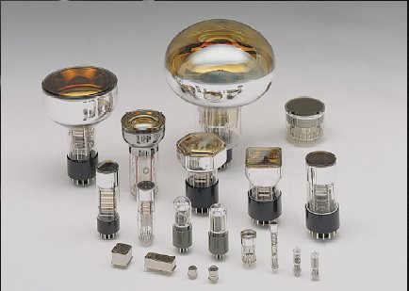
Rivelatori di Luce (oggi)
a
vuoto
Alte
Amplificazioni
10⁶-10⁷
Bassi livelli
di luce
Fotomoltiplicatori
a vuoto
e
fotodiodi
a stato solido
oggi
stessa amplificazione
APD
Geiger
Alte
Amplificazioni
10⁵-10⁶
Bassi livelli
di luce
-OK Gain
-aumentare superficie
attiva
Prestazioni costo
1x1 mm
1600 celle
6x6 mm
2x2 array

Slide 3
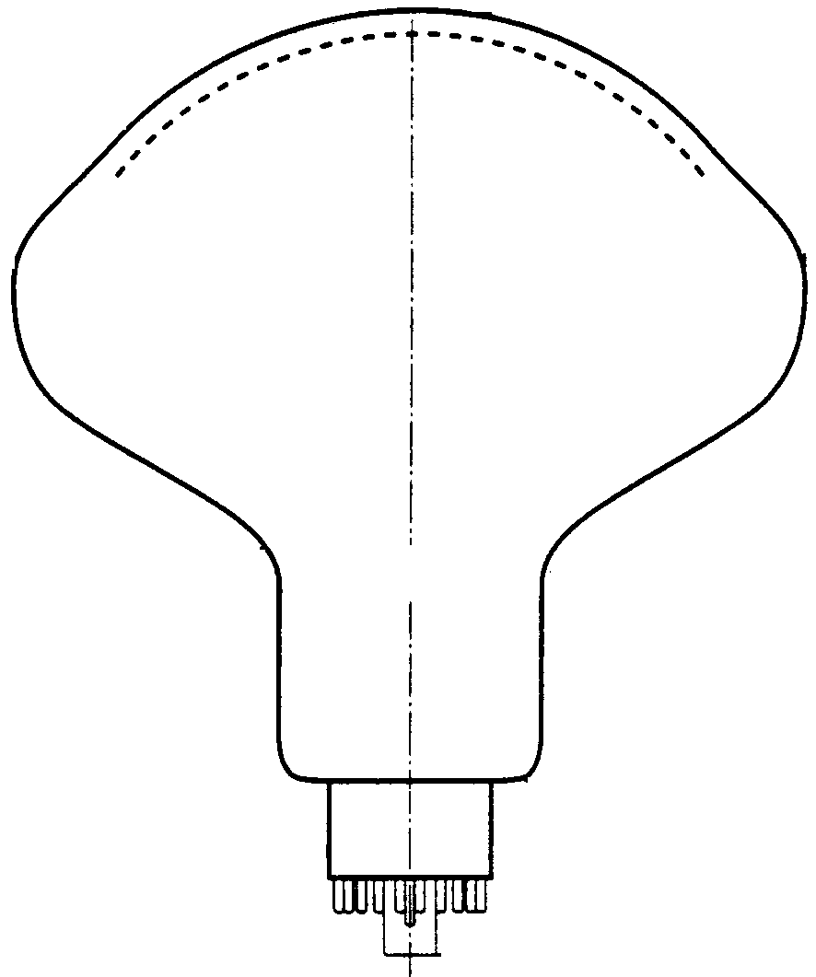

Le due tecniche possono anche convergere
luce
Per concentrare luce da
grandi superfici
corrente
Fotomoltiplicatore
a stato solido
con SiPM
Sez.INFN-Na&Hamamatsu
luce
Amplificazione
corrente
APD Geiger
SiPM
Fotomoltiplicatore
a vuoto
Geiger regions
Amplificazione
out

Slide 4
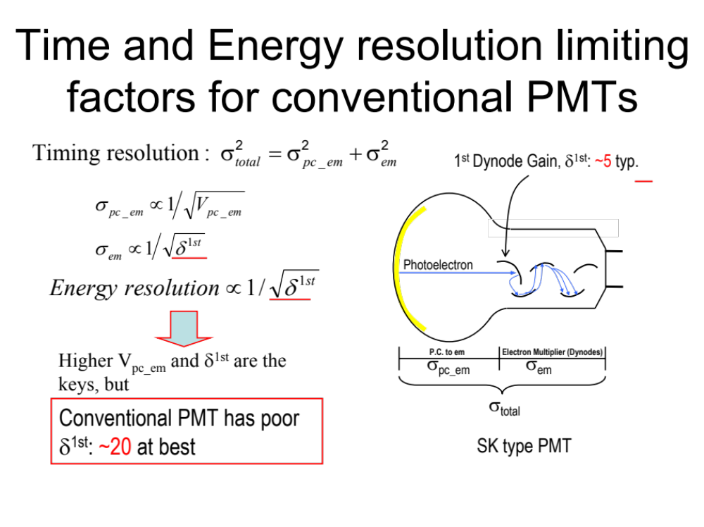

Slide 5
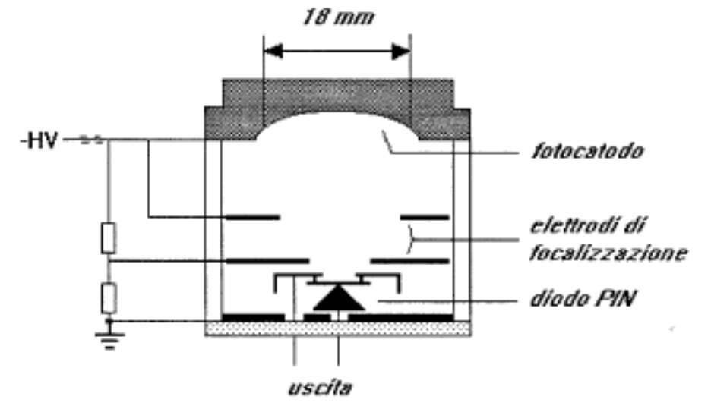
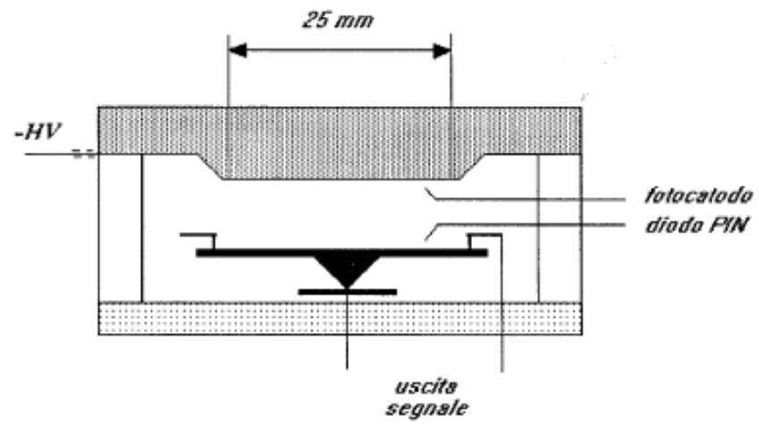
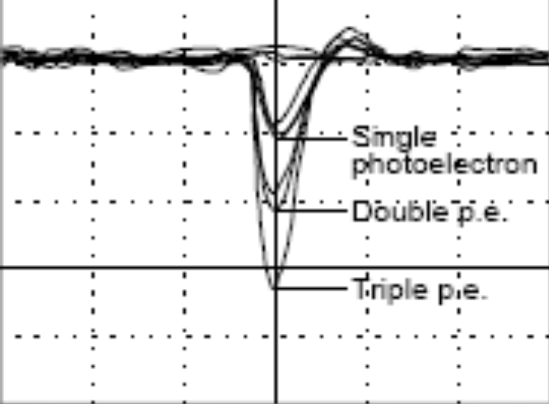
1° applicazione di SI in Hybrid- Photomultiplier HPD
diodo p-i-n
Proximity focused HPD
Electrostatically focused HPD
DEP
V_{k} fino a 15kV
Vbias=100V
G=q(V_{k}-V_{p})/3.6 eV
Con diodo PIN G=3500 a 15kV
Guadagno piu’ stabile, meno fluttuazioni

Slide 6
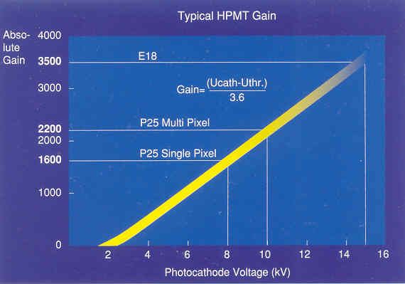
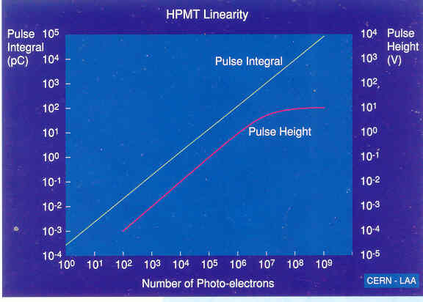
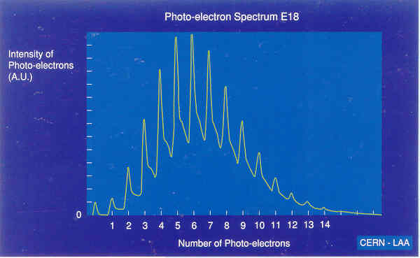
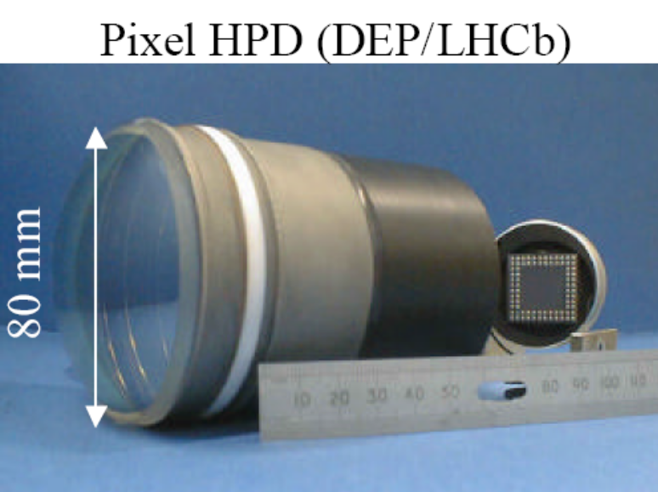
1° applicazione di SI in Hybrid- Photomultiplier HPD
diodo p-i-n

Slide 7
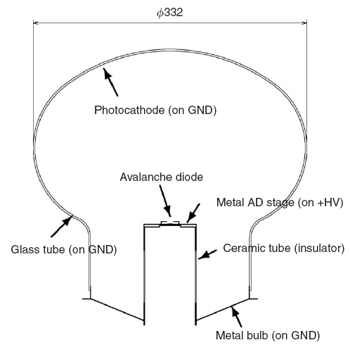
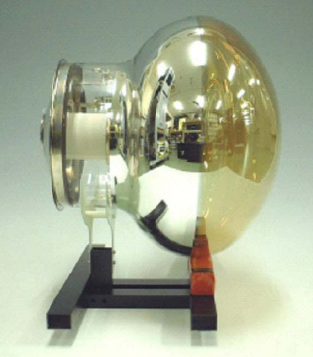
13 inch HAPD for T2K by Hamamatsu

Slide 8
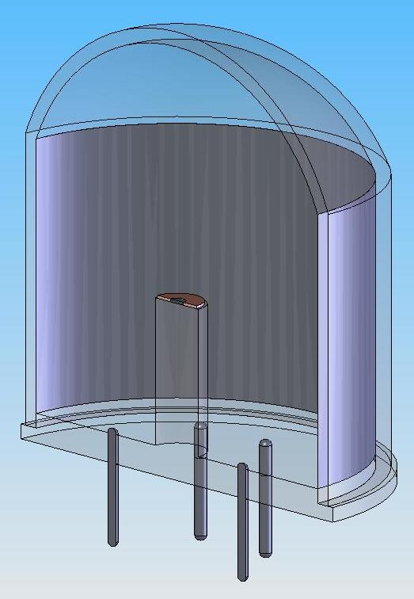
QUPID
(Quartz Photon Intensifying Detector)
Quartz
Photo Cathode
(-10 kV)
APD (0 V)
Quartz
Quartz

Slide 9
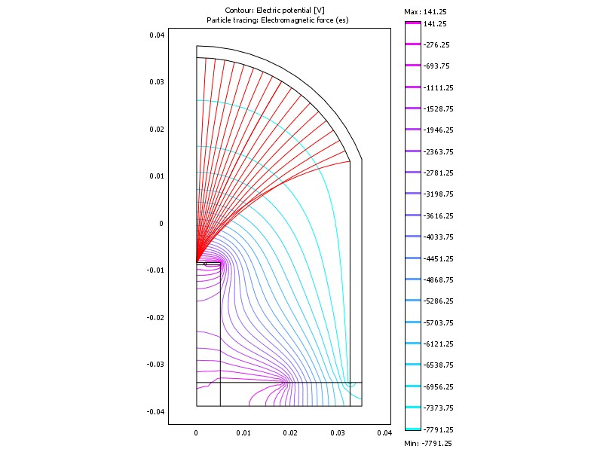
Simulation of Electron Trajectories

Slide 10
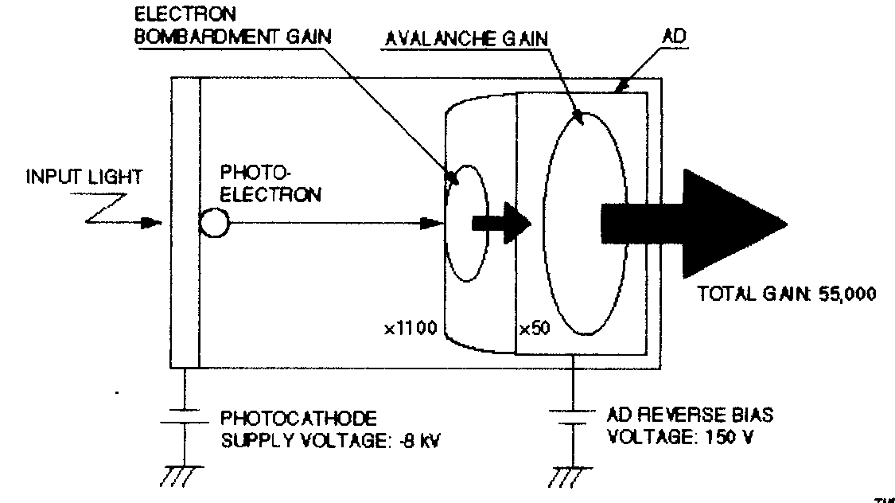
HAPD-Hamamatsu
R7110U-07 (con APD)
Photon counting
Gain
Guadagno per bombardamento
elettronico su targhetta APD
G=q(Vk-Vp)/3.6 eV
≈ 8KeV/3.6 eV ≈ 2200
APD: diodo in regime
avalanche, risposta
proporzionale G=50
G₁
X
G₂
Range fotoelettroni IN APD: 4KeV 0.3 μm, 10KeV 1.5μm

Slide 11
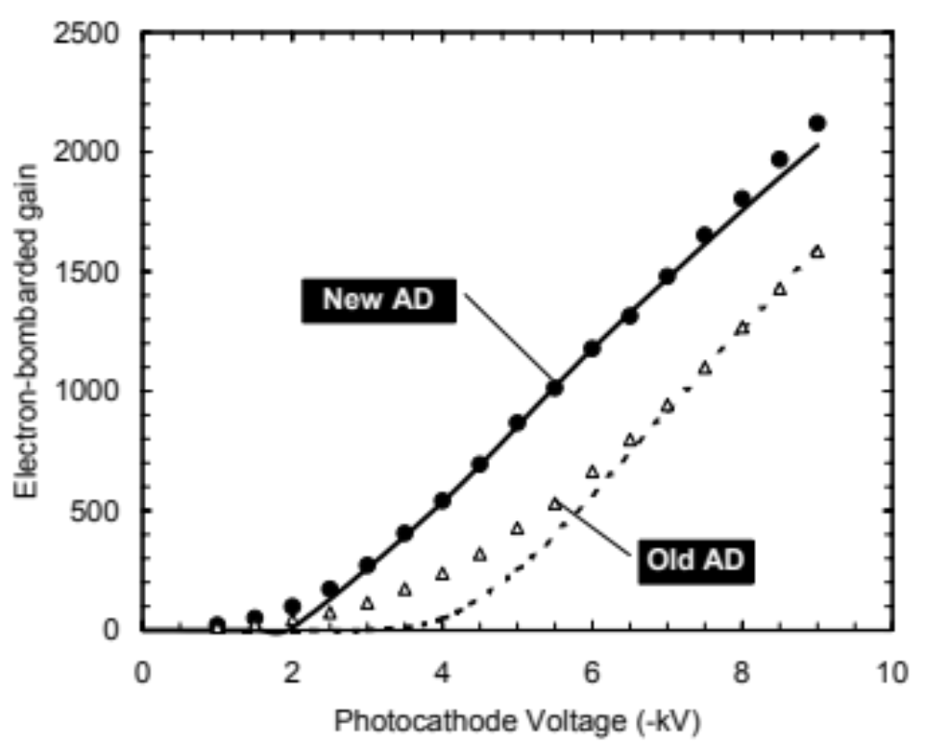
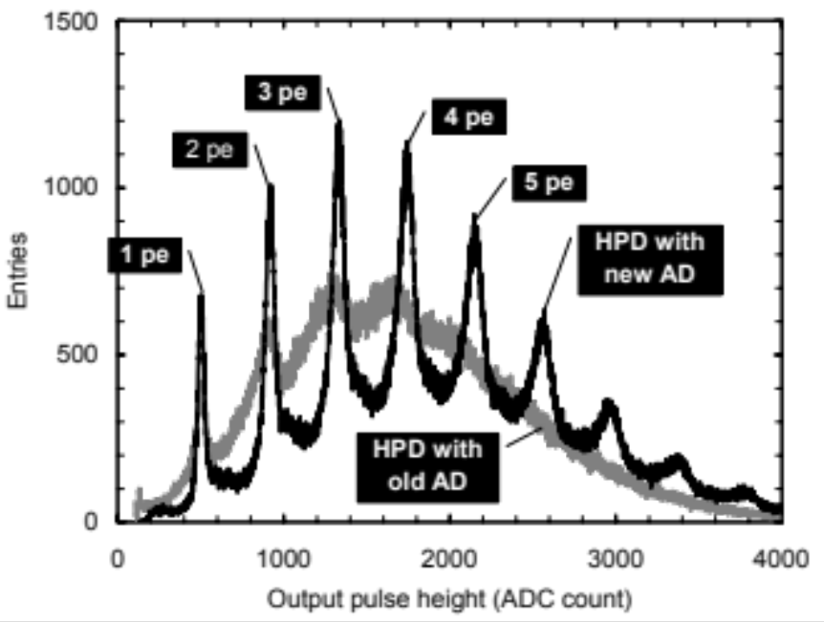
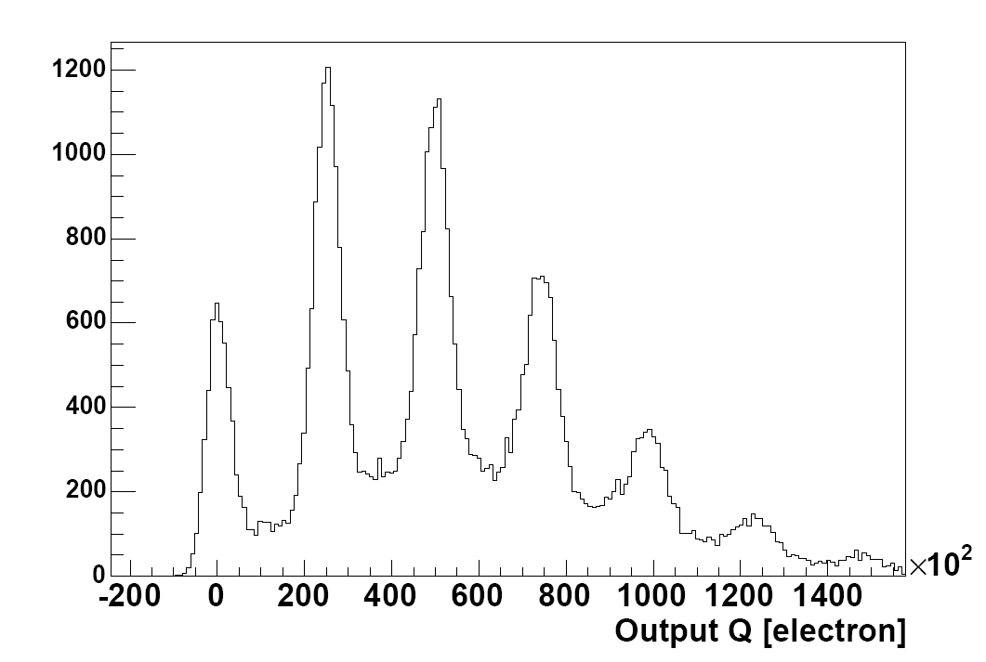

Slide 12
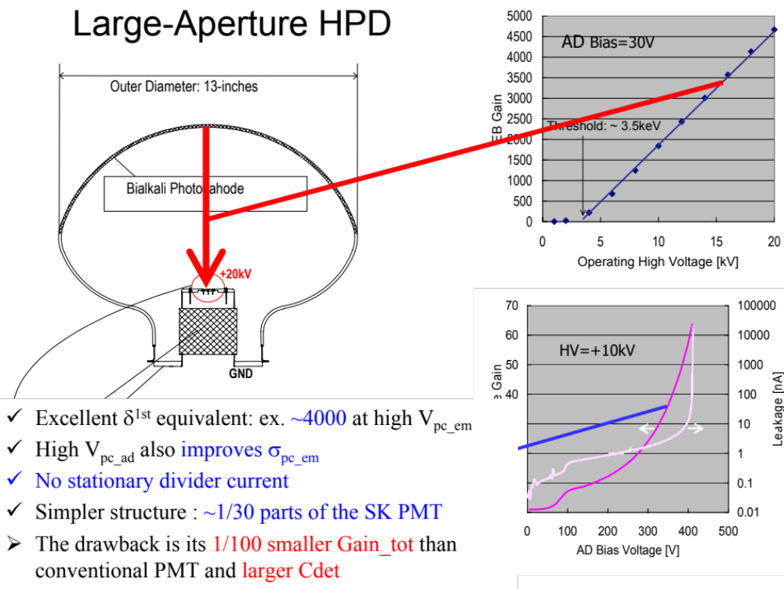

Slide 13
Towards a new generation of photodetectors: the VSiPMT
(Vacuum Silicon PhotoMulTiplier)
GC Barbarino
Università degli studi di Napoli Federico II
INFN Napoli

Slide 14
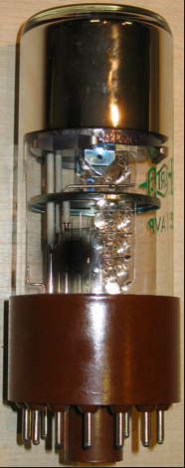
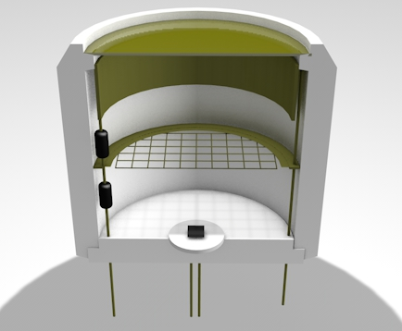
Evoluzione fotomoltiplicatori
(
)
APD
SiPM
Fotocatodo +
amplificazione via
electron bombarding
Basso guadagno
Alte tensioni/isolamenti
Scarso successo
2 sezioni:
Fotocatodo
+Giunzione Geiger
amplificatrice di
elettroni
2 sezioni:
Fotocatodo
+dinodi amplificatori
di elettroni

Slide 15
The project: VSiPM
Vacuum Silicon PhotoMultiplier Tube (VSiPMT)
Photocathode
SIPM is:
Compact
Cheap
Single photon capability
Linear
Low voltage operation
BUT
Small sensitive surface
Focusing Ring
Focusing Grid
SiPM
A combination of a classical vacuum glass PMT standard envelope hosting a photocatode and a
Silicon PhotoMultiplier (SiPM) acting as an electron multiplying detector
(in the place of the dinodes chain).

Slide 16
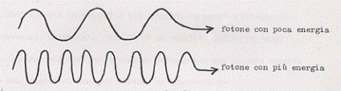
Vacuum Silicon PhotoMultiplier Tube (VSiPMT)
An innovative design for a modern hybrid photodetector based on the combination of a Silicon PhotoMultiplier (SiPM) with a hemispherical PMT standard envelope
photons
photocathode
e⁻
E
Field shape rings
Extraction/acceleration
field
HV = 2-5 kV
SiPM
V_{bias}=70-73 V
The classical dynode chain of a PMT is replaced with a SiPM, acting as an electron multiplying detector.

Slide 17
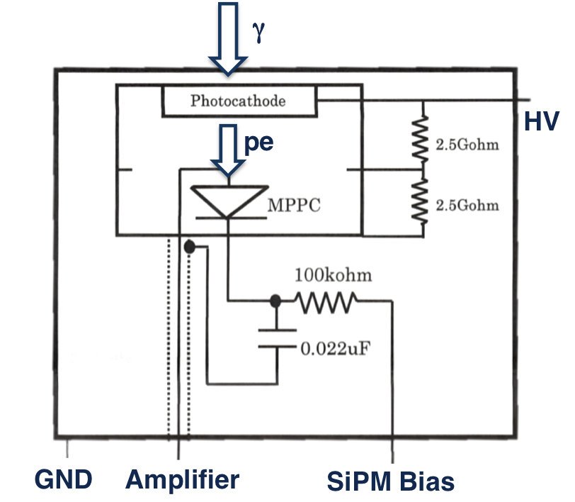

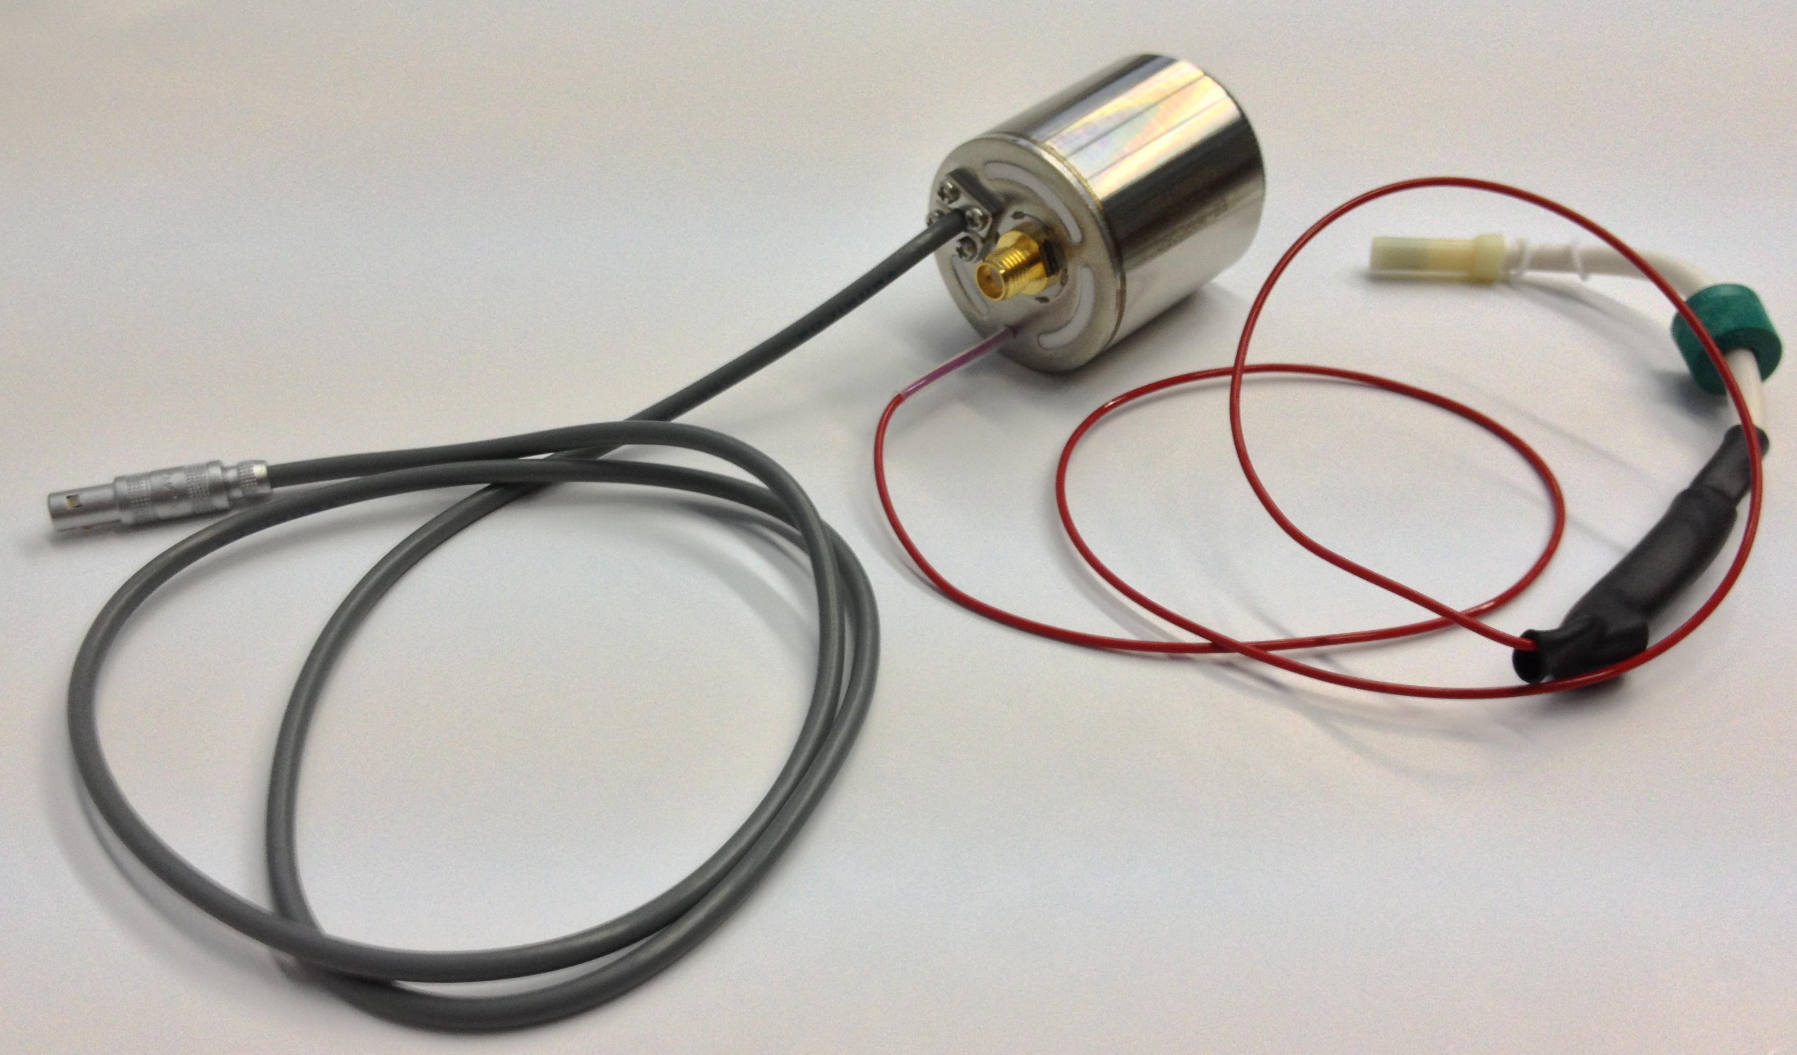
VSiPMT Prototype
Naples – HAMAMATSU Collaboration
p⁺nνn⁺ configuration for photoelectrons, special non-windowed series for ε optimization.
High voltage (-2/3 kV expected) to transport pe from the photocatode to geiger diode.
No divider: no power dissipation or complicated circuit to reduce the dissipation
Only a very simple amplifier (< 5mW).

Slide 18
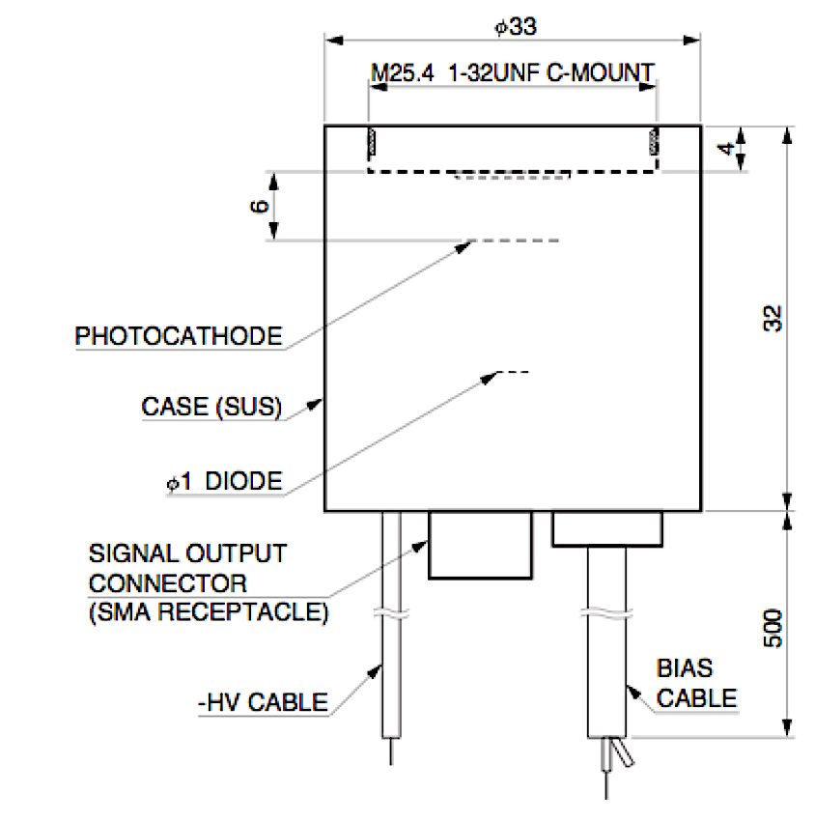

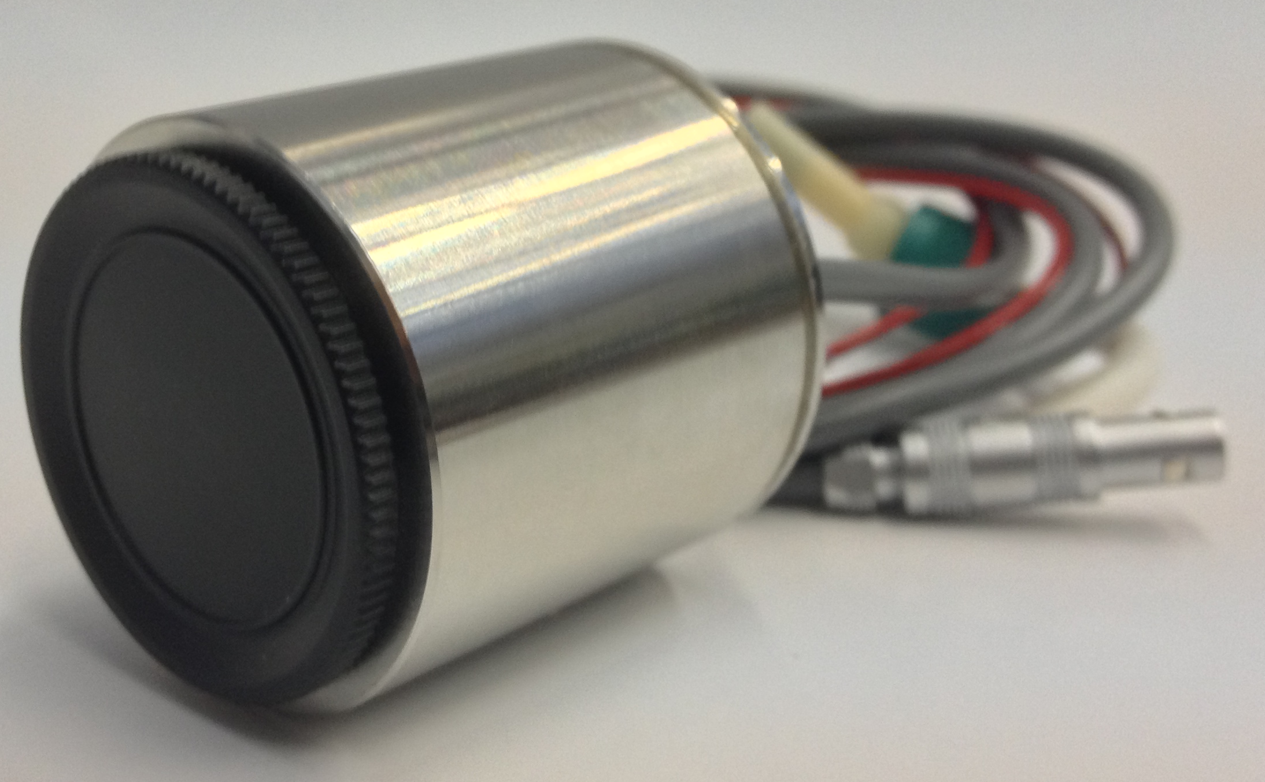
Hamamatsu Prototypes
7x7 mm² entrance window
3 mm diameter GaAsp photocathode
2 protoypes:
SiPM 1 mm² / 50 μm / 400 cells
SiPM 1 mm² /100 μm / 100 cells
both p⁺nνn⁺ configuration
33 mm
32 mm

Slide 19
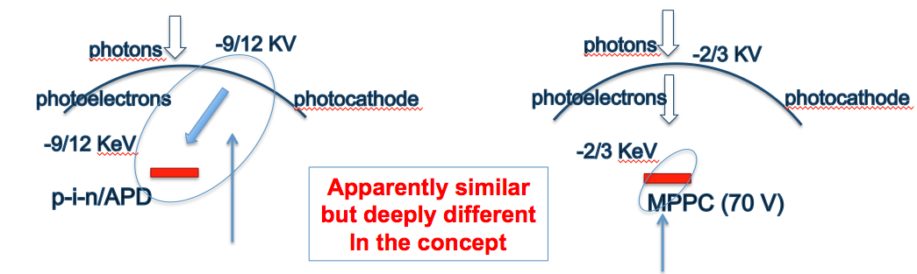
Many advantage in VSiPMT solution
hybrid/APD
VSiPMT
Need of HV to obtain a high gain
High gain obtained with low voltage in the SiPM
Drawback of APD solution
- G=E_{phe}/E_{e,h}≈10⁴-10⁵
- too low Gain. HV gain
- G depending on HV
- Need a strong HV critical stabilization.
- Difficult and expensive insulation
Lot of advantage in the SiPM solution
- G > 10⁶ : more of a factor 10.
- Low HV, only for photoelectron transfer
- Normal insulation
- No HV stabilization
- Low voltage Gain: easy to stabilize

Slide 20
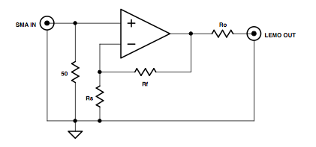
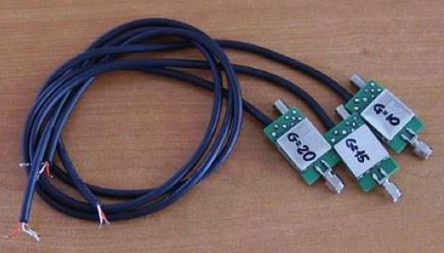
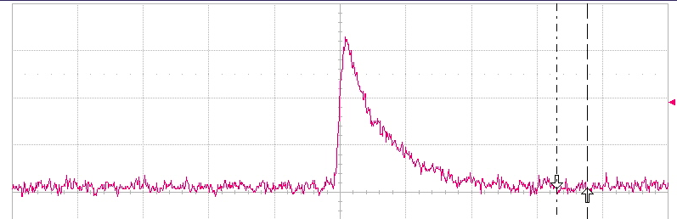
Amplification
Single-state amplifiers based on an OP-AMP in non inverting configuration.
3 different gain
2 nphe
12 mV
40 ns
Power consumption < 5mW

Slide 21
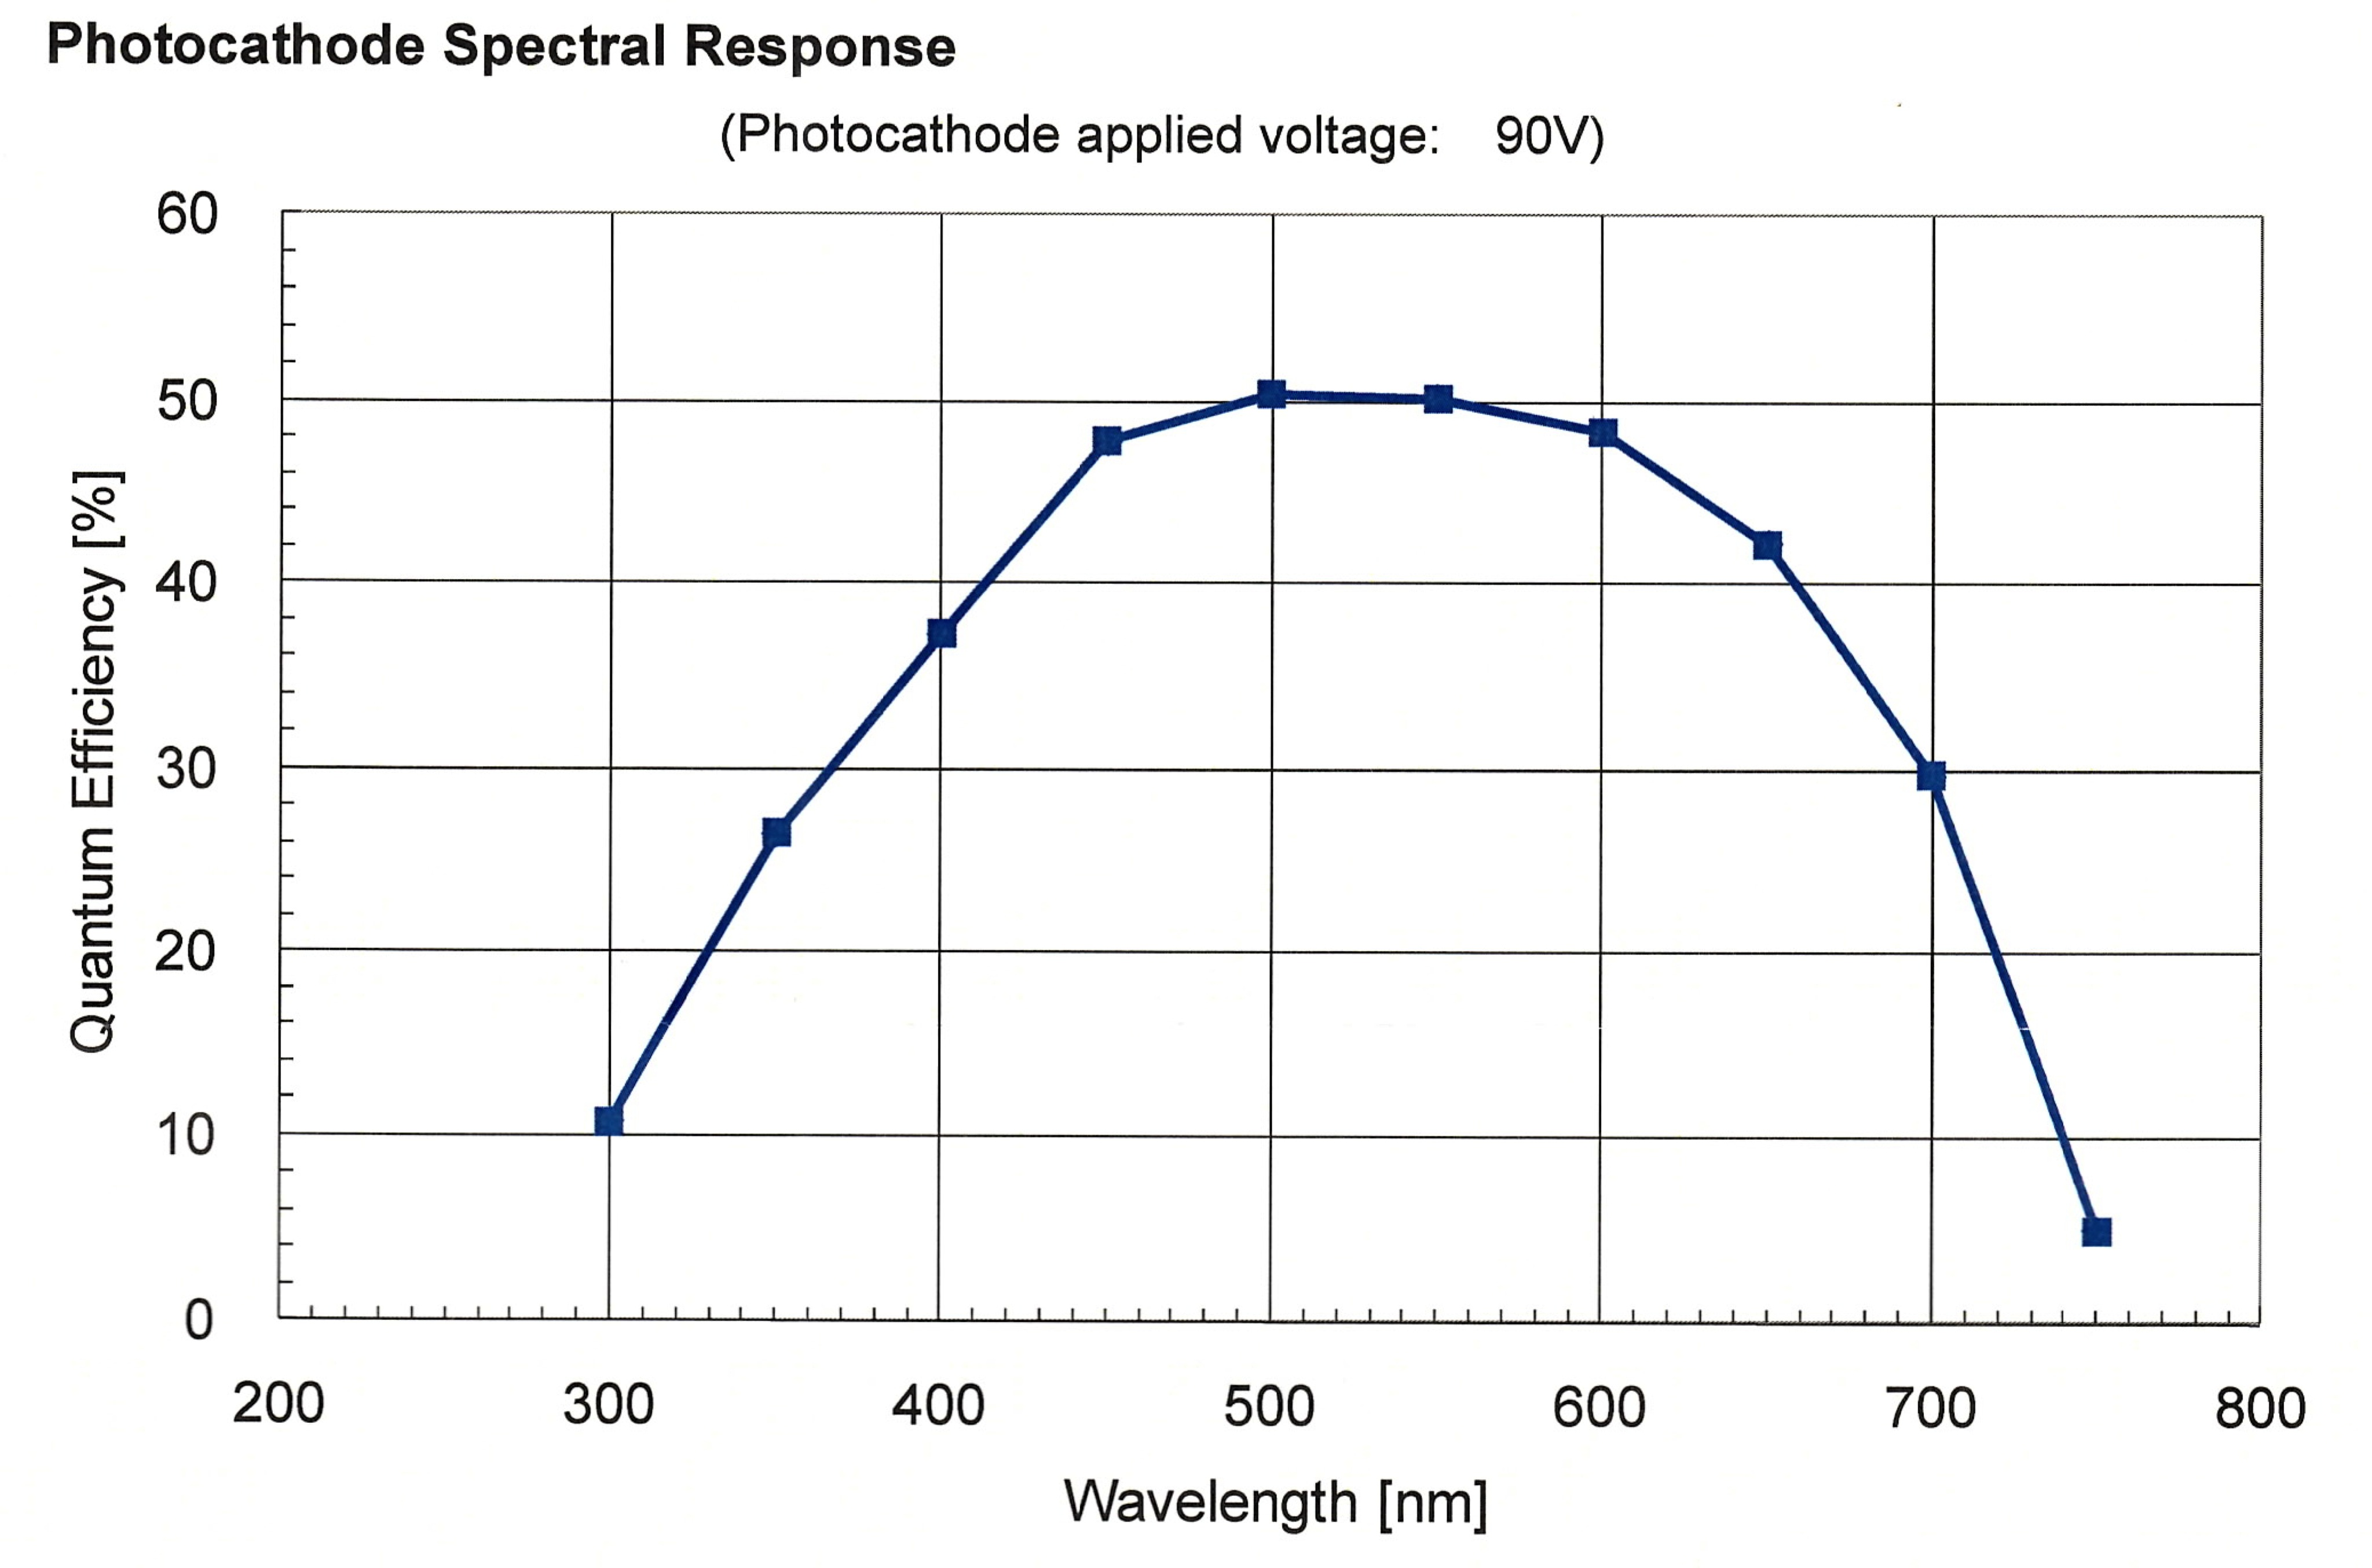
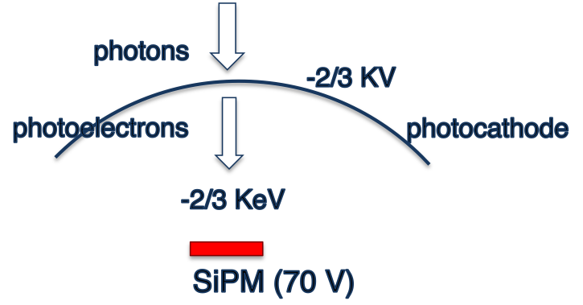
Efficiency
Photocathode response
Photocathode characteristics
by HAMAMATSU
  (38 % q.e.)
HV: photoelectron transfer NO power consumption (NULL current) unlike PMTs.
LV-based gain EASY STABILIZATION
Reducing the SiO₂ coating layer it will be possible to reach the plateau region at even lower voltages.
Efficiency is highly stable over 3200 V.
No need for high voltage stabilization.

Slide 22
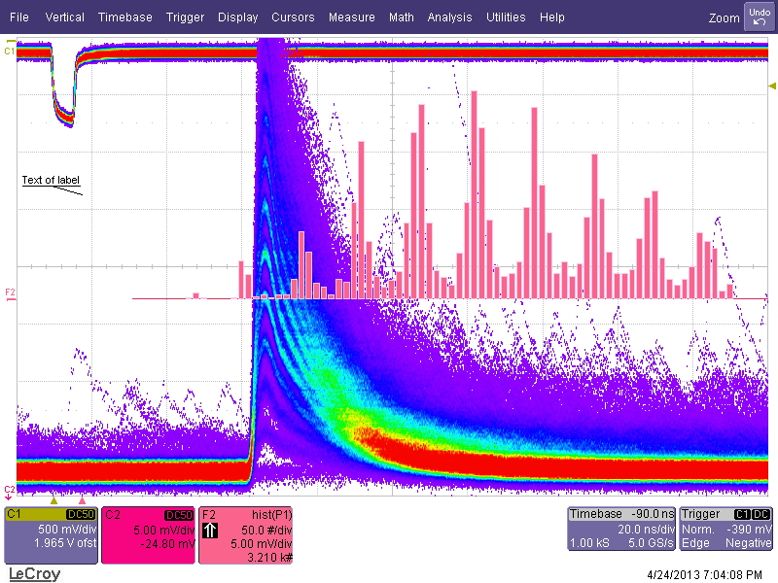
Waveforms
Peak values istogram
MEASUREMENT CONDITIONS:
VSiPMT illuminated by a pulsed laser light at low intensity (407nm)
Oscilloscope triggered in synch with the laser
Responses for multiple triggers are overlaid
Well separated waveforms
5 mV/div
20 ns/div
Excellent photon counting capability

Slide 23
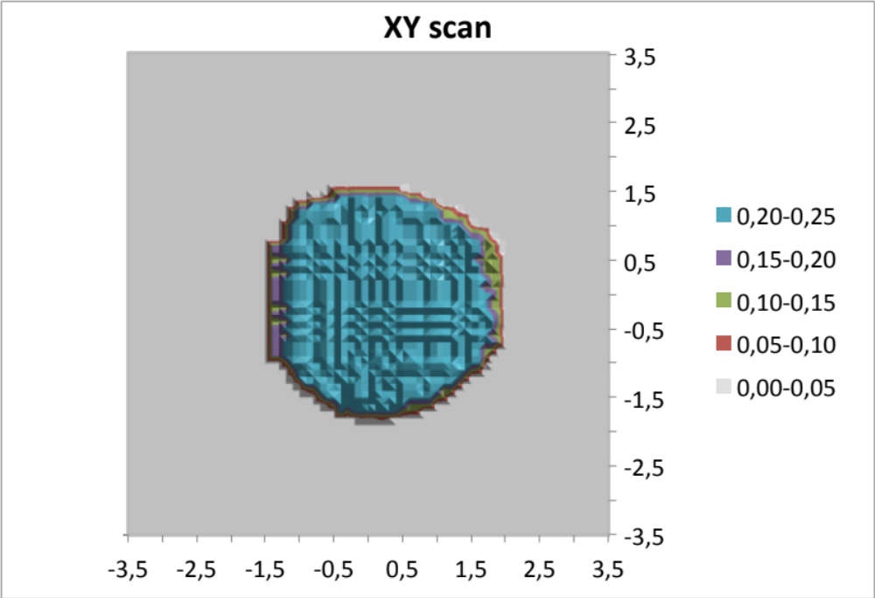
Photocathode homogeneity scan
XY scan
Entrance window 7x7 mm²
Entrance window 7x7 mm²
From 1mm² SiPM to 7mm² photocathode
Surface
3 mm
3 mm
3 mm
Homogeneous efficiency
≈ 0.25 over a 7mm² surface
3 mm
Homogenity ε > 95%

Slide 24
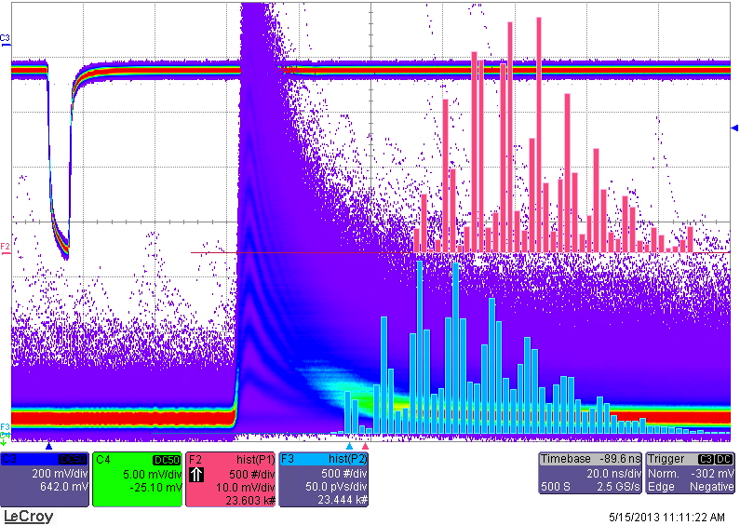
Gain
Peak values hystogram
High gain (10⁵÷10⁶)
Linear trend
Area hystogram
Total Gain = G_{VSiPMT} x G_{AMP}
Ideal Working Point: 72.2V
G ≈ 6x10⁶ (G_{AMP} = 20);
Dark Count ≈ 60 kcps;
TTS < 0.5ns.

Slide 25
Transit Time Spread
SiPM bias
Pulse laser
VSiPMT
Optical Fiber
AMP
Ext.
Trigger
HV supply
START
STOP
Oscilloscope
Photocathode fully illuminated with single photons

Slide 26
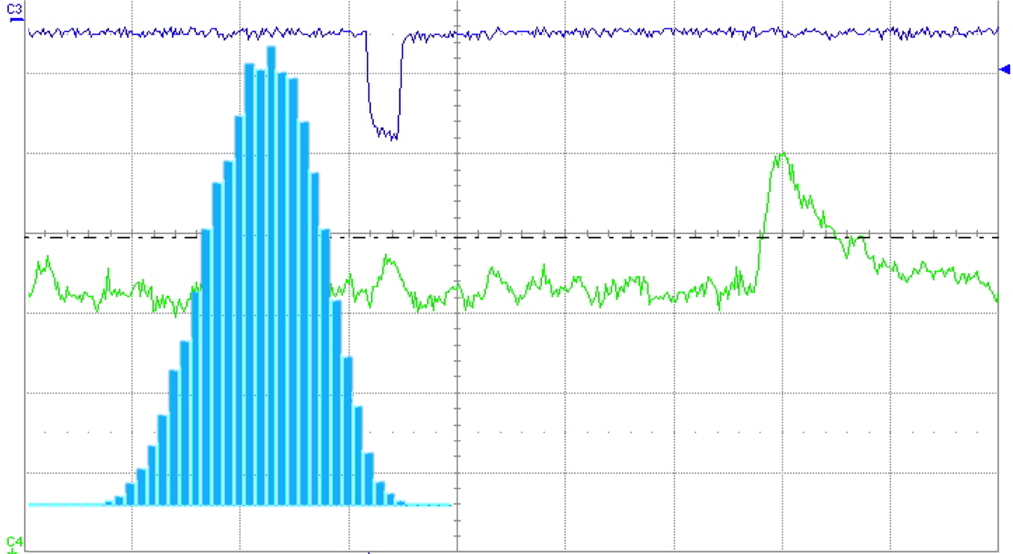
Transit Time Spread
Laser Trigger
ΔT
VSiPMT
spe signal
VSiPMT
TTS (σ) < 0.5 ns
ΔT distribution
VSiPMT much better than PMTs

Slide 27
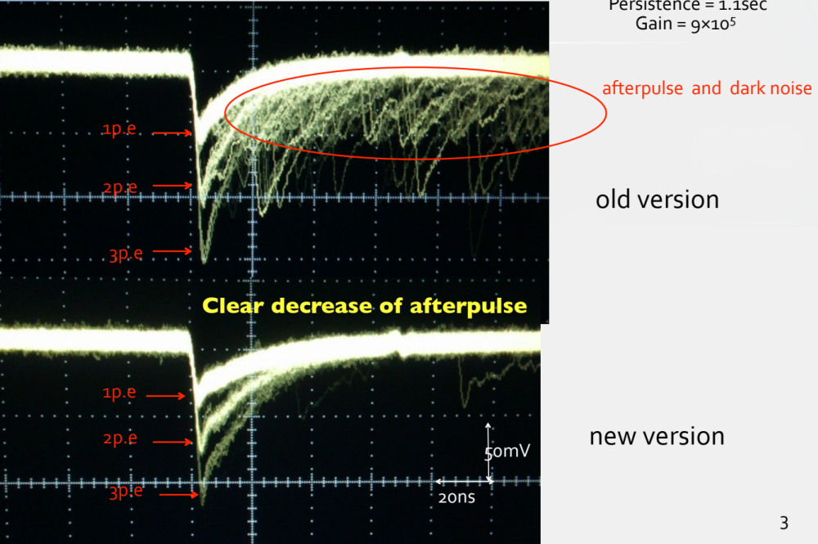
Further improvements of the next VSiPMT prototype
Today Hamamatsu solves the only one weak figure of VSiPMT: dark counts
Hamamatsu has developed a new MPPC (SiPM)
Dark counts: few Khz,
equivalent to a PMT
Moreover:
-Reduction of afterpulse rate (almost negligible < 0,3% ): much better than a PMT
-Wider operation voltage range

Slide 28
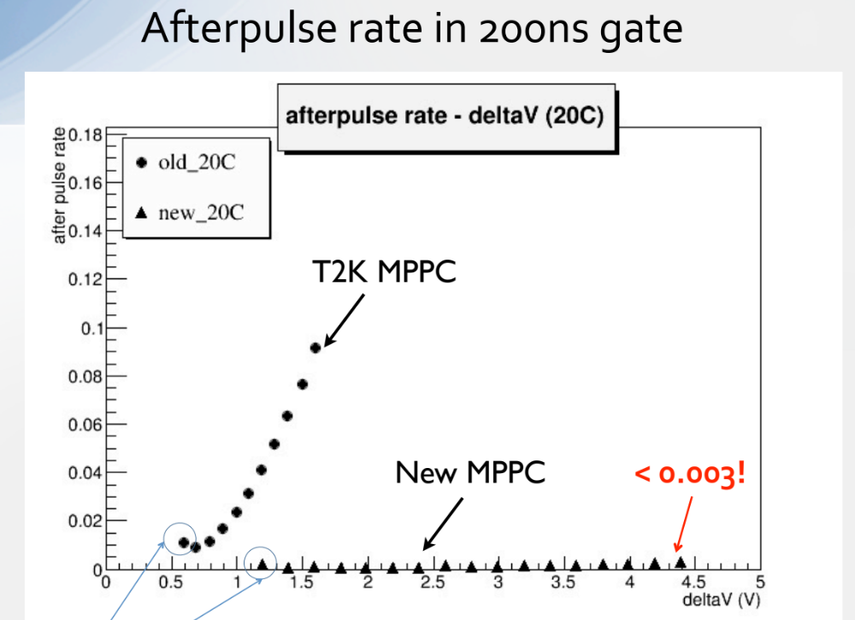
SiPM internal afterpulses
In the new Geiger diode
version the intrinsec
afterpulses are negligible
Less than a classical
PMT < 0,3% !!
old
<10%
<0,3%

Slide 29
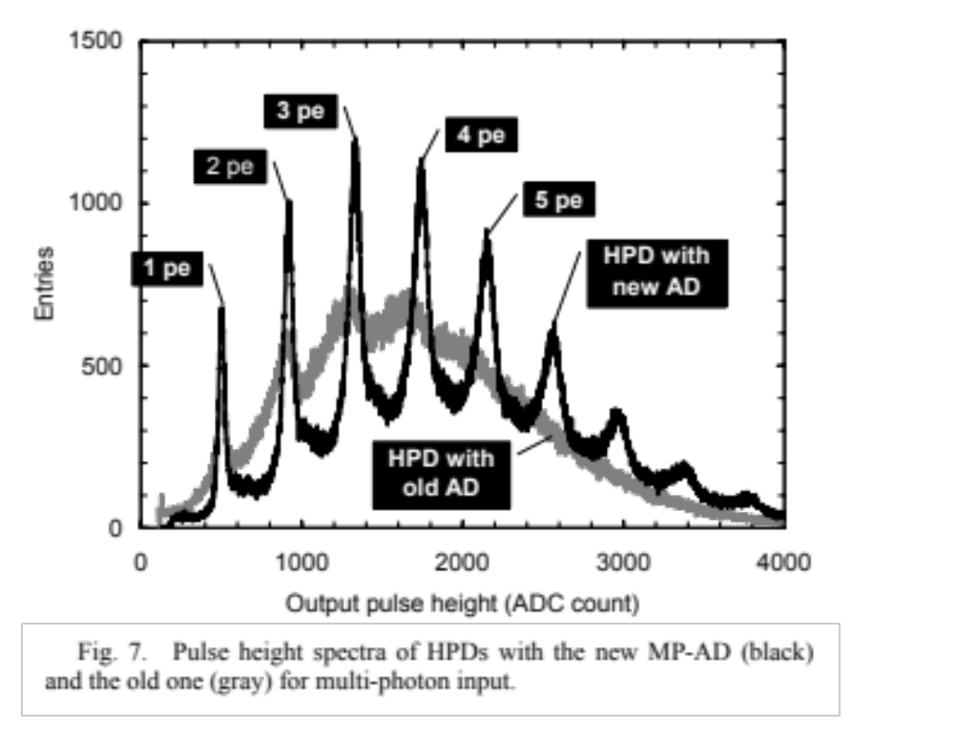
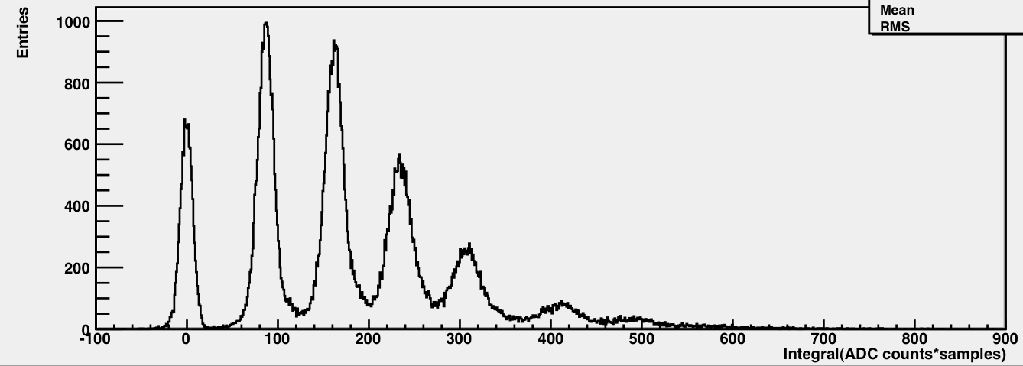
With APD electron
multiplication depends
on first ionization
fluctuations
pe
1 pe
2 pe
No fluctuation in geiger regime
Sum of digital pixel. Pe’s better
separated.
pedestal
3 pe
4 pe
5 pe
6 pe

Slide 30
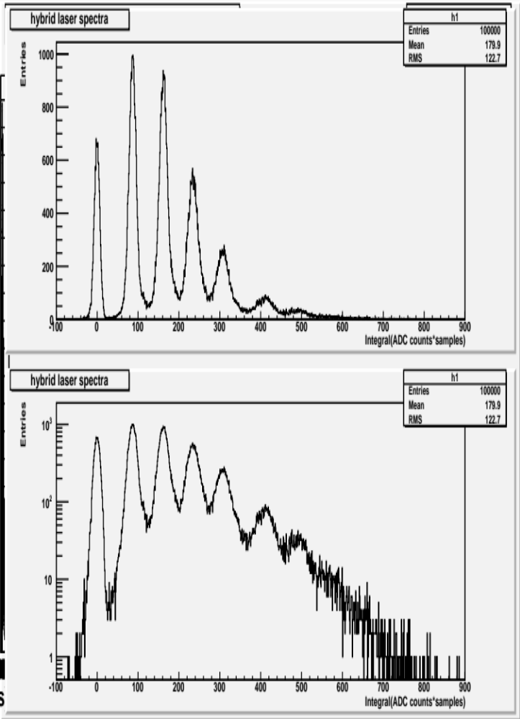
Dark count rates
1 pe
2 pe
Excellent photon counting capability
pedestal
3 pe
4 pe
5 pe
@threshold 2.5 pe
Old: 800 Hz
New SiPM Generation: 80 Hz
@threshold 1.5 pe
Old: 10 kHz
New SiPM Generation: <1 kHz
@threshold 2.5 pe
Old: 100 kHz
New SiPM Generation: <10 kHz

Slide 31
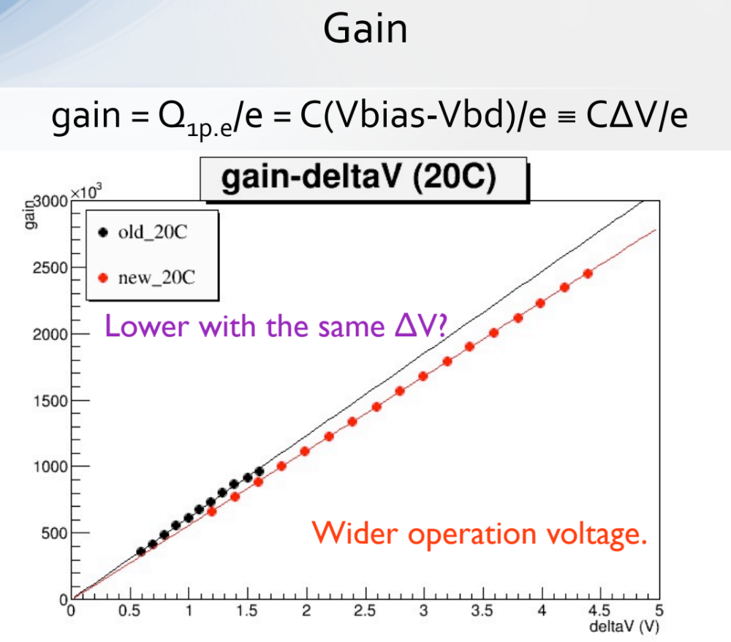

Slide 32
PMT vs VSIPMT
Features | PMT | VSiPMT | Comparison
Efficiency | QE_{photocathode}x ε_{1dynode(0.8)} | QE_{photocathode}x FillFactor_{(twd 1)} | ≈equivalent
Gain | 10⁵ - 10⁶ | 10⁵ - 10⁶ | ≈equivalent
Timing | ns | Fraction of ns (no dynode spread) | VSiPMT
Linearity | Depending on gain | Depending on #cells | ≈equivalent
Power Consumption | Divider Dissipation | VSiPMT: No dissipation Amp. (G=10-20): <5mW | VSiPMT
Power Supply Stability | HV Stabilization | LV easy stabilization | VSiPMT
Dark counts rate (new) | ≈ kHz @ 0.5pe | ≈ few kHz @0.5pe | ≈equivalent (today)
Photon Counting | Difficult | Excellent | VSiPMT
Afterpulse (new) | ≈10% @0.5pe | <0,3% @0.5pe | VSiPMT (today)
Peak-to-valley ratio | ≈3 | >60 | VSiPMT

Slide 33
Conclusions and perspectives
The VSiPMT prototypes show excellent performances beyond expectations:
  UNRIVALLED photon counting capability
  Absence of divider (NO POWER CONSUMPTION)
  Low voltage high gain (EASY STABILIZATION)
  Very fast response (TTS < 0.5 ns )
Patent pending for VSiPMT by INFN (prof. G. Barbarino)
Our road map from now on:
  Construction of two new VSiPMT prototypes of 1” and 3” photocathode.
  1” and 3” VSiPMT cover all the requirements of next 10 years big astroparticle physics experiments
    dark matter, Air Cerenkov, km³ in Mediterranean sea.
Moreover, we believe that also particle physics and applied physics will benefit of such a device.
MOST of the VSiPMT features overcome PMT detection capabilities
Notes:
Aggiungere l'incontro col giapponese

Slide 34
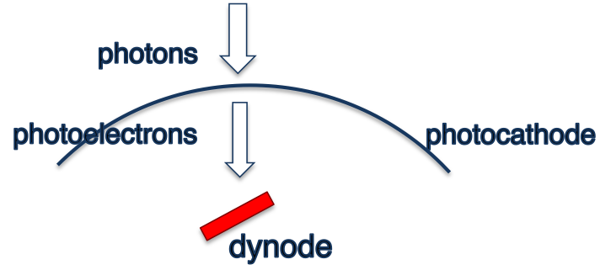
Efficiency: VSiPMT vs PMT
PMT Efficiency
VSiPMT Efficiency
ε = ε _{photocathode} x ε _{1st} _{dynode}
ε = ε _{photocathode} x ε _{SiPM} ₍₅₀₎
0,30 ≈ 0,38 x 0,8
0,23 ≈ 0,38 x 0,61
Fill factor
ε = ε _{photocathode} x ε _{SiPM} ₍₁₀₀₎
0,30 ≈ 0,38 x 0,78
VSiPMT efficiency improvable with fill factor

