Slide 1
Perché superare i PMT a dinodi
FLUTTUAZIONI NEL GUADAGNO DEL PRIMO DINODO:rende impossibile photon counting.
BASSA CAPACITA’ DI DISTINGUERE IL SINGOLO FOTONE
LINEARITA’ LEGATA AL GUADAGNO
TT ELEVATO
TTS ELEVATO
STRUTTURA COMPLESSA E COSTOSA
ALTA SENSIBILITA’ AI CAMPI MAGNETICI
ALTO CONSUMO
PESSIMO FUNZIONAMENTO A TEMPERATURE CRIOGENICHE
ALTA RADIOATTIVITA’ METALLO DIFFUSO (dinodi)

Slide 2
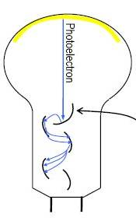
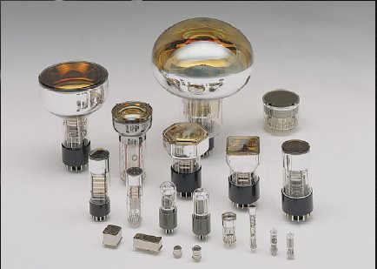
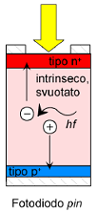
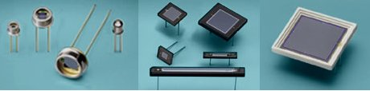
Rivelatori di Luce (UV-IR)
luce
nasce nel 1913 ed e’ commerciale RCA nel 1936
a
vuoto
corrente
Alte
Amplificazioni
Bassi livelli
di luce
Amplificazione
10⁶-10⁶
a
stato
solido
luce
corrente
No/basse
Amplificazioni
Alti livelli
di luce
Amplifi
cazione
Assente/
debole
Tecnologia in forte sviluppo

Slide 3
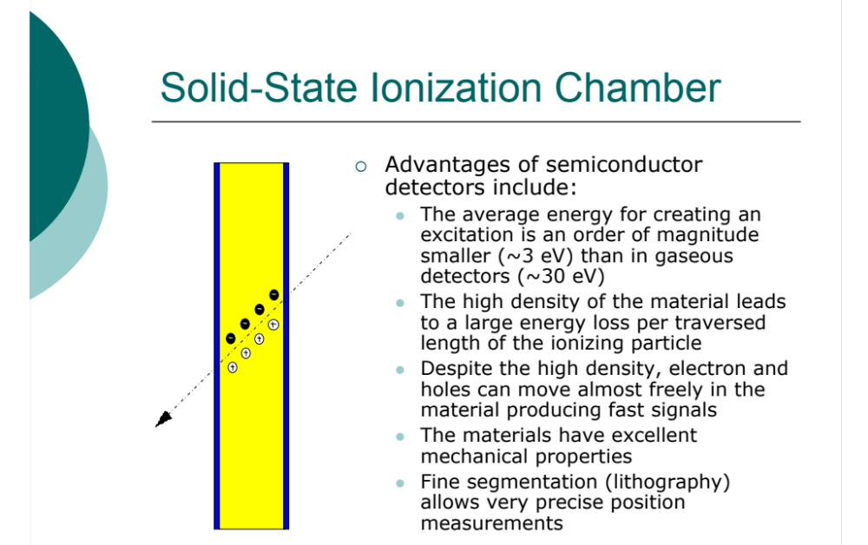

Slide 4


Affinché i fotoni vengano assorbiti e producano coppie elettrone-lacuna, la loro energia deve essere maggiore della bandgap del materiale, cioè deve essere hν>Eg, o, equivalentemente, hc/λ>Ec.
Per il Silicio, Eg=1.12eV e quindi risulterebbe λg=1.11μm.
coefficiente di assorbimento del materiale
Il suo inverso, 1/α, è detto lunghezza di penetrazione ed è la distanza entro la quale circa il 63% dei fotoni viene assorbito.
Nella costruzione o nella scelta di un fotodiodo, deve essere dunque scelto un materiale la cui lunghezza di penetrazione alla lunghezza d’onda da rivelare sia di dimensioni dell’ordine della regione di svuotamento.

Slide 5
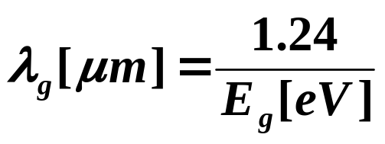
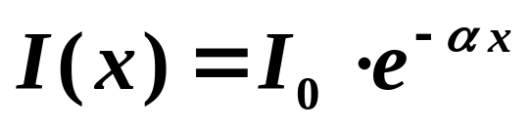
Photodetectors
Absorption Coefficient and Photodiode Materials

Absorbed Photon create Electron-Hole Pair.
Cut-off wavelength vs. Energy bandgap
Incident photons become absorbed as they travel in the semiconductor and light intensity decays exponentially with distance into the semiconductor.
Absorption coefficient

Slide 6
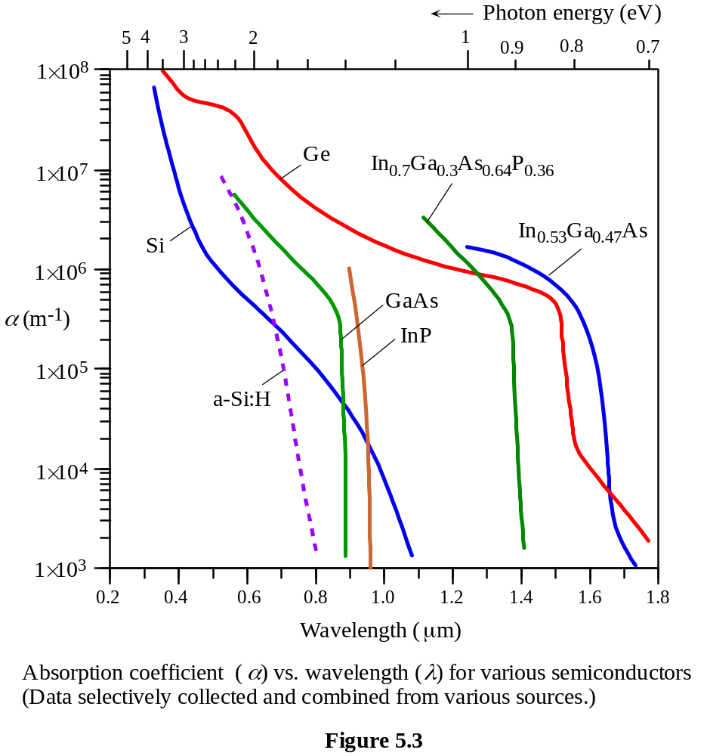
Absorption Coefficient
Absorption coefficient α is a material property.
Most of the photon absorption (63%) occurs over a distance 1/α (it is called penetration depth δ)

Slide 7
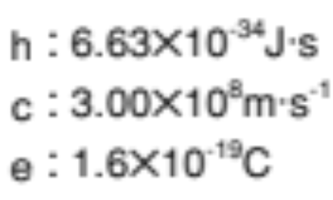
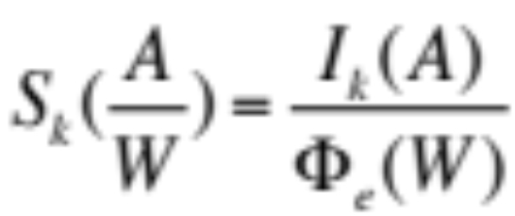
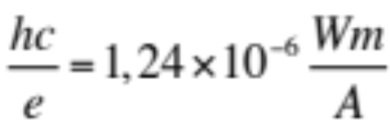
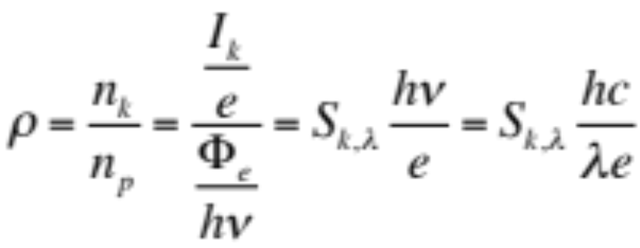
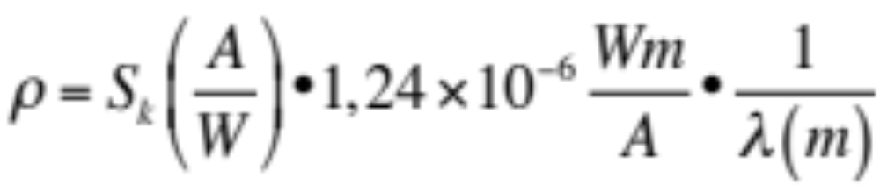
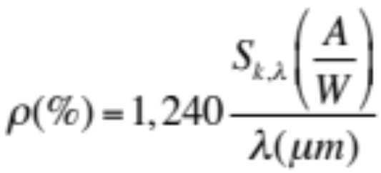
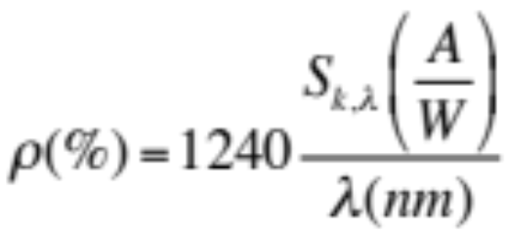
Spectral Responsitivity (S_{k})
Quantum efficiency (Q.E.) ρ

Slide 8
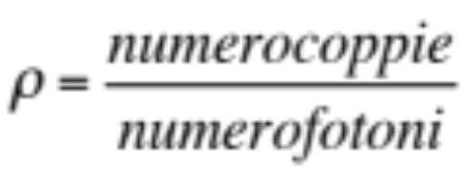
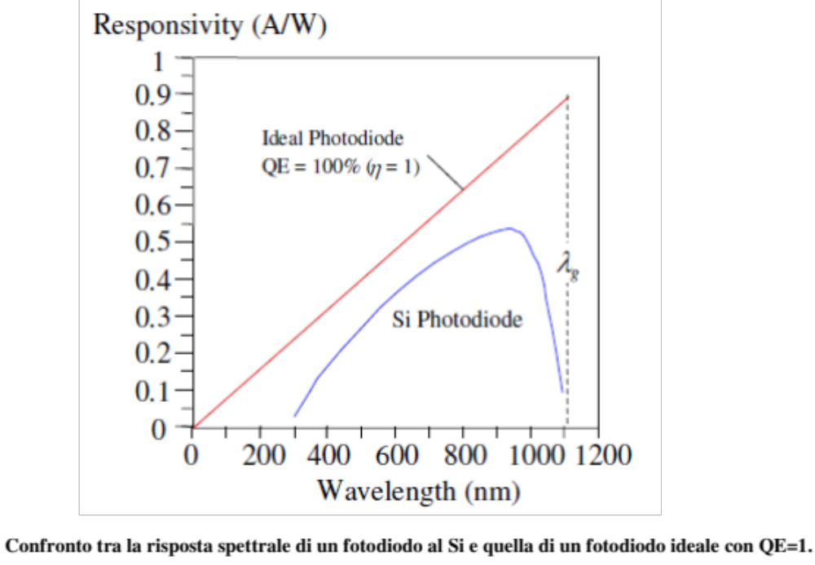
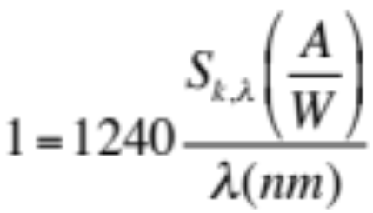
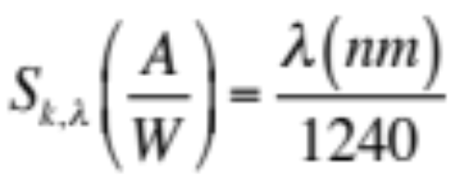
Per i fotodiodi si definisce efficienza quantica il rapporto tra il numero di coppie prodotte e raccolte agli elettrodi e il numero di fotoni incidenti:
Si definisce, inoltre, spectral responsitivity del fotodiodo il rapporto tra la fotocorrente prodotta e il potere ottico incidente:
Ideal Photodiode

Slide 9
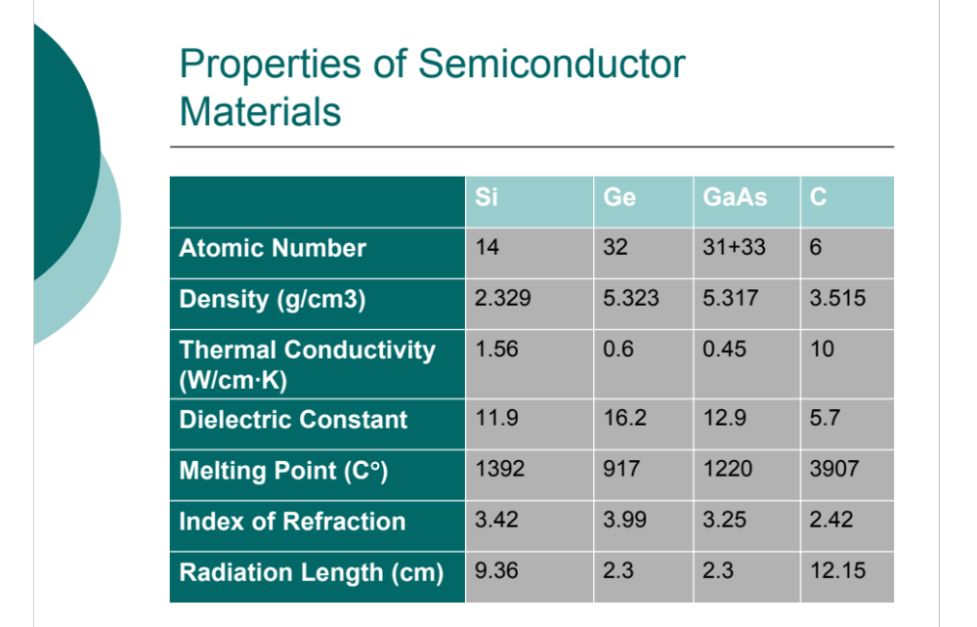
Relative high Z useful for photon detection via photoelectric effect

Slide 10
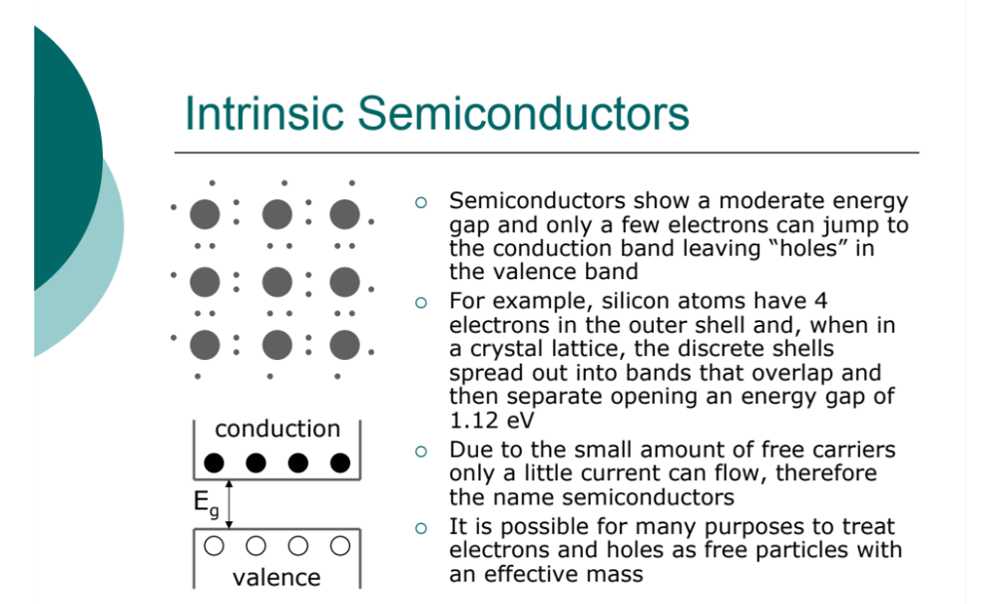
1,12 eV
intrinsic semiconductor: no good radiation detector-thermic current-low sensitivity

Slide 11
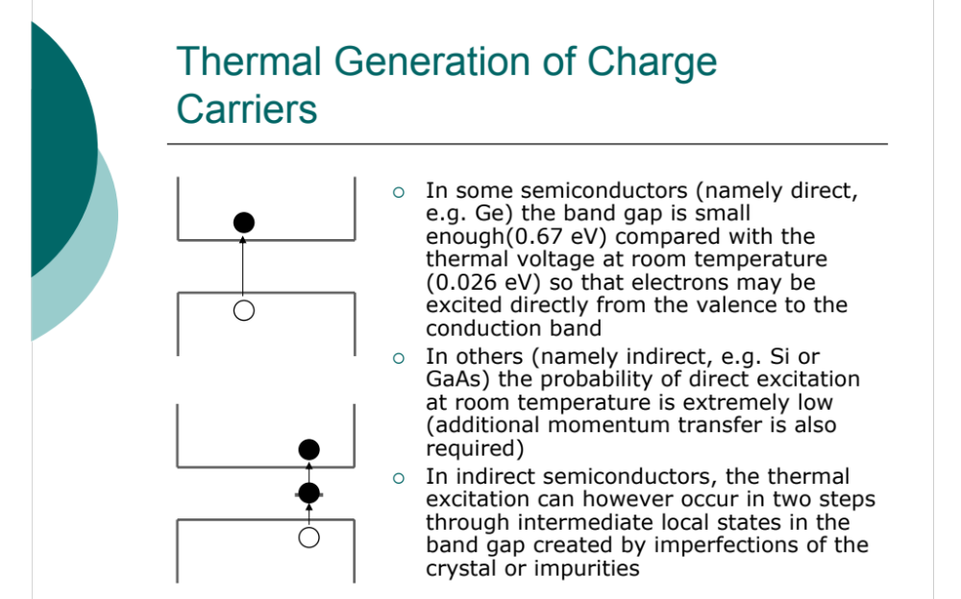

Slide 12
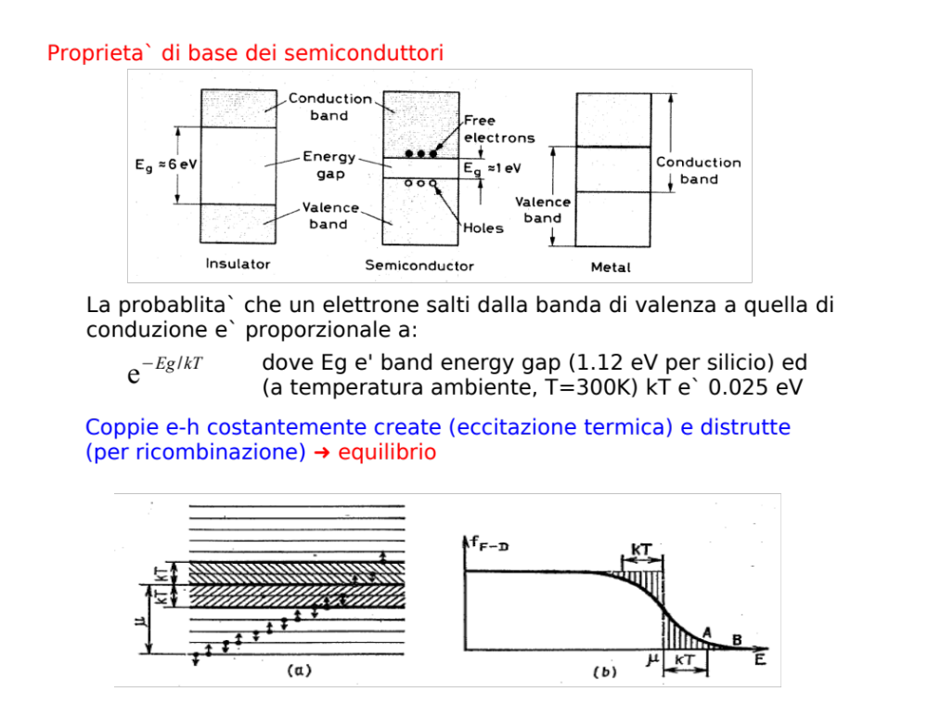

Slide 13
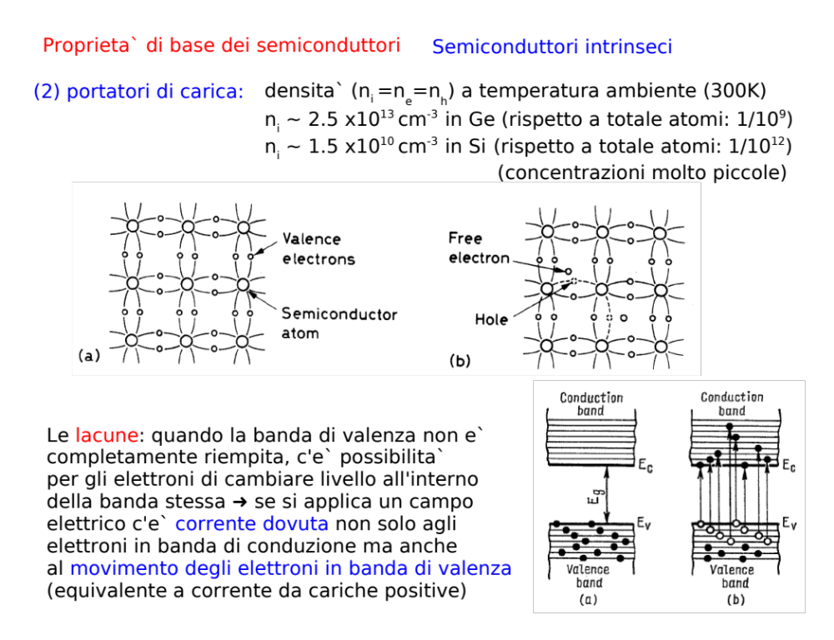
≈10²² atoms/cm³

Slide 14
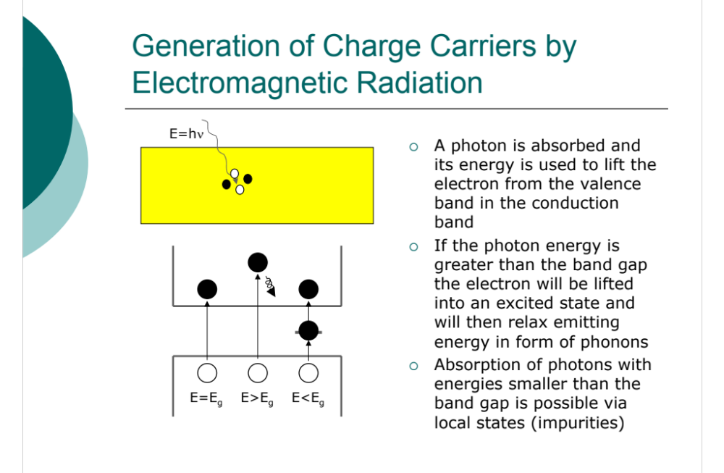

Slide 15
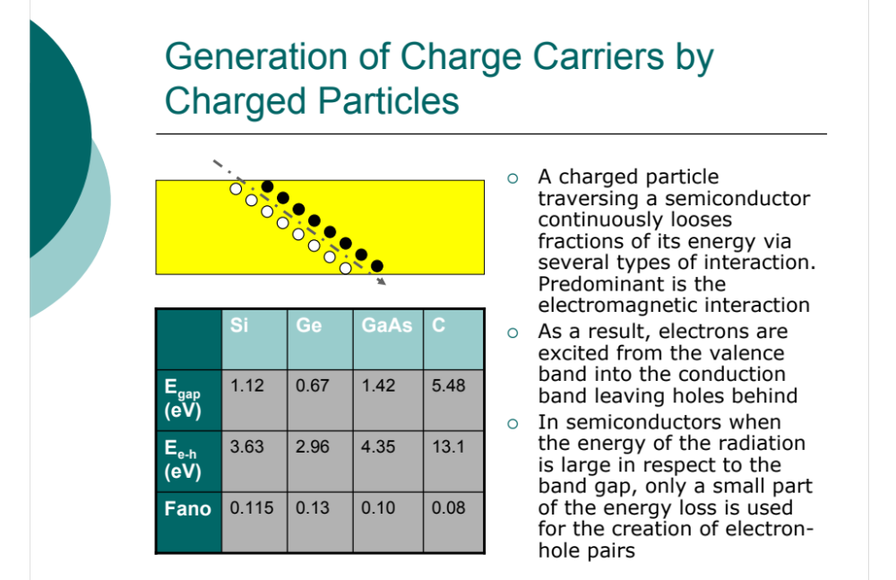

Slide 16
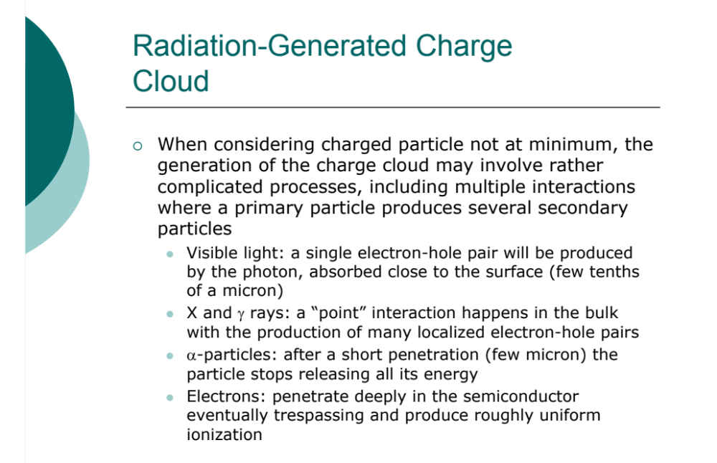

Slide 17
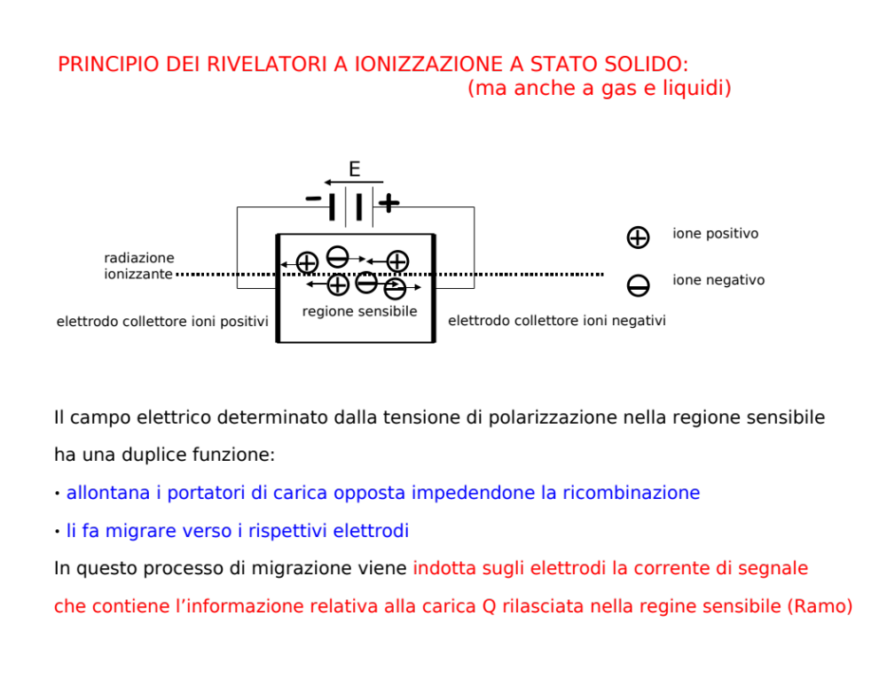

Slide 18
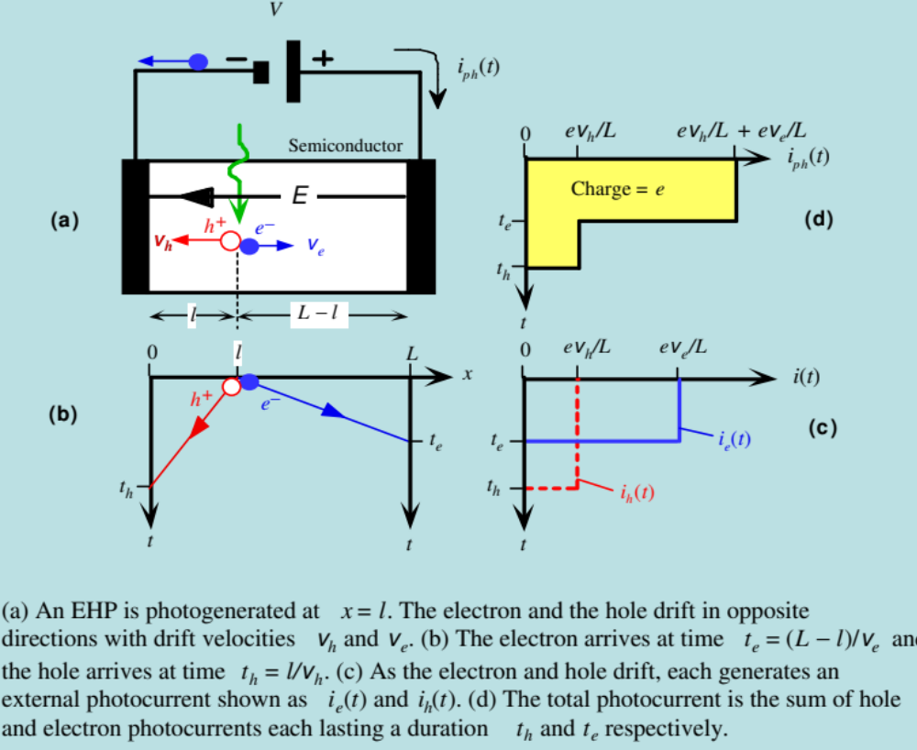

Slide 19
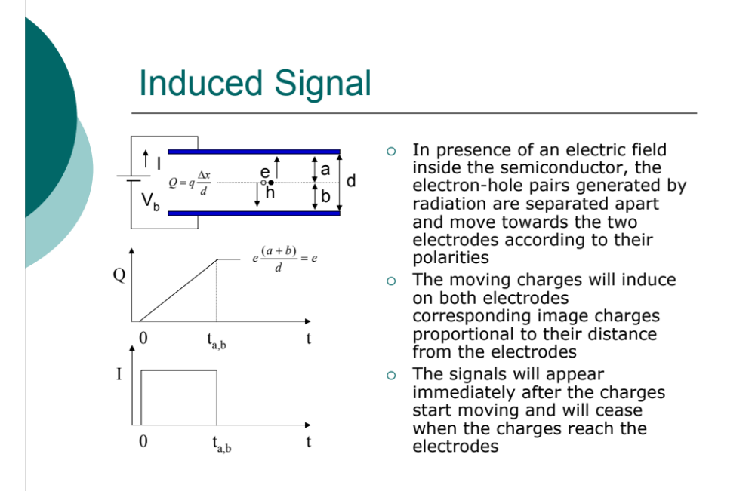

Slide 20
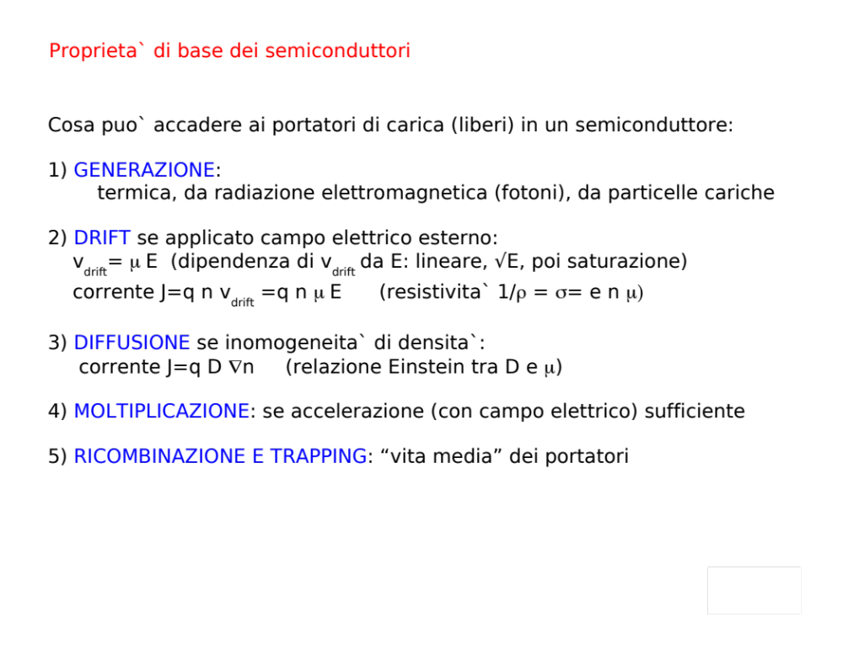

Slide 21
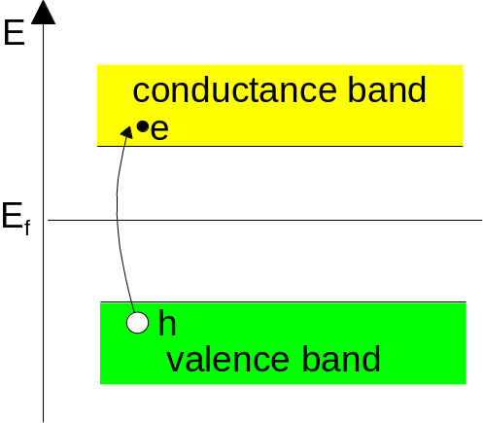
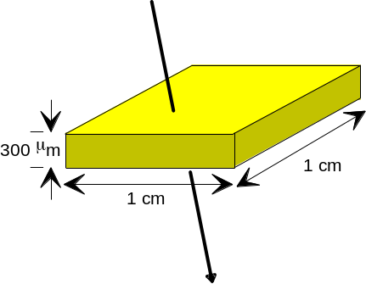
Come ottenere un segnale?
In a pure intrinsic (undoped) material the electron density n and hole density p are equal. n = p = n_{i}
In this volume
we have 4.5 ⋅10⁸ free charge carriers, but only 3.2 ⋅10⁴ e-h pairs produced by a M.I.P.
➔ Reduce number of free charge carriers,
i.e. deplete the detector (drogaggio, giunzione e polarizzazione inversa)

Slide 22
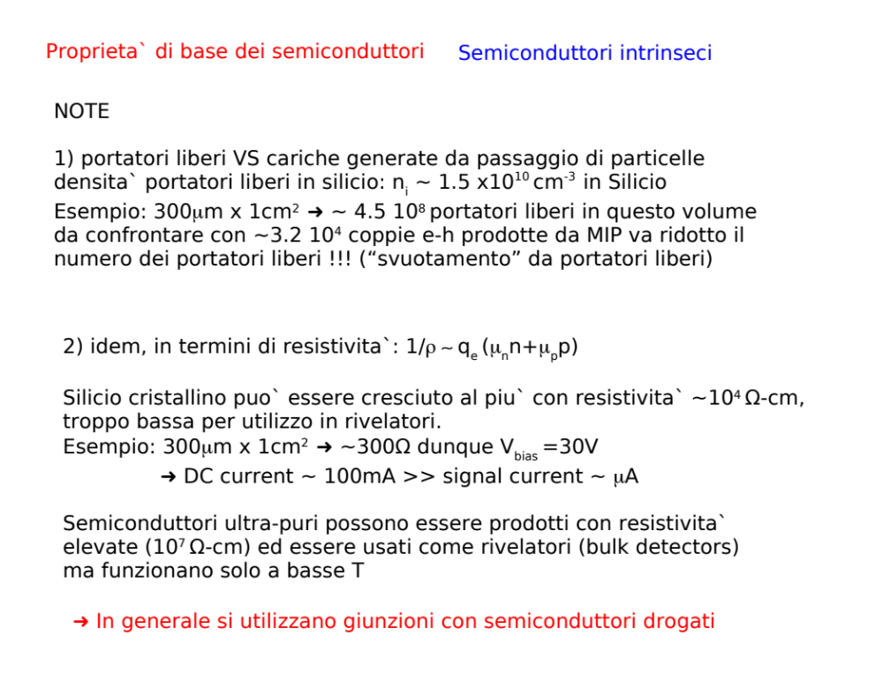

Slide 23
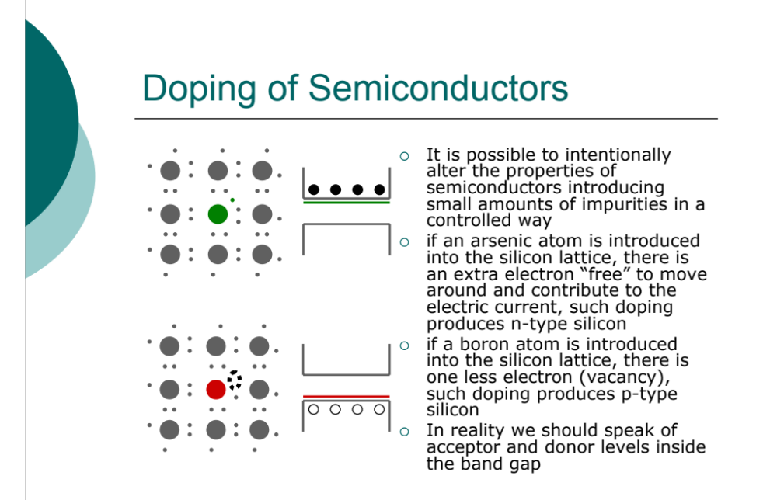
1,12 eV
Questa extra lacuna va ad occupare una posizione all’interno della gap proibita, spostando la gap più verso la banda di valenza.
Typical doping:
10¹³ atoms/cm³ on a density of
10²² atoms/cm³

Slide 24
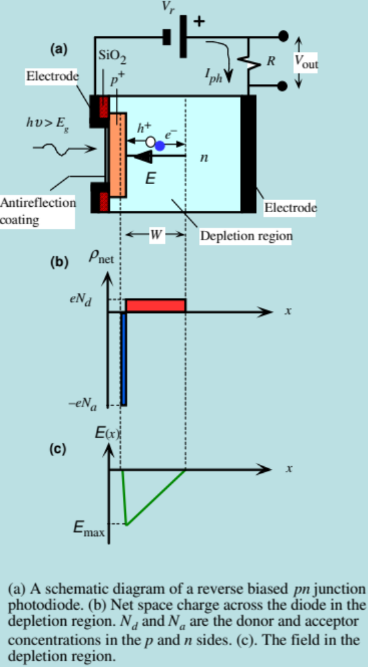
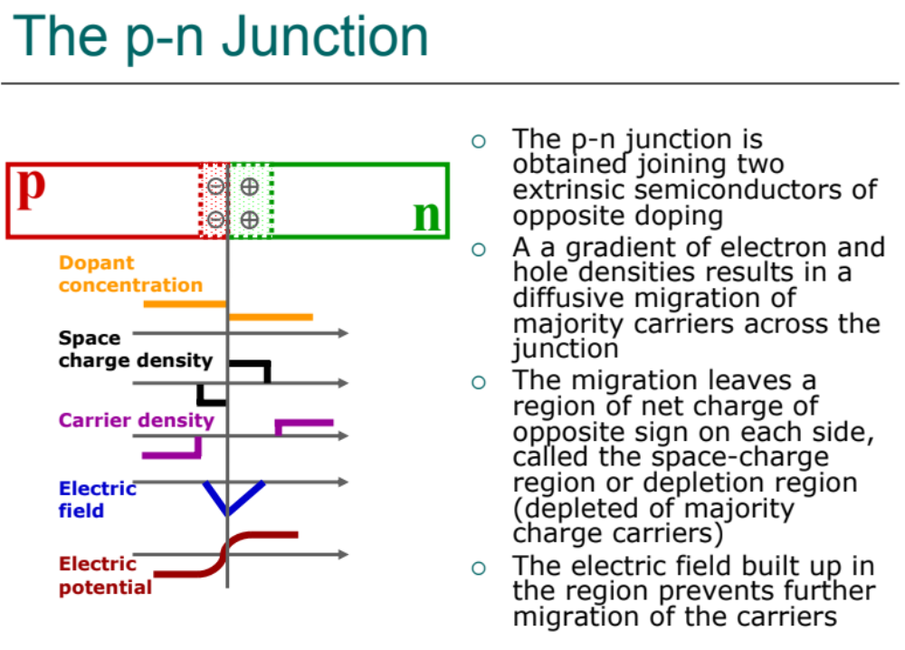

Slide 25
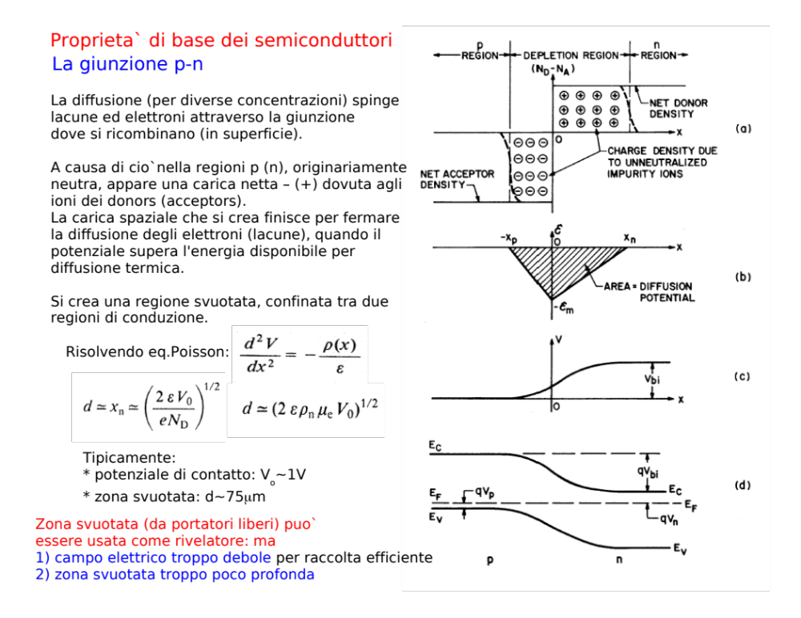

Slide 26
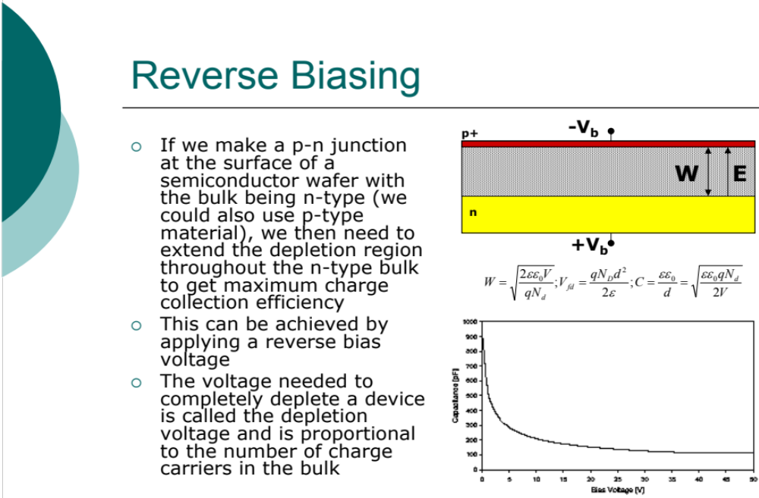
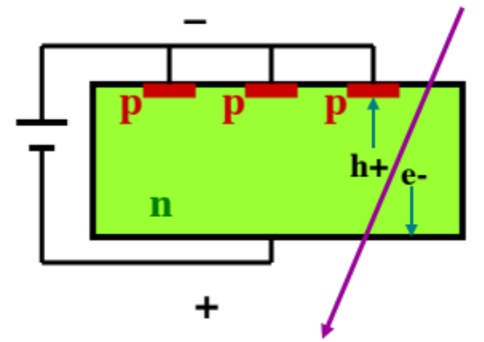
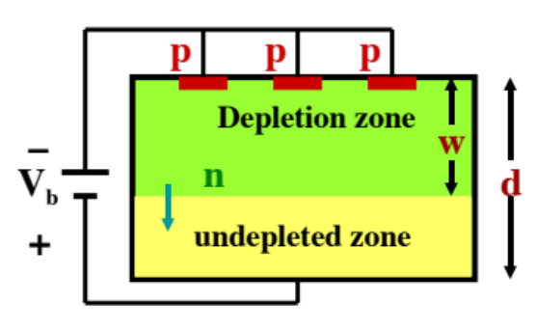
C

Slide 27
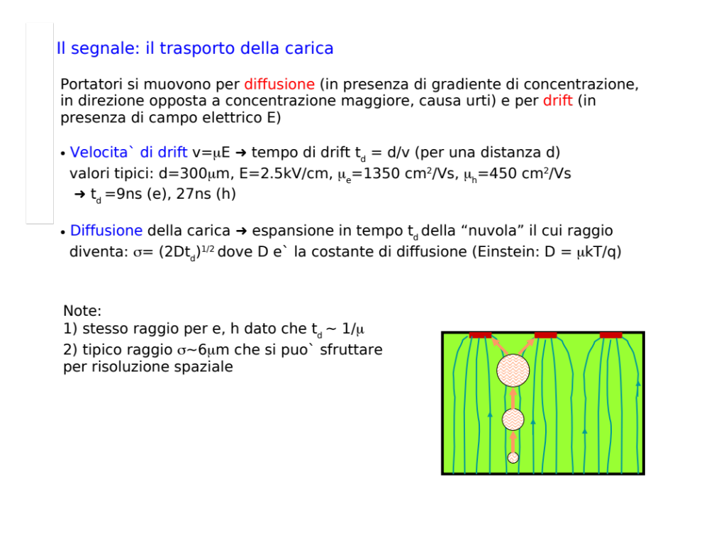
p+
p+
p+
n

Slide 28
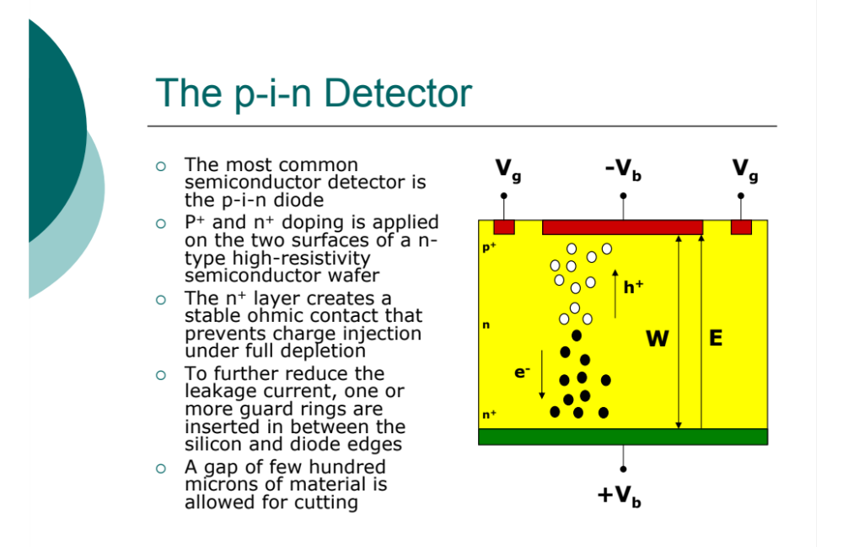
Heavily doped semiconductor as electrical contacts: 10²⁰ atoms/cm³ highly conductive
p+,n+ sign

Slide 29
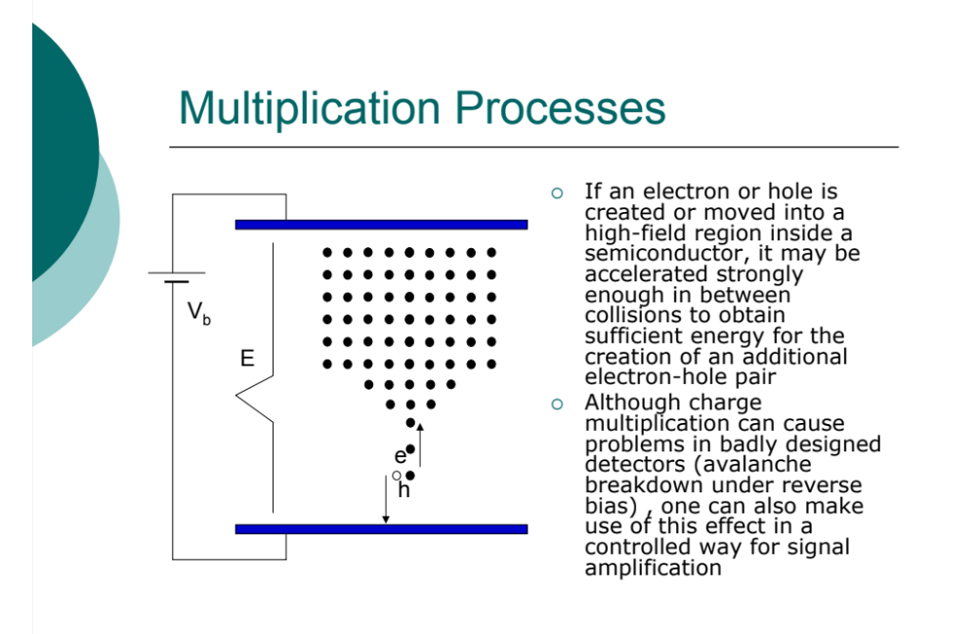

Slide 30
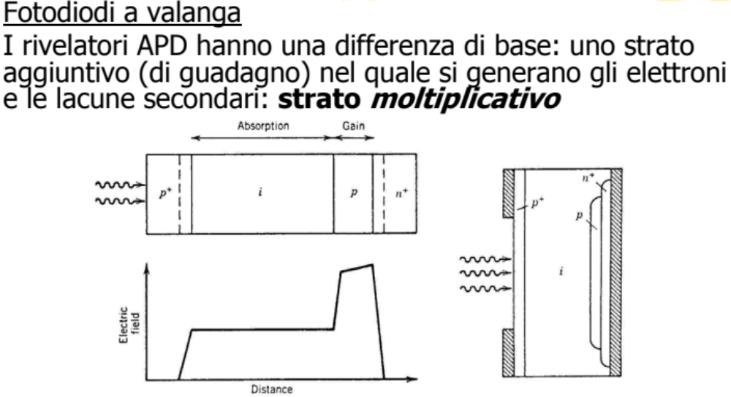
-
+
+
-

Slide 31
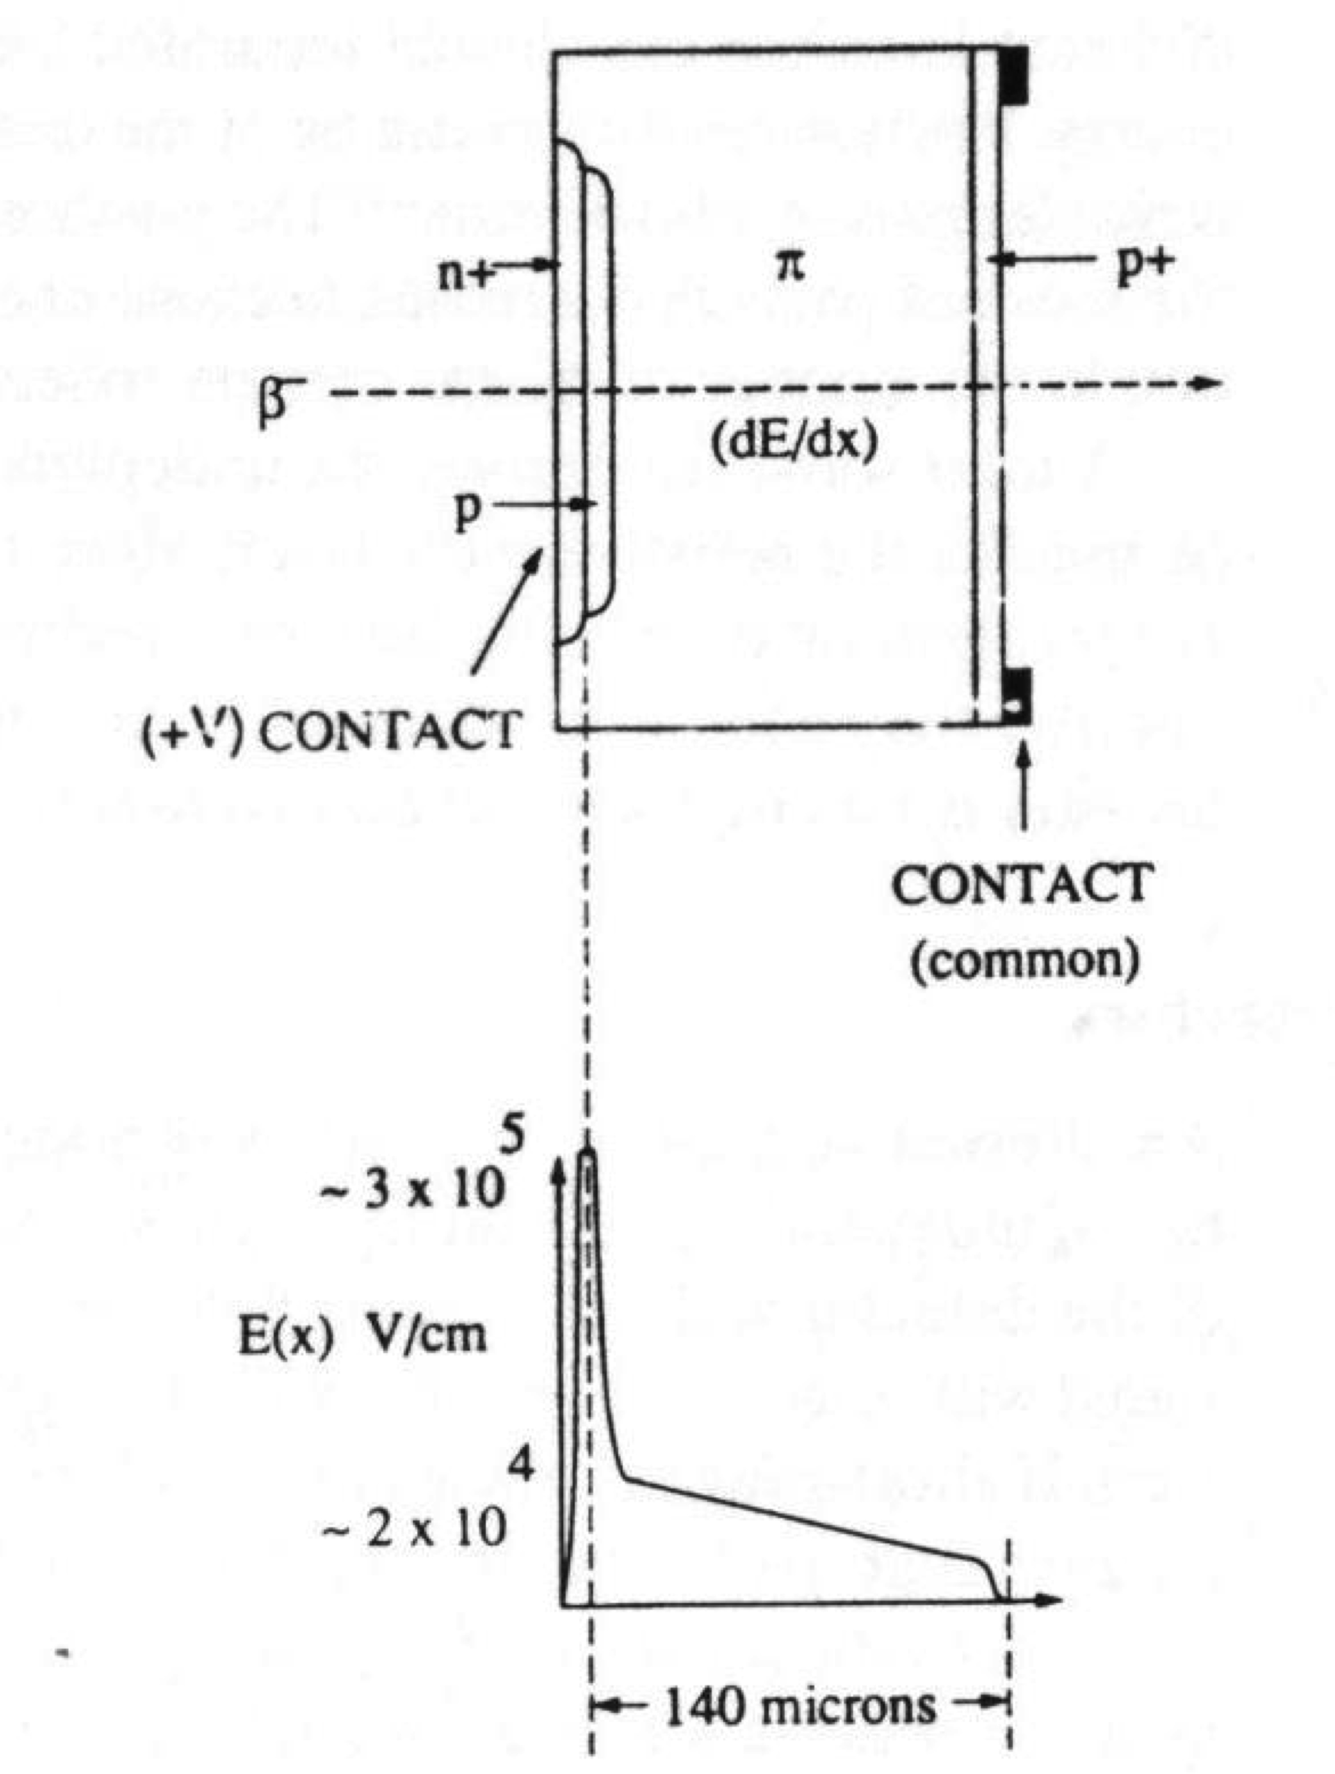
Difficulty to achieve uniform multiplication
in entrance windows.
Gain strong function of applied voltage and
temperature.
In drift region no multiplication.
If all incident radiation interacts within drift
region: all electrons are subject to the same
multiplication in high field region.
Statistical variation in avalanche process
introduce fluctuations in multiplication
lowering the energy resolution.
+
-

Slide 32
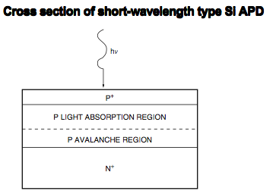
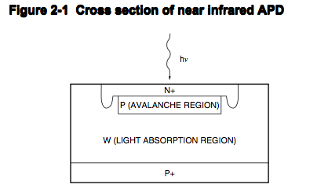
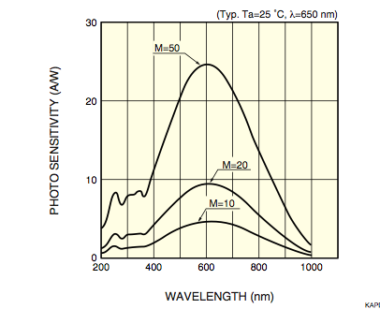
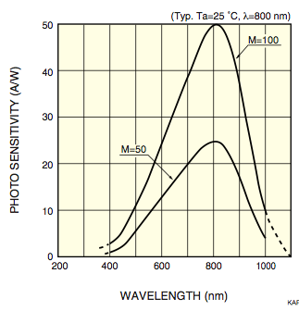



Slide 33


Slide 34

Impact Ionization
diode structure
Simulated diode reverse current
depletion width
-V
IMPACT IONIZATION ON
IMPACT IONIZATION OFF
p+
n
n+
E
electric field
in the reversed
bias diode
V_{BD}
V_{APD}
V < V_{APD} => photodiode 1 collected pair/generated pair
V_{APD} < V <V_{BD} => APD <M> collected pairs/generated pair
V > V_{BD} => Geiger-mode APD inf. collected pairs/generated pair

Slide 35


La ricerca di nuovi fotorivelatori porta inevitabilmente
ai dispositivi al silicio
Diodi p-n
luce
luce
ed oggi + ?
A questo punto rispetto ai
classici PMT mancano:
-superficie attiva
-guadagno per bassi livelli di luce
p-i-n
Amplificazione
1
APD
Amplificazione
50-100

Slide 36

Giunzioni pn in regime Geiger G-APD
-High gain as PMT
-small active surface
matrici di microcelle in parallelo
ogni microcella: GM-APD + R_{quenching}
V. M. Golovin and A. Sadygov
MEPHI

Slide 37


+
-
-
+
First a thin layer (2 to 4 μm) is grown epitaxial on a wafer (typically 300 μm thick)
The first step towards a p-n junction is the diffusion of dopants with high concentration into the epitaxial layer p+,n+.
The junction is then formed some 0.5 μm below the surface by a shallow diffusion (or ion implantation) with the opposite dopant.
In a final step an extremely thin but heavily doped layer is created on the surface which distributes the potential uniformly over the whole area of the diode.
Passivation of the surface with SiO2.
Techniques of photolithography are used to remove selectively areas oxide where entrance window are to be located

Slide 38


Slide 39



Slide 40

SiPMT / G-APD / MPPC
Front contact
Al
Out
hν
Current (a.u.)
R_{quenching}
Two pixels fired
R_{quench}
One pixel
fired
Three pixels
fired
ARC
n⁺
n⁺
p
π
p
p⁺ silicon wafer
n pixels
Back contact
Time (a.u.)
-V_{bias}
- V_{bias}
Altezza impulso
microcontatori indipendenti in regime geiger limitato
Geiger spento dalla caduta del campo e resistenza di
quenching R.
Segnale in uscita somma segnali singoli geiger
V Geiger 10-20% sopra la tensione di brekdown 25-60 V

Slide 41


Slide 42


Slide 43



SiPM: da Hamamatsu MPPC
100 euro!!

Slide 44




Slide 45


Quenching
resistor 1x1
1600 pixel
=145 Ω
microcel
=230 kΩ
Quenching
resistor 3x3
14400 pixel
=26 Ω
microcel
=380 kΩ

Slide 46


Caratteristiche I – V, polarizzazione inversa dei fotorivelatori più comuni, dipendenza del guadagno fotoconduttivo G dalla polarizzazione
Fotorivelatori:
PIN
APD
SiPM

Slide 47



SiPM: Tecnica costruttiva
- pixel
R
R
+
+
Metal-Resistor-Semiconductor
R superficiale disaccoppiamento diodi
30-80 MΩ cm.
R_{Si} microcell quenching ~ 300KΩ
C microcell ~ 50 fC
RC ~ durata segnale ~ 15-20 ns
ITC-irst
Notes:
Aggiungere guadagno IRST, crosstalk,buchi nelle celle

Slide 48


SiPM: efficienza
= QE (γ) / dE/dx (mip)
E _{Si-PM} = ε _{geom} (1-R)(1-e^{αx})ε _{GM}
_{geom}: area geometrica sensibile. Aree morte necessarie per resistori
    di isolamento per ridurre cross talk. Ampio sviluppo tecnologico ~0,6
QE: assorbimento nella regione di svuotamento: per λ=400nm (3,10 eV)
α=5,4x106 cm⁻¹, 99,9% in 2μm. Ottimizzazioni per γ e mip.
spessore di svuotamento, compromesso fra assorbimento e corrente
oscura (meglio per mip <1μ si riduce corrente oscura).
R: coefficiente di riflessione (5%)
sviluppo tecnologico
ε _{GM} : efficienza trigger Geiger (90-100%)

Slide 49

+
-

Slide 50




Slide 51
Geiger-mode APD
Diode biased at V_{D} > V_{BD}
-V_{D}
i=i_{MAX}
i
p+
t < t₀ i=0 (if no free carriers
in the depletion region)
t = t₀ carrier initiates the avalanche
t₀ < t < t₁ avalanche spreading
t > t₁ self-sustaining current
n
n-
t₀
t₁
t
In order to be able to detect another photon, quenching mechanism needed:
V_{BIAS}
v_{D}
Two solutions:
large resistance:
passive quenching
analog circuit:
active quenching
[extended literature from politecnico
di Milano (Cova et al.)]
v_{BD}
V_{D}
t
i
t₀
t₁
t₂
t

Slide 52
Passive quenching (1)
Studied in detail in the ’60 to model micro-plasma instabilities
[ R.J. McIntrye, JAP vol.32, n.6 1961; R. Haitz, JAP vol.35, n.5 1964 ]
The GM-APD can be modeled with an electrical circuit and
two probabilities.
DIODE
OFF condition:
switch open, capacitance charged to V_{BIAS},
no current flowing
P₀₁ = turn-on probability
probability that a carrier traversing the
high-field region triggers the avalanche
ON condition
R_{Q}
V_{BD}
C_{D}
V_{BIAS}
V_{D}
R_{S}
R_{Q} = quenching resistance
R_{S} = series resistance (emulates
the avalanche spreading)
C_{D} = diode capacitance
V_{BD} = breakdown voltage
V_{BIAS} = bias voltage

Slide 53

Passive Quenching (2)
DIODE
I_{INT}
I_{D}
ON condition:
avalanche triggered, switch closed
the capacitance discharges to V_{BD} with
a time constant R_{S}xC_{D}, at the same time
the diode current grows to (V_{BIAS}-V_{BD})/R_{Q}
P₁₀ = turn-off probability
probability that the number of carriers
traversing the high-field region
fluctuates to zero.
OFF condition:
switch open
diode capacitance recharghes from V_{BD}
to V_{BIAS} with a time constant R_{Q}xC_{D}
Ready for new detection
R_{Q}
V_{BD}
C_{D}
V_{BIAS}
V_{D}
R_{S}

Slide 54


Slide 55
GAIN
The area of the current pulse represents the gain
GAIN = Area/q = I_{MAX} x τ / q = C x (V_{BIAS}-V_{BD})/q
The capacitance should be large in order to have
a high gain.
On the other hand, a large capacitance leads to longer
recovery times.
GAIN
C₂>C₁
C₁
V_{BIAS}-V_{BD}

Slide 56


Slide 57


Slide 58


Slide 59


+
-

Slide 60

+
-
+

Slide 61

The noise rate decreases as the temperature becomes lower. The temperature coefficient of noise rate at 0.5 p.e. threshold is −5 %/◦ C. There is a factor 2 reduction of the dark count every 8°C

Slide 62



Slide 63


Slide 64





Slide 65


Slide 66





cell1
cell2
cell1
cell2
Solutions:
operate at low over-voltage => low gain => few photons emitted
optical isolation structure:

Slide 67


Slide 68




Afterpulses

Slide 69





Slide 70

Effetto del crosstalk ottico e degli after – pulses sull’andamento temporale della fototensione di uscita di un SiPM e sulla sua risoluzione temporale
S = risposta elettrica del SiPM ad un impulso luminoso costituito da un singolo fotone
d = risposta elettrica del SiPM ad un impulso luminoso costituito da un singolo fotone: durante questa fotorivelazione si ha l’attivazione spuria di una seconda microcella, limitrofa a quella colpita dal fotone; a causa dell’interferenza ottica fra i 2 pixels la risposta del SiPM sovrastima l’intensità ottica incidente

Slide 71


Slide 72



Slide 73
Esercizi

Slide 74


Example
(b) What is the thickness of a Ge and In_{0.53}Ga_{0.47}As crystal layer that is needed for absorbing 90% of the incident radiation at 1.5 μm?
For Ge, α ≈ 5.2 × 10⁵ m⁻¹ at 1.5 μm incident radiation.
For In_{0.53}Ga_{0.47}As, α ≈ 7.5 × 10⁵ m⁻¹ at 1.5 μm incident radiation.
(b)
For Ge, α ≈ 5.2 × 10⁵ m⁻¹ at 1.5 μm incident radiation.
For In_{0.53}Ga_{0.47}As, α ≈ 7.5 × 10⁵ m⁻¹ at 1.5 μm incident radiation.

Slide 75
Example
InGaAs pin Photodiodes
Consider a commercial InGaAs pin photodiode whose responsivity is shown in fig. Its dark current is 5 nA.
What optical power at a wavelength of 1.55 μm would give a photocurrent that is twice the dark current? What is the QE of the photodetector at 1.55 μm?
What would be the photocurrent if the incident power in a was at 1.3 μm? What is the QE at 1.3 μm operation?
Responsivity (A/W)
1
0.8
0.6
The responsivity of an InGaAs pin photodiode
0.4
0.2
0
800
1000
1200
1400
1600
1800
Wavelength (nm)

Slide 76




Solution
(a) At λ = 1.55×10⁻⁶ m, from the responsivity vs. wavelength curve we have R ≈ 0.87 A/W. From the definition of responsivity,
we have
From the definitions of quantum efficiency η and responsivity,
∴
Note the following dimensional identities: A = C s⁻¹ and W = J s⁻¹ so that A W⁻¹ = C J⁻¹. Thus, responsivity in terms of photocurrent per unit incident optical power is also charge collected per unit incident energy.

Slide 77

Solution
(b) At λ = 1.3×10⁻⁶ m, from the responsivity vs. wavelength curve, R = 0.82 A/W.
Since P_{o} is the same and 11.5 nW as in (a),
The QE at λ = 1.3 μm is

Slide 78
Example
Bandgap and photodetection
(a) Determine the maximum value of the energy gap which a semiconductor, used as a photoconductor, can have if it is to be sensitive to yellow light (600 nm).
(b) A photodetector whose area is 5×10⁻² cm² is irradiated with yellow light whose intensity is 20 mW cm⁻². Assuming that each photon generates one electron-hole pair, calculate the number of pairs generated per second.
Solution
(a) Given, λ = 600 nm, we need E_{ph} = hυ = E_{g} so that,
E_{g} = hc/λ = (6.626×10⁻³⁴ J s)(3×10⁸ m s⁻¹)/(600×10⁻⁹ m) = 2.07 eV
(b) Area = 5×10⁻² cm² and I_{light} = 20×10⁻³ W/cm².
The received power is
P = Area ×I_{light} = (5×10⁻² cm²)(20×10⁻³ W/cm²) = 10⁻³ W
N_{ph} = number of photons arriving per second = P/E_{ph}
= (10⁻³ W)/(2.059×1.60218×10⁻¹⁹ J/eV)
= 2.9787×10¹⁵ photons s⁻¹ = 2.9787×10¹⁵ EHP s⁻¹.

Slide 79
Example
Bandgap and Photodetection
(c) From the known energy gap of the semiconductor GaAs (E_{g} = 1.42 eV), calculate the primary wavelength of photons emitted from this crystal as a result of electron-hole recombination. Is this wavelength in the visible?
(d) Will a silicon photodetector be sensitive to the radiation from a GaAs laser? Why?
Solution
(c) For GaAs, E_{g} = 1.42 eV and the corresponding wavelength is
λ = hc/ E_{g} = (6.626×10⁻³⁴ J s)(3×10⁸ m s⁻¹)/(1.42 eV×1.6×10⁻¹⁹ J/eV)
= 873 nm (invisible IR)
∴The wavelength of emitted radiation due to EHP recombination is 873 nm.
(d) For Si, E_{g} = 1.1 eV and the corresponding cut-off wavelength is,
λ_{g} = hc/ E_{g} = (6.626×10⁻³⁴ J s)(3×10⁸ m s⁻¹)/(1.1 eV×1.6×10⁻¹⁹ J/eV)
= 1120 nm
Since the 873 nm wavelength is shorter than the cut-off wavelength of 1120 nm, the Si photodetector can detect the 873 nm radiation (Put differently, the photon energy corresponding to 873 nm, 1.42 eV, is larger than the E_{g}, 1.1 eV, of Si which mean that the Si photodetector can indeed detect the 873 nm radiation)

