Slide 1
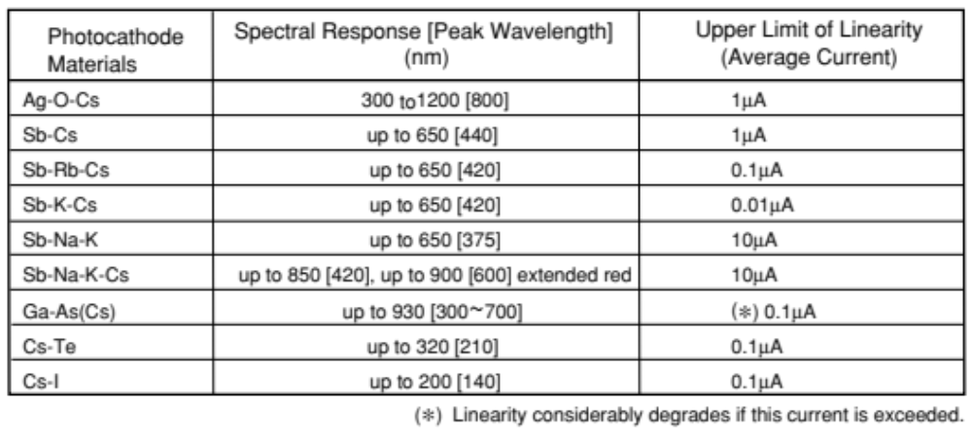
Linearity
The photomultiplier tube exhibits good linearity in anode output current over a wide range of incident light levels as well as the photon counting region. it offers a wide dynamic range. However, if the incident light amount is too large, the output begins to deviate from the ideal linearity. This is primarily caused by anode linearity characteristics, but it may also be affected by cathode linearity characteristics when a photomultiplier tube with a transmission mode photocathode is operated at a low supply voltage and large current.
Photocathode materials
and cathode linearity
limits for transmission
mode photocathodes
In the reflection mode photocathodes which are formed on a metal plate have a low resistivity, the linearity will not be a problem. To reduce the effects of photocathode resistivity on the device linearity, it is recommended to apply a voltage of 50 to 300 volts between the photocathode and the first dynode. For semiconductors, the photocathode surface resistivity increases as the temperature decreases. Thus, consideration must be done on the photocathode resistivity when cooling the photomultiplier tube.

Slide 2
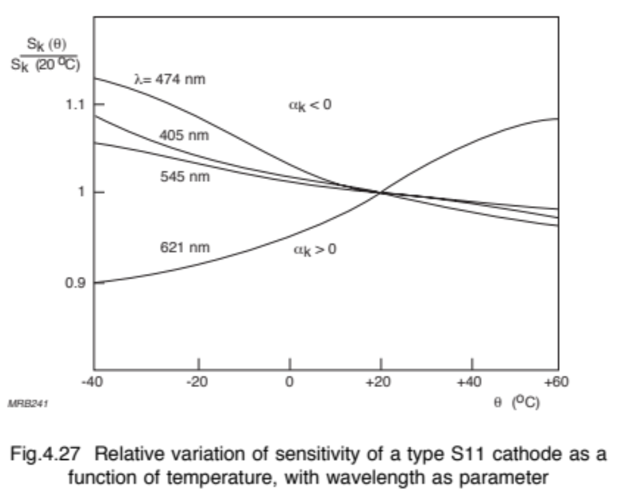
The spectral sensitivity characteristic does not vary much with temperature.

Slide 3
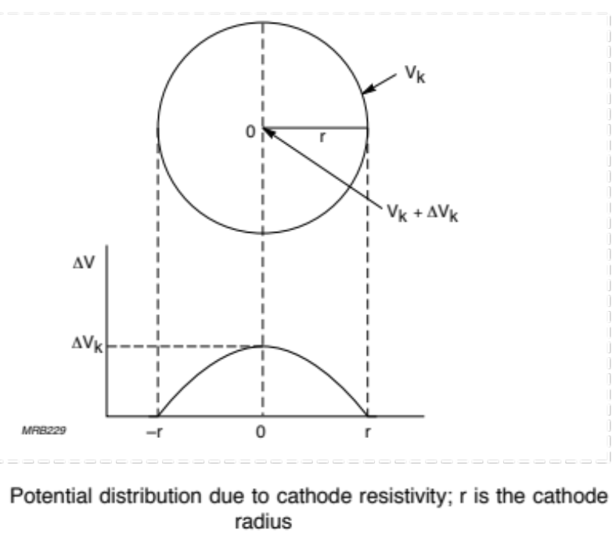
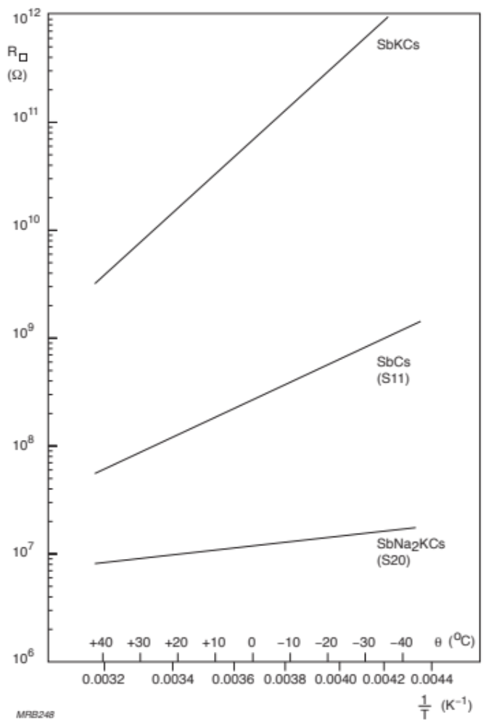
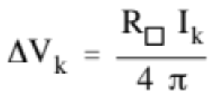
A circular cathode of uniform sensitivity, uniformly illuminated and emitting
a total current Ik. Let R be its surface resistivity (the bulk resistivity divided by the thickness); the potential difference between the centre and the edge is then:
If it exceeds a few volts, this potential difference increases the input-system convergence and causes loss of electrons emitted from the cathode edge.
Surface resistivities of three photoemissive materials as func- tions of temperature

Slide 4
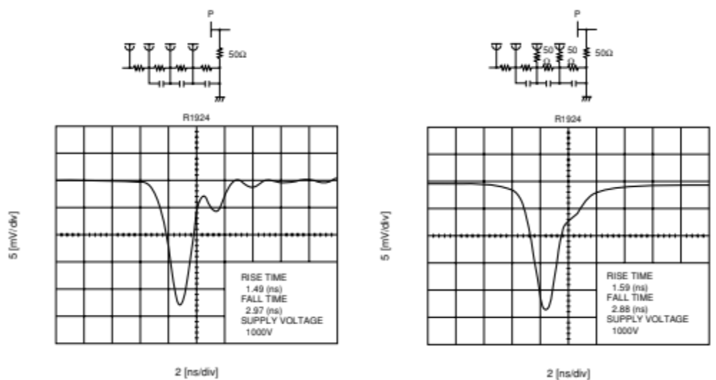
In applications handling a fast pulsed output with a rise time of less than 10 nanoseconds, inserting damping resistors R10 into the last dynode and if necessary, R9 into the next to last dynode can reduce ringing in the output waveform. As damping resistors, noninduction type resistors of about 10 to 200 ohms are used.
Effect of damping resistors on ringing

Slide 5
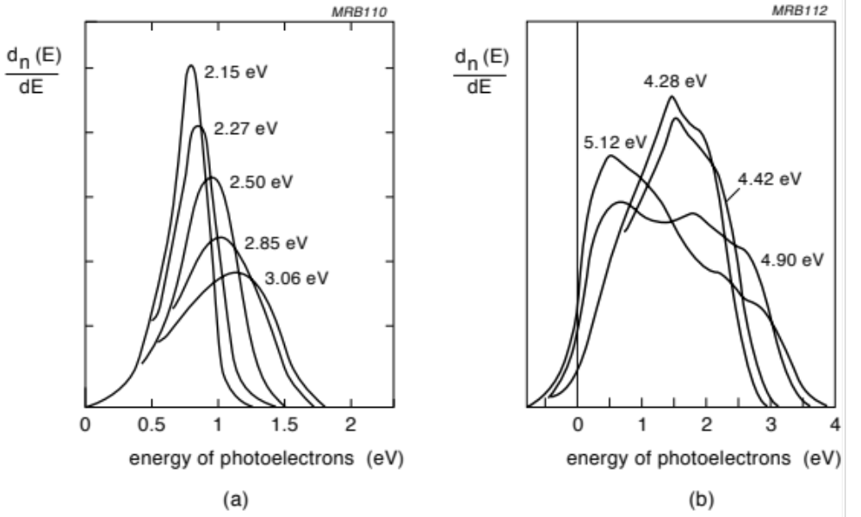
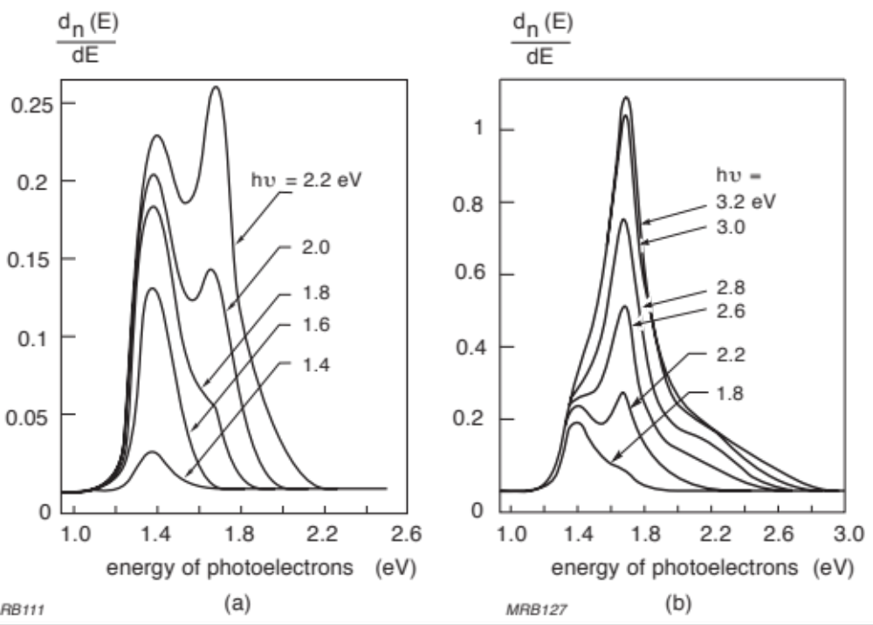
Time characteristic
Relative distribution of photoelectron energies, Eph, from a layer of SbKCs at 290 K, for incident photon energies (a) from 2.15 eV to 3.06 eV, and (b) from 4.28 eV to 5.12 eV
E_{phe} vs. E_{ph}
NEA
Photoelectron energy distribution (in electrons per photon per eV) from a layer of GaAs(Cs) for incident-photon energies (a) from 1.4 eV to 2.2 eV, and (b) from 1.8 eV to 3.2 eV

Slide 6
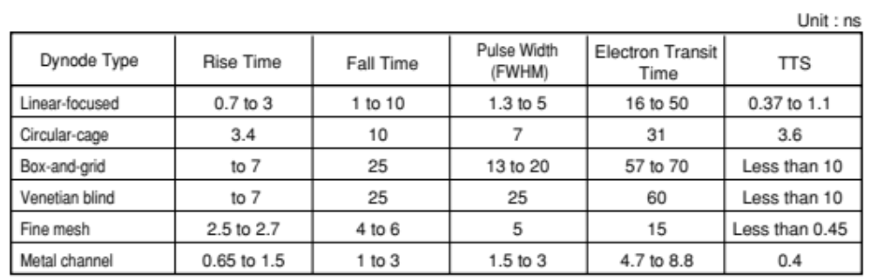
Time characteristic
The time response is determined primarily by the transit time required for the photoelectrons emitted from the photocathode to reach the anode after being multiplied as well as the transit time difference between each photoelectron. Accordingly, fast response photomultiplier tubes are designed to have a spherical inner window and carefully engineered electrodes so that the transit time difference can be minimized.
lists the timing characteristics of 2-inch diameter head-on photomultiplier tubes categorized by their dynode type. As can be seen from the table, the linear-focused type and metal channel type exhibit the best time characteristics, while the box-and-grid and venetian blind types display rather poor properties.
Transit-time fluctuations in the cathode/first-dynode space have two components: a chromatic one due to the spread of photoelectron initial velocities, and a geometric one due to path-length differences.

Slide 7
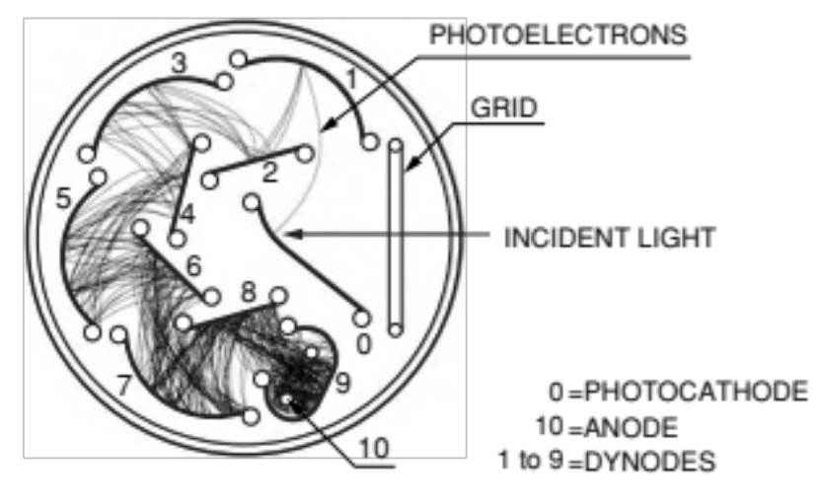
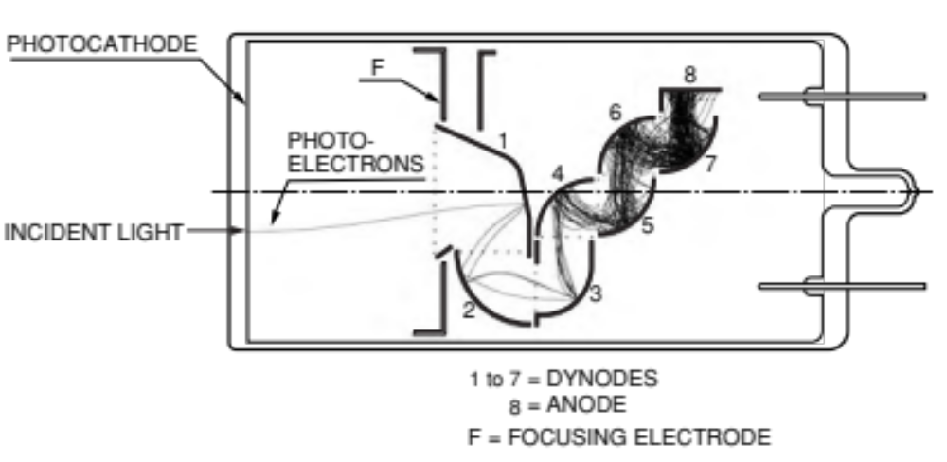
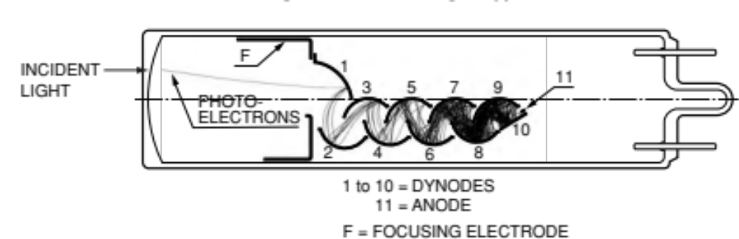
Circular-cage, box-and-grid, and linear-focused dynode structures
transmission mode
Circular-cage type
side-on type
Compactness
Time response
Box-and-grid type
head-on type
Collection efficiency uniforminty
Linear-
focused
type
Time
resolution
linearity
transmission mode

Slide 8
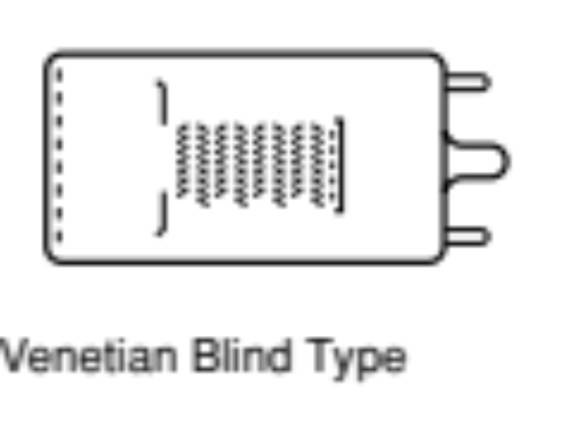
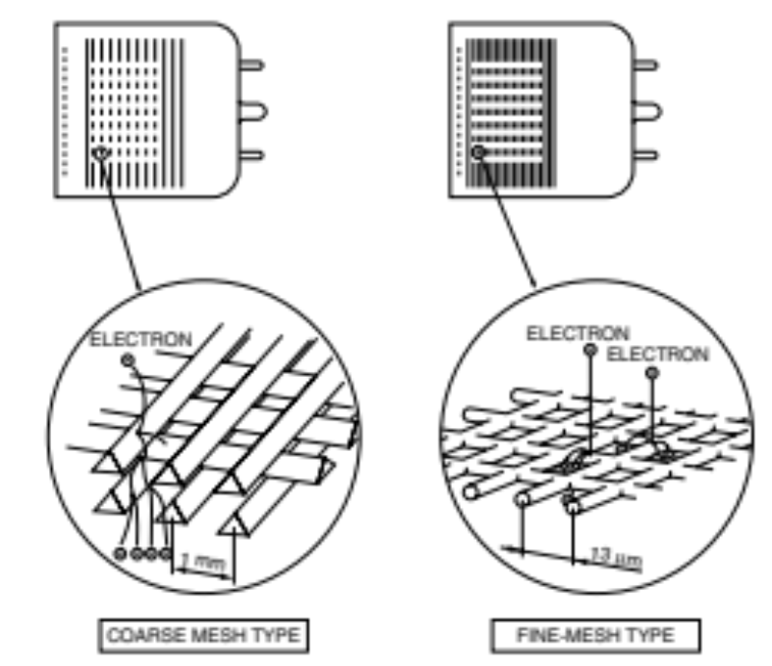
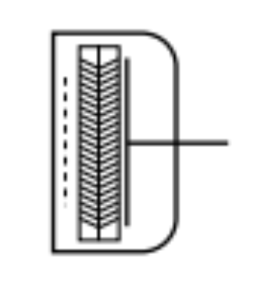
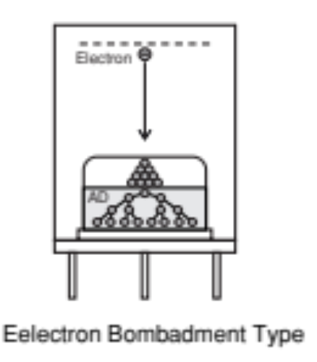
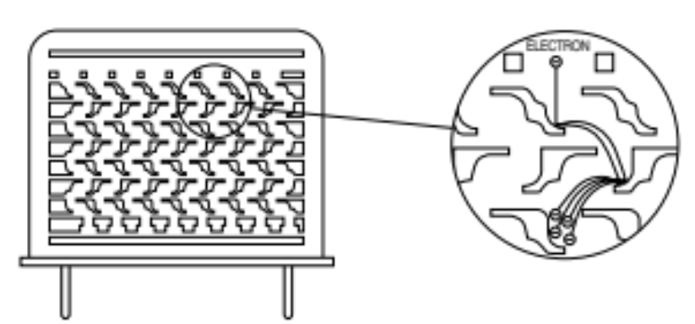
Mesh-type
Parallel
electric
Field
Magnetic
field parallel
Anode
Position
proximity
Simple design, collection
for large area
Metal Channel type
Microchannel
Plate
Time, position
Short electron path, proximity, magnetic
And time resolution
Time, power photon
counting

Slide 9
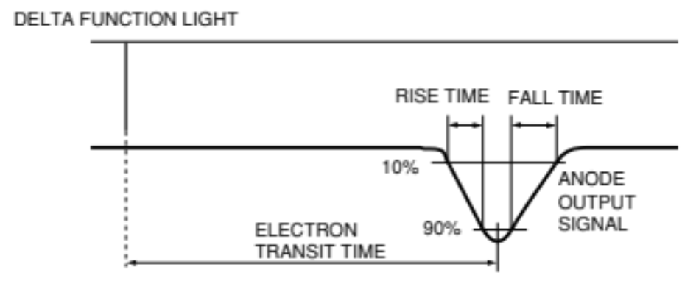
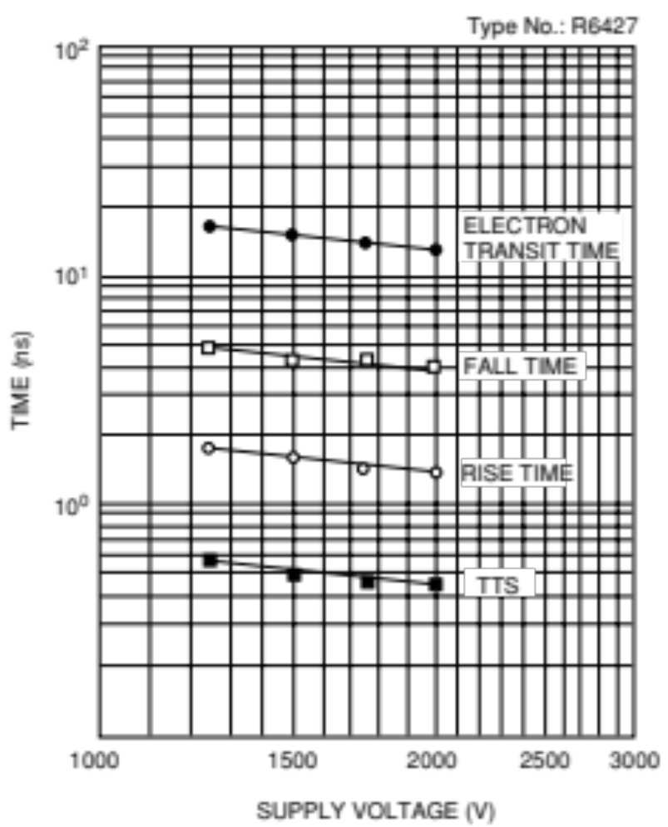
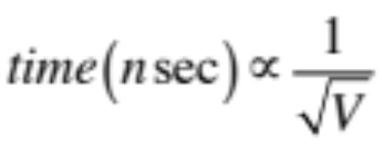
The time response is mainly determined by the dynode type, but also depends on the supply voltage. Increasing the electric field intensity or supply voltage improves the electron transit speed and thus shortens the transit time. In general, the time response improves in inverse proportion to the square root of the supply voltage.

Slide 10
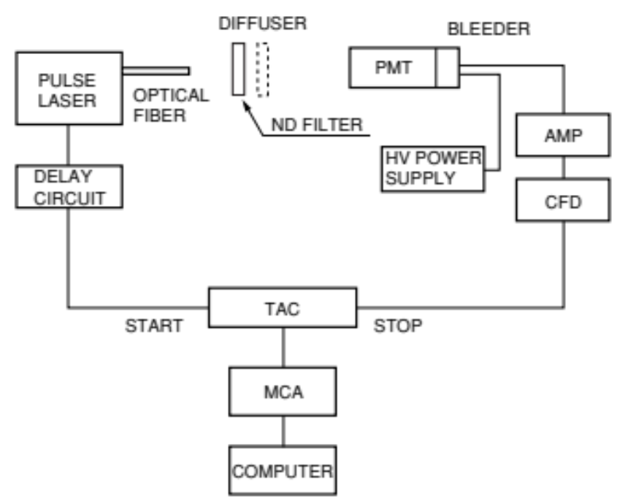
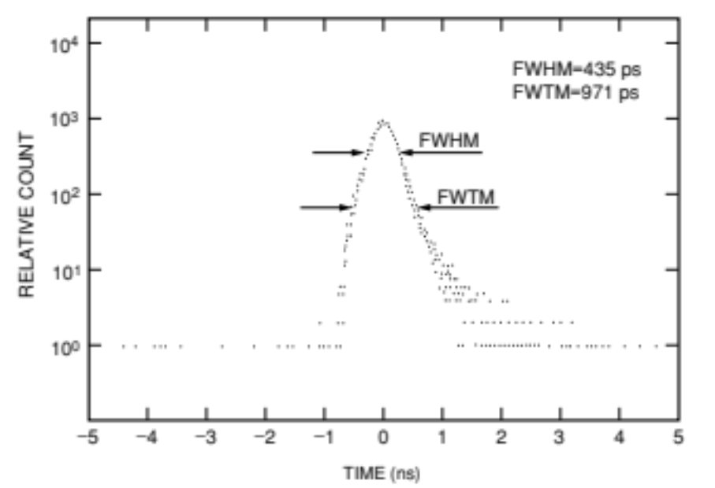
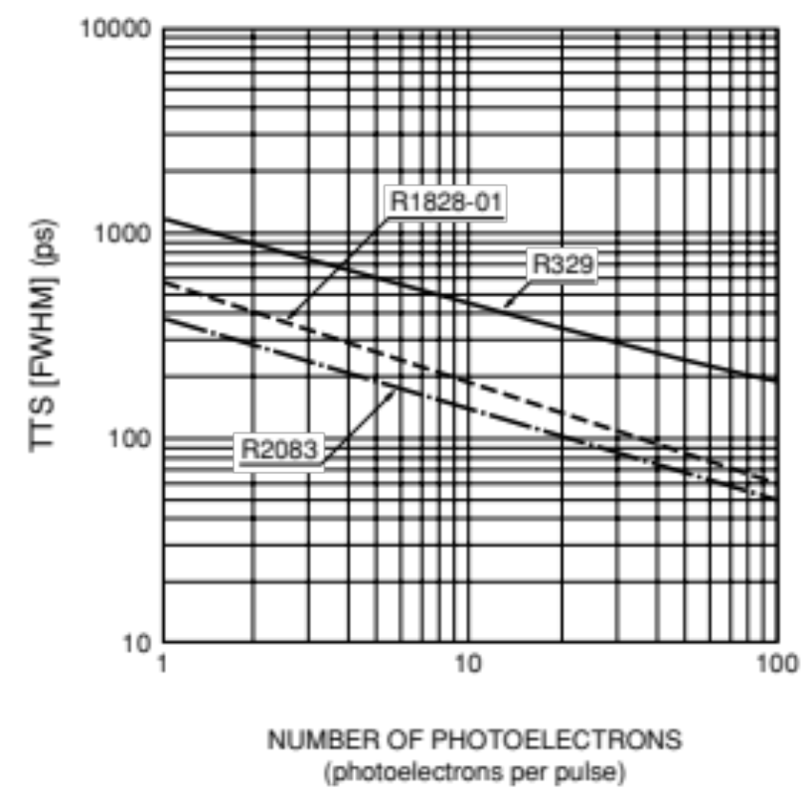
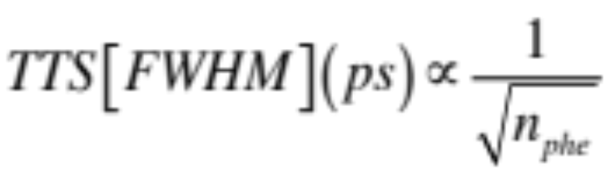
Block diagram for TTS measurement
The TTS improves as the number of photoelectrons per pulse increases, in inverse proportion to the square root of the number of photoelectrons.

Slide 11
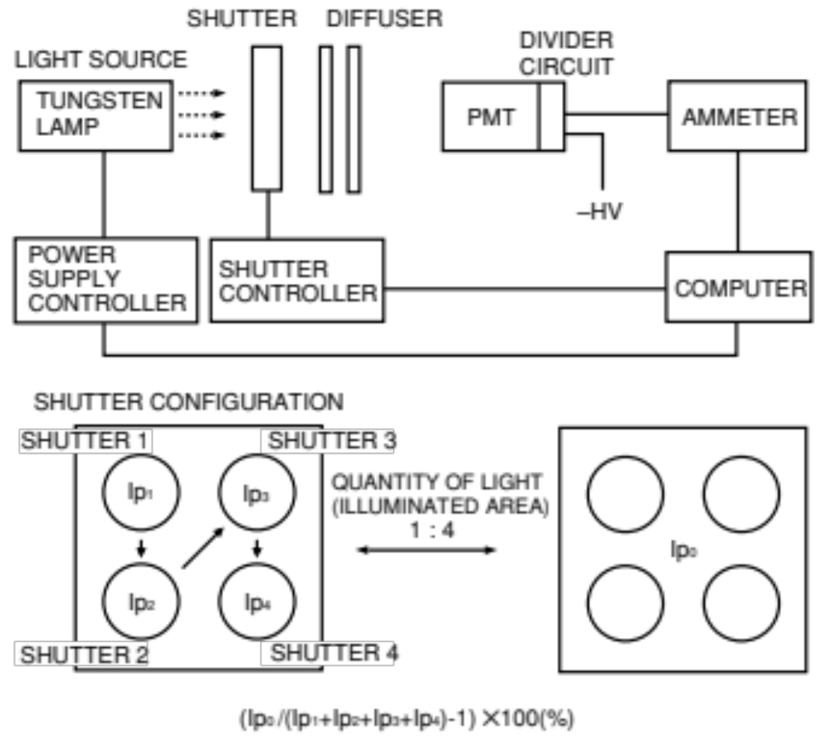
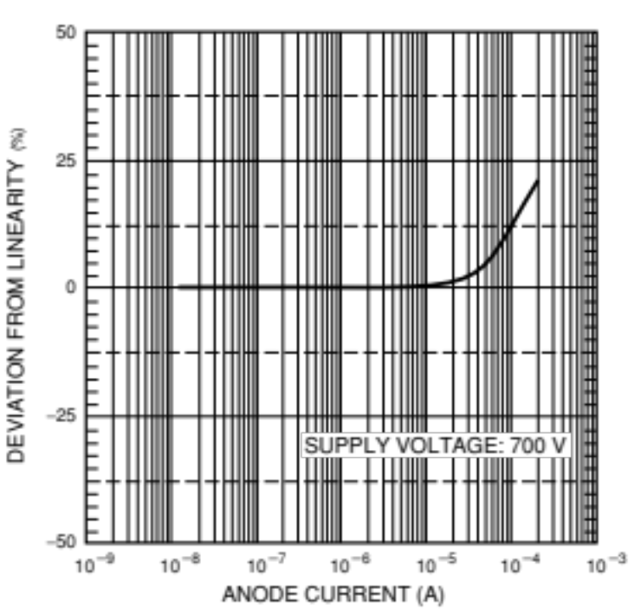
Linearity measurement (DC)
Each aperture is opened in the order of 1, 2, 3 and 4, finally all four apertures are opened, and the photomultiplier tube outputs are measured (as Ip1, Ip2, Ip3, Ip4 and Ip0, respectively). Then the ratio of Ip0 to (Ip1+Ip2+Ip3+Ip4) is calculated
(Ip0/(Ip1+Ip2+Ip3+Ip4)-1)✕100(%)
This value represents a deviation from linearity and if the output is within the linearity range. Repeating changing the intensity of the light source

Slide 12
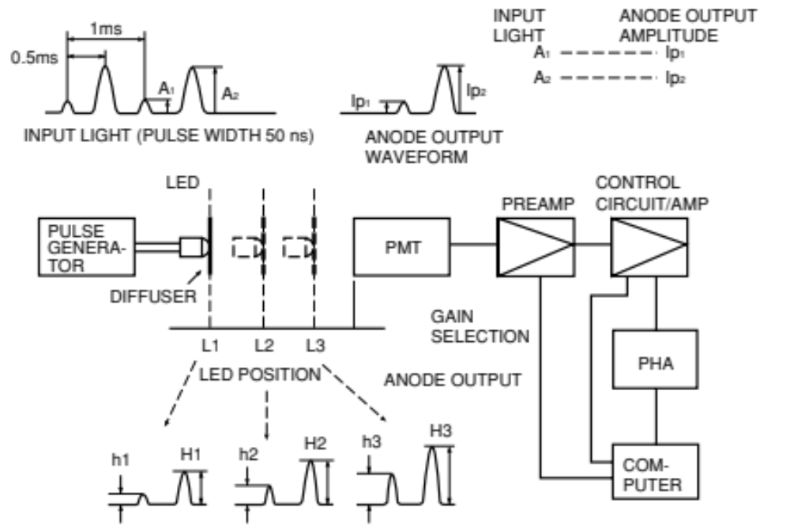
Linearity measurement (pulse mode)
An LED operated in a double-pulsed mode is used to provide higher and lower pulse ampli- tudes alternately. The higher and lower pulse amplitudes are fixed at a ratio of approximately 4:1.At sufficiently low light levels
Ip02/Ip01 = 4
(Ip2/Ip1)-(Ip02/Ip01)/(Ip02/Ip01)✕100 (%)
This indicates the extent of deviation from linearity at the anode output Ip2.
If the anode output is in the linearity range, the following relation is always established:
(Ip2/Ip1) = (Ip02/Ip01)
Block diagram for pulse mode linearity measurement

Slide 13
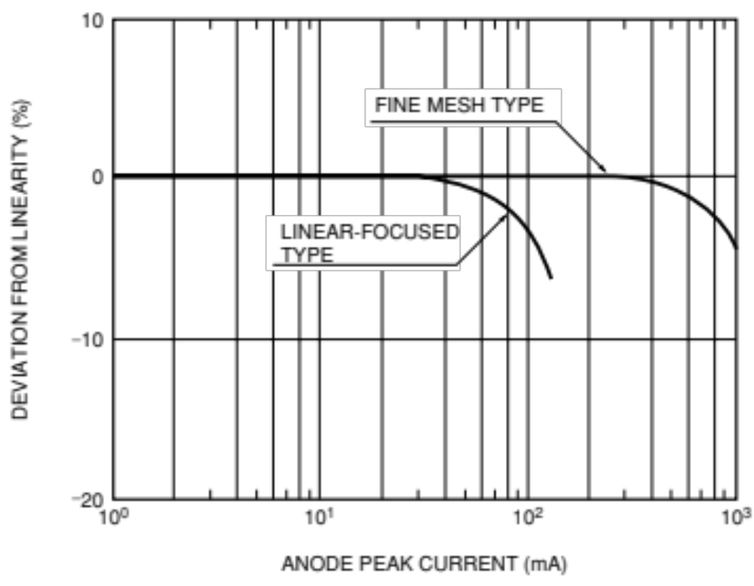
Pulse linearity

Slide 14
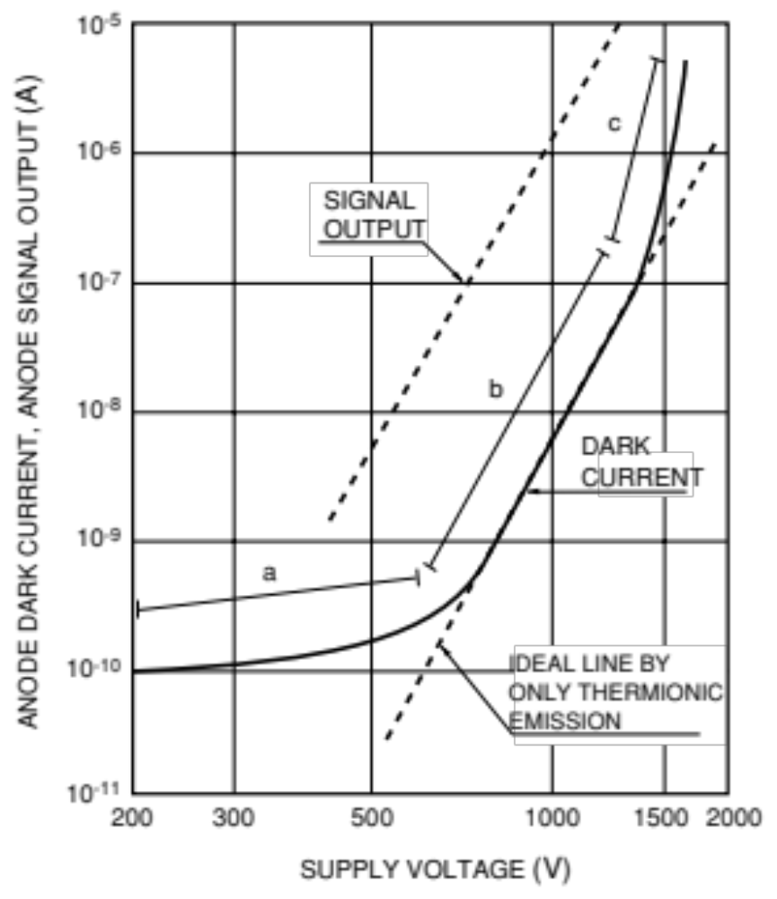
Causes of dark current
Dark current may be categorized by cause as follows:
Thermionic emission current from the photocathode and dynodes
(b) Leakage current (ohmic leakage) between the anode and other electrodes inside the tube
(c) Photocurrent produced by scintillation from glass envelope or electrode supports
(d) Field emission current
(e) Ionization current from residual gases
(f) Noise current caused by cosmic rays, radiation from radioisotopes contained in the glass envelopes and environmental gamma rays
Region a is dominated by the leakage current, region b by the thermionic emission, and region c by the field emission and glass or electrode support scintillation.

Slide 15
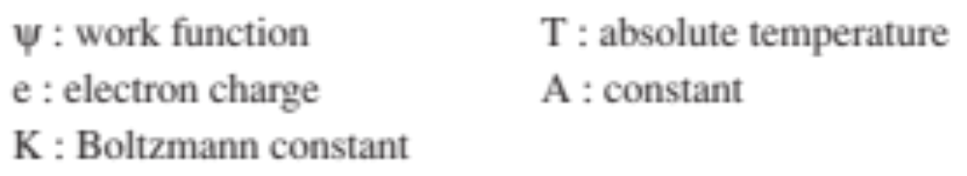
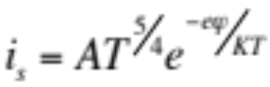
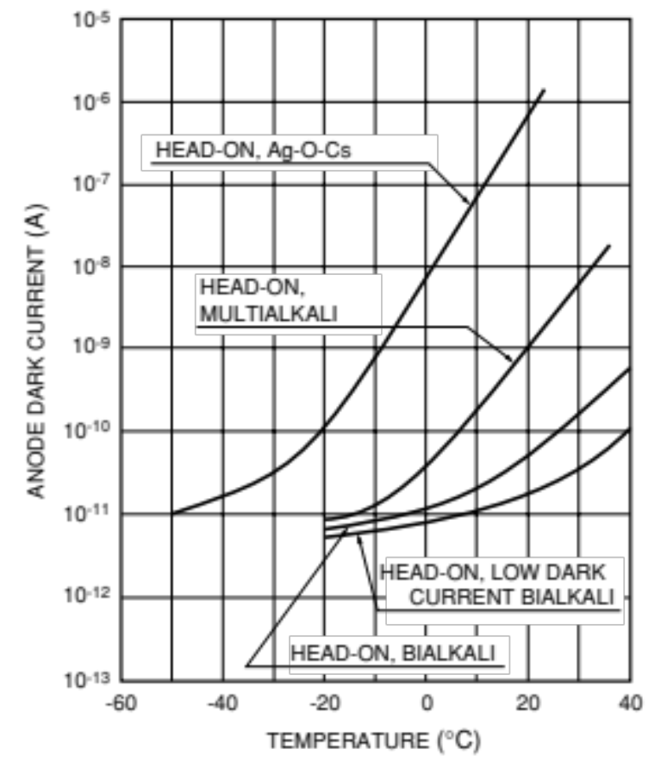
Thermionic emission 1
The photocathode and dynode surfaces are composed of materials with a very low work function, they emit thermionic electrons even at room temperatures. When the photocathode work function is low, the spectral response extends to the light with lower energy or longer wavelengths, with an increase in the thermionic emission.
Alkali metals, the Ag-O-Cs photocathode with a spectral response in the longest wavelength range exhibits the highest dark current. The photocathodes for the ultraviolet range (Cs-Te, Cs-I) provide the lowest dark current.
In the range 300 to 500 nm is between 10 and 1000 electrons/cm²s.
If the sensitivity extends towards the long wavelengths (lower electron affinity) is as high as a few million electrons/cm²s.
The photocathode has a much larger effect on the dark current because the photocathode is larger than each dynode. Thermionic emission varies exponentially with the supply voltage.
Dark current resulting from thermionic emission varies exponentially with the supply voltage.

Slide 16
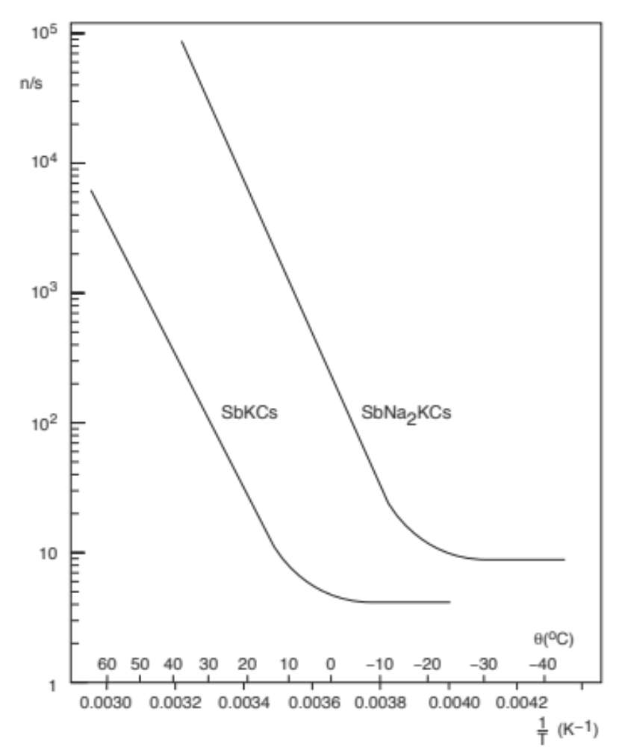
Thermionic emission 2
At normal temperatures, thermionic emission is the predominating cause of the dark current, at least at normal supply voltages. At low temperatures, it becomes negligible compared with other causes, and the dark pulse rate tends towards a plateau as the temperature decreases.
Number of dark pulses per second as a function of temperature, for SbKCs and SbNa2KCs photocathodes

Slide 17
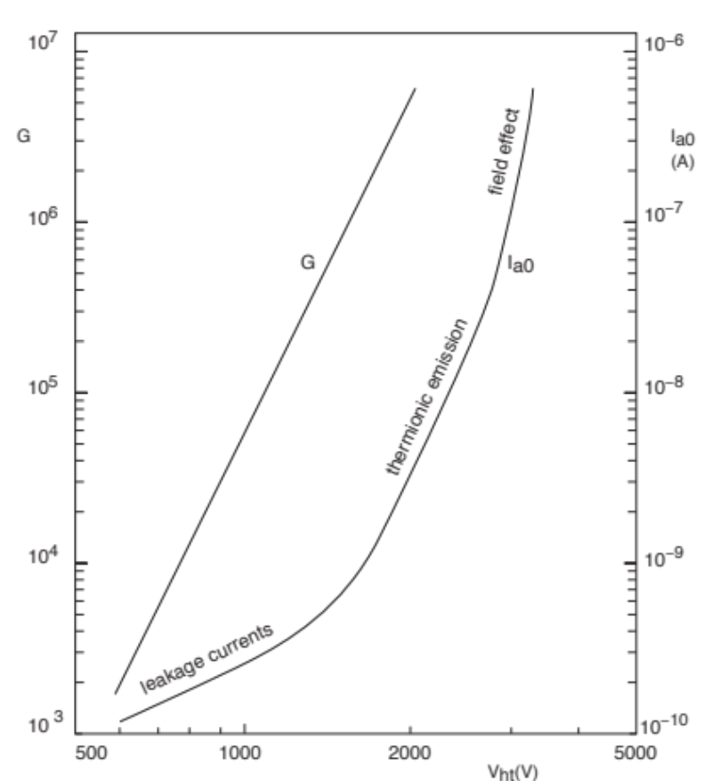
Leakage current (ohmic leakage)
The quality of the insulating materials used in the tubes is very important. If the insulation resistance is around 10¹² ohms, the leakage current may reach the nanoampere level, (I) = supply voltage (V)/insulation resistance (R). Low gain dependence.
Field emission
Electrons emitted by field effect bombard the envelope glass and other surfaces causing emission of photons which can reach the photocathode.
The dark pulse rate due to field emission does not depend much on temperature. It depends on the applied voltage and increases faster than the gain, which is one of the principal factors that sets a practical limit to gain.
Figure shows the three ranges of supply voltage in which each of the three causes of dark current, predominates.

Slide 18
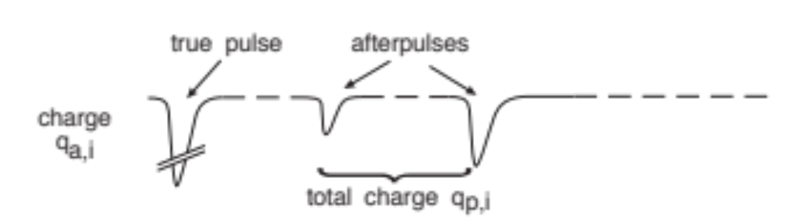
ionization current of residual gases (ion feedback/afterpulses)
photomultiplier tube is kept at a vacuum as high as 10-6 to 10-5 Pa. The molecules of the residual gases may be ionized by collisions with electrons. These positive ions return to the photocathode (ion feedback) and produce many photoelectrons which result in afterpulses.
generating an output pulse appearing after the main photocurrent. The transit time of the ions depends more on the input system electric field and the mass of the ions than on the distance from the cathode at which they originate. The usual ions are H+, and He+, and CH +(typical transit times of about 0.3 μs, 0.4 μs and 1 μs). The amplitude of the resulting afterpulses increases very rapidly with increasing cathode to first-dynode voltage. Ionization afterpulses originating in the electron multiplier come mainly from the last stages, where the electron current is largest. The relative amplitude of these pulses increase rapidly with gain.
Background radiation
When muons pass through the glass envelope, Cherenkov radiation may occur, releasing a large number of photons (Window). Glasses contains an of the radioactive element ⁴⁰K emits beta and gamma rays which may cause noise. Scintillation is due to interaction of low-energy α- and β-radiation with the glass of the envelope; such radiation may come from the surroundings or from ⁴⁰K.

Slide 19
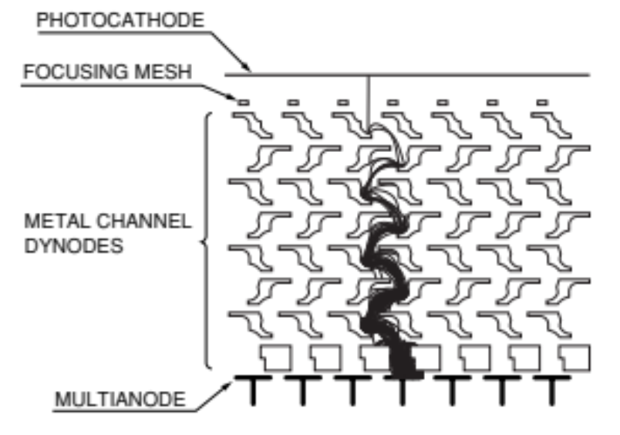
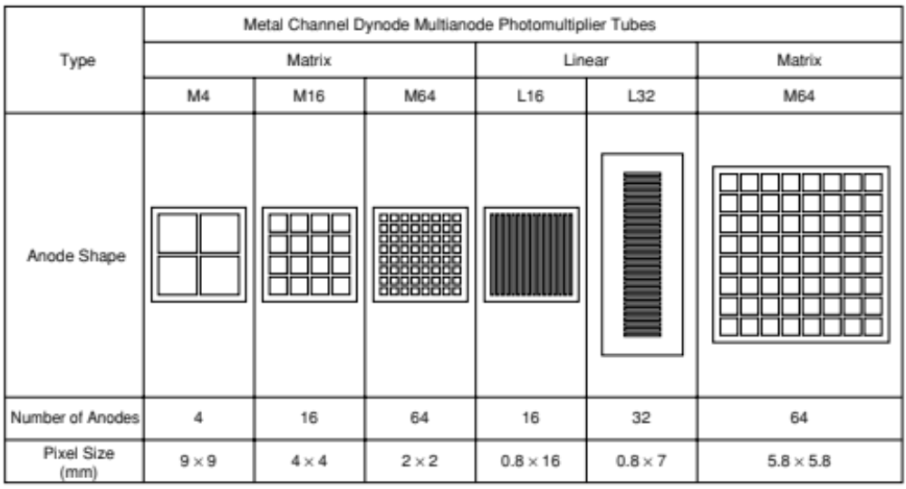
Multianode Photomultiplier Tubes
Metal channel dynode type multianode photomultiplier tubes
Compared to the other types of dynodes, metal channel dynode type have a very low crosstalk during secondary electron multiplication. Minimum spatial spread in the secondary electron flow.
Crosstalk is mainly caused by the broadening of the electron flow when light is converted into electrons and those electrons are multiplied by the dynode section.
≈1-2-3%

Slide 20
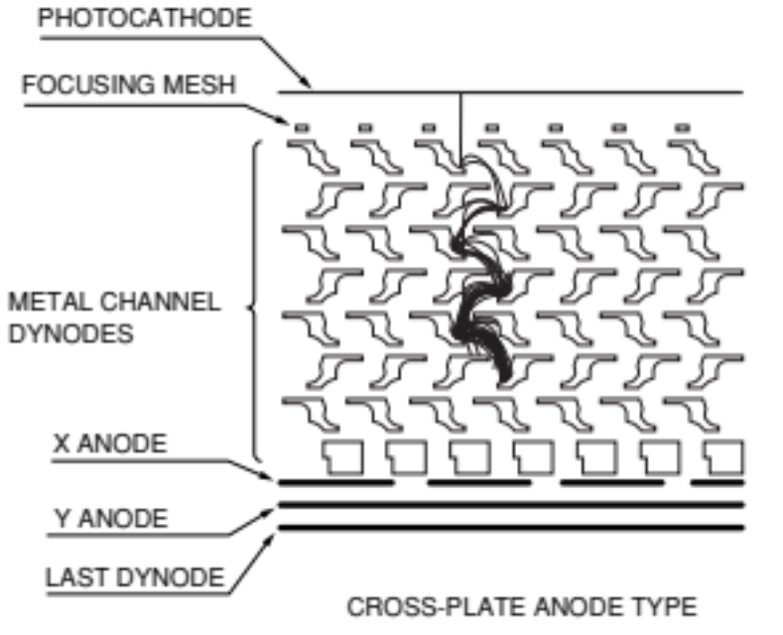
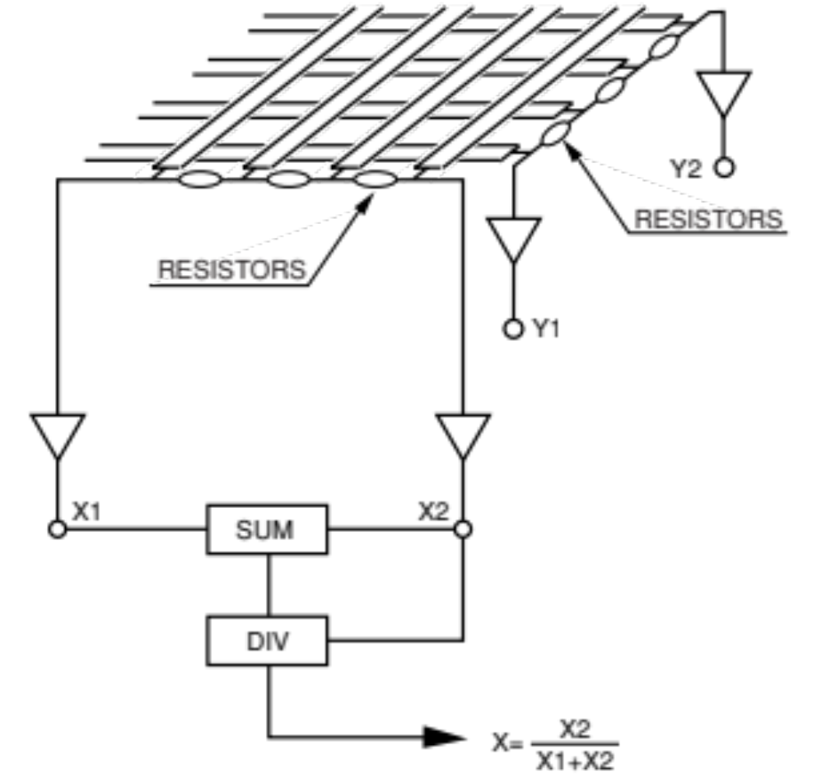
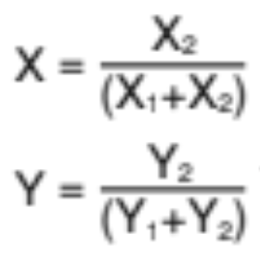
Center-of-Gravity Position Sensitive Photomultiplier Tubes
Center-of-gravity detection method for reading out the output signal from a position-sensitive photomultiplier tube using a cross-plate anode. Anodes linearly arranged in the X and Y directions. Anode in the same direction is connected by a resistor string.The collected electrons are divided into four signal components X1, X2, Y1 and Y2 corresponding to the anode position By (SUM) and divider (DIV) circuits, the center of gravity in the X and Y directions isobtained.

Slide 21
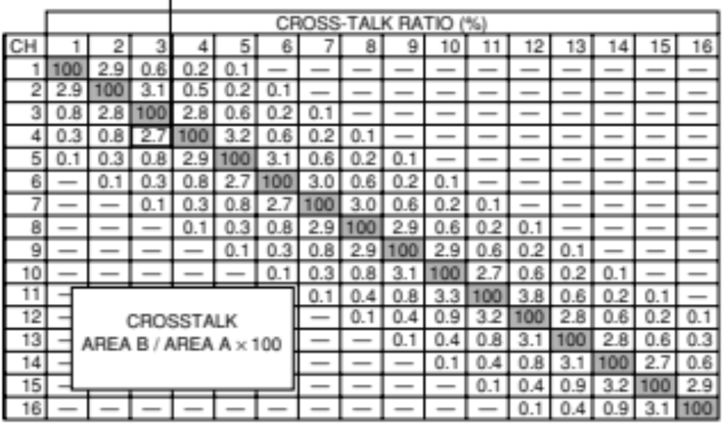
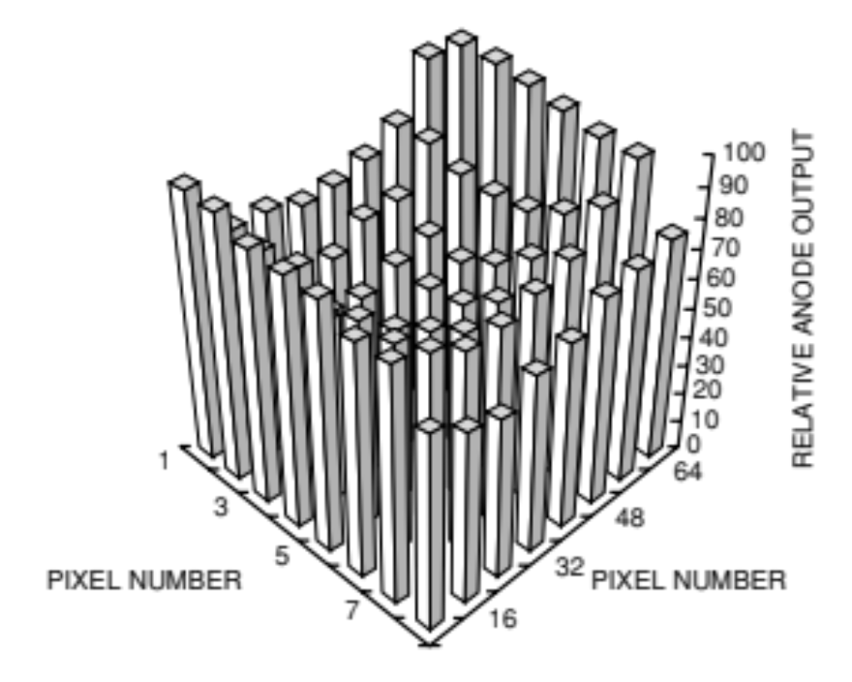
Crosstalk of 16-channel linear anode
Anode output uniformity per pixel
Typical uniformity data obtained from each anode when uniform light is illuminated over the entire photocathode of a 64-channel multianode photomultiplier tube. The non-uniformity observed here probably originates from gain variations in the secondary electron multiplier because the photocathode itself has good uniformity. Currently, non-uniformity between each anode is about "1:1.7" on average.

Slide 22
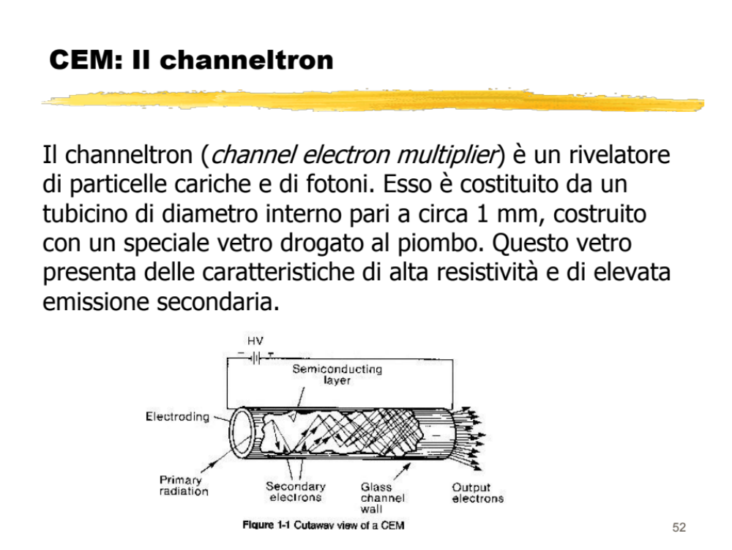

Slide 23
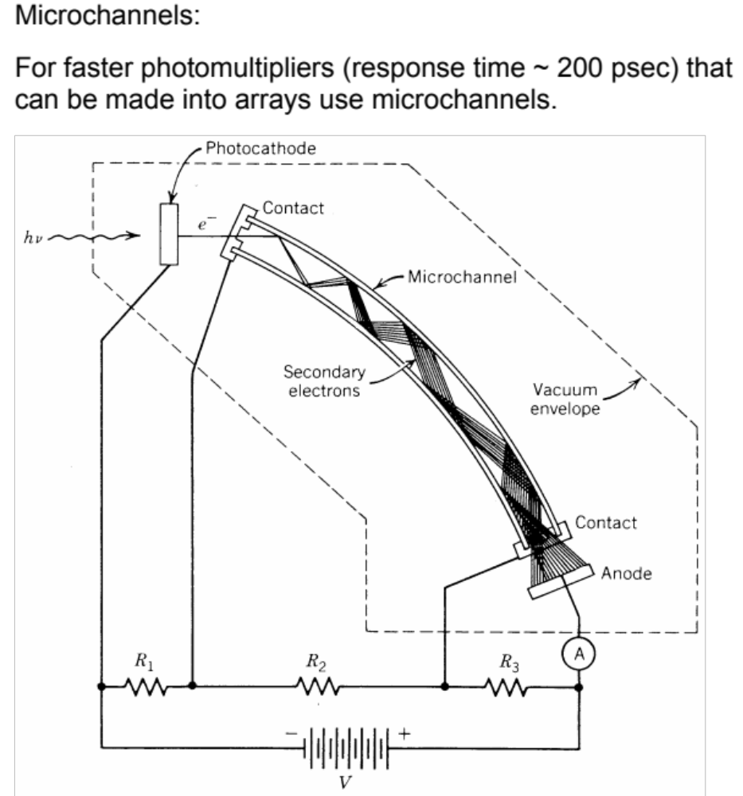

Slide 24
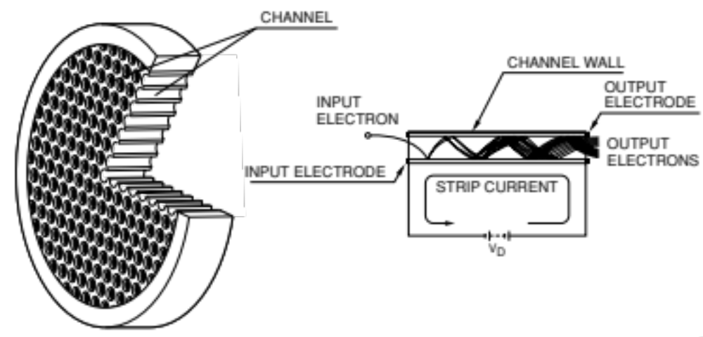
Microchannel plate MCP
Schematic structure of an MCP and its principle of multiplication
The MCP consists of a two-dimensional array of a great number of glass capillaries (channels) bundled in parallel and formed into the shape of a thin disk. Each channel has an internal diameter ranging from 6 to 20 microns with the inner wall processed to have the proper electrical resistance and secondary emissive properties. When a primary electron impinges on the inner wall of a channel, secondary electrons are emitted and accelerated by the electric field created by the voltage applied across both ends of the MCP.

Slide 25
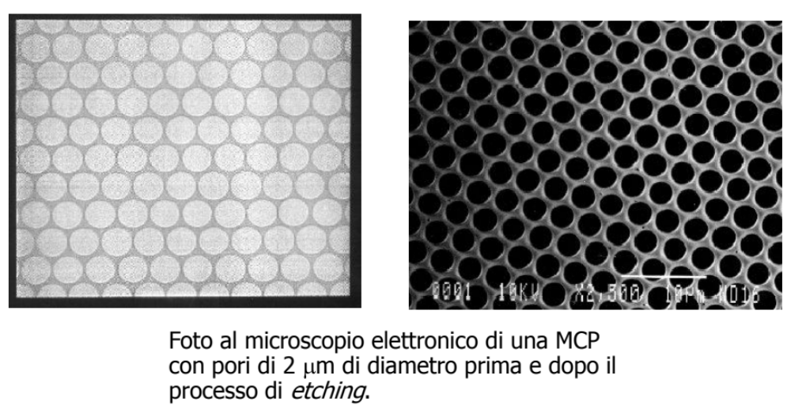

Slide 26
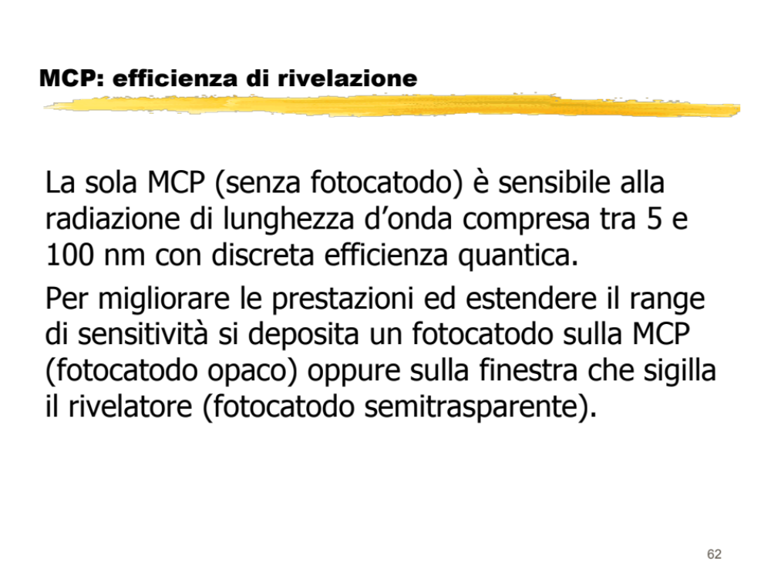

Slide 27
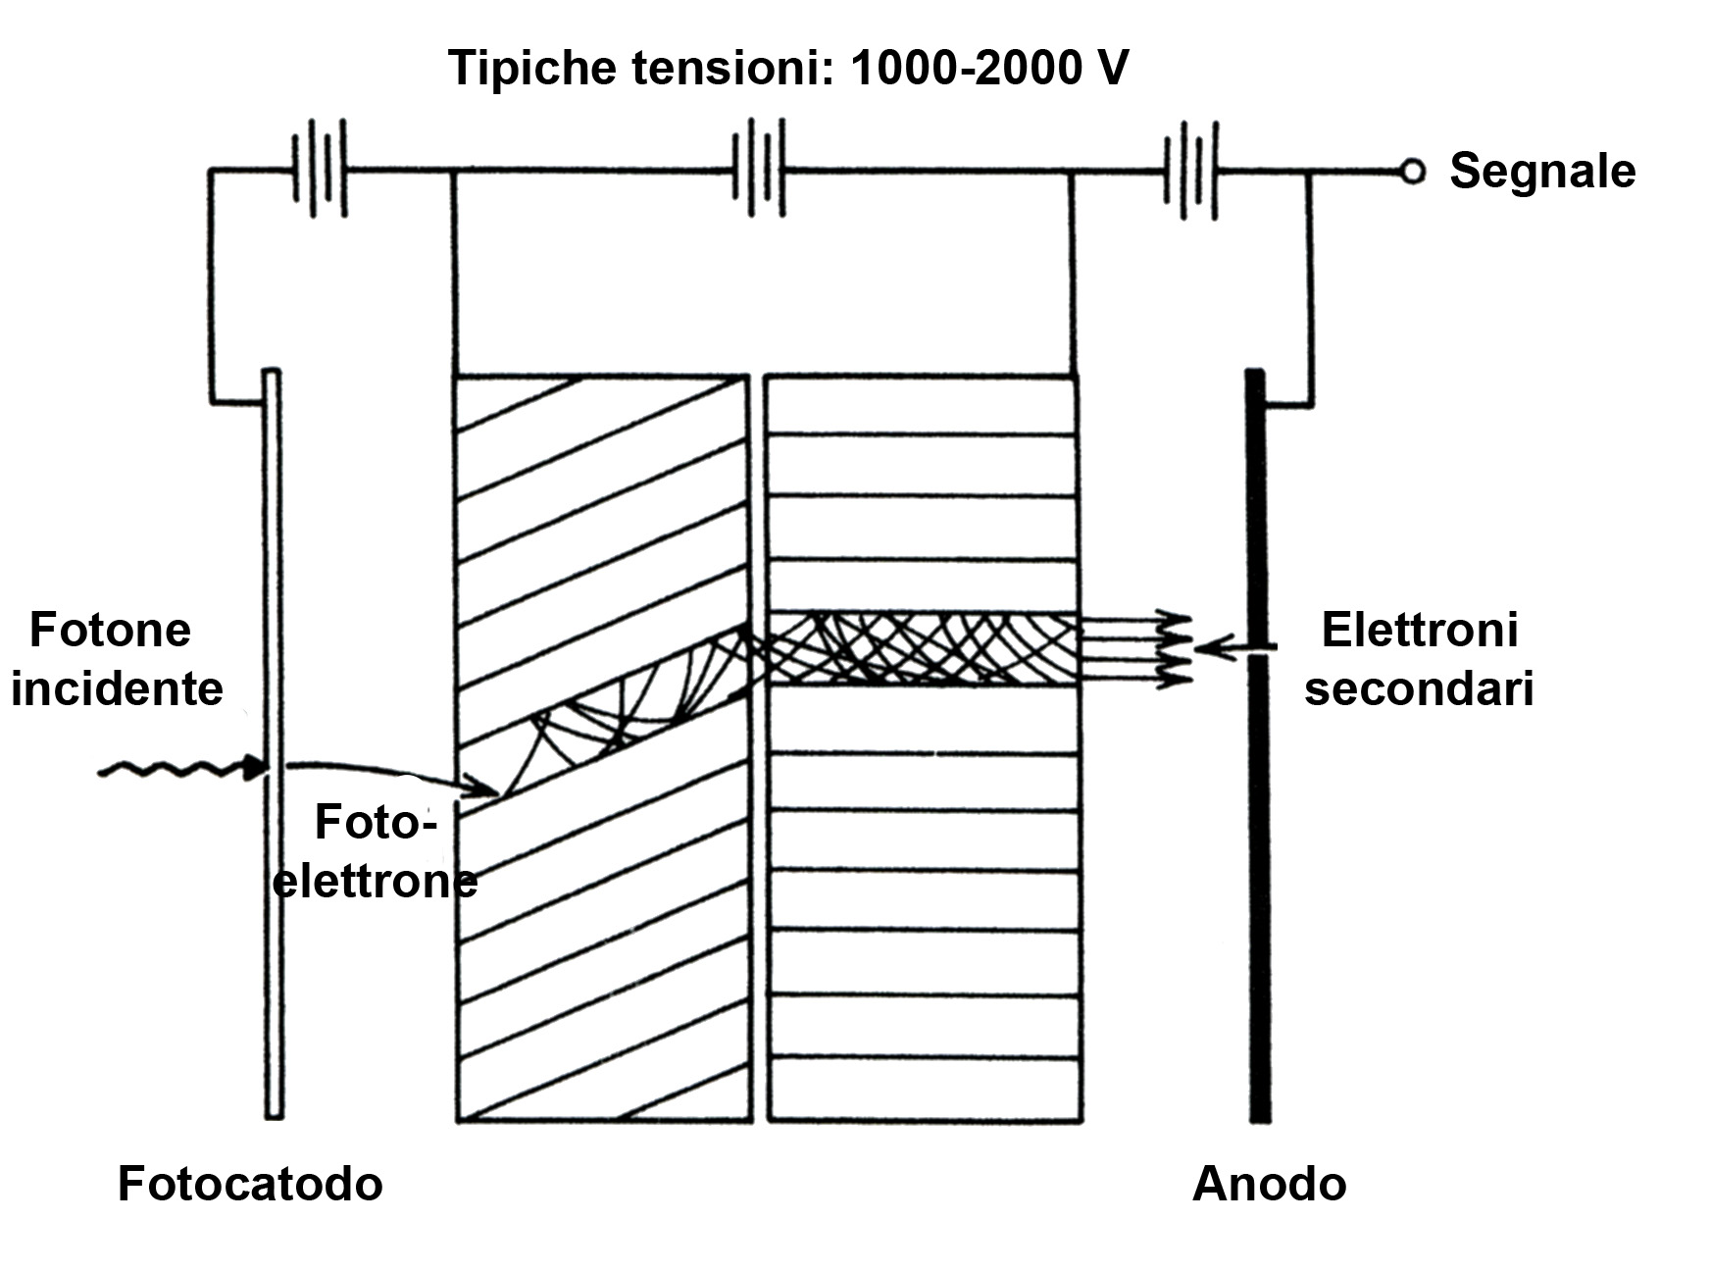
Thermionic emission 1
MULTICHANNEL PLATE
Consiste di un insieme di tubicini di materiale vetroso ad alta resistività affacciati ad un fotocatodo e confluenti su un anodo. La loro superficie interna funge da emettitore secondario di elettroni, che vengono accelerati e moltiplicati nel loro interno da una ddp di circa 1000 V.
STRUTTURA A “CHEVRON”
Piegandoli opportunamente (struttura a "chevron") si evita che gli ioni positivi driftando indietro acquistino energia sufficiente per innescare ulteriori processi di emissione secondaria.

Slide 28
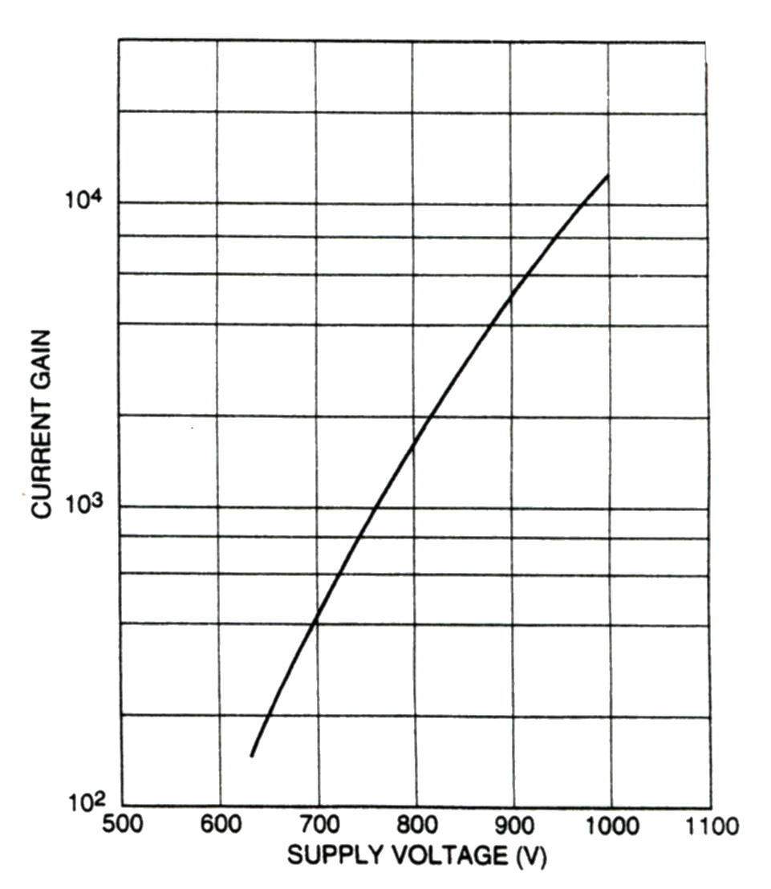
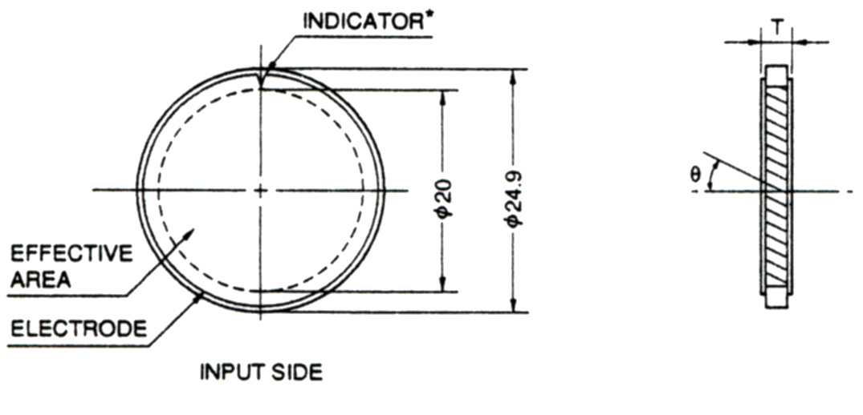
Il guadagno è limitato a 10⁶ -10⁷ da effetti di carica spaziale all'uscita dei tubicini.
Il diametro dei tubicini è di 15 -50 μ e la lunghezza è di circa 40 volte il diametro.
Il tempo di transito è di circa 1ns ( 10 volte meno di un P.M.) e lo spread di questo di circa 100 ps ( minore di quello dei P.M.).
Non risentono di problemi di campi magnetici, hanno problemi di instabilità di guadagno a lungo termine, rates, e sono costosi.

Slide 29

Tipiche caratteristiche
di un MCP

Slide 30


Cross section of a typical MCP-PMT
Voltage-divider circuit
MCP-PMT consists of an input window, photocathode, MCP, and anode. This process is repeated along the channels, and finally a large number of electrons are collected by the anode as an output signal. The photocathode to MCP distance is approximately 2 millimeters, forming a close proximity structure. Two MCPs are stacked to obtain sufficient gain. A thin film called "ion barrier" is usually formed on the photoelectron input side of the MCP in order to prevent ions generated inside the MCP from returning to the photocathode. The gain of an MCP is determined by the length-to-diameter ratio α (=L/d) of a channel: μ = EXP (G . α)
If the gain becomes higher than 10⁴, noise increases due to ion feedback effects. To avoid this, α is usually selected to be around 40.

Slide 31



Typical gain of an MCP-PMT (using a two-stage MCP of 6 μm channel diameter)
In an MCP-PMT, a strong electric field is applied in nearly parallel from the photocathode to MCP. In the case of proximity-focused MCP-PMTs, it has little effect on the TTS.

Slide 32


Slide 33

Pulse linearity of an MCP-PMT (11 mm effective diameter, 6 mm channel diameter)

