Slide 1
Definizione
Un resto di supernova (SNR) è un involucro gassoso che un’esplosione di supernova lascia dietro di sé. E’ costituito dagli strati più esterni della stella esplosa che si dilatano nello spazio formando un guscio.
La materia espulsa spazza via il gas e la polvere circostante e espandendosi produce un’onda shock che eccita e ionizza il gas (riscaldamento e ionizzazione), questo porta alla formazione di raggi x e onde radio sotto forma di radiazione di Sincrotrone. Gradualmente l’espansione rallenta finché il resto non si dissolve nell’ambiente.
Un resto di supernova può raggiungere diametri di una decina o centinaia di anni luce.
I SNR sono oggetti radio ma anche visibili in ottico, in X e γ.
Un oggetto che ha uno spettro radio non termico e risulta polarizzato è identificato come resto di supernova.

Slide 2
SNR
un resto di supernova (SNR dalla dizione inglese Supernova remnant) è il materiale lasciato dalla gigantesca esplosione di una supernova. Questo può accadere in due modi: quando una stella molto massiccia termina il suo combustibile nucleare, e collassa su se stessa sotto l'azione della propria forza di gravità, oppure quando una nana bianca accumula abbastanza materiale da una stella compagna da raggiungere la massa critica e fa la stessa fine. In entrambi i casi, l'esplosione risultante espelle con molta forza la maggior parte o forse tutta la materia che componeva la stella.
Nel caso dell'esplosione di una stella massiccia, il nucleo della stella può collassare così rapidamente da formare un oggetto estremamente compatto formato da materia degenere. Si tratta generalmente di una stella di neutroni o a volte di un buco nero, a cui ci si riferisce come resto di supernova compatto. In tutte le esplosioni, gli strati esterni della stella sono espulsi all'esterno ad una velocità di migliaia di chilometri al secondo, dando luogo a una nube di gas e polveri in espansione che raccoglie anche il mezzo interstellare.
Questa nube è spesso attraversata da onde d'urto generate dall'esplosione stessa e’ detta resto di supernova diffuso. Il resto di supernova compatto, quando esiste, dovrebbe trovarsi al centro di quello diffuso, ed in alcuni casi è così (come nel caso della Nebulosa del Granchio e della Nebulosa delle Vele). Spesso però l'esplosione è asimmetrica: il grosso del gas va da una parte e l'oggetto compatto viene "sparato" nell'altra direzione. In tal caso l'oggetto compatto esce rapidamente (poche centinaia o migliaia di anni) dal resto di supernova diffuso e diventa difficile mettere in relazione i due. Un resto di supernova diffuso è un oggetto effimero: in poche migliaia di anni si dissolve nel mezzo interstellare, che arricchisce degli elementi pesanti prodotti nel corso della vita della stella, e scompare.

Slide 3
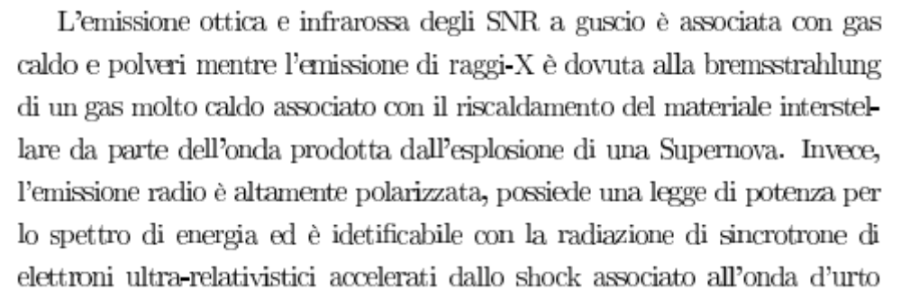

Slide 4
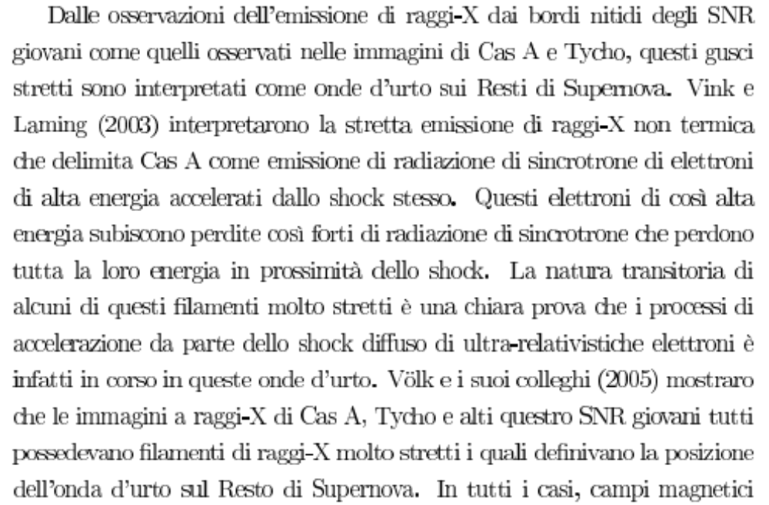

Slide 5
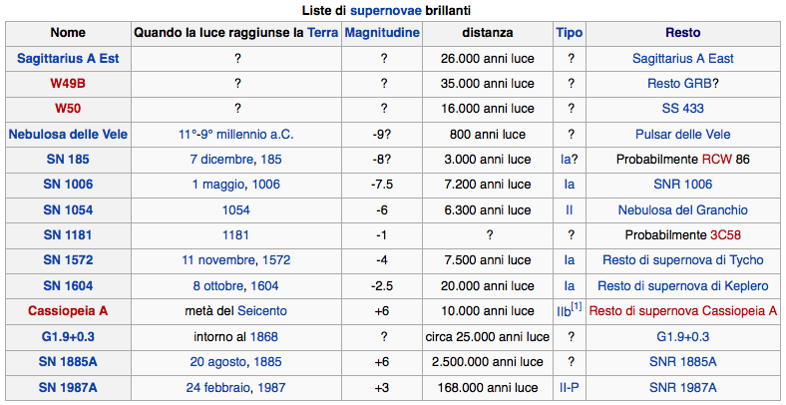

Slide 6
The Supernova Remnant MSH 15-52 has been observed in very high energy (VHE) γ-rays using the HESS 4-telescope array located in Namibia. A γ-ray signal is detected at the 25 sigma level during an exposure of 22.1 h live time. The image reveals an elliptically shaped emission region around the pulsar PSRB1509–58, This morphology coincides with the diffuse pulsar wind nebula as observed at X-ray energies by ROSAT. The overall energy spectrum from 280 GeV up to 40 TeV can be fitted by a power law with photon index Γ = 2.27 ± 0.03 stat ± 0.20 syst. The detected emission can be plausibly explained by inverse Compton scattering of accelerated relativistic electrons with soft photons.
The white contour lines denote the X-ray (0.6–2.1 keV) count rate measured by ROSAT (Trussoni et al. 1996). The black point and black star lie at the pulsar position and at the ex- cess centroid, respectively. The right-bottom inset shows the simulated PSF smoothed identically.
The data are consistent with a power law (dN/dE ∝ E−Γ) up to ∼40TeV with a photon index of Γ = 2.27 ± 0.03_{stat} ^{± 0.20}_{syst} and a differential flux at 1TeV of
^{(5.7 ± 0.2}_{stat} ^{± 1.4}_{syst}^{) × 10−12 TeV−1 cm−2 s−1.}

Slide 7
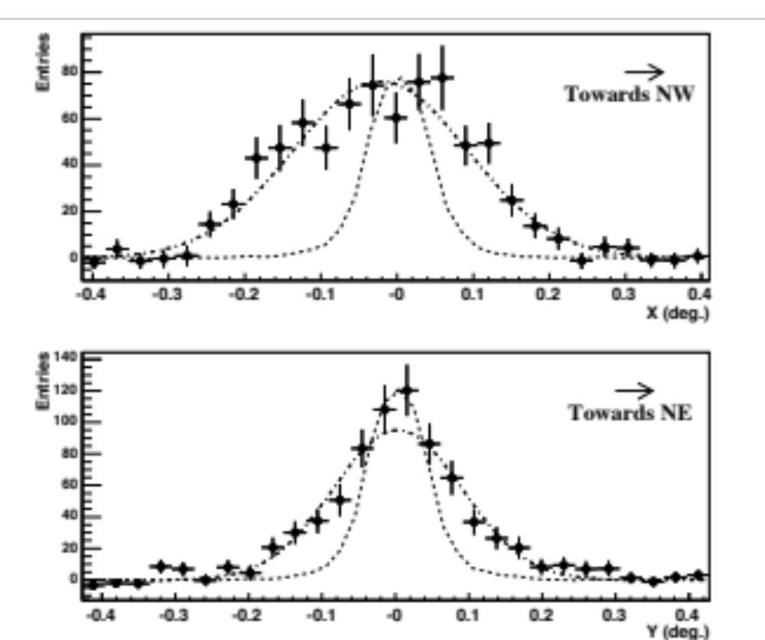
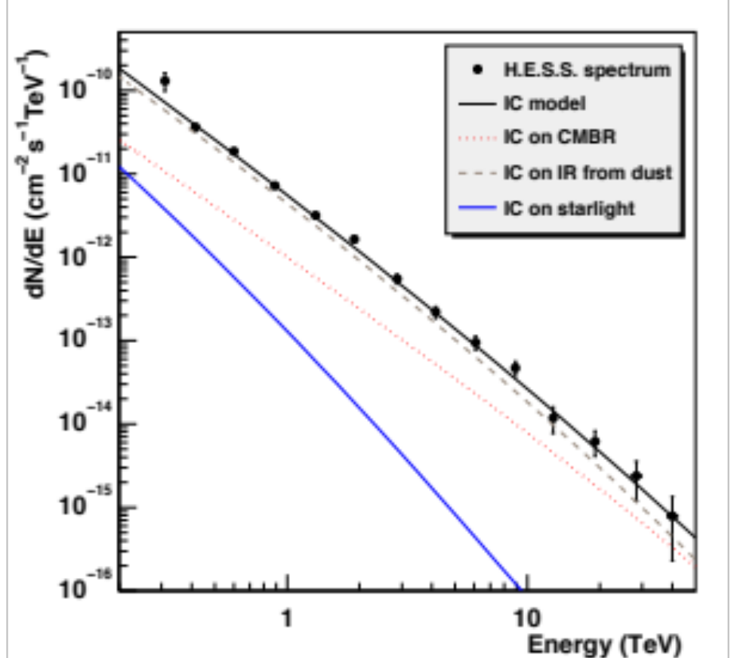
MSH 15-52
The energy spectrum of gamma rays follows a power law, dN/dE ~ E-2.27, over two decades in energy. The lines show a model fit to the X-ray and TeV gamma-ray data, where electrons generate X-rays by synchrotron radiation in a 17 microGauss magnetic field, and gamma rays by upscattering of infrared photons emitted from interstellar and of starlight photons.
Projection of the unsmoothed excess map along the major (top) and minor (bottom) axes relative to the pulsar position. The dot-dashed lines are the best- fit Gaussians to these distributions, and the dashed lines show the distribution for a Monte-Carlo point source ex- cess at the pulsar position.
Elongazione lungo asse pulsar

Slide 8
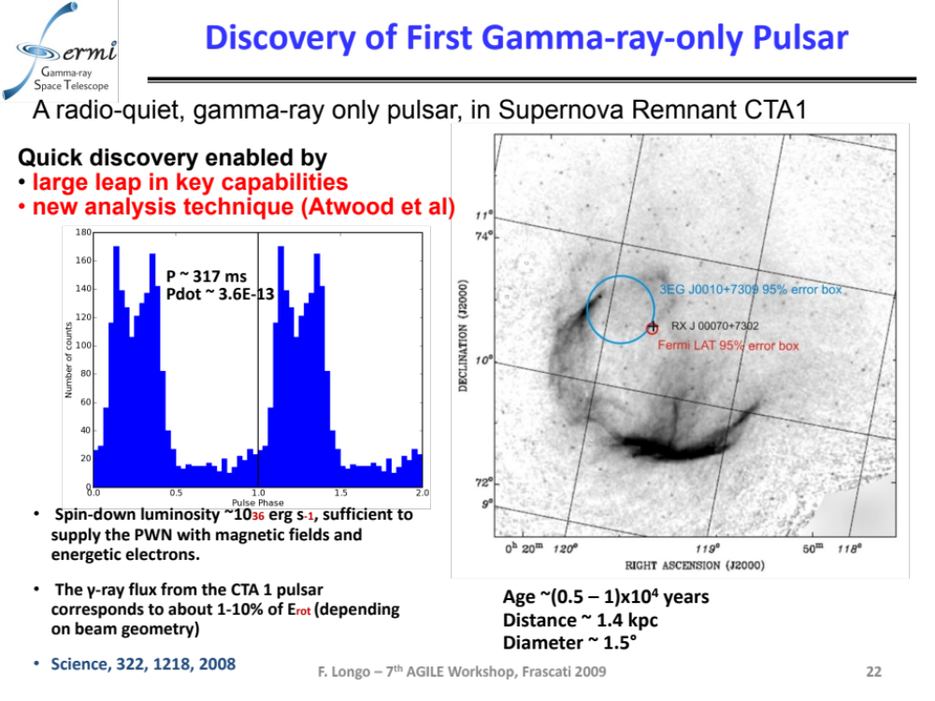

Slide 9
probabile disallineamento a grande angolo
con spin e asse mahnetico della pulsar
Atomic lines
In filaments

Slide 10
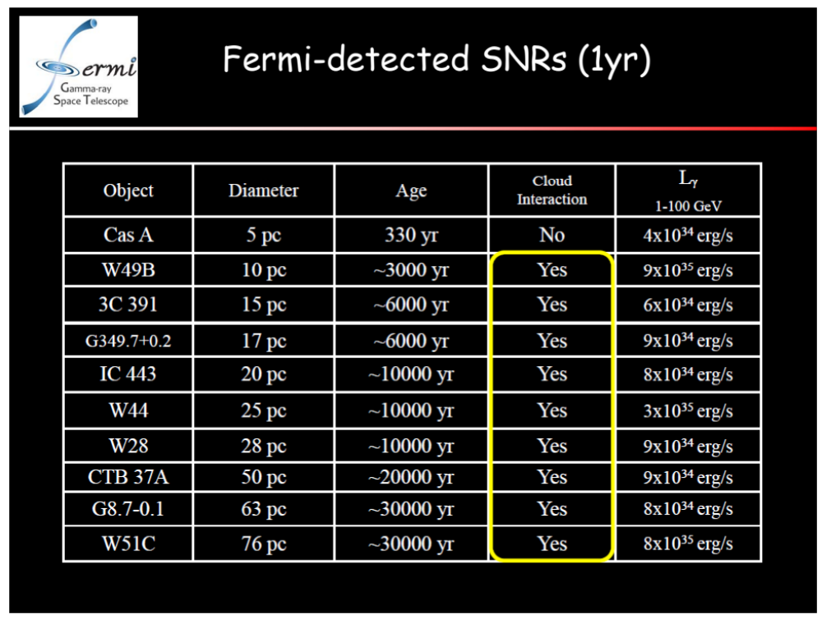

Slide 11
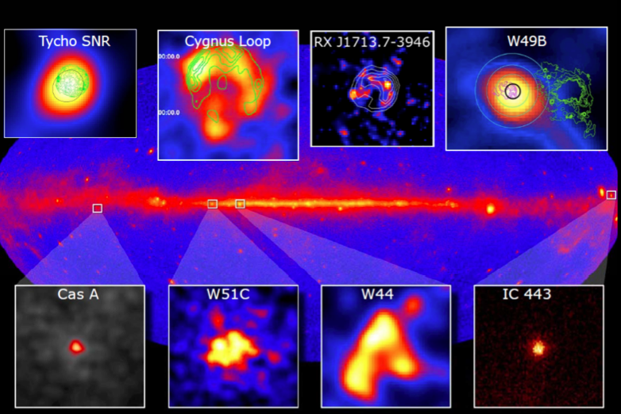
Towards a first Fermi LAT SNR catalog
Various classes - historical and middle-aged, point-sources, extended, shell-like

Slide 13
Contorni X
Eletroni
Accelerati
sincro
Puro leptonico scenario (X,e,gamma)=densita’ di radiazione x 24 rispetto a densita’ media
galattica

Slide 14
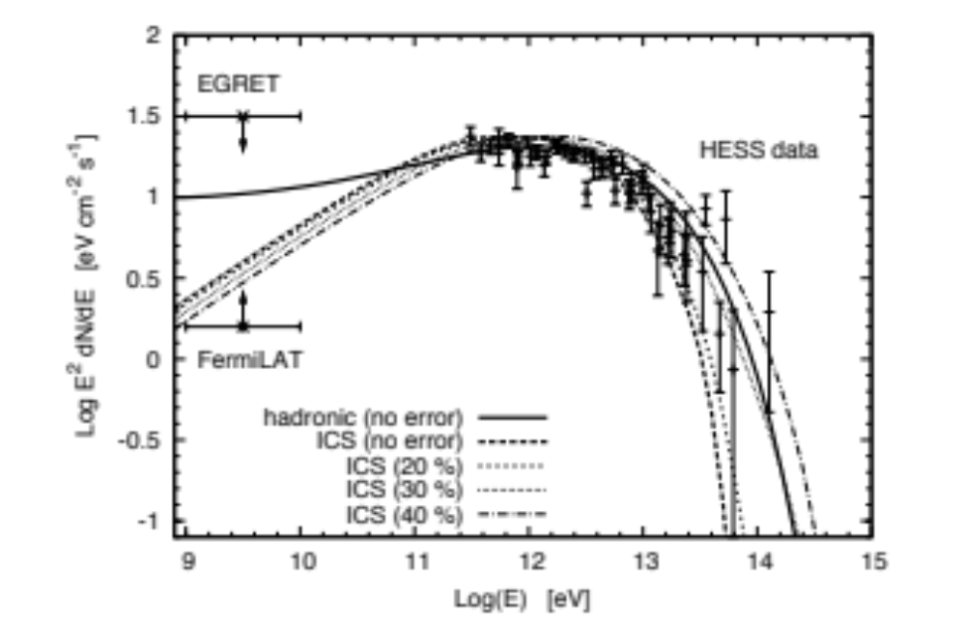
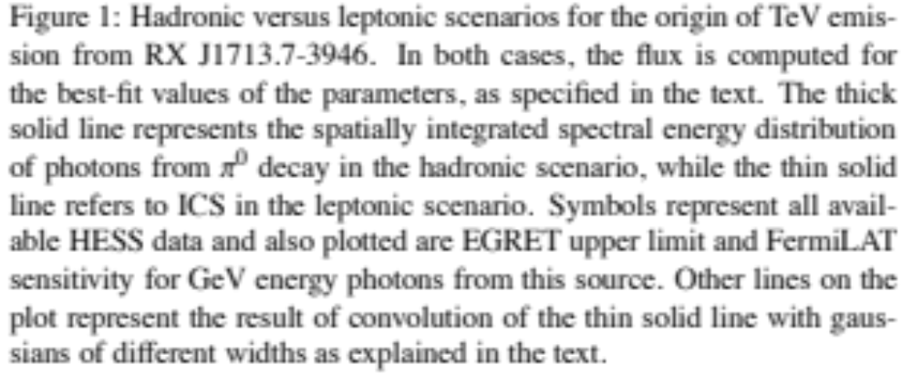
Gamma (1-100 Mev
da elettroni
accelerati
Leptonico: compton
Inverso su radiazione da elettroni accelerati fino
al Tev
Adronico: interazione p
con gas ISM

Slide 15
(+0,6/-0,7)x10^-9 cm-2s-1 >1 Gev
IC scattering di fotoni con elettroni relativistici nel fronte di shock di SNR. Non solo leptonico
Probabilmente la densita’ di protoni e’ troppo bassa per produrre significativo segnale adronico

Slide 16
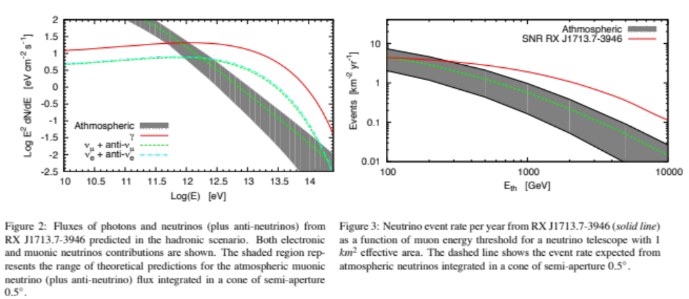
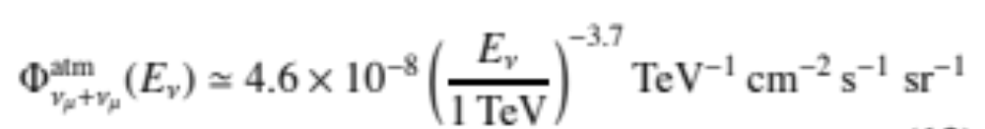

Slide 17
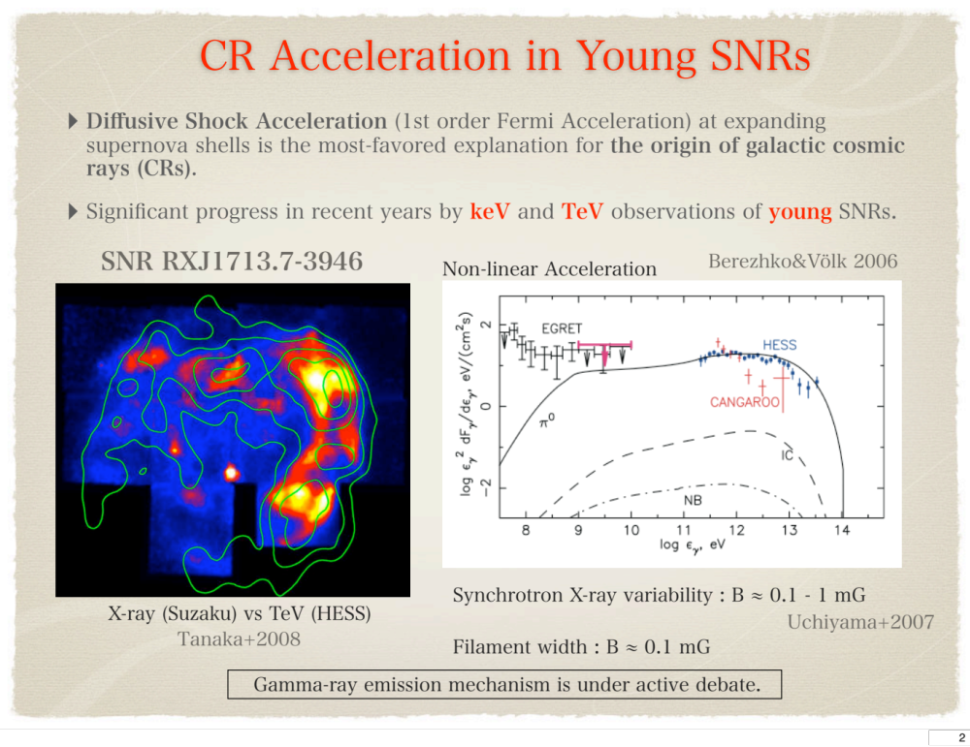

Slide 18
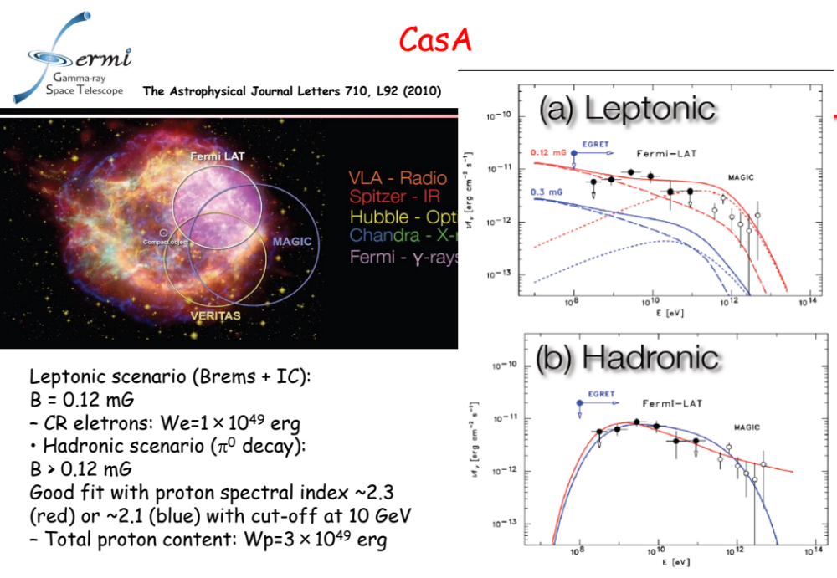
Elettroni accelerati al fronte di shock
tracciati da X-ray filaments
Br
IC
No pulsar, no pulsation from neutron star

Slide 19
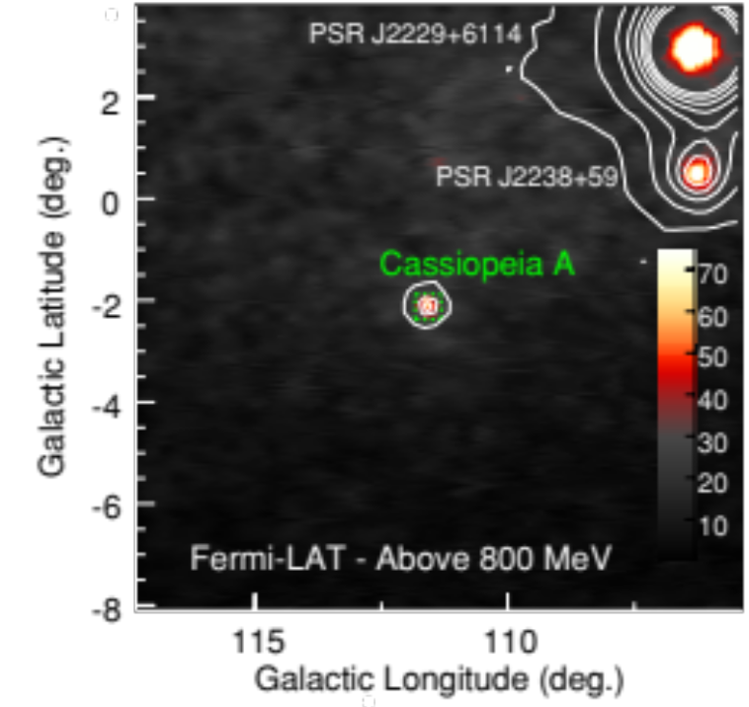
The prediction of the bremsstrahlung flux is controlled by the strength of the magnetic field and therefore the gamma-ray flux provides a measure of the amplified magnetic field in the supernova shell
Inverse- Compton (IC) scattering is another important mechanism of gamma-ray production by high-energy electrons; seed photons that can be upscattered to gamma rays include the interstellar radiation field, the cosmic microwave background (CMB), and the far-infrared (FIR) radiation by Cas A itself.
X(termici)
Chandra
da
Si
S
Ar
Ca
Fe
+emissione
X al centro
Pulsar?
In addition to these leptonic emissions, the decay of π0 mesons produced in inelastic collisions between high-energy protons (and nuclei) and background gas may contribute to the GeV gamma-ray flux.
Galactic diffuse emission (conservatively estimated to be 10%)
The integral photon flux above 500 MeV amounts to (8.7 ± 1.3) × 10−9 photons cm−2 s−1.

Slide 20
The detection of gamma-ray emission from the direction of Cas A raises the following questions: “Is there a compact source such as a pulsar dominating the emission”? and “What is the radiating particle population responsible for the emission?” Two emission scenarios seem plausible: emission from the central compact object (CCO) in Cas A or emission generated in the SNR.
the spectrum does not support a pulsar hypothesis. The energy spectra of pulsars are usually flat at energies below 1 GeV and show exponential cutoffs in the ener gy range between 1 GeV and 8 GeV. Chandra nell’X misura per una frazione del 16% una radiazione pulsata con periodo 0,68 s a 3σ.
Circa 2x10^-7 cm2 s-1
These characteristics do not mirror the LAT spectrum which is best described by a power-law shape with an index of Γ = 2.0 ± 0.1 up to 50 GeV with no significant sign of a high-energy cutoff. This is rather high for a gamma-ray pulsar
The scenario in which the GeV gamma rays are emitted in the shell of the SNR is therefore favored. The gamma-ray emission could be produced by electrons accelerated at the forward shock through relativistic bremsstrahlung or IC. Alternatively, the GeV gamma-ray emission could be predominantly produced by accelerated hadrons through interaction with the background gas and subsequent π0 decay.

Slide 21
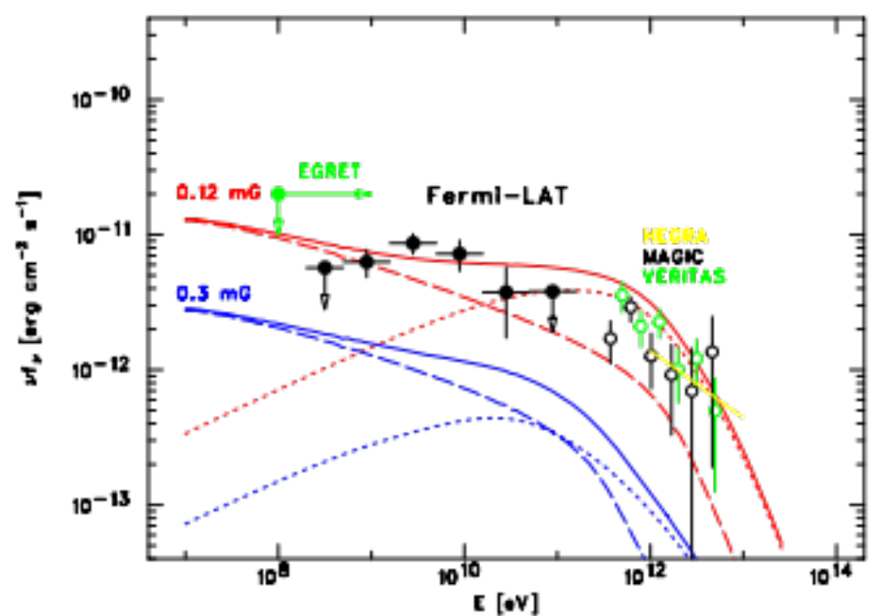
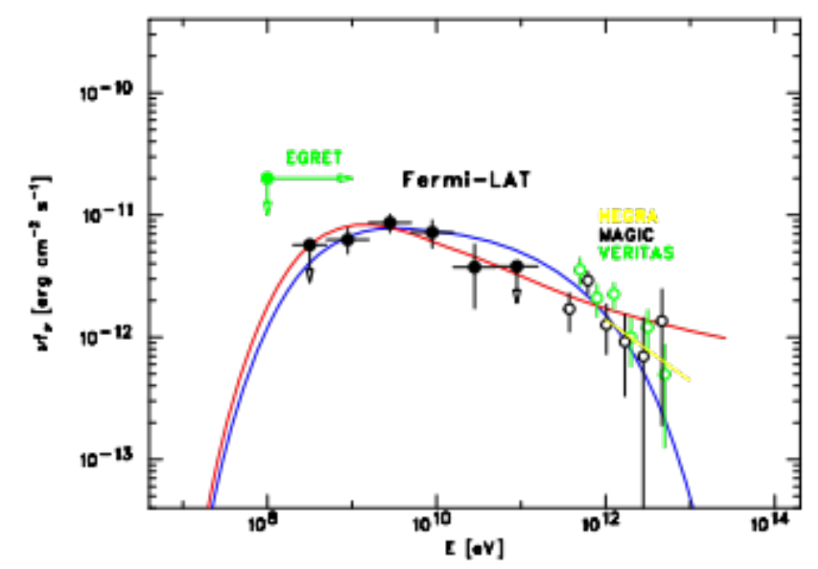
Emax=40 Tev
Energy spectrum of Cas A in a leptonic emission model. Shown is the Fermi-LAT detected emission (filled circles) in comparison to the energy spectra detected by MAGIC (black open circles; Albert et al. 2007) and VERITAS (green open circles; Humensky 2008). The red curves show a leptonic model calculated for B = 0.12 mG while the blue curves show one for B = 0.3 mG. Dashed lines show the bremsstrahlung components with n_{eff} ≃ 26 cm−3, and dotted lines show the IC component.
Same as Figure 3 but in a hadronic emission model. Shown are π0 decay spectra for two possible proton spectra. The blue line shows a harder proton index of 2.1 with a cutoff energy of 10 TeV (W_{p} ^{= 3.2 × 1049 erg for n}_{H} = 10 cm−3 ). The red line shows a softer proton index of 2.3 without a cutoff.

Slide 22
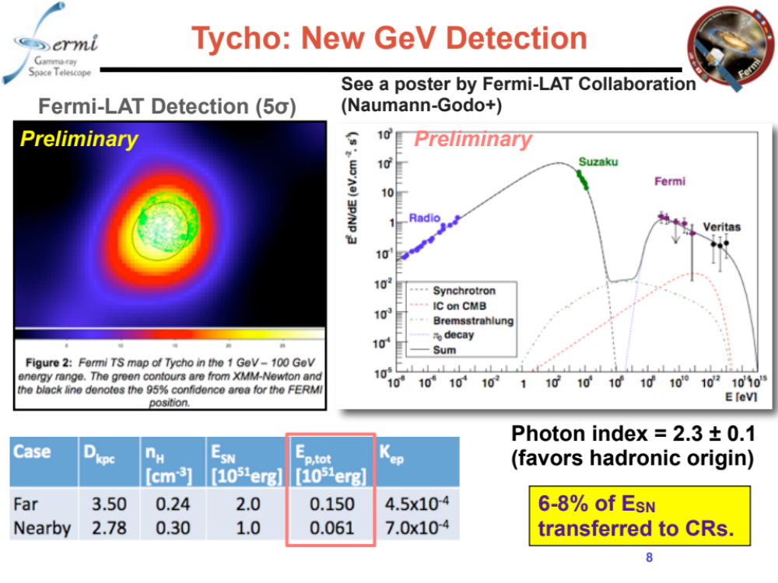
X come Cas A filamenti

Slide 23
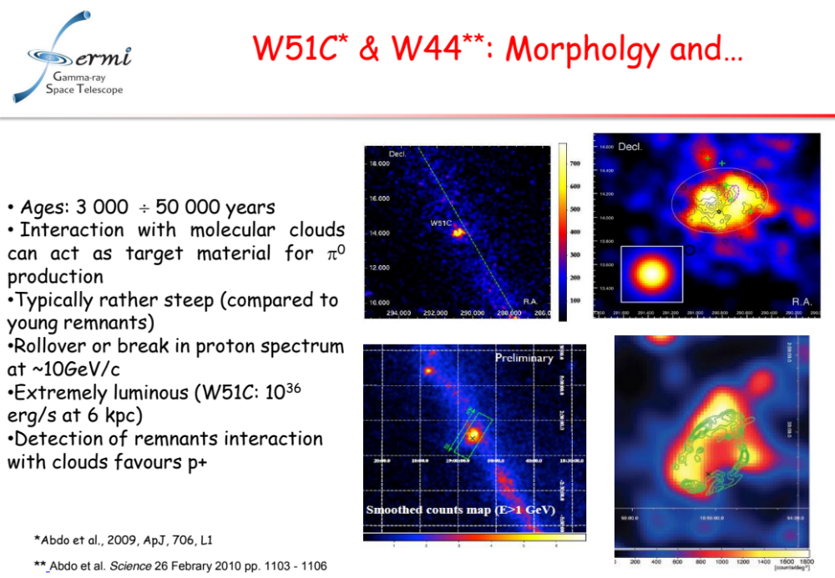

Slide 24
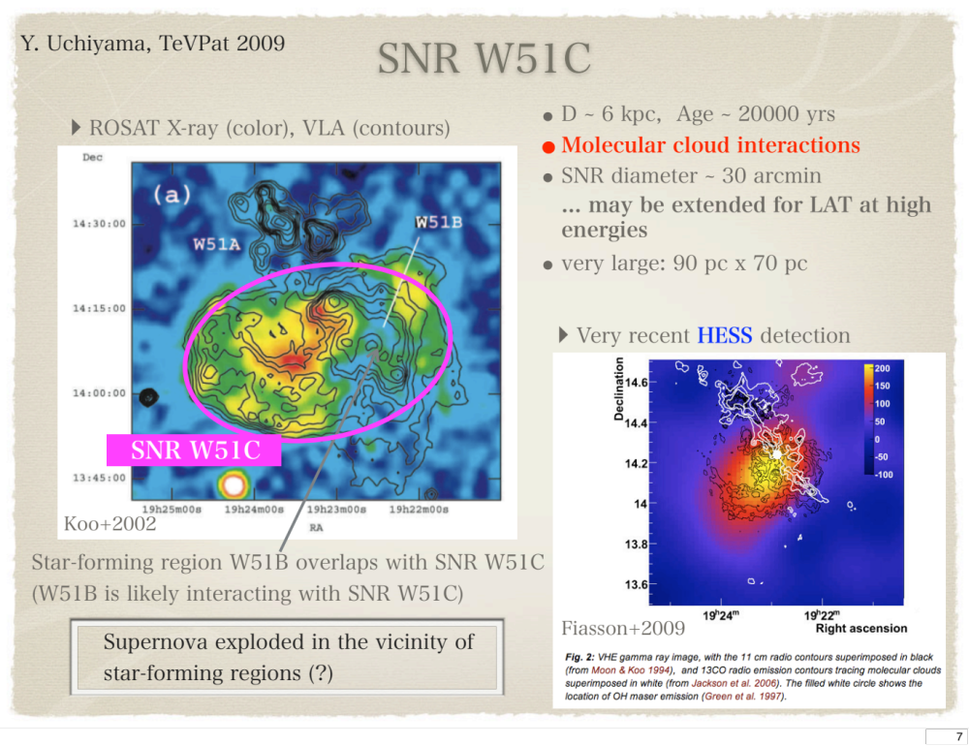
X termici: kT=0,3keV

Slide 25
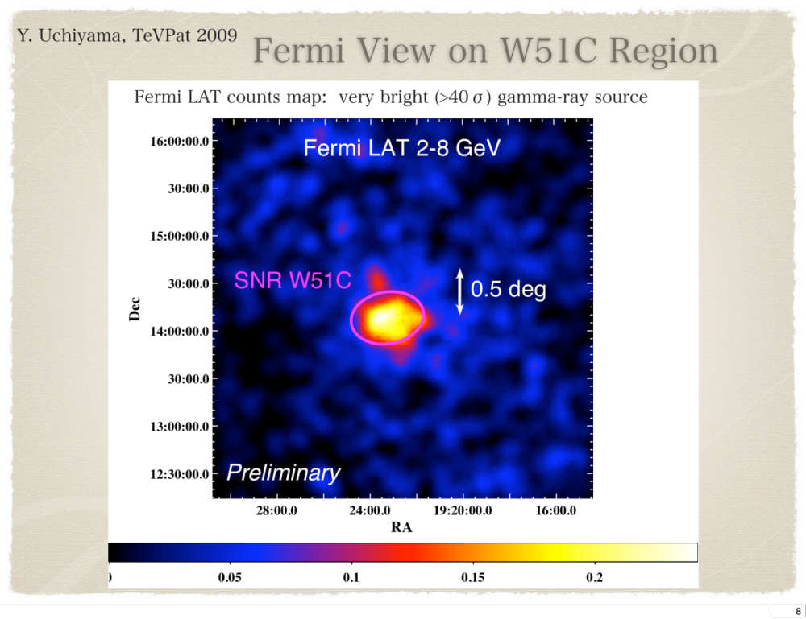

Slide 26
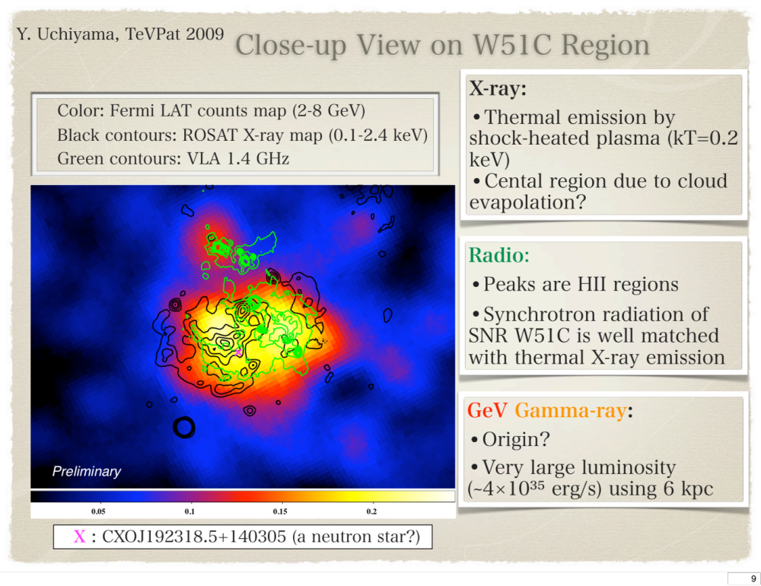
10% da attribuire a pulsar non vista
a 5 σ

Slide 27
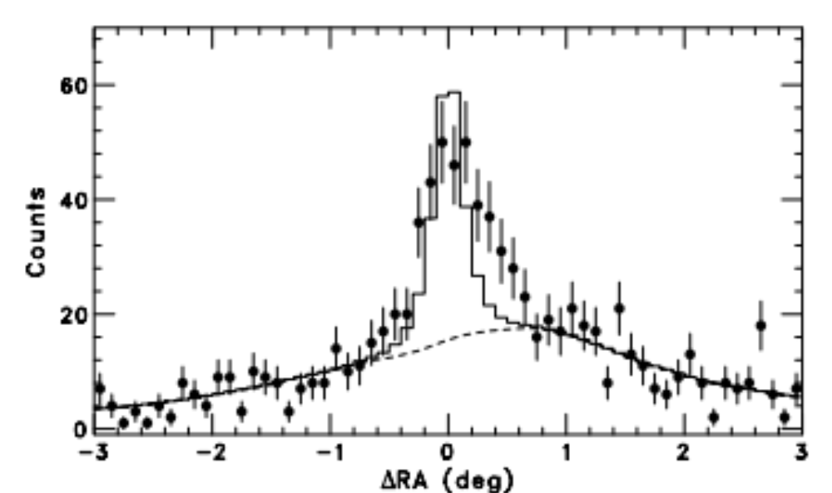
The discovery of bright gamma-ray emission coincident with supernova remnant (SNR) W51C is reported using the Large Area Telescope (LAT) onboard the Fermi Gamma-ray Space Telescope. W51C is a middle-aged remnant (∼104 yr) with intense radio synchrotron emission in its shell and known to be interacting with a molecular cloud. The gamma-ray emission is spatially extended, broadly consistent with the radio and X-ray extent of SNR W51C. The energy spectrum in the 0.2–50 GeV band exhibits steepening toward high energies. The luminosity is greater than 1 × 1036 erg s−1
The observed gamma-rays can be explained reasonably by a combination of efficient acceleration of nuclear cosmic rays at supernova shocks and shock–cloud interactions. The decay of neutral π mesons produced in hadronic collisions provides a plausible explanation for the gamma-ray emission.
W51C (G49.2−0.7) is a radio-bright SNR at a distance of D ≃ 6 kpc with an estimated age of ∼3×104 yr (Koo et al. 1995). It has an elliptical shape with an extent of 50′ × 38′. The radio continuum map exhibits thick shell-like structures (Subrahmanyan & Goss 1995). The bulk of the X-ray emission comes from thermal plasma with a temperature of kT ∼ 0.3 keV
VHE HESS gamma-ray emission coincident with W51C (Fiasson et al. 2009). Also, the Milagro Collaboration has reported a possible excess of multi-TeV gamma-rays in this direction (Abdo et al. 2009a).
One-dimensional profile of the observed 2–10 GeV gamma-rays (data points) along right ascension. The counts map is integrated over the direction of declination with a width of ∆δ = 1◦.6 centered on W51C. The dashed curve shows the profile of the galactic+isotropic diffuse model. The histogram represents the sum of a simulated point source and the diffuse model.

Slide 28
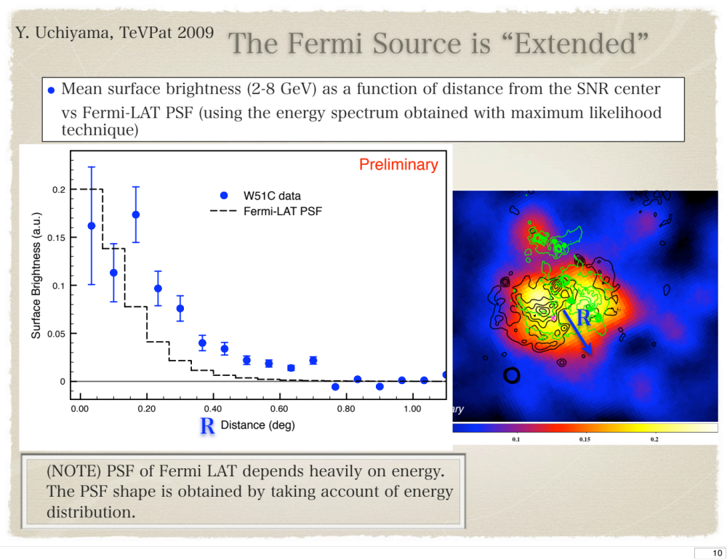

Slide 29
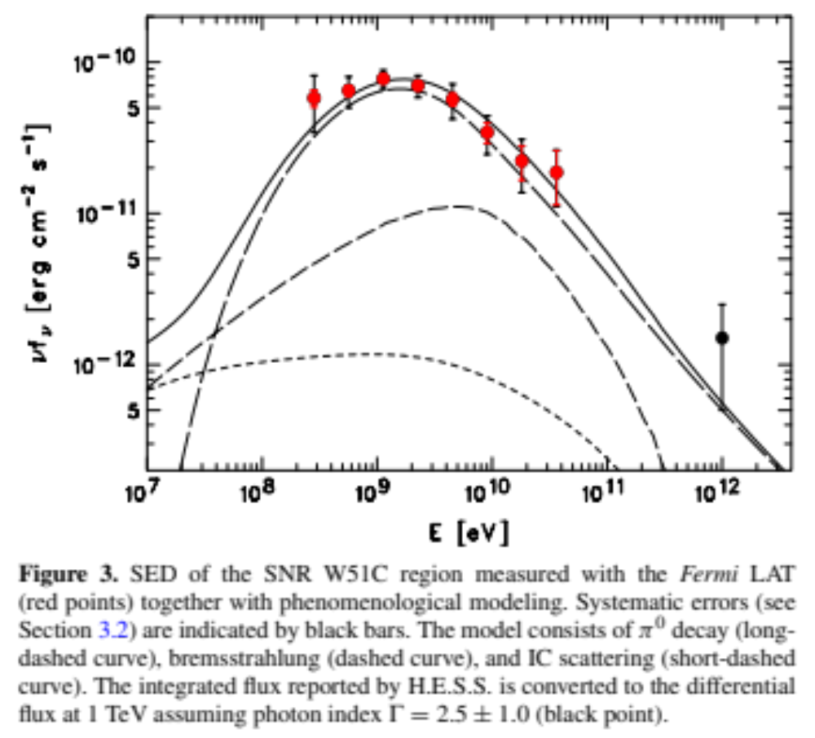

Slide 30
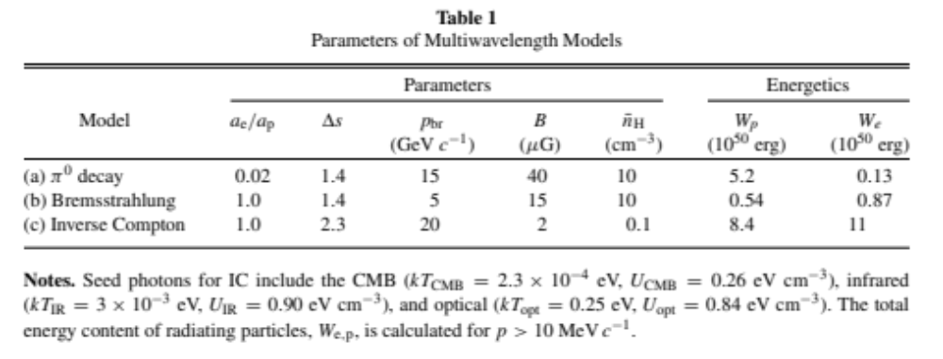
Ipotesi di calcolo per W51. Densita’ di energia per elettroni e protoni
Sul fronte di shock
Radiazione:CMB,IR,ottico
Da notare che We densita’ di elettroni per accelerazione per inverso compton
e’ la stessa che da’ radio e bremstralhung sul fronte di shock

Slide 31
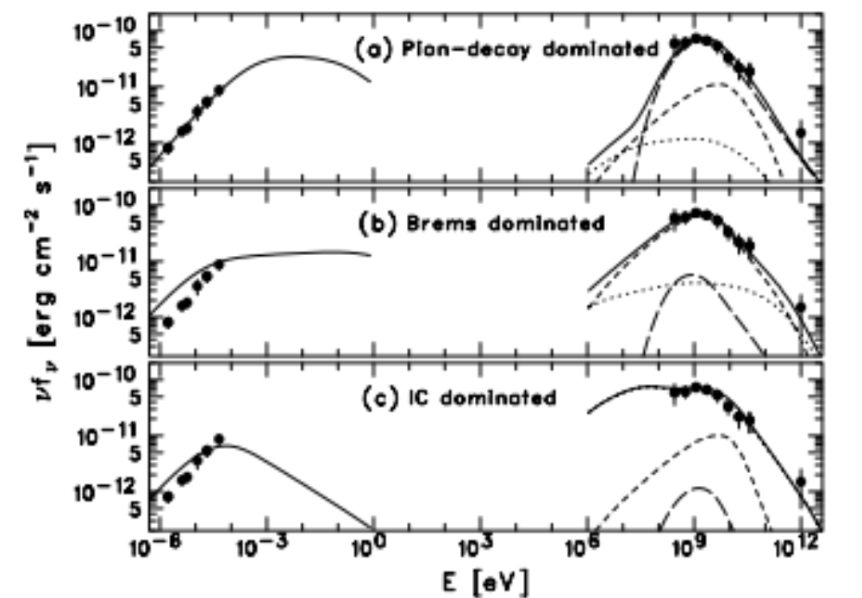
W51
Three different scenarios for the multiwavelength modeling (see Table 1). The radio emission (from Moon & Koo 1994) is explained by synchrotron radiation, while the gamma-ray emission is modeled by different combinations of π 0 decay (long-dashed curve), bremsstrahlung (dashed curve), and IC scattering (dotted curve). The sum of the three component is shown as a solid curve.

Slide 32
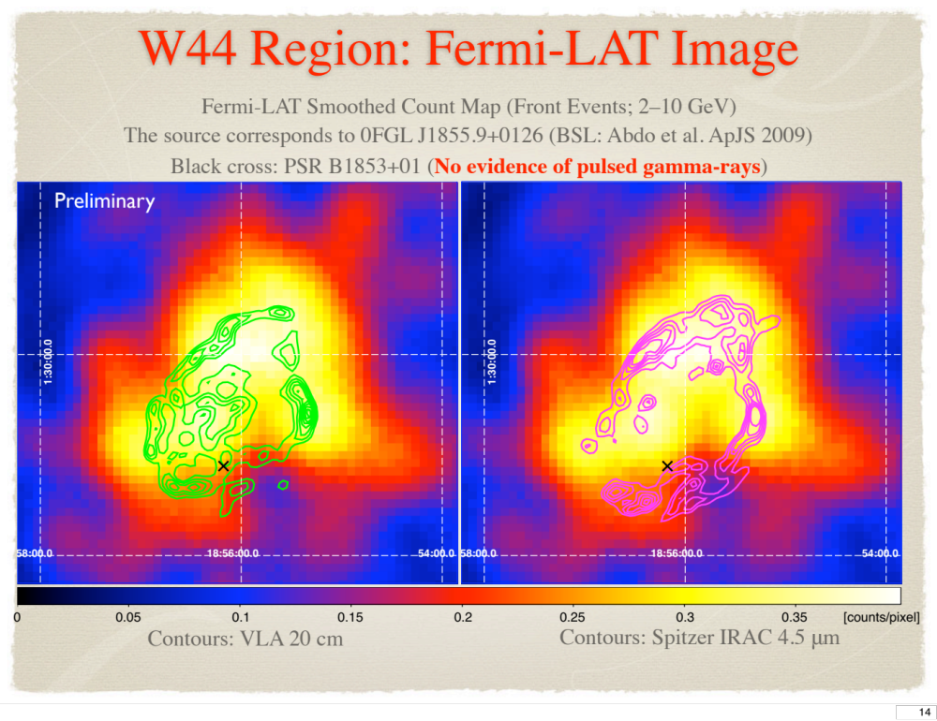
Limite pulsar:1,6x10^-7 photons cm^-2s^-1
Interazione con nubi molecolari: alta densita’ del bersaglio 100/cm3

Slide 33
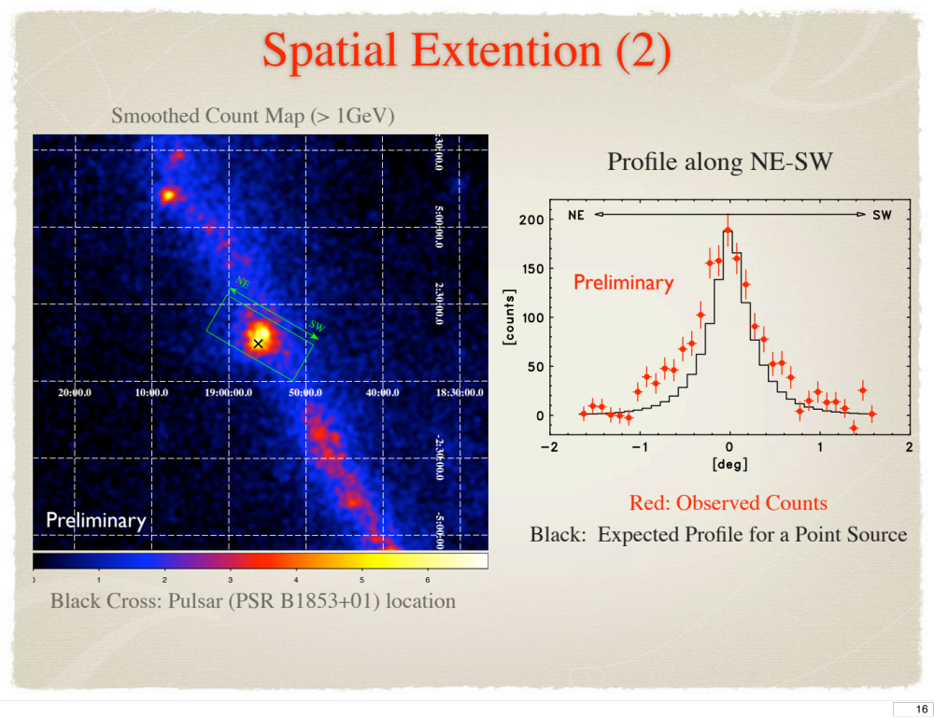
Interazione con gas denso (100 cm-3):
π0 e irragiamento e+-
Difficile misurare la pulsar
1,6x10^-7 cm-2s-1 >100 Mev

Slide 34
1,2x10^-6 photons cm-2 s-1 >100 Mev

Slide 36
W 44
Recent observations of supernova remnants (SNRs) hint that they accelerate cosmic rays to energies close to ~1015 electron volts. However, the nature of the particles that produce the emission remains ambiguous. We report observations of SNR W44 with the Fermi Large Area Telescope
at energies between 2 × 108 electron volts and 3 × 1011 electron volts. The detection of a source with a morphology corresponding to the SNR shell implies that the emission is produced by particles accelerated there. The gamma-ray spectrum is well modeled with emission from protons and nuclei. Its steepening above ~109 electron volts provides a probe with which to study how particle acceleration responds to environmental effects such as shock propagation in dense clouds and how accelerated particles are released into interstellar space.
Galactic cosmic rays (GCRs) are thought to be accelerated in the expanding shock waves of supernova remnants (SNRs) (1, 2), a conjecture that has been strengthened by recent observations of young SNRs in x-rays (3) and TeV gamma rays (4–6). Magnetic field amplification is essential to make the maximum particle energy attainable large enough to explain the GCRs (7). It also implies that a large fraction of the kinetic energy released by a supernova ex- plosion is transferred to cosmic rays (8). If strong magnetic fields are present in the gamma-ray– emitting region, the TeV images of young SNRs
(4–6) are more likely to show the accelerated protons and nuclei via their hadronic interactions with the ambient gas and subsequent p decays into gamma rays. However, the identification has been inconclusive because high-energy electrons can also shine in gamma rays via bremsstrahlung and/or inverse Compton processes.
The 95% upper limit to pulsar and/or PWN flux is 1.6 × 10-7 photons cm-2 s-1 above 100 MeV.

Slide 38
For a broken power law where the photon index is abruptly changed at a break energy, the photon indices are G₁ ^{= 2.06 T 0.03}
The resulting gamma-ray flux integrated above 100 MeV (25) amounts to F_{>100MeV} ^{= [1.22 T}
^{× 10-6 photons cm-2 s-1.}
Most of the emission comes from the SNR shell, which is known to interact with molecular clouds. When high-energy particles interact with dense gas, two emission processes become important: p0 decays and electron bremsstrahlung. Simple model curves with dominant p0-decay emission fit the data reasonably well

Slide 40
Evidenza π0 (FERMI)

Slide 43
SED of the SNR W51C region measured with the Fermi LAT (red points) together with phenomenological modeling. The model consists of π0 decay , bremsstrahlung , and IC scattering .The integrated flux reported by H.E.S.S. is converted to the differential flux at 1 TeV assuming photon index Γ = 2.5 ± 1.0 (black point).
1/100 come sulla terra
molecolar gas density: 100 cm-3

Slide 47
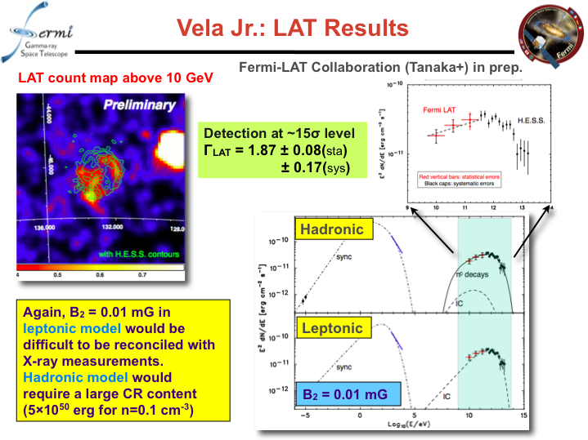

Slide 50
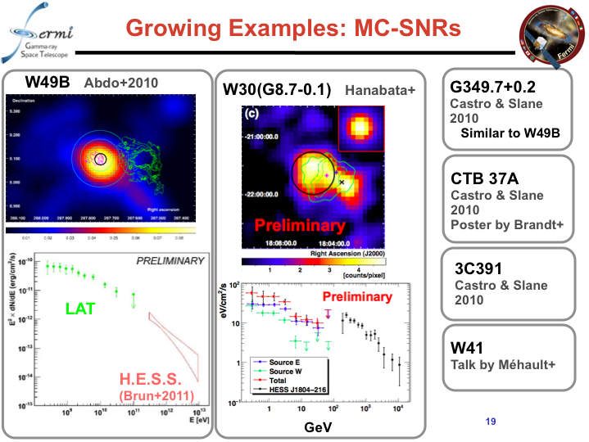

Slide 52
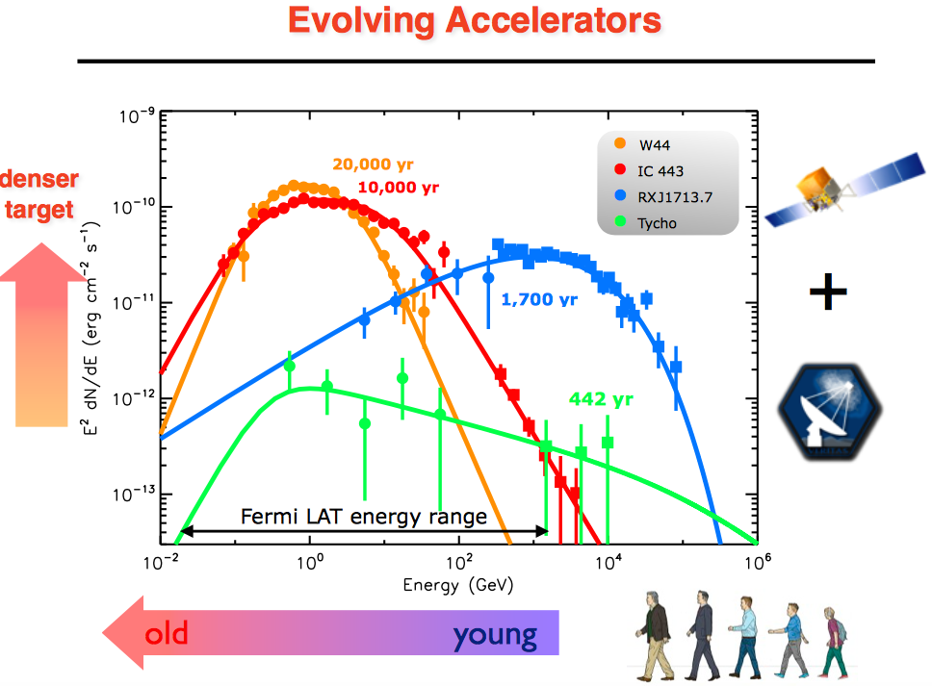

Slide 55
Young SNRs are preferred targets for seeing particle acceleration at work since in these objects the shocks are still strong and actively accelerating particles to the highest energies. Gamma-ray instruments have the angular resolution to spatially resolve some of the closer SNRs.

Slide 62
Proton
pp

Slide 68
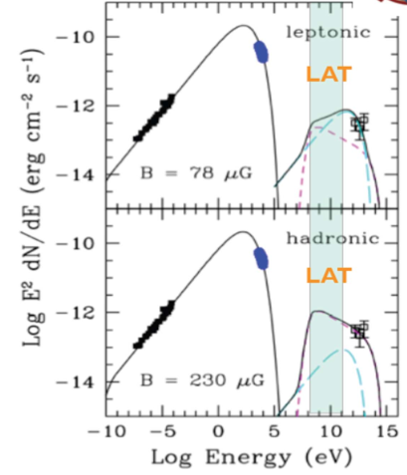
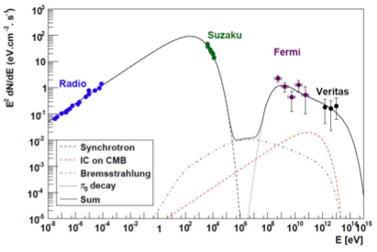
SNR spectrum and CR acceleration
Need to simultaneously constrain broad-band spectrum
Hadronic acceleration models definitely favored for Thyco, but not for all SNRs

Slide 69
