Slide 1
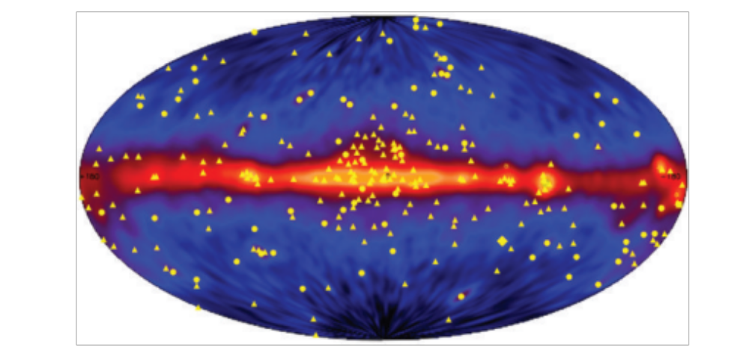
γ-ray waveband ν>3×1019 Hz; λ<0.01nm; E > 100 keV
Photons with energies greater than about 100 keV are referred to as γ -rays. Except at the very highest energies, these studies have to be carried out from above the atmosphere.
An image of the celestial sphere at γ -ray energies ε ≥ 100 MeV from observations made by the EGRET instrument of the Compton Gamma-Ray Observatory (CGRO). The emission from the plane of the Galaxy consists of diffuse γ -ray emission from the interstellar gas, most of it associated with γ -rays produced by the decay of neutral pions, π 0 , generated in collisions between cosmic ray protons and nuclei and the interstellar gas. The yellow symbols show the distribution of discrete sources detected in the all-sky survey: circles are active galactic nuclei; five-point stars are pulsars; squares are solar flares; the diamond is the Large Magellanic Cloud; and the triangles are unidentified sources. (Courtesy of NASA and the EGRET science team.)

Slide 2
Between 100 keV and 1 MeV, photoelectric absorption is the dominant absorption mechanism but at higher energies Compton scattering and then electron–positron pair production become the principal absorption processes. The detectors used in γ -ray satellites are similar to those used in particle physics experiments but they have to be miniaturised so that they can be flown in orbit. At the very highest energies, E > 10^11 eV, γ -rays from extraterrestrial sources are so energetic that they initiate electromagnetic cascades in the upper atmosphere and the Cerenkov radiation of the ultra-relativistic electrons and positrons produced in these showers can be detected at ground level.
γ -ray emission from the plane of our Galaxy was first detected by the OSO III satellite in 1967. This was followed by the SAS-2 satellite which discovered the diffuse γ-ray background and by the COS-B satellite which provided a detailed map of the Galactic γ -ray emission and discovered about 25 discrete γ -ray sources. These included the pulsars in the Crab and Vela supernova remnants and the quasar 3C 273. A γ -ray map of the whole sky in the energy band ε ≥ 100 MeV was obtained from observations with the EGRET instrument of the Compton Gamma-Ray Observatory
The image of the sky is dominated by the intense γ -ray emission from the Galactic plane. At photon energies, ε > 100 MeV, the principal emission mechanism is the decay of neutral pions, π0, created in collisions between the nuclei of atoms and molecules of the interstellar gas and cosmic ray protons and nuclei. At lower energies, non-thermal processes, in particular inverse Compton scattering and bremsstrahlung, can make contributions to the background γ -ray emission. At high Galactic latitudes, most of the discrete sources are associated with active galactic nuclei. In particular, the most intense and variable sources are associated with those radio quasars which exhibit the phenomenon of superluminal motions. The variability is so rapid, on the time-scale of days or less, that relativistic beaming of the γ -rays is needed to account for their observed properties.

Slide 3
The first evidence of γ -ray line emission came from balloon observations in the early 1970s by the Rice University Group. In 1977 definitive observations of the electron– positron annihilation line at 511 keV in the direction of the Galactic Centre were made by balloon observations. Since then observations have also been made of the 1.809 MeV line of radioactive 26Al by the HEAO-C satellite, this line also being detected from the direction of the Galactic Centre. These studies have been greatly advanced by observations by the INTEGRAL γ -ray observatory of ESA.
Another unexpected discovery was that of γ -ray bursts which were detected by the US Vela satellites and also by Soviet satellites. The Vela satellites were launched to monitor the sky in γ -rays to confirm compliance with the Nuclear Test Ban treaties. Bursts of γ -rays were discovered, but they proved to be of astronomical rather than terrestrial origin. The bursts last between 0.01 and 100 seconds and are uniformly distributed over the sky. Their nature as distant luminous extragalactic objects was established once it was realised that they have significant after-glows at X-ray, optical and infrared wavelengths which enabled their positions to be determined accurately. The bursts are associated with extremely violent events involving stellar-mass objects in distant galaxies.
Very high energy γ -rays with ε ∼ 10^11−12 eV are detected by the optical Cherenkov radiation technique. γ -rays of these energies initiate electron–photon cascades in the upper atmosphere. The electrons are of such high energy that their velocities exceed the speed of light in air and consequently they emit optical Cherenkov radiation. The optical light emitted by these showers is detected at sea-level by telescope arrays. The introduction of multi-element detector arrays in the focal planes of the telescopes of the arrays, for example in the operation of the HESS array in Namibia, have revolutionised studies in these energy ranges.
Cygnus X 3, Hercules X 1, sistemi binari.
Among the more important observations have been images of the ultra-high energy γ-ray emission from supernova remnants, presumably associated with the high energy protons accelerated in their shells, and some relatively nearby active galactic nuclei which are of cosmological importance in setting upper limits to the extragalactic optical and infrared background radiation.

Slide 4
Lo spettro di osservazione dei processi astrofisici
Il cielo appare diverso a seconda dello parte di spettro elettromagnetico
osservato
Esistono numerose fasi evolutive stellari non visibile nell’ottico
tipicamente fasi turbolente invisibili ai nostri occhi
L’Astronomia visibile osserva la parte piu’ “tranquilla e stabile dell’Universo”
Luce emessa dalle superfici delle sorgenti (galassie, stelle) fasi stabili
Astronomia infrarossa studia il debole calore emesso dalle grandi distese
di gas interstellare. Materia fredda che collassa a formare galassie e stelle.
Basse energie: grandi regioni di polvere interstellare
Produzione di raggi X, γ, ν coinvolgono enormi energie. Queste astronomie
studiano regioni tormentate che sono e furono sedi di esplosioni.
Alte energie = fenomeni locali intensi (vita di una stella)

Slide 5
Fisica delle Astroparticelle temi rilevanti di indagine
I telescopi che rivelano ogni componente dello spettro di radiazione
permettono di indagare fenomeni fondamentali ancora non compresi come:
Radiazione Cosmica di Fondo (CMB): microonde
Sorgenti astrofisiche: acceleratori cosmici di particelle,raggi cosmici
        supernovae, pulsars, buchi neri. X, γ, ν
Gamma Ray Burst (GRB): γ, X
-Esistenza di antimateria nel cosmo ? antiparticelle
-Materia oscura: nuove particelle?
In parte nel visibile

Slide 6
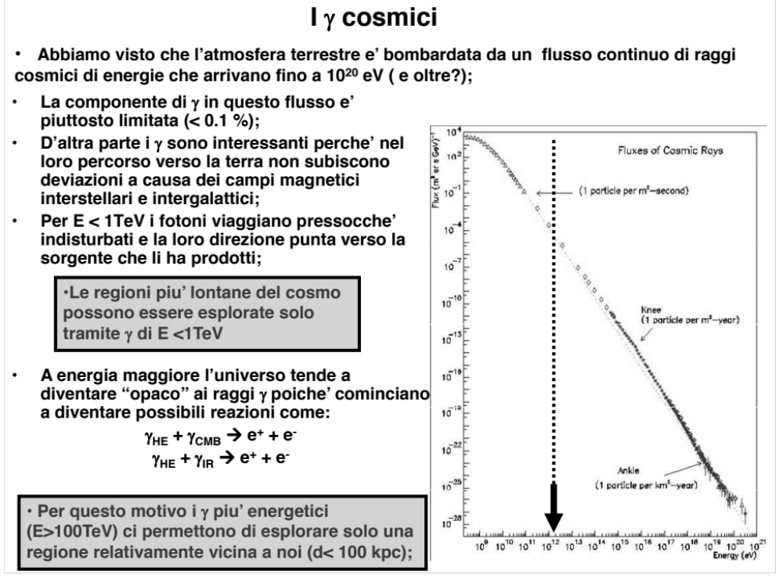

Slide 7
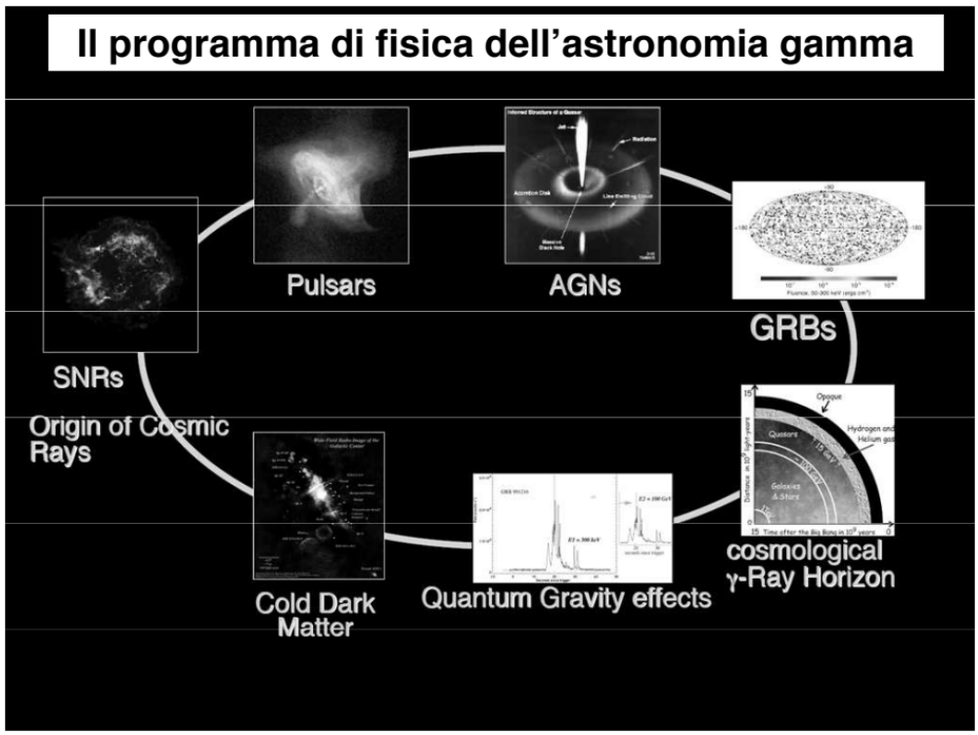

Slide 8
Fisica delle Astroparticelle temi rilevanti di indagine
I telescopi che rivelano ogni componente dello spettro di radiazione
permettono di Indagare fenomeni fondamentali ancora non compresi come:
Radiazione Cosmica di Fondo (CMB): microonde
Sorgenti astrofisiche: acceleratori cosmici di particelle,raggi cosmici
        supernovae, pulsars, buchi neri. X, γ, ν
Gamma Ray Burst (GRB): γ, X
-Esistenza di antimateria nel cosmo ? antiparticelle
-Materia oscura: nuove particelle?
In parte nel visibile

Slide 9
Esperimenti sui Gamma Ray burst dal cosmo
-Intensa radiazione gamma di durata variabile msec-100 sec mai nello stesso punto
-presenza di afterglow nell’ottico, X-ray, radio dopo ore-settimane.
-la maggior parte dei GRB durano 2-10 sec e presentano afterglow.
Fenomeni che originano i GRB
-Formazione di buchi neri in una esplosione di stella massiva( GRB > 2 sec.)
-Collisione di due stelle di neutroni o buchi neri (GRB di breve durata < 2 sec.)
-Studio di prime stelle nell’Universo con massa 100-1000 volte il Sole fatte di H ed He.
-Studi di afterglow nell’X per capire l’origine sulla base dell’assorbimento o meno.
-All sky X survey.
-Nuovi fenomeni?
GRB: energia > 100 volte Supernova e 10¹¹ volte energia del Sole in un anno.
Notes:
Aggiungere GRB nuovo laboratorio cosmico per lo studio della fisica nucleare e fondamentale. Energia emessa

Slide 10
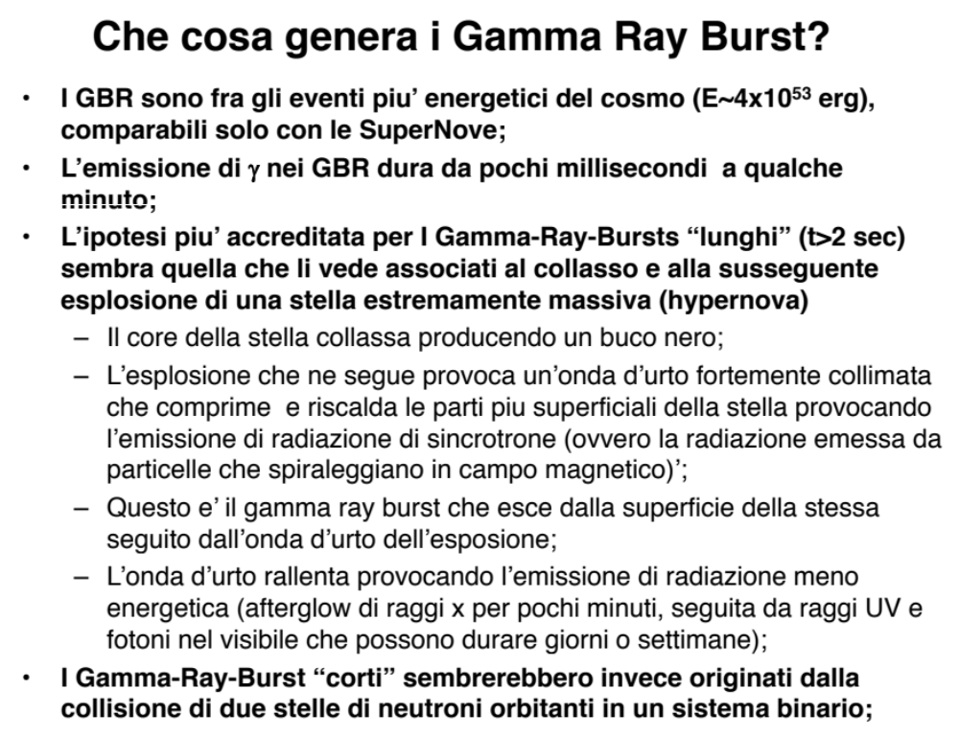

Slide 11
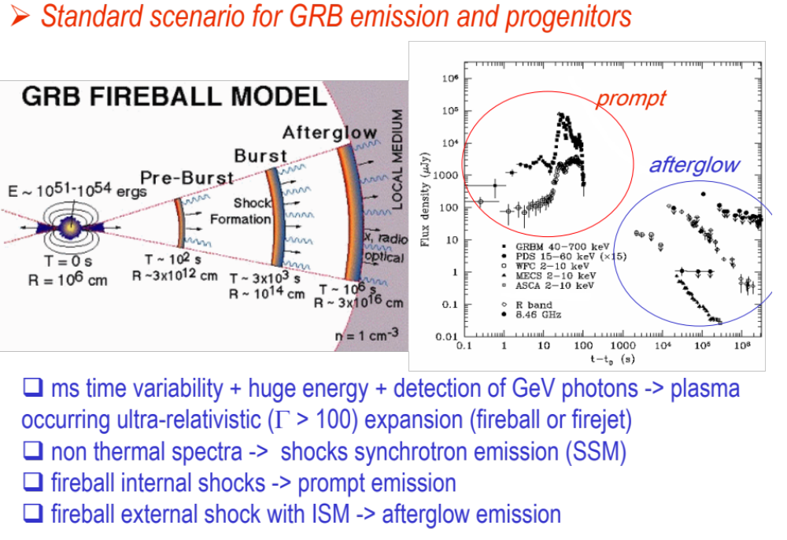

Slide 12
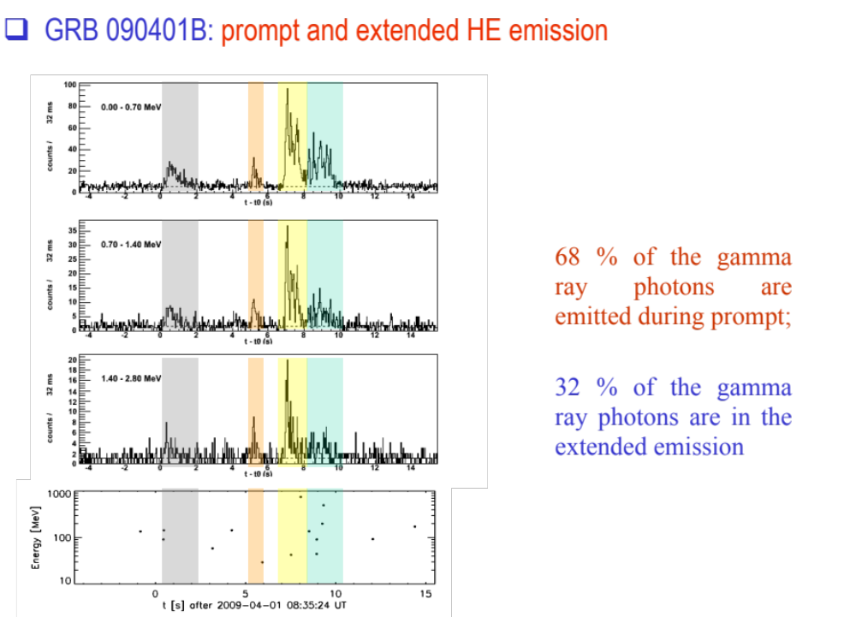

Slide 13
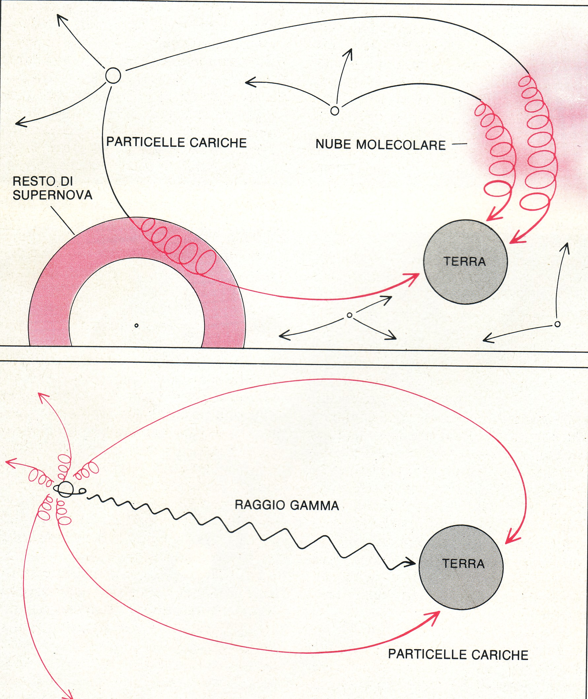
Osservazione dalla terra
-particelle cariche (p, e, N)
deviate dal campo
magnetico non utili
per cercare le
sorgenti
-particelle neutre (γ, ν)
puntano sulle
sorgenti non deviati
da campi eletttrici
e magnetici

Slide 14
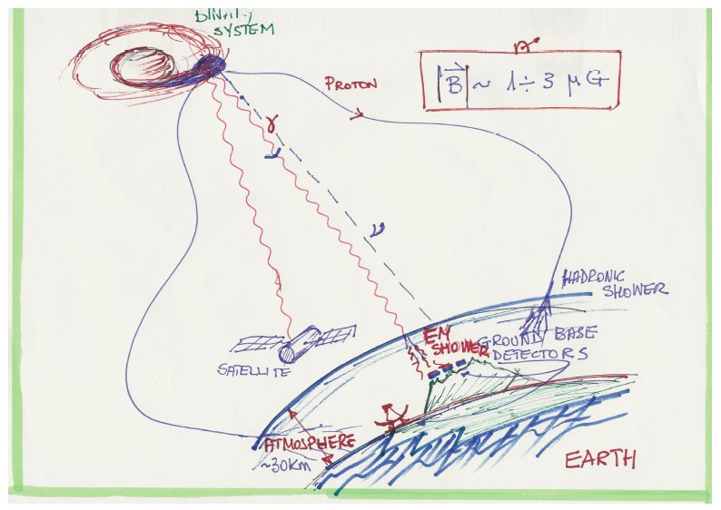

Slide 15
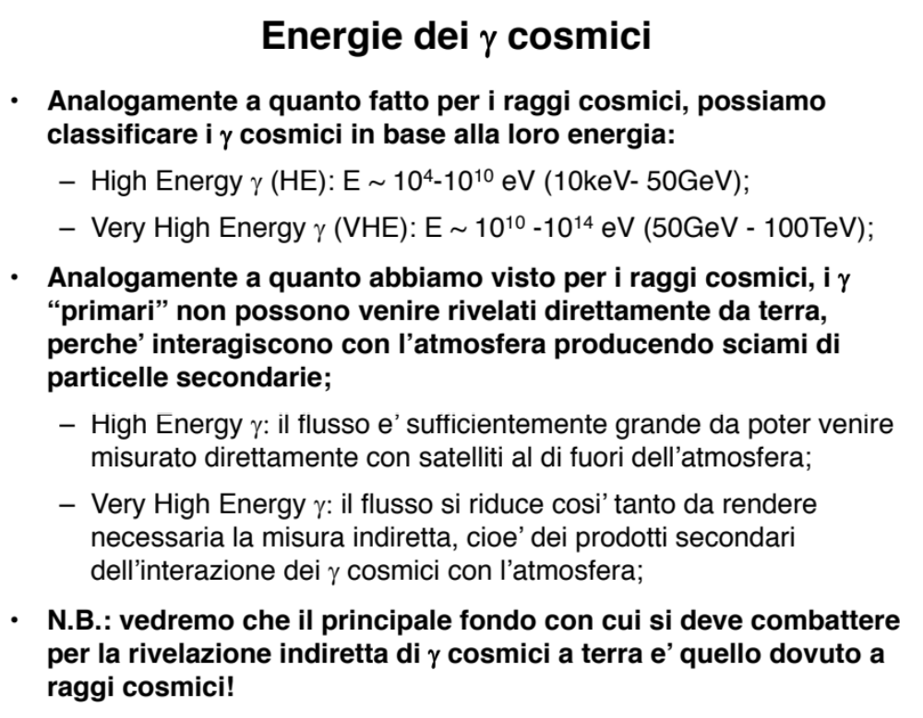

Slide 16
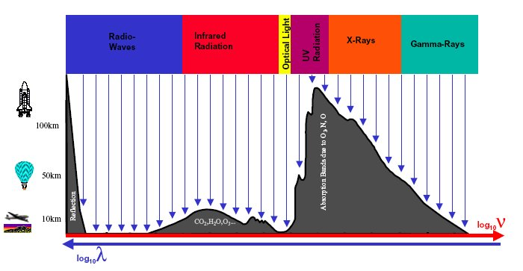
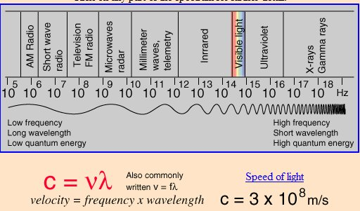
Influenza dell’atmosfera sulla sperimentazione con telescopi
Radio, Infrarossi, Ultravioletti, Raggi X, Raggi γ

Slide 17
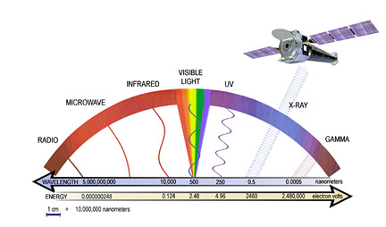
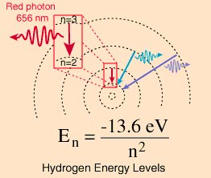
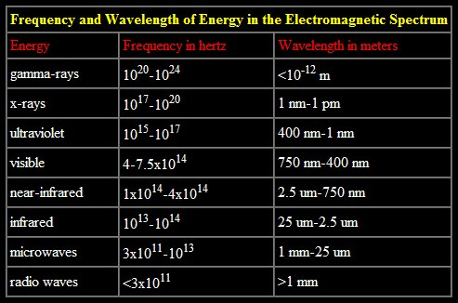

Slide 18
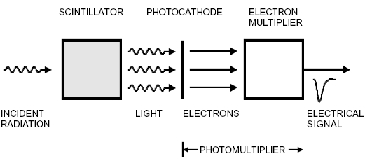
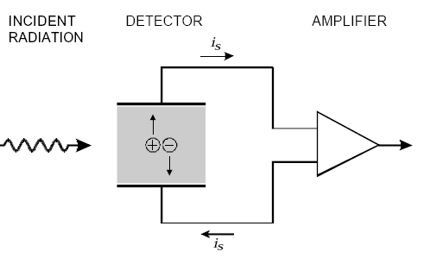
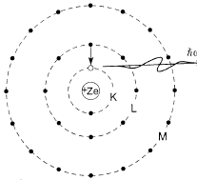
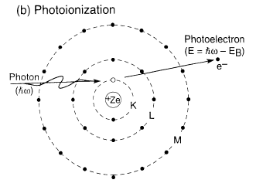
Rivelazione X, gamma indiretta: attraverso gli effetti prodotti
Eccitazione atomi
di sostanze liquide
e solide: emissione
di luce
la luce produce
corrente di elettroni
per effetto fotoelettrico
Amplicazione
Segnale
elettrico
Ionizzazione del
materiale: corrente
di elettroni. Gas,
liquido, semiconduttore
Misura diretta
Della corrente
di elettroni
X, γ

Slide 19
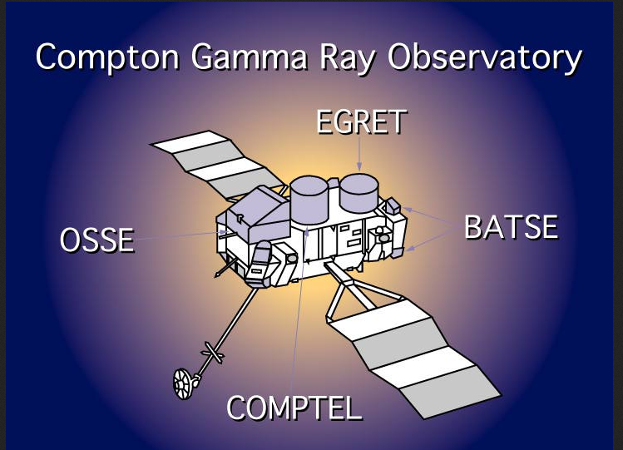

Slide 20
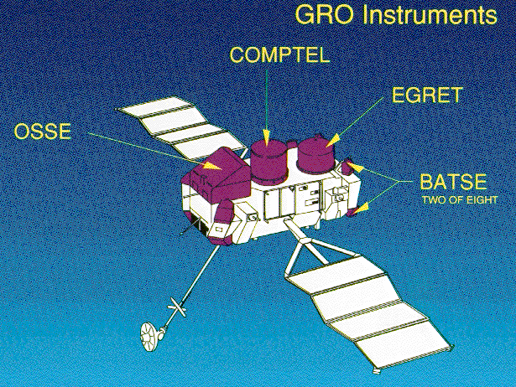

Slide 21
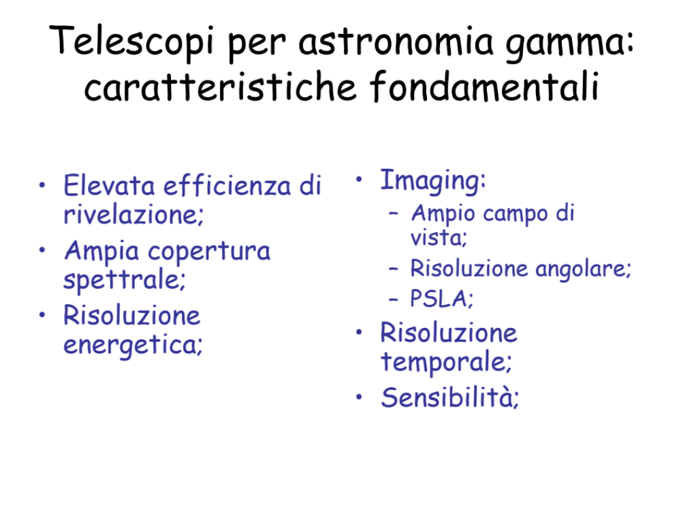

Slide 22
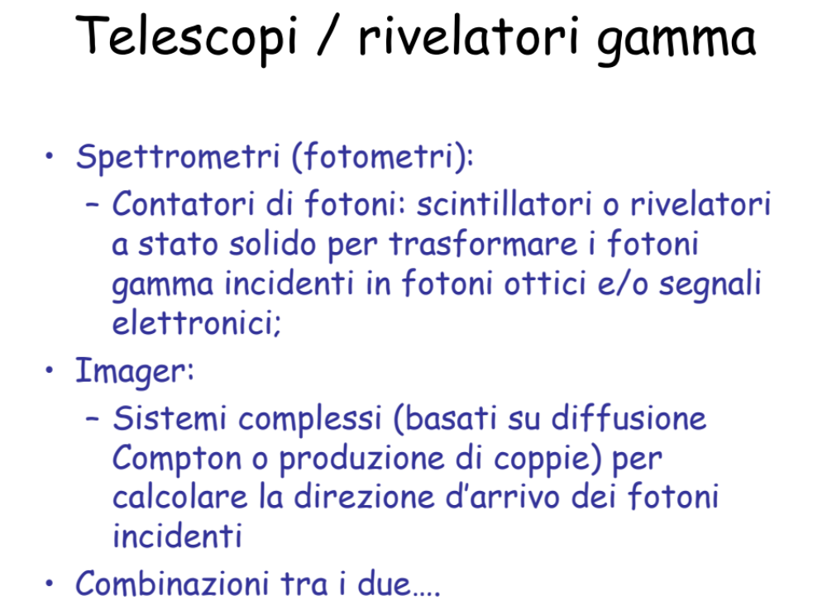

Slide 23
Interactions of Gamma Rays
In contrast to charged particles, which deposit energy continuously along their track, photon interactions are localized.
In passing through a medium, photons will traverse a certain distance unaffected, until depositing energy either by 3 possible processes
Effetto Fotoelettrico
Effetto Compton
Produzione di Coppie
e⁻
X
X⁻
γ + atomo → ione⁺ + e⁻
θ_{γ}
γ + e → γ’ + e’
Z
γ + campo Coul. → e⁺ + e⁻
Un fascio di fotoni non perde energia attraverso la materia ma la sua intensità si attenua

Slide 24
Rivelazione di fotoni
Rivelatore di fotoni
Convertire fotoni in elettroni e rivelare questi ultimi
E< 100 KeV (eff. Fotoelettrico)
elettroni estratti
E = 100 KeV – 2 MeV (eff. Compton)
Elettrone di rinculo
E> 2 MeV (coppie)
Rivelazione di sciami
E_{γ} ~ qualche MeV
Rivelatori ~ 1 – 2 cm : γ secondari sfuggono
T_{e}~ qualche MeV
Rivelatori ~ 10 cm : è possibile contenere tutti i processi
Cammino ~ qualche mm
Scelta del materiale assorbitore

Slide 25
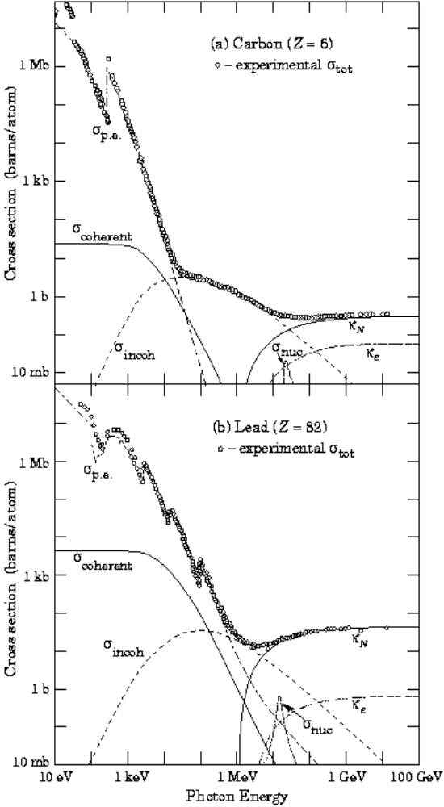
Rivelazione di fotoni
Per poter essere rivelato un fotone deve creare o cedere energia ad una particella carica
e⁻
Effetto
fotoelettrico
X
X⁻
γ + atomo → ione⁺ + e⁻
Vengono estratti principalmente elettroni delle shell K
σ_{foto} ∝ Z⁵/ E³_{γ}
Diffusione
Compton
e
θ_{γ}
γ + e → γ’ + e’
σ _{compton}
Diffusione su elettrone quasi libero
σ_{C} ∝ Z ln E_{γ} / E_{γ}
Produzione
di coppie
Z
γ + campo Coul. → e⁺ + e⁻
La creazione di coppie avviene solo per E > 2 m_{e} ed è il fenomeno dominante per E > 20 MeV.
σ_{pair} ∝ Z² ~ cost
I(x) = I_{o} exp(-7/9 x/X_{o})

Slide 26
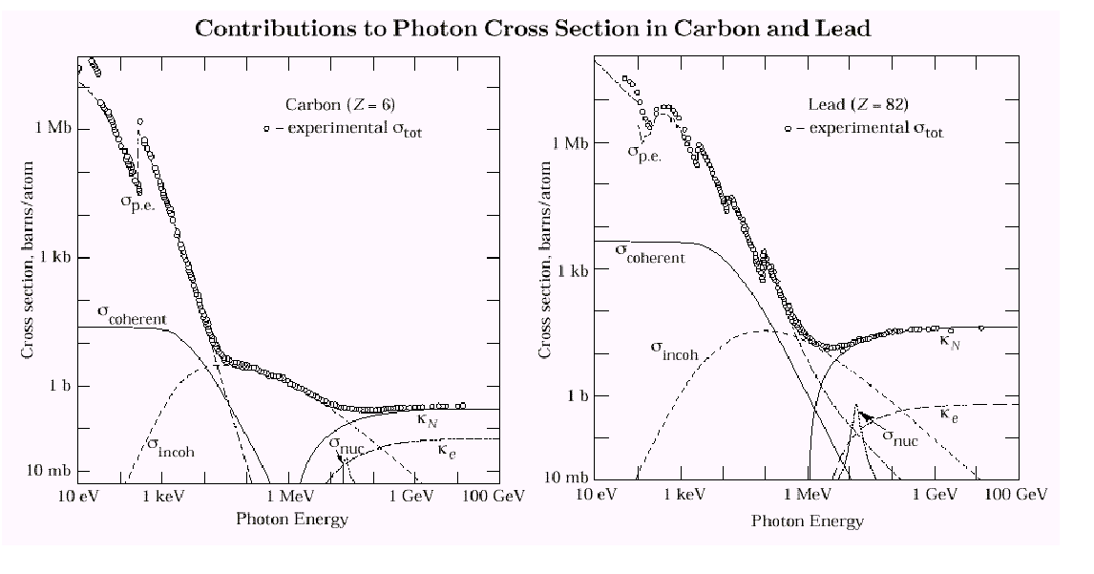
Photons
photo-electric effect
7
⎛
m
e
c
2
⎞
2
σ
≈
Z
5
α
4
⎜
⎜
pe
⎜
⎜
Z = 6
Z = 82
⎝
E
⎠
γ
σ ∝ Ζ⁵ , Ε^{−3.5}
Compton scattering
σ ∝ Ζ , Ε⁻¹
Z
ln
E
γ
σ
c
≈
E
γ
pair production occours if E_{γ} > 2m_{e}c²
7
A
1
∝ Z (Z+1) ; ∝ lnE/m_{e} for E< 1GeV, constant E >1GeV
σ
pair
≈
9
N
A
X
0
Probability of conversion in 1X₀ is e^{-7/9} - L_{pair} = 9/7 X₀ (γ disappears)

Slide 27

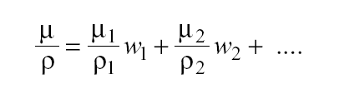

Interactions of Gamma Rays
The probability of undergoing an interaction is an exponential function of distance. The fraction of photons that suffered any interaction after traversing a distance x is
where μ is a linear absorption coefficient, expressed in cm⁻¹, which is the sum of the individual absorption coefficients of the relevant interactions.
The absorption can be parameterized more generally by the mass attenuation coefficient μ /ρ, expressed in cm²g⁻¹, which is independent of the density or physical state of the absorber.
For a mixture of elements of weight fractions w_{i} the composite mass attenuation coefficient is
N_{A} Σ σ_{i}
A
Probabilità di assorbimento dipende dall’energia
μ =

Slide 28
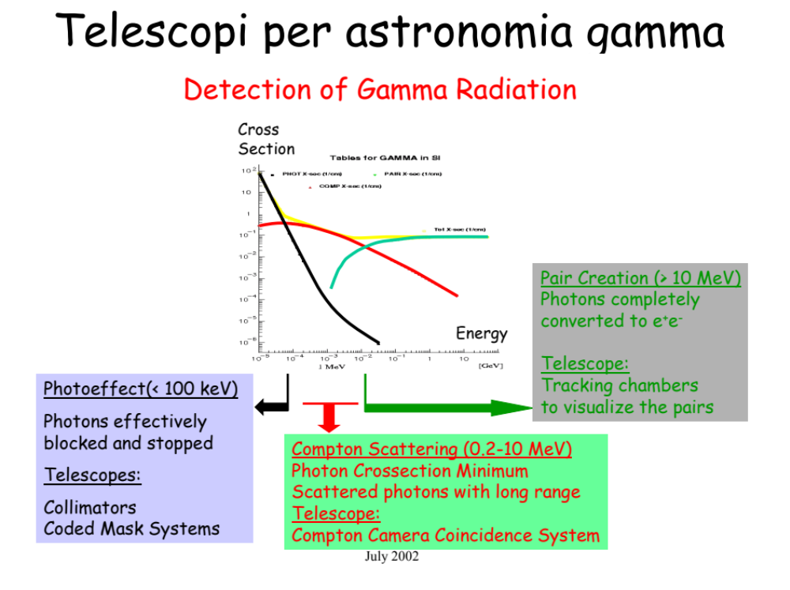

Slide 29
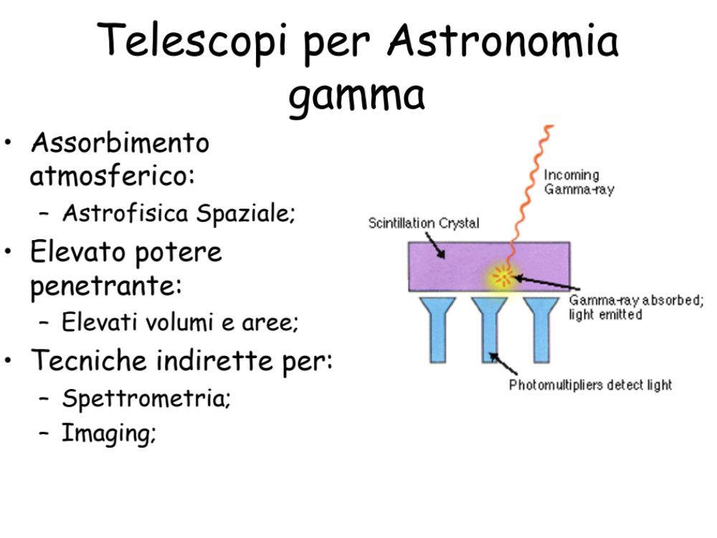

Slide 30
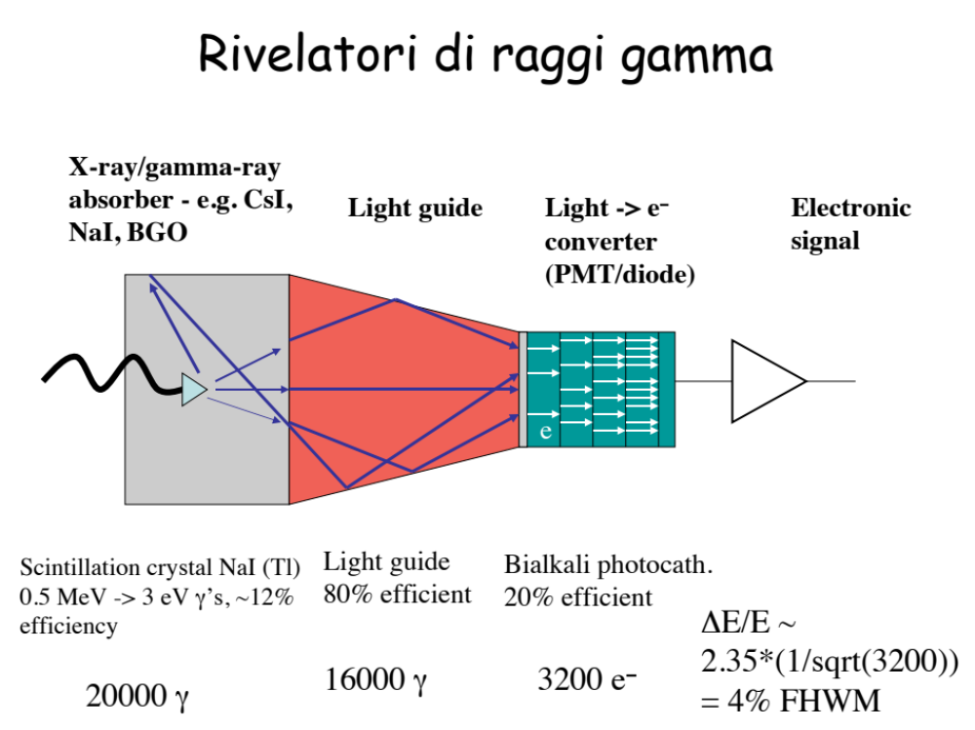

Slide 31
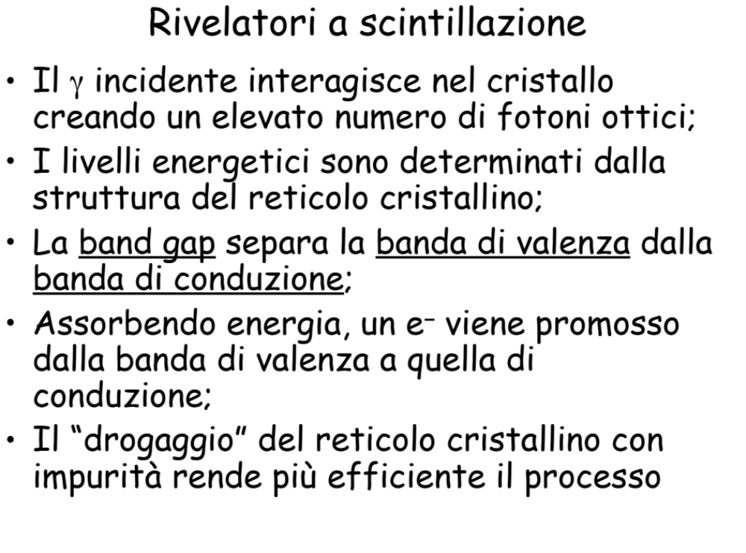

Slide 32
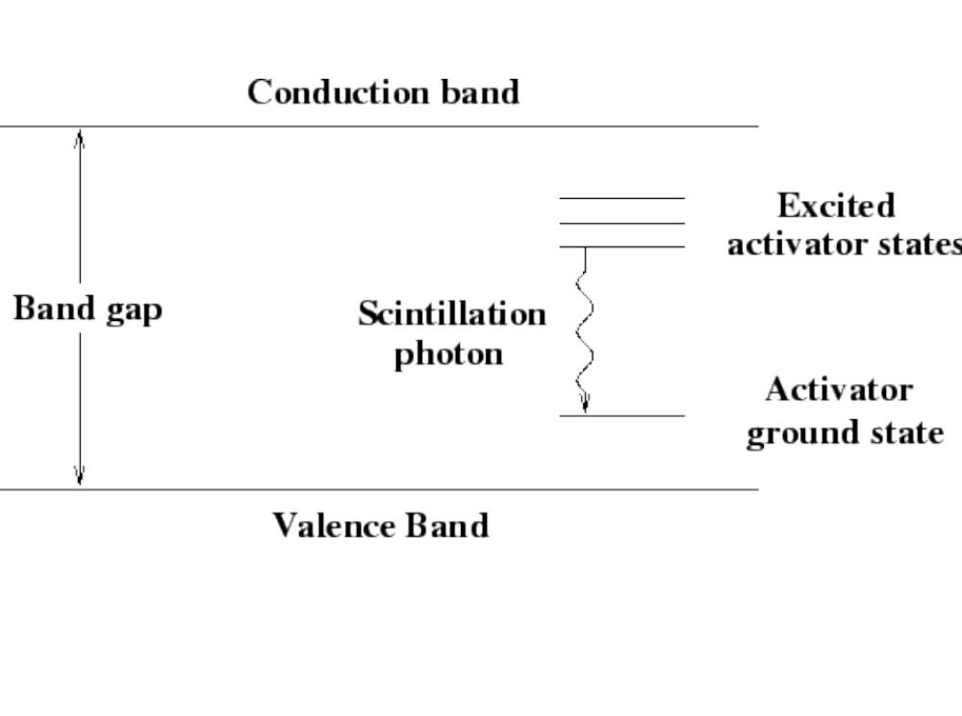

Slide 33
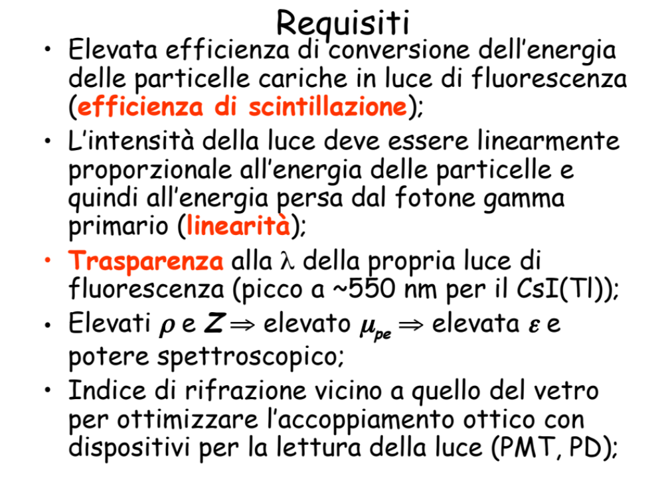

Slide 34
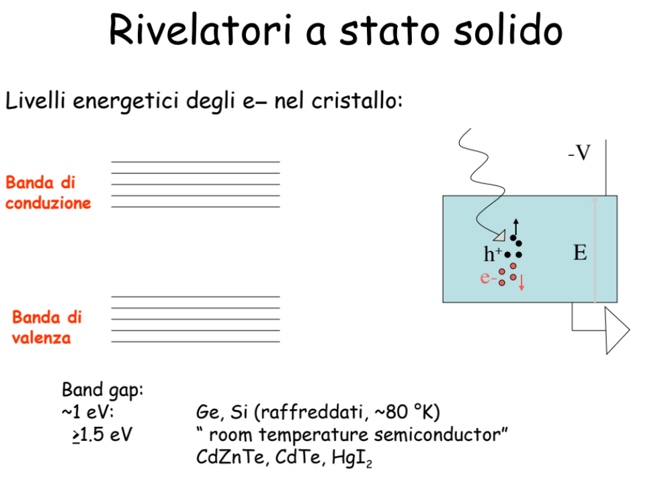

Slide 35
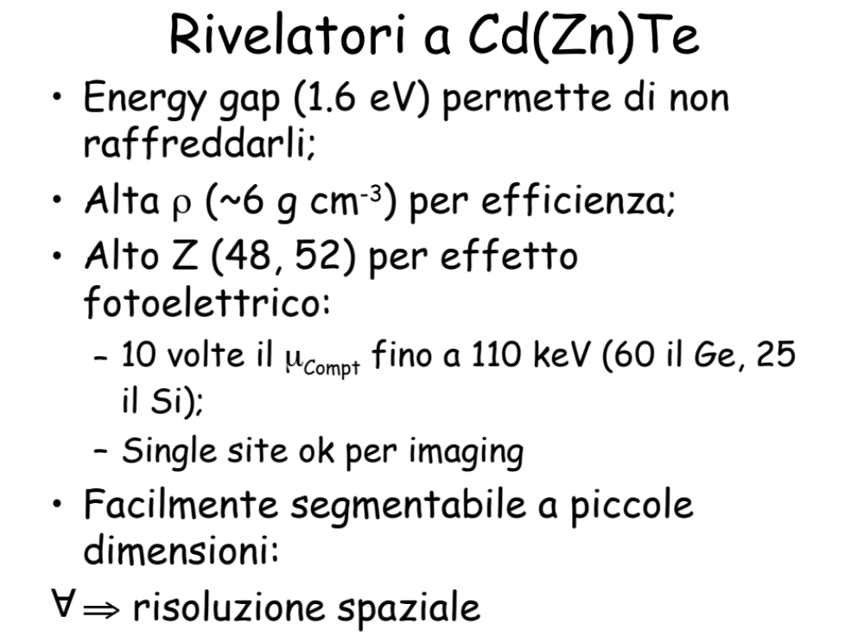

Slide 36
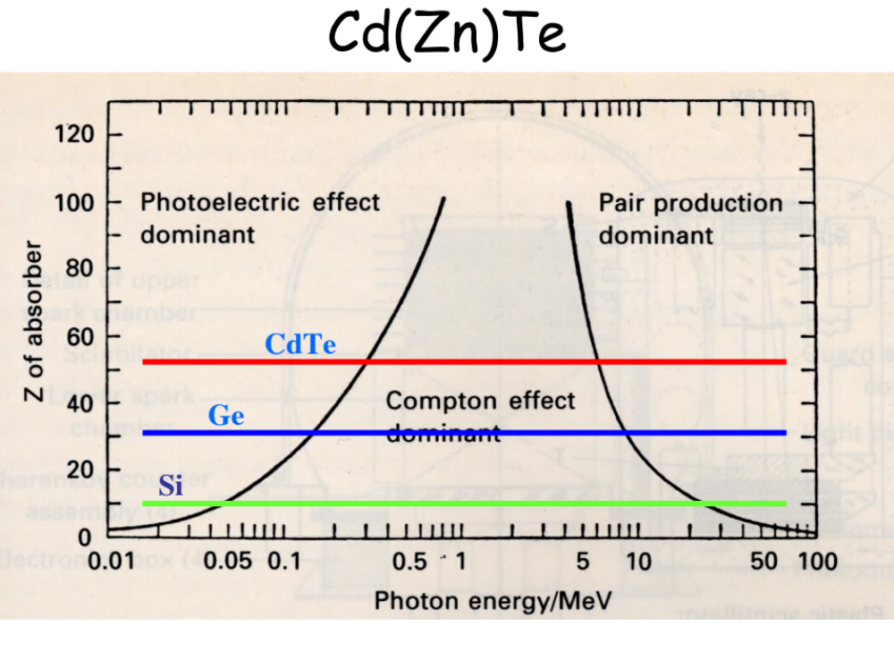

Slide 37
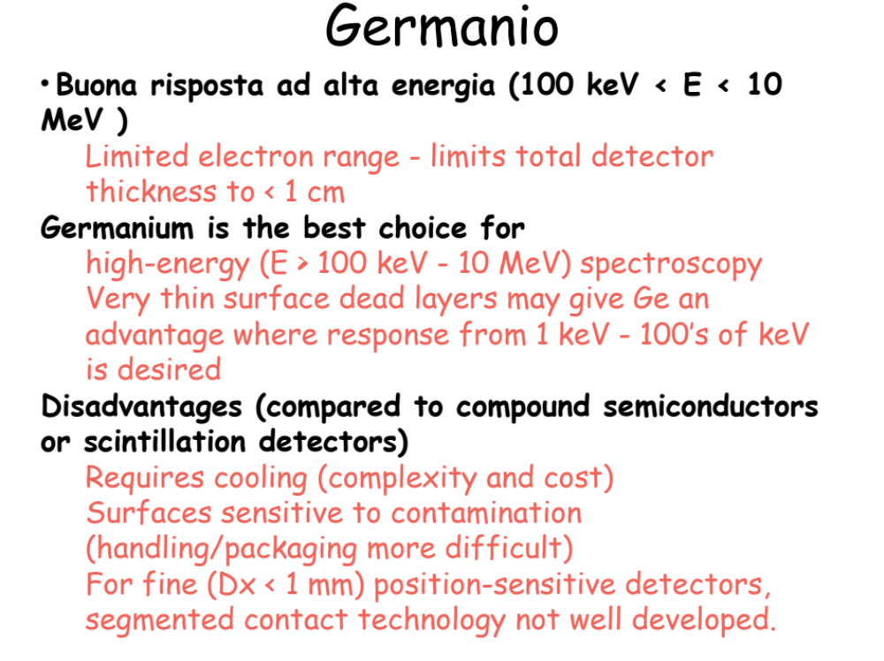

Slide 39
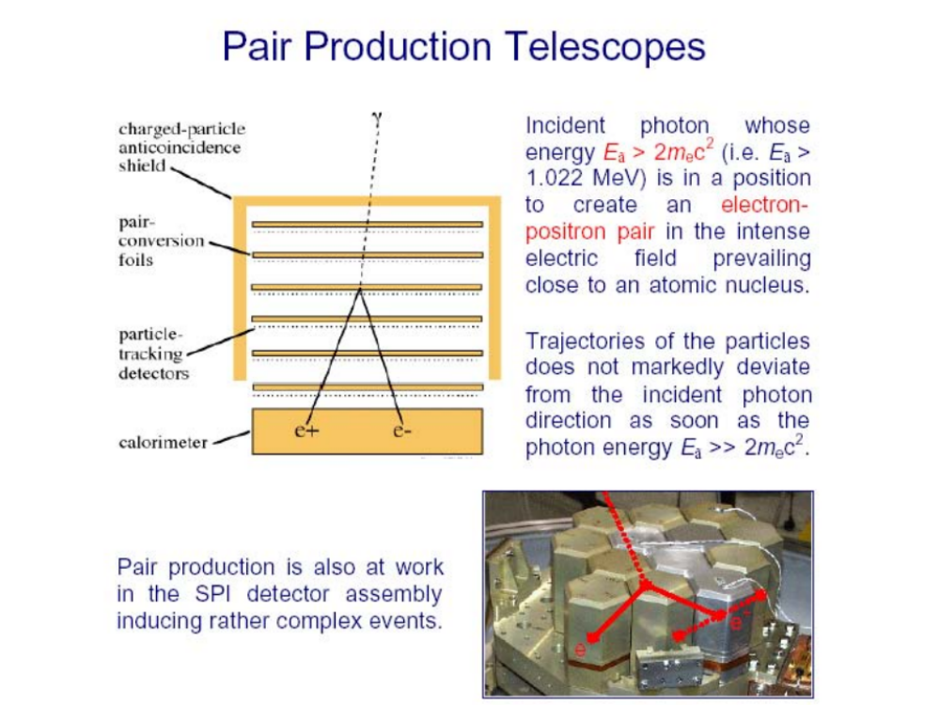

Slide 40
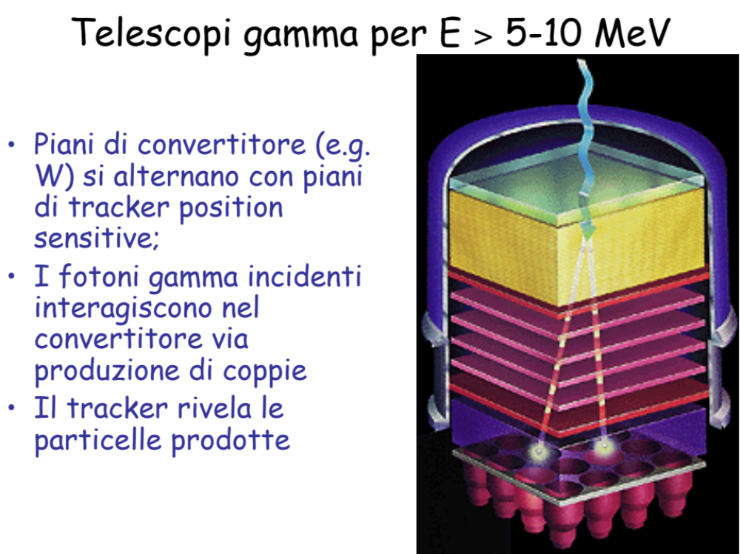

Slide 41
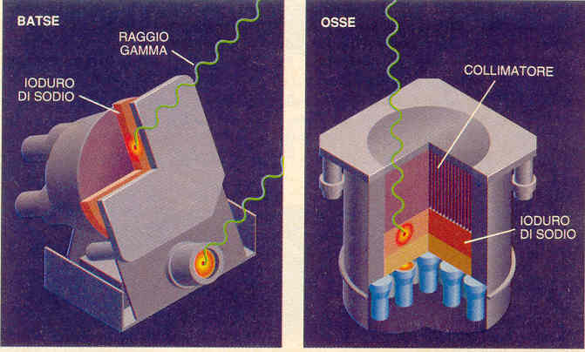
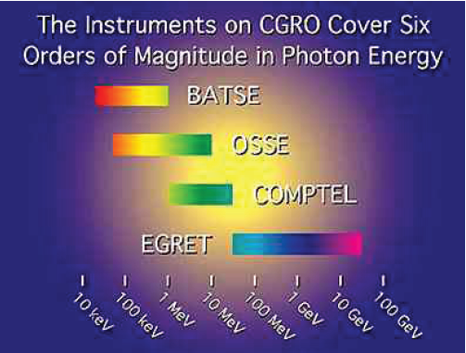
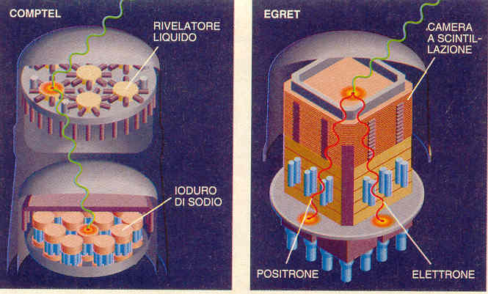
Raggi gamma misurati dagli
effetti prodotti:
-effetto fotoelettrico γ → e
(batse, osse)
-effetto Compton γ → e+ γ
(comptel)
-creazione di coppie γ → e+ e−
(egret)

Slide 42
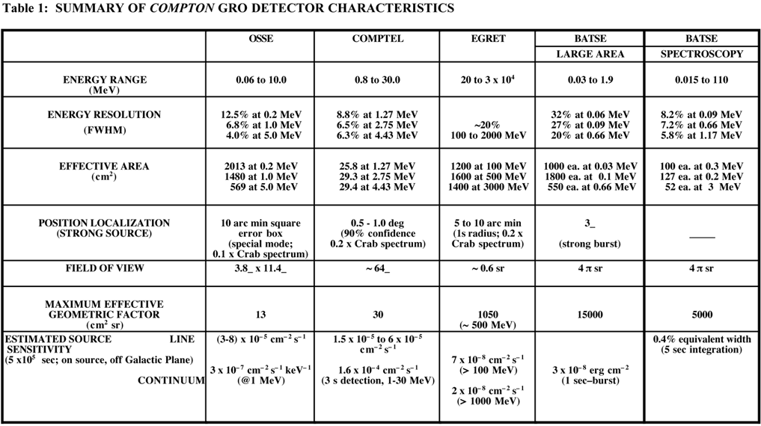

Slide 44
The table of instrument capabilities for the four experiments describes their fields of view, sensitivities to continuum and line emissions, and angular and energy resolutions. An appreciation of the purpose and design of Compton's four instruments is gained from understanding that above the energies of X-ray photons (~10 keV - about 10,000 times the energy of optical photons) materials cannot easily refract or reflect the incoming radiation to form a picture. Hence, alternative methods are required to collect gamma-ray photons and thereby image sources in the sky. At gamma-ray energies, three methods are currently used, sometimes in combination: (1) partial or total absorption of the gamma ray's energy within a high-density medium, such as a large crystal of sodium iodide, (2) collimation using heavy absorbing material, to block out most of the sky and realize a small field of view, and (3) at sufficiently high energies, utilization of the conversion process from gamma rays to electron-positron pairs in a spark chamber, which leaves a telltale directional signature of the incoming photon.
COMPTEL
COMPTEL consists of two detector arrays. In the upper one, a liquid scintillator, NE 213A, is used and, in the lower, NaI crystals. Gamma rays are detected by two successive interactions: an incident cosmic gamma-ray is first Compton scattered in the upper detector, then totally absorbed in the lower. The locations of the interactions and energy losses in both detectors are measured. The accuracy in the measurement of these parameters determines the overall energy and angular resolution of the telescope.

Slide 45
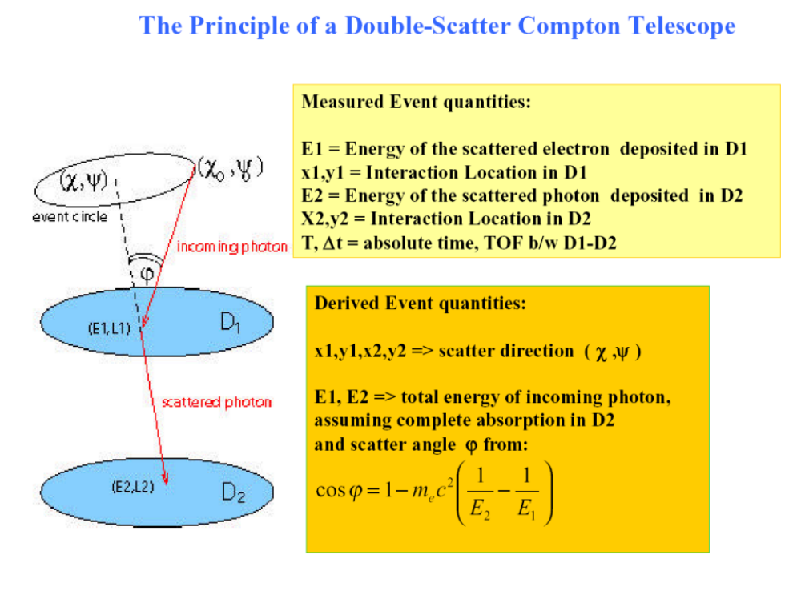
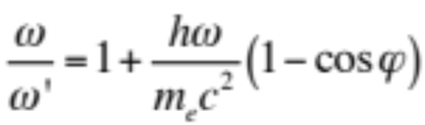

Slide 46
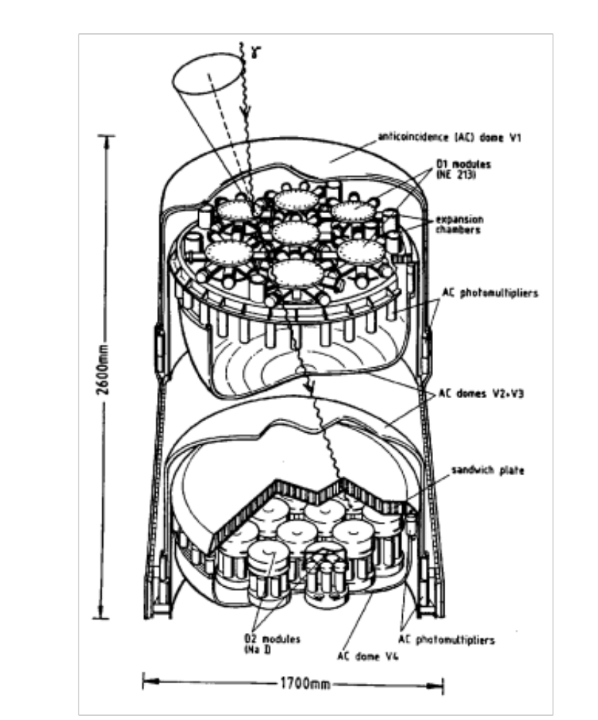
8 PMT
7 PMT

Slide 47
The two detectors are separated by a distance of 1.5 m. Each detector is entirely surrounded by a thin anticoincidence shield of plastic scintillator which rejects charged particles. On the sides of the telescope structure, between both detectors, are two small plastic scintillator detectors containing weak 60Co sources, used for in-flight calibration of the instrument. Each calibration source consists of a cylindrical piece of 60Co-doped plastic scintillator of 3 mm thickness and 1.2 cm diameter viewed by two 1.9 cm-diameter photomultiplier tubes (PMTs).
The Upper Detector (D1) consists of 7 cylindrical modules of liquid scintillator NE 213A. Each module is 27.6 cm in diameter, 8.5 cm thick, and viewed by eight photomultiplier tubes. The total area of the upper detector is approximately 4188 cm^2. The Lower Detector (D2) consists of 14 cylindrical NaI (Tl) blocks of 7.5 cm thickness and 28 cm diameter, which are mounted on a supporting baseplate. Each block of NaI is viewed from below by seven photomultiplier tubes. The total geometrical area of the lower detector is 8620 cm^2. Each anticoincidence shield consists of two 1.5 cm-thick domes of plastic scintillator NE 110, with each dome viewed by 24 photomultiplier tubes. With the exception of the front-end electronics, all detector electronics are mounted on a platform outside the detector assembly.
1) Double-Scatter Telescope Mode
COMPTEL operates primarily as a double-scatter gamma-ray telescope. In this mode an incident cosmic gamma ray is electronically identified by a delayed coincidence satisfying time-of-flight criteria between the upper and the lower detectors, combined with the absence of a signal from all charged particle shields and from the calibration detectors.

Slide 48
The quantities measured for each selected gamma-ray event are:
The energy of the recoil electron of the Compton scattered gamma ray in the upper detector Ee' (Ee' > 50 keV), summing pulse heights of the eight.
The location of the interaction in the upper detector, determined from the relative pulse heights of the eight PMTs.
The pulse shape of the scintillation in the upper detector, provided by the output of a pulse-shape discriminator circuit; (sigma=2cm.)
The energy loss Ee" in the lower detector ( Ee" > 500 keV), determined from the summed pulse heights of the seven PMTs.
The location of the interaction in the lower detector, determined from the relative pulse heights of the seven PMTs. (sigma 1cm.)
The time-of-flight of the scattered gamma ray from the upper to the lower detector; and
The absolute time of the event.
2) Burst Mode
In addition to the normal double-scatter telescope mode of operation, two of the NaI crystals in the lower D2 detector assembly of COMPTEL are also operated simultaneously as burst detectors. One of the burst modules provides energy coverage over a low range (~100 keV to ~1 MeV), and the other over a high range (~1 MeV to ~10 MeV). The burst detectors are sensitive to incident radiation over 4 steradians

Slide 49
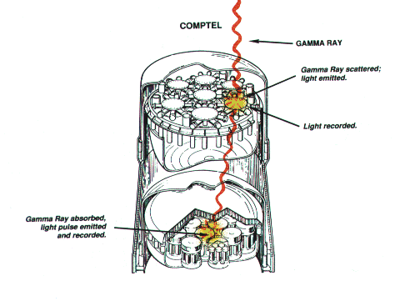
3) Solar Modes
i. Solar Gamma-Rays
In the event of a solar flare, COMPTEL can observe solar gamma rays in both the double-scatter telescope mode, provided the Sun is within the field of view of the instrument, and in the burst mode. Telescope observations of solar gamma rays have the advantage of a known source position.
ii. Solar Neutrons In addition to observing gamma rays
from a solar flare, COMPTEL is also capable of detecting
solar neutrons. Neutron interactions
within the instrument occur when an
incident solar neutron elastically scatters
off a hydrogen nucleus in the liquid
scintillator of an upper D1 module.
The scattered neutron may then
interact and deposit all or a portion of
its energy in one of the lower D2 modules

Slide 50
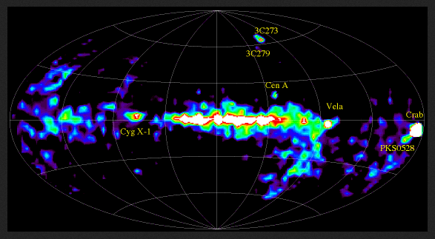
63 gamma-ray sources detected by the Imaging Compton Telecope (COMPTEL) Two unique sources that appear in the COMPTEL energy range are isotopes of titanium (Ti-44) and aluminum (Al-26), which are both produced in supernova explosions. Ti-44 has a half-life of 60 years; Al-26 has a half-life of 700,000 years. The detection of decaying titanium, therefore, can lead to the discovery of young supernova remnants. Other objects in COMPTEL's range include pulsars and active galactic nuclei (AGN), which are thought to host massive black holes of one million to one billion times the mass of the Sun.

Slide 51
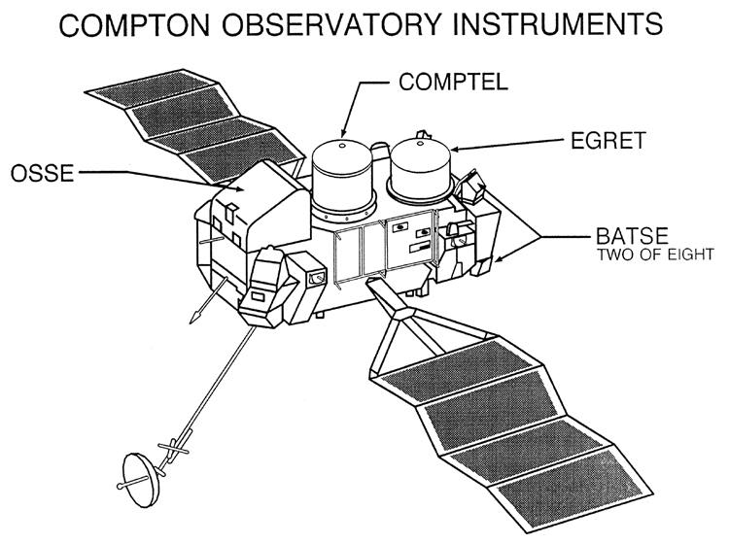
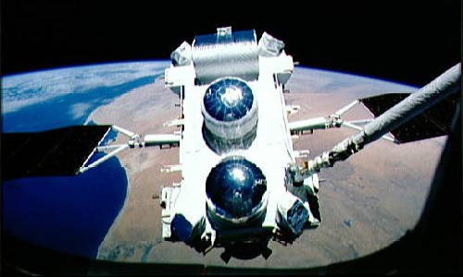
CGRO-BATSE (1991-2000)
(Compton Gamma Ray Observatory)
30 keV to 30 GeV
CGRO/BATSE (25 KeV÷10 MeV)

Slide 52
The BATSE experiment on CGRO studied some of the most energetic objects in the Universe, including gamma-ray bursts. These mysterious bursts are seen to occur at random in the sky about once per day. As a result of BATSE observations, most scientists now believe that these bursts originate from the most distant parts of the observable Universe. Prior to BATSE, prevailing theories assumed that the bursts were from objects within our galaxy, the Milky Way. BATSE is providing the most comprehensive and sensitive observations of gamma-ray bursts since their accidental discovery by nuclear bomb detection satellites over 25 years ago.
Other discoveries that BATSE has made since launch involve black hole, neutron star systems, and pulsars within the Galaxy. These extremely dense remnants of stellar explosions are associated with physical processes and conditions that cannot be observed on Earth. These objects produce highly variable radiation mostly in the x-ray and gamma-ray wavelengths. BATSE's sensitive, all-sky, continuous monitoring capability is unprecedented in astronomy and is extremely valuable for the study of these objects. New objects have been discovered and new features of previously known objects have been found. Closer to home, powerful gamma-ray flashes high above thunderstorms have been discovered with BATSE.

Slide 53
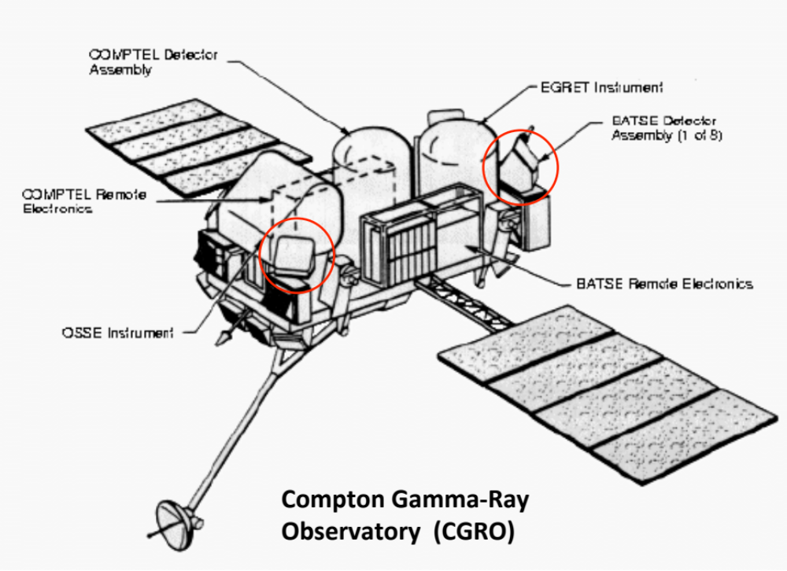

Slide 54
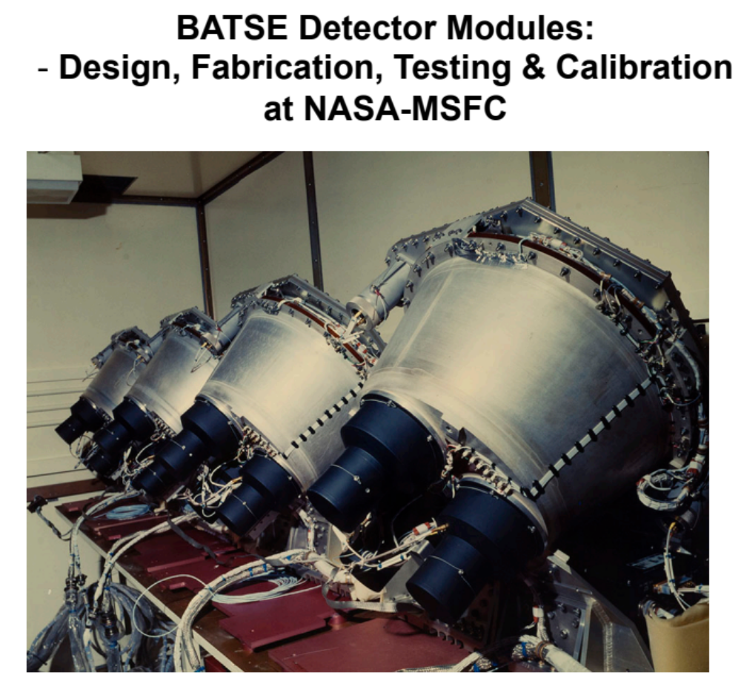

Slide 55

The Burst And Transient Source Experiment (BATSE)
The Burst and Transient Spectrometer Experiment: an all sky monitor sensitive from about 20-600 keV.

Slide 56



LAD
SD
moduli disposti a ottaedro

Slide 57


Slide 58

The primary objective of BATSE is the detection, location and study of gamma-ray bursts. With its large detecting elements and versatile data system, BATSE is providing the most sensitive and comprehensive set of observations of gamma-ray bursts yet obtained.

Slide 59
BATSE (the Burst And Transient Source Experiment) consists of eight uncollimated detector modules arranged on the corners (one at each of the satellite's corners (left, right; front and back; top and bottom) of the Compton Gamma Ray Observatory to provide the maximum unobstructed view of the celestial sphere. Each detector module contains a Large-Area Detector (LAD), optimized for sensitivity and directional response, and a spectroscopy detector (SD) optimized for broad energy coverage and energy resolution.
Each detector module contains two NaI(Tl) scintillation detectors: a Large Area Detector (LAD) for sensitivity and directional response, and a Spectroscopy Detector (SD) optimized for energy coverage and energy resolution. The eight planes of the LADS are parallel to the eight faces of a regular octahedron, with the orthogonal primary axes of the octahedron aligned with the coordinate axes of the Compton spacecraft.
The LAD detector is a disk of NaI scintillation crystal 20 inches in diameter and one-half inch thick, mounted on a three-quarter inch layer of quartz. A light collector housing on each detector brings the scintillation light into three 5-inch diameter photo-multiplier tubes (PMTs). The signals from the three tubes are summed at the detector. A quarter-inch plastic scintillation detector in front of the LAD is used as an anticoincidence shield to reduce the background due to charged particles
Directions to burst sources are determined by comparing count rates among separate detectors. Significant corrections are needed to account for the effects of atmospheric scattering.

Slide 60
The most significant and unexpected observation made by BATSE thus far is the isotropy of gamma-ray bursts. This observation coupled with statistical evidence for a non-homogeneous spatial distribution has ruled out the galactic disk distribution expected by many before launch. The observed time profiles of individual gamma-ray bursts show an enormous diversity in overall shape, pulse structure and duration. Models of bursts must be able to account for this diversity.
All eight detector modules have been operating well since the experiment was activated on April 21, 1991. Since activation, the rate of gamma-ray bursts observed by BATSE has been approximately 0.85 per day. Correcting for Earth blockage, experiment dead-time due to false triggers and for operational reasons (primarily SAA passages), the full-sky burst rate at the BATSE sensitivity is estimated to be about 800 bursts per year.
Gamma-Ray Bursts. The in-flight performance of BATSE for detecting GRB at least as good as the pre-launch predictions. A trigger sensitivity of about 10⁻⁷ erg/(cm²s) is typically achieved for most bursts. The burst occurrence rate at the normal threshold settings is slightly less than one per day. The rate of on-board triggers is significantly larger than this, averaging about 2.5 per day. At the beginning of the mission many of these were solar flares.
Nearly all the others are attributed to the effects of electron precipitation. Events may occur locally, producing -ray secondaries in the Compton spacecraft which trigger BATSE, or as auroral events at some distance from the spacecraft. The two types of events leave distinctive signatures in BATSE and are not easily confused with -ray bursts.

Slide 61

Discrete Longer-Lived Sources and Pulsars
The Compton-BATSE experiment has considerable capabilities for observations of steady sources, pulsed sources and longer-lived transient sources.
Figure shows the light curve obtained for the Crab Pulsar for a 1.5 x 105 s exposure. The data was collected over a period of 14 days, with about 1/4 of each GRO orbit devoted to this source.

Slide 62


Slide 63

Hard X-Ray Source Monitoring. Using the full unocculted sky viewing of the BATSE detectors, a significant contribution can be made to monitoring a large number of hard x-ray sources, many of which are variable, much like the contributions made by GINGA and Ariel-V at somewhat lower energies. While the BATSE detectors do not have the sensitivity and energy resolution of the collimated, pointed OSSE experiment, they do have the capability to provide frequent samples of the intensity of moderately strong steady sources, using the Earth occultation technique. This is demonstrated in Figure which shows occultation edges in the data due to Cyg X-1.
56 sorgenti
The Compton-BATSE experiment has
considerable capabilities for observations of steady sources, pulsed sources andlonger-lived transient sources. A list of known sources that may be observable by BATSE occultation or periodic emission analysis is available.

Slide 64


Distribuzione
di sorgenti
rivelata da BATSE
-isotropa
-galassie lontane
Gamma di alta
Energia rivelati da
EGRET

Slide 65

Come cerchiamo queste sorgenti cosmiche ?
p, N
ν
X,γ
X,g
X

Slide 66

Brillamento delle Pulsar

Slide 67


Slide 68



Slide 69
The full-sky viewing of BATSE enabled the nearly continuous observation of all pulsars brighter than about 15 mCrab. Most of the known accretion - powered x-ray pulsars have periods in 1 - 1000 seconds, so the 1.024 s samples BATSE continually returned in the telemetry were used to measure the current state of previously known sources, and search for new ones. By detecting the pulse arrival time (which can usually be done to an accuracy of a few percent of the pulse period), we measured the orbit of the neutron star around the companion, and the rotation period of the neutron star. Histories for some sources over most the mission are available here.
REMERBER that:
These pulsing X-ray stars or X-ray pulsars actually consist of a pair of stars orbiting around each other. One member of the pair is a small, solid star commonly known as a neutron star while the other is a normal gaseous star like our Sun, but usually many times more massive. The neutron star is only a few dozen kilometers in size but has a mass roughly equal to the Sun.
The neutron star is the collapsed core of a giant star that ran out of nuclear fuel at an earlier time. Normal stars, like our Sun, are composed of hot gas that, like any unconfined gas will try and expand to fill up space. On the other hand, the gravity of the star tries to collapse the gas under its own weight. The balance between the forces of expansion and collapse produce an ordinary stable star. However, the balance can't last forever since stars are cooling down by emitting radiation into space; in other words they shine! Their gas remains hot by ``burning'' hydrogen gas in their cores by the process of nuclear fusion. Eventually all stars use up their fuel supply, cool off and collapse. The collapsed remnant of stars within a certain mass range will be neutron stars while less massive stars become white dwarfs and more massive stars collapse into black holes.

Slide 70
The material in a relatively small body like the Earth is made of atoms. The atoms contain lightweight electrons orbiting around a small, heavy nucleus of protons and neutrons. But the pressures in a neutron star are so great that the atoms themselves collapse and the electrons are absorbed by the nuclei. The material in a neutron star is composed of atomic nuclei compressed tightly together and contains mostly neutrons; hence the name neutron star. The weight of the star attempts to further compress the neutrons together. But the neutrons respond to the increasing confinement not by squeezing closer together, but instead by moving faster, as prescribed by a fundamental quantum mechanical property known as the Heisenberg uncertainty principle. The neutrons thus act much like the particles in a hot gas and provide a counter pressure (technically known as ``degeneracy pressure'') that resists further gravitational collapse. Since this pressure is only the result of confinement of neutrons and not due to heating, the neutron star can exist as a permanent object like the Earth.
Many neutron stars have magnetic fields that are more than one trillion times stronger than the familiar field on the surface of the Earth that moves compass needles. In this respect, these neutron stars are like giant rotating bar magnets. When in orbit with a normal stellar companion, gas from the companion can be pulled onto the neutron star. The hot gas falling onto the neutron star is channeled by the magnetic field onto the North and South magnetic poles. Thus two ``hot spots'' on the neutron star surface are formed akin to the two auroral zones on the Earth but far hotter. In fact, at these hotspots the infalling gas can reach half the speed of light before it impacts the surface. So much energy is released by the infalling gas that the hotspots, which are only a few hundred square meters in size, can be up to ten thousand times brighter than the Sun! Temperatures of millions of degrees are produced so the hotspots emit mostly X-rays. As the neutron star rotates, we observe pulses of X-rays.

Slide 71
The gas that supplies the X-ray pulsar can reach the neutron star by a variety of ways that depend on the size and shape of the neutron star's orbital path and the nature of the companion star. Some companion stars of X-ray pulsars are very massive young stars that emit a stellar wind from their surface. The neutron star is immersed in the wind and continuously captures gas that flows nearby. In other systems, the neutron star orbits so closely to its companion that its strong gravitational force can pull material from the companion's atmosphere into an orbit around itself. This material forms a gaseous disk in which material spirals inwards to ultimately fall onto the neutron star. For still other types of X-ray pulsars, the companion star is rotating very rapidly and apparently shedding a disk of gas around its equator. The orbits of the neutron star with these companions are usually large and elliptical in shape. When the neutron star passes nearby or through the disk it will capture material and temporarily become an X-ray pulsar. The circumstellar disk expands and contracts for unknown reasons, so these temporary or transient X-ray pulsars are observed only intermittently often with months to years between episodes of X-ray pulsation.
BATSE continuously monitors the entire sky except for that portion blocked by the Earth and so is well-suited to observe X-ray pulsars. Both persistent and transient X-ray pulsations are observed. Typically about seven X-ray pulsars are being observed at any one time with pulsation periods ranging from 0.5 seconds to 681 seconds.
BATSE is also providing an unprecedented record of the pulse frequency histories for many X-ray pulsars. The same material that produces the X-ray pulsations also cause the neutron stars to spin faster or slower so much can be learned about the details of the accretion process or the neutron star by monitoring its changes in pulse frequency, which measures the rotation rate.

Slide 72

OSSE
The Oriented Scintillation Spectrometer Experiment (OSSE) has been designed to undertake comprehensive observations of astrophysical sources in the 0.05-10 MeV energy range. Secondary capabilities for gamma-ray and neutron observations above 10 MeV have also been included, principally for solar flare studies. The use of NaI(Tl) scintillation techniques provides large area and high sensitivity in the 0.05-10 MeV region.

Slide 73
OSSE
The Oriented Scintillation Spectrometer Experiment, (OSSE), detected gamma rays entering the field of view of any of four detector modules, which could be pointed individually, and were effective in the 0.05 to 10 MeV range. Each detector had a central scintillation spectrometer crystal of NaI(Tl) 12 in (303 mm) in diameter, by 4 in (102 mm) thick, optically coupled at the rear to a 3 in (76.2 mm) thick CsI(Na) crystal of similar diameter, viewed by seven photomultiplier tubes, operated as a phoswich: i.e., particle and gamma-ray events from the rear produced slow-rise time (~1 μs) pulses, which could be electronically distinguished from pure NaI events from the front, which produced faster (~0.25 μs) pulses. Thus the CsI backing crystal acted as an active anticoncidence shield, vetoing events from the rear. A further barrel-shaped CsI shield, also in electronic anticoincidence, surrounded the central detector on the sides and provided coarse collimation, rejecting gamma rays and charged particles from the sides or most of the forward field-of-view (FOV). A finder level of angular collimation was provided by a tungston slat collimator grid within the outer CsI barrel, which collimated the response to a 3.8° x 11.4° FWHM rectangular FOV. A plastic scintillator across the front of each module vetoed charged particles entering from the front. The four detectors were typically operated in pairs of two. During a gamma-ray source observation, one detector would take observations of the source, while the other would slew slightly off source to measure the background levels. The two detectors would routinely switch roles, allowing for more accurate measurements of both the source and background. The instruments could slew with a speed of approximately 2 degrees per second.

Slide 74


Slide 75


Slide 76


Slide 77


Slide 78


Slide 79
The objective of the Energetic Gamma Ray Experiment Telescope (EGRET) is to make a major advance in high energy (20 MeV to about 30 GeV) gamma-ray astrophysics using a gamma-ray telescope with more than an order of magnitude greater sensitivity and better angular and energy resolution than instruments previously flown. The study of the gamma-ray sky reveals the sites of the most energetic interactions occurring in astrophysics. In addition, since high energy gamma rays have a very low interaction cross section, they have a very high penetrating power and can reach the Earth from essentially any part of the Galaxy or universe.
the specific objectives of this experiment are:
-To search for localized gamma-ray sources in the energy range from 20 MeV to 30 GeV and to measure the intensity, energy spectrum, position, and possible time variations of each;
-To improve the knowledge of the locations and nature of known high energy gamma-ray sources not identified with objects seen at other frequencies;
-To examine supernova remnants and search for evidence of cosmic-ray particle acceleration revealed by high energy gamma rays;
-To search for high energy gamma-ray bursts, to study the spectra of low energy gamma-ray bursts;
-To detect and examine the high energy gamma-ray emission from other galaxies, including both normal galaxies and active galaxies;

Slide 80
EGRET is designed to cover the energy range from 20 MeV to about 30 GeV. The instrument uses a multilevel thin-plate spark chamber system to detect gamma rays by the electron-positron pair production process. A calorimeter using NaI(Tl) is placed beneath the instrument to provide good energy resolution over a wide dynamic range. The instrument is covered by a plastic scintillator anticoincidence to prevent triggering on events not associated with gamma rays. A gamma ray entering the telescope within the acceptance angle has a reasonable probability (about 35% above 200 MeV) of converting into an electron-positron pair in one of the thin plates between the spark chambers in the upper portion of the telescope. If at least one particle of the pair is detected by the directional time-of-flight coincidence system as a downward moving particle, and if there is no signal in the large anticoincidence scintillator surrounding the upper portion of the telescope, the track imaging system is triggered, providing a digital picture of the gamma-ray event. Low energy backward-moving charged particles which do not reach the anticoincidence are rejected by the time-of-flight measurement.
La lunghezza di radiazione X₀ è la distanza media attraversata da un elettrone di alta energia che perde tutta la sua energia tranne 1/e per Bremsstrahlung.
X₀=(716.4 A)/(Z(Z+1)ln(287/2^{1/2}))
The telescope consists of two levels of a four by four scintillator array in a time-of-flight coincidence. The upper spark chamber assembly consists of 28 spark chamber modules interleaved with twenty-seven 0.02 radiation length plates in which the gamma ray may convert into an electron pair. The initial direction is usually determined from the upper spark chamber The lower spark chamber assembly, between the two time-of-flight scintillator planes, allows the electron trajectories to be followed, provides further information on the division of energy between the electrons, permits seeing the separation of the two electrons for very high energy gamma rays, and shows the entry points of the electrons into the NaI detector.

Slide 81

Tantalium foil
coverter
Particelle cariche
10^5 x gamma
5 gas refill (2 anni)

Slide 82

The energy of the gamma ray is determined in large part from measurements made in an eight radiation-length thick, 76 cm x 76 cm square NaI(Tl) scintillator crystal below the lower time-of-flight scintillator plane. Spark chamber measurements of Coulomb scattering in the thin plates and position information in the spark chamber system also aid in the energy determination. The energy resolution of the experiment is about 20% (FWHM) over the central part of the energy range. The resolution is degraded to about 25% above several GeV due to incomplete absorption in the NaI calorimeter, and at energies below about 100 MeV where ionization losses in the spark chamber plates comprise an appreciable portion of the total energy. In addition, some particles may completely miss the calorimeter.
The EGRET operating mode may be altered in two ways. In the common mode, an energy deposition of 7 MeV in the NaI(Tl) calorimeter is required for an event. This mode increases instrument live time by reducing the rate of triggers. For an observation where low energy sensitivity is desired in spite of the poor angular accuracy, it would be reasonable to remove the calorimeter coincidence requirement. The 16 tiles in each of two planes form 96 recognized sub-telescopes which point in 9 different directions, each approximately 0.1 steradians in size. These 9 direction groupings are utilized to limit triggers due to earth albedo gamma rays, but simultaneously maximize celestial exposure. Vertical only would give the best efficiency. The field of view would be greatly reduced and not available to others.

Slide 83

E_{c} ≈ 800/Z

Slide 84
C. Instrument Parameters and Capabilities
Type: spark chambers, NaI(Tl) crystals, and plastic scintillators.
Energy Range: 20 MeV to about 30 GeV.
Energy Resolution: approximately twenty percent over the central part of the energy range.
Total Detector Area: approximately 6400 cm2
Effective Area: approximately 1500 cm2 between 200 MeV and 1000 MeV, falling at higher and lower energies.
Point Source Sensitivity: varies with the spectrum and location of the source and the observing time. Under optimum conditions, well off the galactic plane, it should be approximately 6 x 10-8 cm-2s-1 for E > 100 MeV for a full two week exposure.
Source Position Location: Varies with the nature of the source intensity, location, and energy spectrum from 5 - 30 arcmin.
Field of View: approximately a gaussian shape with a half width at half maximum of about 20. Note that the full field of view will not generally be used.
Timing Accuracy: 0.1 ms absolute
Weight: about 1830 kg (4035 lbs)
Size: 2.25 m x 1.65 m diameter
Power: 190 W (including heater power)

Slide 85


Slide 86


Slide 87


Slide 88


Slide 89


Slide 90


^{Extragalactic Contribution}

Slide 91

^{The Crab Nebula}

Slide 92


Slide 93


Slide 94
AGILE
AGILE is the first of a new generation of high-energy space missions based on solid-state silicon technology, combining for the first time two sophisticated co-axial instruments: a gamma-ray detector, sensitive to photons with energy in the range 30 MeV - 50 GeV, and a hard X-ray detector, sensitive in the range 18 - 60 keV. The instrument is completed by a calorimeter (energy range 250 keV - 100 MeV) and by an anti-coincidence system. Its optimum angular resolution, 0.1 - 0.2 degrees in gamma-rays and 1-2 arcminutes in X-rays, the very large field of view as well as its small dead time (100 microsec), makes AGILE a very good instrument to study persistent and transient gamma-ray sources.
Figure shows schematically the AGILE baseline configuration of total weight of a 130 kg including the Si-Tracker, Super-AGILE, Mini-Calorimeter, the Anticoincidence system and electronics. The AGILE instrument is made of the following elements.

Slide 95


Slide 96


Slide 97


Slide 98


Slide 99

1,12 eV
intrinsic semiconductor: no good radiation detector-thermic current-low sensitivity

Slide 100


Slide 101



Come ottenere un segnale?
In a pure intrinsic (undoped) material the electron density n and hole density p are equal. n = p = n_{i}
In this volume
we have 4.5 ⋅10⁸ free charge carriers, but only 3.2 ⋅10⁴ e-h pairs produced by a M.I.P.
➔ Reduce number of free charge carriers,
i.e. deplete the detector (drogaggio, giunzione e polarizzazione inversa)

Slide 102


Slide 103

1,12 eV
Questa extra lacuna va ad occupare una posizione all’interno della gap proibita, spostando la gap più verso la banda di valenza.
Typical doping:
10¹⁰ atoms/cm³ on a density of
10²² atoms/cm³

Slide 104



Slide 105


Slide 106



C

Slide 108
1,12 eV
intrinsic semiconductor: no good radiation detector-thermic current-low sensitivity

Slide 110
Come ottenere un segnale?
In a pure intrinsic (undoped) material the electron density n and hole density p are equal. n = p = n_{i}
In this volume
we have 4.5 ⋅10⁸ free charge carriers, but only 3.2 ⋅10⁴ e-h pairs produced by a M.I.P.
➔ Reduce number of free charge carriers,
i.e. deplete the detector (drogaggio, giunzione e polarizzazione inversa)

Slide 112
1,12 eV
Questa extra lacuna va ad occupare una posizione all’interno della gap proibita, spostando la gap più verso la banda di valenza.
Typical doping:
10¹⁰ atoms/cm³ on a density of
10²² atoms/cm³

Slide 115
C

Slide 116


Slide 117


Slide 118


Slide 119


Slide 120


Slide 121


Slide 122


The GRID is made of 12 Silicon-Tungsten planes and the Mini-Calorimeter positioned at the bottom of the istrument. Super-AGILE with its 4 Si-detectors and the ultra-light coded mask system is positioned on top of the first GRID tray. The istrument size is a 63 x 63 x 58 cm3, including the AC system for a total weight of the external envelope of a 100 kg.
layout of the fundamental 9.5 x 9.5 cm2 unit (tile) of the AGILE Silicon Tracker. The Silicon microstrip pitch is 121 μm, for a floating strip readout system of 242 μm pitch. Each Si-tile has 384 readout channels read by 3 TA1 chips.

Slide 123
The AGILE Gamma-Ray Imaging Detector (GRID) is sensitive in the energy range a 30 MeV–50 GeV. It is characterized by the smallest ever obtained deadtime for gamma- ray detection (< 200 μs) and by a trigger based exclusively on Silicon plane detectors. GRID consists of a Silicon-Tungsten Tracker, a Cesium Iodide Mini-Calorimeter, an Anticoincidence system made of segmented plastic scintillators, and fast readout electronics and processing units1. The GRID is designed to achieve an optimal angular resolution (source location accuracy 50’- 200’ for intense sources), an unprecedently large field-of-view (a 3 sr), and a sensitivity comparable to that of EGRET for on-axis (and substantially better for off-axis) point sources.
AGILE will be greatly enhanced by its detection and imaging capabilities in the hard X-ray range (10-40 keV). The Super-AGILE detector consists of an additional plane of four Silicon square units positioned on top of the GRID Tracker plus an ultra-light coded mask structure with a top absorbing mask at the distance of 14 cm from the Silicon detectors. The main goals of Super-AGILE are the simultaneous gamma-ray and hard X-ray detection of astrophysical sources (unprecedented for gamma-ray instruments), optimal source posi- tioning (1-3 arcmins, depending on intensity), fast gamma-ray burst and transient alert.
La lunghezza di radiazione X₀ è la distanza media attraversata da un elettrone di alta energia che perde tutta la sua energia tranne 1/e per Bremsstrahlung.
X₀=(716.4 A)/(Z(Z+1)ln(287/2^{1/2}))

Slide 124
Silicon-Tracker, the gamma-ray pair-converter and imager is made of 12 planes, with two Si-layers per plane providing the X and Y coordinates of interacting charged particles. The fundamental Silicon detector unit is a tile of area 9.5 x9.5 cm2, microstrip pitch equal to 121 μm, and thickness 410 μm. The adopted “floating read- out strip” system has a total of 384 readout channels (readout pitch equal to 242 μm) and three readout TAA1 chips per Si-tile. Each Si-Tracker layer is made of 4 x 4 Si-tiles, for a total geometric area of 38 x 38 cm2. The first 10 planes are made of three elements: a first layer of tungsten (0.07 X₀) for gamma-ray conversion, and two Si-layers with microstrips orthogonally. For each plane there are then 2 x 1536 readout microstrips. Since the GRID trigger requires at least three Si-planes, two more Si-planes are inserted at the bottom of the tracker without the tungsten layers. The total readout channel number for is 36864. Both digital and analog information (charge deposition in Si-microstrip) is read by TAA1 chips. The distance between mid-planes equals 1.9 cm (optimized by Montecarlo simulations). The GRID has an on-axis total radiation length near 0.8 X. Figure schematically shows the layout and typical results of experimental tests carried out at of the tracking performance of the AGILE Silicon detectors. The positional resolution obtained by these detectors is excellent, being below 40 μm for a large range of photon incidence angles.

Slide 125
Mini-Calorimeter (MC), made of 30 Cesium Iodide (CsI) bars arranged in two planes, for a total (on-axis) radiation length of 1.5 X0. The signal from each CsI bar is collected by two photodiodes placed at both ends. The MC goals are: (i) obtaining additional information on the energy deposited in the CsI bars by particles produced in the Si-Tracker, and therefore contributing to the determination of the total photon energy; (ii) detecting GRBs and other impulsive events with spectral and intensity information in the energy band a 0.3 ° 100 MeV.
Anticoincidence (AC) System, aimed at both charged particle background rejection and preliminary direction reconstruction for triggered photon events. The AC system completely surrounds all AGILE detectors (Super-AGILE, Si-Tracker and MC). Each lateral face is segmented in three plastic scintillator layers (0.6 cm thick) connected with photomultipliers placed at the bottom. A single plastic scintillator layer (0.5 cm thick) constitutes the top-AC whose signal is read by four light photomultipliers placed externally to the AC system and supported by the four corners of the structure frame. The segmentation of the AC System and the trigger logic ensure the large GRID field of view.

Slide 126


Slide 127


Slide 128


Slide 129


Slide 130


Slide 131



Slide 132


La ricerca di nuovi fotorivelatori porta inevitabilmente
ai dispositivi al silicio
Diodi p-n
luce
luce
ed oggi + ?
p-i-n
Amplificazione
1
APD
Amplificazione
50-100

Slide 133





new
APD in regime Geiger/SiPM
luce
4/2007
1x1 mm
1600 celle
Molte celle Geiger con amplificazione
10⁵-10⁶. Luce proporzionale alle celle
accese
1 anno
di
progresso
luce
3x3 mm
14400 celle
1x1 mm²
fino a 1600 celle
si/no
4/2008
6x6 mm
2x2 array

Slide 134



Hard X-ray-imager ( 15-45 KeV

Slide 135

A photon beam (of energy range a 30 ° 500 MeV) was produced by Bremsstrahlung of electrons of momentum ranging from 0.15 to 1 GeV/c hitting a thin lead target.

Slide 136


Slide 137


Slide 138

The combination of simultaneous hard X-ray and gamma-ray data will provide a formidable combination for the study of high-energy sources. Given the sensitivities of the GRID and Super-AGILE, simultaneous hard X-ray/gamma-ray information is anticipated to be obtain- able for: (1) GRBs, (2) blazars with strong X-ray continuum such as 3C 273 and Mk 501, (3) Galactic jet-sources with favorable geometries, (4) unidentified variable gamma-ray sources.

Slide 139


Fov

Slide 140

ground-based and space instruments

Slide 141


Slide 142


Slide 143
Non sappiamo se la stella che produce tale energia sia una stella di neutroni o un buco nero. Di certo, AGILE ha ora rivelato diversi episodi ripetitivi di emissione gamma che sempre precedono la produzione di fortissimi getti radio di grande potenza. Tale scoperta getta nuova luce sulle proprietà degli oggetti più energetici della Galassia, e prelude a ulteriori studi osservativi e teorici per comprendere questi enigmatici oggetti e buchi neri ancor più massivi.
I buchi neri e le stelle compatte di neutroni sono gli oggetti più energetici e estremi della nostra Galassia. Possono sprigionare enormi getti di materia ad altissima velocità sotto forma di “getti” se sollecitati da gas intrappolato dal loro enorme campo gravitazionale. Uno tra gli oggetti più noti per la sua erraticità e potenza è il sistema binario Cygnus X-3 che occasionalmente (1-2 volte l’anno) produce potentissimi getti radio accompagnati da attività spasmodica rivelata nei raggi X. Uno dei fenomeni possibili, mai osservato finora, è l’emissione di radiazione gamma prodotta da forti accelerazioni di particelle legate alla formazione di getti
AGILE, ha individuato per la prima volta radiazione gamma proveniente da Cygnus X-3, la sorgente galattica più “prolifica” nella sua produzione di getti di alta potenza.
Nel corso di decenni di osservazioni, Cygnus X-3 ha sempre mostrato un comportamento erratico con osservazioni alle alte energie spesso controverse. Una speciale campagna di osservazioni della costellazione del Cigno a partire dal 2007 da parte del satellite AGILE ha permesso di rivelare per la prima volta diversi episodi di emissione gamma molto intensa da Cygnus X-3. All’aumentare dei dati, con grande sorpresa, è emerso un quadro ripetitivo del fenomeno. La radiazione gamma, e quindi l’accelerazione estrema di particelle, non viene prodotta a caso, né durante e dopo la formazione dei getti radio, ma prima.

Slide 144


Slide 145


Slide 146

The LAT sensitivity is a good match ^{for the SEDs expected from} young high-energy pulsars – especially in the region of GeV spectral cut-offs

Slide 147


