Slide 1
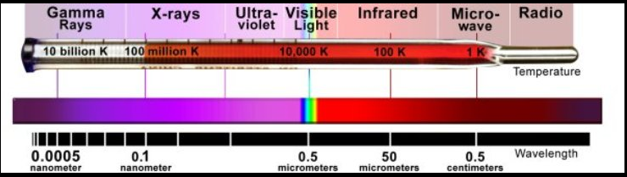
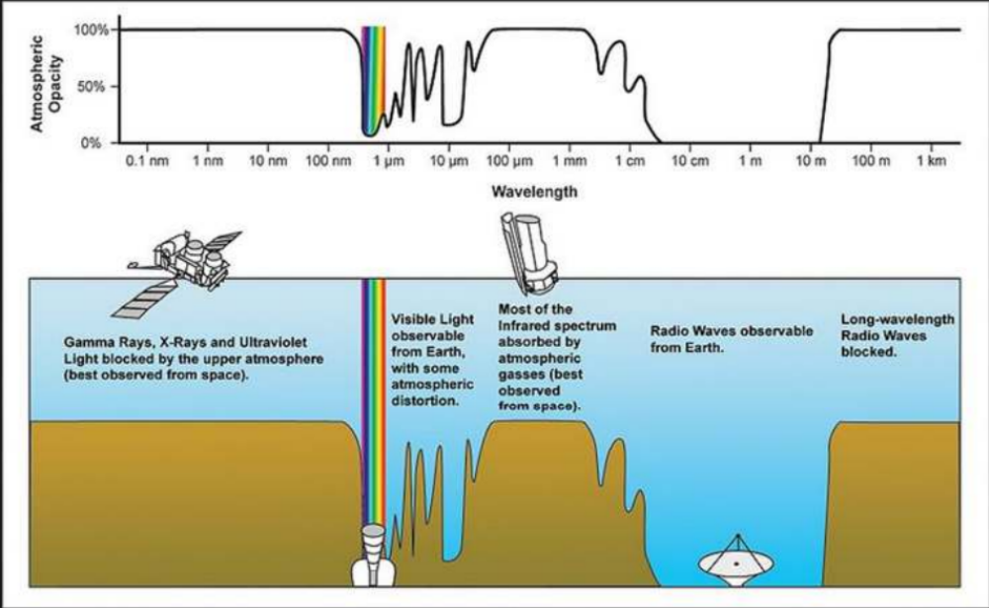

Slide 2
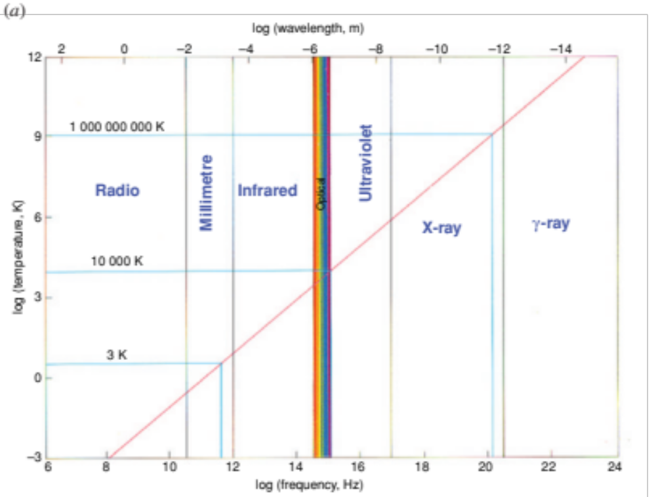
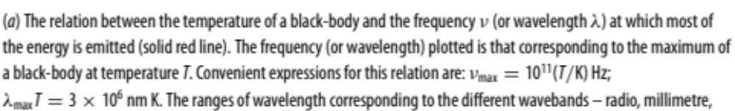

Slide 3

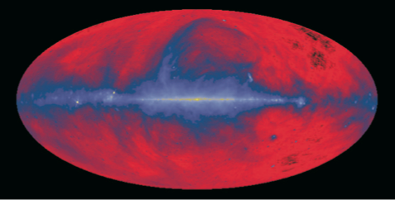
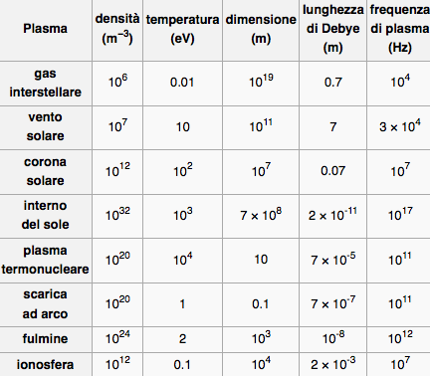
Images of the celestial sphere at a radio frequency of 408 MHz in a Hammer–Aitoff projection. This image is dominated by the radio emission of relativistic electrons gyrating in the interstellar magnetic field, the process known as synchrotron radiation. The radiation is most intense in the plane of the Galaxy but it can be seen that there are extensive ‘loops’ and filaments of radio emission extending far out of the plane. (Courtesy of Max-Planck-Institut fu ̈r Radioastrotiomie, Bonn.)
1 eV = 11600 °K
-Emissioni associate direttamente ai fenomeni osservati nella banda ottica
-Emissione radiazione di sincrotrone da parte di elettroni che spiralizzano in H.
-Molte galassie emettono nel radio.
radiazione non proviene dalla galassia stessa ma da giganteschi radiolobi che si estendono ben al dei confini. Queste energia viene fornita dal nucleo attivo della Galassia dalla quale viene espulsa nella forma di getti di plasma relativistico dando luogo a una sorgente estesa.
-Importante e nuova componente: Plasma relativistico e campi magnetici. I raggi cosmici sono una componente del plasma relativistico presente nella nostra galassia.
-I resti di supernovae sono sorgenti radio: sorgenti di radiazione di sincrotrone, capaci di accelerare particelle cariche.
-impulsi radio da stelle di neutroni magnetizzate, rotanti, compatte densita’ 1018 Kg/m3≥≥

Slide 4

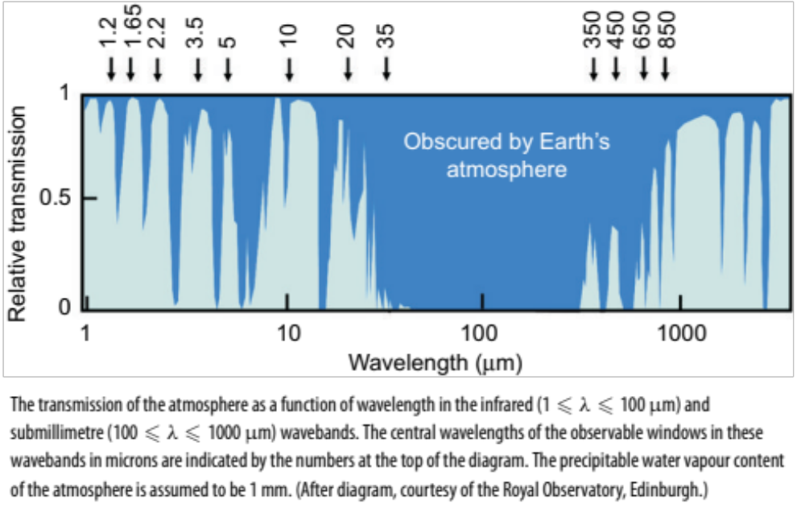
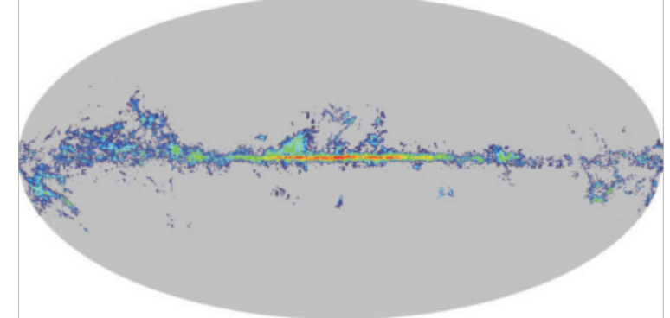
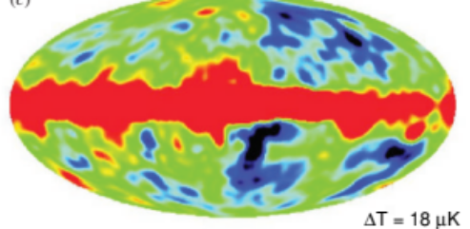
In questa regione sotto al mm forte assorbimento in atm. Dovto a vapore acqueo, CO2 e altre molecole. Fra 350-850 mm bisogna operare in atm secca e/o alta quota
Hawaii 4200m. JCMT, CSO, SMA.
Chile 5100m. ALMA
Polo Sud.
In altre parti di spettro
Fuori atm con satelliti…
1 mm.
In questa regione i rivelatori usati sono ricevitori eterodina e bolometri.
-Domina in questa regione CMB osservata a 5,7 mm.
-emissione molecole gas interstellare: H non osservato
0 dipolo elettrico, CO. + diffusa emissione di
sincrotrone del mezzo interstellare
CMB
CO

Slide 5
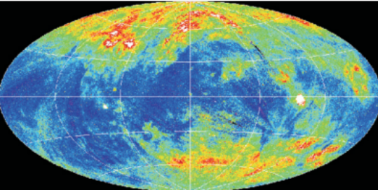
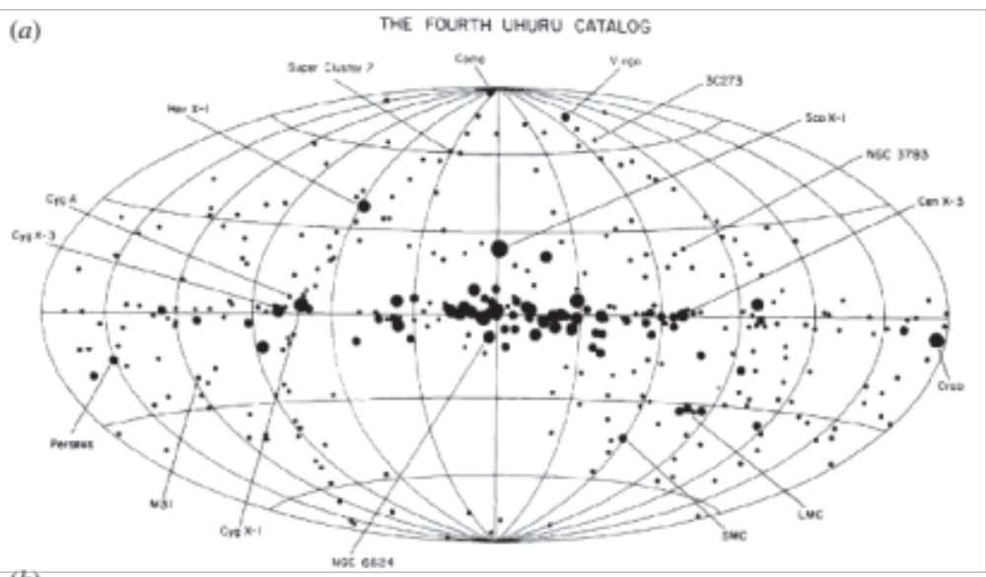
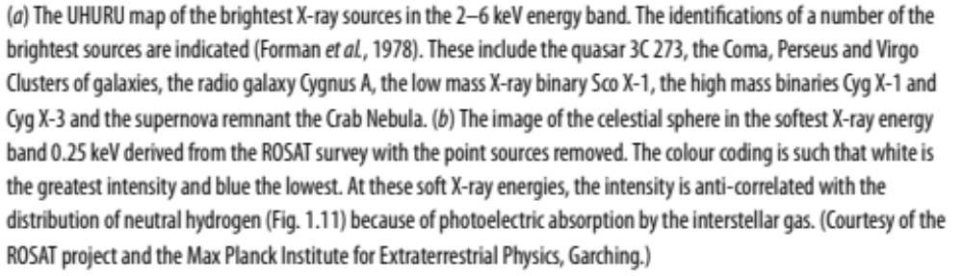

Slide 6
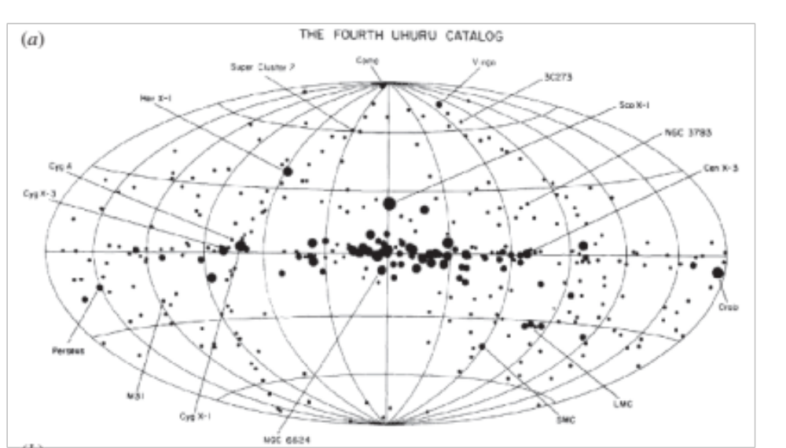
UHURU (1970-1973)
-survey of X-ray sources in
the 2-20 keV
-5 × 10⁻⁴ the flux from the
Crab Nebula
-resolution of about 30 arc
minutes.
-two sets of proportional
counter, each with ~0.084 m²
⁻Pulse-shape discrimination
-anticoincidence techniques
to reduce the background due
to particles
-Pulse-height analysis
-0.52° X 0.52° and 5.2° X 5.2°
-0.52° detector gave finer
angular resolution.
-5.2° detector had higher
sensitivity for isolated sources.
X-ray catalog, contains 339
objects and covers the whole
sky in the 2—6 keV band.
The UHURU map of the brightest X-ray sources in the 2–6 keV energy band. The identifications of a number of the brightest sources are indicated (Forman et al., 1978). These include the quasar 3C 273, the Coma, Perseus and Virgo Clusters of galaxies, the radio galaxy Cygnus A, the low mass X-ray binary Sco X-1, the high mass binaries Cyg X-1 and Cyg X-3 and the supernova remnant the Crab Nebula.
the distribution of sources consists of a Galactic population of the types shown in Fig. 1.13a as well as an isotropic distribution of extragalactic sources, most of them being associated with active galactic nuclei

Slide 7
The variability of some of the Galactic sources was found to be due to the fact that the compact X-ray emitter is a member of an eclipsing binary star system. In a number of these cases, the X-ray binaries were found to contain ‘pulsating’ X-ray sources and these were soon identified with magnetised rotating neutron stars but, in the cases of the X-ray sources, the source of energy is the infall of matter transferred from the primary star, the process known as accretion.
in a number of cases, the masses of the invisible secondaries exceed the upper limit for stable neutron stars. These objects must be associated with stellar-mass black holes in binary systems and as such are objects of the greatest astrophysical interest.
In extragalactic astronomy, the nuclei of active galaxies were found to be intense and often variable X-ray sources, the emission processes taking place close to the Schwarzschild radius of a supermassive black hole. Other important classes of extragalactic X-ray sources are the clusters of galaxies. In 1978, the Einstein X-ray Observatory was launched. It provided the first high resolution images of many X-ray sources and made deep surveys of small areas of sky. Many different classes of astronomical object were detected as X-ray sources including regions of star formation and normal galaxies. Perhaps most significant of all was the fact that X-ray emission was detected from all types of star and not just from the binary sources in which there are special reasons why they should be strong X-ray sources.

Slide 8
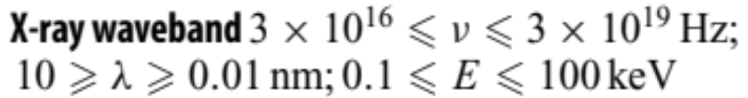
Atmosfera opaca ai raggi X a causa dell’assorbimento per effetto fotoelettrico negli strati di atmosfera: quindi esperimenti su satellite. Rivelatori usati: contatori proporzionali, scintillatori, contatori a microcanali e CCD. Questi ultimi hanno una eccellente risoluzione spaziale e di carica, usati nelle moderne missioni X. Calorimetri/bolometri, convertono l’energia dell’X in calore con ottima risoluzione. Vanno tenuti a bassa temperatura. Fino a 20keV contatori proporzionali, contatori a scintillazione fino a 1MeV.
Tipico Detector per Raggi X:
-Contatori di anticoincidenza: il rivelatore e’ coperto da uno strato di scintillatore plastico o liquido con funzione di anticoincidenza per rigettare i raggi cosmici.
-Ricostruzione della forma del segnale. L’X da un segnale stretto e rapido dovuto a ionizzazione locale della conversione dell’X a fine range. Una particella cosmica perde energia lungo il cammino in modo distribuito e da un segnale piu’ largo.
-Strati alternati di cristalli scintillatori sensibili ai fotoni :
-Scintillatori e scintillatori plastici insensibili ai fotoni.
I fotoni daranno segnale nel cristallo e non nel plastico. Le particelle cariche in entrambi i rivelatori.
-collimatori. Efficaci a piccoli angoli di incidenza che accuratamente riproducono l’immagine del cielo nel piano focale. Per raccoglier molti fotoni occorrono molti collimatori quasi paralleli uno all’interno dell’altro convergenti nel piano focale.

Slide 9
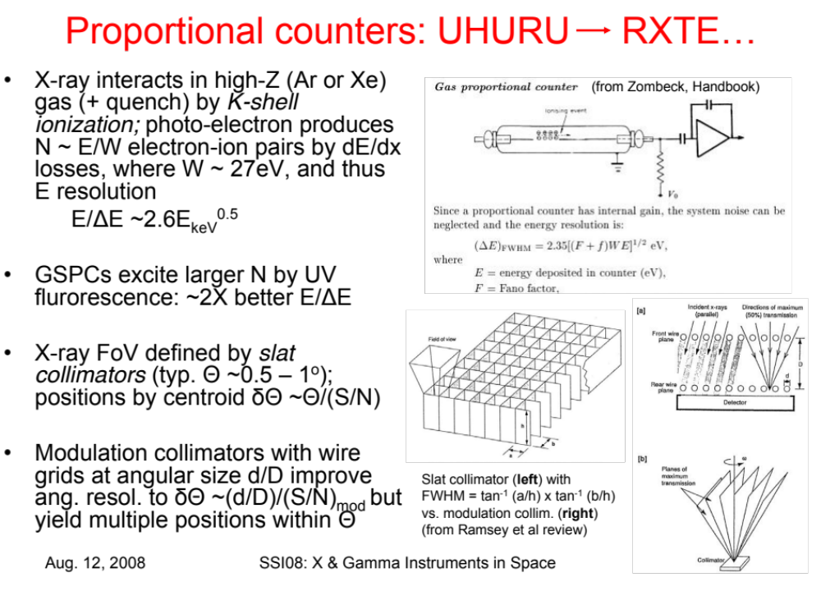
Z=54
Kr=36
Ar=18

Slide 10
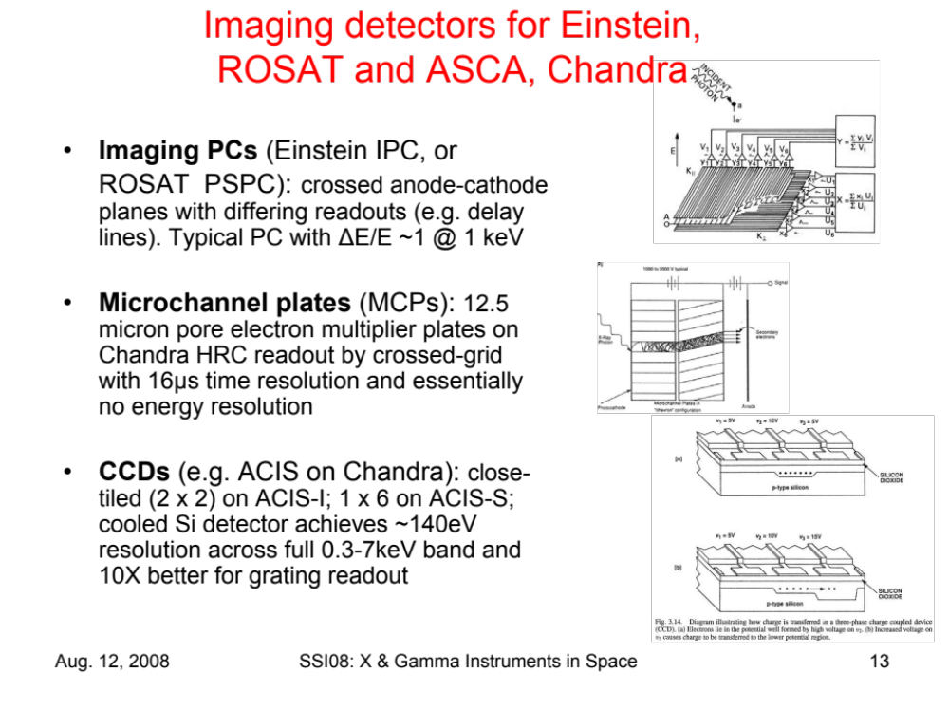

Slide 11
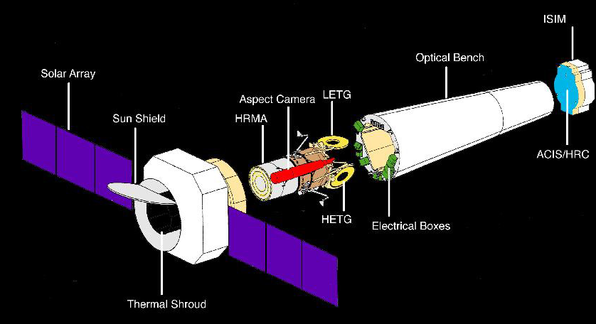
The AXAF-I mission will develope and place into orbit a telescope for capturing high-resolution images and spectra of X-ray sources. Its imaging observations will produce "picture-like" images analogous to those made in visible light with an optical telescope. It uses optics and detectors which are sensitive to X-rays to capture images of astronomical phenomena characterized by very high temperatures.
Reticoli diffrazione Bragg (0,1-9 keV), CCD (0,1-10 keV) ,Microchannel plate (0,1-10 keV).
1,2 m diametro
10 m lunghezza
Vetro, iridio coated, cromo dinding

Slide 12
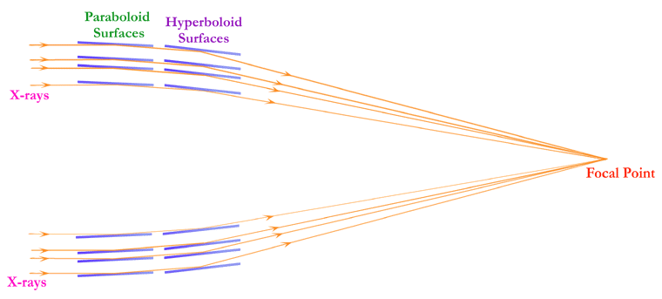
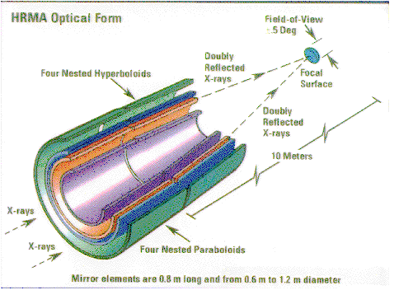
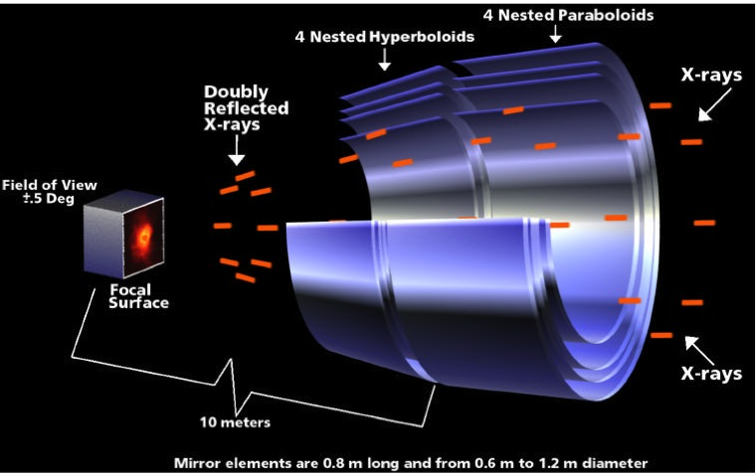
In an X-ray telescope, the mirrors are much different from those in optical telescopes. With their very short wavelengths, X-rays are not reflected from the surface of a conventional mirror. X-ray telescopes use "grazing-incidence" mirrors finely polished cylinders of glass
This configuration, coupled with a slight curvature of the surfaces, funnels the rays toward a point of focus behind the mirrors.
four sets of these cylindrical mirrors, mounted concentrically in a nested array in order to increase the area for collecting X-ray energy. The diameter of the largest mirror set will be 47.2 inches (1.2 m). Piccola componente campo elettrico sulla superficie. Incidenza radente.

Slide 13
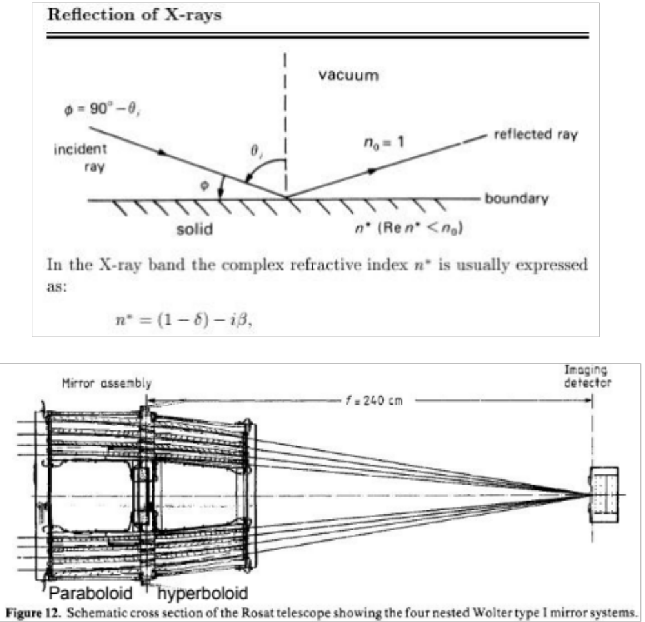
E

Slide 14
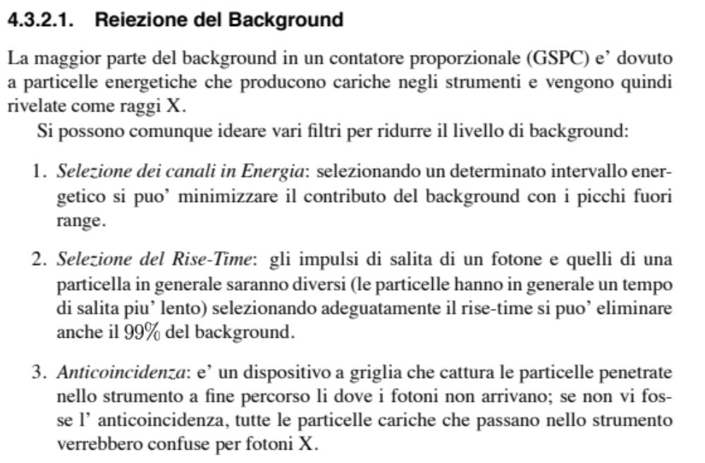

Slide 15
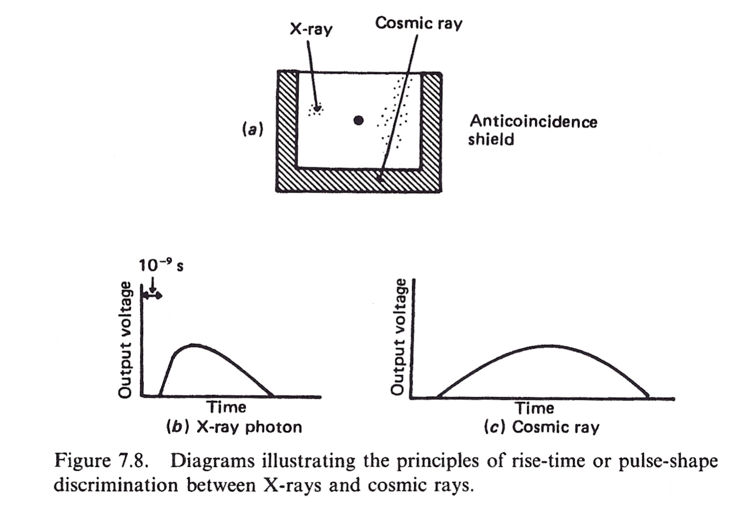
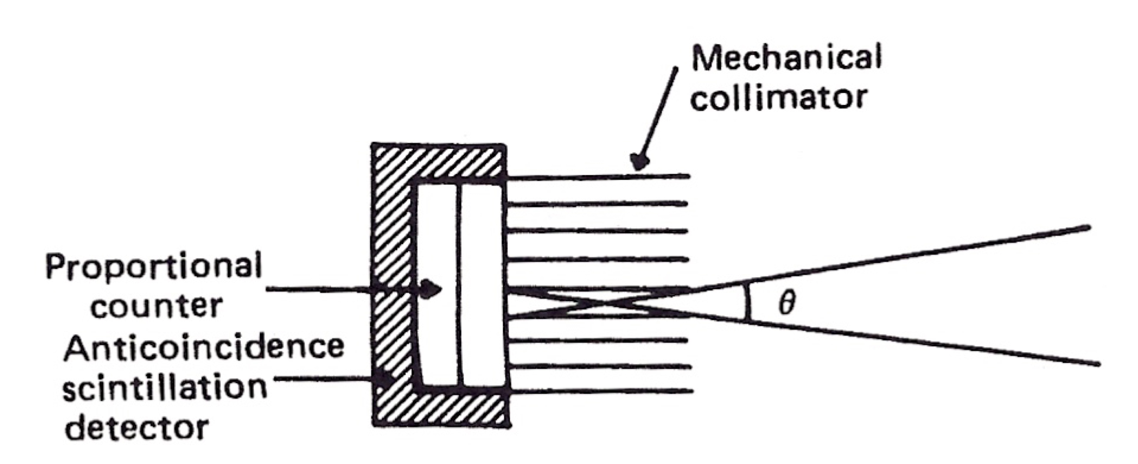

Slide 16
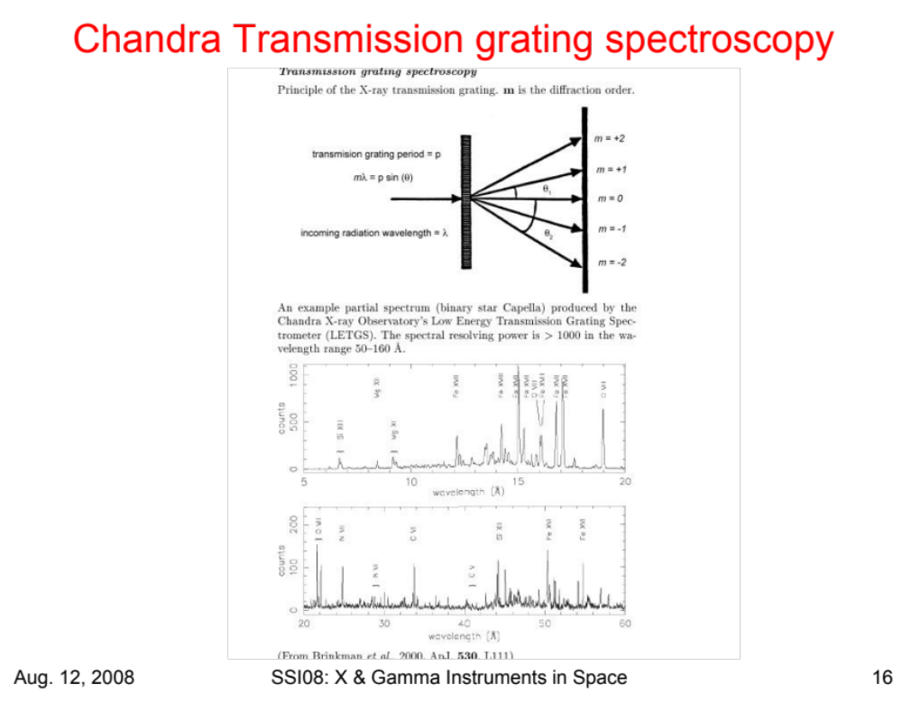
0,1-9 keV

Slide 17
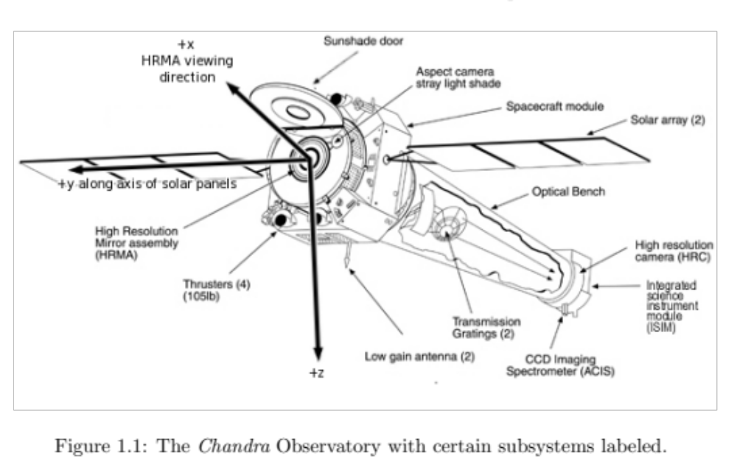
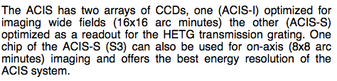
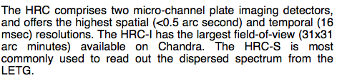

Slide 18
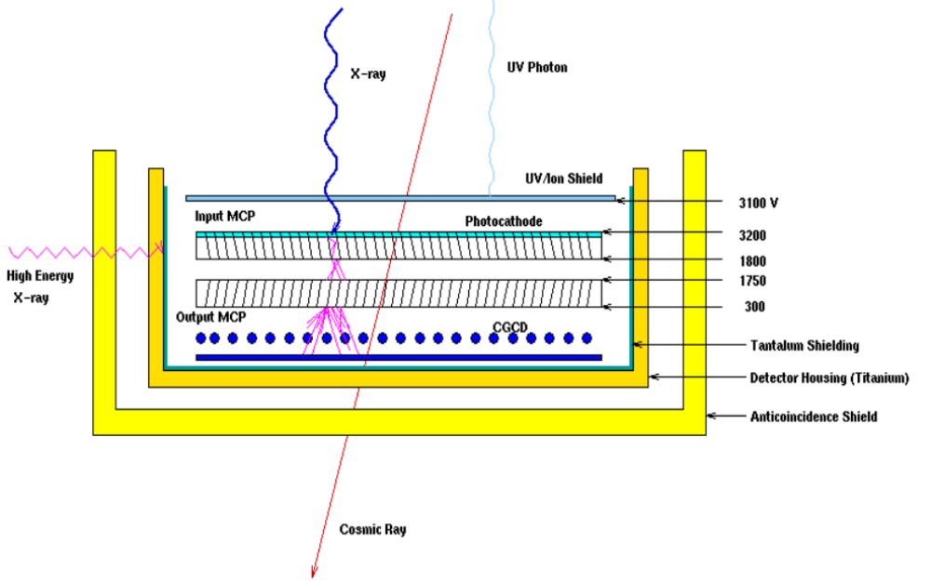
The sensor of the imaging detector consists of a two-stage configuration (chevron) of 100 mm x 100 mm Galileo
Electro-Optics Corp. radioisotope-free lead oxide glass microchannel plates (MCPs). A UV/Ion shield consisting of
aluminized polyimide prevents low energy ions, low energy electrons. The front MCP is coated with CsI in order
to increase the quantum efficiency over that of the bare glass of the MCP. An incident x-ray photon interacts within
a channel (pore) of the front MCP producing one more electrons with a probabilty that depends on the photon energy.
The initial electron or electrons are accelerated by an applied electric field across the plates and generate secondary
electrons; this process ultimately produces and EUV and UV radiation from reaching the sensor surface. The UV/Ion
shield is held electrically positive (+100 Volts) with respect to the front surface of the MCP in order to prevent electrons generated in the shield.
The primary components of the (HRC) are two Micro-Channel Plates (MCP). They each consist of a 10-cm square cluster of 69 million tiny lead-oxide glass tubes that are about 10 micrometers in diameter (1/8 the thickness and 1.2 millimeters long. The tubes have a special coating that causes electrons to be released when the tubes are struck by X-rays.
(-)
The axes of the millions of tubes that comprise the input and output MCPs are not parallel to the optical axis but are canted ("biased") at an angle of 6°

Slide 19
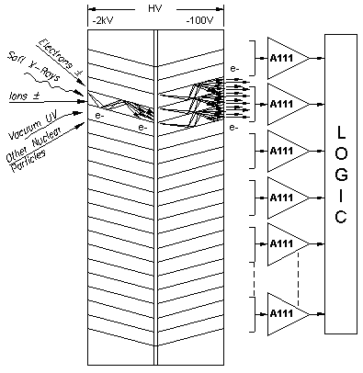
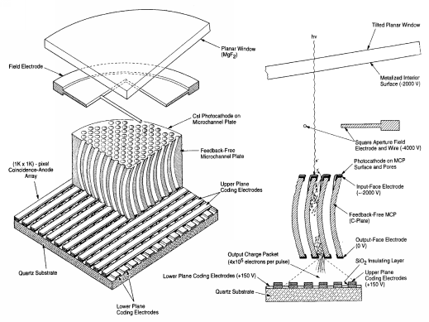
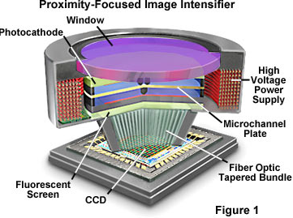
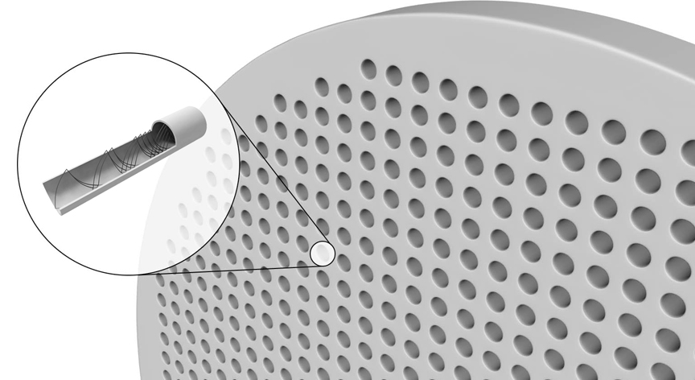

Slide 20
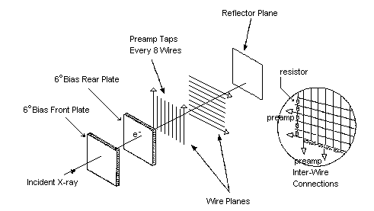
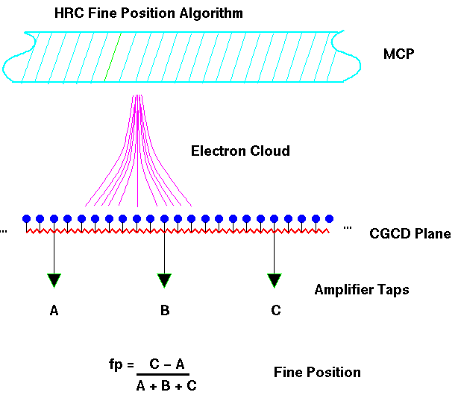
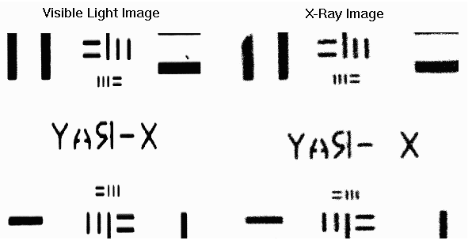
The electronic readout system is a crossed grid charge detector (CGCD). The CGCD consists of two planes of wires (one set of wires orthogonal to the other) mounted on a laser ruled ceramic substrate. The wires (100 microns in diameter with 200 micron center to center spacing) are resistively coupled (40 kOhm); every eighth wire is connected to a charge sensitive preamplifier. The cloud of electrons emerging from the rear MCP is collected by several wires. 65 preamplifiers per wire plane (axis) divide the image plane into 64 x 64 coarse positions.
The fine position (digitized to 6.429 microns) is determined from a "three tap" centroid calculation. The combined MCP/CGCD is capable of < 25 micron (FWHM) resolution over the entire field of the detector.
TEST HCR

Slide 21
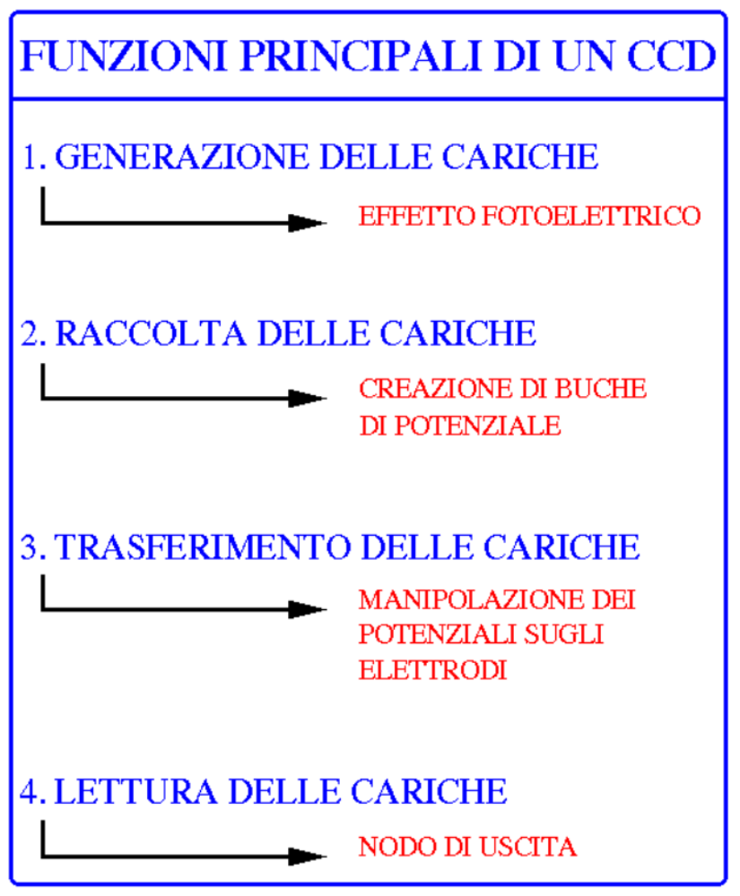

Slide 22
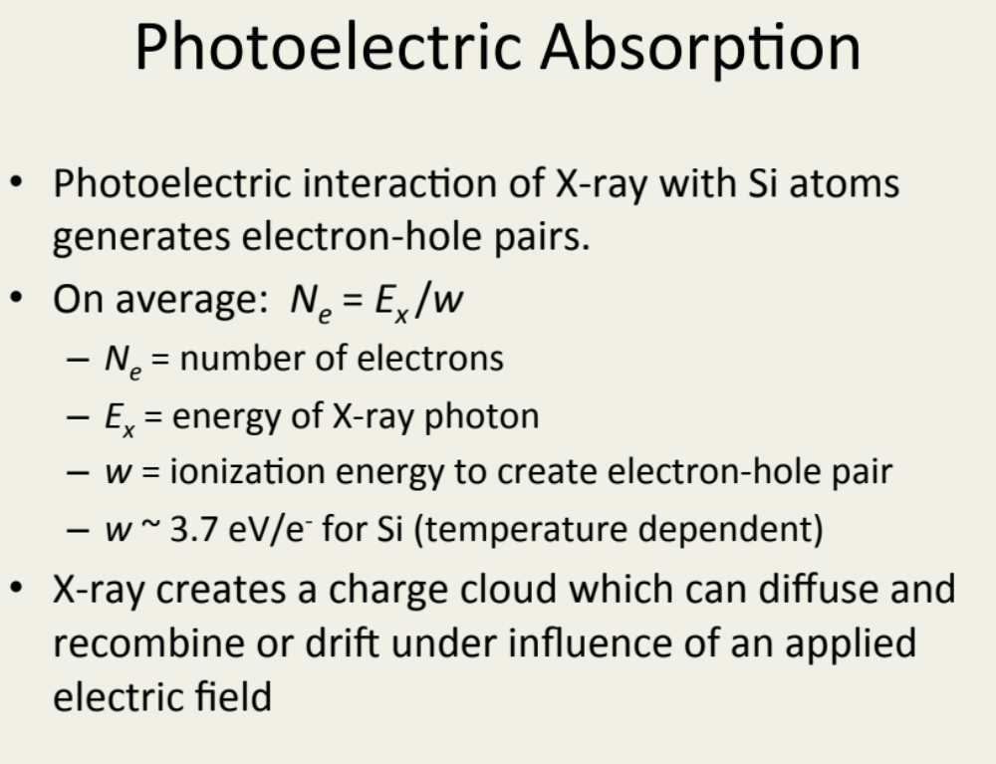

Slide 23
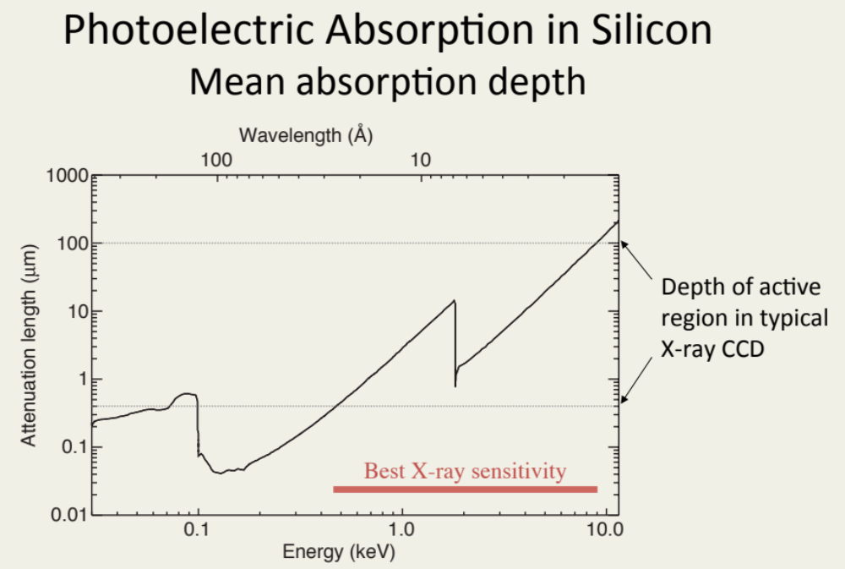
(cm2) , μ= σ (cm2) x Ν (nuclei/cm3) μ x t (probabilita’ di inetrazione in t)
Ν (nuclei/cm3) = NAv/grammo-atomo x gr/cm3 NAv=6.10^23 atomi/grammo-atomo

Slide 24
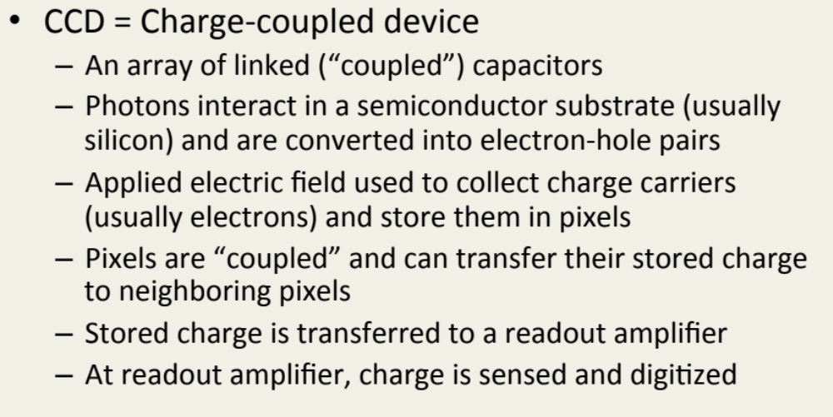

Slide 25
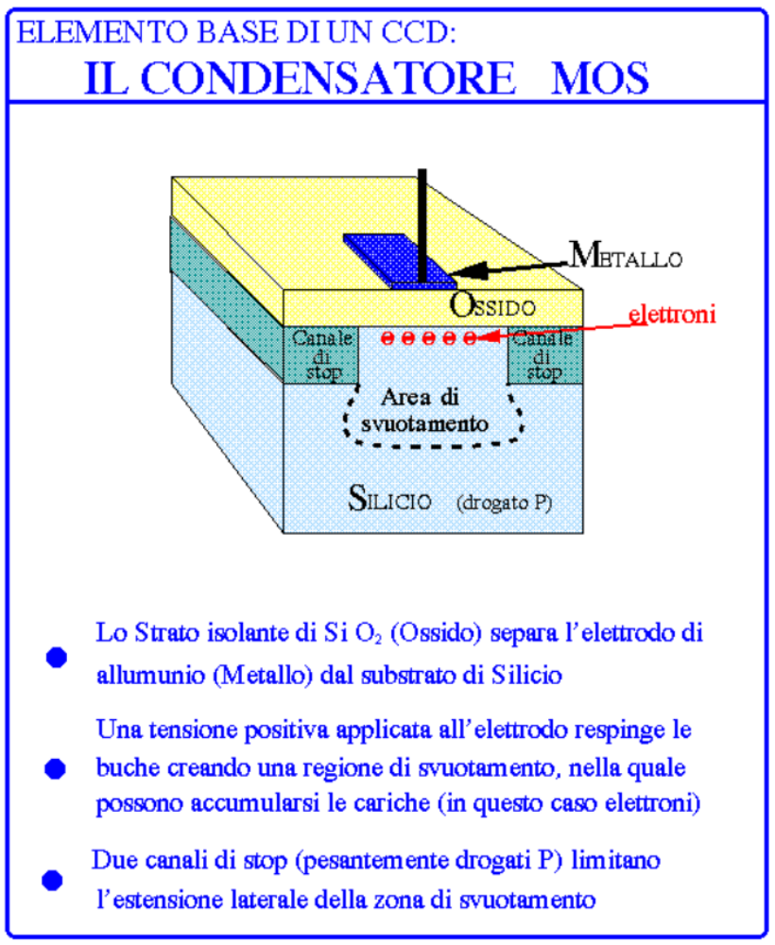
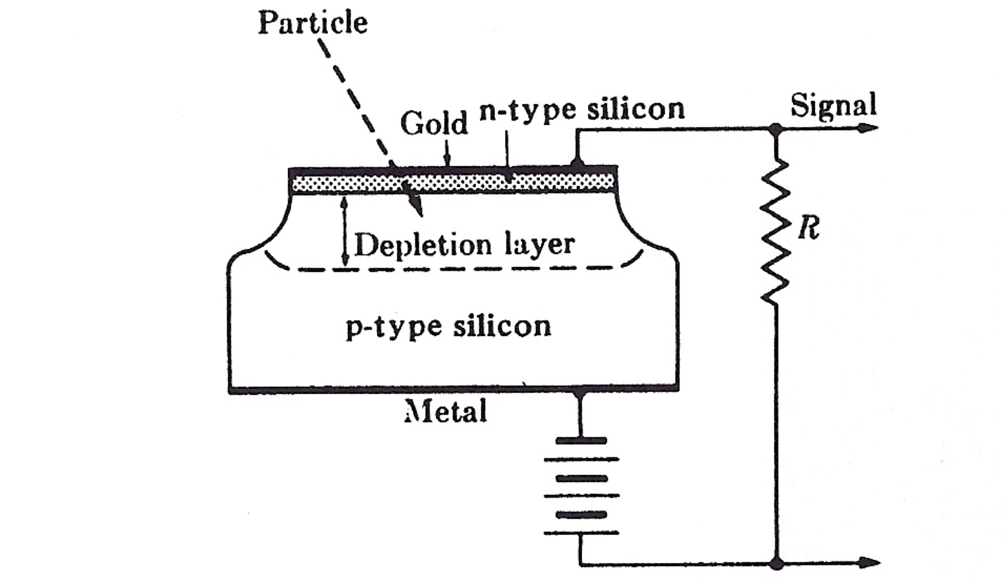

Slide 26
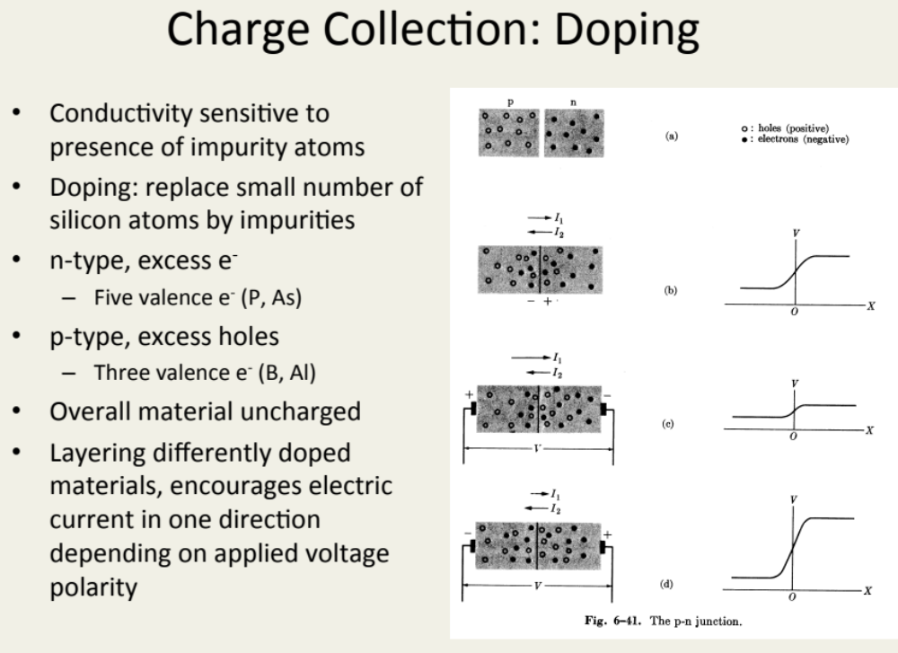

Slide 27
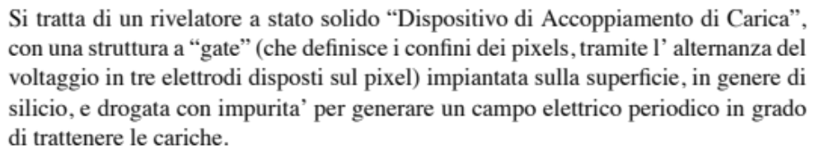
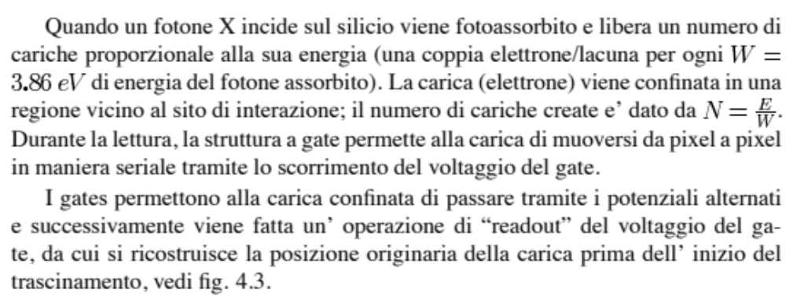

Slide 28
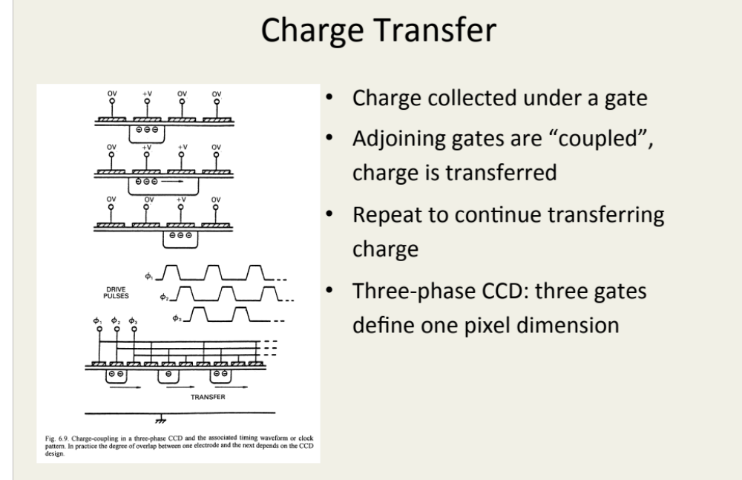

Slide 29
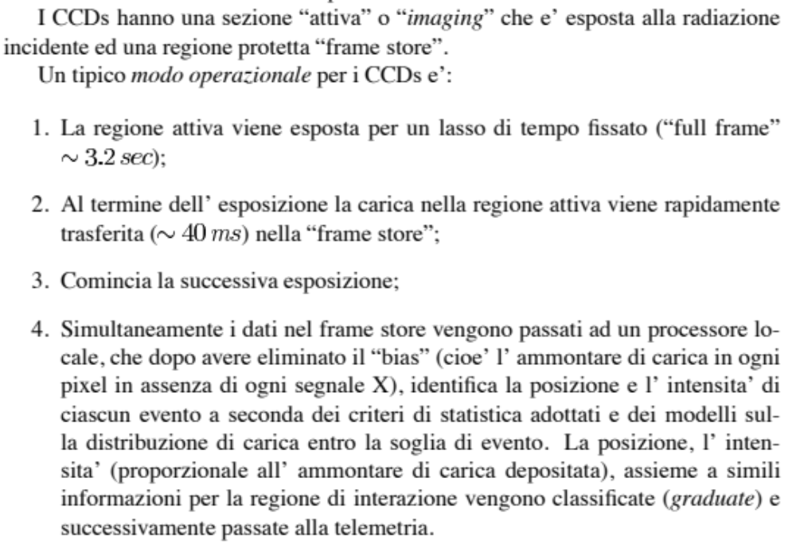

Slide 30
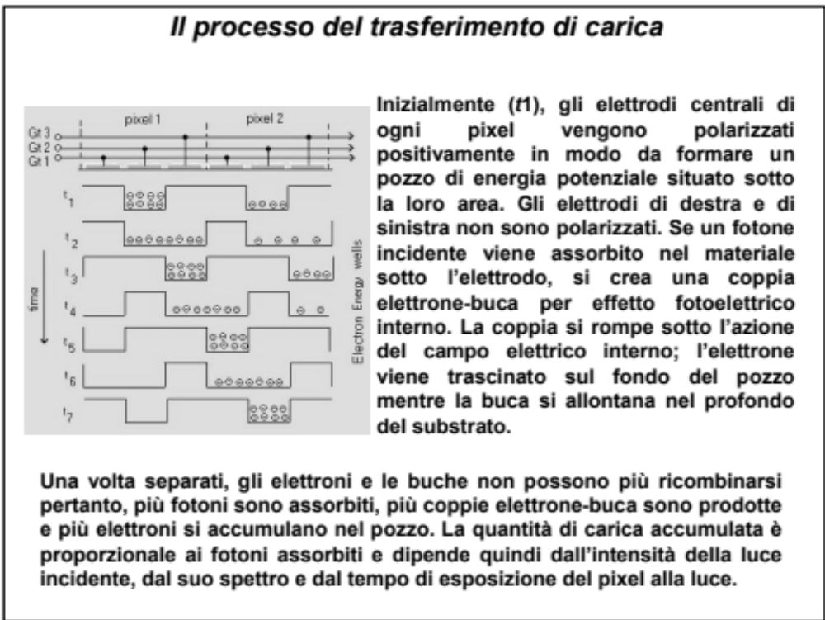

Slide 31
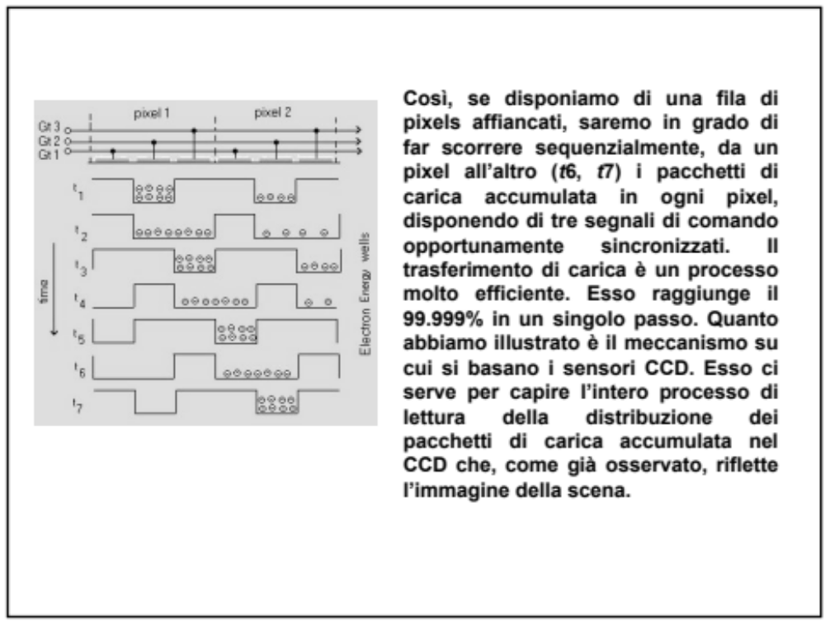

Slide 32
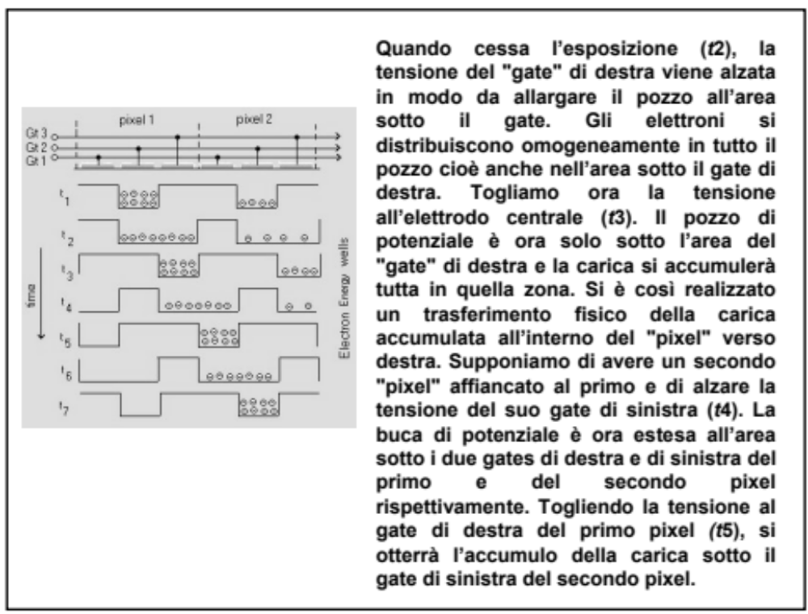

Slide 33

trasferimento
fra 2 pixel

Slide 34


Slide 35


The Chandra Advanced CCD Imaging
Spectrometer (ACIS) is one of two
focal plane instruments. This instrument is an array of charged coupled devices (CCD's)
This instrument is especially useful because it can make X-ray images, and at the same time, measure the energy of each incoming X-ray.
It is the instrument of choice for studying temperature variations across X-ray sources such as vast clouds of hot gas in intergalactic space, or chemical variations across clouds left by supernova explosions.
consiste in un circuito integrato formato da una riga,
una griglia, di elementi semiconduttori in grado
di accumulare una carica elettrica proporzionale
all'intensità della radiazione X che li colpisce. Questi
elementi sono accoppiati in modo che ognuno di essi,
sollecitato da un impulso elettrico, possa trasferire la
propria carica ad un altro elemento adiacente.
Inviando al dispositivo (device) una sequenza
temporizzata d'impulsi, si ottiene in uscita un
segnale elettrico grazie al quale è possibile ricostruire
la matrice dei pixel che compongono l'immagine
proiettata sulla superficie del CCD stesso.

Slide 36


Slide 37


Slide 38

BEPPO-SAX
1996-2003
Energy Range : 0.1 - 300 keV

Slide 39


Slide 40

MECS (Medium Energy Concentrator Spectrometers): a medium energy (1.3-10 keV) set of three identical grazing incidence telescopes with double cone geometry with position sensitive gas scintillation proportional counters in their focal planes.
LECS (Low Energy Concentrator Spectrometer): a low energy (0.1-10 keV) telescope, identical to the other three, but with a thin window position sensitive gas scintillation proportional counter in its focal plane.
HPGSPC, a collimated High Pressure Gas Scintillation Proportional Counter (4-120 keV)
PDS, a collimated Phoswich Detector System (15-300 keV). Perpendicular to the axis of the NFI and pointed in opposite directions there are two coded mask proportional counters (Wide Field Cameras) that provide access to large regions of the sky in the range 2-30 keV. Each WFC has a field of view of 20° x 20°(FWHM) with a resolution of 5'.
Finally, the four lateral active shields of the PDS will be used as a monitor of gamma-ray bursts with a fluence greater than about 10-6 erg cm-2s-1 in the range 60-600 keV, with a temporal resolution of about 1 ms.

Slide 41
Gli strumenti MECS e LECS (acronimi rispettivamente di Medium Energy e High Energy Concentrator Spectrometer) consistono ognuno in un sistema di 30 specchi coallineati ai cui fuochi vi sono dei contatori proporzionali che utilizzano gas xenon a 1 atmosfera
Gli strumenti a campo stretto sono:
- Uno spettrometro/concentratore a bassa energia (LECS), sensibile tra 0.1 e 10 keV.
- Uno spettrometro/concentratore a media energia (MECS), costituito da 3 unità distinte e
sensibile tra 2 e 10 keV
- Un contatore proporzionale con gas ad alta pressione (HPGSPC), sensibile tra 3-120 keV e
avente area efficace di 240cm2 a 30keV
- Un contatore proporzionale con detector a cristalli (PDS) avente sensibilità compresa tra 15-300 keV
Strumenti a campo largo sono:
- Una Wide Field Camera (WFC) composta da due unità e sensibile a fotoni con energia compresa tra 2 e 30 Kev e ha area efficace di 140cm2 a 10 keV.
- Un Gamma Ray Burst Monitor (GRBM) , con sensibilità compresa tra 60 e 600 keV

Slide 42



SPECCHI AD INCIDENZA RADENTE.
=

Slide 43

LECS:
The Detector Unit (DU) consists of a gas cell, a photomultiplier tube (PMT), Front End Electronics (FEE) and two high-voltage supplies. The detector is protected by an Al cover on which a shutter mechanism is mounted. The shutter will be opened once in orbit.
In order to determine the true energy of an X-ray event, a burst length dependant compensation must be applied to the energy data.
The gain of the detector is monitored by two Fe55 (5,9 keV
radioactive sources
In this configuration a uniform electric field is maintained across the gas cell and this causes scintillation of the xenon gas as the electrons travel towards the grid. The amount of light produced is proportional to the energy of a detected X-ray but also depends on the depth the X-ray penetrated into the gas cell before being photoabsorbed. This depth can be determined by measuring the duration of the scintillation light that is produced and is referred to as the burst length.

Slide 44


Anticoincidenza, altezza di impulso, durata impulso

Slide 45




Slide 46

MECS: medium energy
concentrator spectromiter

Slide 47


An X-ray photon absorbed in the gas cell liberates a cloud of electrons. A uniform electrical field across the cell drifts the cloud up to the scintillation region, with an higher electric field, where UV light is produced through the interaction of the accelerated electrons with the Xe ions. The amplitude of the UV signal, detected by a PMT, is proportional to the energy of the incident X-ray.
The UV readout system consists of a crossed-wire anode position sensitive Hamamatsu photomultiplier (PMT) with quantum efficiency of ~20%.
XENON GSPC
gas scintillation proportional counter

Slide 48


The HPGSPC instrument is a High Pressure (5 atm.)(Gas Scintillation Proportional Counter filled with a high purity gas mixture of Xenon (90%) and Helium (10%) at 5 atmospheres. After penetrating the beryllium window, the X-ray photon is absorbed in the gas cell by a Xenon atom via the photoelectric effect. The primary photoelectron emitted gives rise to a localised cloud of secondary electrons at the position of X-ray absorption. The secondary electron cloud, driven by a relatively moderate electric field, after drifting in the so called Drift Region, enters a high field region (Scintillation Region) in which the electrons acquire sufficient energy to excite the Xenon atoms. As a result of collisions, the excited atoms form excited diatomic Xenon molecules which then deexcite by the emission of VUV photons in the 1500-1950 angstrom range. Typical duration of scintillation, measured as the time interval between the 10% and 90% of the signal, is 3.5 -6sec and does not depend on the energy. In the case of the HPGSPC VUV light is collected by an array of seven photomultipliers in an Anger Camera configuration. The number of electrons emitted per keV by the cathode of central photomultiplier is about 250.
5 atmosfere
BEPPO-SAX
a High Pressure Gas Scintillation
Proportional Counter (HPGSPC)
operating in the 3-120 keV energy band

Slide 50


Finestre di berillio 50μm diametro 30 μm spessore
In entrata quarzo 5mm spessore
80mm diametro

Slide 51
BEPPO-SAX
1996-2003
Energy Range : 0.1 - 300 keV

Slide 52


The hard X-ray energy band (15-300 keV) covered by the PDS experiment is now assuming key importance
for high energy astrophysics thanks to many exciting and unexpected results obtained with gamma-ray astronomy
experiments like BATSE and OSSE aboard CGRO, SIGMA aboard the GRANAT satellite and balloon experiments.
In addition to well known classes of strong hard X-ray emitters (galactic X-ray pulsars, black hole candidates,
AGN) The detection plane of PDS is an array of four scintillation detectors. Each of the four detectors is composed by two crystals of NaI(Tl) and CsI(Na) optically coupled and forming what is known as PHOSWICH (acronym of PHOsphor sandWICH). The NaI(Tl) thickness is 3 mm and the CsI(Na) thickness is 50 mm.
The scintillation light produced in each phoswich (PHW) is viewed, through a quartz light guide, by a PMT EMI D-611. The NaI(Tl) acts as the X-ray detector, while the CsI(Na) scintillator acts as an active shield. The scintillation events (due to photons or charged particles) detected by each phoswich can be divided into three classes: those that deposit energy only in the NaI crystal (NaI events or ``good events''); those that deposit energy only in the CsI crystal (CsI events); those that deposit energy in both crystals (mixed events). The events of the first class are accepted, while the events of the other two classes are rejected.
BEPPO-SAX

Slide 53


Slide 54


Slide 55


Slide 56


Slide 57


Slide 58


Slide 59


Slide 60


Slide 61

GRB 970228
This second observation has shown a strong drop, about 20 times lower, in the source flux. The pictures taken during the two follow-up observations are shown in the figure below.

Slide 62


Slide 63


Slide 64

Chandra is designed to observe X-rays from high-energy regions of the universe, such as the remnants of exploded stars. The two images of the Crab Nebula supernova remnant and its pulsar shown below illustrate how higher resolution can reveal important new features.
Chandra is designed to observe X-rays from high-energy regions of the universe, such as the remnants of exploded stars. The two images of the Crab Nebula supernova remnant and its pulsar shown below illustrate how higher resolution can reveal important new features.
The image on the left is from the High Resolution Imager on the Rontgen satellite (Rosat), the observatory with the best imaging capability before Chandra. The image on the right, taken by the Advanced CCD Imaging Spectrometer (ACIS) on Chandra, has approximately fifty times better resolution (pixel area fifty or more times smaller) than the one on the left. In the Chandra image, new details-rings and jets in the region around the pulsar-provide valuable information for understanding how the pulsar transmits energy to the nebula as a whole.

Slide 65


-survey of the soft X-ray band
of 0.1 keV - 2 keV
field of view 2°-wide band
-multiwire proportional counters with
a cathode strip readout for position
determination.
65% argon, 15% methane, 20% xenon
-+2-dimensional position detector based
on microchannel plates (MCPs)
ROSAT (1990-1999)
The image of the celestial sphere in the softest X-ray energy band 0.25 keV derived from the ROSAT survey with the point sources removed. The colour coding is such that white is the greatest intensity and blue the lowest. (Courtesy of the ROSAT project and the Max Planck Institute for Extraterrestrial Physics, Garching.)

Slide 66


Slide 67


Slide 68


Slide 69


Slide 70


