Slide 1
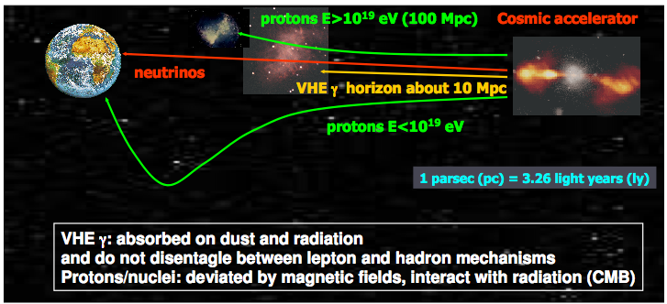
Motivation for the high energy neutrino detection
Neutrino will provide unique pieces of information on High Energy Universe
Physics case
Astrophysical high energy neutrino sources (SNR, microquasars, AGN, GRB)
Origin of cosmic rays
Unknown neutrino sources
Indirect search of Dark Matter

Slide 3
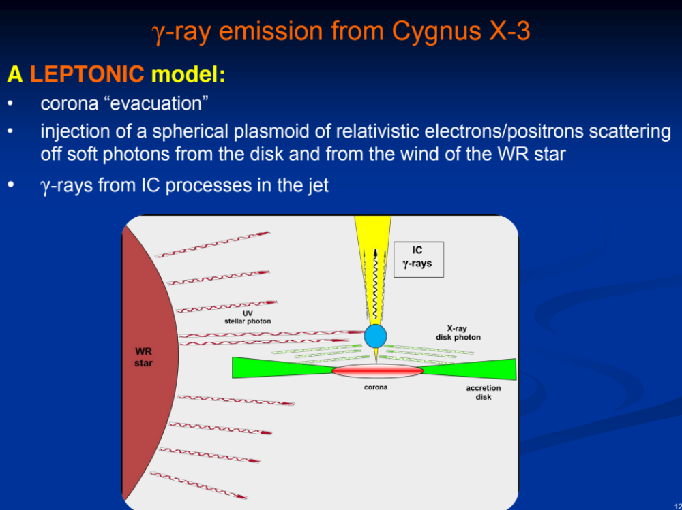

Slide 4
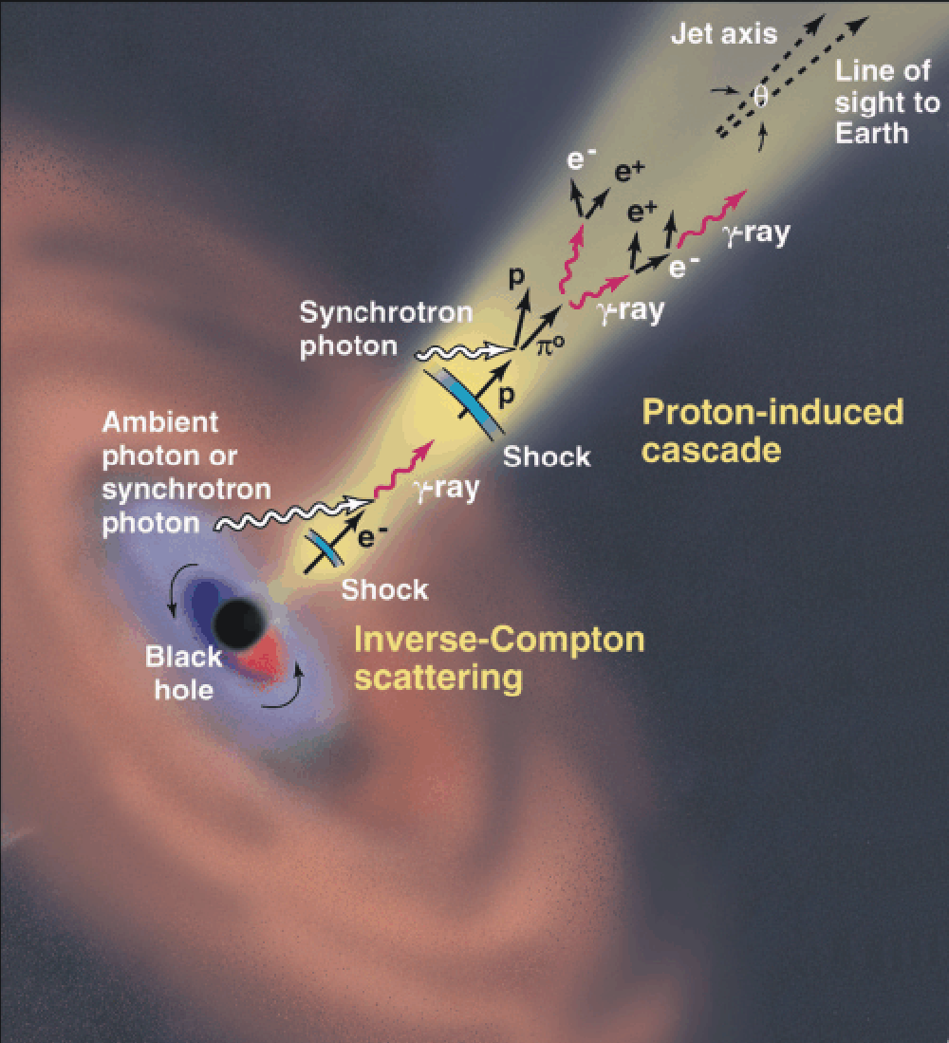
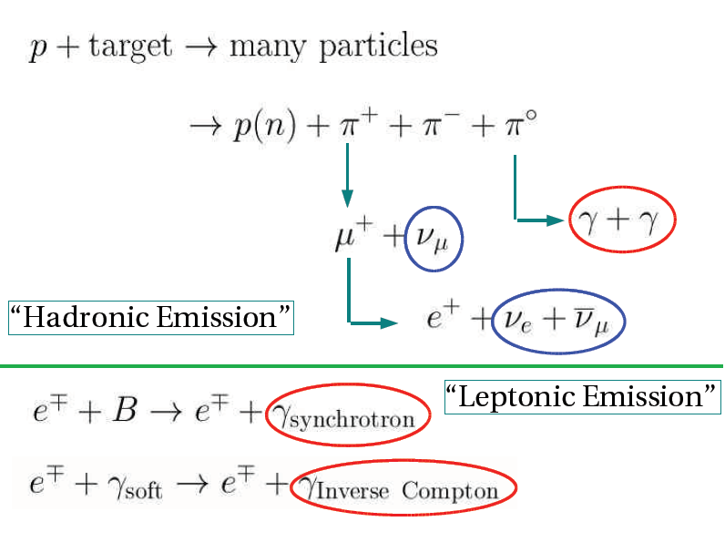
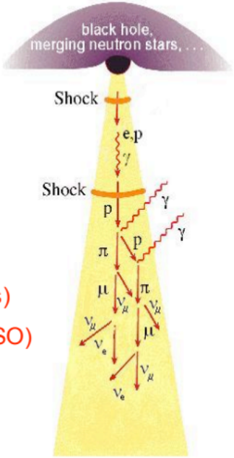
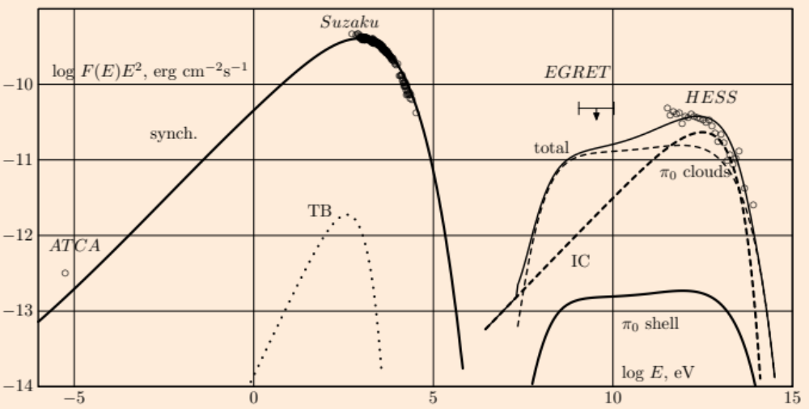
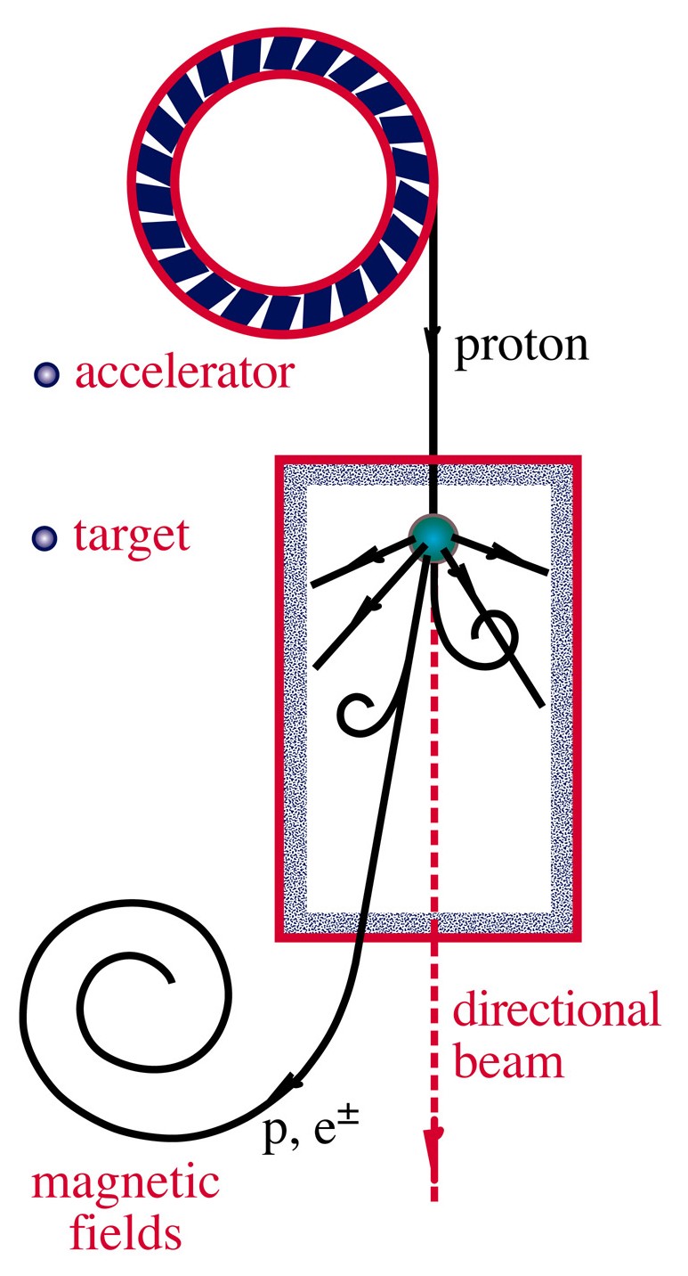
Cosmic accelerators
AGN
(N,γ)
a terra
nelle sorgenti

Slide 5
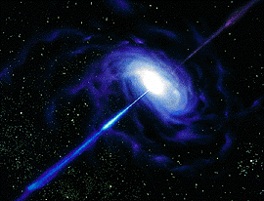
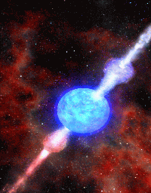
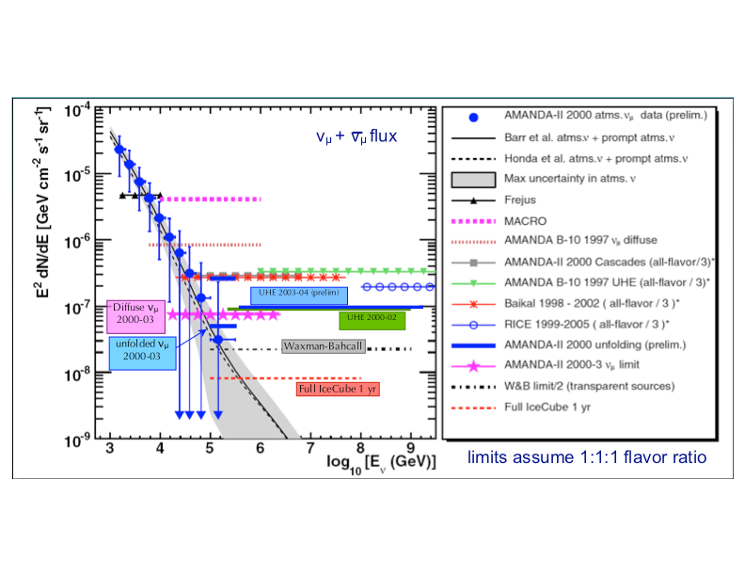
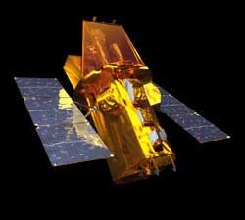
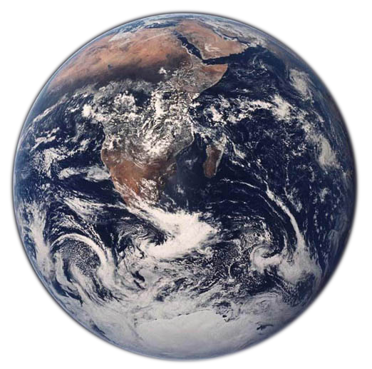
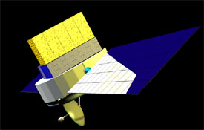
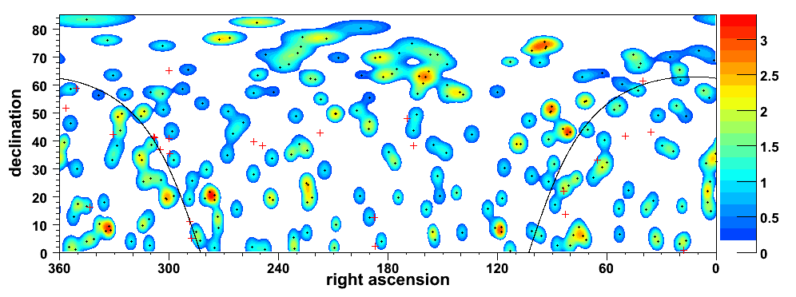
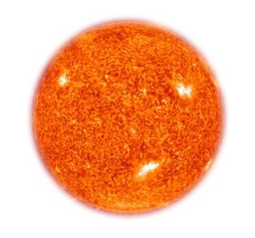
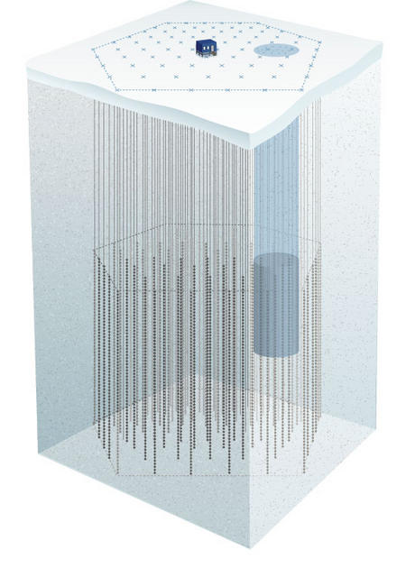

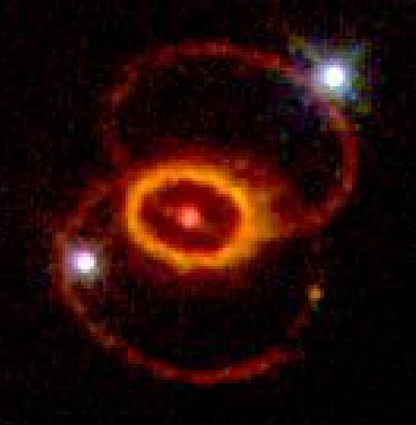
A Wealth of Science
AGNs, GRBs:
cosmic
accelerators?
γ
ν
Diffuse Sources
anisotropy
χχ
?
Point Sources
χχ
GZK/UHE ν
Supernovae
DM: Solar WIMPs
(see subsequent talks)
CRs

Slide 6
Motivations of high energy neutrino astronomy
Extend the high energy CR and γ Horizon (<50 Mpc)
Identify the sources of UHE particles
Explore deep inside the source (where τ »1 for CR and γ)
Probe hadronic models in astrophysical sources

Slide 7
High energy neutrino fluxes
Astrophysical sources are expected to produce a diffuse high energy neutrino flux with spectral index ≈2
The most powerful and/or the closest sources could give a clear point-like neutrino signal
Time correlations between ν events and photons will be clear signatures for transient source detection

Slide 8
Event rate in a neutrino detector

Slide 9
ν and γ beams
neutral pions are observed as gamma rays
charged pions are observed as neutrinos
π⁻
π⁰
π⁺
γ
γ
ν_{μ} μ⁺
ν_{μ} μ⁻
e⁺ e⁻
e⁺
γ
e⁻
μ⁺
e⁺
γ
2 ν_{μ} ~ γ
e⁺
ν_{e}
ν_{μ}

Slide 10
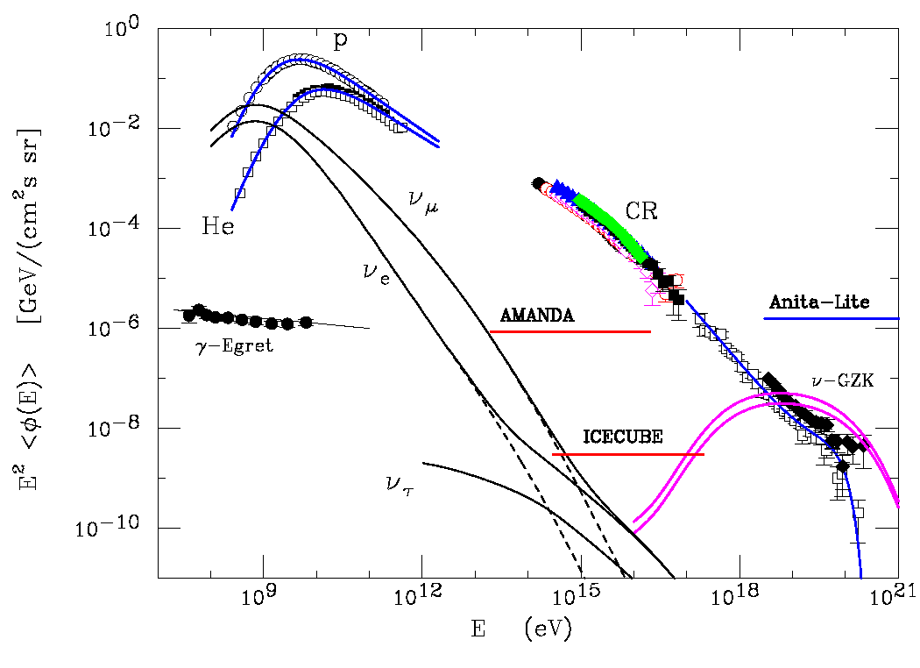
Componenti del flusso di neutrini
Neutrini Galattici ed Extra Galattici:
  Flusso diffuso Galattico (simile al flusso di γ misurato da Egret)
    Interazione dei RC confinati col mezzo interstellare
    Flusso concentrato sul piano galattico
  Flusso diffuso Extra Galattico
    Dominato dal decadimento di Pioni creati nelle interazioni pγ di protoni di UHE con la radiazione cosmica di fondo (neutrini GZK)
    Puo` essere separato dal flusso atmosferico per la differente componente di sapore e per il differente spettro energetico.
Neutrini atmosferici:
  Standard
    decadimento di Pioni e Kaoni carichi
  Decadimento debole di particelle con breve vita media contenenti quark pesanti (charm)
    Difficile predirne il flusso a causa della scarsa conoscenza della dinamica di produzione delle particelle charmed nelle interazioni adroniche

Slide 11
atm+ galattici

Slide 12
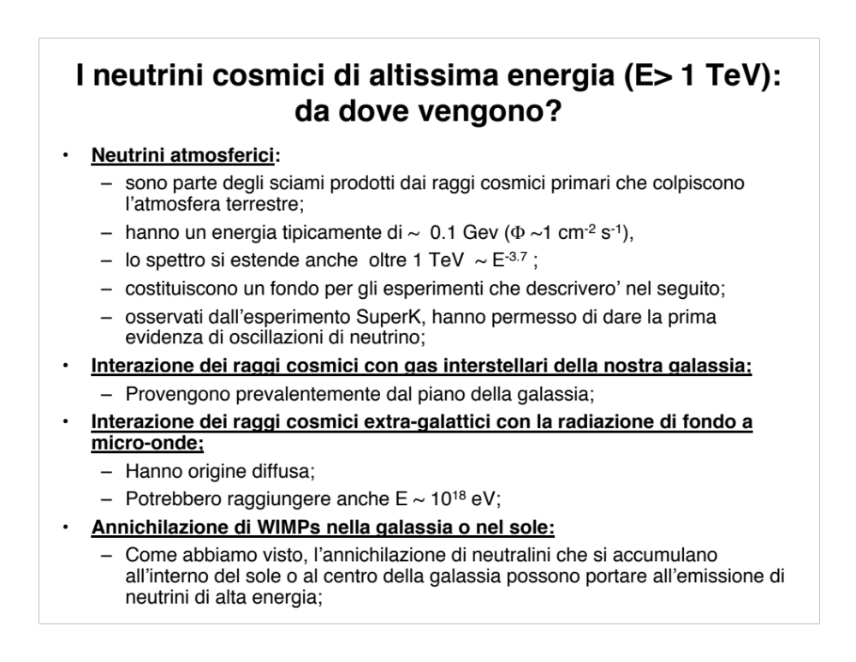

Slide 13
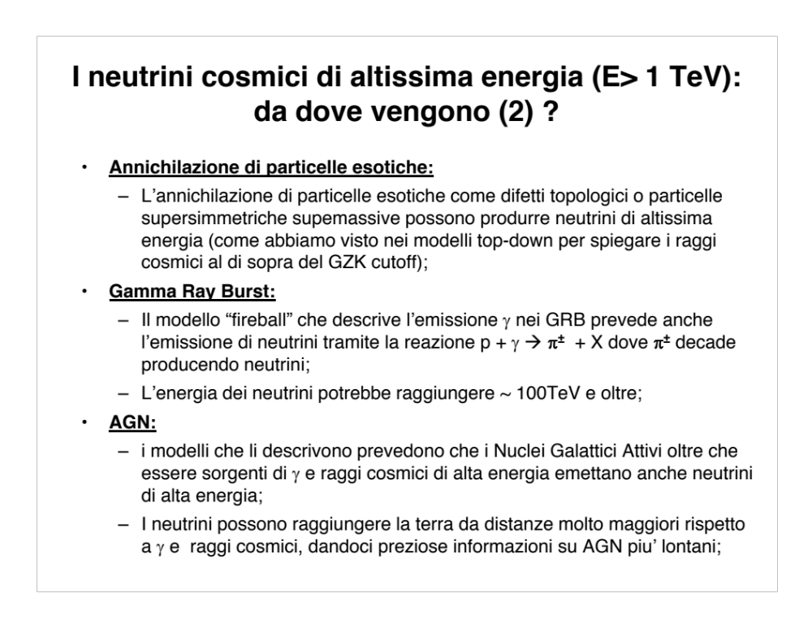

Slide 14
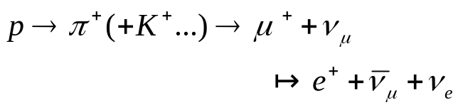
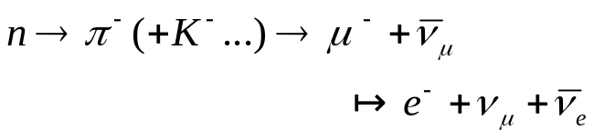
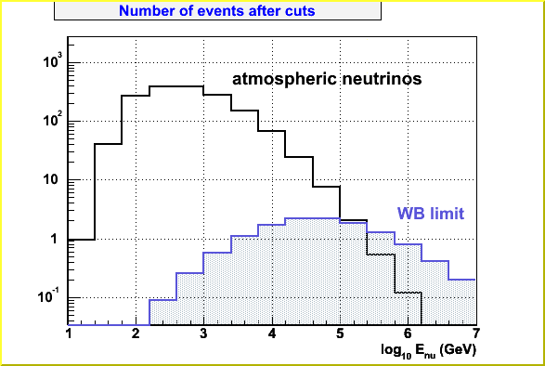
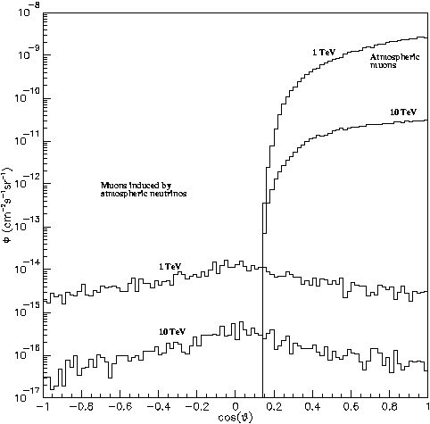
Physical Background
There are two kinds of background:
  -Muons produced by cosmic rays in the atmosphere (→ detector deep in the sea and selection of up-going events).
  -Atmospheric neutrinos (cut in the energy).
p
ν_{atm}
φ (cm⁻²s⁻¹sr⁻¹)
10⁻⁸
10⁻¹¹
10⁻¹⁴
10⁻¹⁷
atm. μs
1 TeV
μ
10 TeV
μs induced by
atm. νs
1 TeV
μ
ν_{atm}
10 TeV
-1 0 1
ν
cos θ
p

Slide 15
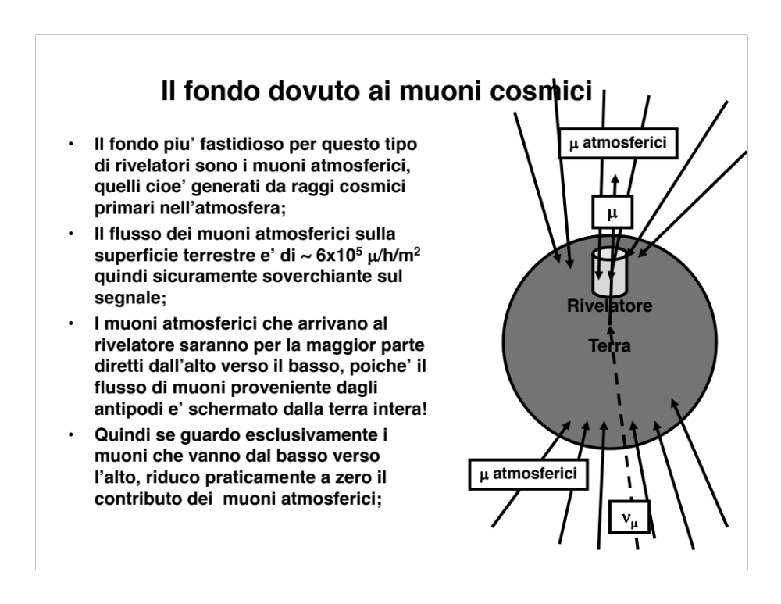

Slide 16
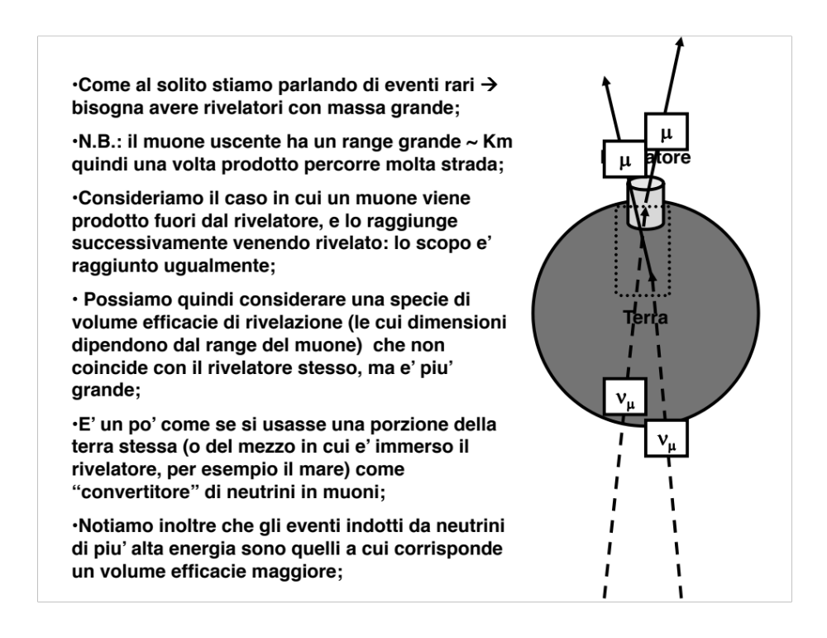

Slide 17
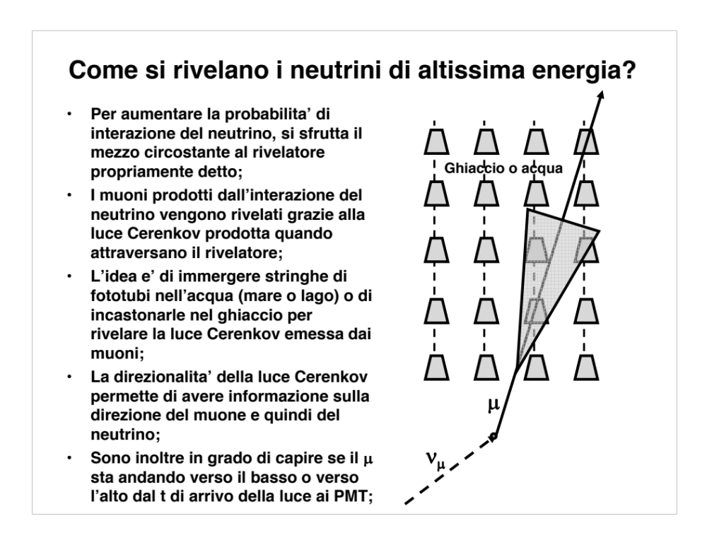

Slide 18
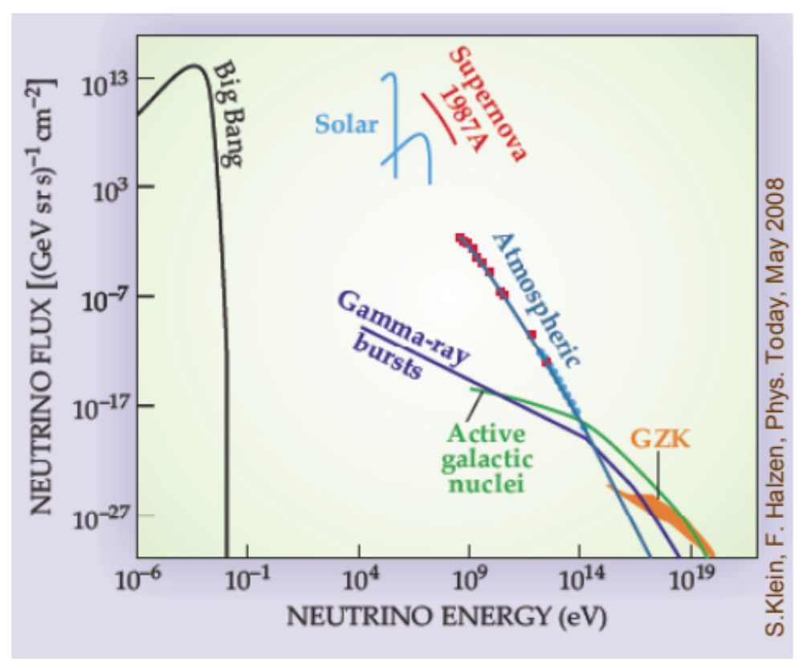
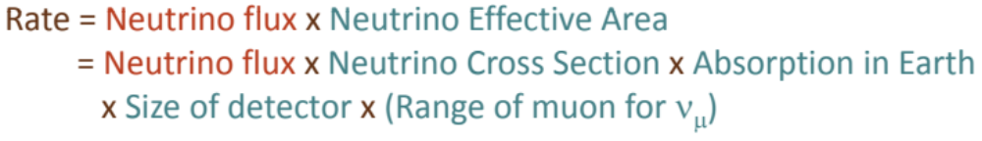

Slide 19
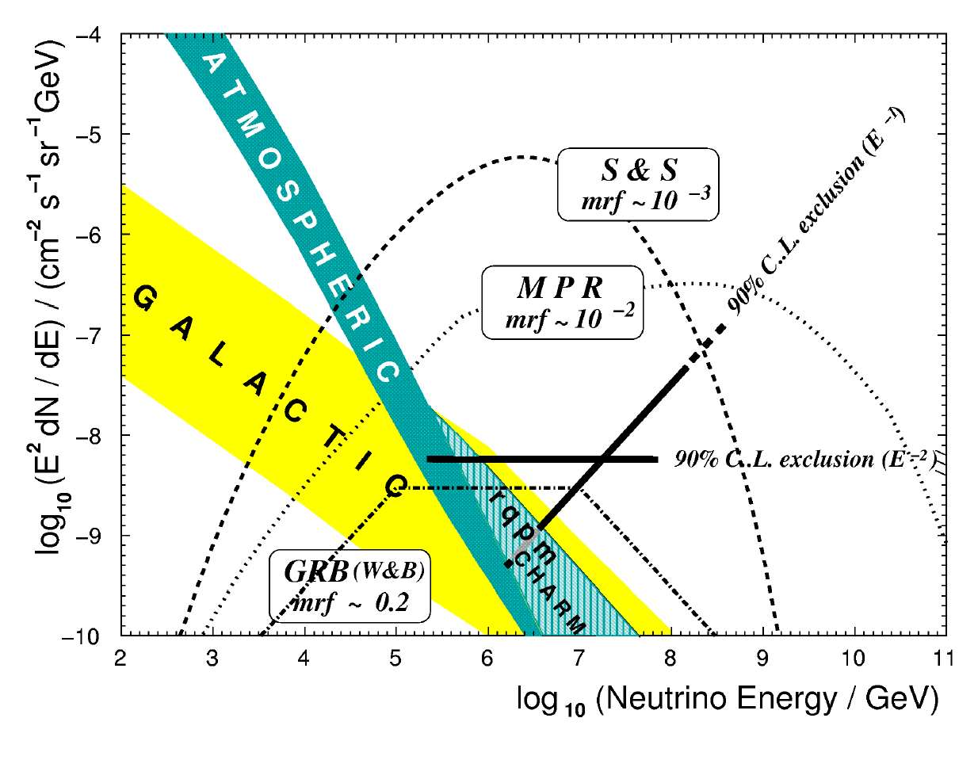
galactic and extragalactic cosmic rays
Stecker&Salamonb model for pγ interactions in the core of AGN
The atmospheric background flux is up to two order of magnitude larger at 1 TeV, but it drops rapidily, meeting the benchmark flux at about 100 TeV
Mannheim et al model for pg interactions in extragal,actic sources
GRB model by Waxman&Bahcall

Slide 20
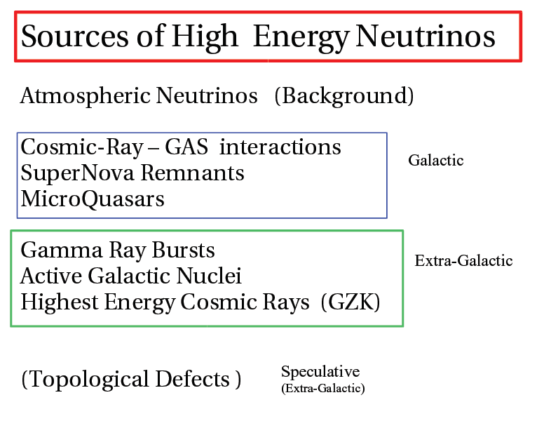

Slide 21
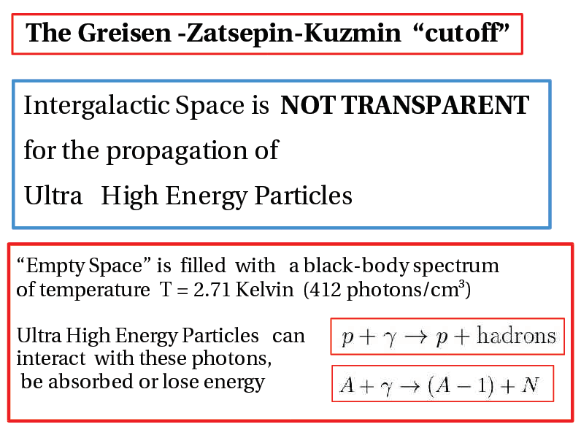

Slide 22
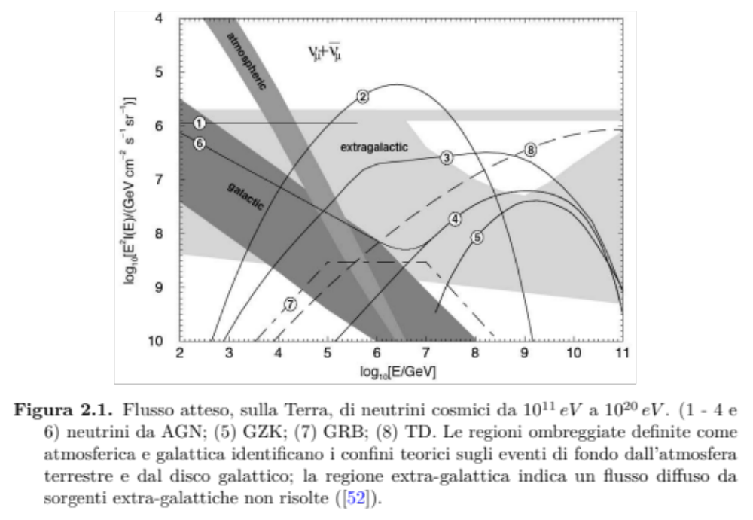
AGN
GZK
GRB

Slide 23
INDIRECT DARK MATTER DETECTION
WIMPS (neutralinos) become massive astrophysical objects - Sun, Earth, Galactic Centre
Neutralinos self annihilate into fermions or combinations of gauge and Higgs bosons
Subsequent decays of c, b, t quarks, Z, W, Higgs bosons can produce significant flux of high energy neutrinos
Complements direct detection
χ
ν
Sun: over time neutralino population
builds up at the core to an equilibrium
value
Notes:
Direct searches for neutralino dark matter rely on detecting the nuclear recoil caused when a halo neutralino travelling at approx 200 km/s collides with an atomic nucleus in the detector - Jessica will tell you about these direct detection methods
Similar processes occurring in celestial bodies can slow the neutralino down to below the body’s escape velocity, in which case further scattering in subsequent orbits will result in it eventually settling at the core of the body.
Neutralinos are their own antiparticle
The number density of captured neutralinos increases until the capture rate and annihilation rate balance
In most regions of supersymmetric parameter space, this equilibrium has been reached in the sun’s core, but not in the Earth owing to its smaller mass.
Many annihilation channels e.g. bottom, charm or top quarks, tau leptons and gauge bosons produce high energy neutrinos as secondary decay products
These neutralinos escape from the core of the star or planet and be visible as a neutrino flux the Earth’s surface and may be detected in neutrino telescopes
Thus large area neutrino telescopes are excellent tools for the indirect detection of neutralinos.
The neutrino energy spectrum depends on the neutralino mass and on the annihilation channel, the W and Z bosons produce much harder neutrinos than b or c quarks - for the hardest spectra the average neutrino energy is about half the mass of the neutralino I.e. approx 50-150 GeV
Candidate sources are locations where the neutralino number density may be high enough to produce a significant annihilation rate - these are principally the centres of the sun and the earth where neutralinos accumulate due to gravitational capture,
Also the Galactic centre - there is significant evidence for a 2.9x10^6 solar mass black hole at the centre of the galaxy and there is strong speculation that a strong enhancement in the dark matter density close to the central black hole will cause a corresponding increase in the annihilation rate to a level where neutrino flux is accessible to the current generation of neutrino telescopes.
Indirect detection via neutrinos is complementary to direct detection in the following ways 1. Large area neutrino telescopes are more sensitive than a next generation direct detection experiment in certain regions of parameter space 2. The neutralino concentrations detected by neutrino telescopes have built up over the lifetime of the solar system, whereas direct detection experiments measure the neutralino density in the local halo. This may be of particular significance for models with clumpy halos e.g. if we happen to be in a non-clumpy part of the Galaxy then direct detection rates would be correspondingly reduced whilst indirect detection rates would remain unaltered.

Slide 24
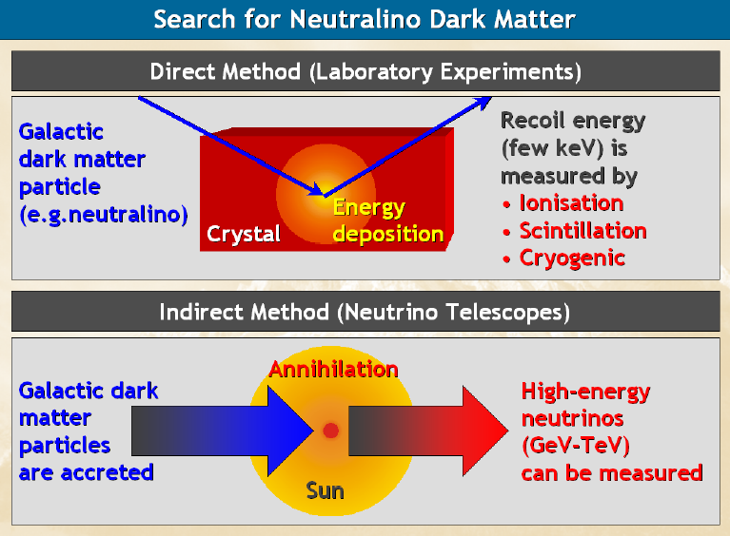

Slide 25
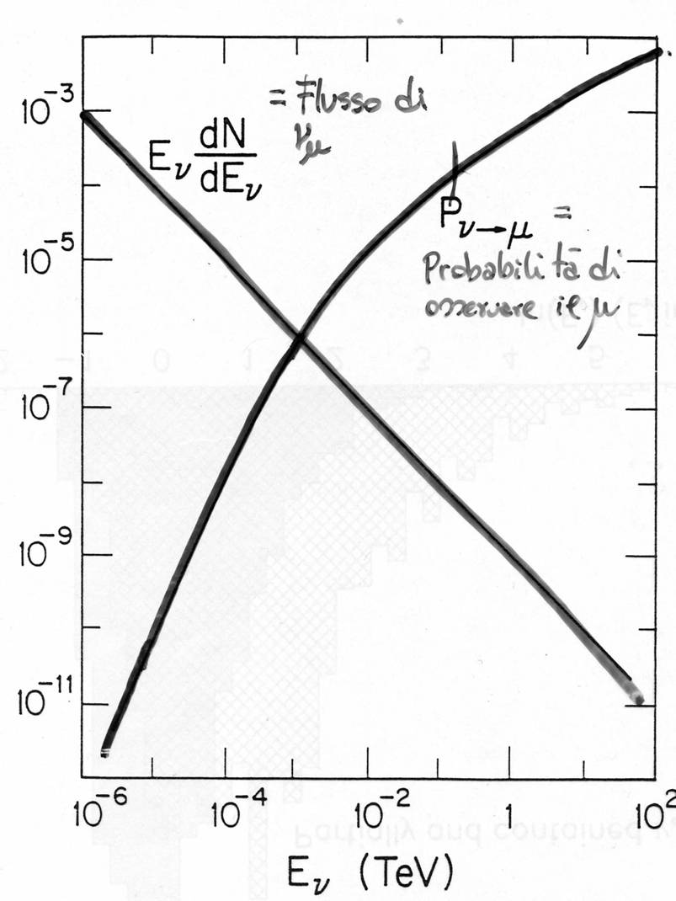
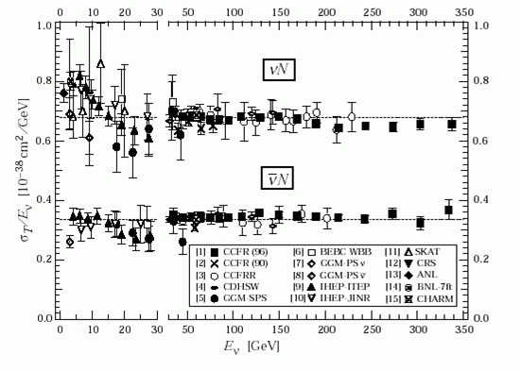
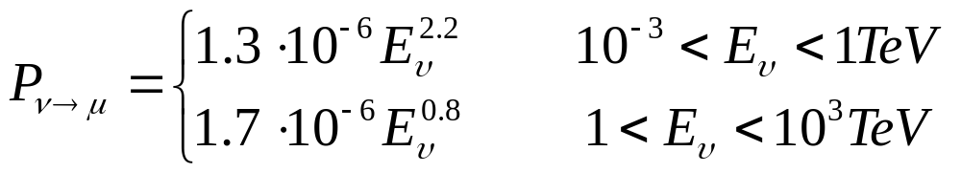
From a neutrino to a detectable muon
The ν cross section increases with energy
The muon range increases with energy for E_{μ}< 1TeV

Slide 26
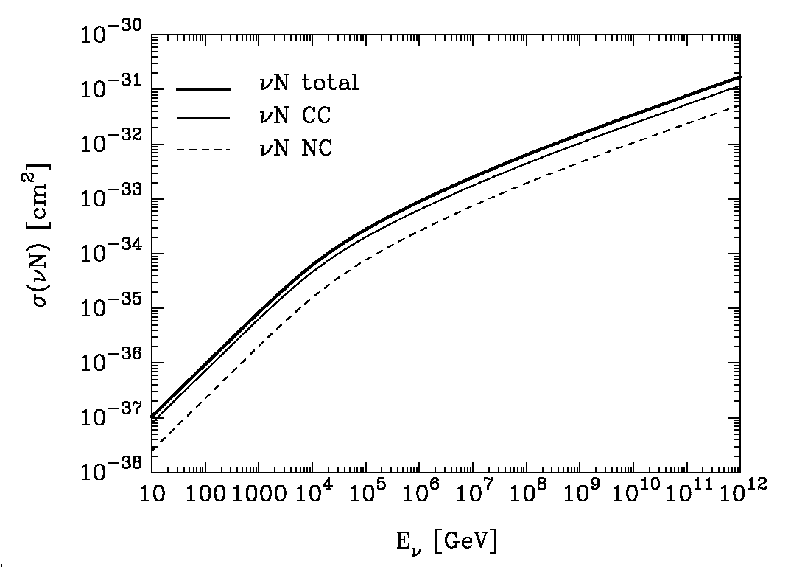
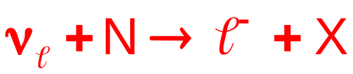
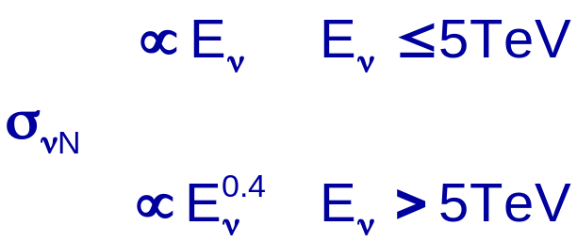
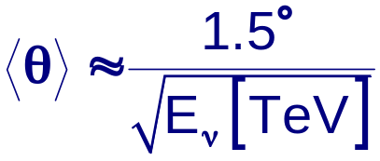
Neutrino cross section
Neutrinos are detected indirectly, following a DIS on a target nucleus N:
10⁻³³ cm²
10⁻³⁵cm²
1 TeV
1 PeV
Gandhi
At >TeV energies the muon and the neutrino are co-linear
ν_{μ}
μ
N
θ
X
Reconstruction of the μ trajectory allows the identification of the ν direction

Slide 27
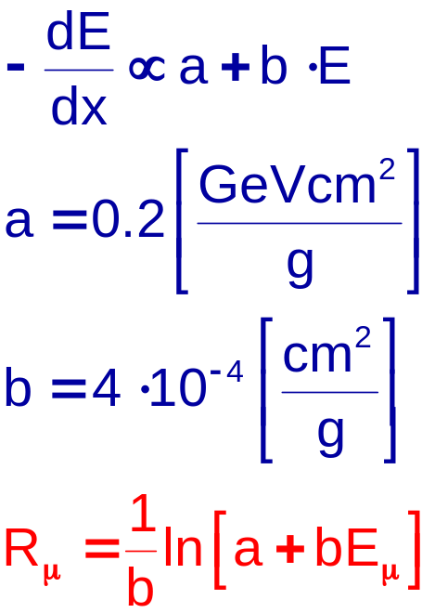
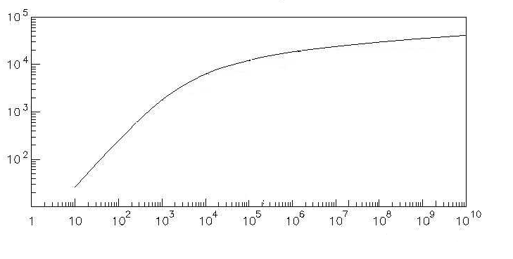
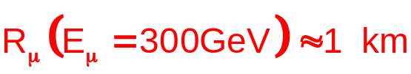
Muon Range
2·10⁴
In water
2·10³
Range (m)
1 TeV
1 PeV
Gaisser
E_{μ}(GeV)
Muons have long tracks in water
Due to its larger mass (m_{μ}/ m_{e}~200) radiative losses of muons are strongly suppressed with respect to electrons

Slide 28
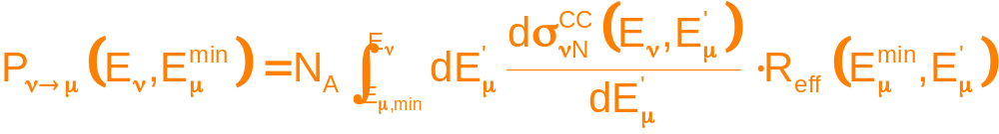
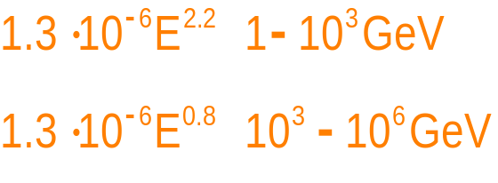
Neutrino detection probabilty
Due to the long muon range the target volume is much bigger than the detector instrumented volume
ν
μ
ν
μ
ν
μ
Instrumented detector D<R_{μ}
Probabilty to produce a detectable (E_{μ}>E_{min}) muon

Slide 29
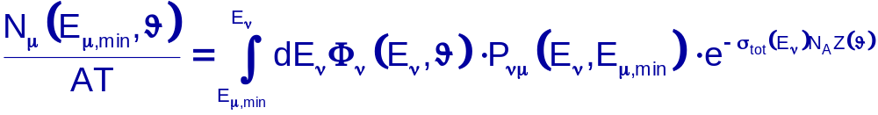
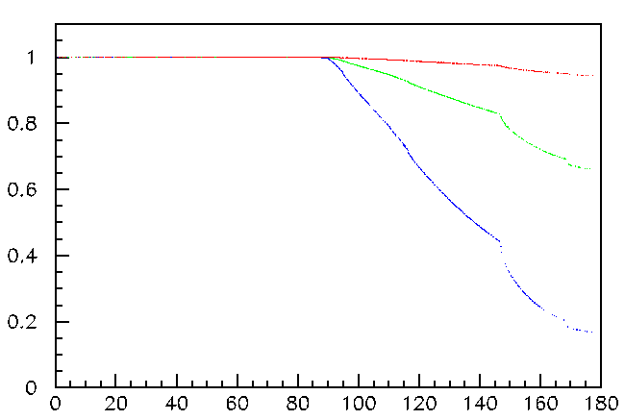
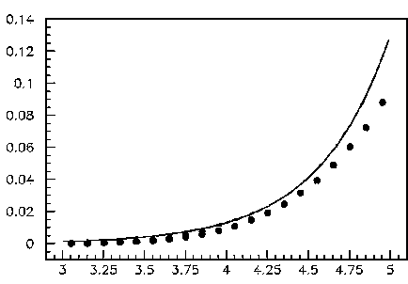
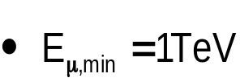
Neutrino-induced muon fluxes
The number of muon events in units of detection area A and observation time T is:
Neutrino flux spectrum
Probabilty to produce a detectable (E_{μ}>E_{min}) muon
Earth transparency to HE neutrinos → >PeV neutrinos search for “horizontal” tracks
P_{Earth}
1 TeV
E_{μ,min}=1GeV
10 TeV
P_{νμ}·10⁻³
100 TeV
LogE_{μ}(GeV)
deg

Slide 30
ν Propagation in the Earth
Lower hemisphere 50% opaque for E_{ν} ~ PeV
Regeneration of ν_{τ}
  ν_{τ} − τ – ν − cascade:
  Look for excess of upward cascades between 0.1 and 10 PeV
For E_{ν} > PeV can use downward neutrinos as well as upward
90% Allowed
directions
at 100 TeV
~ 50% allowed
at 1 PeV
Earth absorbs
~90% of upward ν
for Eν > 10 PeV

Slide 31



Sky coverage
μQSO
TeV sources
Galactic centre
Mediterranean km³
1.5 π sr common view per day
Galactic coordinates
ICECUBE

Slide 32

Earth screening against other particles
Neutrino telescopes look downword
Neutrinos interact weakly
Light signal are weak
Need environment schielded against day-light

Slide 33


LNGS
Macro
1°exp
2400 m
3800 m
KM3NeT
3400 m
ANTARES + NEMO + NESTOR
join their efforts to prepare
a km³-scale neutrino telescope
in the Mediterranean
→KM3NeT Design Study

Slide 34


Slide 35
DETECTION PRINCIPLES
Neutrino telescopes use Cherenkov radiation to detect the charged lepton produced when a high energy neutrino undergoes charged current interaction in or near the detector volume.
Use water or ice as Cherenkov medium
Light detected by lattice of Photomultiplier Tubes (PMTs) housed in transparent spheres spread over a large volume
Notes:
Cherenkov effect - high energy particles moving through a medium with a velocity greater than the speed of light in that medium give off visible light with a wavelength spectrum proportional to 1/lambda squared.
The wavefront travels in a direction at angle theta to the particle direction where cos theta = 1/ beta n, assume beta = 1 and typical refractive index for water 1.35 gives an angle of 42.2degrees in water.
With few photons produced per meter segment of particle track both an exceptionally transparent medium and exceptionally sensitive detectors are required.
For the medium deep water and Antarctic ice have been used in experiments
(The deep ocean provides a clear natural medium with relatively small amounts of photon scattering - important in reconstruction of muon direction as scattering will reduce the number of Cherenkov photons seen and cause their arrival times to be spread out around the expected time)
Large area PMTs sensitive to single photons provide the best possible detectors

Slide 36


Slide 37


Slide 38


Detecting neutrinos
p, α
ν_{μ}
μ
p
γ_{č}
ν_{μ}
γ
2500 m
depth
43°
μ
Cherenkov light from μ induced by ν
interaction detected by 3D PMT array
Time & position of hits allow the
reconstruction of the μ (~ ν) trajectory
ν
interaction
Notes:
Simulation de l’interaction νN→μX
Section efficace vs énergie
Absorption dans la Terre
Simulation des bruits de fond
muons atmosphériques
muons induits par ν atmosphériques

Slide 39


Slide 40

Backgrounds: atmospheric muons and neutrinos
Atmospheric neutrinos:
upward tracks are good neutrino candidates;
event direction and energy criteria can be used to discriminate background from astrophysical signals.
Atmospheric muons:
downgoing events background is due to mis-reconstructed (fake) tracks;
improve analysis filters for atmospheric muon background rejection.
ANTARES

Slide 41
Background for cosmic neutrino searches
1TeV
Atmospheric μ
10TeV
φ (cm⁻² s⁻¹ sr⁻¹)
Upgoing
Muons produced by cosmic rays in the atmosphere ( detector deep in the sea and selection of up-going events).
Muons induced
by atm ν
Downgoing
Atmospheric neutrinos (cut in the energy).
1TeV
p
10TeV
μ
ν
Number of events after cuts
ν
p

Slide 42

Deep-sea ν-Telescope at work
Upward-going neutrinos interact in rock or sea water.
Emerging charged particles (in particular muons) produce Cherenkov light in water.
Detection by array of photomultipliers.
Focus of scientific interest: Neutrino astronomy in the energy range 1 to 100 TeV.

Slide 43


Slide 44


Slide 45


Slide 46

ICECUBE
Deep ice array
80 strings / 60 OM’s each
17 m OM spacing
125 m between strings
hexagonal pattern over 1 km²
geometry optimized for detection of TeV – PeV (EeV) ν‘s based on measured absorption & scattering properties of
Antarctic ice for UV–blue Cherenkov light
Surface array IceTop
2 frozen-water tanks
(2 OM’s each) on top of every string

Slide 47


Slide 48


Slide 49




Slide 50




IceCube
IceTop

Slide 51


Slide 52


Slide 53


Slide 54

The Enhanced Hot Water Drill (EHWD)
Drill camp (5 MW hot water heater)
Hose Reel
Hot water hoses (2)
IceTop Tanks
(w/ sun shield)
Drill head
Solar heated
Facilities
Drill speeds ~ 2 m/minute
  ~40 hours to drill a hole
  ~12 hours to deploy a string
  Deploy: DOMs, pressure sensors, Std. Candle, dust logger, …

Slide 55


Slide 56


Slide 57


Slide 58


Slide 59


Slide 60


Slide 61


Slide 62


Slide 63


Slide 64


Slide 65


Slide 66


Slide 67

Where do they come from?
Cascade events with 15° of uncertainty
• Track events
28 detected events:
21 cascades
7 tracks
From S. Razzaque arXiv:1309.2756 Sept 2013
Better resolution in KM3NeT detector for cascade events ➔4° – 1.5° for 3TeV -1PeV (no systematics included)
ν_{μ} the best probe for neutrino astronomy

Slide 68


Slide 69

KM3NeT
Detection Units
Primary junction box
Secondary junction box
Electro-optical cable
-A 3-D PMT’s array of a vertical structure of a neutrino telescope.
-anchored on the seafloor
-connected to a seabed cable network for power distribution and data transmission
About 11000 KM3NeT-DOMs (Digital Optical Modules) attached to about 600 KM3NeT Detection Units
Propriety KM3NeT Collaboration

Slide 70
Site selection criteria
Depth
  Reduction of atmospheric muon flux
Water optical transparency
  Optimisation of detector performances (efficiency and angular resolution)
Weak and stable deep sea currents
  Reduce stresses on mechanical structures
  Reduce stimulation of bioluminescent organisms
Low optical noise
Low optical background (40K + bioluminescence) ⇒ detector performances
Low biofouling and sedimentation
Distance from the shelf break and from canyons
  Installation safety
Proximity to the coast and to existing infrastructures
  Easy access for sea operations
  Reduction of costs for installation and maintenance

Slide 71


Water Optical Properties
Optical water properties measured in joint 2002 NEMO-ANTARES campaigns
Absorption lengths measured at Capo Passero are compatible with optically pure sea water
Large differences between Toulon and Capo Passero site are observed in the blue region
Values measured with the ANTARES Test 3’ setup are in good agreement with the AC9 data

Slide 72




Optical background in Capo Passero and Toulon-2
bioluminescence
No luminescent bacteria have been
observed in Capo Passero
at depth > 2500 m

Slide 73

Seafloor layout
KM3NeT will be built by several “building blocks”
Hypotesis: 1 Building block = 1/3 of KM3NeT:
  104 Dus
    14 SJBs (incl. EMSO node)
  1 PJB
  2.3 km² floor area
To define the deep-sea infrastructure capable to serve 1/3 of the full detector (e.g. 104 DU) at ~100km from the on-shore laboratory, the following working scheme was assumed:
  one MEOC provides power and fibers to a PJB
  Power transmitted by DC/DC.
  The PJB is connected with a “star” configuration to SJBs
  Each SJB is connected to 8 DU
  Each DU needs ~350 W and n_floors*2 colours:
  Several MVC needed. Investigating options for mass production

Slide 74





TDR - Detection Unit concepts
DUs are the mechanical structures that hold OMs,
enviromental sensors, electronics,…
Triangular arrangements of OMs with single-PMTs or multi-PMT
Evolution of the ANTARES storey
Slender string
Vertical sequence of multi-PMTs OMs
Flexible tower with horizontal bars equipped with single-PMTs or multi-PMT OMs (20 storeys @ 40m)
Simulations indicate that local 3D OM arrangement resolve ambiguities in the reconstruction of the muon azimuthal angle

Slide 75

The ANTARES Detector
12 lines of 25 storeys
900 PMs

Slide 76


Single PMT Optical Module
8” PMT with 35% quantum efficiency inside a 13” glass sphere
good timing
evolution from pilot projects: ANTARES-NEMO-NESTOR
well known technology

Slide 77


Slide 78




O.M. assembly : procedure
mu-metal cage positioned into the glass hemisphere
3 cycle of outgassing @ 300mbar
Mixture gel preparation and pouring into the glass hemisphere
3 cycle of outgassing 3 @ 300 mbar
(5 minutes)
PMT positioning into the sphere with an accuracy tool
5 minutes of outgassing @ 300 mbar
The gel polymerize @ atmosferic pressure
mu-metal
Mixture of SilGel
vacuum box
Positioned PMT

Slide 79

Optical Module overview
FEM +
framework
PMT base
Mu-metal cage
Gel
Vacuum box

Slide 80


Slide 81

Electronics & Data Readout Concepts
Front-end options studies
New improved front-end chip
in the deep-sea
  New FPGA/CPU
Minimize active electronics in deep-sea
  Reflective optical modulator
  on-shore timestamp
Both options use fibers, Wavelength Division Multiplexing and Point-to-point networks
“ALL DATA TO SHORE”
Submarine
Telecom cable
Interlink cables

Slide 82



The KM3 electro-optical cable
DC solution with sea return
Working Voltage 10 kV
Power up to 100 kW
Optical fibres 20
Converter
Vin 10 kV DC
Vout 400 DC
+
Splitter ottico

Slide 83
NEMO TOWER
17 Add module
(Att. 15 x 0.4 dB = 6 dB max)
λ₁
18 Drop module
(Att. 16 x 0.4 dB =6.4 dB max)
Floor 18
λ₂
Floor 17
λ₃
Floor 16
λ₄
λ₅
Floor 2
λ₆
Floor 1
Σλ_{n}
MUX Tx/Rx
DEMUX Tx/Rx

Slide 84
Power distribution
Cable Terminator
Assembly
Medium
Voltage
converter

Slide 85


DC/DC Medium Voltage Converter (MVC)
Deep-sea voltage DC/DC converter
(10 kV to 375 V)
A version developed by ALCATEL/LUCENT
for NEPTUNE & NEMO has been deployed
and is operating at 3500 m depth at Capo Passero site
dV= 10kV/48=200V
200 V to 50 V
10kV
400V
Control / start-up 1
Control / start-up 2
Control / start-up 3
Control / start-up 4
Control / start-up 5
Control / start-up 6
50 V x 8 =400 V

Slide 86


Major alternative options
Optical Modules
Single-PMT OM
One large PMT (8”) in a 13” glass sphere
Multi-PMT OM
31 small PMTs (3”) in a 17” glass sphere

Slide 87



Multi-PMT Optical Module
31 3” PMTs inside a 17” glass sphere
Cooling shield and stem
First prototype end of 2011
Single vs multi photon hit separation
Larger photocade area per OM

Slide 88

Alluminium heatsink
power board
sphere logic board
octopus long board
to PMT bases
Top foam core
Bottom foam core
PMT with base
Reflection ring
Gel interface
Glass sphere

Slide 89




Mechanical cooler
T7
Heat removed by
convection D and
conduction AB C
T5
T11
A: power board 900 mW
B: OM logic board 5.06 W
C: Octopus short 70 mW
C: Octopus long 270 mW
D: PMT base 35 mW (x 31)
Tot: ≈ 7 W

Slide 90




Three design options
1-horizontal bar of 6 m, 4/6 optical module and electronic container, resolve ambiguities
(multi-pmt).
2-String and multi-PMT
3-Triangle and 6 optical module in pairs at 1,1 m from centre
3
1
2
1
2
3
Performance and cost within 20%

Slide 91




Test of the string prototype
Storage on deck of the Pelagia
Deployment and recovery

