Slide 1


GRB Seminar
D. Vivolo
Univ. Federico II and INFN Naples, Italy

Slide 2
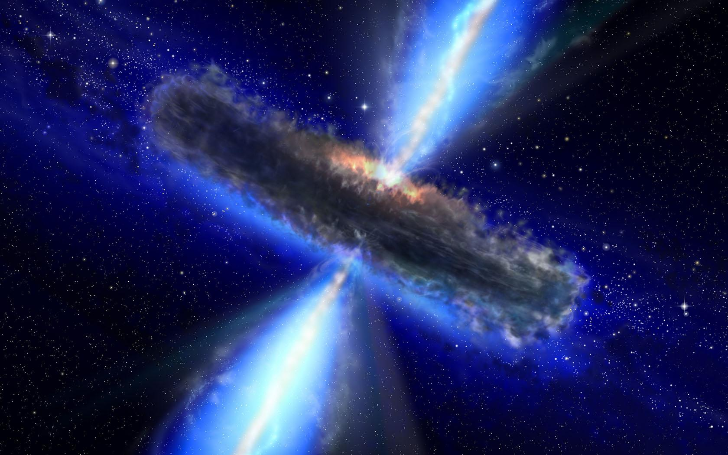
D. Vivolo
GRBs
Among the most luminous sources in the Universe (up to L_{γ}~10⁵² erg/s) and highly variable (few ms to few minutes) sources of gamma rays
History
Missions
Phenomenology
Fireball
Neutrinos
Perspectives
10⁵⁰ -10⁵⁴ ergs released in a short time scale only in the form of γ-rays.
(sun: 10³³ erg/sec; supernova: 10⁵¹ ergs on a month time scale)

Slide 3
D. Vivolo
GRBs
GRBs have been observed up to z ~ 8.2!!!
hope to use GRB as cosmological tool
History
Missions
Phenomenology
Fireball
Neutrinos
Perspectives
Predicted to produce high energy neutrinos, primarily through interactions between protons and gamma rays.

Slide 4
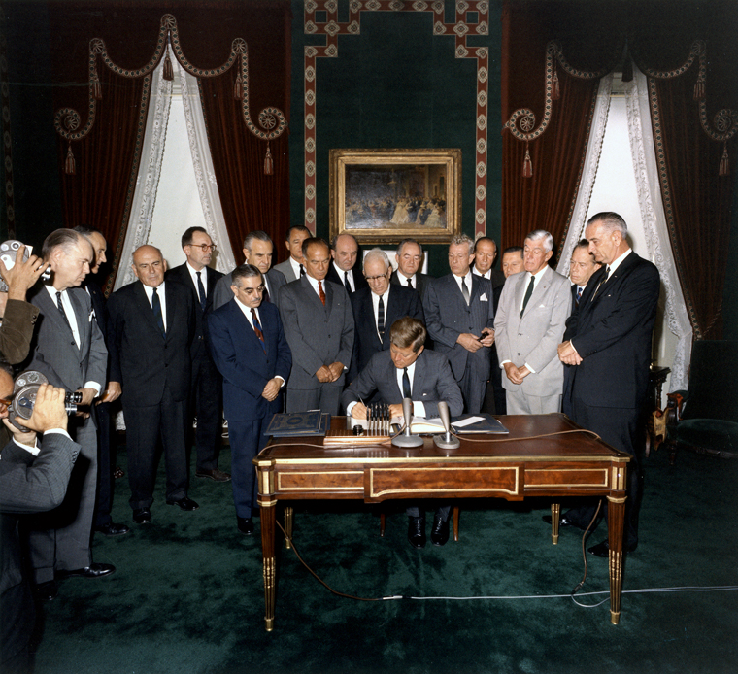
D. Vivolo
Partial Test Ban Treaty
History
Missions
Phenomenology
Fireball
Neutrinos
Perspectives

Slide 5
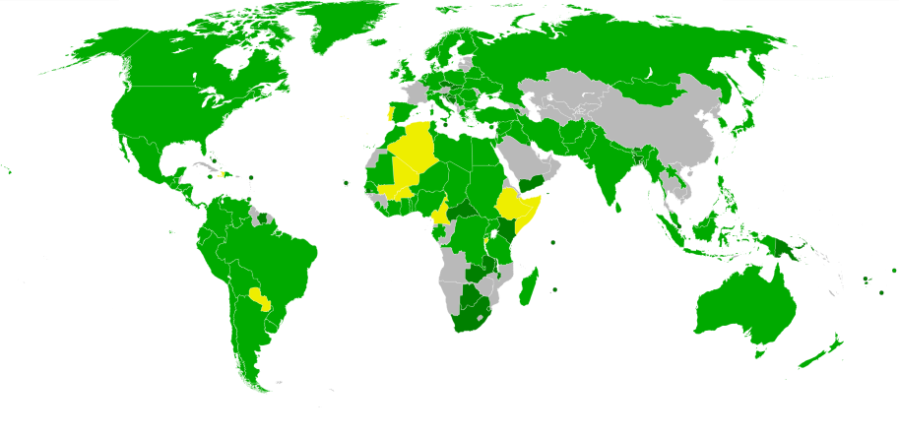
D. Vivolo
Partial Test Ban Treaty
Treaty Banning Nuclear Weapon Tests in the Atmosphere,
in Outer Space, and Under Water
History
Missions
Phenomenology
Fireball
Neutrinos
Perspectives
Negotiated among USA, UK and USSR from the 15th of July 1963 and signed in Moscow the 5th of August 1963.

Slide 6
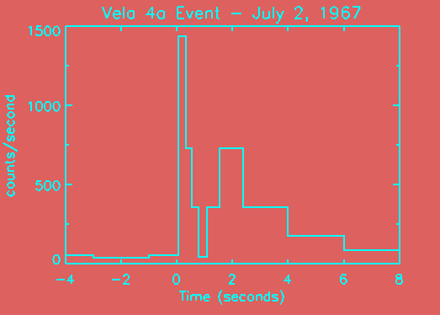
D. Vivolo
Partial Test Ban Treaty
US and USSR military satellites to monitor adherence to the treaty
History
Missions
Phenomenology
Fireball
Neutrinos
Perspectives
The signature of a nuclear detonation is a brief, but intense, pulse of gamma rays
gamma-ray detectors
Vela Satellites
1969: Ray Klebesadel and Roy Olson, while analysing data transmitted by the U.S. Vela 4 satellite, observed a gamma-ray signal occurred on July 2, 1967.
Notes:
Most satellites about 800 km. Vela more than 100,000 km.
Above the Van Allen radiation belt, reducing the noise in the sensors.
Extra height -> detect explosions behind the Moon

Slide 7
D. Vivolo
Milestones
History
Missions
Phenomenology
Fireball
Neutrinos
Perspectives
Military secrecy: detection kept secret until 1973
“Observations of Gamma-Ray Bursts of Cosmic Origin”
R. Klebesadel, R. Olson, and I. Strong (LANL)
Identification of a cosmic source for the previously unexplained observations of gamma-rays.
1974: Data from Soviet KONUS satellites is published, confirming the detection of these bursts of gamma rays

Slide 8
D. Vivolo
Milestones
1975 - Texas Symposium on Relativistic Astrophysics: more than 100 different possible theoretical models of GRB were listed, most of which could not be ruled out by the observations then available, including:
History
Missions
Phenomenology
Fireball
Neutrinos
Perspectives
Magnetic flares
Black Hole evaporation
Anti-matter accretion
Deflected AGN jet
Magnetars, Soft Gamma-Ray Repeaters (SGRs)
Mini BH devouring NS
…..
1976: Start of the InterPlanetary Network (IPN), a set of gamma-ray detectors placed on spacecrafts studying the Sun and planets. Localization of GRB by triangulation to a few arcmins. Still working

Slide 9
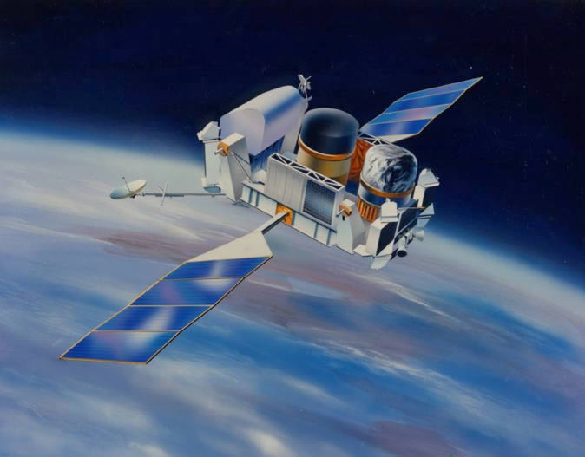
D. Vivolo
CGRO: Overview
5th April 1991: NASA launches aboard the space shuttle Atlantis the Compton Gamma Ray Observatory (CGRO) the heaviest astrophysical payload ever flown at the time of its launch.
History
Missions
Phenomenology
Fireball
Neutrinos
Perspectives
Four instruments covering six decades of the electromagnetic spectrum, from 30 keV to 30 GeV
OSSE
EGRET
COMPTEL
BATSE

Slide 10

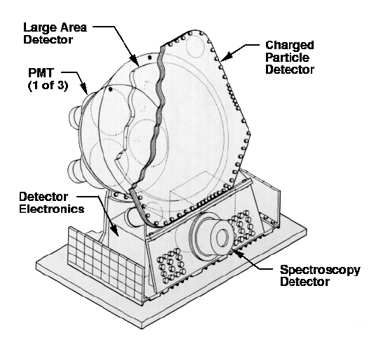
D. Vivolo
CGRO: BATSE
Burst And Transient Source Experiment: all-sky monitor detecting and locating strong transient sources
History
Missions
Phenomenology
Fireball
Neutrinos
Perspectives
Eight BATSE detectors, one facing outward from each corner of the satellite, sensitive to gamma-ray energies from 20 keV to over one thousand keV.
NaI crystals scintillators.
Flashes recorded by PMTs.
Output signal digitized and analyzed to determine arrival time and energy of the gamma ray.
Large area detector sensitive to faint transient events.
Smaller detector optimized for spectroscopic studies of bright events.

Slide 11

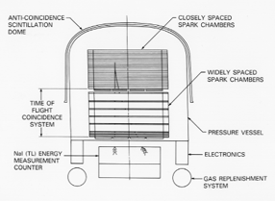
D. Vivolo
CGRO: EGRET
Energetic Gamma-Ray Experiment Telescope: all-sky monitor detecting and locating strong transient sources
History
Missions
Phenomenology
Fireball
Neutrinos
Perspectives
Energy range: 20 MeV – 30 GeV
Large field of view: ~80° in diameter
Angular resolution: 67% confinement angle 5.5° @ 100 MeV, 0.5° @ 5 GeV.
LAYERED STRUCTURE
Spark chamber interleaved with tantalum foils and tracking layers.
Energy reconstruction: NaI calorimeter (Total Absorption Shower Counter, TASC)
Plastic scintillator dome
to veto events from charged particles entering from above
γ rays (~35% above 200 MeV) interact in the foils to produce HE e⁻-e⁺ pairs.
Reconstruction of energies and directions of the e⁻-e⁺ pairs yields energies and directions of the incident photons
Time-of-flight coincidence system
to identify down-going events before the spark chamber is triggered.
The ions are accelerated by high voltages, creating avalanches of secondary ionizations.

Slide 12
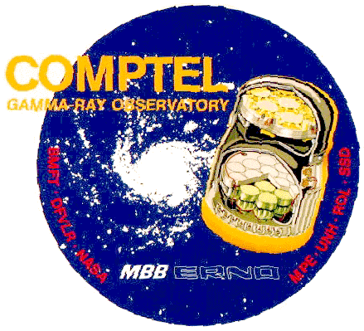
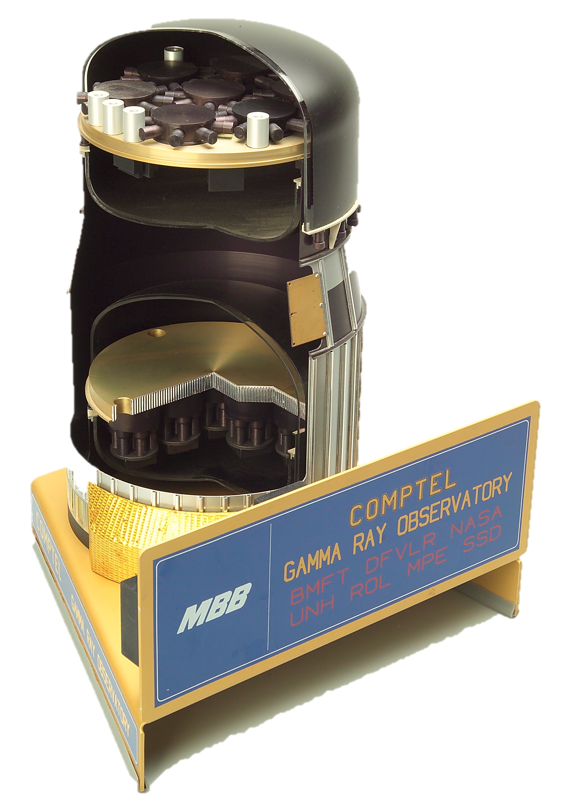
D. Vivolo
CGRO: COMPTEL
Imaging Compton Telescope: uses Compton Effect and two layers of γ-ray detectors to reconstruct an image of a γ-ray source in the energy range 1 to 30 MeV.
History
Missions
Phenomenology
Fireball
Neutrinos
Perspectives
Two detector arrays
Gamma rays are detected by two interactions: an incident cosmic gamma-ray is first Compton scattered in the upper detector, then totally absorbed in the lower.
The locations of interactions and energy losses in both detectors are measured.
Data obtained by COMPTEL can be used to reconstruct sky images over a wide field of view with a resolution of a few degrees.

Slide 13
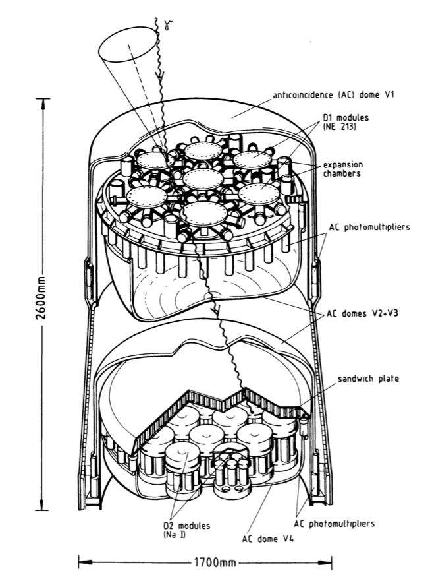
D. Vivolo
CGRO: COMPTEL
Imaging Compton Telescope: uses Compton Effect and two layers of γ-ray detectors to reconstruct an image of a γ-ray source in the energy range 1 to 30 MeV.
History
Missions
Phenomenology
Fireball
Neutrinos
Perspectives
Each detector is surrounded by an anticoincidence shield of NE110 plastic scintillator for charged particles rejection. Two domes, each one viewed by 24 PMTs.
Upper Detector (D1): 7 cylindrical modules of liquid scintillator NE213A. Each module is viewed by eight photomultiplier tubes.
Lower Detector (D2): 14 cylindrical NaI (Tl) blocks, mounted on a supporting baseplate. Each block of NaI is viewed from below by seven photomultiplier tubes.
Data obtained by COMPTEL can be used to reconstruct sky images over a wide field of view with a resolution of a few degrees.

Slide 14
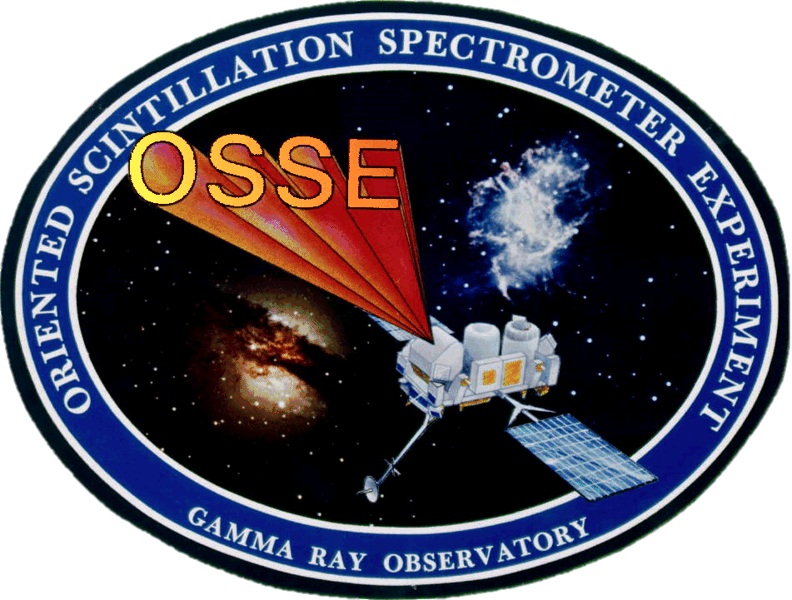
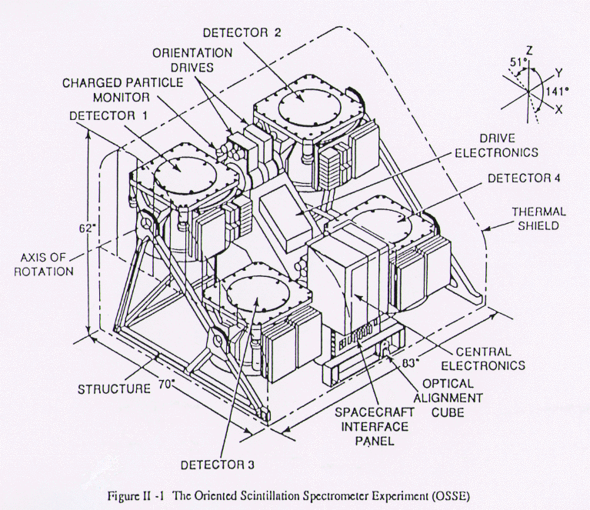
D. Vivolo
CGRO: OSSE
Oriented Scintillation Spectrometer Experiment: four NaI scintillation detectors, energies from 50 keV to 10 MeV.
History
Missions
Phenomenology
Fireball
Neutrinos
Perspectives
Each detector can be individually pointed, allowing observations of a gamma-ray source alternated with observations of nearby background regions for an accurate subtraction of background contamination
Independent pointing systems. The synchronization of the four detectors is provided by the central electronics.
Primary element: NaI(Tl) crystal optically coupled to a CsI(Na) crystal - PHOSWICH (acronym of PHOsphor sandWICH). Each phoswich is viewed from the CsI face by seven PMTs, providing an energy resolution of 8% at 0.661 MeV.

Slide 15
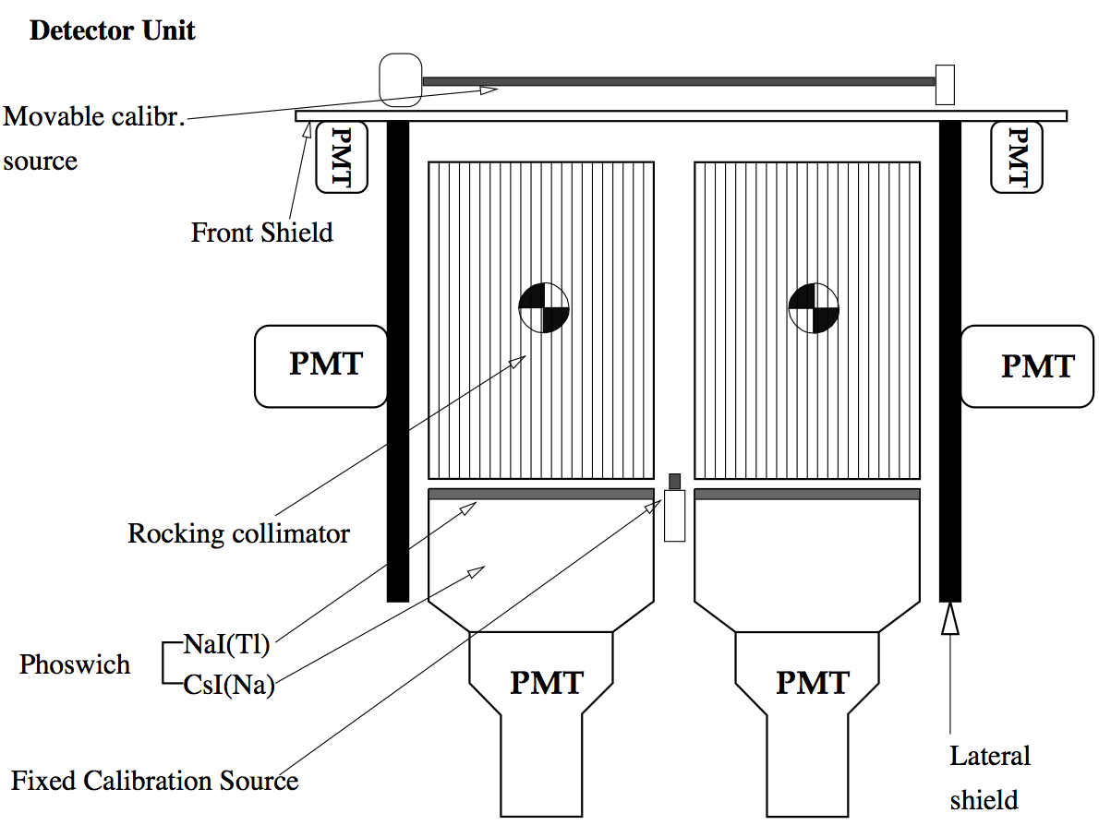
D. Vivolo
CGRO: OSSE
Oriented Scintillation Spectrometer Experiment: four NaI scintillation detectors, energies from 50 keV to 10 MeV.
History
Missions
Phenomenology
Fireball
Neutrinos
Perspectives
Each detector can be individually pointed, allowing observations of a gamma-ray source alternated with observations of nearby background regions for an accurate subtraction of background contamination
Anticoincidence shields system surrounding the sides and the front of detectors and collimators
Two independent collimators, one for each pair of detectors Each collimator bench can be independently rocked back and forth for simultaneous monitoring of source and background
CPD for charged particle rejection

Slide 16
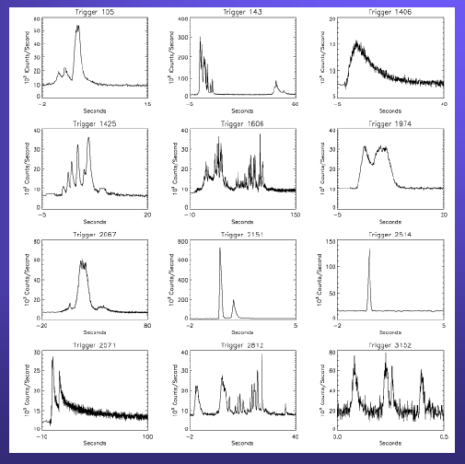
D. Vivolo
CGRO: Results
Over 2,700 gamma-ray bursts in nine years:
Wide range of morphologies
~25% have fast rise, slow decay profile
Durations from ms up to thousands of seconds
No evidence for periodicities
History
Missions
PhenomenologyFireball
Neutrinos
Perspectives

Slide 17
D. Vivolo
CGRO: Results
Over 2,700 gamma-ray bursts in nine years:
Wide range of morphologies
~25% have fast rise, slow decay profile
Durations from ms up to thousands of seconds
No evidence for periodicities
History
Missions
PhenomenologyFireball
Neutrinos
Perspectives
small size (R<ct)
compact source
Compactness problem
number of photons with E>500keV & size of the source imply that the source is extremely optically thick to pair creation (  ➔ e⁺e⁻)

Slide 18
D. Vivolo
CGRO: Results
Over 2,700 gamma-ray bursts in nine years:
Wide range of morphologies
~25% have fast rise, slow decay profile
Durations from ms up to thousands of seconds
No evidence for periodicities
History
Missions
PhenomenologyFireball
Neutrinos
Perspectives
small size (R<ct)
compact source
Compactness problem
number of photons with E>500keV & size of the source imply that the source is extremely optically thick to pair creation (  ➔ e⁺e⁻)
Solution
Ultrarelativistic outflow (Lorentz factor >100) ➔ optically thin emitting region
Relativistic Fireball Model

Slide 19
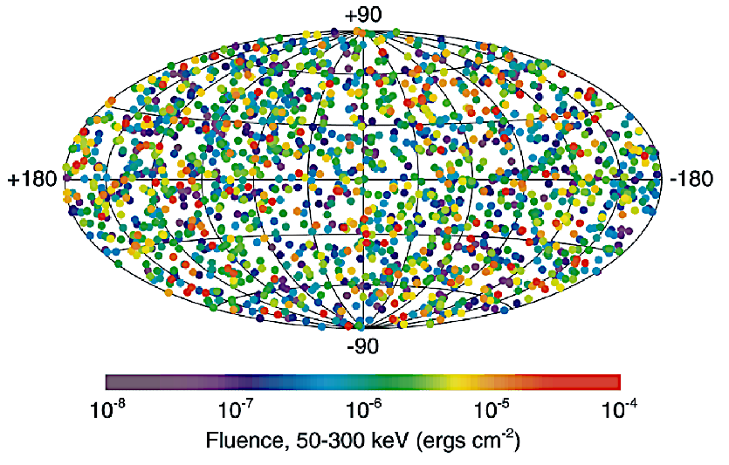
D. Vivolo
CGRO: Results
Over 2,700 gamma-ray bursts in nine years:
the conclusive proof that GRBs occur isotropically distributed in the sky, not concentrated along the plane of the Milky Way. This means that gamma-ray bursts originate far outside of the Milky Way galaxy.
History
Missions
PhenomenologyFireball
Neutrinos
Perspectives

Slide 20
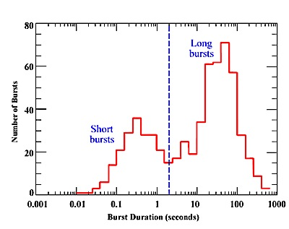
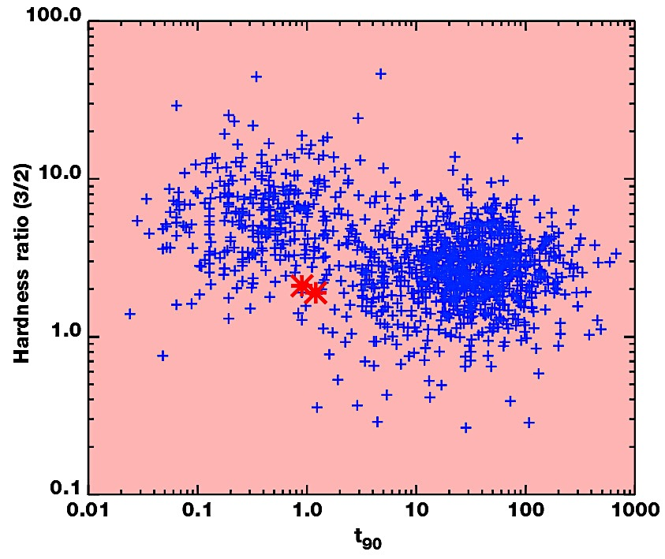
D. Vivolo
CGRO: Results
Over 2,700 gamma-ray bursts in nine years:
Two families: Short-Hard / Long-Soft Bursts
History
Missions
PhenomenologyFireball
Neutrinos
Perspectives
t90: the time over which the 90% of the fluence above background is measured

Slide 21
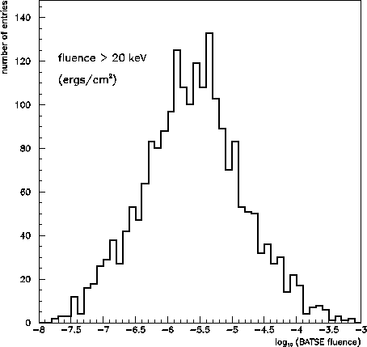
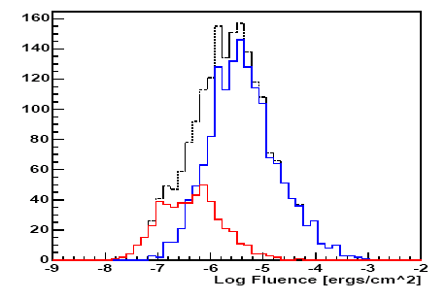
D. Vivolo
CGRO: Results
Over 2,700 gamma-ray bursts in nine years:
Measure of the fluence of the typical GRB: this quantity ranges between 10⁻⁴ - 10⁻⁷ erg cm⁻².
History
Missions
PhenomenologyFireball
Neutrinos
Perspectives
Omodei 2005
Fluence distribution of 477 short and 1496 long BATSE GRBs

Slide 22
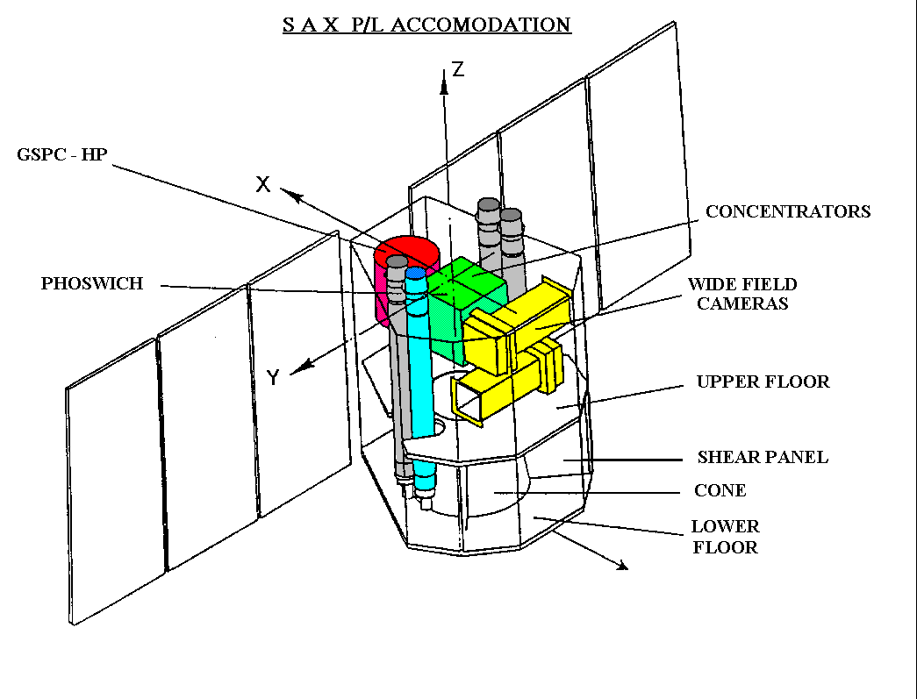
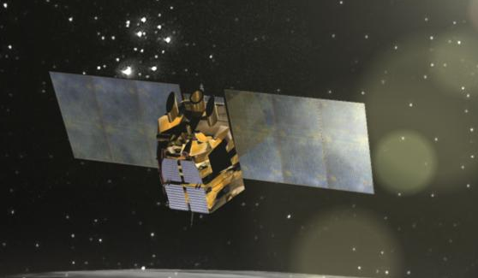

D. Vivolo
BeppoSax: Overview
30th April 1996: project of the Italian Space Agency (ASI) with participation of the Netherlands Agency for Aerospace Programs (NIVR).
History
Missions
Phenomenology
Fireball
Neutrinos
Perspectives
Wide spectral coverage: from 0.1 to over 200 keV.
More than tree decades of energy (first X-ray mission ever) with:
relatively large area,
good energy resolution,
imaging capabilities (resolution of about 1')
HPGSPC
High Pressure Gas Scintillation Proportional Counter
(3-120 keV).
LECS-MECS
Low Energy
(0.1-10 keV)
Medium Energy
(1-10 keV)
Concentrator Spectrometer.
PDS: Phoswich Detector System (15-300 keV).
Notes:
Originally planned to work for two years, it remained in operation for seven years until it was deorbited and fell into the Pacific Ocean on April 29, 2003.
Satellite per Astronomia X, "Beppo" in honour of the Italian astronomer Giuseppe "Beppo" Occhialini, a pioneer in the study of cosmic rays

Slide 23
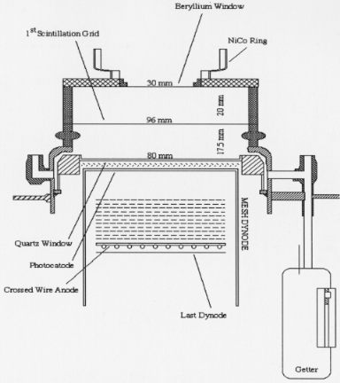
D. Vivolo
BeppoSax: MECS
Three units, each composed of a Mirror Unit (MU), and of a position sensitive Gas Scintillation Proportional Counter (GSPC) located at the focal plane and connected to the MU by a Carbon fiber envelope.
History
Missions
Phenomenology
Fireball
Neutrinos
Perspectives
MU: 30 nested coaxial and confocal mirrors (double cone)
Detector Unit
Gas cell: cylindrical ceramic body (96 mm internal diameter).
50 mm thick entrance Beryllium window (30 mm diameter)
UV Suprasil quartz exit window (80 mm diameter and 5 mm thickness)
UV readout system: crossed-wire anode position sensitive Hamamatsu PMT
Notes:
Originally planned to work for two years, it remained in operation for seven years until it was deorbited and fell into the Pacific Ocean on April 29, 2003.
Satellite per Astronomia X, "Beppo" in honour of the Italian astronomer Giuseppe "Beppo" Occhialini, a pioneer in the study of cosmic rays

Slide 24
D. Vivolo
BeppoSax: MECS
X-ray photo-absorption,
electron cloud drifted in a high electrical field region,
Scintillation: interaction of the accelerated electrons with the Xe ions,
UV light detected by a position sensitive PMT,
amplitude of signal proportional to the energy of the absorbed X-ray,
duration of the signal (dependant on the inteaction point) used to discriminate genuine X-rays against induced by background events (on board and/or onground).
History
Missions
Phenomenology
Fireball
Neutrinos
Perspectives
Energy range: 1.3 – 10 keV
Energy resolution: ~8% at 6 keV
Position resolution: ~0.5 mm (1 arcmin) at 6 keV
HV: -8 kV for the Be window, -7 kV for the scintillation grid
Notes:
Originally planned to work for two years, it remained in operation for seven years until it was deorbited and fell into the Pacific Ocean on April 29, 2003.
Satellite per Astronomia X, "Beppo" in honour of the Italian astronomer Giuseppe "Beppo" Occhialini, a pioneer in the study of cosmic rays

Slide 25
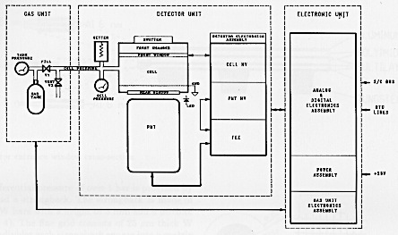
D. Vivolo
BeppoSax: LECS
Similar to MECS.
Main difference: thin window allowing transmission of low-energy X-rays into a detector that does not have separate drift and scintillation regions.
This is to minimize the loss of electrons to the window in the low-field drift region of a conventional GSPC
History
Missions
Phenomenology
Fireball
Neutrinos
Perspectives
Detector Unit
Gas cell:
1.25 μm thick multilayer polyamide
1.2 atm Xenon
UV readout :
PMT Hamamatsu position sensitive
Notes:
Originally planned to work for two years, it remained in operation for seven years until it was deorbited and fell into the Pacific Ocean on April 29, 2003.
Satellite per Astronomia X, "Beppo" in honour of the Italian astronomer Giuseppe "Beppo" Occhialini, a pioneer in the study of cosmic rays

Slide 26
D. Vivolo
BeppoSax: LECS
X-ray photo-absorption,
electron cloud drifted in a high electrical field region,
Scintillation: interaction of the accelerated electrons with the Xe ions,
UV light detected by a position sensitive PMT,
amplitude of signal proportional to the energy of the absorbed X-ray,
duration of the signal (dependant on the inteaction point) used to discriminate genuine X-rays against induced by background events (on board and/or onground).
History
Missions
Phenomenology
Fireball
Neutrinos
Perspectives
Energy range: 0.1-10 keV
Energy resolution: ~8% at 6 keV
Position resolution: ~0.5 mm (1 arcmin) at 6 keV
HV: 4 KV/cm
Notes:
Originally planned to work for two years, it remained in operation for seven years until it was deorbited and fell into the Pacific Ocean on April 29, 2003.
Satellite per Astronomia X, "Beppo" in honour of the Italian astronomer Giuseppe "Beppo" Occhialini, a pioneer in the study of cosmic rays

Slide 27
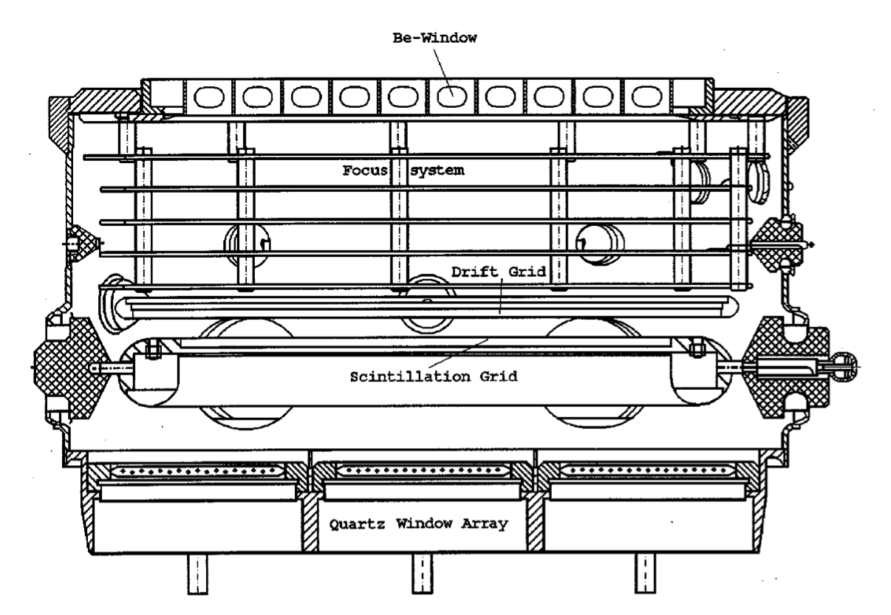
D. Vivolo
BeppoSax: HPGSPC
High Pressure Gas Scintillation Proportional Counter filled with a high purity gas mixture of Xenon (90%) and Helium (10%) at 5 atm.
History
Missions
Phenomenology
Fireball
Neutrinos
Perspectives
Detector Unit
After penetrating the Be window, the X-ray photon is absorbed in the gas cell by a Xe atom via photoelectric effect.
The primary pe emitted gives rise to a cloud of secondary electrons, driven in a Drift Region, and entering a high field region (Scintillation Region) in which the electrons acquire sufficient energy to excite the Xenon atoms.
Notes:
Originally planned to work for two years, it remained in operation for seven years until it was deorbited and fell into the Pacific Ocean on April 29, 2003.
Satellite per Astronomia X, "Beppo" in honour of the Italian astronomer Giuseppe "Beppo" Occhialini, a pioneer in the study of cosmic rays

Slide 28
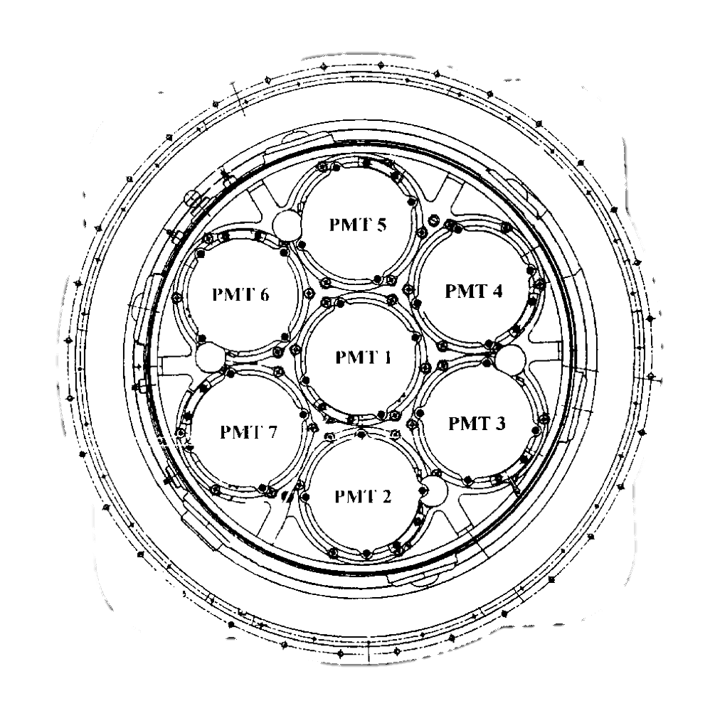
D. Vivolo
BeppoSax: HPGSPC
High Pressure Gas Scintillation Proportional Counter filled with a high purity gas mixture of Xenon (90%) and Helium (10%) at 5 atm.
History
Missions
Phenomenology
Fireball
Neutrinos
Perspectives
Detector Unit
Excited diatomic Xenon molecules then deexcite by the emission of VUV photons collected by an array of seven PMTs in an Anger Camera configuration
Notes:
Originally planned to work for two years, it remained in operation for seven years until it was deorbited and fell into the Pacific Ocean on April 29, 2003.
Satellite per Astronomia X, "Beppo" in honour of the Italian astronomer Giuseppe "Beppo" Occhialini, a pioneer in the study of cosmic rays

Slide 29
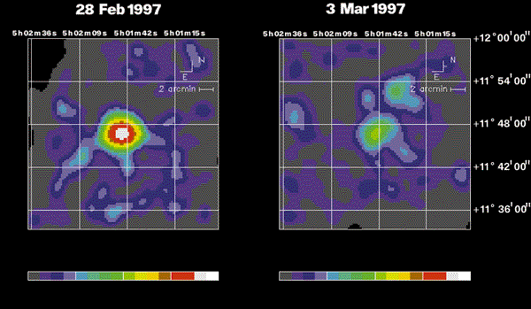
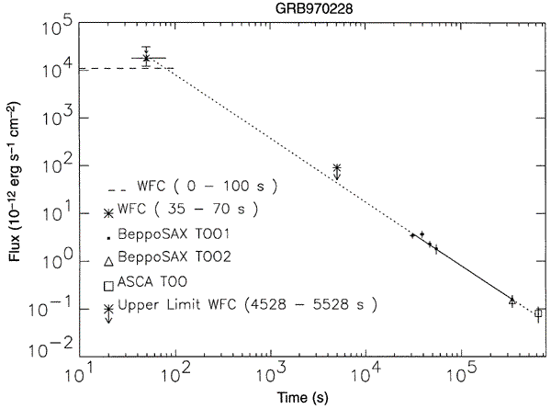
D. Vivolo
BeppoSax: Results
More than 1000 GRB detected:
The first discovery of an X-ray afterglow
History
Missions
PhenomenologyFireball
Neutrinos
Perspectives
GRB970228
Discovered fading X-ray afterglows: “all” long-duration GRBs have X-ray afterglows;
Power law decay ~t^{-χ}, χ ~ 1.1 – 1.5;
Lack of data between ~100 s and 8 hours;
Prompt, early afterglow, afterglow.

Slide 30
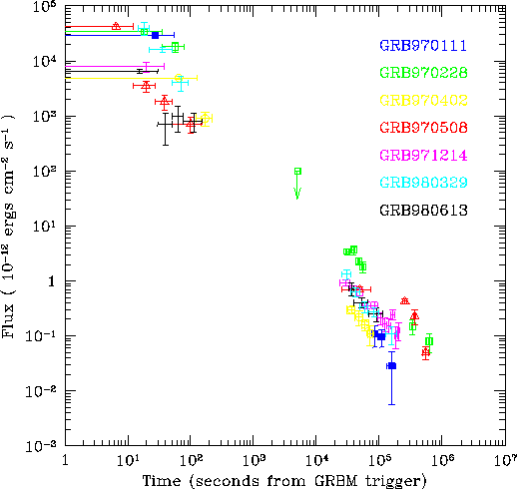
D. Vivolo
BeppoSax: Results
More than 1000 GRB detected:
The first discovery of an X-ray afterglow
History
Missions
PhenomenologyFireball
Neutrinos
Perspectives
GRB970228
Discovered fading X-ray afterglows: “all” long-duration GRBs have X-ray afterglows;
Power law decay ~t^{-χ}, χ ~ 1.1 – 1.5;
Lack of data between ~100 s and 8 hours;
Prompt, early afterglow, afterglow.

Slide 31
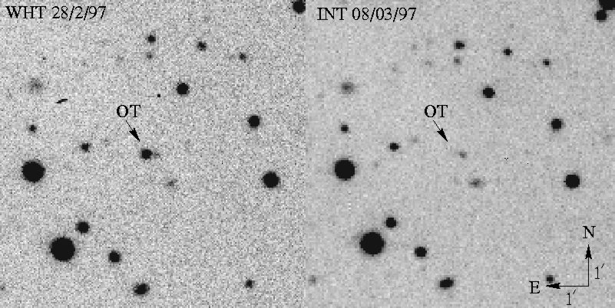
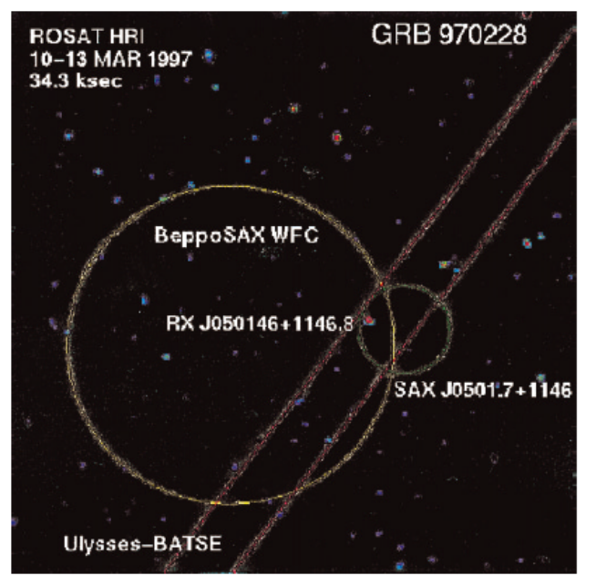
D. Vivolo
BeppoSax: Results
More than 1000 GRB detected:
First discovery of a GRB optical counterpart
History
Missions
PhenomenologyFireball
Neutrinos
Perspectives
GRB970228

Slide 32
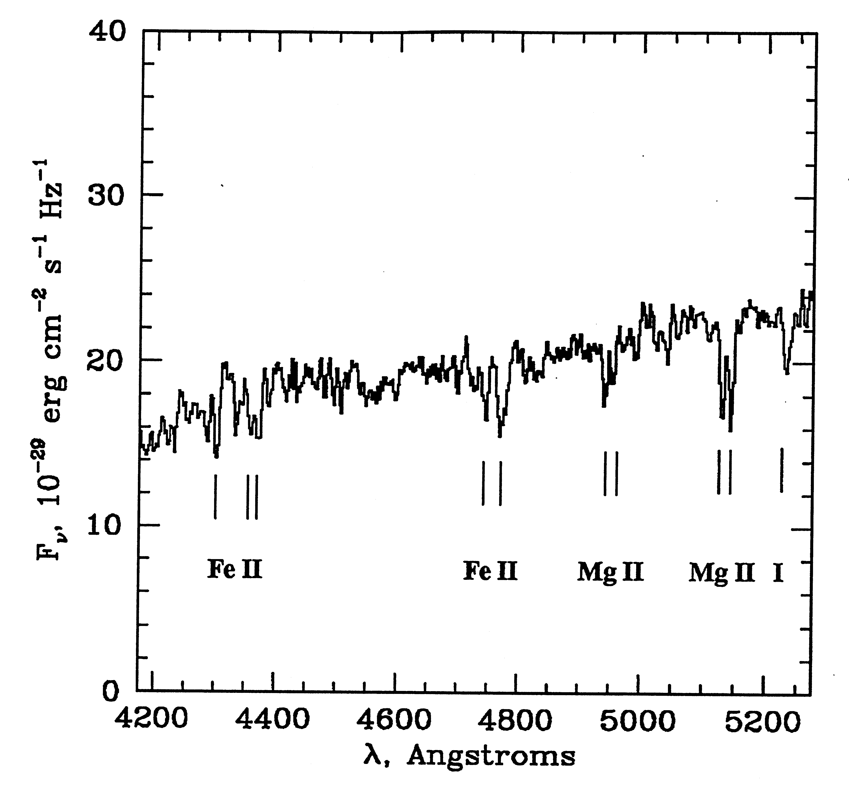
D. Vivolo
BeppoSax: Results
More than 1000 GRB detected:
First GRB redshift measurement
History
Missions
PhenomenologyFireball
Neutrinos
Perspectives
GRB 970508
Redshifts determined from host galaxy emission lines or absorption lines in intervening matter

Slide 33
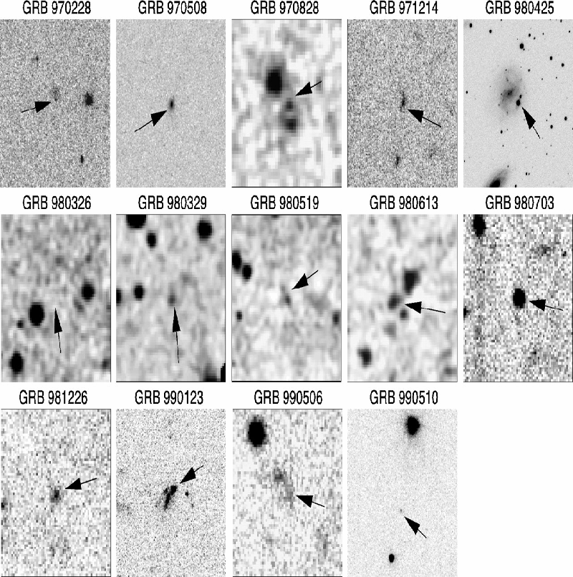
D. Vivolo
BeppoSax: Results
More than 1000 GRB detected:
Long GRB are hosted in faint (m_{R}~26), irregular galaxies with high star-formation rates
History
Missions
PhenomenologyFireball
Neutrinos
Perspectives

Slide 34
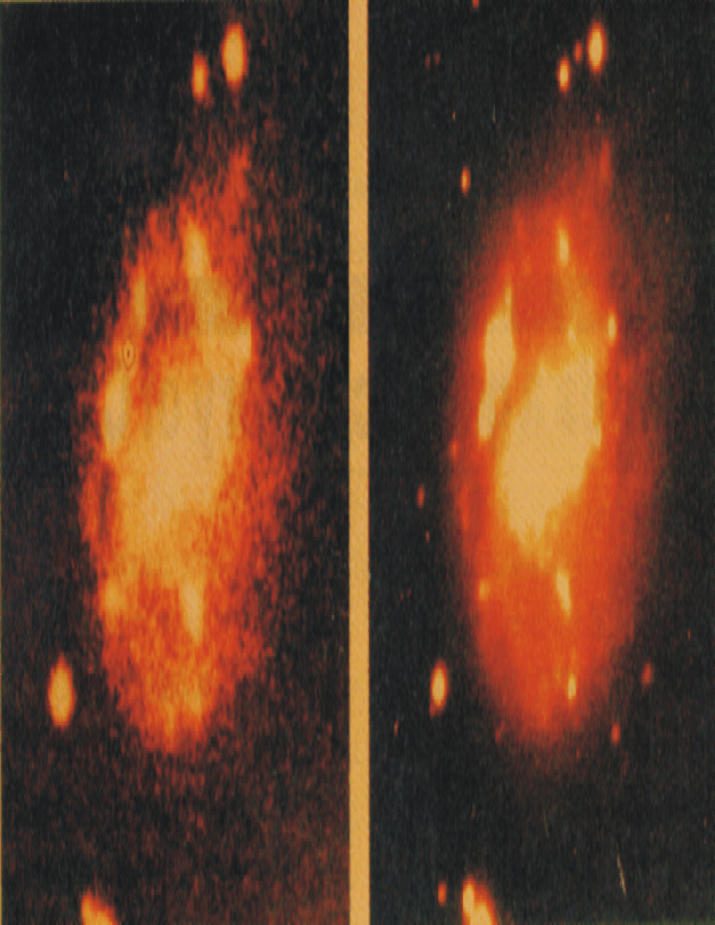
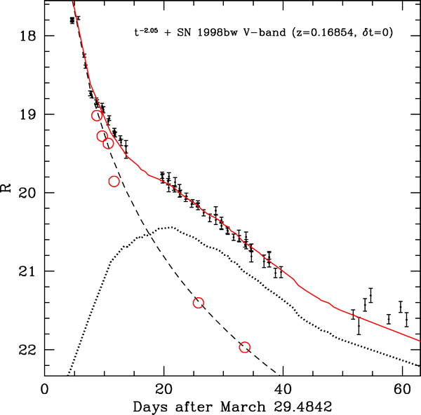
D. Vivolo
BeppoSax: Results
More than 1000 GRB detected:
Connection of GRBs to Supernovae
History
Missions
PhenomenologyFireball
Neutrinos
Perspectives
Host galaxy of SN 1998bw
Spatial and temporal coincidence of GRB 980425 with SN 1998bw (Type Ic)
Matheson et al. 2004
Afterglow light curve can be decomposed into two components: power law decay + supernova bump (SN1998bw redshifted)

Slide 35
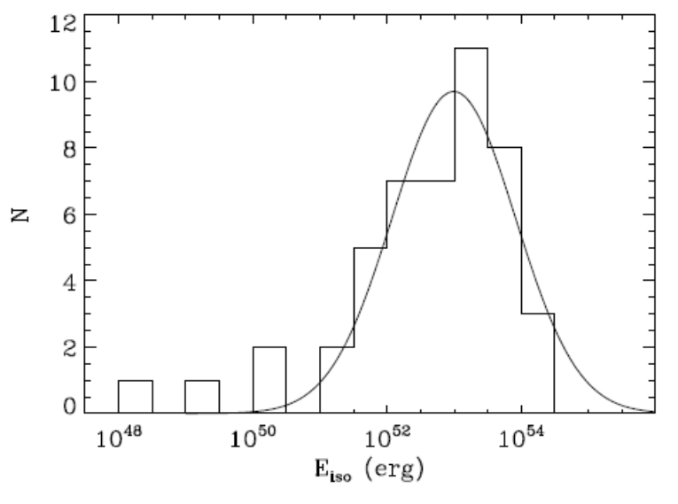
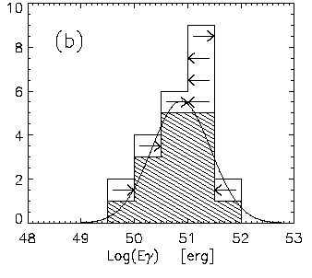
D. Vivolo
BeppoSax: Results
More than 1000 GRB detected:
Amati Relation between E_{pk} and E_{iso}
History
Missions
PhenomenologyFireball
Neutrinos
Perspectives
High dispersion of the gamma-ray energy released E_{iso} assuming isotropy;
Much lower dispersion when Eiso is collimation corrected (E_{γ}), assuming a jet emission.
<log(Eiso)> = 53 σ = 0.9

Slide 36
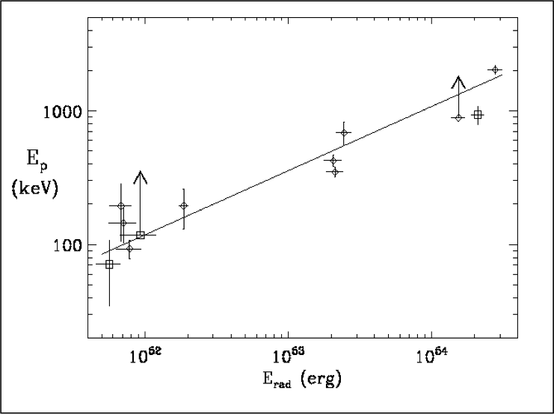
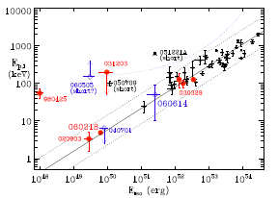
D. Vivolo
BeppoSax: Results
More than 1000 GRB detected:
Amati Relation between E_{pk} and E_{iso}
History
Missions
PhenomenologyFireball
Neutrinos
Perspectives
Found with time averaged spectra of 12 GRBs with known z.
Confirmed by many long (HETE2, SWIFT) GRBs and XRFs of known z.

Slide 37
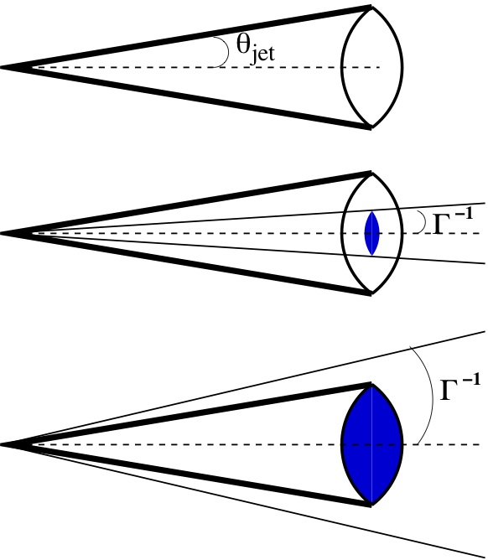
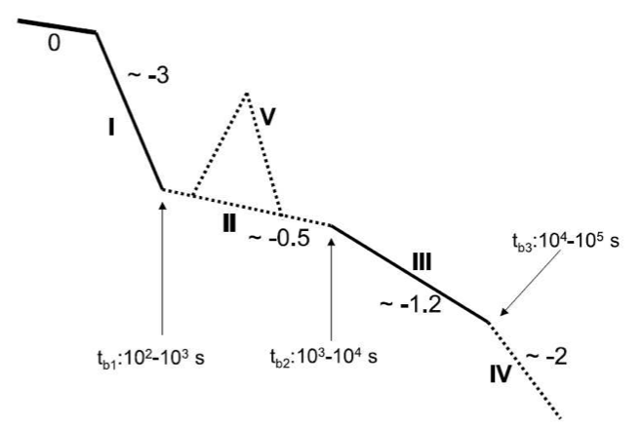
D. Vivolo
Jet emission
Evidence of jet-like emission in the optical afterglow lightcurve
History
Missions
PhenomenologyFireball
Neutrinos
Perspectives
0: prompt emission;
I: tail of the GRB emission (transition from the prompt phase to the afterglow);
II: continuous energy injection by the central engine;
III: normal spherical decay of the afterglow by the decelerating fireball;
IV: decay after the jet break;
V: random flare.
Notes:
Initially, when the object moves ultra-relativistically, the observer only receives signal from within the light cone and has no information from the outside of it. As the jet slows down, the light cone becomes wider and the observer receives emission from regions of the jet, where earlier the observer was outside of those light cones. The whole jet is visible to the observer when 1/Γ = θ, where θ is the opening angle of the jet itself. As the external shock slows down and loses its energy, the afterglow light curve decays as a power-law in time. However, this light curve decay is influenced by the fact that the observer sees an increasing amount of light from the slowing jet. When 1/Γ = θ, the observer sees the complete jet, there is no more emission to compensate for the energy loss and therefore a break in the light curve occurs, followed by the steepening of the decay.

Slide 38

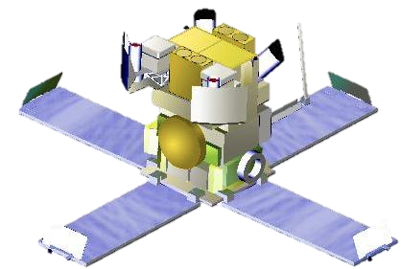
D. Vivolo
HETE: Overview
High Energy Transient Explorer: international collaboration between USA, Japan, France, and Italy, headed by the Center for Space Research at MIT.
HETE-2 Successully launched with a Pegasus launcher, on October 9 2000 from the Kwajalein missile range facility, an atoll in the Pacific ocean.
History
Missions
Phenomenology
Fireball
Neutrinos
Perspectives
The first HETE was lost during the launch on Nov.4, 1996.
Notes:
Originally planned to work for two years, it remained in operation for seven years until it was deorbited and fell into the Pacific Ocean on April 29, 2003.
Satellite per Astronomia X, "Beppo" in honour of the Italian astronomer Giuseppe "Beppo" Occhialini, a pioneer in the study of cosmic rays

Slide 39
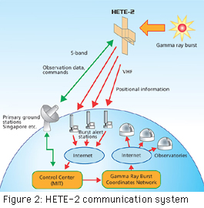
D. Vivolo
HETE: Overview
Primary goals: multiwavelength observation of GRBs and prompt distribution of precise GRB coordinates to the astronomical community for immediate follow-up observations.
History
Missions
Phenomenology
Fireball
Neutrinos
Perspectives
Notes:
Originally planned to work for two years, it remained in operation for seven years until it was deorbited and fell into the Pacific Ocean on April 29, 2003.
Satellite per Astronomia X, "Beppo" in honour of the Italian astronomer Giuseppe "Beppo" Occhialini, a pioneer in the study of cosmic rays

Slide 40
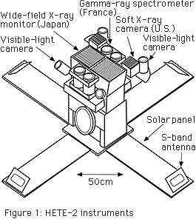
D. Vivolo
HETE: Overview
Total energy range: 1 keV to ~500 keV
GRB location precision; 10 arc-minutes (typical) to as low as 10 arc-seconds.
History
Missions
Phenomenology
Fireball
Neutrinos
Perspectives
Payload:
a set of wide-field γ-ray detectors (FREGATE)
(E=8-500 keV)
a wide-field, medium-energy X-ray imaging system
(E=2-25 keV)
a wide-field, low-energy X-ray imaging system
(E=1-10 keV)
a set of optical imaging cameras
Notes:
Originally planned to work for two years, it remained in operation for seven years until it was deorbited and fell into the Pacific Ocean on April 29, 2003.
Satellite per Astronomia X, "Beppo" in honour of the Italian astronomer Giuseppe "Beppo" Occhialini, a pioneer in the study of cosmic rays

Slide 41
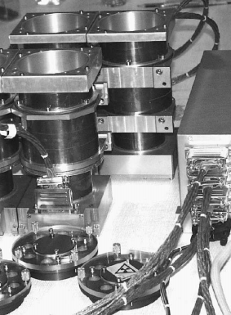
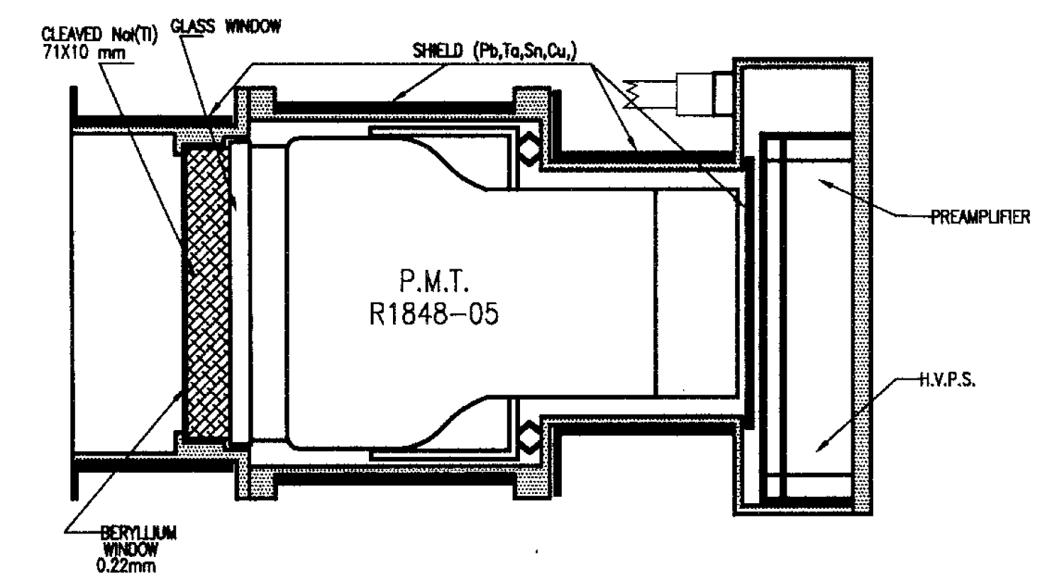
D. Vivolo
HETE: FREGATE
FREnch GAmma TElescope: 4 identical detectors, pointing towards the same direction and co-aligned on the spacecraft in order to share the same ﬁeld of view, but behaving like independent instruments.
History
Missions
Phenomenology
Fireball
Neutrinos
Perspectives
Each FREGATE detector consists of a NaI crystal read by a PMT (Hamamatsu 1848)
Two on-board radioactive sources of Barium 133 illuminate the detectors from the outside, allowing to monitor the gain of the detectors from the ground
Notes:
Originally planned to work for two years, it remained in operation for seven years until it was deorbited and fell into the Pacific Ocean on April 29, 2003.
Satellite per Astronomia X, "Beppo" in honour of the Italian astronomer Giuseppe "Beppo" Occhialini, a pioneer in the study of cosmic rays

Slide 42
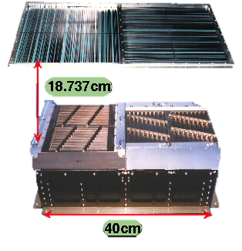
D. Vivolo
HETE: WXM
Wide field X-ray Monitor: quick GRB localization within <20’.
Two identical units of one-dimensional position sensitive X-ray detectors. Oriented orthogonally to each other to measure X and Y directions independently.
History
Missions
Phenomenology
Fireball
Neutrinos
Perspectives
For each WXM unit:
a one-dimensional coded mask with a series of slits of randomly varying width (random mask).
two 1-D position-sensitive proportional counters (PSPCs).
The location of the GRB is determined by measuring a set of two shift distances of the mask pattern in the X and Y direction.
Notes:
Originally planned to work for two years, it remained in operation for seven years until it was deorbited and fell into the Pacific Ocean on April 29, 2003.
Satellite per Astronomia X, "Beppo" in honour of the Italian astronomer Giuseppe "Beppo" Occhialini, a pioneer in the study of cosmic rays

Slide 43
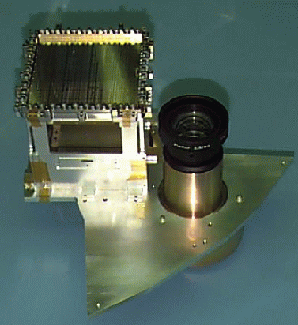
D. Vivolo
HETE: SXC
Soft X-ray Cameras: GRB localization within <20’’.
A set of CCD-based one-dimensional coded-aperture X-ray imagers, similar in function to the WXM.
History
Missions
Phenomenology
Fireball
Neutrinos
Perspectives
Two SXCs: one localizes X-rays parallel to the spacecraft X-axis, the other parallel to the Y-axis. Because of the small CCD pixel size, the angular size of a SXC pixel is only 33 arc-seconds.
Specifics:
Effective Area: 7.4 cm² per SXC;
CCDs: Two 2048x4096 pixels CCDs, 15μm pixels;
Energy Range: 500 eV to 14 keV;
Spectral Resolution: 46eV @ 525eV, 129 eV @ 5.9 keV;
Detector Quantum Efficiency: 93% @ 5 keV, > 20% (0.5-14 keV);
Timing Resolution: 1.2 s;
Field of View: 0.91 sr (FWHM).
Coded Mask
CCD
Notes:
Originally planned to work for two years, it remained in operation for seven years until it was deorbited and fell into the Pacific Ocean on April 29, 2003.
Satellite per Astronomia X, "Beppo" in honour of the Italian astronomer Giuseppe "Beppo" Occhialini, a pioneer in the study of cosmic rays

Slide 44
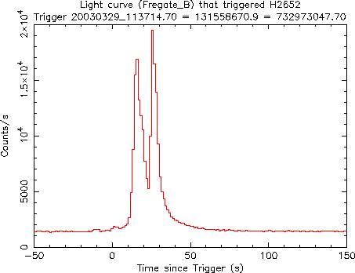
D. Vivolo
HETE: Results
183 GRBs well localized, detected afterglows: 54 X-rays, 51 optical, 27 radio:
HETE-2—localized burst GRB030329/SN2003dh confirms the GRB – SN connection.
History
Missions
PhenomenologyFireball
Neutrinos
Perspectives
z = 0.1675 ⬄ probability of detecting a GRB this close by is ~1/3000
First localization by HETE released after 73 minutes, first optical detection after 37 more
The first burst whose afterglow definitively exhibited characteristics of a SN, confirming the existence of a relationship between the two phenomena
Notes:
Originally planned to work for two years, it remained in operation for seven years until it was deorbited and fell into the Pacific Ocean on April 29, 2003.
Satellite per Astronomia X, "Beppo" in honour of the Italian astronomer Giuseppe "Beppo" Occhialini, a pioneer in the study of cosmic rays

Slide 45
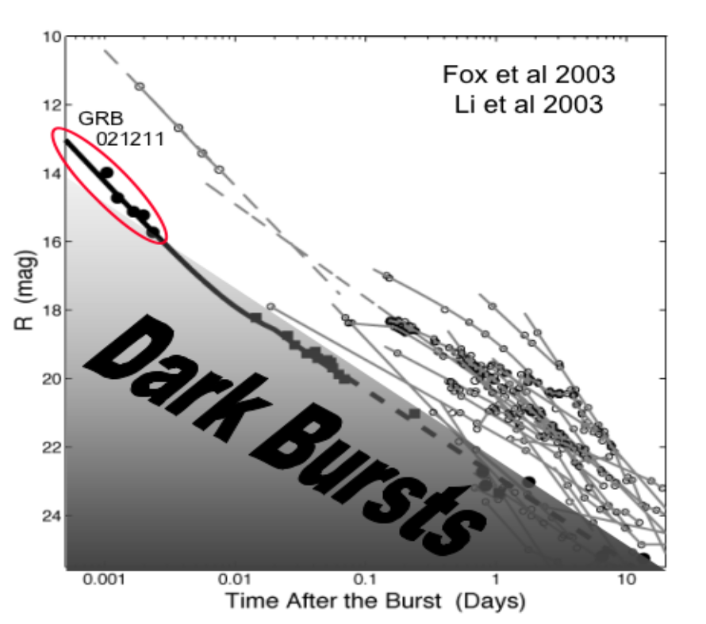
D. Vivolo
HETE: Results
183 GRBs well localized, detected afterglows: 54 X-rays, 51 optical, 27 radio:
Explanation to “optically dark” GRBs
History
Missions
PhenomenologyFireball
Neutrinos
Perspectives
Optical afterglows are extinguished by dust in the host galaxy
GRB021211
The optical afterglow of GRB021211 is much fainter than those previously observed: without HETE’s prompt localization, this GRB would very likely have been listed as “dark”, instead of “dim”.
Notes:
Originally planned to work for two years, it remained in operation for seven years until it was deorbited and fell into the Pacific Ocean on April 29, 2003.
Satellite per Astronomia X, "Beppo" in honour of the Italian astronomer Giuseppe "Beppo" Occhialini, a pioneer in the study of cosmic rays

Slide 46
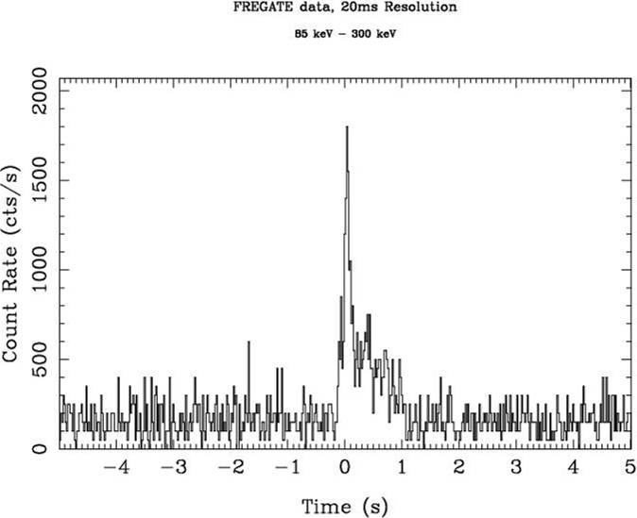
D. Vivolo
HETE: Results
183 GRBs well localized, detected afterglows: 54 X-rays, 51 optical, 27 radio:
The first short/hard GRB to be found with an optical counterpart, leading to a firm establishment of the cosmological origin of this subclass of GRBs.
History
Missions
PhenomenologyFireball
Neutrinos
Perspectives
GRB020531
The first detection of a short, hard GRB that has allowed rapid (t = 2-3 hours) optical and X-ray follow-up observations: none from BeppoSax in 6 years.
X-Ray afterglow detected, no optical detection.
Notes:
Originally planned to work for two years, it remained in operation for seven years until it was deorbited and fell into the Pacific Ocean on April 29, 2003.
Satellite per Astronomia X, "Beppo" in honour of the Italian astronomer Giuseppe "Beppo" Occhialini, a pioneer in the study of cosmic rays

Slide 47


D. Vivolo
SWIFT: Overview
Spacecraft launched into a low-Earth orbit on a Delta 7320 rocket on November 20, 2004
History
Missions
Phenomenology
Fireball
Neutrinos
Perspectives
Multi-wavelength GRBs and afterglow observatory: gamma-ray, X-ray, ultraviolet and optical wavebands
UVOT
Baseline capabilities:
<90s reaction time for X-ray and UV/optical telescopes;
about 100 GRB discovered per year;
0.5-5 arcsec positions for almost every GRB;
spectroscopy: 180-600nm and 0.3-150keV;
results publicly distributed within seconds.
XRT
BAT

Slide 48



D. Vivolo
SWIFT: BAT
Burst Alert Telescope: 32,768 pieces of 4x4x2 mm³ CdZnTe (1.2x0.6 m sensitive area) in a hierarchical structure.
History
Missions
Phenomenology
Fireball
Neutrinos
Perspectives
Coded Aperture Mask
Graded-Z
shield
Optical Bench
Module
Control Box
Radiator
Power
Supply Box
BAT detector array

Slide 49

A Kalman Filter approach for track reconstruction in a neutrino telescope: road to ANTARES
D. Vivolo
SWIFT: BAT
Burst Alert Telescope Specifics
History
Missions
Phenomenology
Fireball
Neutrinos
Perspectives
Coded Aperture Mask
Graded-Z
shield
Optical Bench
Module
Control Box
Radiator
Power
Supply Box
BAT detector array

Slide 50


D. Vivolo
SWIFT: X-Ray Telescope
XRT measures the fluxes, spectra, and lightcurves of GRBs and afterglows over a wide dynamic range covering more than seven orders of magnitude in flux.
History
Missions
Phenomenology
Fireball
Neutrinos
Perspectives
The XRT studies the X-ray counterparts of GRBs beginning 20-70 seconds from burst discovery and continuing for days to weeks.

Slide 51

D. Vivolo
SWIFT: X-Ray Telescope
A composite telescope tube holding the focal plane camera, containing a single CCD-22 detector, a three-phase frame-transfer device achieving an usebul bandpass of 0.2 – 10 keV.
History
Missions
Phenomenology
Fireball
Neutrinos
Perspectives

Slide 52

D. Vivolo
SWIFT: UVOT
Ultraviolet/Optical Telescope
History
Missions
Phenomenology
Fireball
Neutrinos
Perspectives
Uniquely suited for afterglow studies. It has ultraviolet capability which is not possible from the ground and much more sensitivity than any other quick reaction telescope.
UVOT observations enables optimal ground-based observations by providing rapid optical images of the GRB field so that any optical or infrared counterpart can be quickly identified.
Immediately after a GRB is detected and located by the BAT, the spacecraft slews to point both the UVOT and the XRT at the GRB location.

Slide 53


D. Vivolo
SWIFT: UVOT
History
Missions
Phenomenology
Fireball
Neutrinos
Perspectives
The light travels through an open door down the baffle until reducing stray light background. The detector sits in front of the detector power supply between two filter wheels.
The detectors are copies of two micro-channel plate intensified CCD (MIC) detectors from the XMM-Newton/OM design, operating in photon counting mode

Slide 54

D. Vivolo
SWIFT: Results
BATdetects GRBs and positions them to arcmin accuracy;
XRT and UVOT point to the burst location, observing their afterglows and determining positions to arcsec accuracy, all within approximately 100 s;
Alert data from all the three instruments are sent to the ground via NASA's TDRSS relay satellite.
History
Missions
PhenomenologyFireball
Neutrinos
Perspectives
Annual average rate of approx. 105 per year
Swift is detecting GRBs at higher redshift than previous missions due to its higher sensitivity and rapid afterglow observations. The average redshift for the Swift GRBs is 〈z〉=2.3, when compared with 〈z〉=1.2 for the previous observations. z_{max}=8.2!!!
Approximately 8% of Swift GRBs lie at z>5, consistent with model predictions

Slide 55

D. Vivolo
SWIFT: Results
First short GRB X-ray afterglow localization
History
Missions
PhenomenologyFireball
Neutrinos
Perspectives
In contrast to long bursts, the evidence on short bursts is that they can originate from regions with low star-formation rates.
Short bursts can be associated with an old stellar population, and may arise from mergers of compact binaries (NS-NS, NS–BH).

Slide 56

D. Vivolo
SWIFT: Results
investigation GRB afterglows by filling the temporal gap between observations of the prompt emission and the afterglow
History
Missions
PhenomenologyFireball
Neutrinos
Perspectives
In long GRBs, the non-thermal prompt X-ray emission can show:
smoothly transitions into the decaying afterglow;
A steep-to-shallow transition;
Erratic flaring behaviour, lasting long after the prompt phase in approximately 25% of X-ray afterglows.
Example of GRBs with steep-to-shallow transition (GRB 050315), large X-ray flare (GRB 050502B) and more gradually declining afterglow (GRB 050826)

Slide 57
D. Vivolo
SWIFT: Results
Supernova connection and...NON connection!
History
Missions
PhenomenologyFireball
Neutrinos
Perspectives
GRB 060218 lasted longer than any previous burst and was softer than any previous burst, and was associated with SN2006aj at only z=0.033.
The BAT trigger enabled XRT and UVOT observations during the prompt phase of the GRB and initiated multiwavelength observations of the supernova from the time of the initial core collapse.
GRB 060614: low-redshift, long-duration, bright burst (fluence in 15–150 keV band of 2.2×10⁻⁵ erg cm⁻²) with T90 duration of 102 s.
A host galaxy was found at z=0.125 but NO supernova was observed to limits greater than 100 times fainter than previous detections.
Some characteristics shared short bursts
light curve shape similar in many respects to that of several Swift and HETE-2 short-duration bursts and a subclass of BATSE short bursts

Slide 58


D. Vivolo
AGILE: Overview
Astro‐rivelatore Gamma a Immagini LEggero: launched from the Shriarikota ISRO base (Chennai-Madras), India on April 23, 2007.
History
Missions
Phenomenology
Fireball
Neutrinos
Perspectives
Prepared by ASI with the participants INFN&IASF.
Sensitive in the range 30 Mev-50 Gev & 15-45keV.
Large FOV: 1/5 of the entire sky at energies above 30Mev (3 sr)
Payload: three detectors combined into one integrated instrument with broad-band detection and imaging capabilities.
GRID
MC
Super-AGILE

Slide 59


D. Vivolo
AGILE: Super-AGILE
Scientific goals:
photon-by-photon detection and imaging;
simultaneous X-ray and γ-ray spectral studies of high energy sources;
burst trigger for the GRID and MC;
burst alert and quick on-board positioning capability for transient and GRBs.
History
Missions
Phenomenology
Fireball
Neutrinos
Perspectives
4x1D Coded Mask
Sensitive in the range 10-40keV;
excellent timing ≲4 μs;
angular resolution 2arcmin;
FOV ≳1 sr.

Slide 60


D. Vivolo
AGILE: GRID
Gamma-Ray Imaging Detector composed by a Silicon-Tungsten Tracker, a CsI Calorimeter (MC, energy range 25keV-200MeV) and an Anticoincidence System for charged particle background rejection and preliminary direction reconstruction of triggered photons.
History
Missions
Phenomenology
Fireball
Neutrinos
Perspectives
Sensitive in the range 30MeV-50GeV;
Smallest ever obtained deadtime ≲ 200μs;
Source location accuracy 15´;
FOV 2.5 sr.

Slide 61

D. Vivolo
AGILE: Results
SuperAGILE localized ~1 GRB/month, MC about 1 GRB/week ;
uncertainty on the localization: 3 arcmin;
minimum detected fluence: ~5 10⁻⁷ erg cm⁻²;
detected GRBs provided to IPN for triangulation;
History
Missions
PhenomenologyFireball
Neutrinos
Perspectives
AGILE and Fermi LAT will provide a wealth of data on a variety of sources

Slide 62




D. Vivolo
Fermi: Overview
Originally called the Gamma-Ray Large Area Space Telescope (GLAST), the mission was renamed for the physicist Enrico Fermi.
History
Missions
Phenomenology
Fireball
Neutrinos
Perspectives
Spacecraft launched from Cape Canaveral Air Station on June 11th 2008 at 12:05PM EDT (18:05PM Rome)
Large Area Telescope (LAT)
GLAST Burst Monitor (GBM)

Slide 63

D. Vivolo
Fermi: Overview
Originally called the Gamma-Ray Large Area Space Telescope (GLAST), the mission was renamed for the physicist Enrico Fermi.
History
Missions
Phenomenology
Fireball
Neutrinos
Perspectives
Spacecraft launched from Cape Canaveral Air Station on June 11th 2008 at 12:05PM EDT (18:05PM Rome)
Large Area Telescope (LAT)
GLAST Burst Monitor (GBM)

Slide 64

D. Vivolo
Fermi: LAT
Pair-Conversion Telescope
Photon interactions in GLAST energy range dominated by pair conversion:
determine photon direction;
clear signature for background rejection.
History
Missions
Phenomenology
Fireball
Neutrinos
Perspectives
γ
Precision Si-strip Tracker (TKR)
70 m² of Si detectors in 36 planes
AntiCoincidence Detector (ACD)
Conversion foil
Particle tracking detectors
Thermal Blanket and
micro-meteorite shield
e⁺
e–
Electronics system
(flexible, multi-level trigger and online computing)
CsI Calorimeter
The instrument must measure direction, energy and arrival time of gamma rays over a large energy range (~20 MeV to > 300 GeV)
Notes:
The Calorimeter also helps to reject cosmic rays, since their pattern of energy deposition is different from that of gamma rays.

Slide 65





D. Vivolo
Fermi: GBM
NaI (location & low-E spectrum)
History
Missions
Phenomenology
Fireball
Neutrinos
Perspectives
BGO (mid-E spectrum)

Slide 66

D. Vivolo
Fermi: Results
GBM detects ~250 GRBs/year, ~half in the LAT FoV
LAT detected 35 GRBs in 3 years (30 long, 5 short)
10 redshift measurements;
4 joint BAT-GBM-LAT detections
History
Missions
PhenomenologyFireball
Neutrinos
Perspectives
Notes:
Originally planned to work for two years, it remained in operation for seven years until it was deorbited and fell into the Pacific Ocean on April 29, 2003.
Satellite per Astronomia X, "Beppo" in honour of the Italian astronomer Giuseppe "Beppo" Occhialini, a pioneer in the study of cosmic rays

Slide 67


D. Vivolo
Fermi: Results
Fluence in GBM energy range and “GBM” time window
(LAT bursts vs. entire sample in GBM spectral catalog)
History
Missions
PhenomenologyFireball
Neutrinos
Perspectives
LAT bursts are among the brightest GBM bursts
Long GRBs: LAT fluence ~10% of GBM fluence
Short GRBs: LAT fluence > GBM fluence
Notes:
Originally planned to work for two years, it remained in operation for seven years until it was deorbited and fell into the Pacific Ocean on April 29, 2003.
Satellite per Astronomia X, "Beppo" in honour of the Italian astronomer Giuseppe "Beppo" Occhialini, a pioneer in the study of cosmic rays

Slide 68

D. Vivolo
Fermi: Results
Delayed Onset for Fermi LAT Short GRBs high energy emission and Extended GeV Radiation
History
Missions
PhenomenologyFireball
Neutrinos
Perspectives
Notes:
Originally planned to work for two years, it remained in operation for seven years until it was deorbited and fell into the Pacific Ocean on April 29, 2003.
Satellite per Astronomia X, "Beppo" in honour of the Italian astronomer Giuseppe "Beppo" Occhialini, a pioneer in the study of cosmic rays

Slide 69


D. Vivolo
Fermi: Results
Fermi extends the broadband GRB spectrum
History
Missions
PhenomenologyFireball
Neutrinos
Perspectives
GRB 080916C: high energy delay and broadband spectrum
α = -1.02 +/- 0.02 - β = -2.21 +/- 0.03
E_{peak} = 1170 +/- 142 keV
Band function over 6 decades in energy
Spectra fitted with single Band function over up to 6 energy decades
single dominant emission mechanism
Notes:
Originally planned to work for two years, it remained in operation for seven years until it was deorbited and fell into the Pacific Ocean on April 29, 2003.
Satellite per Astronomia X, "Beppo" in honour of the Italian astronomer Giuseppe "Beppo" Occhialini, a pioneer in the study of cosmic rays

Slide 70

D. Vivolo
Fermi: Results
A Hard Component in Long GRBs
History
Missions
PhenomenologyFireball
Neutrinos
Perspectives
Best fit spectrum to interval b (T0+4.6 s to T0 + 9.6 s) is a band function (smoothly broken power-law) + power-law component.
Notes:
Originally planned to work for two years, it remained in operation for seven years until it was deorbited and fell into the Pacific Ocean on April 29, 2003.
Satellite per Astronomia X, "Beppo" in honour of the Italian astronomer Giuseppe "Beppo" Occhialini, a pioneer in the study of cosmic rays

Slide 71

D. Vivolo
Progenitors/1
Long-Soft bursts: Collapsar model
History
Missions
PhenomenologyFireball
Neutrinos
Perspectives
  Death of a massive (> 40 M_{sun}), rotating, low-metallicity star:
    Massive for a core-collapse forming a BH
    Rotating to drive a pair of jet along the rotation axis
    Low-metallicity to retain mass an angular momentum

Slide 72


D. Vivolo
Progenitors/2
Evidences
History
Missions
PhenomenologyFireball
Neutrinos
Perspectives
Long-Soft Bursts are located in star forming region (irregular galaxies, arms of spiral galaxies) were massive stars are always found
Supernovae connection:
  Bump observed in the optical afterglow
  Connection with Type Ib/c (core-collapse supernovae)

Slide 73

D. Vivolo
Progenitors/3
Short-Hard Bursts: NS-NS (NS-BH) merger
History
Missions
PhenomenologyFireball
Neutrinos
Perspectives
  NS-NS (NS-BH) in a binary system will lose energy through gravitational waves
  The 2 objects will get closer until tidal forces rip the NS apart and matter falls into a BH.
  The process has ms timescale
Evidence for the merger model are less striking:
Afterglow localized outside older galaxies
Good candidate for gravitational wave detection
Other progenitor still possible (giant magnetar flares…)

Slide 74
D. Vivolo
The Fireball model
History
Missions
PhenomenologyFireball
Neutrinos
Perspectives
Initial phase
(10^{6.5} cm)
Catastrophic event: core-collapse of a massive star (long GRB): Formation of black hole + accretion disk system which launches a fireball

Slide 75
D. Vivolo
The Fireball model
Most of the gravitational energy is believed to be converted into gravitational waves and thermal neutrinos
History
Missions
PhenomenologyFireball
Neutrinos
Perspectives
(< 1%) is released in a form of a fireball consisting of a tightly coupled plasma of photons, electron-positron pairs and neutrinos (with a small baryonic load)
Environment
Temperature: T ~ 10¹¹ K (20 MeV)
Electrons, positrons: n_{e} ~ 10³⁵ cm⁻³
Baryons: n_{B} ~ 10³² cm⁻³
Neutrino physics dominated by leptonic processes
ν
e±
γ
n
p
Dynamics
The fireball expands by radiation pressure to relativistic velocities.

Slide 76
D. Vivolo
The Fireball model
History
Missions
PhenomenologyFireball
Neutrinos
Perspectives
Initial phase
(10^{6.5} cm)
Catastrophic event: core-collapse of a massive star (long GRB): Formation of black hole + accretion disk system which launches a fireball
Accelerating
phase
(10⁸ cm)
Fireball accelerates to relativistic velocities Γ ~ 300
by radiation pressure; stops due to energy constraints (baryonic load)
Coasting
phase (10¹² cm)
Energy dissipation (shock acceleration):
gamma-ray burst

Slide 77






D. Vivolo
The Fireball model
Accelerating phase
Coasting phase
History
Missions
PhenomenologyFireball
Neutrinos
Perspectives
Fireball model:

Slide 78


D. Vivolo
The Fireball model
History
Missions
PhenomenologyFireball
Neutrinos
Perspectives
e⁻
p
Internal shocks: irregular flow, where faster shells catch up and collide with slower shells: kinetic E ➔ internal E, which is then radiated as synchrotron and inverse-Compton radiation of relativistically shock-accelerated electrons.
Highly variable temporal structure is well reproduced

Slide 79
D. Vivolo
The Fireball model
History
Missions
PhenomenologyFireball
Neutrinos
Perspectives
Initial phase
(10^{6.5} cm)
Catastrophic event: core-collapse of a massive star (long GRB): Formation of black hole + accretion disk system which launches a fireball
Accelerating
phase
(10⁸ cm)
Fireball accelerates to relativistic velocities Γ ~ 300
by radiation pressure; stops due to energy constraints (baryonic load)
Coasting
phase (10¹² cm)
Energy dissipation (shock acceleration):
gamma-ray burst
Afterglow
phase (10¹⁶ cm)
Interaction with external environment: afterglow

Slide 80
D. Vivolo
The Fireball model
History
Missions
PhenomenologyFireball
Neutrinos
Perspectives
Initial phase
(10^{6.5} cm)
Catastrophic event: core-collapse of a massive star (long GRB): Formation of black hole + accretion disk system which launches a fireball
Accelerating
phase
(10⁸ cm)
Fireball accelerates to relativistic velocities Γ ~ 300
by radiation pressure; stops due to energy constraints (baryonic load)
Coasting
phase (10¹² cm)
Energy dissipation (shock acceleration):
gamma-ray burst
Key features
Total energy ~ 10⁵² erg
Lorentz factors ~ 300
Collimation
Small baryonic load
Afterglow
phase (10¹⁶ cm)
Interaction with external environment: afterglow

Slide 81
D. Vivolo
Prompt neutrino emission
In the GRB fireball model the observed gamma rays are produced by synchrotron radiation (possibly followed by inverse-Compton scattering) by relativistic e⁻ accelerated in internal shocks of an expanding relativistic wind.
History
Missions
PhenomenologyFireball
Neutrinos
Perspectives
The proton density in the wind is too low to allow significant conversion of energy to neutrinos through pp collisions.
However
In the region where electrons are accelerated, also protons are expected to be shock accelerated (by Fermi mechanism, up to energies > 10²⁰eV).
Photo-meson interaction with
synchrotron fireball photons
external photons surrounding the newly formed black hole
will produce a burst of high-energy neutrinos (∼10¹⁴ − 10¹⁵ eV) in coincidence with the GRB, with spectrum tracing the GRB photon spectrum.

Slide 82




D. Vivolo
Prompt neutrino emission
collisions of accelerated protons and the observed
γ-rays in the keV–MeV range leading to pion production
History
Missions
PhenomenologyFireball
Neutrinos
Perspectives
The charged pions then decay
further into neutrinos

Slide 83

D. Vivolo
Prompt GRB flux
The target photon field corresponds to the observed prompt GRB flux, typically parameterized by
dN_{γ}(E)/dE∝E^{αγ} for E<ε_{γ} and dN_{γ}(E)/dE∝E^{βγ} for E > ε_{γ}
History
Missions
PhenomenologyFireball
Neutrinos
Perspectives
Guetta et al. (2004), Waxman & Bahcall (1997)
Parameter | Average Value
fγ | 1.3 MeV⁻¹ cm⁻²
ε_{γ} | 0.2 MeV
α_{γ} | 1
β_{γ} | α_{γ}+1

Slide 84

D. Vivolo
Prompt GRB flux
The target photon field corresponds to the observed prompt GRB flux, typically parameterized by
dN_{γ}(E)/dE∝E^{αγ} for E<ε_{γ} and dN_{γ}(E)/dE∝E^{βγ} for E > ε_{γ}
History
Missions
PhenomenologyFireball
Neutrinos
Perspectives
Guetta et al. (2004), Waxman & Bahcall (1997)
If the protons are injected with a power law with injection index two, one obtains for the prompt GRB neutrino flux:
Guetta et al. (2004), Waxman & Bahcall (1997)

Slide 85


D. Vivolo
Energy breaks
The first energy break can be related to ε_{γ} break from the threshold of the photohadronic interactions at the source
History
Missions
PhenomenologyFireball
Neutrinos
Perspectives
The second break comes from pion cooling in the magnetic field.
Highest energy pions lose some energy via synchrotron emission before decaying, thus reducing the energy of the decay neutrinos. The effect becomes important when the pion lifetime τ’_{π} ≈ 2.6 × 10⁻⁸ ε’_{π}/(m_{π}c²) s becomes comparable to the synchrotron loss time.

Slide 86
D. Vivolo
Energy breaks
The first energy break can be related to ε_{γ} break from the threshold of the photohadronic interactions at the source
History
Missions
PhenomenologyFireball
Neutrinos
Perspectives
The second break comes from pion cooling in the magnetic field.
Parameter | Average Value
Γ_{jet} | 300
t_{var} | 0.01 s
ε_{ε} | 0.1
ε_{β} | 0.1
L_{γ}^{iso} | 10⁵¹ erg cm⁻²
ε_{e}: fraction of jet energy in electrons;
ε_{B}: fraction of jet energy in magnetic field;
L_{γ}^{iso}: isotropic luminosity of the GRB;
t_{var}: variability of the γ-ray light curve;
Γ_{jet}: Lorentz boost factor of the jet.

Slide 87

D. Vivolo
Energy breaks
The first energy break can be related to ε_{γ} break from the threshold of the photohadronic interactions at the source
History
Missions
PhenomenologyFireball
Neutrinos
Perspectives
The second break comes from pion cooling in the magnetic field.
Parameter | Average Value
Γ_{jet} | 300
t_{var} | 0.01 s
ε_{ε} | 0.1
ε_{β} | 0.1
L_{γ}^{iso} | 10⁵¹ erg cm⁻²
ε_{e}: fraction of jet energy in electrons;
ε_{B}: fraction of jet energy in magnetic field;
L_{γ}^{iso}: isotropic luminosity of the GRB;
t_{var}: variability of the γ-ray light curve;
Γ_{jet}: Lorentz boost factor of the jet.

Slide 88
D. Vivolo
Energy ranges
Neutrinos mainly from π-µ-e decays, roughly:
ν_{e} : ν_{µ} : ν_{τ} = 1 : 2 : 0;
Arrival at Earth after oscillations:
ν_{e} : ν_{µ} : ν_{τ} ≈ 1 : 1 : 1
History
Missions
PhenomenologyFireball
Neutrinos
Perspectives
Three ranges of energy:
Quasi thermal neutrinos
Tens of MeV
Tens of GeV
Eν>100 TeV
Very high energy
Tens of MeV
Eν>100 TeV
Tens of MeV
In principle detectable by a km3 underwater neutrino telescope
Low energy
Higher detection cross section
expected from the photopion process in pγ interactions
Simulations for finding the correct geometry and granularity for detection are required
Low detection cross section
associated with the stellar collapse or merger event that triggers the burst
occurs only if neutrons are present in the fireball
Significant detection rates predicted
test of the shock acceleration mechanism (E_{p}~10¹⁶ eV)
Prohibitive detection volume

Slide 89

D. Vivolo
WB flux
History
Missions
PhenomenologyFireball
Neutrinos
Perspectives
Guetta et al. (2004), Waxman & Bahcall (1997)
Normalization of the neutrino flux to the actually observed photon fluence.
proton mean free path
shell width
fraction of proton energy going into a pion per interaction
baryonic loading

Slide 90
D. Vivolo
WB flux
History
Missions
PhenomenologyFireball
Neutrinos
Perspectives
Guetta et al. (2004), Waxman & Bahcall (1997)
ν_{μ} fluence of a single burst E_{ν}² dN_{ν} /dE_{ν}≈0.25(f_{π} /f_{e} )F_{γ} /ln(3)
Average neutrino flux per unit time and solid angle
(single burst fluence multiplied by the GRB rate per solid angle)
≈ 10³ bursts per year over 4π sr
Average burst fluence F_{γ} ≈ 6 × 10⁻⁶erg/cm², so:
E_{ν}²Φ_{ν} ≈ 3 × 10⁻⁹(f_{π}/f_{e})GeV/cm²s sr.
Recent GRB afterglow observations imply f_{e} ∼ 0.1
f_{π}/f_{e} ∼ 1.
E. Waxman J.Bahcall arXiv:hep-ph/9807282v2

Slide 91
D. Vivolo
WB flux
History
Missions
PhenomenologyFireball
Neutrinos
Perspectives
Guetta et al. (2004), Waxman & Bahcall (1997)
ν_{μ} fluence of a single burst E_{ν}² dN_{ν} /dE_{ν}≈0.25(f_{π} /f_{e} )F_{γ} /ln(3)
Average neutrino flux per unit time and solid angle
(single burst fluence multiplied by the GRB rate per solid angle)
≈ 10³ bursts per year over 4π sr
Average burst fluence F_{γ} ≈ 6 × 10⁻⁶erg/cm², so:
E_{ν}²Φ_{ν} ≈ 3 × 10⁻⁹(f_{π}/f_{e})GeV/cm²s sr.
Recent GRB afterglow observations imply f_{e} ∼ 0.1
f_{π}/f_{e} ∼ 1.
E. Waxman J.Bahcall arXiv:hep-ph/9807282v2

Slide 92

D. Vivolo
Baerwald flux
Update of GRB neutrino flux considering that:
synchrotron losses are the leading energy loss mechanism;
the source is optically thin to neutrons (secondary interactions are neglected).
History
Missions
PhenomenologyFireball
Neutrinos
Perspectives
Baerwald et al. arXiv:1009.4010v3
Additional neutrino sources
muon decays in the pion decay chain
decay of kaons produced in the photohadronic interactions
The main qualitative difference among charged pions, muons, and kaons are their different masses and lifetimes, leading to different energies of the second (synchrotron) break.
neutron flux
Not stable. Decaying within or outside the source by
leading to CR and to an additional anti-ν_{e} flux.

Slide 93


D. Vivolo
Baerwald flux/2
ν_{e}
ν_{μ}
History
Missions
PhenomenologyFireball
Neutrinos
Perspectives
the main contribution comes from muon decays. neutron decays show up at low energies.
see the hierarchy in the second break energy among neutrinos from μ, π, and K decays.
before mixing - neutrino and antineutrino fluxes are added

Slide 94


D. Vivolo
Baerwald flux/3
Total electron and muon neutrino fluxes superimposed by flavor mixing (averaged neutrino oscillations)
History
Missions
PhenomenologyFireball
Neutrinos
Perspectives
The shaded band indicates the 3σ allowed range of the total flux from current mixing parameter uncertainties.
The expected neutrino flux is about a factor of three to four larger than the WB flux at 1 PeV

Slide 95
D. Vivolo
History
Missions
PhenomenologyFireball
Neutrinos
Perspectives
Two solutions

Slide 96


D. Vivolo
Numeric Fireball Calculation
Numerical model including:
the additional multi-pion, kaon, and neutron production modes,
the synchrotron losses of the secondaries,
adiabatic cooling,
the full energy dependence of the spectra.
History
Missions
PhenomenologyFireball
Neutrinos
Perspectives
Hummer et al. arXiv:1112.1076v3
The statistical error comes from the extrapolation of the quasi-diffuse flux from a few bursts while the astrophysical uncertainty arises from the particular model in use.

Slide 97
D. Vivolo
LIV
Neutrinos that one would not associate to a GRB, when assuming a classical spacetime picture, may well be GRB neutrinos if the possibility that Lorentz invariance is broken at very high energies is taken into account.
History
Missions
PhenomenologyFireball
Neutrinos
Perspectives
IC: no detection of GRB neutrinos neutrino in a data set taken from April 2008 to May 2010 (10 predicted).
Standard GRB-neutrino searches: temporal coincidence with the associated γ-rays or the early afterglow is expected
Violations of Lorentz symmetry seeded in quantum properties of spacetime suggest that GRB neutrinos with energies of a few TeVs and above could be detected systematically much in advance or much after the accompanying electromagnetic signal.

Slide 98
D. Vivolo
LIV
Two IC40 set GRB neutrino events candidates:
History
Missions
PhenomenologyFireball
Neutrinos
Perspectives
1.3 TeV neutrino 1.95° off GRB090417B
det. 2249s before GRB trigger
localization uncertainty of 1.61º
3.3 TeV neutrino 6.11° off GRB090219
det. 3594s before GRB trigger
localization uncertainty of 6.12º
Two IC59 set GRB neutrino events candidates:
109 TeV neutrino 0.2° off GRB091230A
det. 14 h before GRB trigger
localization uncertainty of 0.2º
35 TeV neutrino 4.5° off GRB091026A
det. 30s before GRB trigger
localization uncertainty of 10.5º

Slide 99
D. Vivolo
LIV
Two IC40 set GRB neutrino events candidates:
History
Missions
PhenomenologyFireball
Neutrinos
Perspectives
1.3 TeV neutrino 1.95° off GRB090417B
det. 2249s before GRB trigger
localization uncertainty of 1.61º
3.3 TeV neutrino 6.11° off GRB090219
det. 3594s before GRB trigger
localization uncertainty of 6.12º
Two IC59 set GRB neutrino events candidates:
109 TeV neutrino 0.2° off GRB091230A
det. 14 h before GRB trigger
localization uncertainty of 0.2º
35 TeV neutrino 4.5° off GRB091026A
det. 30s before GRB trigger
LABELED as cr event
localization uncertainty of 10.5º

Slide 100

D. Vivolo
LIV
Quantum properties of spacetime can introduce small violations of the special relativistic properties of classical spacetime.
History
Missions
PhenomenologyFireball
Neutrinos
Perspectives
The time needed for a ultrarelativistic particle to travel from a given source to a given detector is
t=t₀+t_{LIV}.
time predicted in classical space-time
contribution to the travel time due to quantum properties of spacetime
it applies differently to
photons and neutrinos.
Dependance on Cosmology

Slide 101
D. Vivolo
LIV
If t_{LIV}=0, neutrinos are expected to be detected within the same time window of GRB photons.
History
Missions
PhenomenologyFireball
Neutrinos
Perspectives
According to LIV theories, for sufficiently high energies and sufficiently high redshifts t_{LIV} would be large, and the neutrinos would be detected either significantly before or significantly after the time interval when the low-energy photons of the same GRB are observed.
The temporal window should be made considerably larger and contending with background neutrinos may be a severe challenge.
NEW selection criteria
Based on rather tight directional criteria (direction of ν should be consistent within the PSF of the detector with the direction of the GRB potentially associated to it) while the time-window criteria should be relaxed

Slide 102
D. Vivolo
LIV
According to current models, the emission of neutrinos should coincide with the GRB trigger in gamma rays up to a possible advanced emission of a few tens of seconds or a possible delay of emission of about 100 s.
History
Missions
PhenomenologyFireball
Neutrinos
Perspectives
However:
Neutrino energies are determined by IceCube with a 30% uncertainty;
GRB positions are determined very accuratly if X-ray of optical afterglow is observed;
Redshift determination can be achieved if a strong optical afterglow with suitable absorption lines is detected or if a host galaxy is identified.
If one assigns to each candidate GRB neutrino a time offset
t_{LIV}-Δt_{GRB}
where Δt_{GRB} reflects the GRB uncertainties, for all 3 events the inferred value of t_{LIV} is significantly larger than 1000 seconds!

Slide 103

D. Vivolo
LIV
The 3 IceCube events
(horizontal segments reflecting a 30% uncertainty in their energy)
History
Missions
PhenomenologyFireball
Neutrinos
Perspectives
GRBs in the redshift range from 0.9 to 3.
(About 50% of long GRBs with known z)
assumption that the redshifts of the candidate GRB sources all take value between 0.2 and 8.
(More than 95% of long GRBs with known redshift)

Slide 104
D. Vivolo
History
Missions
PhenomenologyFireball
Neutrinos
Perspectives

