Slide 1
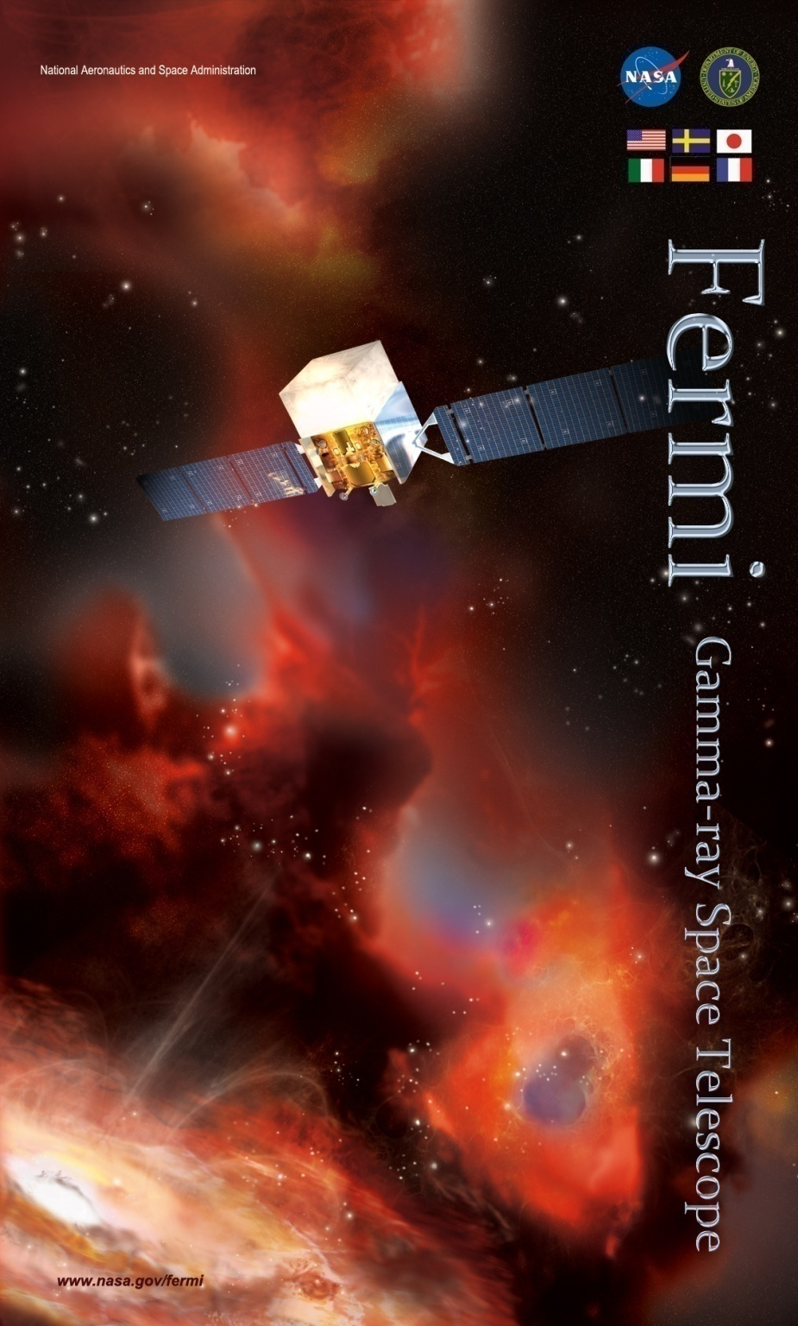
Fermi LAT Collaboration
INFN Team Status Report
Ronaldo Bellazzini
INFN-Pisa
Rappresentante Nazionale Fermi
Riunione Commissione Scientifica Nazionale II
Roma, 30 Settembre 2010

Slide 2
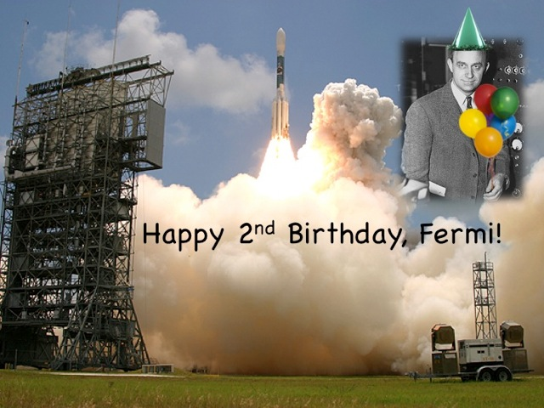
The LAT at 2 years
Observatory status and INFN contributions
Recent science highlights
On-going critical projects

Slide 3
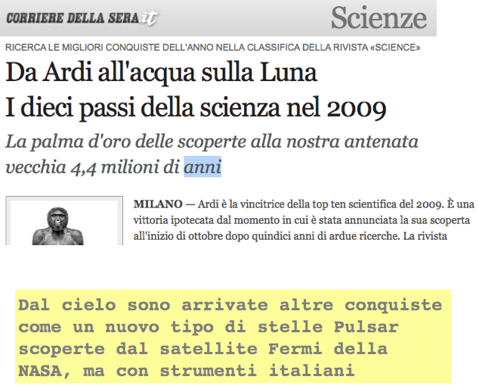
Fermi observations are 2nd most relevant scientific result of the year, Science

Slide 4
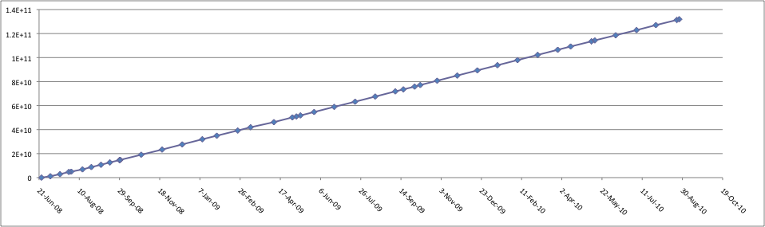
LAT Triggers
The LAT has been read out in orbit more than 130 billion times

Slide 5
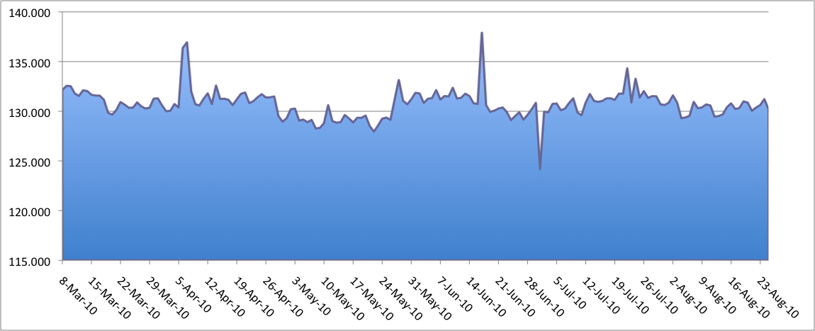
LAT Data Volumes (Gbit/day)
A
D
C
ARs
AR
B
AR
AR
E
A | 5 April 2010 | First TOO of mission: 200 ks (~2.5 days) ToO observation of 3C454.3
B | 29 April 2010 | Changed Rocking Angle from 50 to 45 degrees
C | 27 May 2010 | Changed Rocking Angle back from 45 to 50 degrees
D | 17 June 2010 | Two orbits with GAMMA filter High Energy Pass set to 10 GeV
E | 1 July 2010 | 3 hours for Routine Calibrations

Slide 6
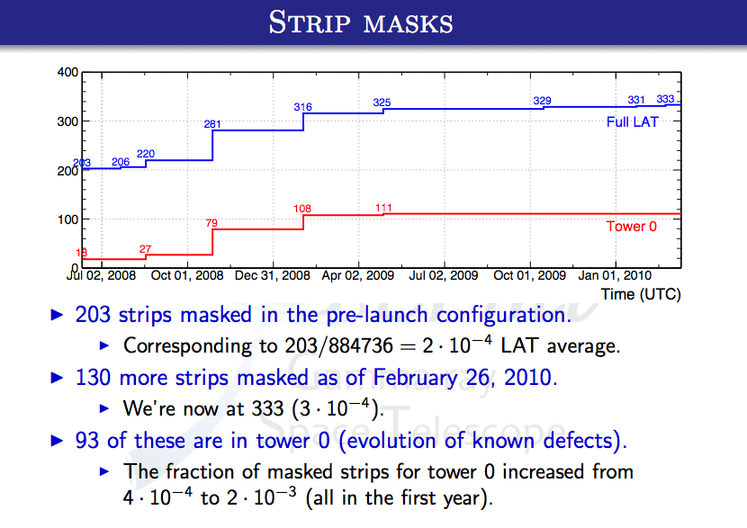

Slide 7
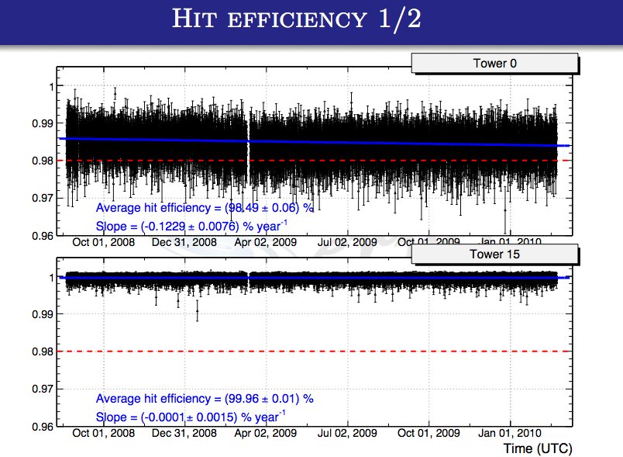

Slide 8
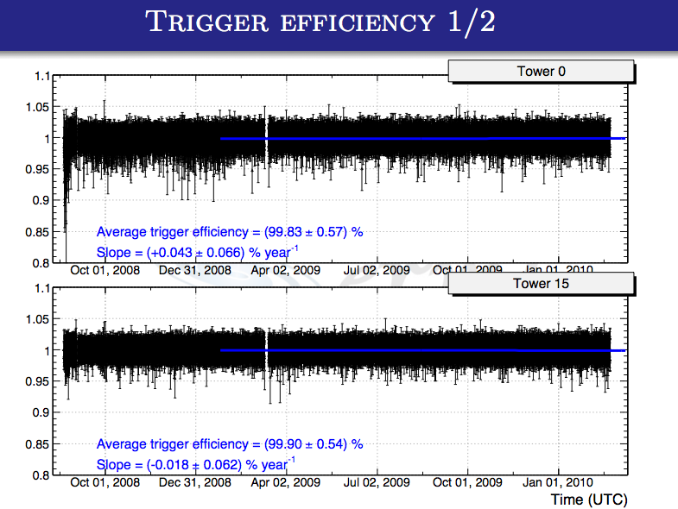

Slide 9
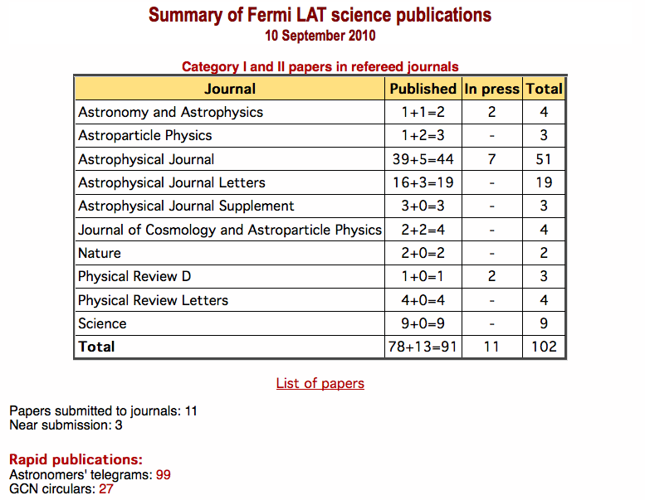
Fermi LAT papers
~25% papers with italian CA

Slide 10
Fermi LAT papers and citations
2,320 citations to date of ~100 Fermi LAT Collaboration papers
# citations
“Measurement of the Cosmic Ray e⁺+ e⁻ Spectrum from 20 GeV to 1 TeV with the Fermi Large Area Telescope” (05/2009)
“The Large Area Telescope on the Fermi Gamma-Ray Space Telescope Mission” (09/2008)
“Fermi/Large Area Telescope Bright Gamma-Ray Source List” (07/2009)
“Fermi Observations of High-Energy Gamma-Ray Emission from GRB 080916C” (03/2009)
“Bright Active Galactic Nuclei Source List from the First Three Months of the Fermi Large Area Telescope All-Sky Survey” (07/2009)
“A limit on the variation of the speed of light arising from quantum gravity effects” (11/2009)
“The First Fermi LAT Catalog of Gamma-Ray Pulsars” (04/2010)
“The First Fermi LAT Catalog of High-Energy Gamma-Ray Sources” (06/2010)
350
298
195
144
159
81
63
57

Slide 11
LAT papers impact
Paper citations (rankings from ADS for papers published since Jan. 2009)
  CR electrons: 350 since May 2009 (#8)
  LAT instrument paper: 298 since June 2009 (#13)
  Bright Source List: 195 since July 2009 (#23)
  LAT Bright AGN Sample: 159 since July 2009 (#38)
  GRB 080916C: 144 since March 2009 (#49)
  CRE interpretation: 89 since Sept. 2009 (#130) [Cat II]
  QG with GRB090510: 81 since Nov. 2009 (#160)
  Vela I: 64 since May 2009 (#256)
  LAT Pulsar Catalog: 63 since April (#262)
  1FGL: 57 since June (#314)

Slide 12
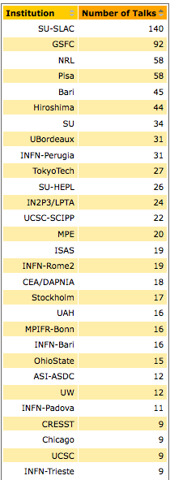
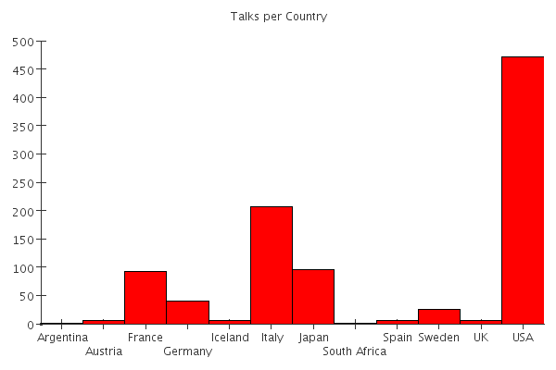
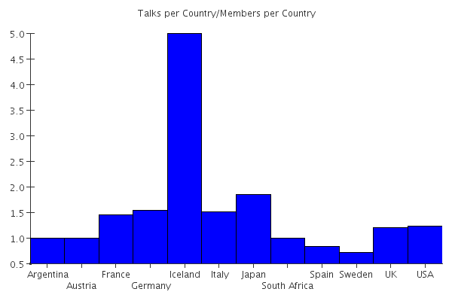
Fermi LAT Talks
Talks per Country (since ~ Sep 2008)
Normalized by members
total
Latronico member of the Speakers Bureau

Slide 13
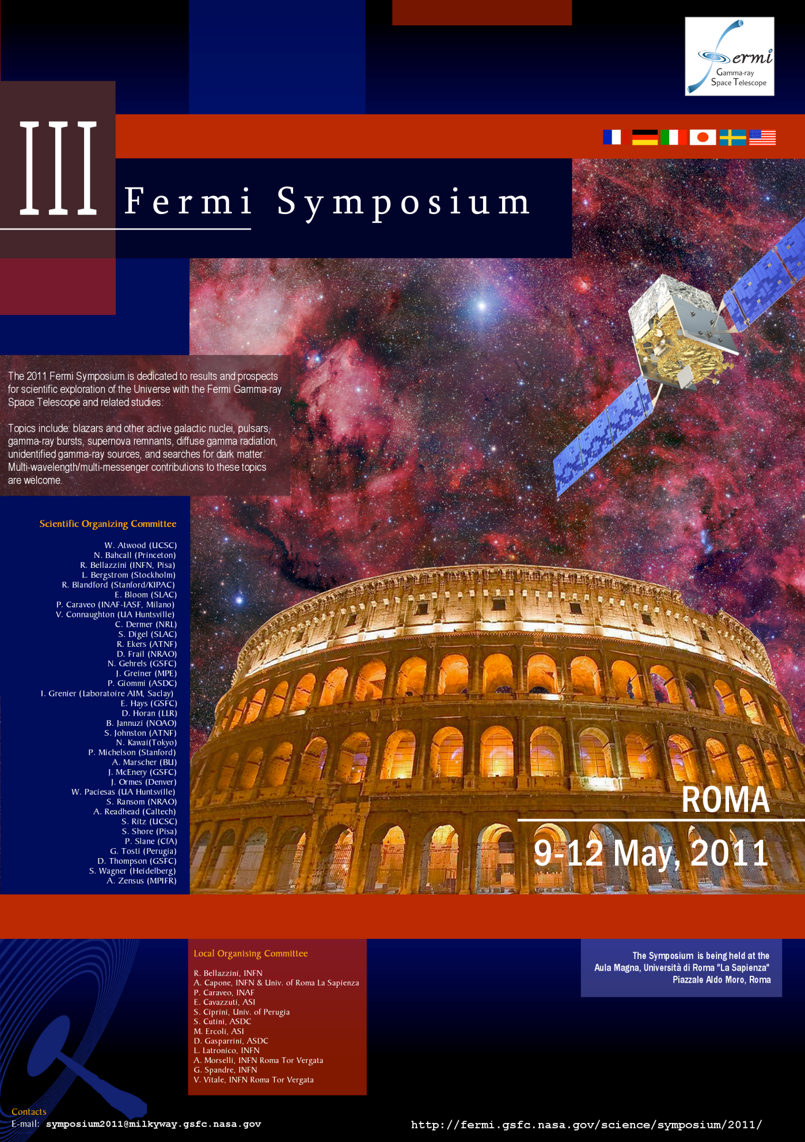
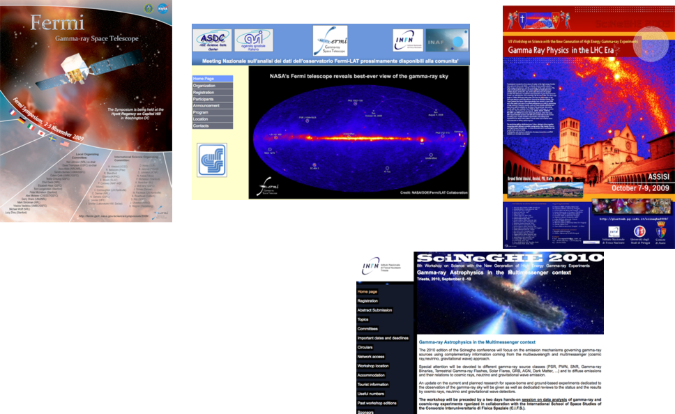
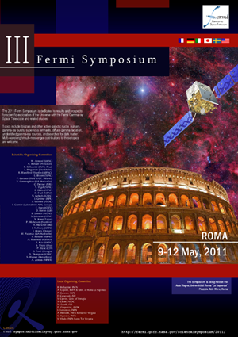

Slide 14
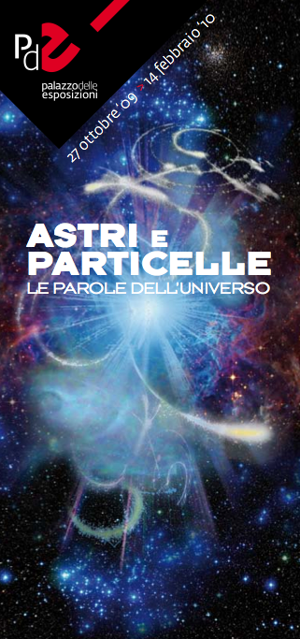

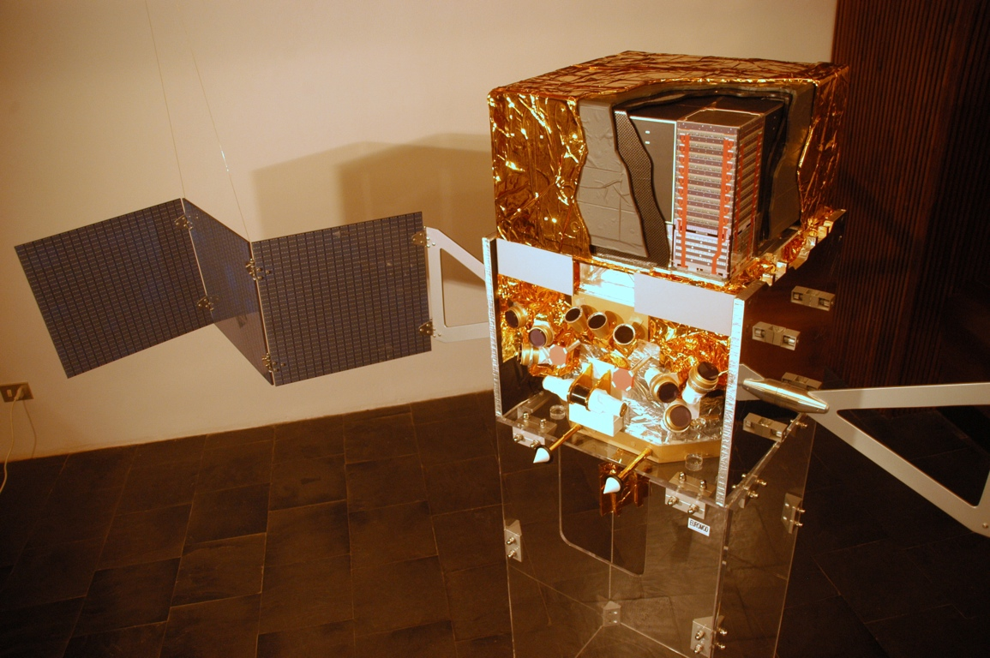
Public Outreach

Slide 15
Fermi LAT Science Working Groups
Analysis coordination
  S.Digel, Gino Tosti (deputy)
Science Working Groups
  Calibration and Analysis Methods (R.Rando, E. Charles)
      Beam Test (Latronico, Bruel)
      IRF development (Rando), IRF monitoring (Cecchi)
  Blazars and other AGNs (E. Cavazzuti, T. Cheung)
  Diffuse and Molecular Clouds (M. Ackermann, J.M. Casandjian)
        Cosmic Rays (Baldini, Monzani)
  Catalogs (D.Thompson, J.Ballet)
  Pulsars, SNR and Plerions (E.J.Grove, P. Saz-Parkinson)
  GRB (J. Chiang, C. Meegan)
  Sources in the Solar System (F.Longo, I. Moskalenko)
  Dark Matter and new physics (L.Latronico, S.Ritz)
All INFN teams are very active in all LAT science areas

Slide 16
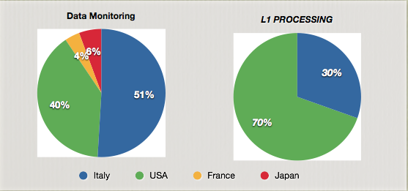
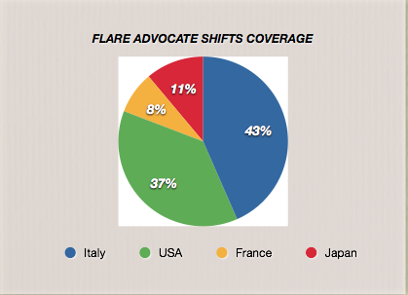
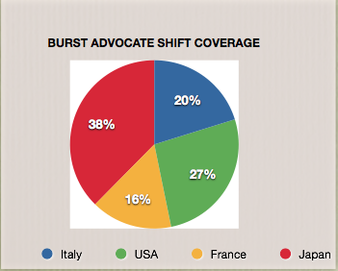
Collaboration Shifts

Slide 17
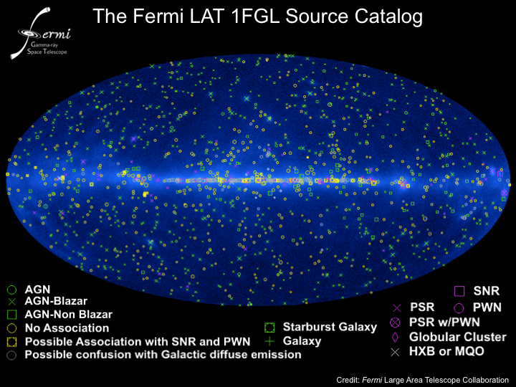
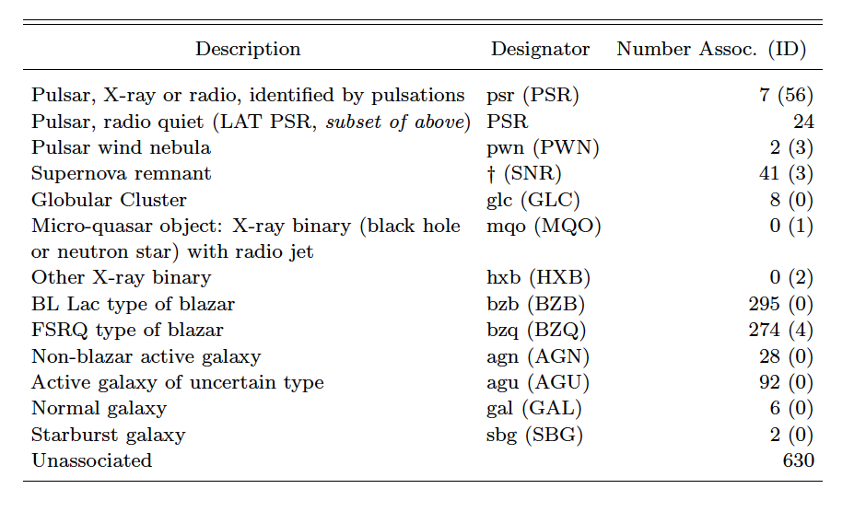
- 1,451 sources; Ap. J. Suppl. 188 405 (2010)

Slide 18
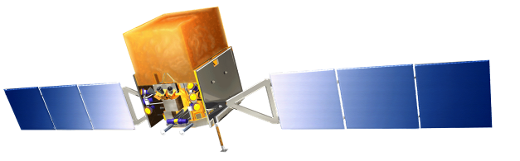
Some science highlights from the past year
Fermi continues to be a finder for millisecond radio pulsars, many in binary systems (nearly 20 to date)
SNR and hints to the gamma-ray / CR connection
discovery of high-energy gamma-ray emission from novae outburst
  “Gamma-Ray Emission Concurrent with the Nova in the Symbiotic Binary V407 Cygni”, Science 329, 817 (2010)
CRE spectrum extensions and anisotropy constraints
Constraints on dark matter from LAT observations of dwarf spheroidal galaxies, diffuse radiation, and clusters of galaxies
GRB summary
Solar System sources

Slide 19
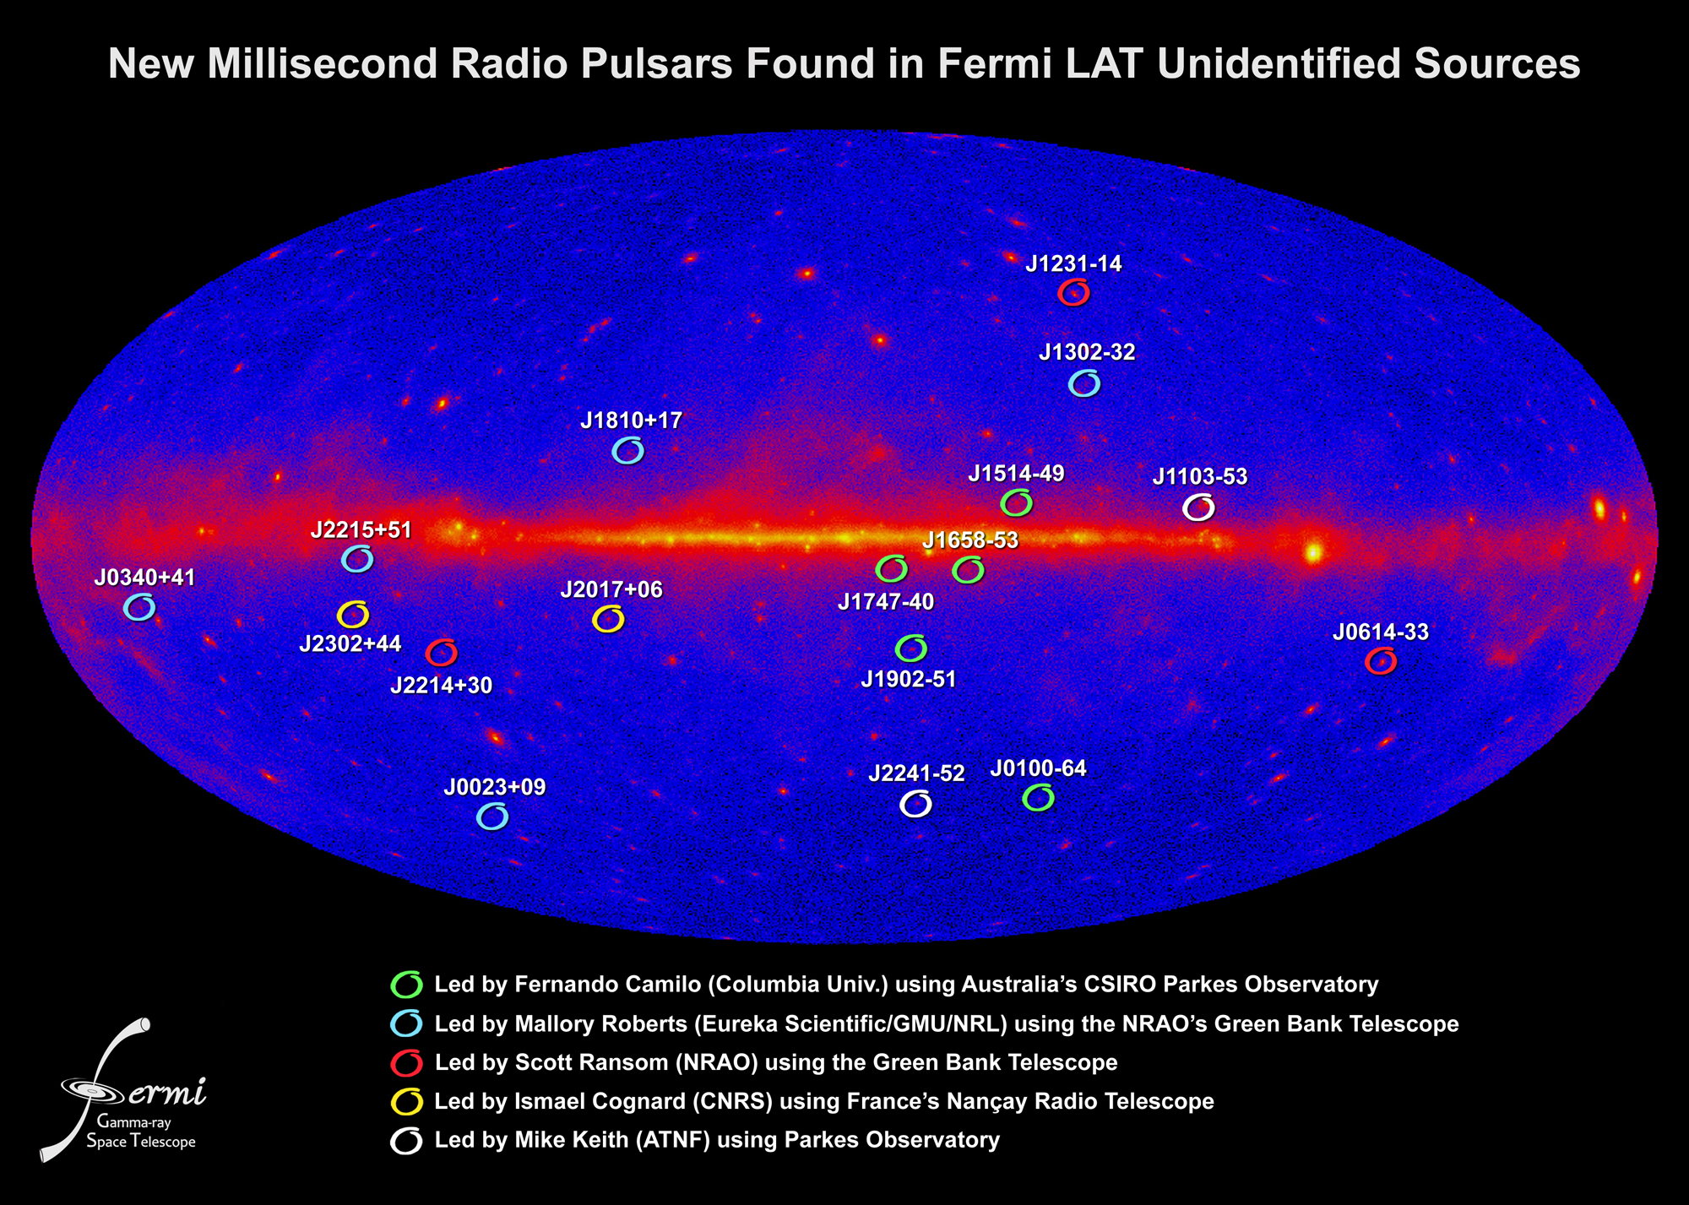
Fermi: a finder for millisecond pulsars

Slide 20
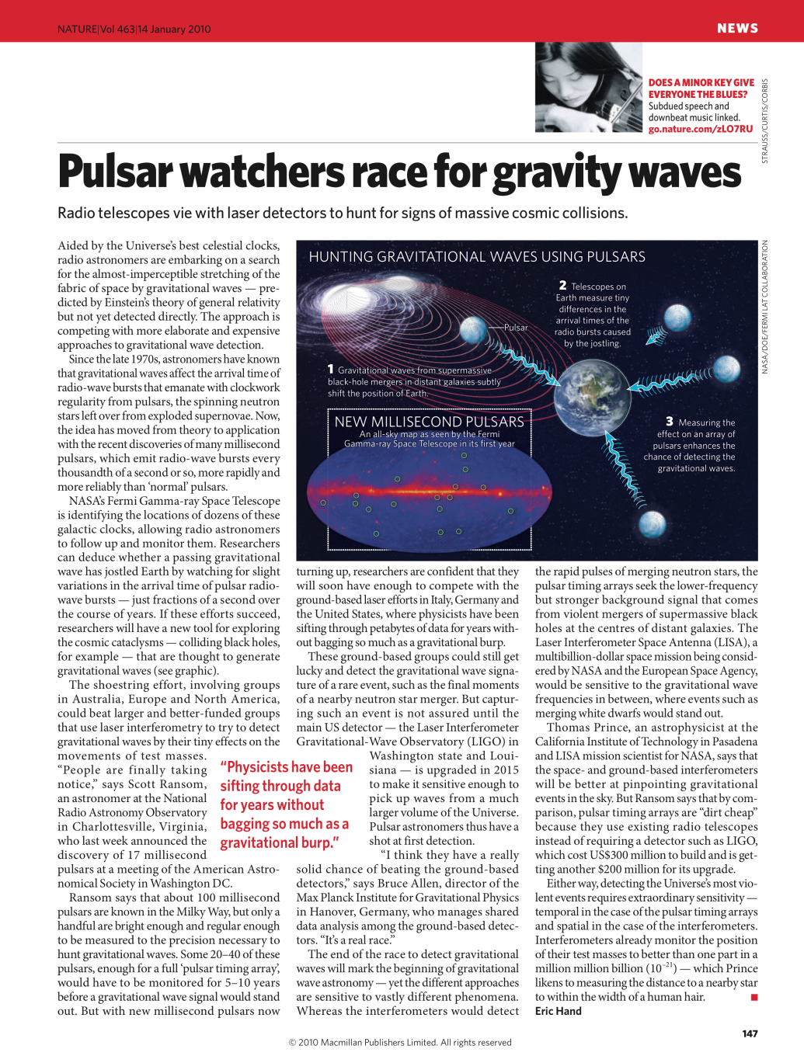
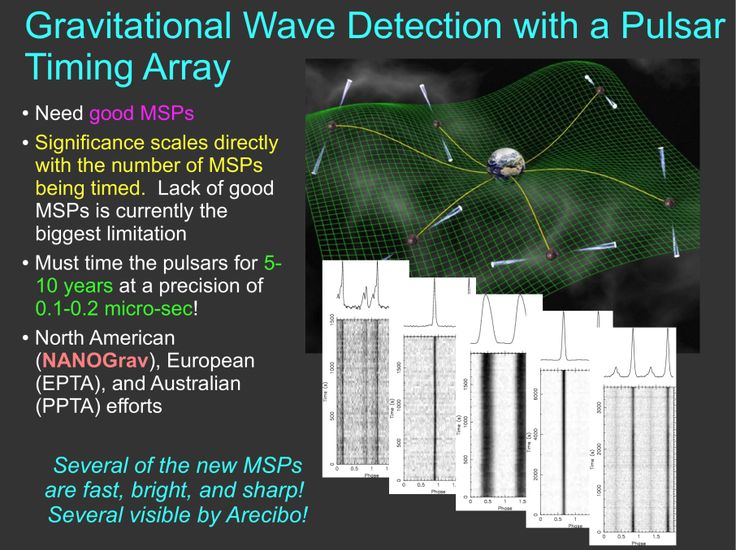
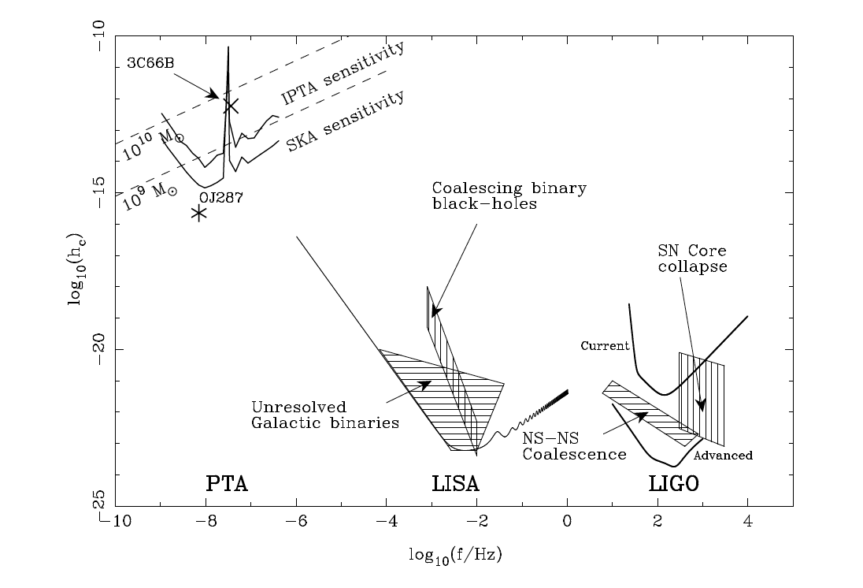
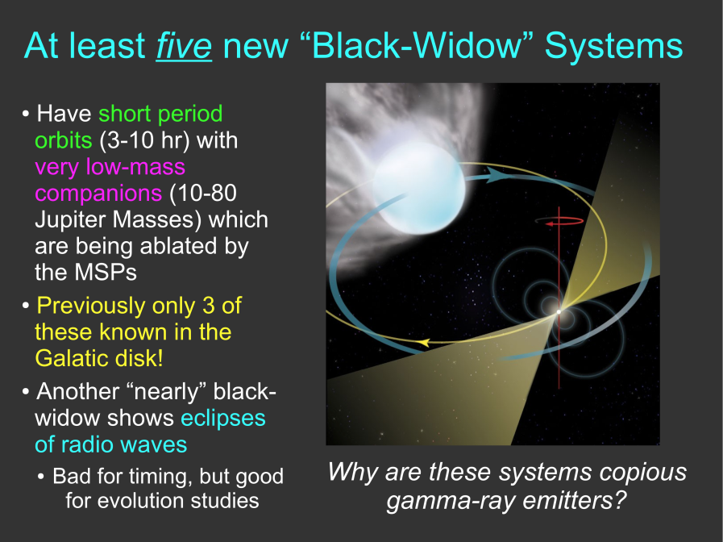
Fermi: millisecond pulsars
Scott Ransom (NRAO), HEAD meeting talk, March 2010
Nature January 14, 2010

Slide 21
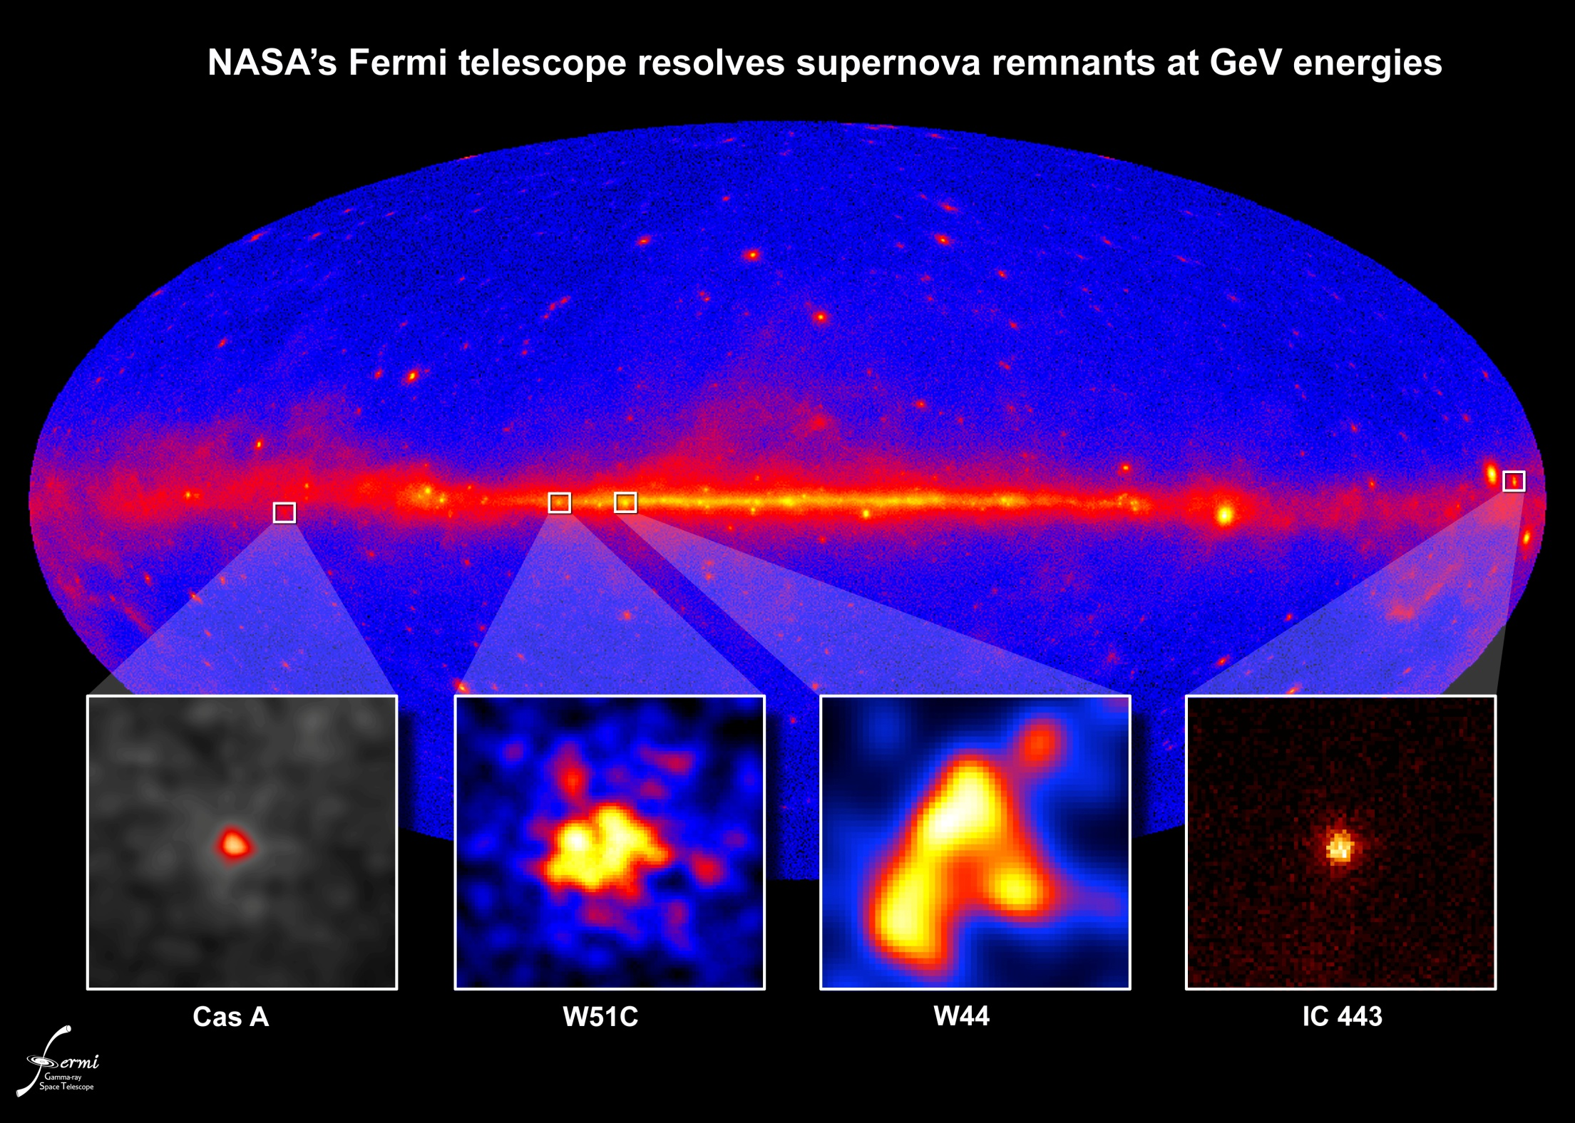
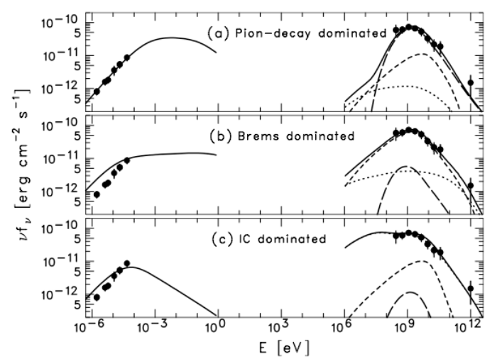
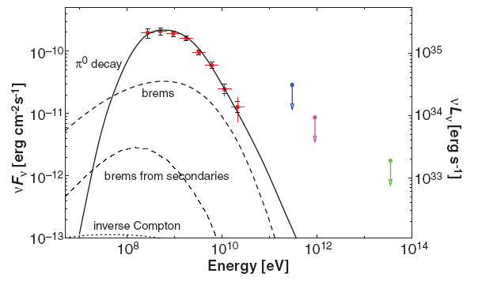
W44
2010, Science, 327, 1103
W51C
2009, ApJ, 706, L1
Hadronic acceleration favored, leptonic not excluded

Slide 22
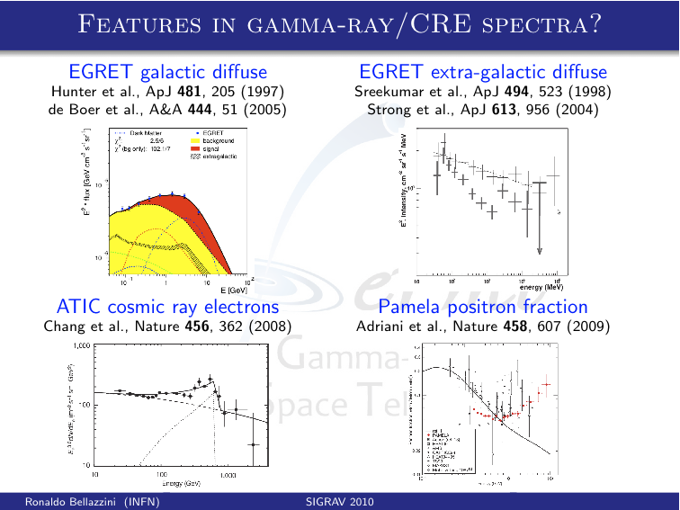

Slide 23
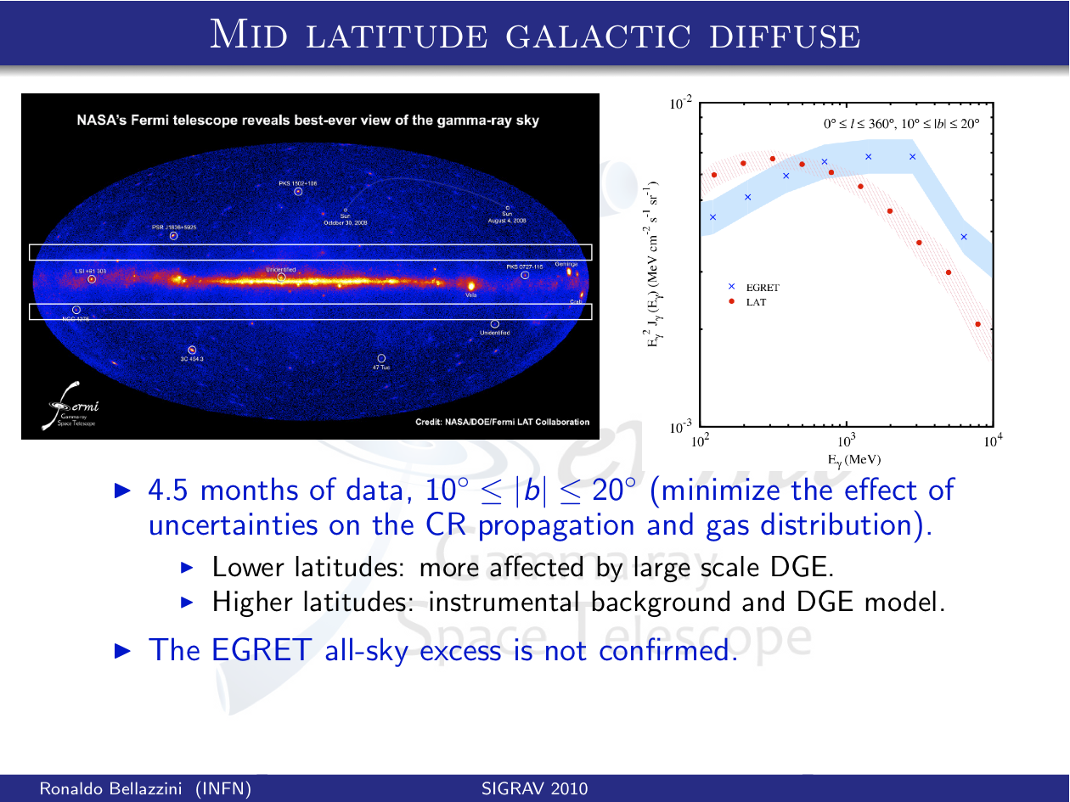

Slide 24
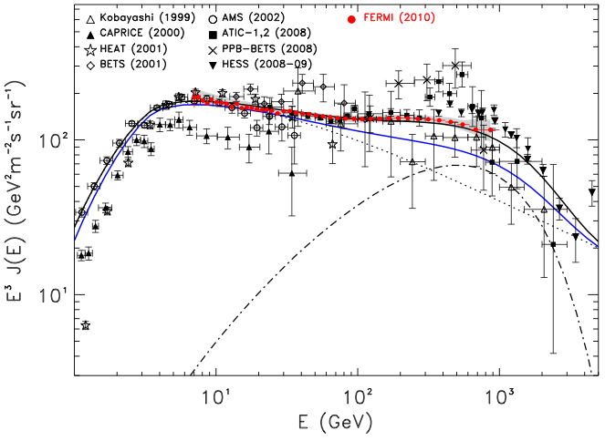
Cosmic-Ray Electron Spectrum
Accepted for publication in Physical Review D, arXiv.1008.3999
7 GeV – 1 TeV - extension of Phys. Rev. Lett. 102, 181101 (2009)
Notes:
Dubus

Slide 25
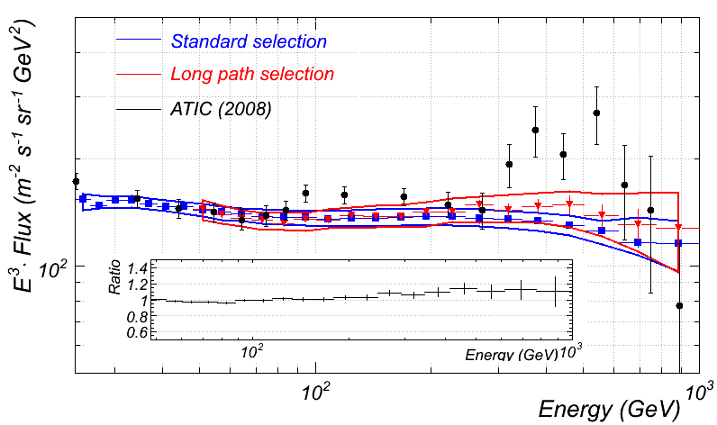
Cosmic-Ray Electron Spectrum
Spectrum for subset of events with X0>13 consistent with PRL
Up tp ~4X energy resolution, ~5% acceptance and higher systematics

Slide 26
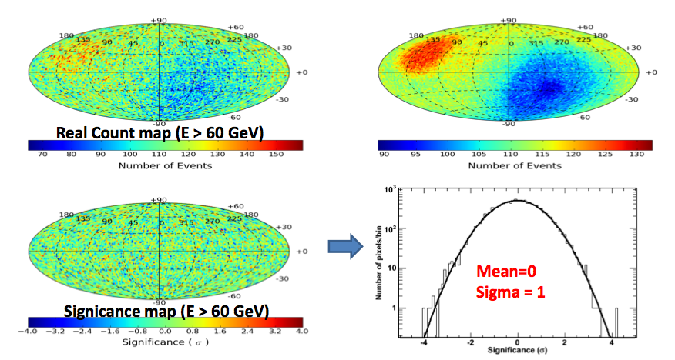
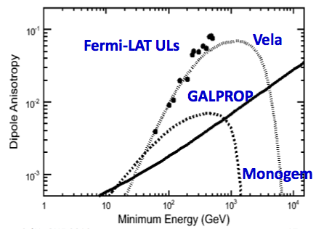
CRE Anisotropy Searches
No-Anisotropy Count map (E>60 GeV)
Accepted for pubblication in PRD (online on Sept. issue
arXiv:1008.5119

Slide 27
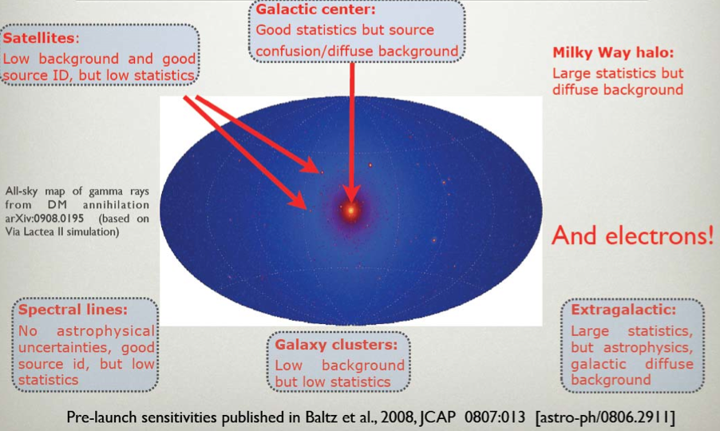
Dark Matter Search Strategies
2010, ApJ, 712, 147
2010, PRL 104, 091302
2010, JCAP, 04, 014
2010, JCAP, 05, 025
No detection so far, but
Upper limits start cutting into interesting parameter space
  <σv> ~ 10⁻²⁵ cm³s⁻¹ from Dwarph Spheroidal and cluster searches

Slide 28
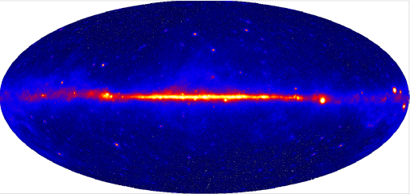
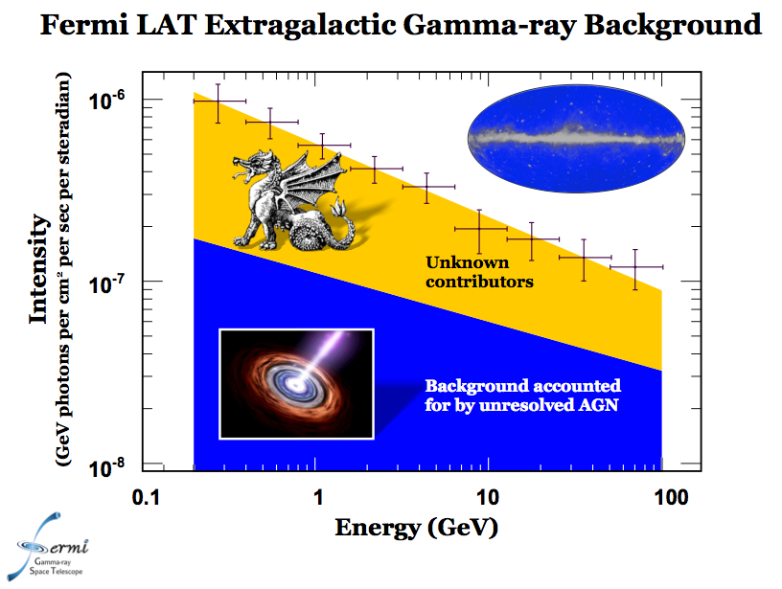
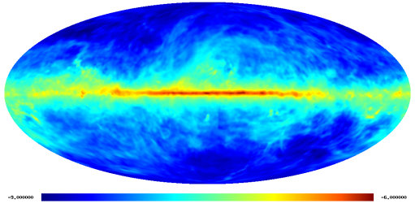
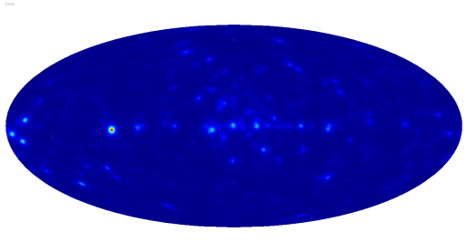
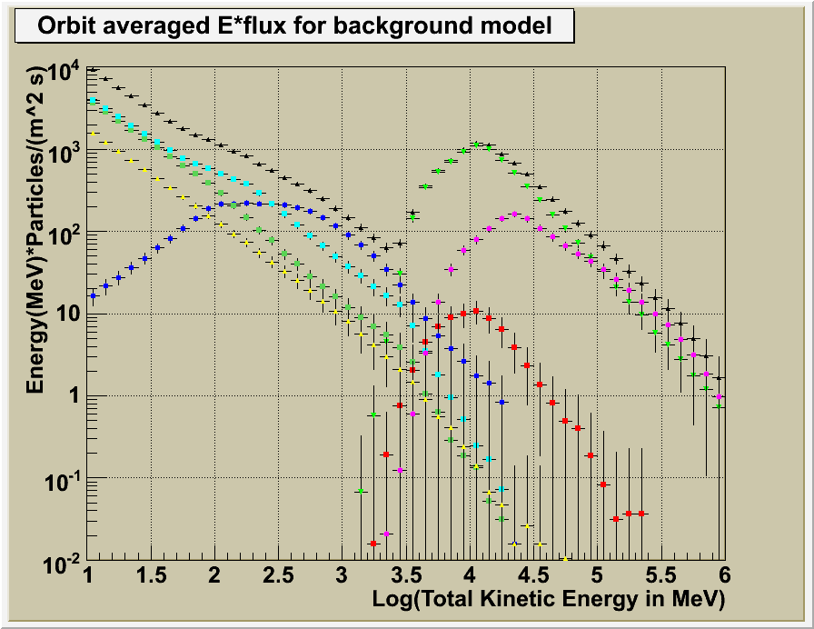
LAT sky
=
γ-ray sky
gal. diffuse
2010, PRL 104, 101101
+
Galactic diffuse model
point sources
+
2010, ApJ, 720, 435
Known sources
isotropic
Residual instrumental bkg
Spectrum is softer than EGRET and appear as a power-law
Unresolved AGNs contribute no more than 30%

Slide 29
?

Slide 30
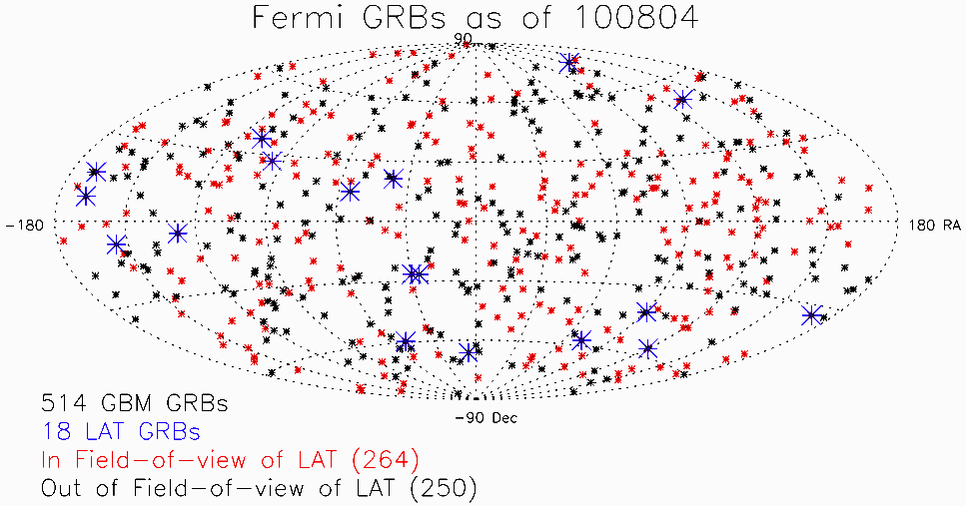
Two years of Fermi Bursts
20 “Official” LAT-detected bursts as of 100903 (GCN Circulars)
LAT Catalog efforts and use of LLE technique have found several more.
http://fermi.gsfc.nasa.gov/ssc/observations/types/grbs/grb_table/

Slide 31
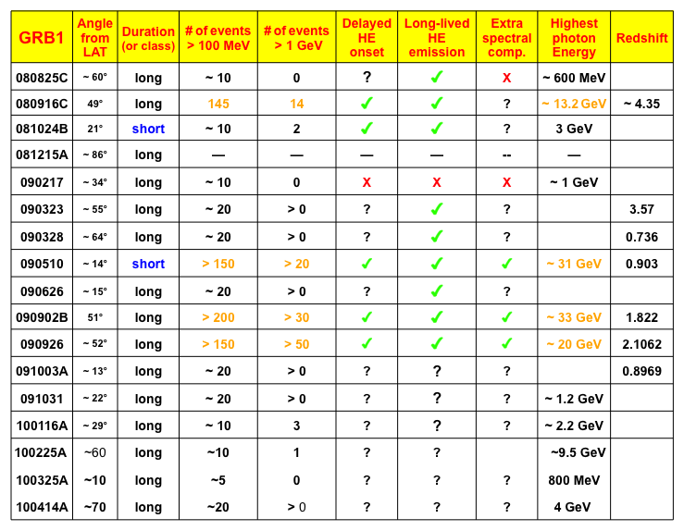

Slide 32
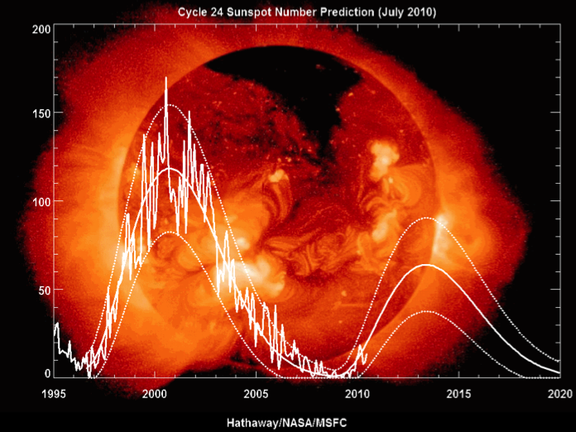
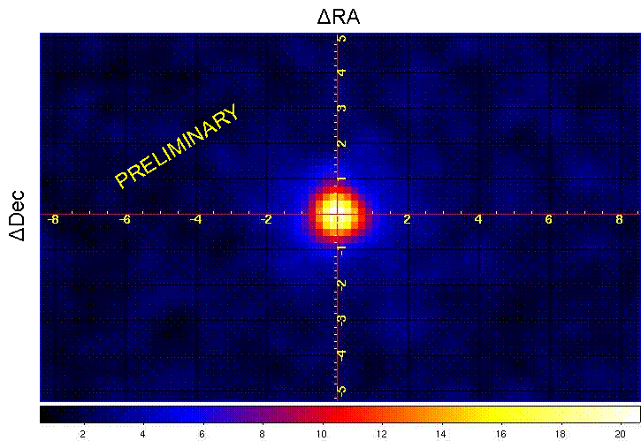
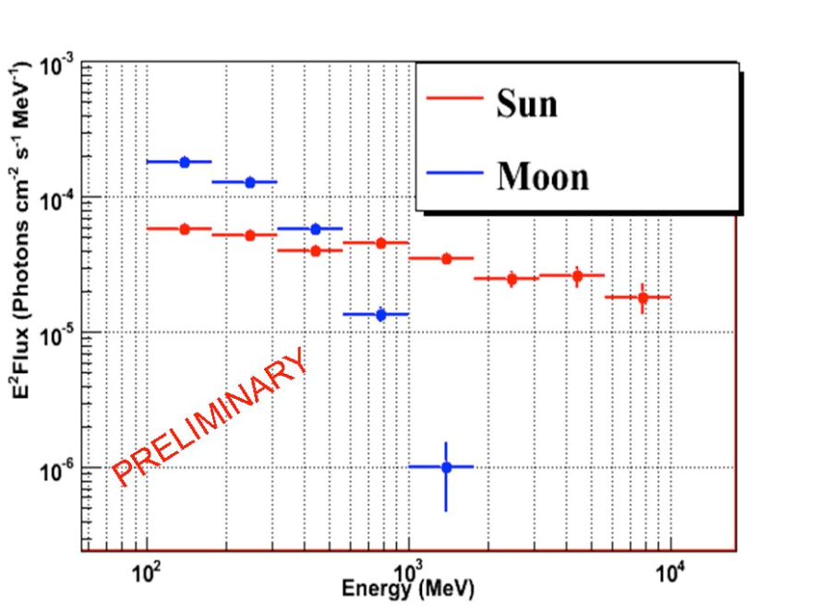
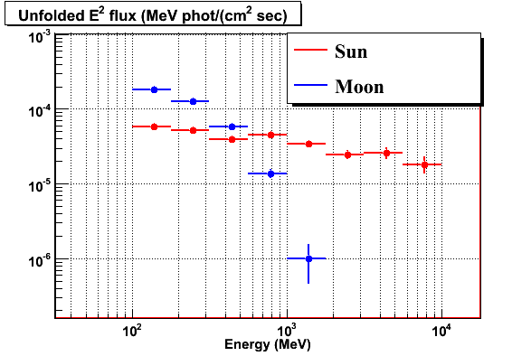
Fermi – The quiet Sun

Slide 33
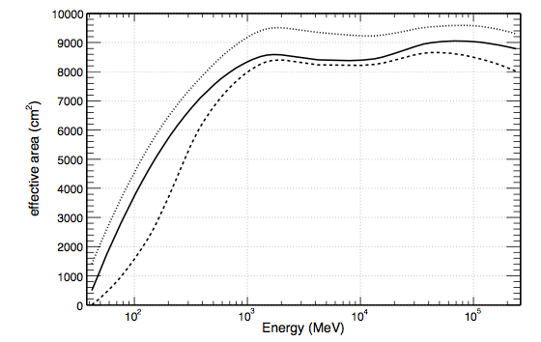


Pass6
  Definition: pre-launch rejection + post-launch fixes
  Use: 2 years of science, reference
Pass7
  Definition: new event classes
  Use: 2FGL and year 3 science, reference for systematics
Pass8
  Definition: fully renewed event sim/rec/event-analysis package
  Use: >year4 science, new science capabilities

Slide 34

Example event with a ghost track
Bad choice for the gamma-ray candidate
Out-of-time Ghost hits
Ghostly hits in the CAL too

Slide 35

Corrected TKR event reconstruction
Much better gamma-ray candidate
Ghost hits detected and ignored.

Slide 36
Beyong ghosts
Expected improvements
Improved subsystems recon
  CAL clustering
  TKR Pat Rec
  ACD recon with better TKR and CAL projections
    Improve on Energy and angular resolution
CR finder
Improved MVA tools
Improved mass model and updated Geant4

Slide 37
Conclusions
The LAT science program is rich and diverse
  Astrophysics of the GeV sky
  More and more astroparticle physics
    CR, GW spin-off, connections to neutrino astrophysics
Significant efforts to improve and extend LAT performance to beat the sqrt(T) rule (Pass8, LLE
INFN teams prove key contributions to the science and the collaboration thanks to solid INFN support (financial, computing)

