Slide 1
From NEMO to KM3NeT-Italy
Carlo Alessandro Nicolau
on behalf of the
KM3NeT-Italy Collaboration

Slide 2
The NEMO Phase 2 project
  The Capo Passero Site
  The NEMO Phase 2 prototype tower
The KM3NeT-Italy project
  Communication architecture
  New electronics
Conclusions

Slide 3
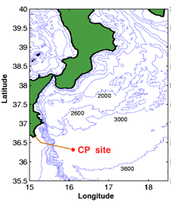
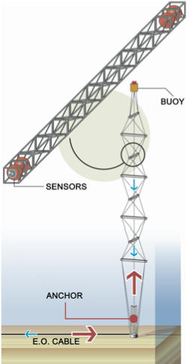
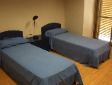
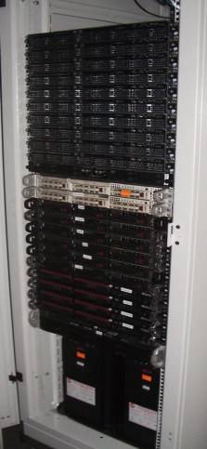
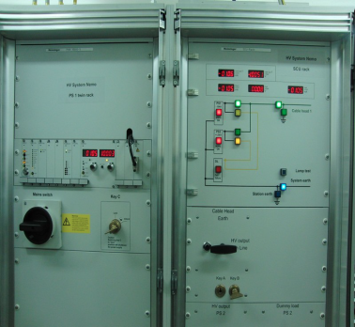
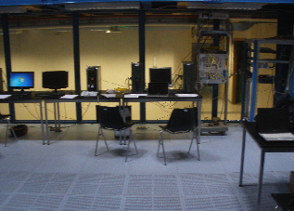
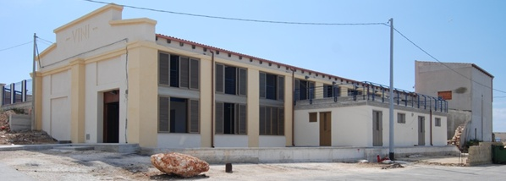
Capo Passero site Infrastructure
And
the NEMO Phase 2 Tower
NEMO Phase 2
Tower
On-shore
Off-shore
Guest House
Power Feeding Equipment
Control Room
DAQ
Shore Laboratory in Capo Passero harbour
BT
2 x opt. fib.
MVC
&
Opt. splitter
20 x opt. fib.
375VDC
10 kV
Operating since
Apr. 2013
~100 km

Slide 4
NEMO Phase 2 Tower
Main characteristics:
8 “Floors”:
  8 m in length
  40 m vertical distance
8 x 4 Optical Modules:
  PMT signal acquisition
8 x 2 Hydrophones:
  Continuous sampling at 24 bit / 192 kHz
Calibration sensors
  Laser beacon
  LED-beacon, TIM-CAL
Oceanographic Sensors:
  Conductivity/Temperature/Depth
  Transmissivity
  Current speed meter
Fully synchronous communication protocol:
  Each device of the apparatus is “timestamp-aware” by design
  Compatible with DWDM standard
  Reduced number of optical fibers
All data to shore

Slide 5
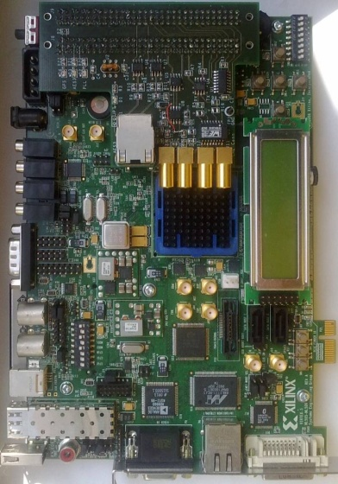
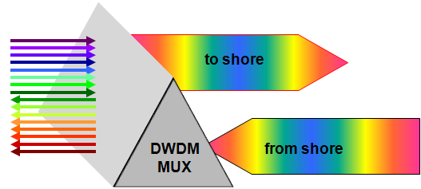

NEMO Phase 2 Point to point link
NEXT FLOOR
Floor Control Module
TRANSCEIVER DWDM
RX
DROP
TX
ADD
PREV. FLOOR
on-shore
lab
EFCM

Slide 6
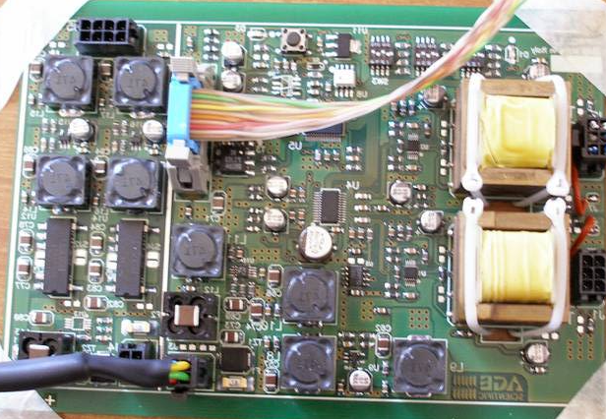
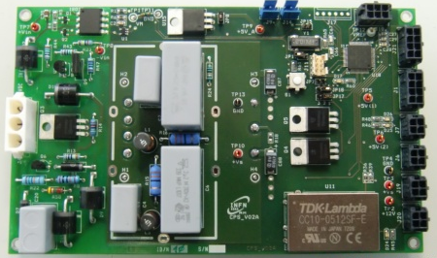
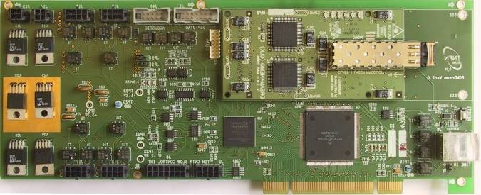
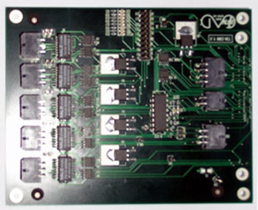
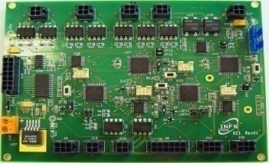
NEMO Phase 2 Floor
Hydrophones
NEXT FLOOR
12V
5.5V
4.2V
backbone
AcouDAQ
RS-485
CPS
375VDC
CPS
ADD/DROP
FCM
backbone
TimCTRL
SCI
RS-232
CTD / CSTAR / DCS
PREV. FLOOR

Slide 7
NEMO Phase 2 Optical Module Electronics
reach upper
floor OMs
Ext. Sensor
LED-Beacon
Controller
LED
Pulser
RFID Reader
Control (I2C)
Trigger
Power
LV RS232
HV
PSU
Front End Module
CLOCK
TO/ FROM FCM
DIN / VCC
Power
Control
Monitor
DOUT / GND
TIM-CAL

Slide 8
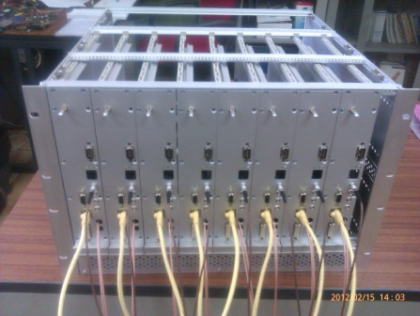
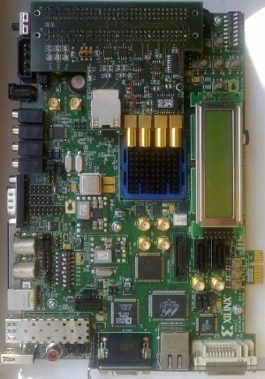
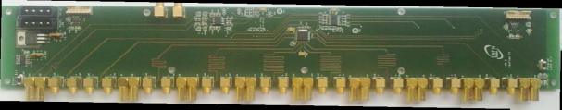
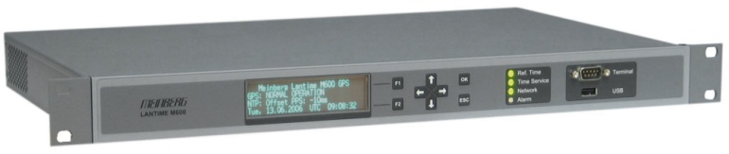
NEMO Phase 2 Timing distribution
On-Shore
Off-Shore
Ethernet Floor
Control Module
Clock / Data / Timing
Embedded in a single bitstream, carried by a single DWDM wavelength
To other EFCMs
FCM
Timing distribution board
Absolute Time Information
GPS receiver

Slide 9
NEMO Phase 2 Data distribution
DWDM MUX
TriDAS
ETHERNET
AES3
Power
Control
Control Room
Slow Control
Media
converter
Audio

Slide 10
KM3Net-Italy project layout
KM3
Net-IT
T#1
Phase 2
Tower
KM3
Net-IT
T#5
2 x opt. fib.
375VDC
KM3
Net-IT
T#2
KM3
Net-IT
T#6
2 x opt. fib.
Junction
Box
375VDC
Main E/O Cable
20 x opt. fib.
6kV
KM3
Net-IT
T#3
KM3
Net-IT
T#7
KM3
Net-IT
T#4
KM3
Net-IT
T#8

Slide 11
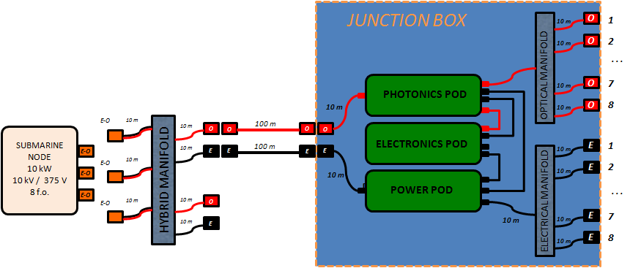
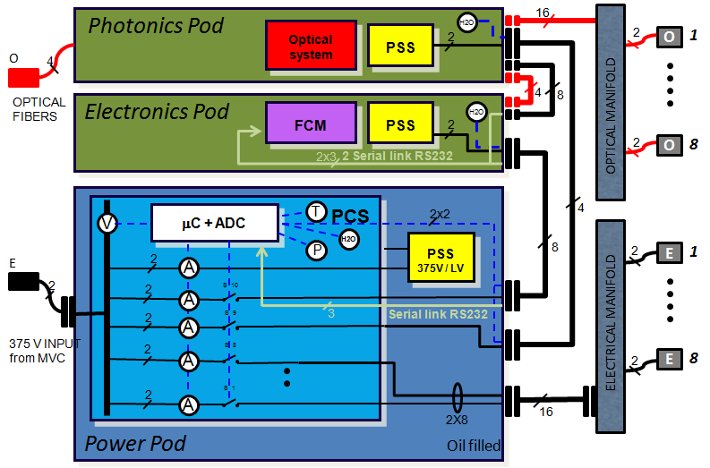
Junction Box

Slide 12
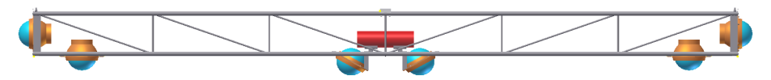
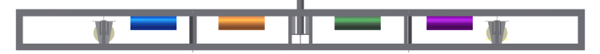
KM3Net-Italy tower layout
14 Floors + Base Tower
6 OMs per floor
Floor #14
FCM
Daisy-chain topology implies
power loss due to connectors
Floor #13
FCM
Star connection topology instead of daisy-chain
FCM
Floor #2
H
H
FCM
Floor #1
Junction
Box
E/O Cable
2
BT
Tower base
375 V

Slide 13
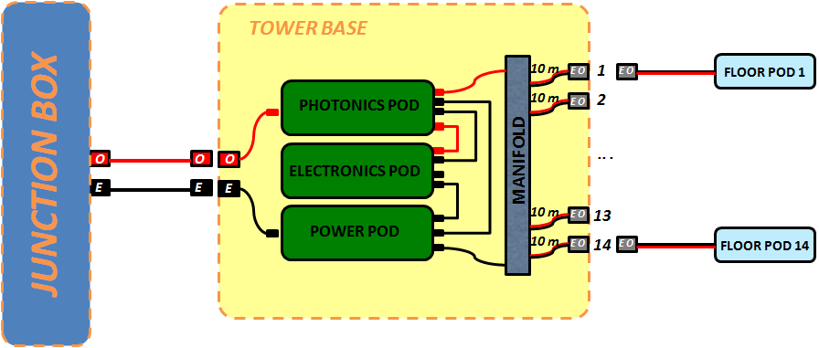
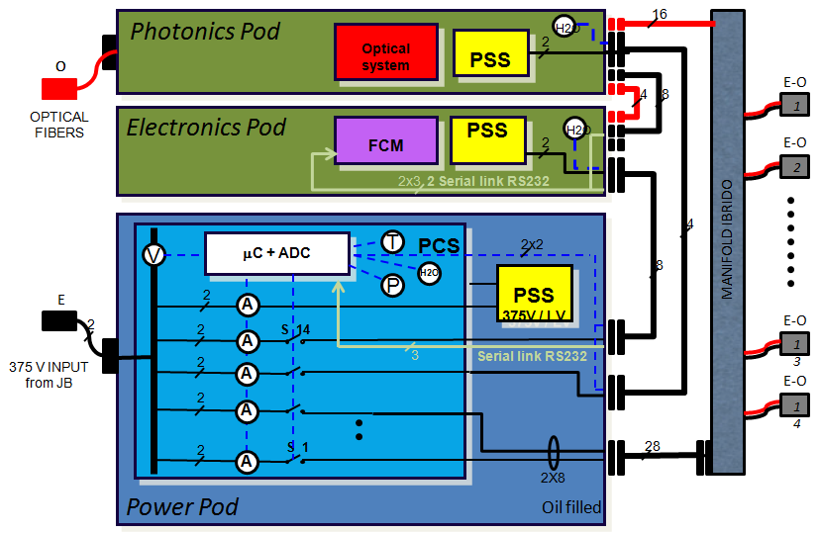
Base Tower
Laser
beacon
Digital
hydrophone

Slide 14


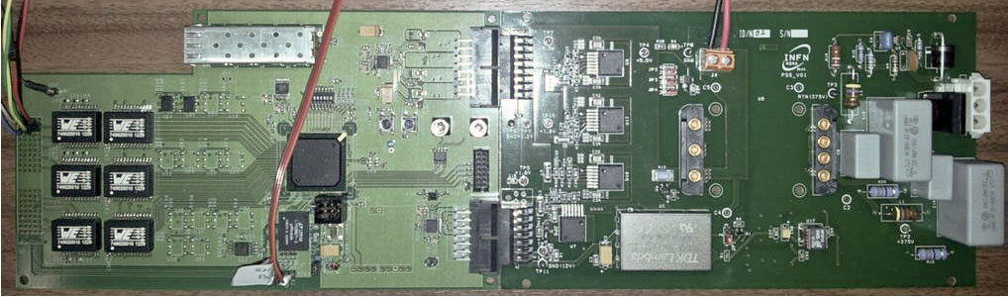
KM3NeT-IT Floor electronics
TimCTRL
Slow Control
Acoustic DAQ
Floor Control Module
CPS
Floor Control Module
Power Supply System
375 V
OM #0
OM #1
OM #2
OM #3
OM #4
OM #5
RS232 Port
Ext Instrument
(Isolated, +12V)
RS232 Port
Compass (+3.3V)
2 x Digital AES3
Hydrophone
Power Connectors
1.2 V, 3.3 V, 5 V, 12 V
(V & I Measurement)
Spare RS232 Port
(Isolated, +12V)

Slide 15
KM3NeT-IT Floor electronics
Xilinx Spartan 6 FPGA
Fixed latency transceiver onboard (up to 2.5Gbps)
2 opto-isolated serial port
1 user serial port
2 x AES3 stereo inputs
6 x OM interface
Power requirement (FCM): ~2 W
Safe reconfiguration from remote
DC/DC (375 V -> 5 V -> 1.2, 2.5, 3.3, 12 V)
Voltage and current measure
Floor Control Module
Power Supply System
NEMO Phase 2
KM3NeT-IT
Simplified integration, lower cost, simplified debug complexity
5 different boards
2 boards
7 processing units
3 architectures
(Xilinx FPGA, Microchip PIC,
Freescale DSP)
1 processing unit
1 architecture
(Xilinx FPGA w/ uBlaze MCU)
Easier code maintainance
From VHDL / DSPASM / C
To VHDL / C++
Dissipative linear voltage regulators
(12 V, 5 V, 3.3 V, 2.5 V, 1.2)
Lower power consumption
From 7.5 W
To ~3 W
Active low noise DC/DC

Slide 16
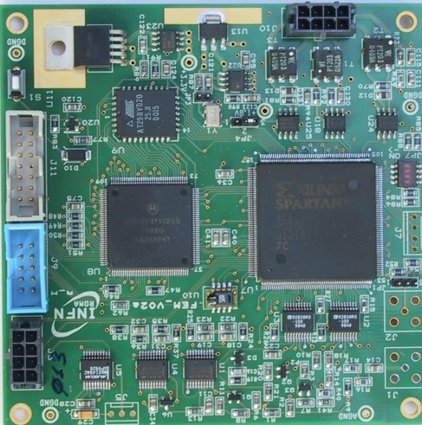
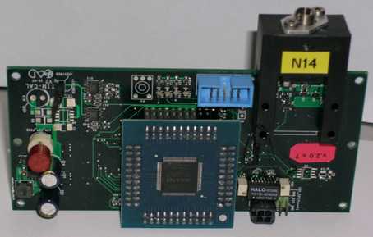
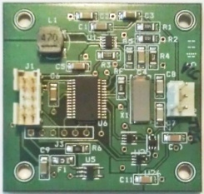
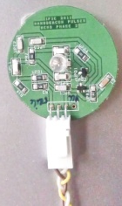
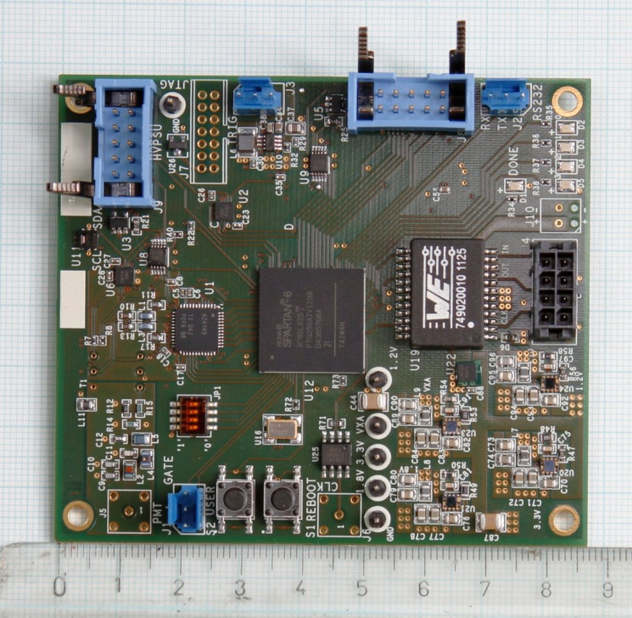

KM3NeT-IT Optical Module
LED beacon
controller
TIM-CAL
FEM
GATE In
HV
PSU
Front End Module
PMT signal
CLOCK
HVPSU
Power
Control
Feedback
TO/ FROM FCM
DIN / VCC
DOUT / GND
LED Beacon
Power
Trigger
USER CONN
(Power, AIN, GPIO, I2C, RS232, ...)

Slide 17
KM3NeT-IT Front End Module
Xilinx Spartan 6 FPGA
Signal sampling:
  single differential 200 MHz 14 bit ADC
  Programmable threshold for Zero-skipping
  8 bit compression on spe signals
  2 kSample FIFO
Analog conditioning:
  Linear analog differential filtering
  ADCs pedestal adjustment
PMT HV management
20 Mbps link to FCM (8b/10b)
Temperature & Humidity sensor
Power requirement: 0.2A @ 5V
Safe reconfiguration from remote (up to three images)
Front End Module
NEMO Phase 2
KM3NeT-IT
Simplified elaboration
No need to “decompress” signals
Simplified calibration process
No need to calibrate each single FEM at different temperatures
2 x 8 bit ADC, non-linear compression
Single 14 bit ADC, linear
2 Processing units
2 Architectures
(Xilinx FPGA, Freescale DSP)
1 processing unit
1 architecture (same as FCM)
Easier code maintainance
From VHDL / DSPASM
To VHDL / C++
Dissipative linear voltage regulators
Reduced power consumption
From ~2 W / OM
To ~1 W / OM
Low noise DC/DC

Slide 18
KM3NeT-IT On-shore data distribution
Per tower
DWDM MUX
TriDAS
15 EFCM per Tower
Slow Control
Ethernet only
Audio
Power
Control

Slide 19
KM3NeT-IT On-shore data distribution – 8 towers
DWDM MUX
15 EFCM (T1)
15 EFCM (T2)
120 EFCM
15 EFCM (T8)
...feasible, but...

Slide 20
Data rate estimation
1 spe → 70 ns → 14 samples (8 bit)
+
16 bytes per spe hit
Timestamp info
x
~1 MB/s per OM
~50 kHz spe background rate
~10 Mbps per OM
x 2 (safety margin) x 6 OMs
+
Hydrophones (24 Mbps per floor)
~150 Mbps per floor
~2.2 Gbps
Per tower
+
Slow control (6 Mbps per floor)
x
15 floors
Not a huge data-rate nowadays...

Slide 21
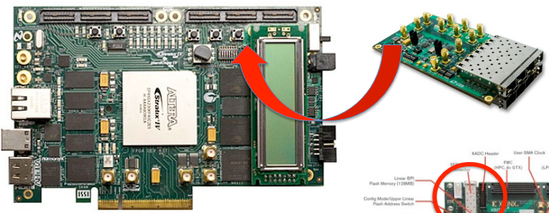
KM3NeT-IT On-shore data distribution
R&D with APE - INFN Roma1 group
8 x SFP
Can serve half a tower
(~1.1 Gbps)
More than one tower per CPU node
Simplified architecture and maintenance
Possible use of GPU for triggering algorithms
PCI-express
Current R&D status:
Preliminary tests have been performed
Xilinx / Altera communication test at 2.5 Gbps
Next step : fixed latency tests

Slide 22
Conclusions
The NEMO Phase 2 prototype tower was successfully deployed on late March 2013 and is currently taking data
Preliminary evaluation of acquired data is in progress
The Capo Passero site confirms expectations
The KM3NeT-Italy project is in the production stage
We expect to see the first tower deployed during 2014

Slide 23
BACKUP SLIDES

Slide 24
to upper floor
from upper floor
Drop
Transceiver
RX
Floor #(n+1)
Add
TX
Drop
Transceiver
RX
Floor #n
Add
TX
Drop
Transceiver
RX
Floor #(n-1)
Add
TX
from lower floor
to lower floor

Slide 25

Tower Base
JUNCTION BOX
TOWER BASE
10 m
E O
1
E O
FLOOR POD 1
PHOTONICS POD
10 m
E O
2
O
O
O
ELECTRONICS POD
MANIFOLD
.. .
E
E
E
POWER POD
10 m
E O
13
10 m
E O
14
E O
FLOOR POD 14

Slide 26
Tower Base
Photonics Pod
16
Optical
system
PSS
2
H2O
O
375 V OUTPUT 14
O
4
8
E-O
OPTICAL
FIBERS
1
Electronics Pod
FCM
PSS
H2O
V
2
E-O
2 Serial link RS232
2
375 V
2x3
4
μC + ADC
T
PCS
2x2
MANIFOLD IBRIDO
V
8
P
H2O
PSS
375V / LV
E
2
A
2
2
S 14
E-O
A
Serial link RS232
13
375 V INPUT
from JB
2
3
A
E-O
2
A
14
2
A
S 1
28
2X8
Power Pod
Oil filled

Slide 27
Junction Box
JUNCTION BOX
10 m
O
1
10 m
O
2
OPTICAL MANIFOLD
. . .
PHOTONICS POD
10 m
O
7
10 m
10 m
O
8
E-O
10 m
10 m
O
O
100 m
O
O
ELECTRONICS POD
E
1
SUBMARINE
NODE
10 kW
10 kV / 375 V
8 f.o.
E-O
10 m
E
E
100 m
E
E
10 m
E-O
10 m
10 m
E
2
E-O
HYBRID MANIFOLD
10 m
POWER POD
POWER POD
. . .
E-O
E-O
10 m
10 m
O
ELECTRICAL MANIFOLD
10 m
E
10 m
10 m
E
7
10 m
E
8

Slide 28
Junction Box
Photonics Pod
16
Optical
system
PSS
2
H2O
2
O
1
O
4
OPTICAL MANIFOLD
OPTICAL
FIBERS
Electronics Pod
4
8
V
FCM
PSS
H2O
2
2 Serial link RS232
2
O
8
375 V
2x3
μC + ADC
T
PCS
2x2
4
V
P
H2O
PSS
375V / LV
8
2
E
1
E
2
A
2
2
A
S 10
Serial link RS232
ELECTRICAL MANIFOLD
2
A
S 9
3
375 V INPUT
from MVC
2
S 8
E
8
A
2
2
A
S 1
2X8
16
Power Pod
Oil filled

Slide 29
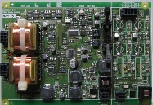
NEMO Phase 2 floor electronics 1/2
FCM
AcouDAQ
Fiber optic interface (DWDM transceiver)
Hardware Glink transceiver at 800Mbps
Xilinx Spartan 6 FPGA
Freescale DSP
FEM Interface (proprietary protocol)
Acoustic Interface (AES3 standard protocol)
Slow Control Interface (SPI standard protocol)
Time calibration Interface (proprietary protocol)
Safe reconfiguration from remote
Power requirements ~7.5 W
Continuous signal sampling:
  192 kHz 24bit-ADC
  2 channels 6Mbps each
Digital Interface Transmitter:
  AES-3 compliant
  Fixed latency
Power requirement: 0.16A @ 5V

Slide 30
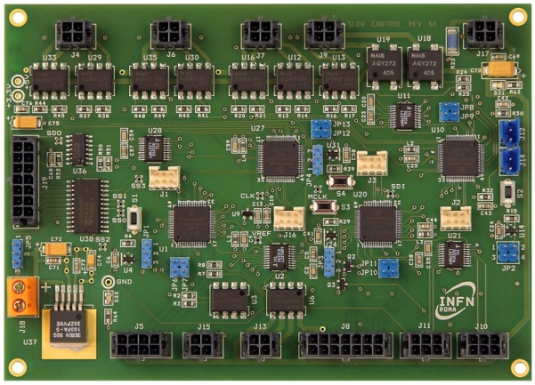
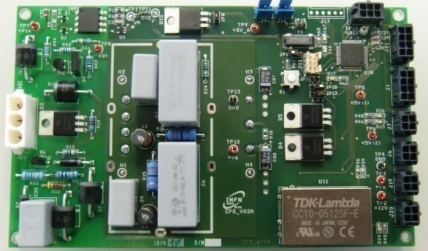
NEMO Phase 2 floor electronics 2/2
SCI
SPI interface to FCM
External instruments interface:
  8 insulated serial ports
  Switchable power supply
  Current measure
Temperature and Humidity sensors
CPS
Conversion of the DC supply from 375 V to 12 V, 5.5 V, and 4.2 V
Communication via RS485
On/off switching of the power feeding lines
Monitoring of electrical parameters at each feeding power line
Temperature measurment, 3-axis accelerometer and magnetic sensor
TimCTRL
Communication with the FCM (clock, data and synch. trigger)
Control of the TIM-CAL operations
Propagation of the trigger signal to the TIM-CALs

Slide 31

NEMO Phase 2 Tower optical module electronics
FEM
Xilinx Spartan 3 FPGA
Freescale DSP
Analog conditioning:
  Non-linear analog compressor (temperature dependent)
ADCs pedestal adjustment
Signal sampling:
  two 100 MHz 8bit-ADCs
  Zero-skipping digital compression
PMT HV management
Temperature & Humidity sensor
Power requirement: 0.4A @ 5V
Safe reconfiguration from remote
Serial port, I2C
nanoBeacon
Generation of light pulses for calibration (triggered by FEM)
Communication via I2C with FEM
Adjustable pulse level
Pulses reach other floors
TIM-CAL
Generation of light pulses for time calibration (triggered by TimCTRL)
Communication via I2C with FEM
Adjustable pulse level

Slide 32
Anode
DC/DC
MVC
1
375 V_{DC} + 3 optical fibers
CTA
Splitter
2
375 V_{DC} + 3 optical fibers
MEOC
3
375 V_{DC} + 2 optical fibers

Slide 33
Jitter measurement
13 ps
7.2 ps
8.2 ps
10 ps
15 ps
Gen
PLL
FanT
eFcm
FCM
Board | JitterRMS [ps]
Generator | 13
PLL | 7.2
FantimeV1 | 8.2
eFcm | 10
FCM | 15

Slide 34
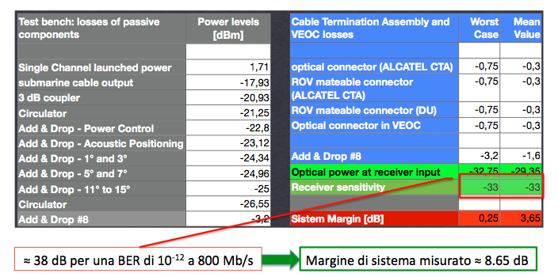
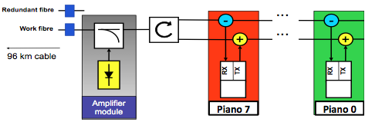
Link budget
38dB for a BER of 10^-12 at 800Mb/s
8.65dB margin without the raman amplifier

Slide 35
Optical Module in NEMO Phase-2
ISEG
TIM-CAL
A glass sphere 13” (Vitrovex):
Single large area photomultiplier : Hamamatsu 10” PMT R7081
Optical gel : Waker SilGel 612
μ-metal wire cage
PMT base circuit : ISEG PHQ7081-i-2m modified
FEM (Front End Module) electronic board
System for timing calibration (TIM-CAL)
FEM
13” OM sketch: lateral view

Slide 36
Towards an 8 towers apparatus
14 + 1 floors per tower
6 Optical Modules per floor
120 Floors
~10 years of R&D and
technical progress
672 Optical Modules
Integration
Minimization of cost
Minimization of power consumption
Simplification

Slide 37



Floor electronics from onshore to offshore
Off-Shore
On-Shore
PMT DAQ Boards
Hydrophones DAQ Board
Ethernet Floor Control Module
To other floors
Floor Control Module
Slow Control Interface
Timing distribution board
PMT DAQ Boards
GPS receiver

Slide 38
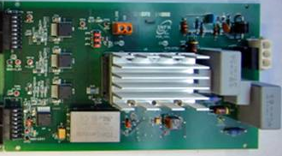
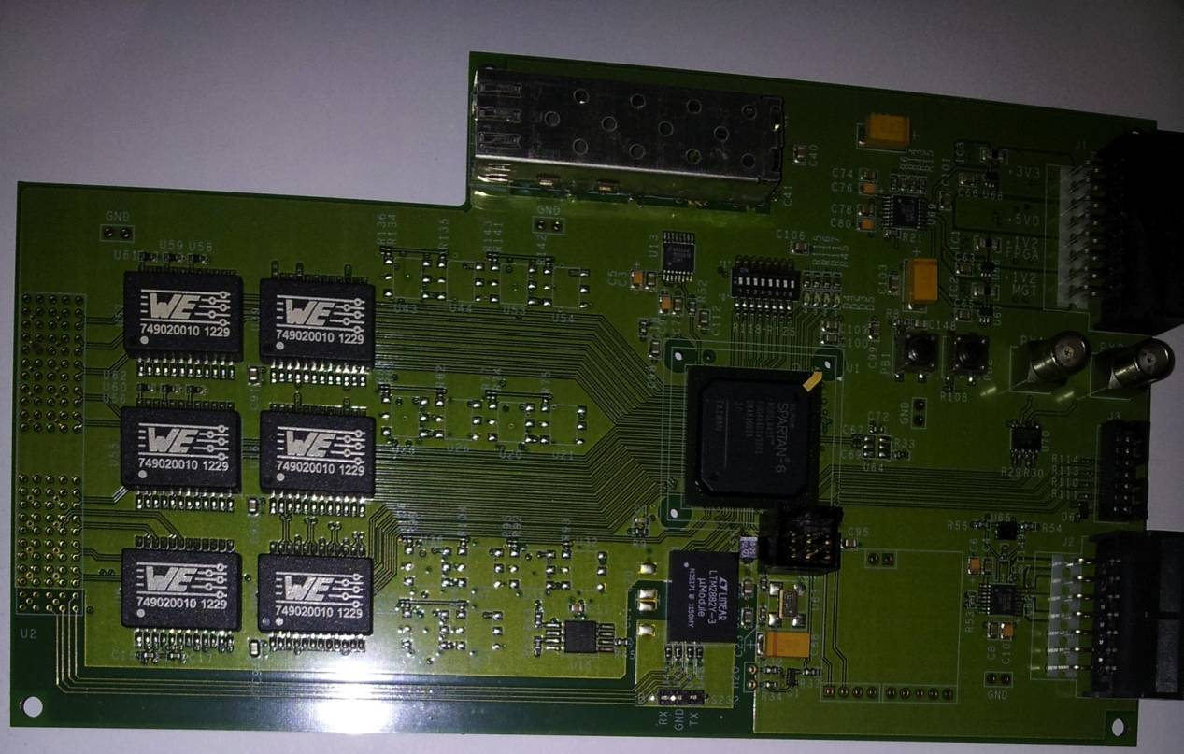


Slide 39

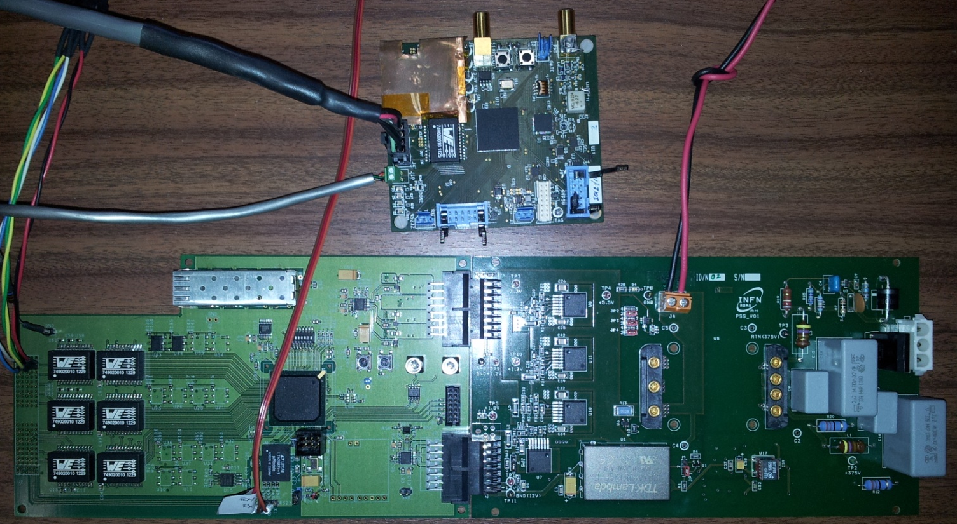

Slide 40
FEM
PMT If
PSS
Tcal If
LED
2 Power Wires
DC-DC
400 → 5
Power Supplies
1.2, 1.2, 3.3, 5, 12
3 Twisted Pairs
Z = 100 Ohm
FCM
FPGA
Om0
Om1
SFP
Om2
2 Fibers
Om3
T&H
Om4
Hydro
Instr
Bussola
Om5
2 Twisted Pairs
Z= 100 Ohm
2 x RS232 Port

Slide 41
Power Connector
1.2, 1.2, 3.3, 5, 12
(V & I Measurement)
Power + RS232
RS232 Port
Ext Instrument
(Isolated, +12V)
T & H Sensor
RS232
RS232 Port
Compass (+3.3V)
RS232
RS232 Port
Debug
(Isolated, +12V)
SFP Laser
I2C
FPGA
Digital Hydros If
(AES3 compliant)
HS Link
SPI
SPI Flash
RS485
XADC
Analog Monitor
Clock
OM #0
OM #1
OM #2
OM #3
OM #4
OM #5

Slide 42
AFE Control
& Monitor
AFE
16bit DAC
16bit ADC
AD4149
14bit/200MHz
HV Pmt Control
16bit DAC
16bit ADC
DDR LVDS
SPI
SPI
Micron N25Q032
Flash
Spartan-6 LX
I2C
I2C
H/T Sensor
Sensirion SHT21
uBlaze
SPI
RS
RS232
Serial Port(s)
LVDS 3 pairs
Clk, Din, Dout
FOX924B-10MHz
1.2V
1.8V
2.5V
3.3V
LED Beacon Driver
24V Step Up
Trigger
Trasformatore Wurth 749020010
5V
TE PolyZen
DC/DC Power Supply
(TI LMZ10501)

Slide 43

Current Sensor
Current Sensor
LEDPULSER
Controler (I2C)
T&H Sensor (I2C)
SHT21
FPGA
Xilinx Spartan 6
Analog Front-End
Control (I2C)
Analog Front-End
LPF
Passivo, lineare
ADC 200 Msps / 14 bit
TI AD4149
Step-down DC/DC
5V Input
1.2, 1.8, 2.5, 3.3 Outputs

Slide 44
Serial Port (3.3V)
LED Pulser
(TRIG, HV)
USER CONN
(Power, AIN, GPIO, I2C, RS232, ...)
HVPSU CONN
(Power, Control, Monitor)
FCM CONN
(Power, Data, Clock)
Clock Out
PMT In
GATE In

