Slide 1

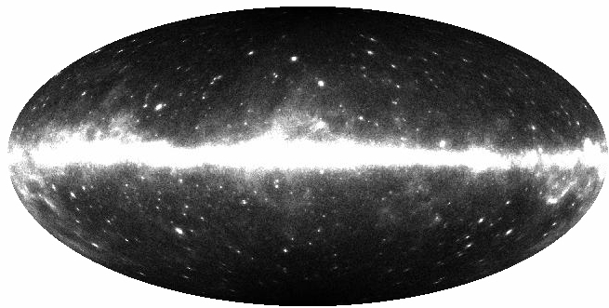
7 questions addressed during this presentation
What are the origins of the Milky-Way γ-ray diffuse emission ?
Is the cosmic ray (CR) density uniform within ~1 kpc from the sun ?
How does the CR density vary with the Galactocentric distance ?
Are the CR and ISM density coupled ?
Does FERMI see the EGRET GeV excess ?
Can we model the Galactic diffuse emission ?
Can the EGB be explained by unresolved AGN ?
Fermi LAT Observations of Galactic and Extragalactic Diffuse Emission
Jean-Marc Casandjian, on behalf of the Fermi LAT collaboration

Slide 2
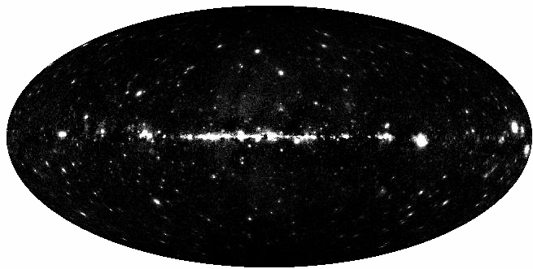
11%
100%
Fermi LAT Observations of Galactic and Extragalactic Diffuse Emission
Jean-Marc Casandjian, on behalf of the Fermi LAT collaboration

Slide 3
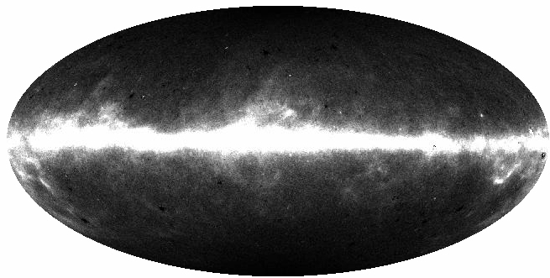
89%
100%
Fermi LAT Observations of Galactic and Extragalactic Diffuse Emission
Jean-Marc Casandjian, on behalf of the Fermi LAT collaboration

Slide 4
1.
What are the origins of the Milky-Way γ-ray diffuse emission ?

Slide 5
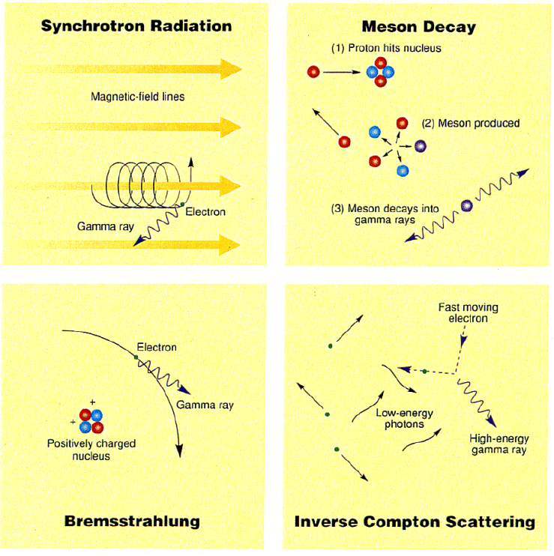
Diffuse Emission : study of CR, ISM and ISRF
Processes for HE γ production :

Slide 6
89%
LAT minus sources

Slide 7
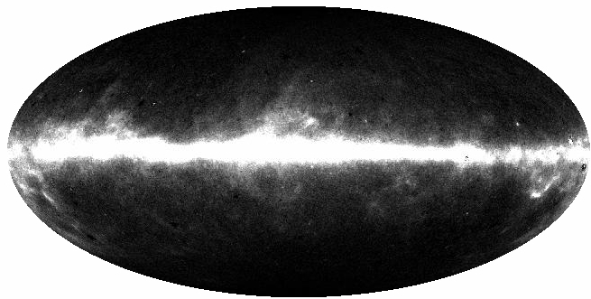
74%
LAT minus sources, isotropic

Slide 8
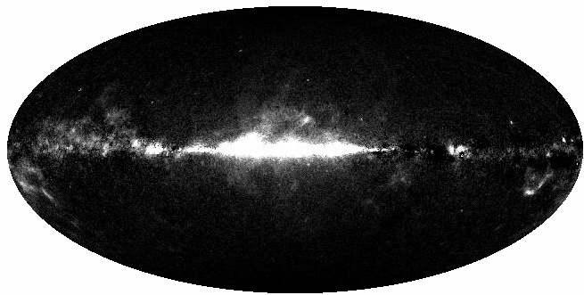
26%
LAT minus sources, isotropic, HI

Slide 9
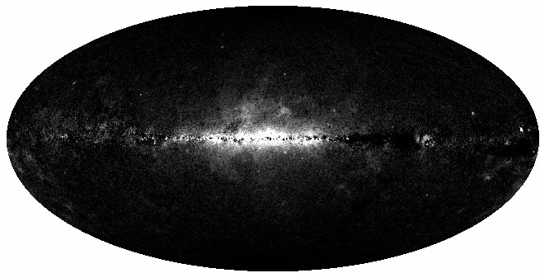
17%
LAT minus sources, isotropic, HI, H2

Slide 10

<1%
LAT minus sources, isotropic, HI, H2, Inverse Compton

Slide 11
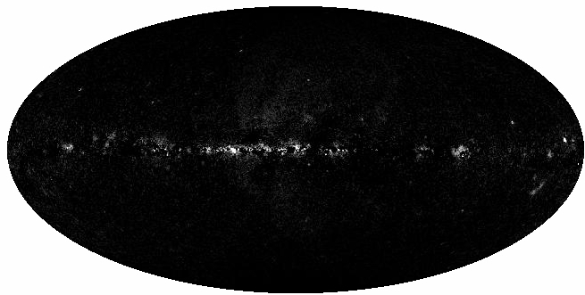
<1%
LAT minus sources, isotropic, HI, H2, Inverse Compton, dark gas

Slide 13
2.
Is the cosmic ray density uniform within ~1 kpc from the sun ?
3 regions were investigated:
200º≤ l ≤ 260º , 22º ≤ |b| ≤ 60º Abdo et al., ApJ 703, 1249 (2009), C.A.: T. Mizuno
100º≤ l ≤ 145º , -15º≤ b ≤ 30º (local arm) Abdo et al., ApJ 710, 133 (2010) C.A.: L. Tibaldo, I. Grenier
210º≤ l ≤ 250º , -15º≤ b ≤ 20º (local arm) Abdo et al., submitted, C.A.: T. Mizuno, L. Tibaldo, I. Grenier

Slide 14
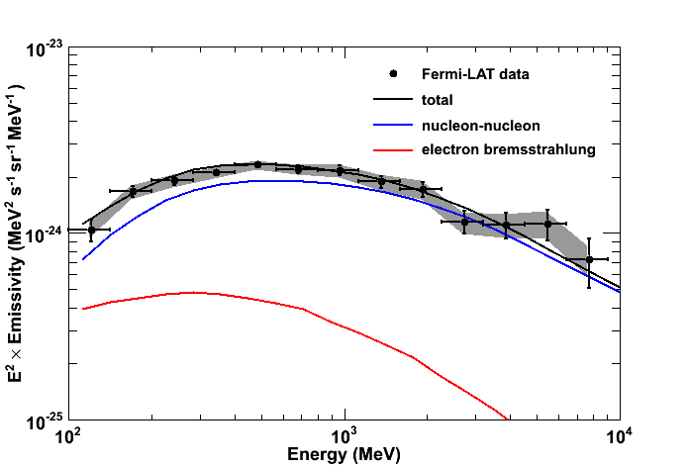
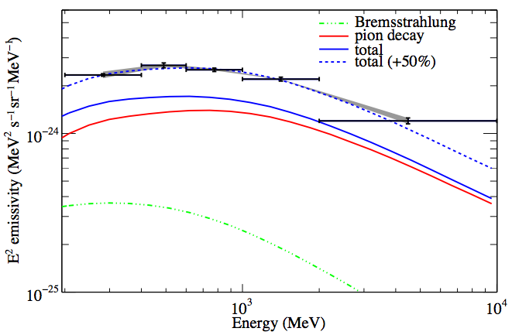
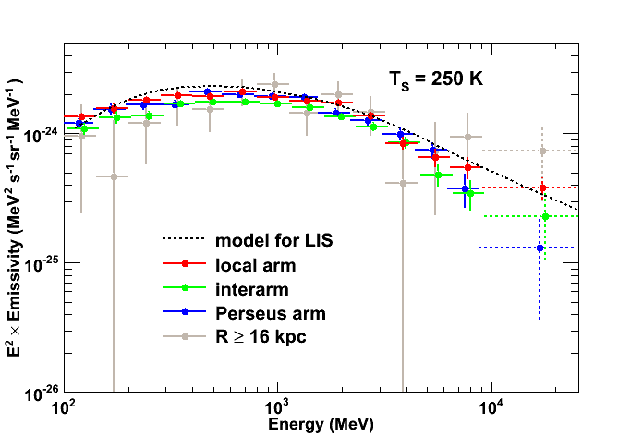
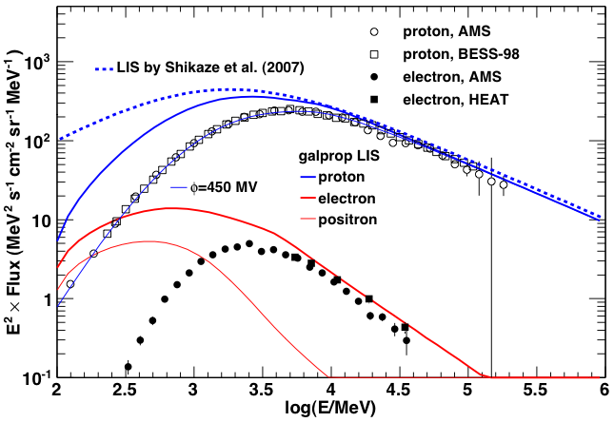
100º≤ l ≤ 145º , -15º≤ b ≤ 30º
200º≤ l ≤ 260º , 22º ≤ |b| ≤ 60º
Preliminary
210º≤ l ≤ 250º , -15º≤ b ≤ 20º

Slide 15
Is the cosmic ray density uniform within ~1 kpc from the sun ?
It is uniform within systematics
the local CR nuclei spectra are close to those directly measured at the Earth

Slide 16
3.
How does the CR density vary with the Galactocentric distance ?
2 regions were investigated:
100º≤ l ≤ 145º , -15º≤ b ≤ 30º Abdo et al., ApJ 710, 133 (2010) C.A.: L. Tibaldo, I. Grenier
210º≤ l ≤ 250º , -15º≤ b ≤ 20º Abdo et al., submitted, C.A.: T. Mizuno, L. Tibaldo, I. Grenier

Slide 17
How does the CR density vary with the Galactocentric distance ?
Decrease of CR densities but with a gradient flatter than expectations for SNR sources as traced by PSR
-> larger halo ?

Slide 18
4.
Are the CR and ISM density coupled ?
Association of CR sources with regions of massive clouds ?
Confinement of CRs by magnetic fields associated with the gas ?

Slide 19
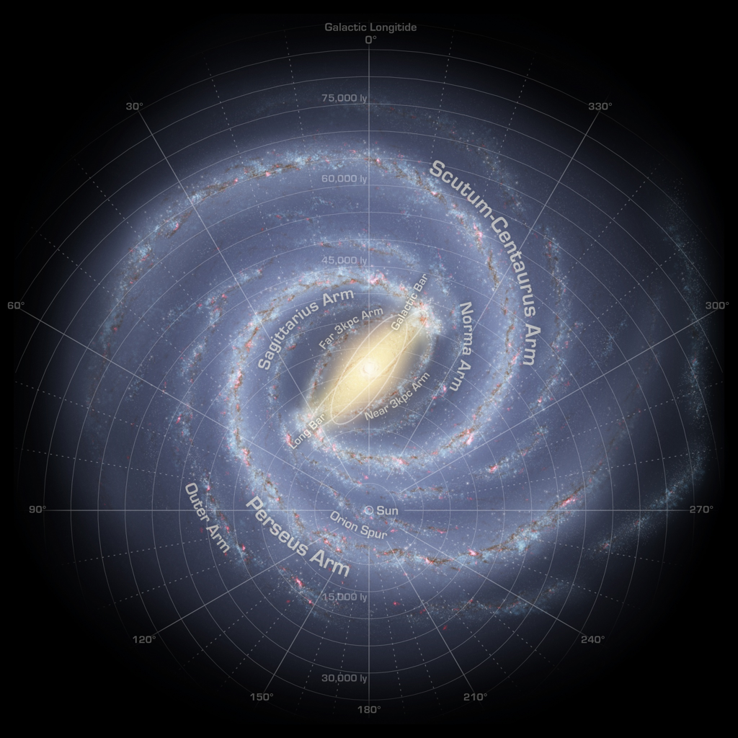
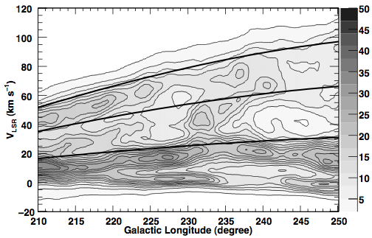
is there an arm/inter arm CR effect
velocity-longitude profile of HI emission
Perseus arm
Inter arm
Local
Notes:
Four regions were defined in Galactocentric distance, namely the Local arm (Galactocentric radius R ≤ 10 kpc), the interarm region (R = 10–12.5 kpc), the Perseus arm (R = 12.5–16 kpc) and the region beyond the Perseus arm (which hosts a faint segment of the outer arm; R ≥ 16 kpc).

Slide 20
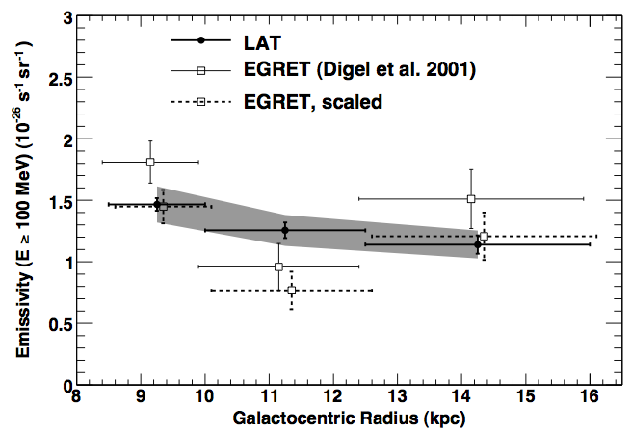
Are the CR and ISM density coupled ?
Systematics related to HI spin temperature
{
{
{
arm
inter-arm
arm
Abdo et al., submitted, C.A.: T. Mizuno, L. Tibaldo, I. Grenier

Slide 21
Are the CR and ISM density coupled ?
No large enhancement in the spiral arms with respect to the interarm region

Slide 22
5.
Does FERMI see the EGRET GeV excess ?

Slide 24
6.
Can we model the large scale structures of the Galactic interstellar emission ?
With Galprop we can
Strong et al., Annual Reviews of Nuclear and Particle Science, 2007
http://galprop.stanford.edu/
(covered by Troy Porter)

Slide 25
7.
Can the EGB be explained by unresolved AGN ?

Slide 29




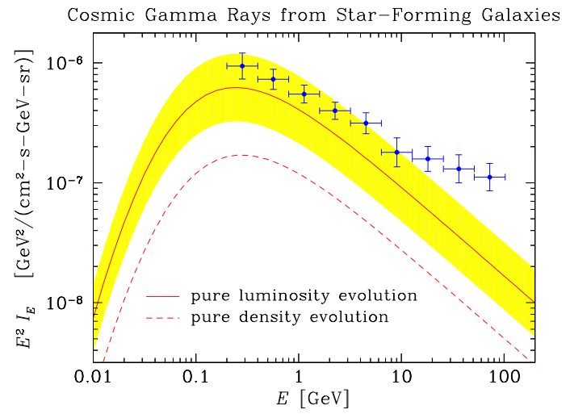
Star Forming Galaxies
Fields,Pavlidou,Pradanovic 2010

Slide 30
Conclusion
7 answers given during this presentation
With the diffuse emission we study the CR, ISM and ISRF.
The CR density is uniform within ~1 kpc from the sun.
We observe a flatter than expected decrease of the CR density with the Galactocentric distance.
No sign of coupling between CR and ISM density was observed.
No FERMI GeV excess.
We can model the Galactic diffuse emission with Galprop.
Unresolved AGN can not explain all the EGB.

