Slide 1
Top physics at hadron colliders
Luca Lista
INFN

Slide 2
Outline
Top quark properties
Top quark production
Top pair production
Top quark decays
Top mass measurement
Single-top measurements
Search for new physics with top

Slide 3
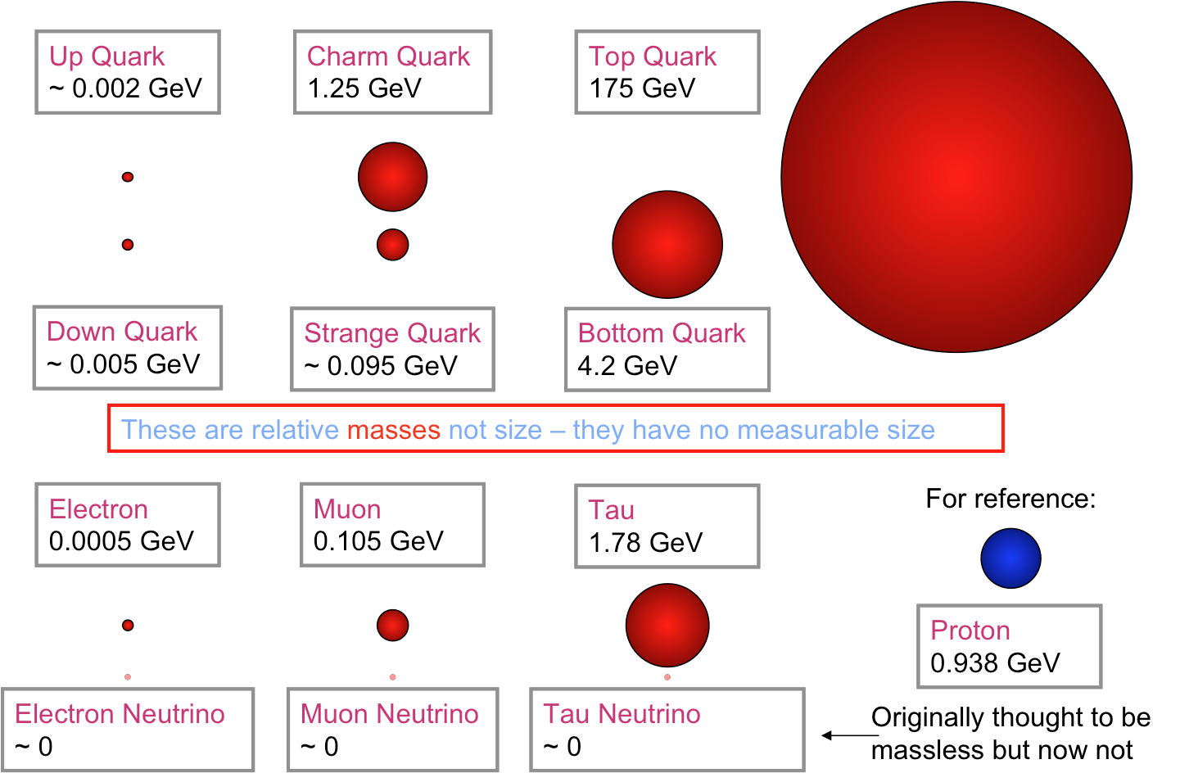
Top: the heaviest quark
Top is by far the heaviest
quark, and the heaviest
particle ever observed
  As heavy as a Au atom!
Top mass is close to the
Electroweak scale
Unlike all other quarks,
it’s heavier than W, so it
can decay into a real W: t→Wq
Decay time faster than typical hadronization time
  Top decays before it can hadronize, so it’s a unique opportunity to study “bare” quark properties

Slide 4
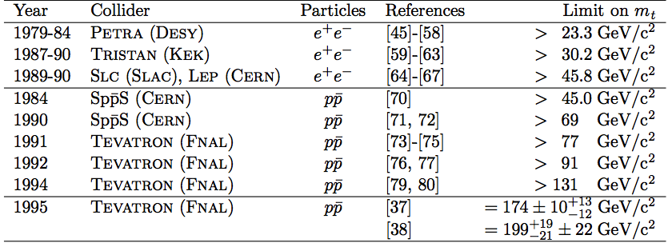
Top history timeline
1977 – b-quark discovered at FNAL, top quark hypothesizes as weak isospin partner and 6th quark to complete the three SM generations
Direct search in e⁺e⁻ colliders, increasing limits on the top mass
~1990– indirect estimate of quark mass from precision EWK measurements (LEP)
1995 – discovered at FNAL by CDF and D0 in direct top-pair production

Slide 5
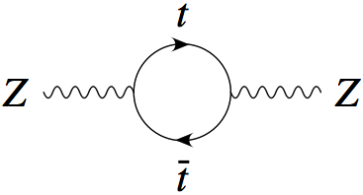
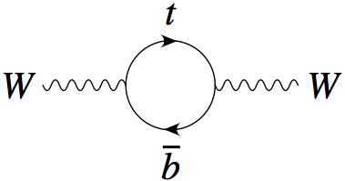
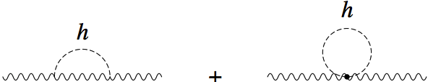
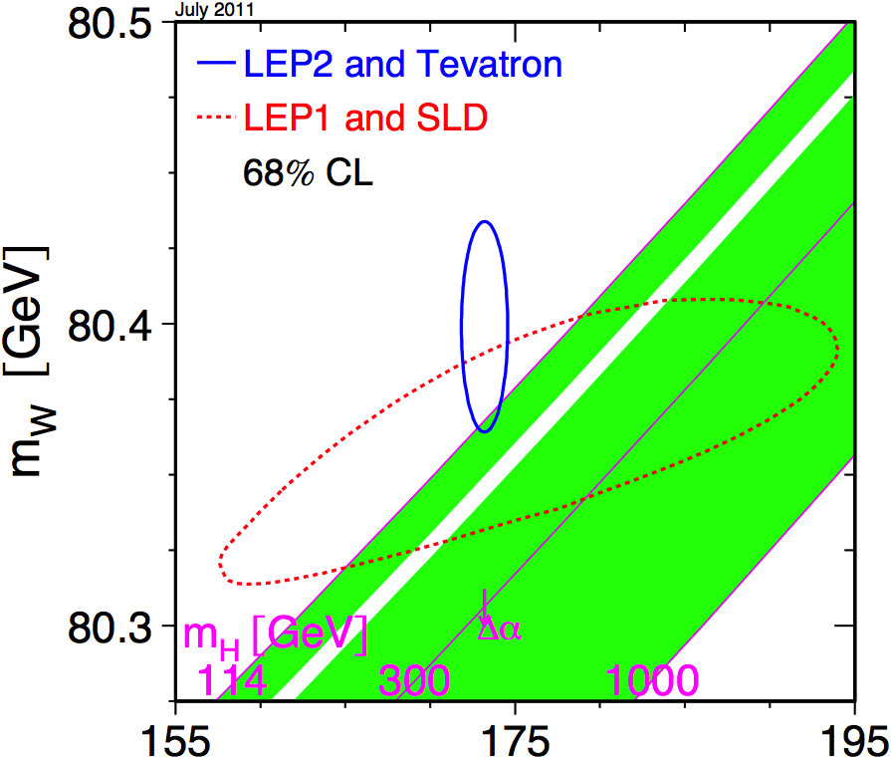
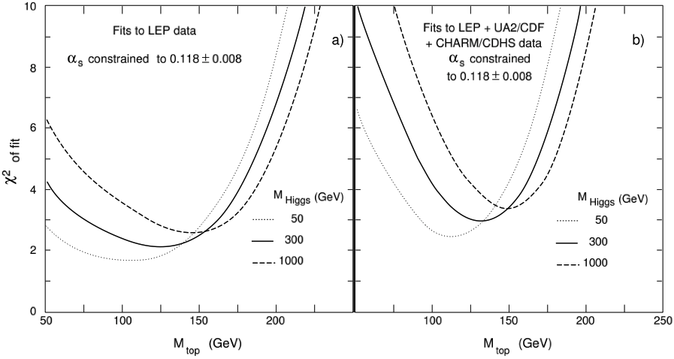
Indirect top quark evidence
Precision measurements of the Elecroweak parameters, mainly from LEP, allowed to measure virtual corrections with sufficient precision to put constraints on the top-quark mass
  Δr ~ m_{t}², ln(m_{H})
1 GeV change on m_{t} ⇒ ~10 GeV change on m_{H}

Slide 6
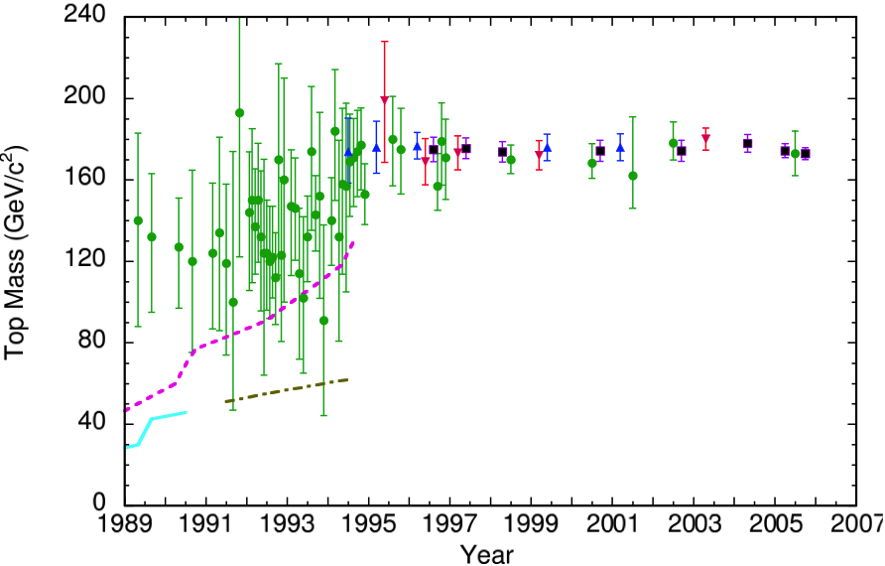
Top mass history
Limits or estimate vs time
indirect EWK data
CDF
D0
World average
Limits from Tevatron
Limits from SppS
Limits from e⁺e⁻

Slide 7
Top quark production

Slide 8
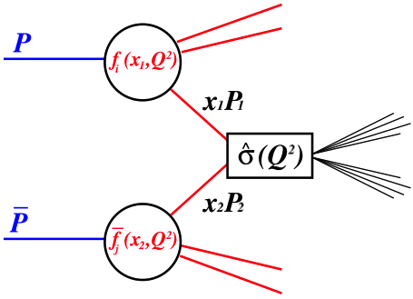
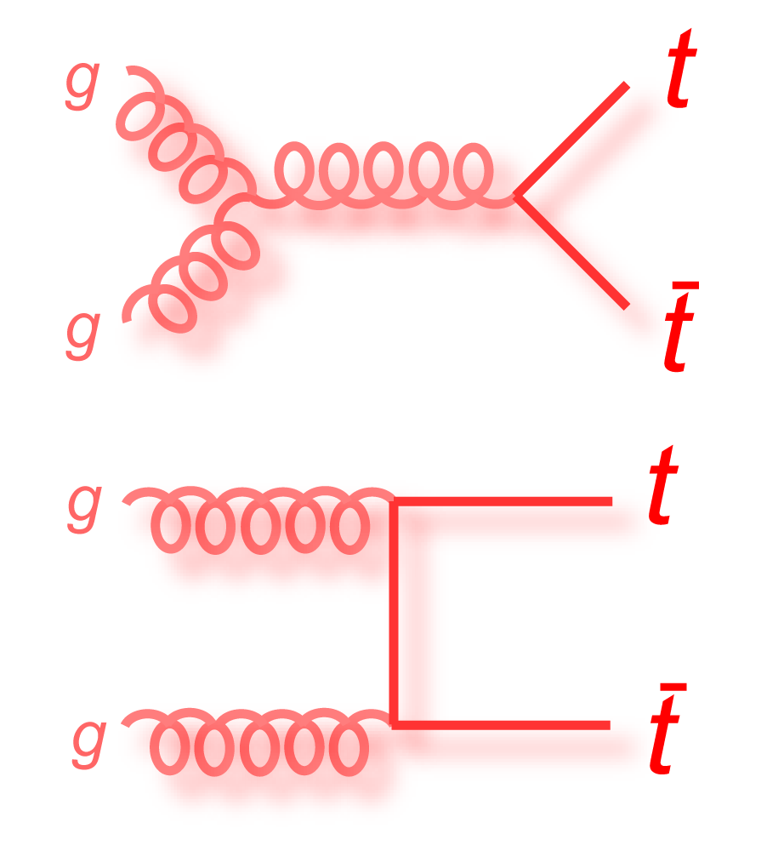
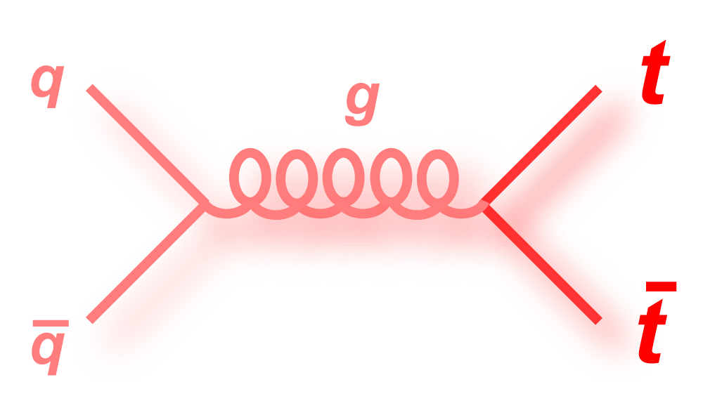
Top quark pair production

Slide 9
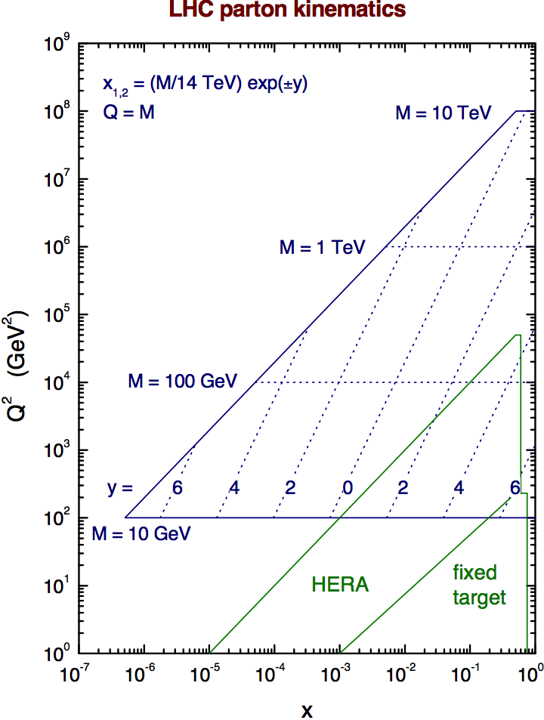
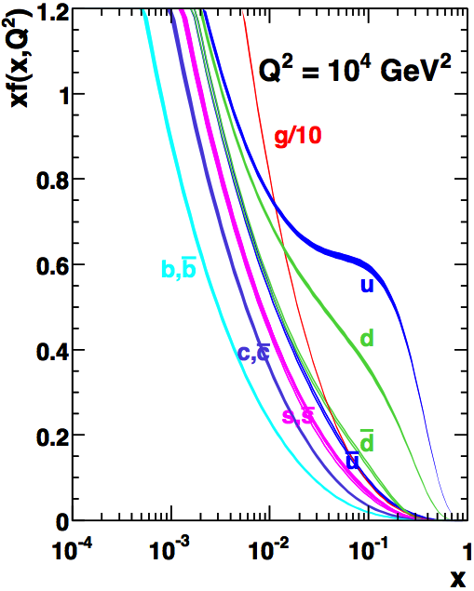




LHC kinematics
Smaller x implies larger gluon contribution
2m_{t}
~ 0.19 at Tevatron
~ 0.025 at LHC (14 TeV)

Slide 10
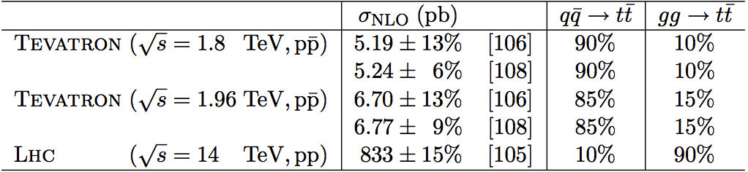
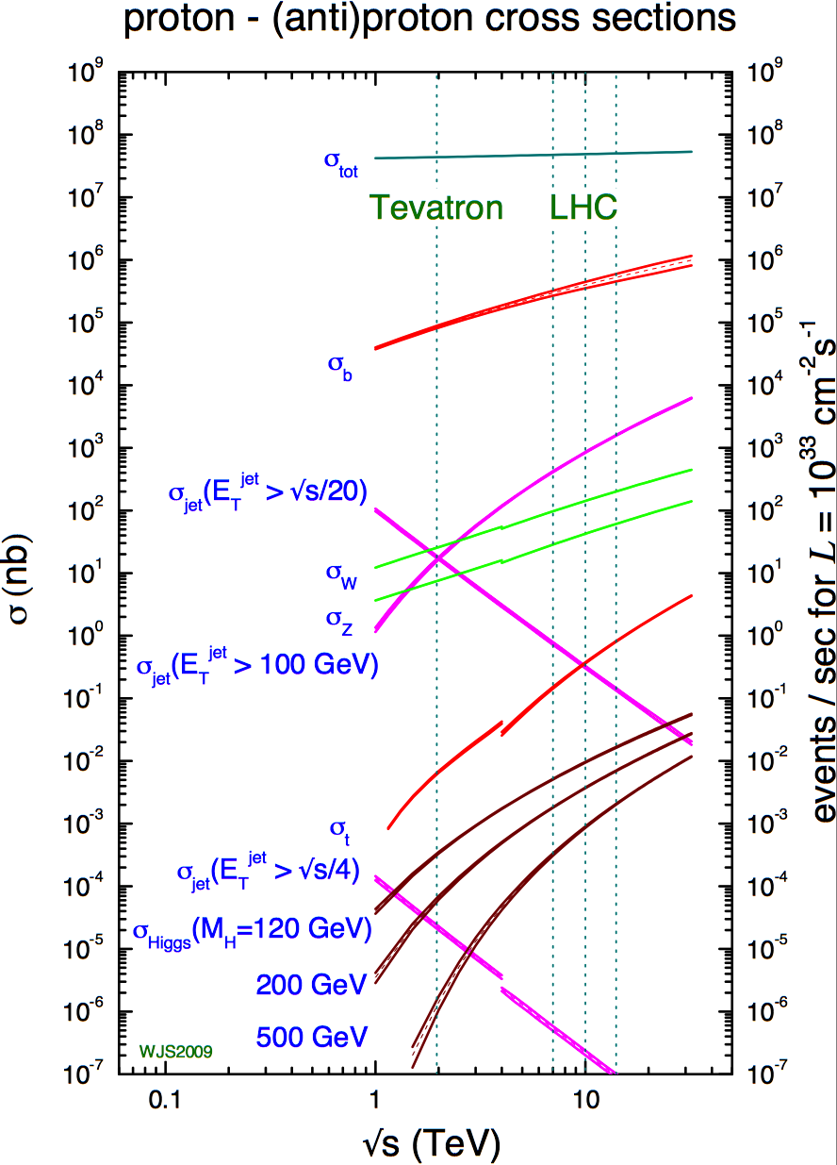
Tevatron vs LHC
Gluon fusion dominates at LHC, while qq^{bar} annihilation dominates at Tevatron
Expectation:
  Tevatron: 10 tt^{bar}/day, LHC: 1 tt^{bar}/s
  Single-top: 4/day vs 0.5/s
LHC is effectively a top factory
top pair production

Slide 11
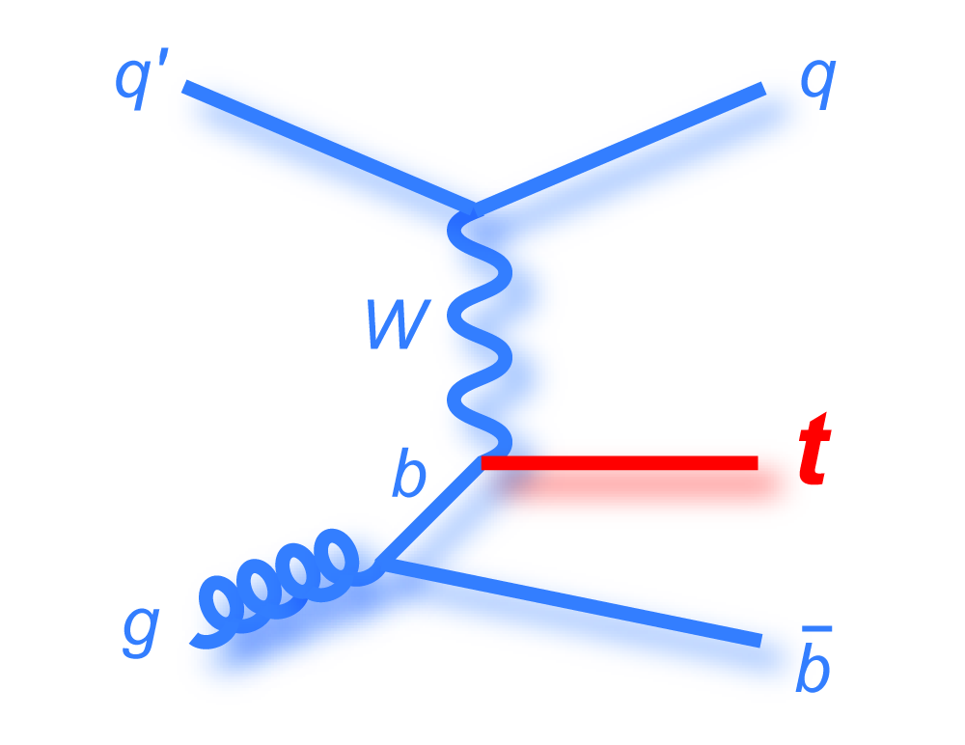
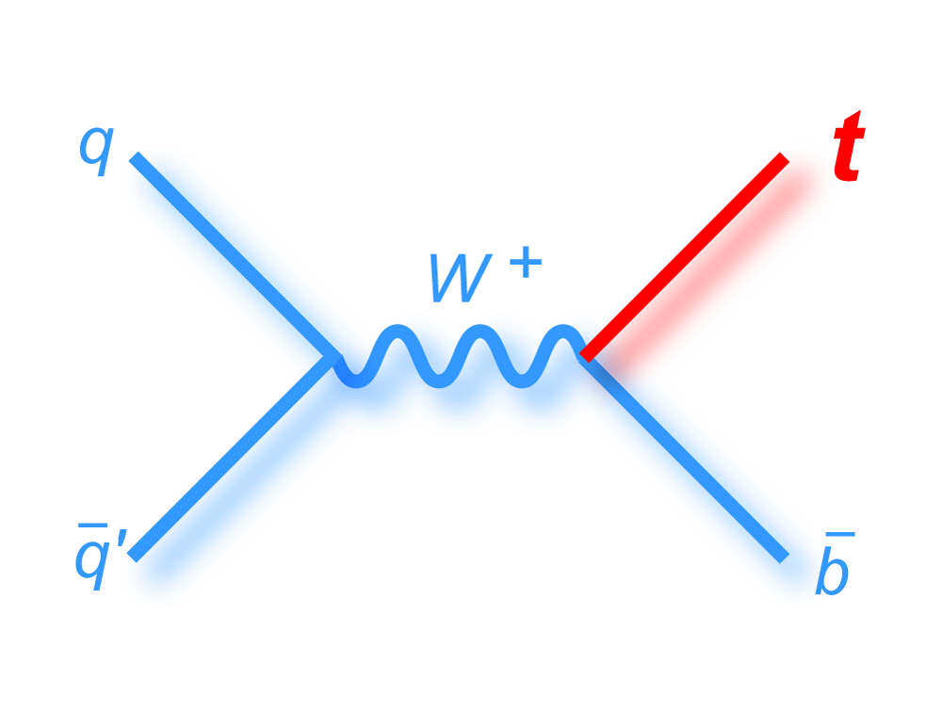
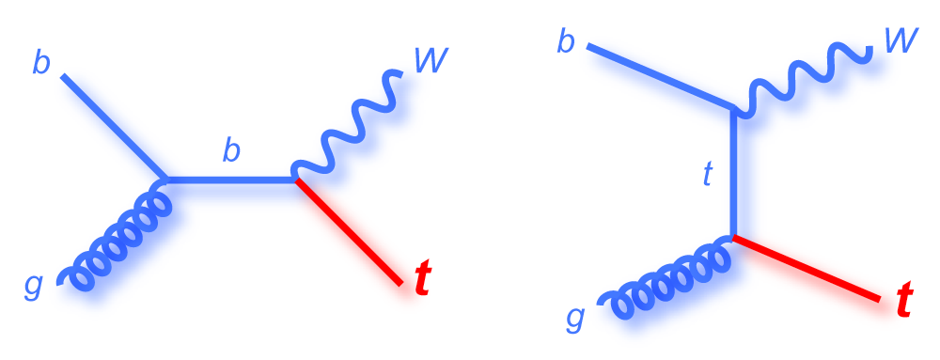
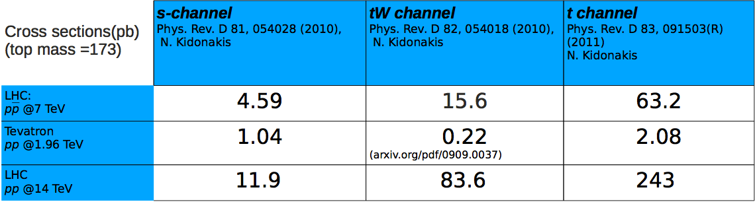
Single-top production
Single top quark production is possible via the mediation of a W
Three possible processes: t, s channels, tW

Slide 12
Top quark decay

Slide 13
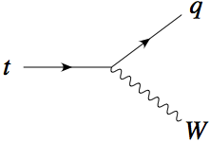
Top quark decays
Main top decay: t→Wb (|V_{tb}|~1)
Top lifetime is ~ 0.5×10⁻²⁴s,
smaller than typical hadronization time
(1/Λ_{QCD} ~ 3×10⁻²⁴s)
  Top decays too quickly to produce top hadrons, so no top spectroscopy is possible
V_{tq}

Slide 14
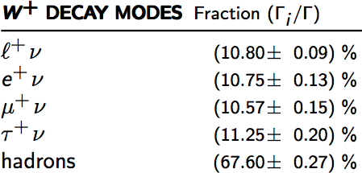
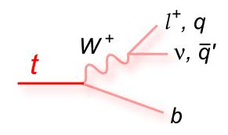
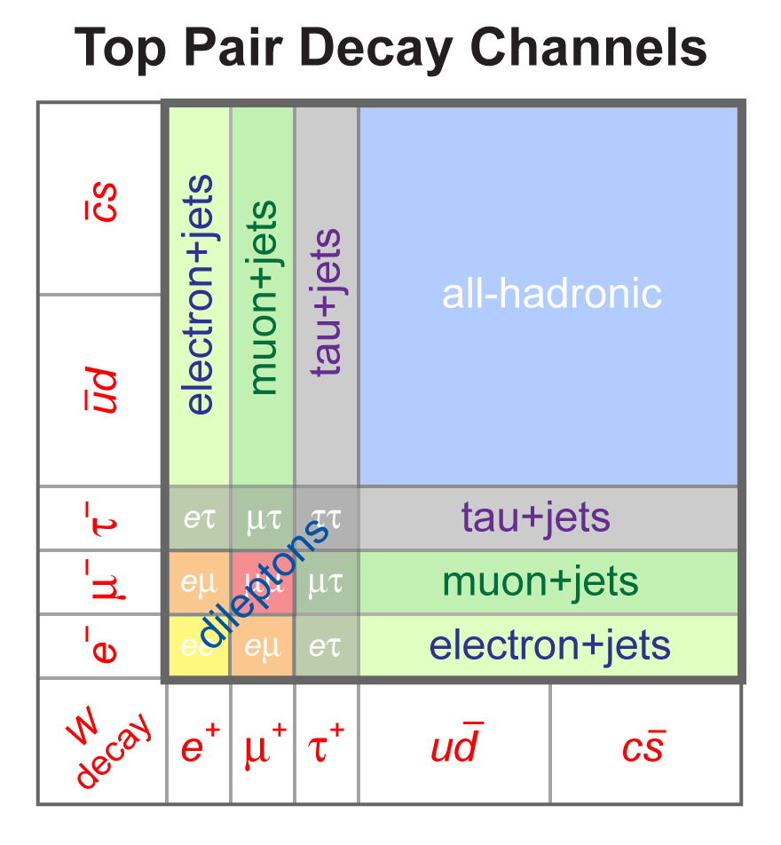
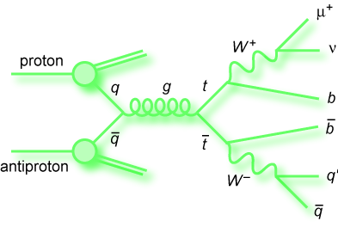
Final states in top events
The signature of top events is dictated by the decay mode of the W boson in t→Wb
Possible decay modes:
  Dileptons (e, μ): ~5%
  Leptons + jets: ~30%
  All hadronic: ~45%
Two b-jets at leas are present in the event
Neutrinos are present when the W
decays leptonically
Non-b jets are present in W hadronic
decays

Slide 15
Top quark identification and reconstruction

Slide 16
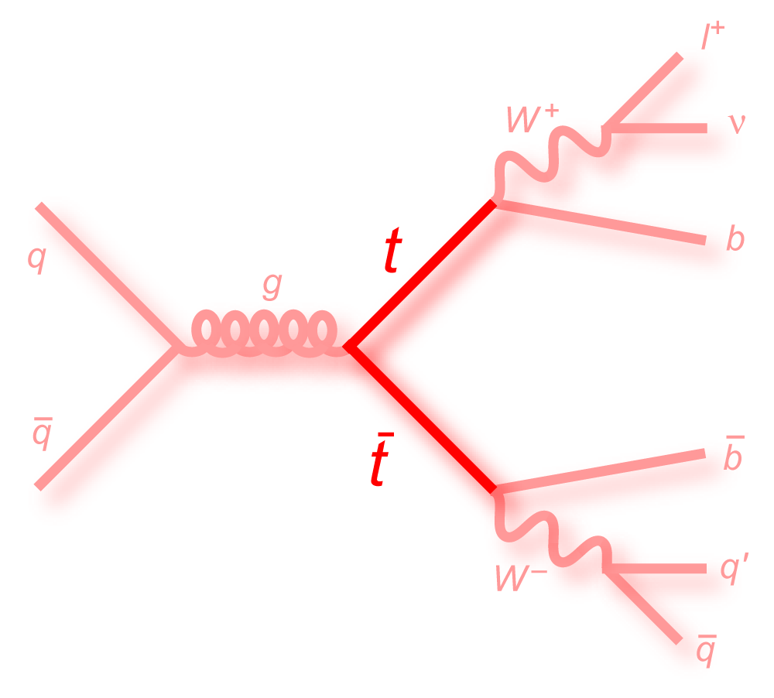
Experimental physics ‘objects’
Top events can be recognized and discriminated from the background using several detector information
Lepton identification
Hadronic jet reconstruction
Identification of b-jets (b tagging)
Reconstruction of neutrinos as missing energy
  in the transverse plane only at hadron colliders
Further background reduction can be achieved using kinematic variables, depending on the specific channel

Slide 17
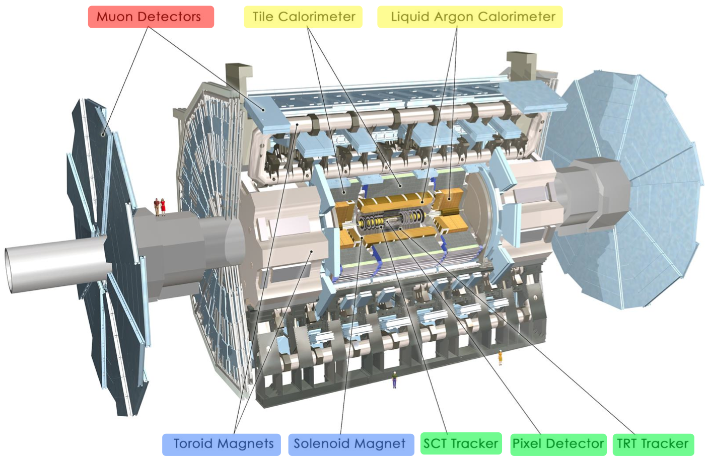
LHC experiments: ATLAS

Slide 18
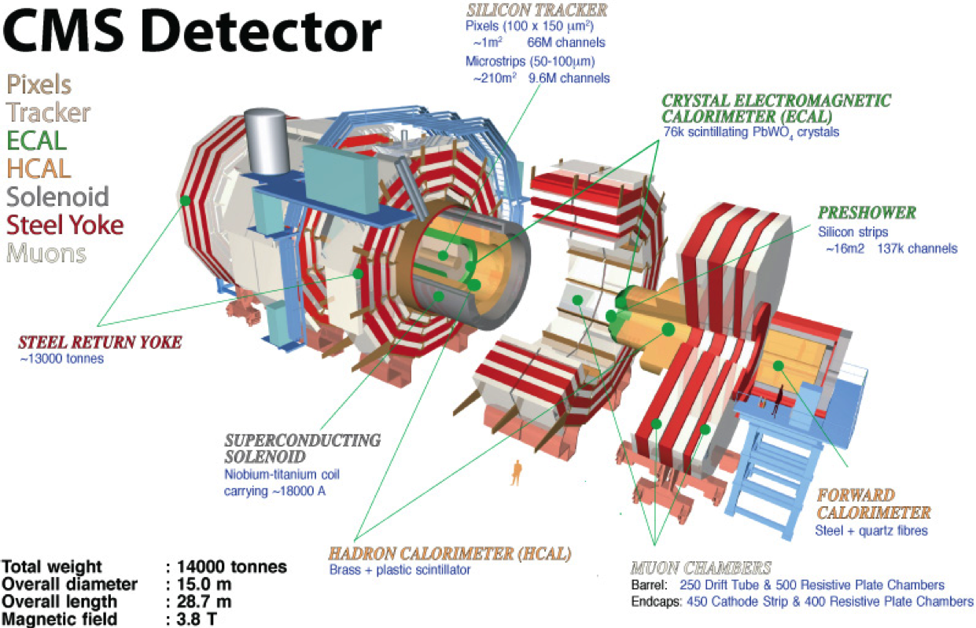
LHC experiments: CMS

Slide 19
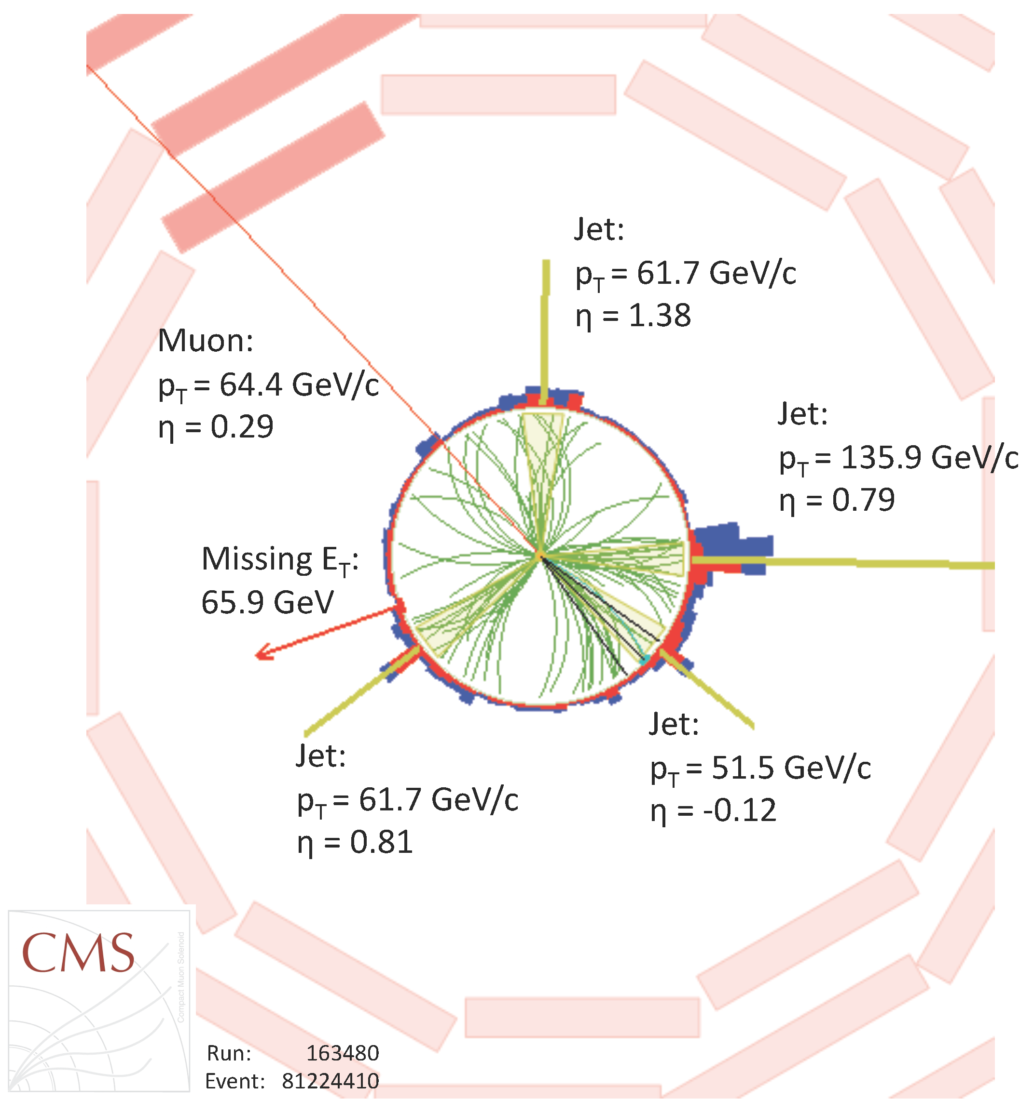

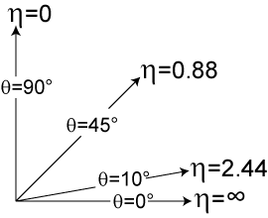
A top-antitop candidate event

Slide 20
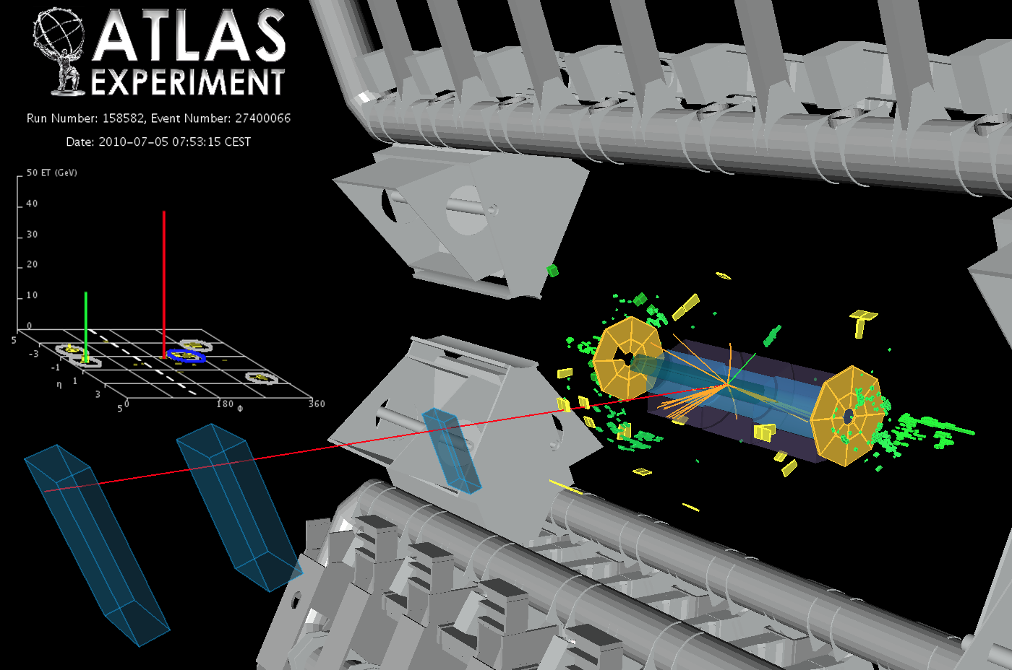
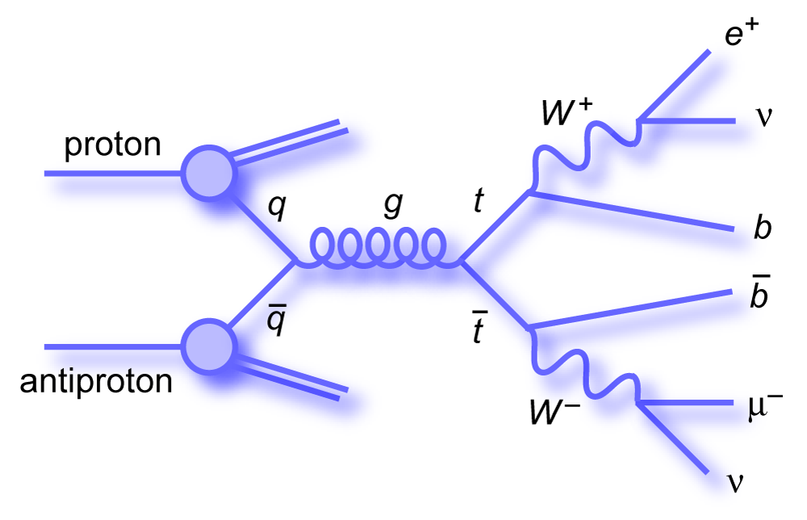
One more candidate (eμ+2 jets)

Slide 21
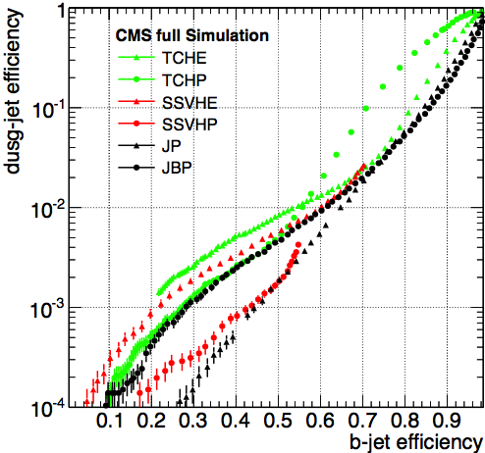
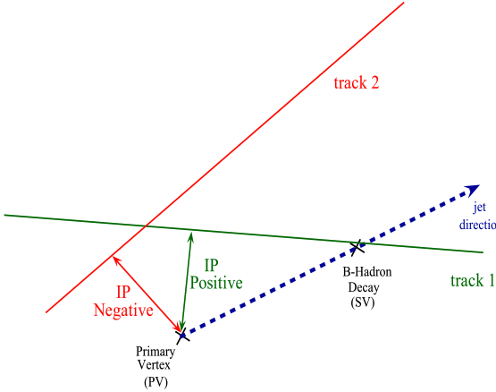
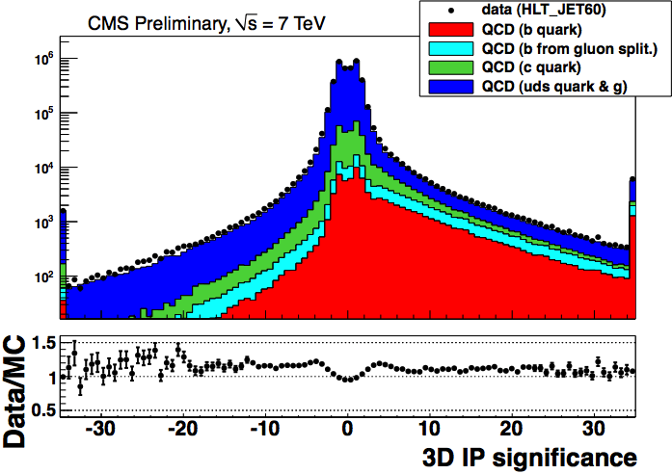
Identifying the b jet: “tagging”
Different algorithms are used to determine whether
a jet is produced from a b-quark fragmentation
b mesons/barions have long lifetimes
  τ~1.5ps, cτ ~ 450μm, l~1.8mm at p=20 GeV/c
  Impact parameter reconstruction can
  detect long-lived tracks
Semileptonic branching ratio is larger
than non-b jets
  ~11%, ~20% including cascade
  decays
Harder b frabmentation
  Some difference in kinematics
  Larger p_{T} of tracks w.r.t. the jet
  direction
Different information can be
combined into a single tagger
algorithm

Slide 22
tt^{bar} cross section

Slide 23
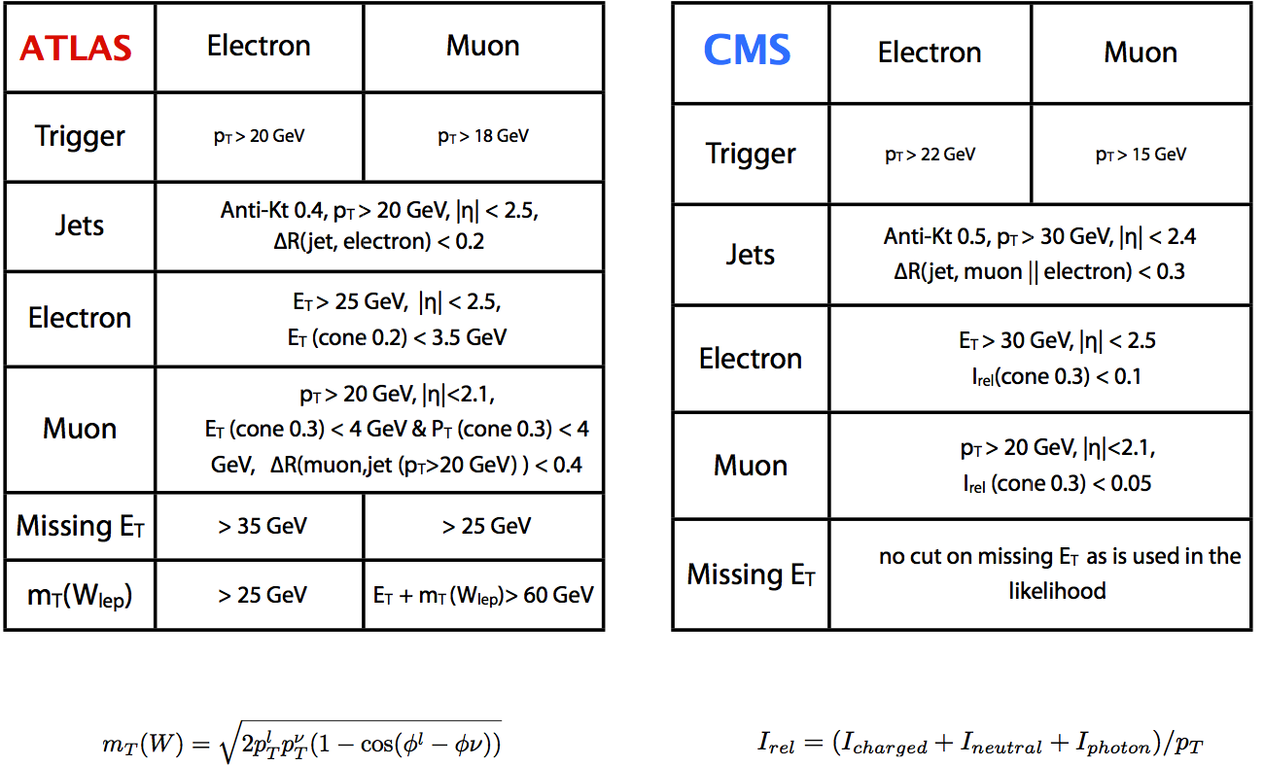
tt^{bar} cross section measurement
Typical event selection for lepton + jets

Slide 24
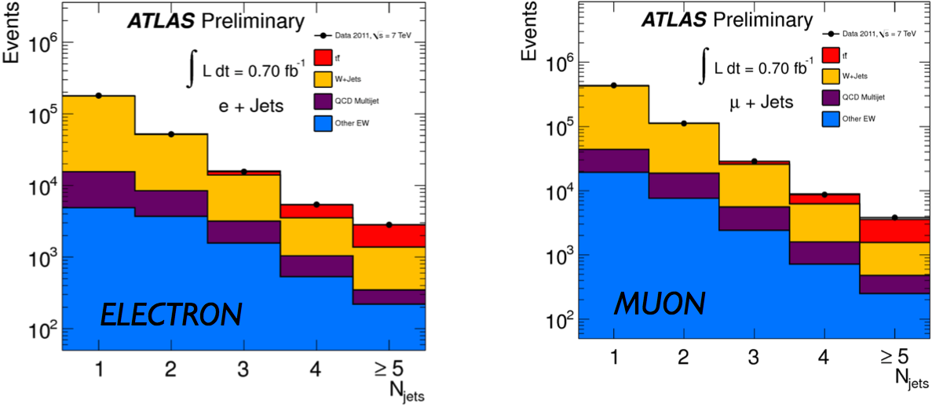

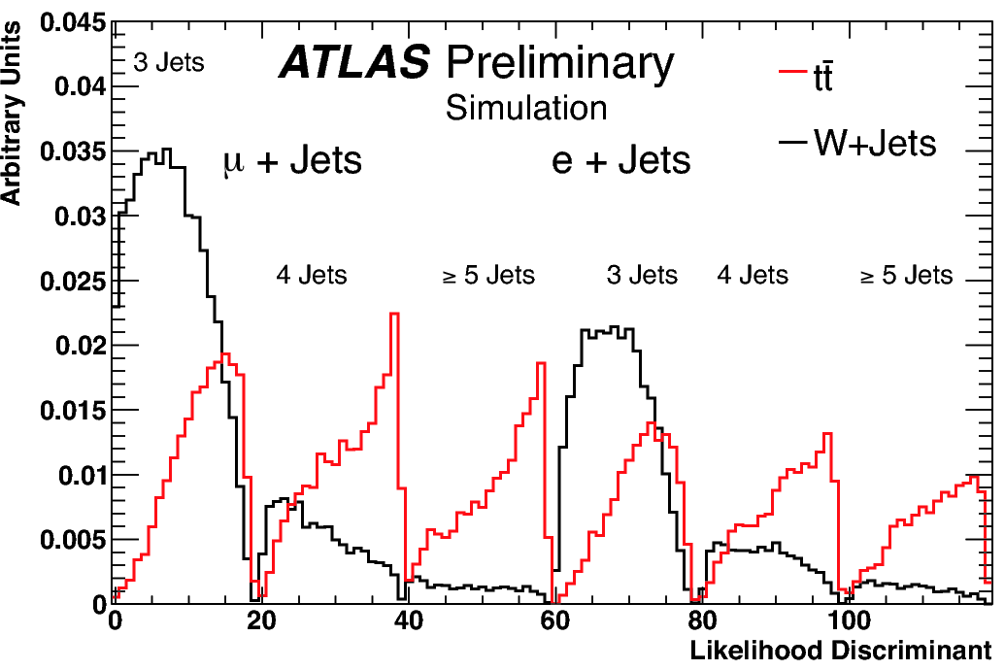
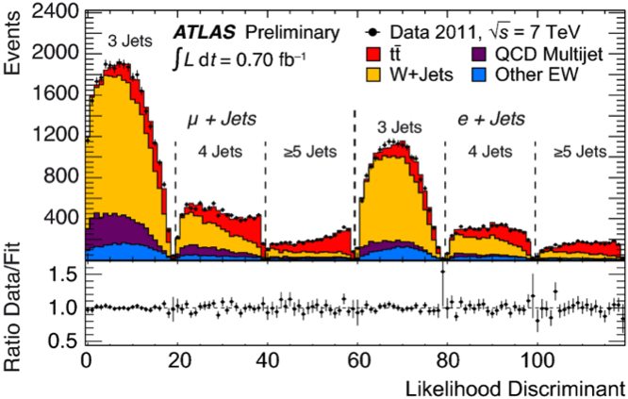
l+jet: jet multiplicity (untagged)
Likelihood discriminator based on
four discriminating variables
ATLAS-CONF-2011-121
Likelihood discriminant based on kinematical quantities

Slide 25
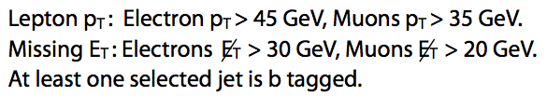
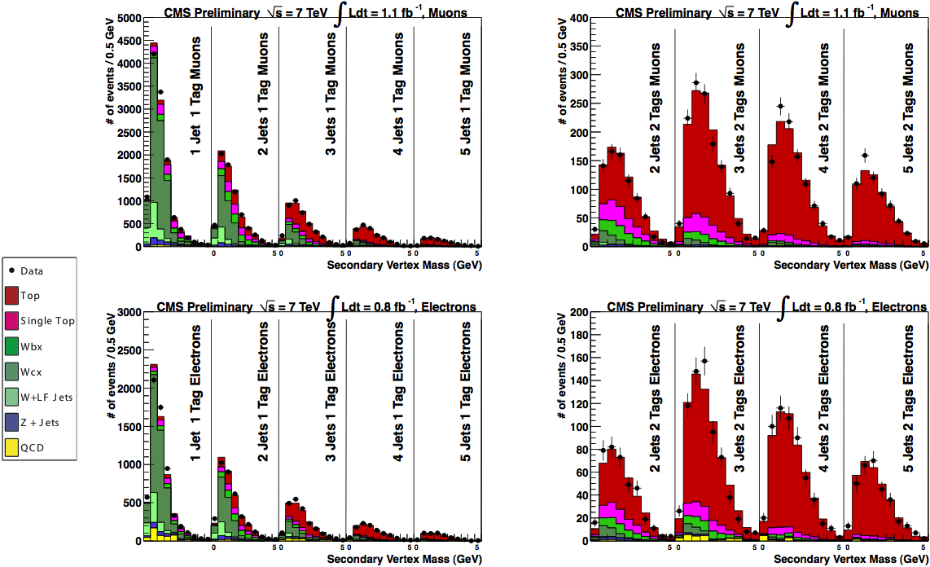
Lepton + jets with b-tag
b-tag = displaced
secondary vertex
CMS PAS TOP-11-003

Slide 26
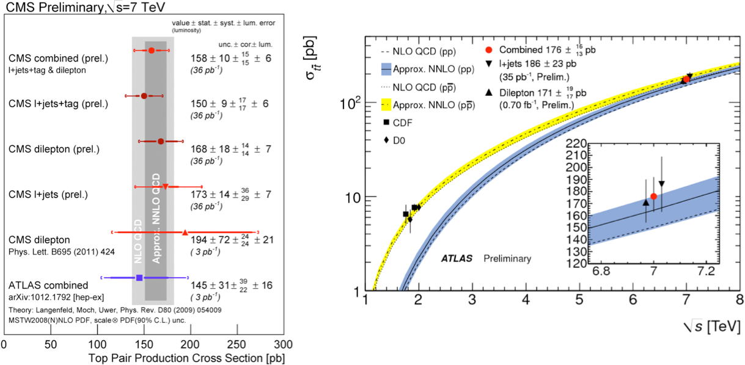
Cross section summary (2010…)
2010 data (no 2011 combination available yet!)

Slide 27
Top mass measurement

Slide 28
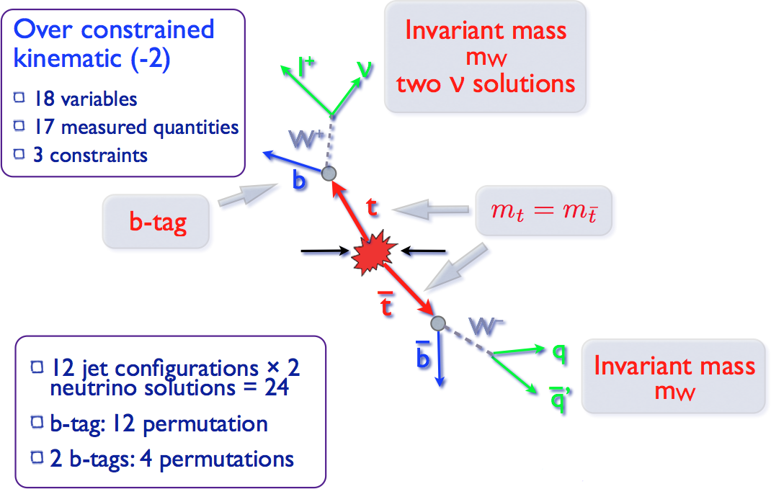
Top event reconstruction (l+jets)
More permutations in all-hadronic mode
Two neutrinos in dileptonic mode

Slide 29
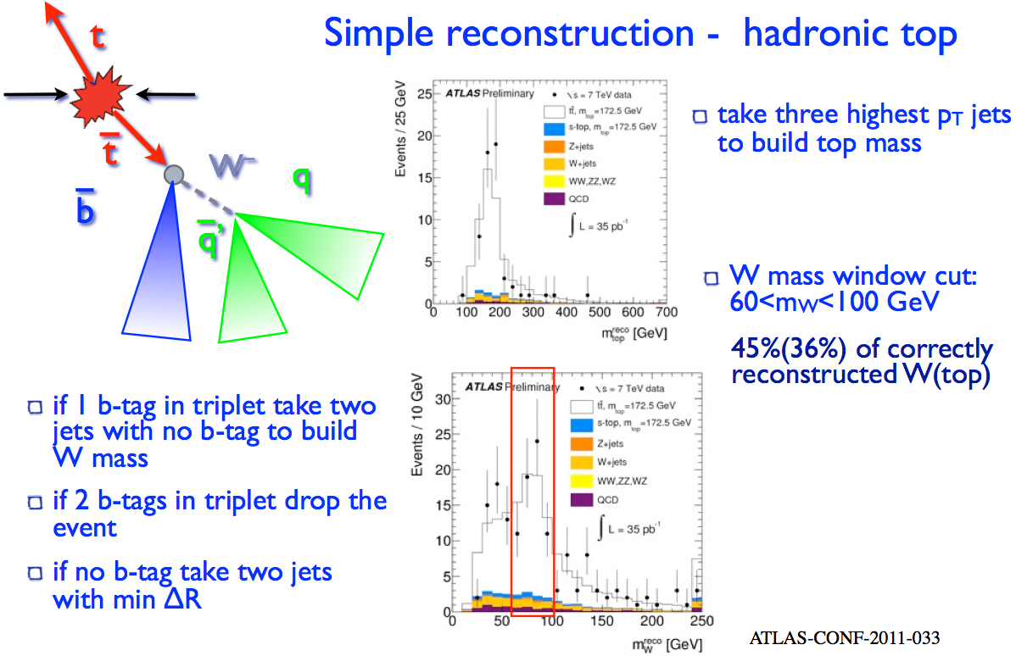
Reconstruct the top mass

Slide 30
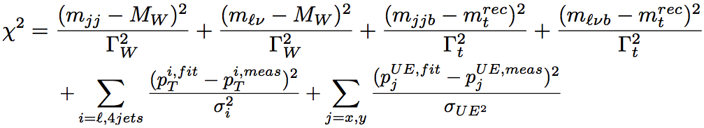
Constrained fit for m_{t}
Mass resolution improves if kinematical constraints are applied
Chi-squared minimization problem
  Gaussian approximation for Breit-Wigner shapes

Slide 31
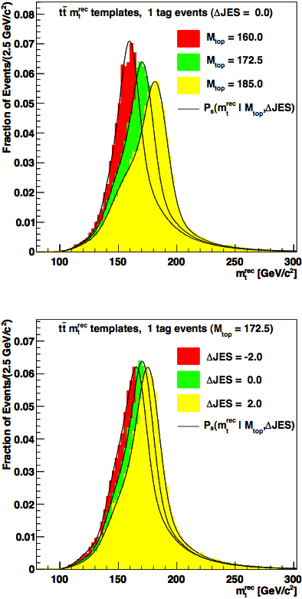
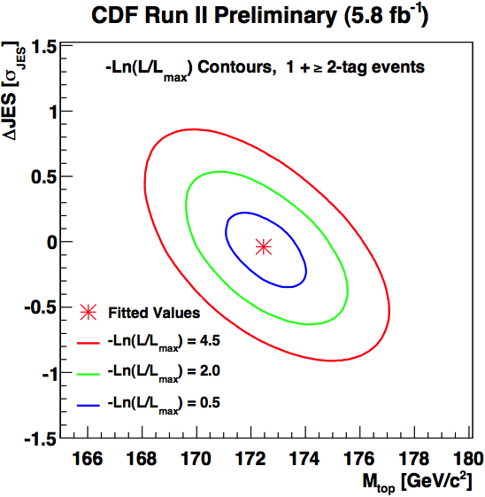
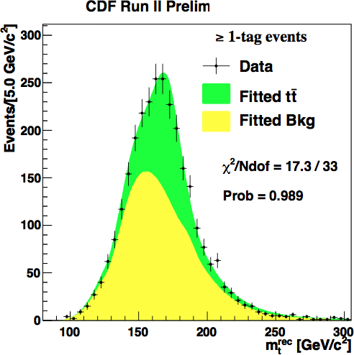

Template method
CDF Conf. Note 10456
Generate m_{t}-dependent observable (e.g.: reconstructed top mass)
Generate template distributions at different m_{t} (Monte Carlo)
Fit the templates to data and determine m_{t}
CDF, 5.8 fb⁻¹
CDF simulation
Fit
Simultaneous determination of Jet Energy Scale
and m_{t} from the same sample improves overall resolution

Slide 32

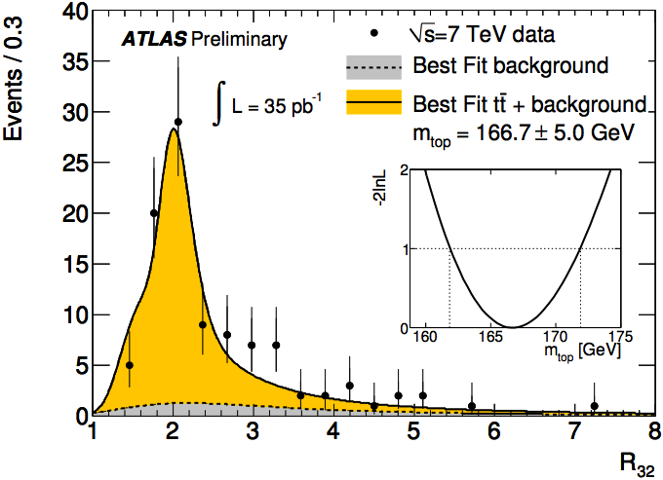
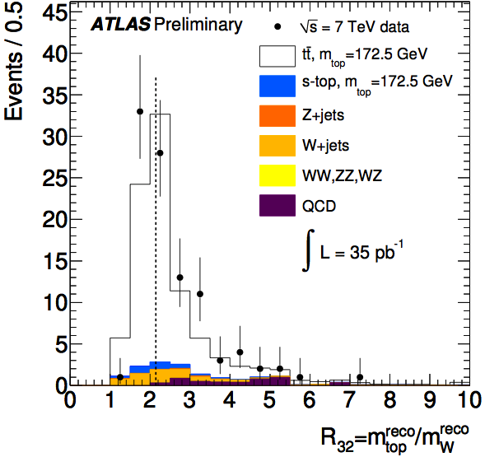
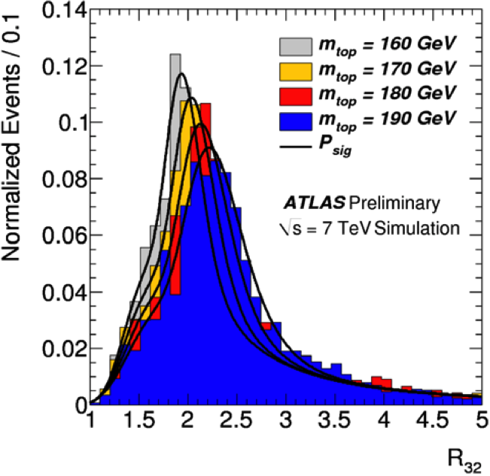


Template method: ATLAS
Similar method, different discriminating variable to reduce systematic uncertainties

Slide 33


Matrix element method
Compute the event probability density as:
where:
Determine sample likelihood
Fit m_{t}, k_{jes}

Slide 34



Application in CDF
CDF/PHYS/TOP/PUBLIC/10191
Signal and background classified using a neural network discriminator
m_{t} = 173.0 ± 0.7 (stat.) ± 0.6 (JES) ± 0.9 (syst.) GeV
= 173.0 ± 1.2 (total) GeV

Slide 35

Ideogram method
Some similarities with Matrix Element method: per-event probability, overall data sample likelihood
Top mass per event extracted from a kinematic constrained fit
Resolution and m_{t} shape included in the model
Probability of wrong assignment taken into account

Slide 36


Mass from cross section
Renormalization scheme subtlety: pole mass or MS mass…
The smallest uncertainty in σ does not imply smallest uncertainty on m_{t}

Slide 37


Summary of m_{t} measurements
Tevatron precision still dominates

Slide 38
Single top

Slide 39



Single top production
t-channel
associated Wt production
s-channel

Slide 40



Interest in single-top
Test of the SM prediction.
  Does it exist? ✔
  Establish different channels separately
  Cross section ∝ |V_{tb}|²
  Test unitarity of the CKM matrix, .e.g.
  Hints for existence of a 4th generation ?
  Test of b-quark PDF
Search for non-SM phenomena
  Search W’ or H⁺ (Wt or s-chan. signature)
  Search for FCNC, e.g. ug → t
  …
Single top as an experimental benchmark
  Object identification: lepton fake rates, QCD background estimates, b-quark jet identification, …
  Redo measurements of top properties in different environment, for example, m_{t}, W polarization in top decay, …

Slide 41


Single top at Tevatron
Sum of s and t channel cross sections measured
Hard to assess experimental significance, analysis heavily relying on multivariate techniques
PRL 103 092002
arXiv:0908.2171v1
Claim: 5.9 standard deviations significance, |V_{tb}| = 0.91 ± 0.11(exp.) ± 0.07(th.)

Slide 42

t-channel single top at LHC
Largest cross section of single-top processes
Improved S/B ratio (≈10%) compared to Tevatron (≈7%)
E.g.: CMS selection
Data sets defined by single lepton (e / μ) or lepton + jet triggers
Charged lepton selection (electron / muon):
  p_{T} (μ) > 20 GeV, E_{T}(e) > 30 GeV
  |η(e)| < 2.5, |η(μ)| < 2.1
  Relative isolation
Jet selection
  2 jets, b tagging/veto
Select only events with leptonic W decays, to suppress QCD-multijets background.
Some acceptance due to W →τν decays.
QCD multijet veto
  M_{T}(W) > 50 GeV

Slide 43





Background estimate from data
CMS: fit M_{T} (W)
QCD veto cut

Slide 44



Signal extraction
Phys. Rev. Lett. 107 (2011) 091802
ATLAS-CONF-2011-101
CMS PAS TOP-11-021
Complementary approaches adopted:
  Maximum likelihood method (cosθ*, |η_{lq}|)
  Multivariate analysis (Boosted Decision Trees, NN)
CMS (36pb⁻¹)
ATLAS (0.7fb⁻¹) :

Slide 45

Tevatron vs LHC
Limits set on tW, s channel still out of reach with 2011 data

Slide 46

More single top channels
tW recent evidence by ATLAS
(arXiv:1205.5764, 2 fb⁻¹)
  σ_{tW} = 16.8±2.9(stat) ±4.9(syst)pb
  (3.4σ signif.)
  SM: σ_{tW} = 15.6pb
s-channel: limit presented by ATLAS (ATLAS-CONF-2011-027, 35pb⁻¹, cut-based):
  σ_{s-ch.} < 26.5pb (95% CL)
  But in SM σ_{s-ch.} = 4.6pb!

Slide 47
More top properties

Slide 48





Spin correlation at CDF
top and anti-top are produced with their spins correlated and decay as bare quarks before losing their spin polarizations
SM prediction: κ ~ 0.8
No conclusive result (κ = 0?)
CDF Conf. Note 10719

Slide 49


Top pair spin correlation
Top pairs produced mainly via gluon fusion (LHC) or quark-antiquark annihilation (Tevatron)
V-A structure of top decay
ATLAS-CONF-2011-117
f_{SM} = A/A_{SM}=1.06 ± 0.21(stat.)⁺⁴⁰₋₂₇(syst.)

Slide 50






Charge asymmetry
Small FB asymmetry predicted by theory
Could be larger with new particles
Note: different initial state in Tevatron and LHC!
A_{FB} = 0.24 ± 0.13 (stat.) ± 0.04 (syst.); A_{FB}(theo)=0.050± 0.015
PRL 101 202001

Slide 51




Charge asymmetry at LHC
CMS PAS TOP-11-014
LHC has a symmetric initial state
Charge asymmetry measured at Tevatron turns
into an angular asymmetry

Slide 52






New physics in top processes
Top processes are suitable to study exotic physics

Slide 53


Search for tt resonances
CMS measured the tt^{bar} invariant mass spectrum in (μνb)(qqb) decays
CMS PAS EXO-11-055

Slide 54



Search for new particles
ATLAS:
  Search for New Phenomena in ttbar Events with Large Missing Transverse Momentum in Proton-Proton Collisions at sqrt(s) = 7 TeV with the ATLAS Detector
arXiv:1109.4725

Slide 55






Top quark charge
Some models predict an exotic −⁴/₃ particle, the true SM top (q=+²/₃) quark being heavier and undetected
b flavour has to be identified (b or ^{bbar)}, Jet charge or lepton tag
Experimental data disfavor
exotic −⁴/₃ quark
Phys. Rev. Lett. 98, 041801 (2007),
Conf. Note 9939, …

Slide 56
References
S. Willenbrock, the Standard Model and the top quark, hep-ph/0211067
A. Quadt, Top quark Physics at hadron colliders, Eur. Phys. J. C 48 (2006) 835-1000
F. Deliot, D. Glenzinski, Top Quark Physics at the Tevatron, arXiv:1010.1202

