Slide 1
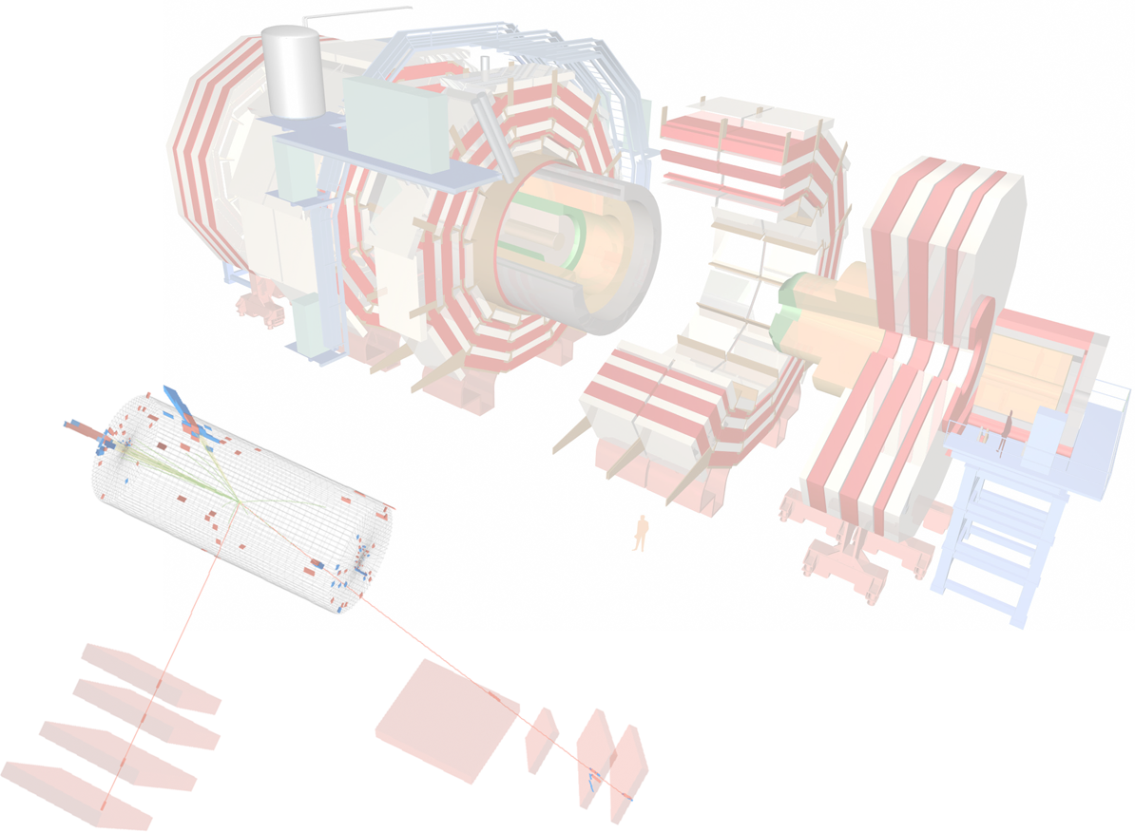
Electroweak results
Luca Lista
INFN - Napoli

Slide 2
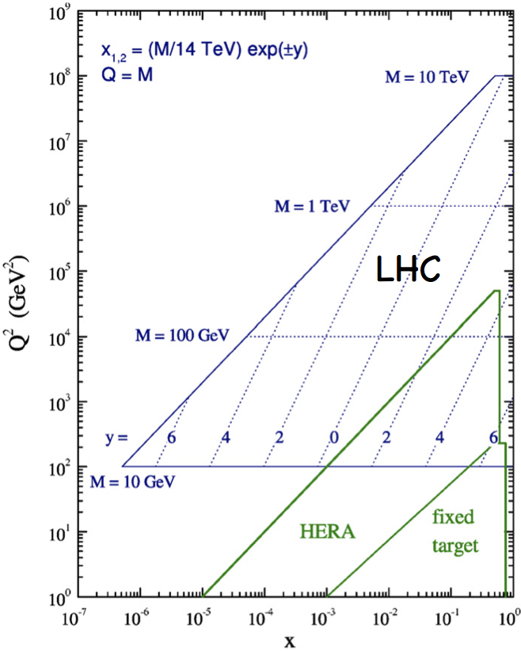
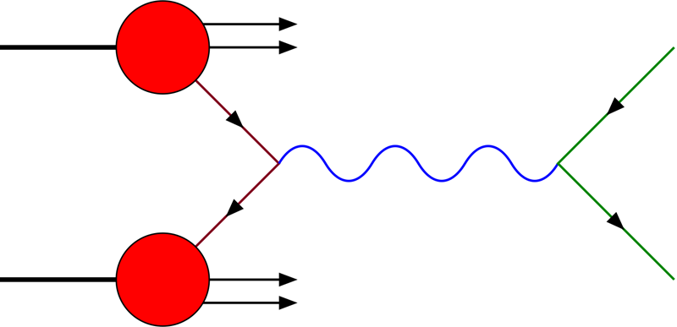
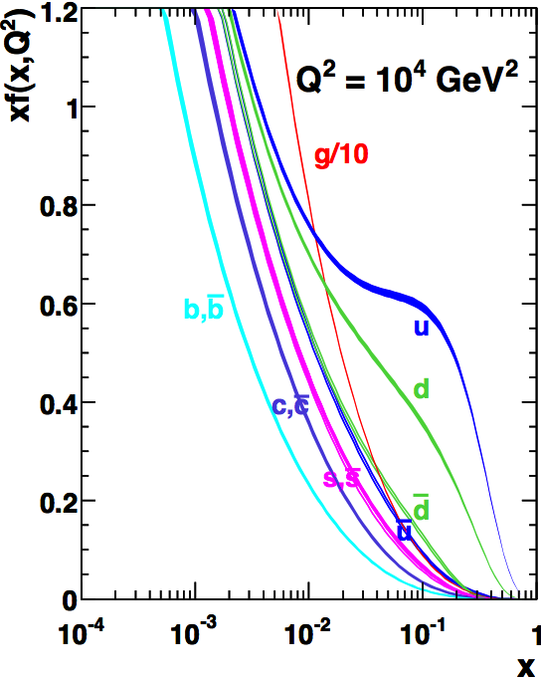

EWK processes at LHC
W and Z production in pp collisions proceeds mainly form
the scattering of a valence quark with a sea anti-quark
The involved parton fractions are low (10⁻³ < x < 10⁻¹) and scattering of a sea quark with a sea anti-quark is also important
W production is charge asymmetric: σ(W⁺)/σ(W⁻)~1.43
(< 2, as from valence + sea only) in the Standard Model
W and Z events produce very clean signals and allow to perform precision measurements
  Large background control samples are available in data and reduce the
  need to rely on simulations
Accurate theoretical predictions are available
Differential distributions are sensitive to PDF
EWK processes are also a tool for detector calibration and backgrounds to searches for Higgs and new physics
Q² (GeV²)
Measurement
range: |y|<2.5
10⁻³< x <10⁻¹
p
l ±
x
q
−
q⁽´⁾
W±, Z, γ*
p
(−)
l ∓, ν_{l}

Slide 3
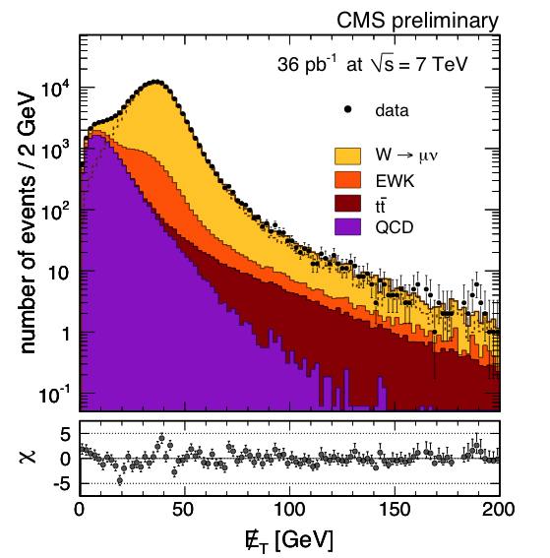
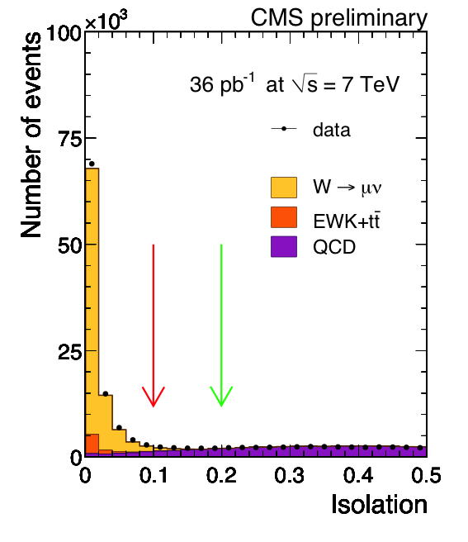
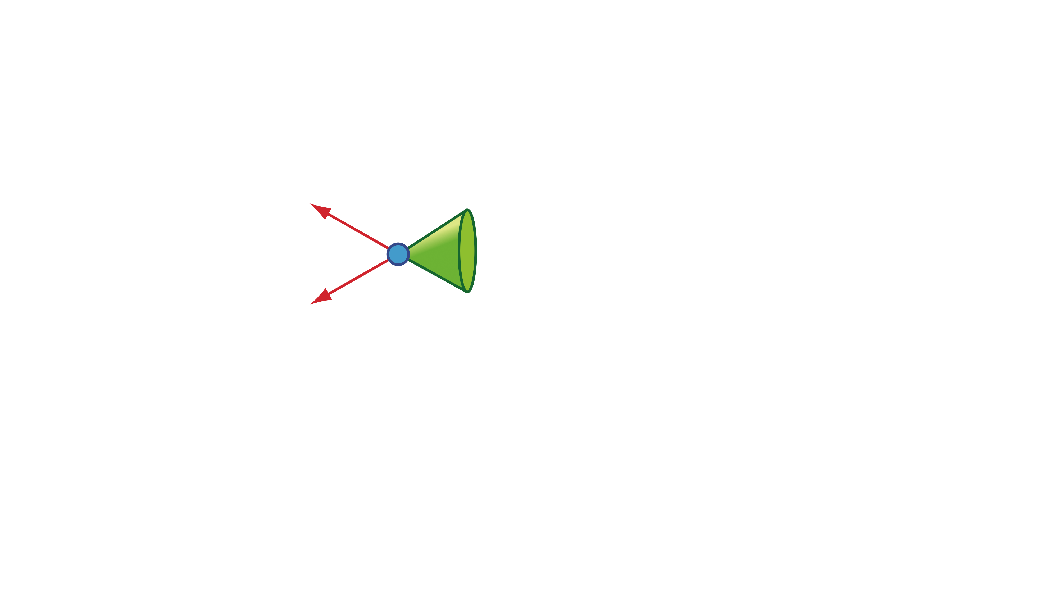
W→lν inc. cross section
W event selection is based on:
  Loose single-lepton trigger
  Lepton identification cuts, well understood
  Lepton p_{T}>25 GeV, η within trigger fiducial volume
  Isolation: tracker and calorimeter activity within
  ΔR=√(Δφ²+Δη²)<0.3, normalized to the lepton p_{T}
  Di-lepton veto (no Drell-Yan events)
Signal extraction
  W yield from fit to missing E_{T} distribution
    Parameterized shapes or fixed binned templates
  QCD shape determined from data
  inverting lepton id / isolation selections
  Lepton efficiencies from Z tag and
  probe as a function of p_{T} and η
  Missing E_{T} studied using Z recoil
  Momentum scale and resolution
  studied from Z→l⁺l⁻ data
QCD-enriched
sample
Signal region
lepton
Z
lepton
hadronic
recoil

Slide 4
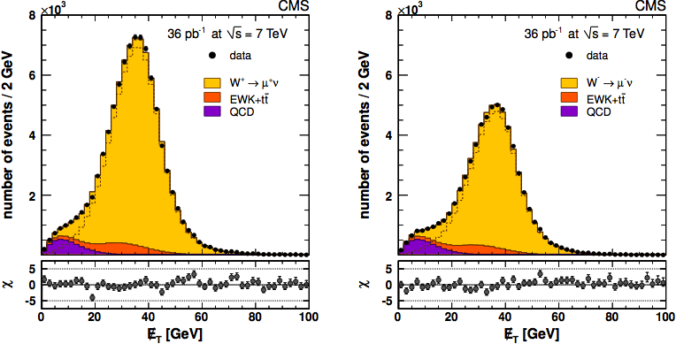
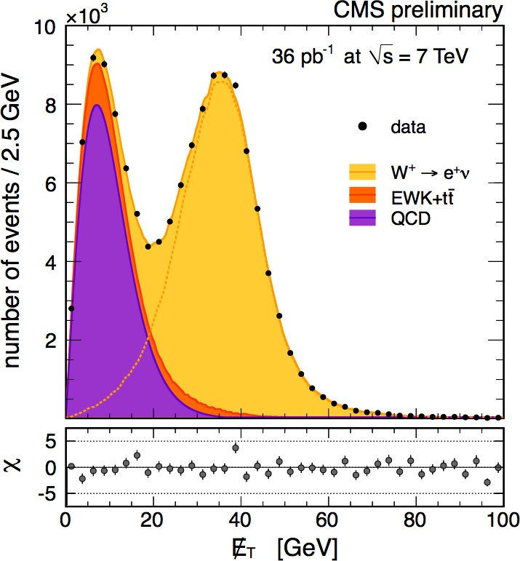
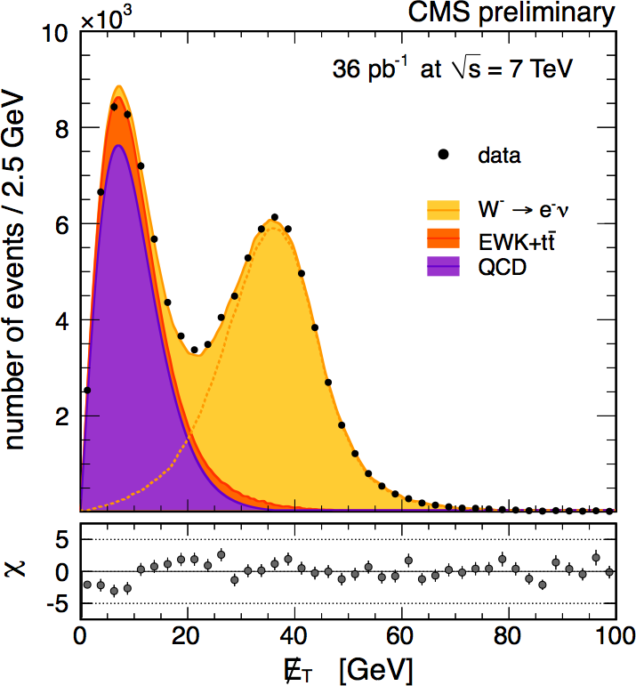
W⁺ and W⁻ production
W⁺→l⁺ν
W⁻→l⁻ν
Fit separately positive and negative lepton missing E_{T} spectra to extract
σ(W⁺) and σ(W⁻)
Alternatively, fit simultaneously the total yield and ratio to extract σ(W±) and
σ(W⁺)/σ(W⁻)
In the ratio several uncertainties cancel
Fixed
templates
W→μν
84091 ± 291
56666 ± 240
Parameterized
shapes
W→eν
81268 ± 302
54703 ± 249
JHEP 10 (2011) 132

Slide 5
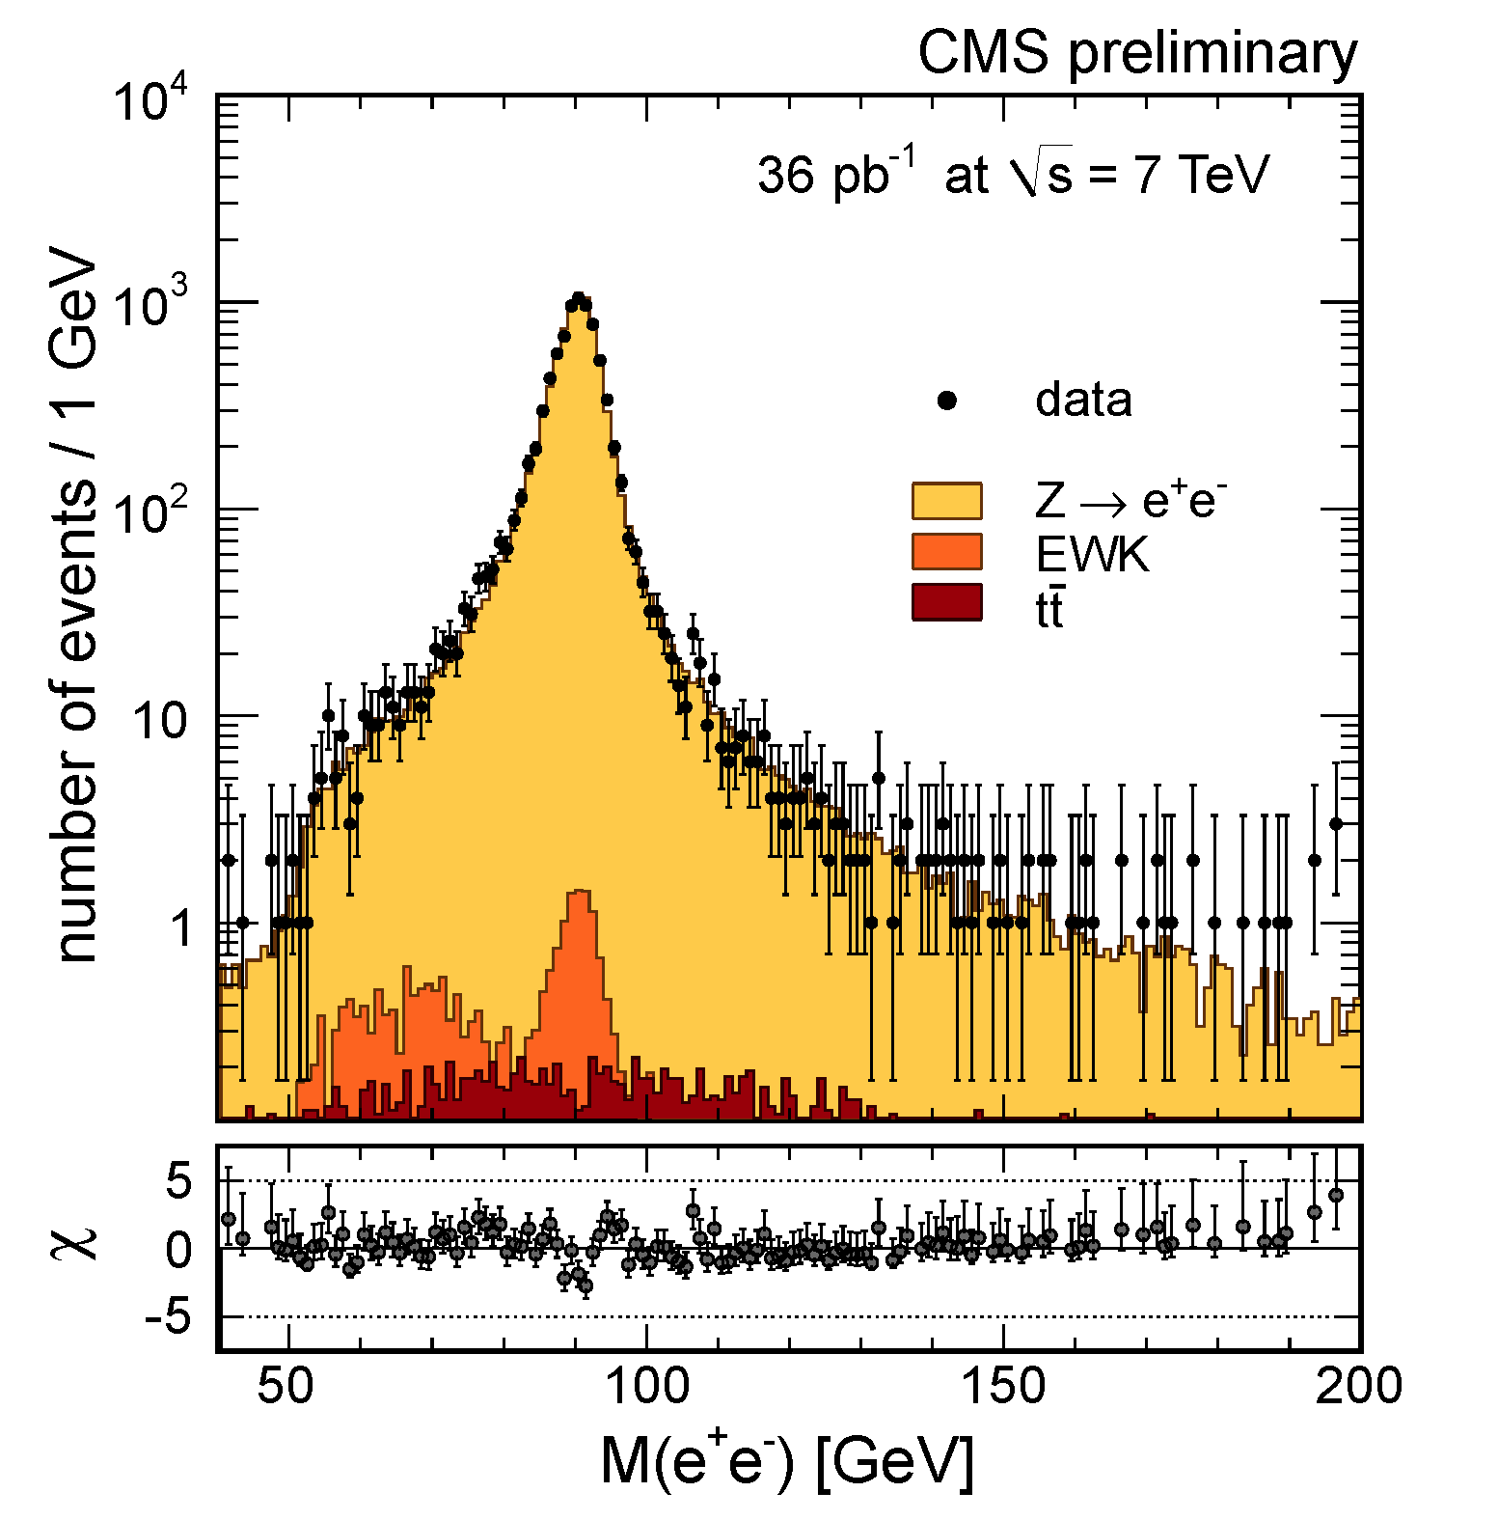
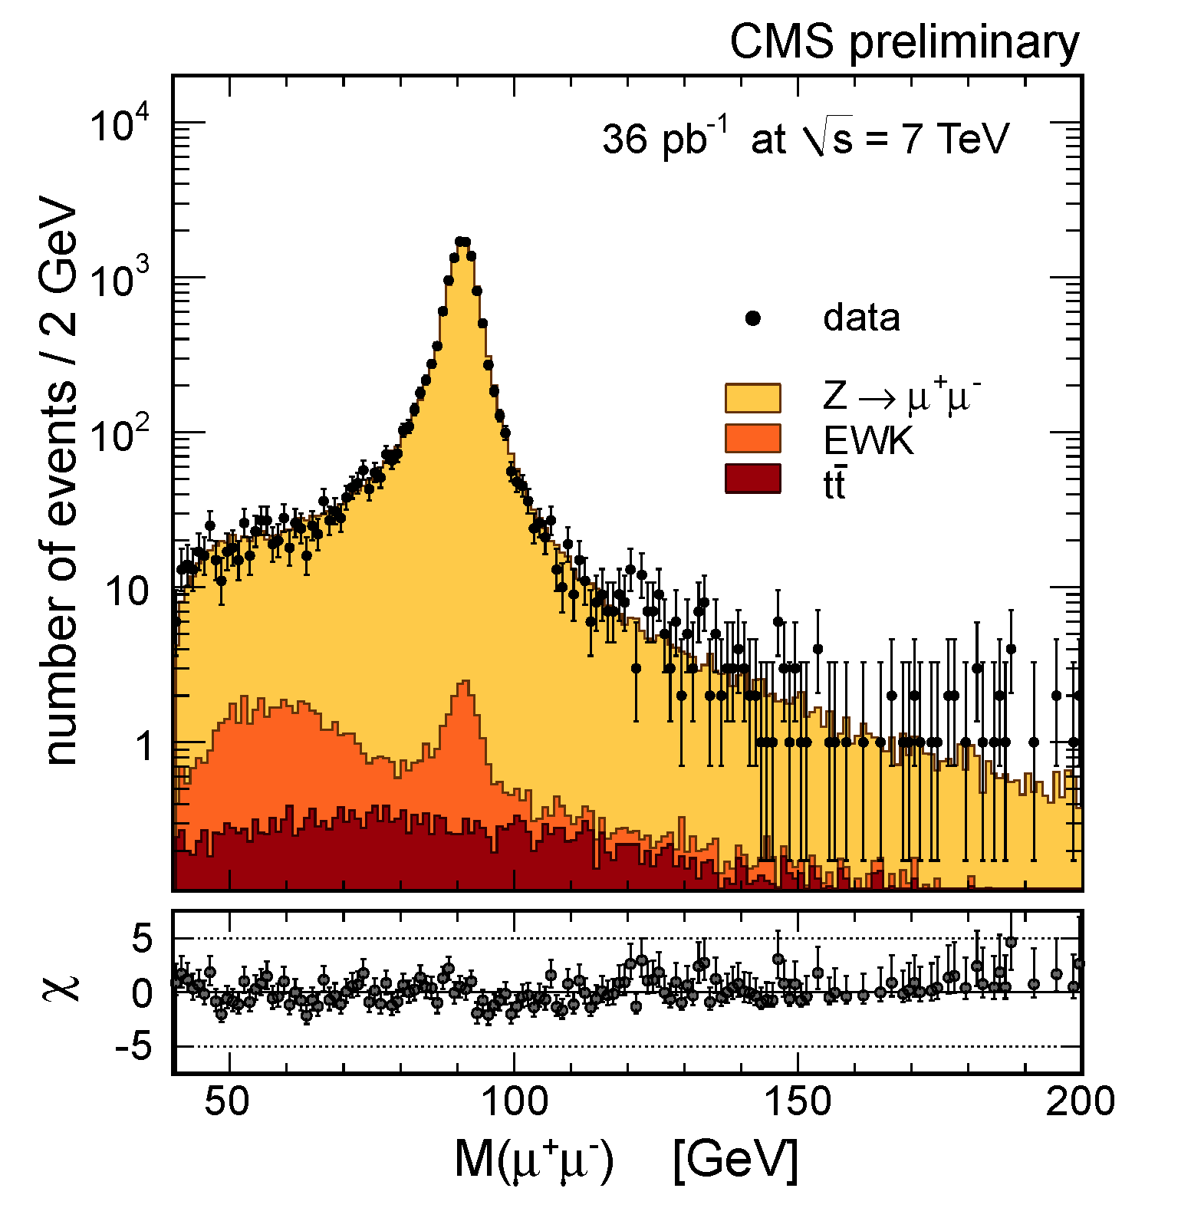
Z→ll analysis
Isolated dilepton pairs with p_{T}>20 (μ), 25 GeV (e) and η within trigger fiducial region. Mass range: 60 < m_{ll} < 120 GeV
Fit simultaneously yield and efficiencies using different dilepton categories (μμ)
Cut and count analysis using tag & probe efficiencies (ee)
Z→e⁺e⁻
Z→μ⁺μ⁻
8406 ± 92
13728 ± 121

Slide 6
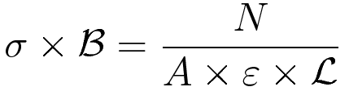
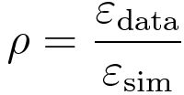
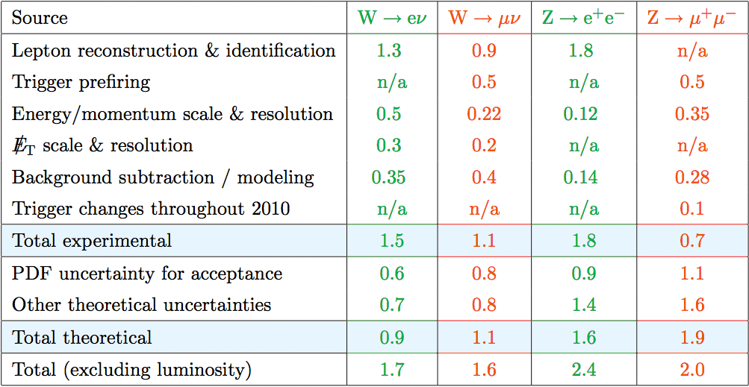
Systematic uncertainties
Data-driven methods to determine efficiencies, background and signal shapes allow to reduce experimental uncertainties
Lumi. uncert.:
4%
Uncert. propagated from
Z T&P to W p_{T}/η spectrum
CMS-DP-2011-002
Theory uncertainties affect acceptance determination:
  PDF (PDF4LHC: CTEQ, MSTW, NNPDF), Initial-state radiation modeling, higher order effects (RESBOS), EWK corrections, Final-state radiation (HORACE), factorization and renormalization scale (FEWZ)

Slide 7
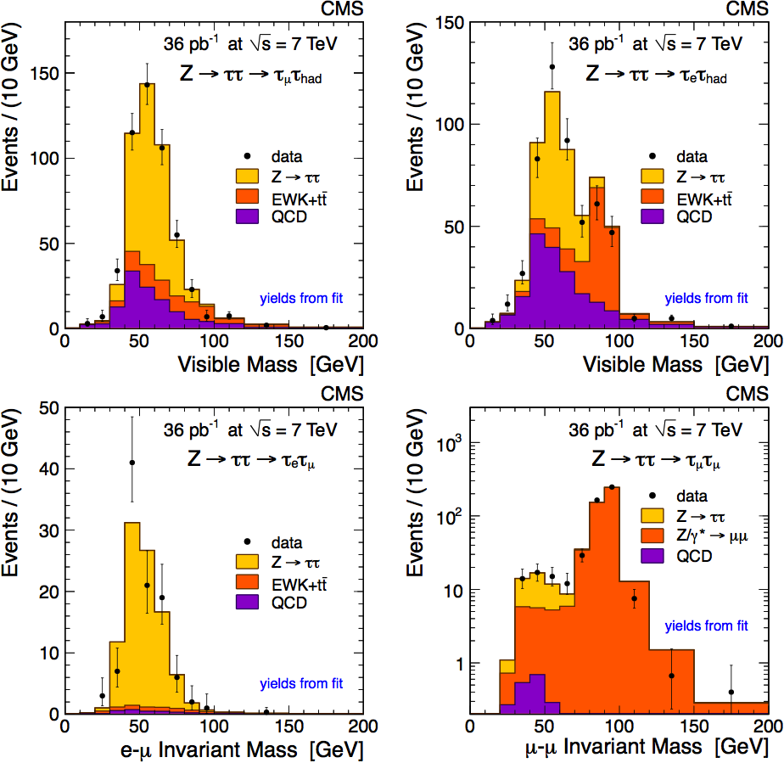
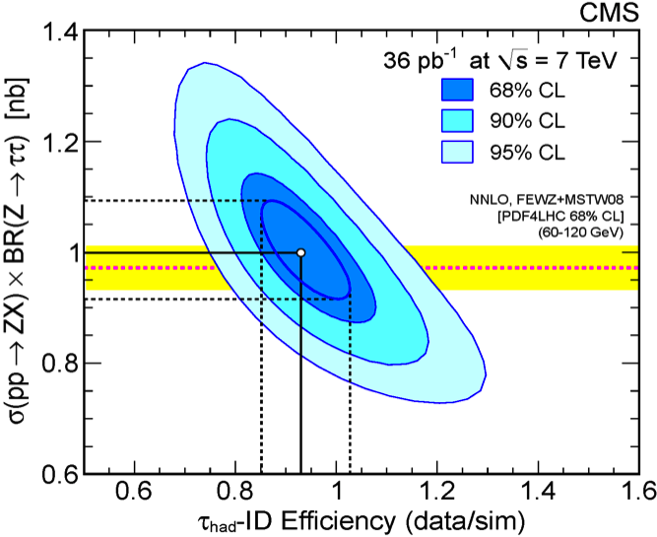
Z→ττ
JHEP 08 (2011) 117
Benchmark for searches using taus (H⁺→τν, H→ττ, …)
Particle Flow: combine tracker and calorimeter measurements to determine particle candidates
Main systematic: tau id, fit from data

Slide 8
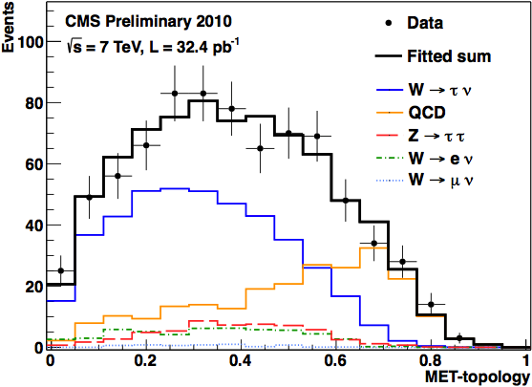
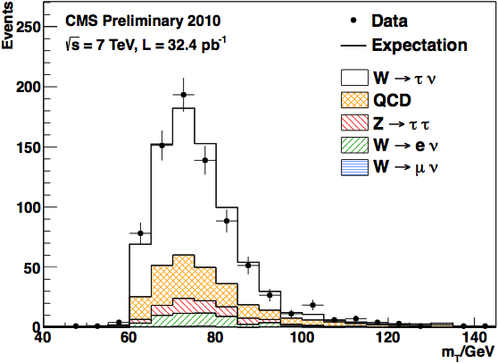
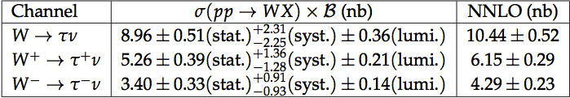
W→τν
CMS-PAS-EWK-11-019
One tau semi-hadronic decay, challenging trigger on tau plus missing E_{T}:
  p_{T} (τ) > 20 GeV, p_{T} (track)>15 GeV, missing E_{T} >25 GeV
32.4 pb⁻¹, full 2010 data sample
Σ_{PF cand.}p_{T} in E_{T}^{miss} direction/opposite

Slide 9
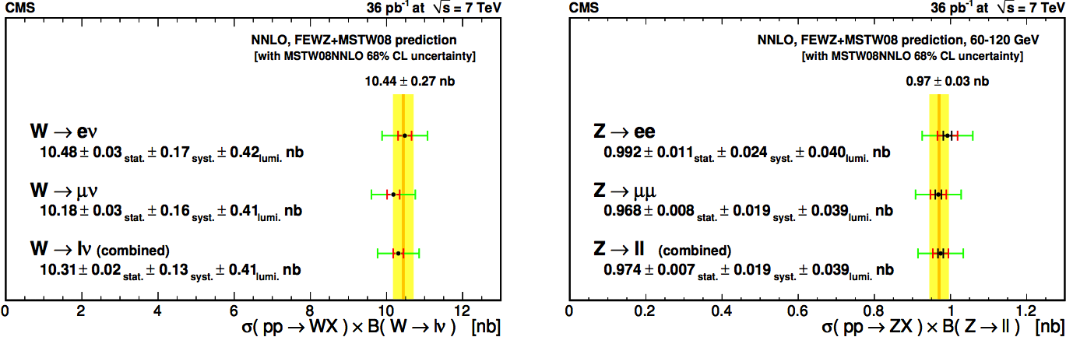
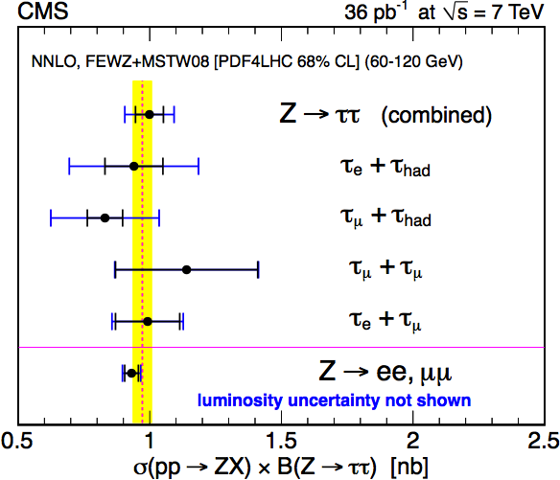
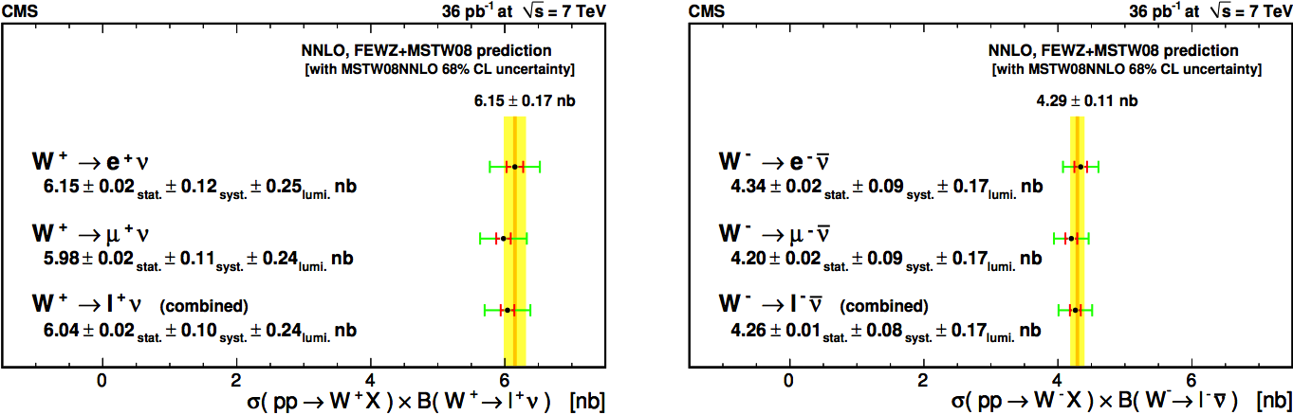
Comparison with theory
W→lν
Z→ll
syst.
stat.
lumi.
Good agreement with theoretical predictions
Systematic uncertainty dominates

Slide 10
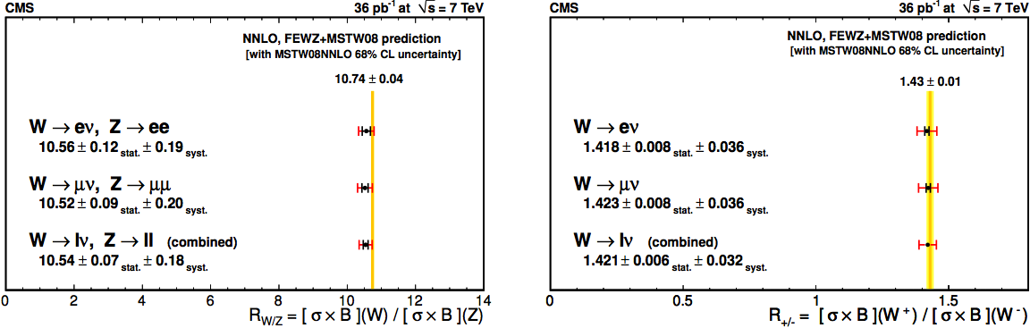
Comparison with theory
σ(W⁺)/σ(W⁻)
σ(W)/σ(Z)
Ratios are not affected by luminosity uncertainty
W⁺/W⁻ potentially sensitive to PDF, W/Z has precise prediction

Slide 11
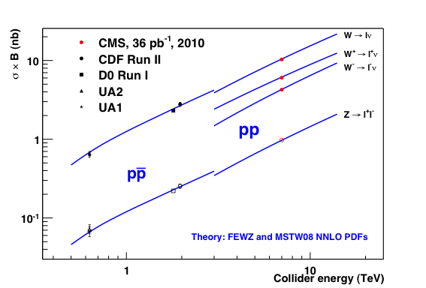
Comparison with theory

Slide 12
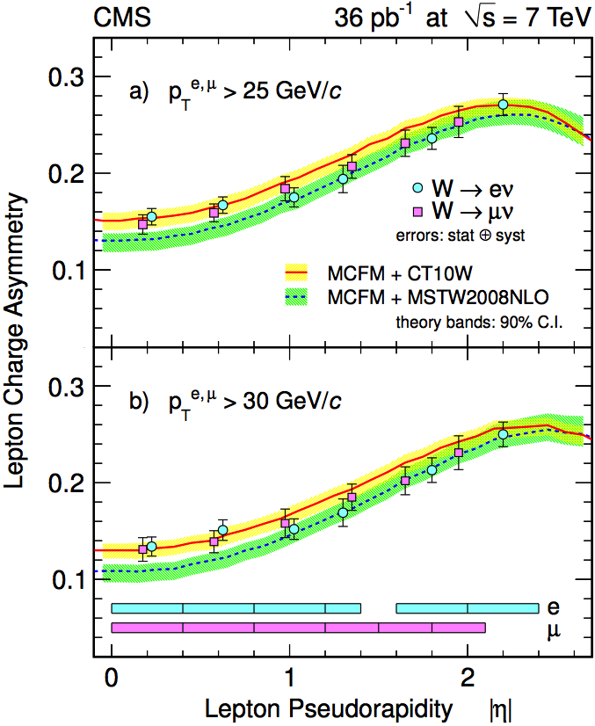
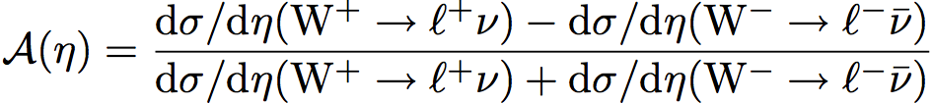
W charge asymmetry
JHEP04 (2011) 050
W⁺/W⁻ ratio measured as a function of the lepton pseudorapidity η
Sensitive to PDF; several uncertainties cancel in the ratio
Similar selection to inclusive cross
section analysis
Two p_{T} thresholds (25, 30 GeV) to
probe different phase space regions
Charge mis-id: 0.1(barrel)-0.4(endcap)%
for electrons, <10⁻⁴ for muons
Statistical uncertainty: ~3%
Systematic uncertainties (~3%), limited by
the size of Drell-Yan control samples
  Separate efficiency estimates for + and − leptons
  p_{T} scale and resolution
  Background and signal modeling

Slide 13
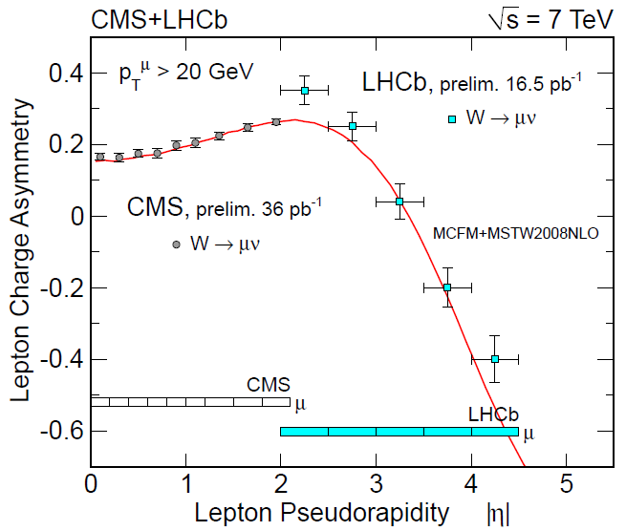
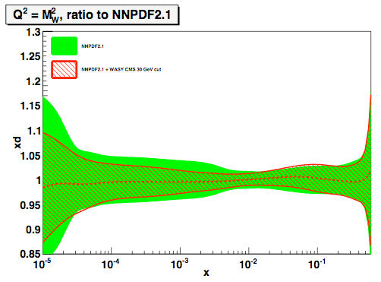
CMS ad LHCb measurements
CMS results already improve d,u,d,u,s quark PDFs by >40% in the range 10⁻³ < x < 10⁻²
CMS complementary w.r.t. LHCb

Slide 14
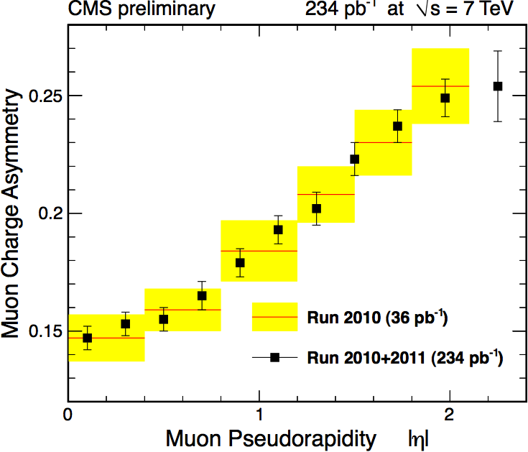
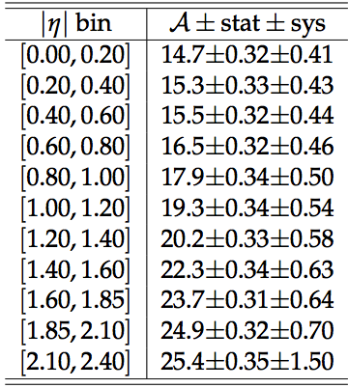
Update with 234 pb⁻¹ (muons)
Improved uncertainties with larger statistics and control samples
CMS PAS EWK-11-005

Slide 15
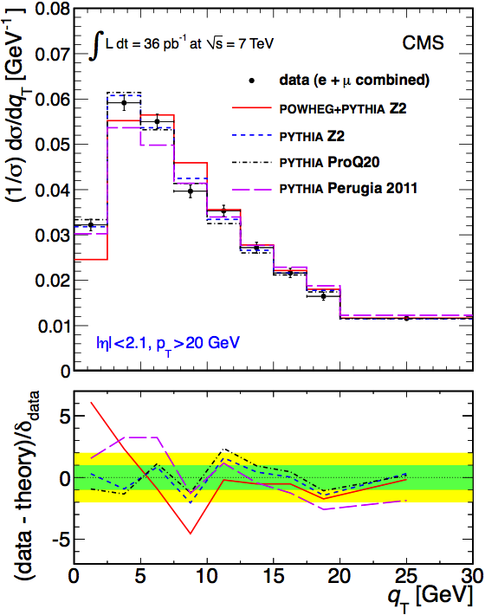
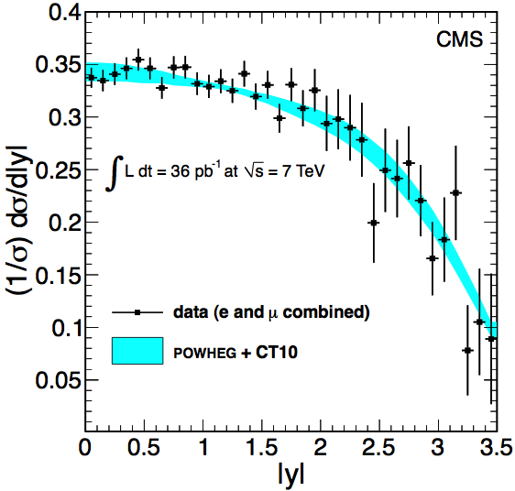
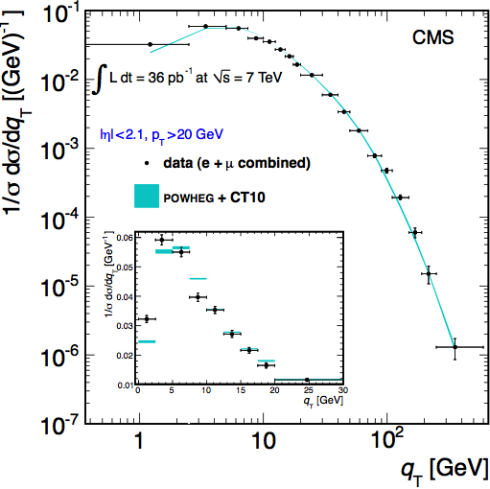
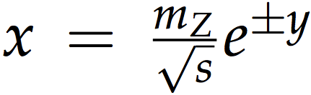
Z differential cross section
Large statistics allows to study differential cross sections vs y and p_{T}
compared to theory after an unfolding procedure correcting for resolution and final-state radiation
FWD cal. contributes
to large |y|
x < 10⁻³
Sensitive to PDF at low x
Good agreement with FEWZ
prediction (NNLO) at high p_{T}
Perturbative contributions dominate
FSR unfolded, not included in FEWZ
CMS-PAS-EWK-10-010
arXiv:1110.4973,
sub. to PRD
Agreement at low p_{T} requires PYTHIA tuning
Non-perturbative contributions

Slide 16
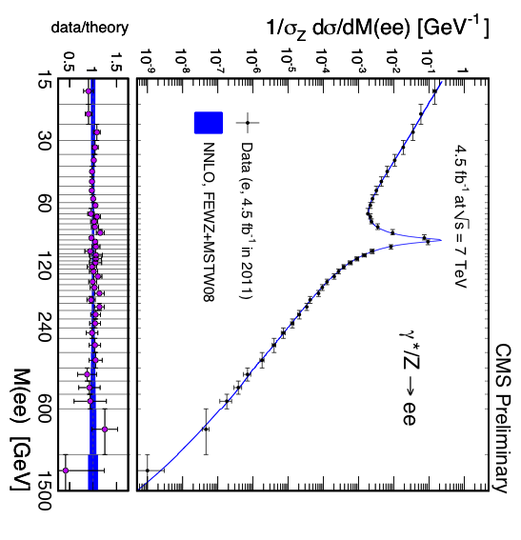
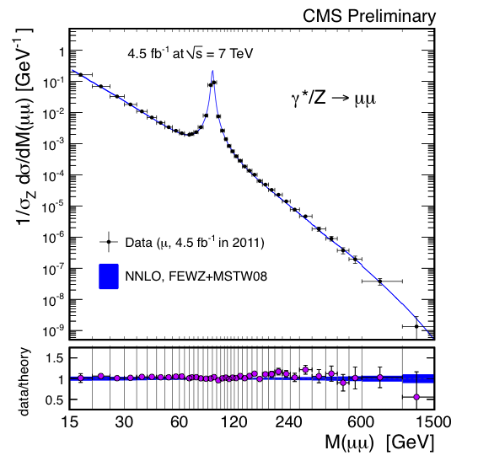
Drell-Yan spectrum (μμ, ee)
CMS-PAS-EWK-11-007
Unfolded distribution, corrected for acceptance, efficiency and FSR effects (not included in FEWZ)

Slide 17
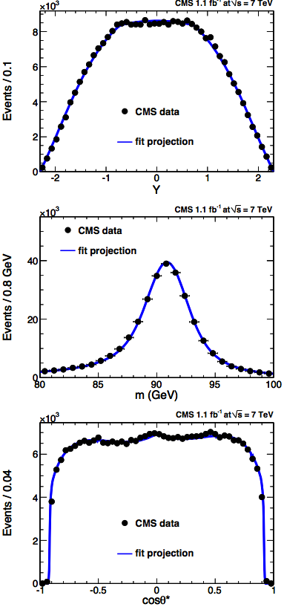
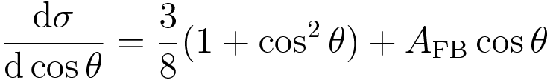
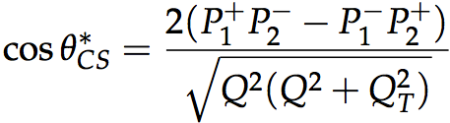
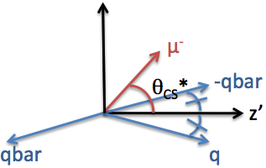
sin²θ_{W} (updated with 1.1fb⁻¹)
FB asymmetry allows a measurement of the Weinberg angle
More precise measurement also using Y and m of the dimuon pair distributions
Collins-Soper frame adopted[*]
PRD84(2011)112002
[*] CS frame: Z rest frame in which the z axis bisects p₁, −p₂,
p₁ and p₂ being the incoming quark and anti-quark momenta

Slide 18
Dibosons

Slide 19
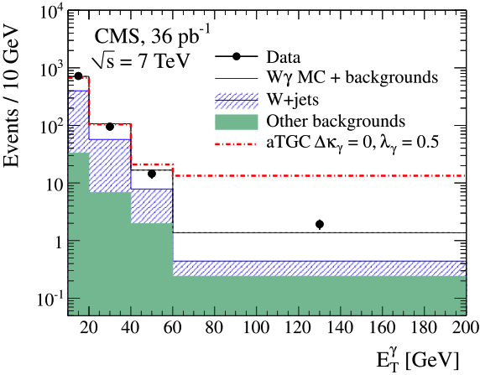
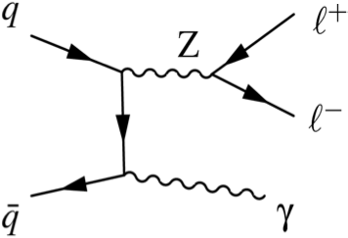
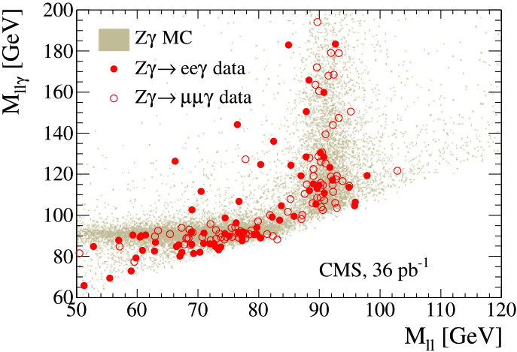
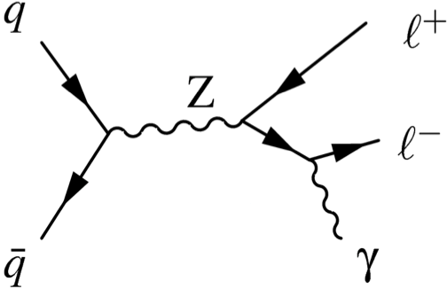
W, Z + γ
PLB701 (2011) 535
Final state common to new physics searches, probes triple gauge coupling
Fake photon estimate is a key task, performed with data-driven methods
ISR
Excess at high ET
with anomalous TGC
FSR

Slide 20
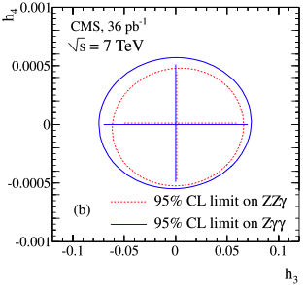
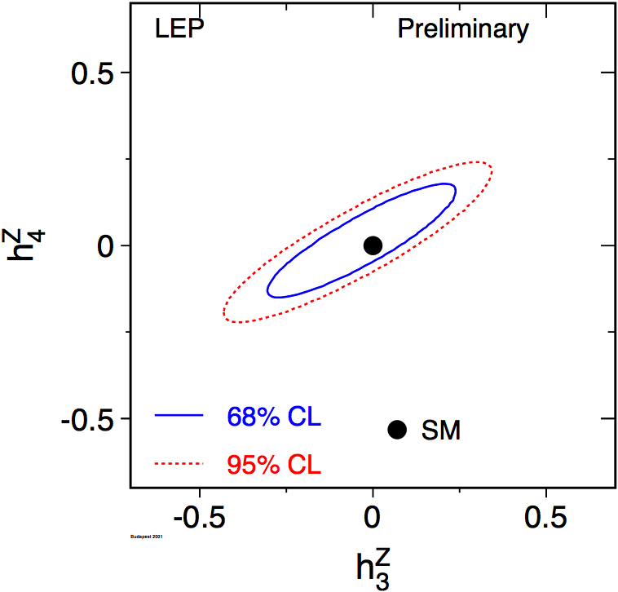
TGC limits
Competitive with LEP and Tevatron limits
CP even

Slide 21
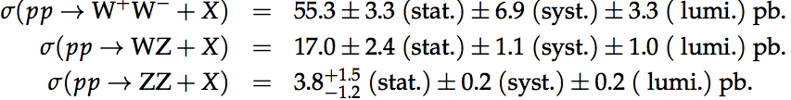
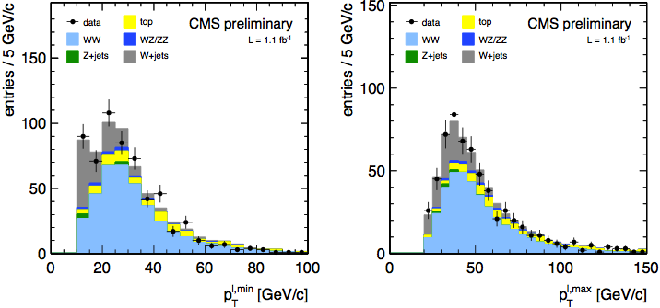
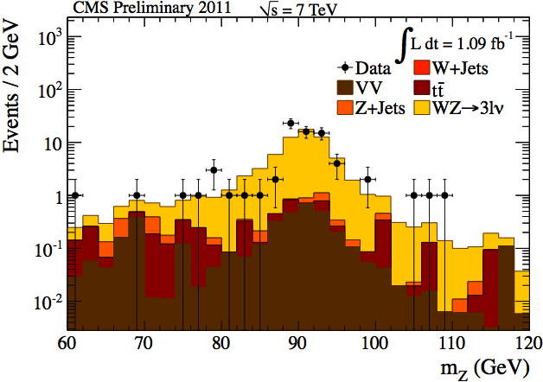

Dibosons: WW, WZ, ZZ
Important test of the SM non-abelian structure; benchmark for Higgs search
Measured production cross sections of W⁺W⁻, WZ, ZZ using leptonic decay modes (1.1fb⁻¹)
WW→lνlν
WZ→lνll
CMS PAS EWK-11-010

Slide 22

Summary

Slide 23

Conclusions
CMS produced many EWK measurements with the first 36 pb⁻¹ of LHC data at 7 TeV
Several updates are available with 2011 data
All measurements are so far in agreement with theoretical predictions from the standard model

